Slide 1





Chemical Language Models beyond SMILES and SELFIES
Wim Dehaen
Prague

Slide 2
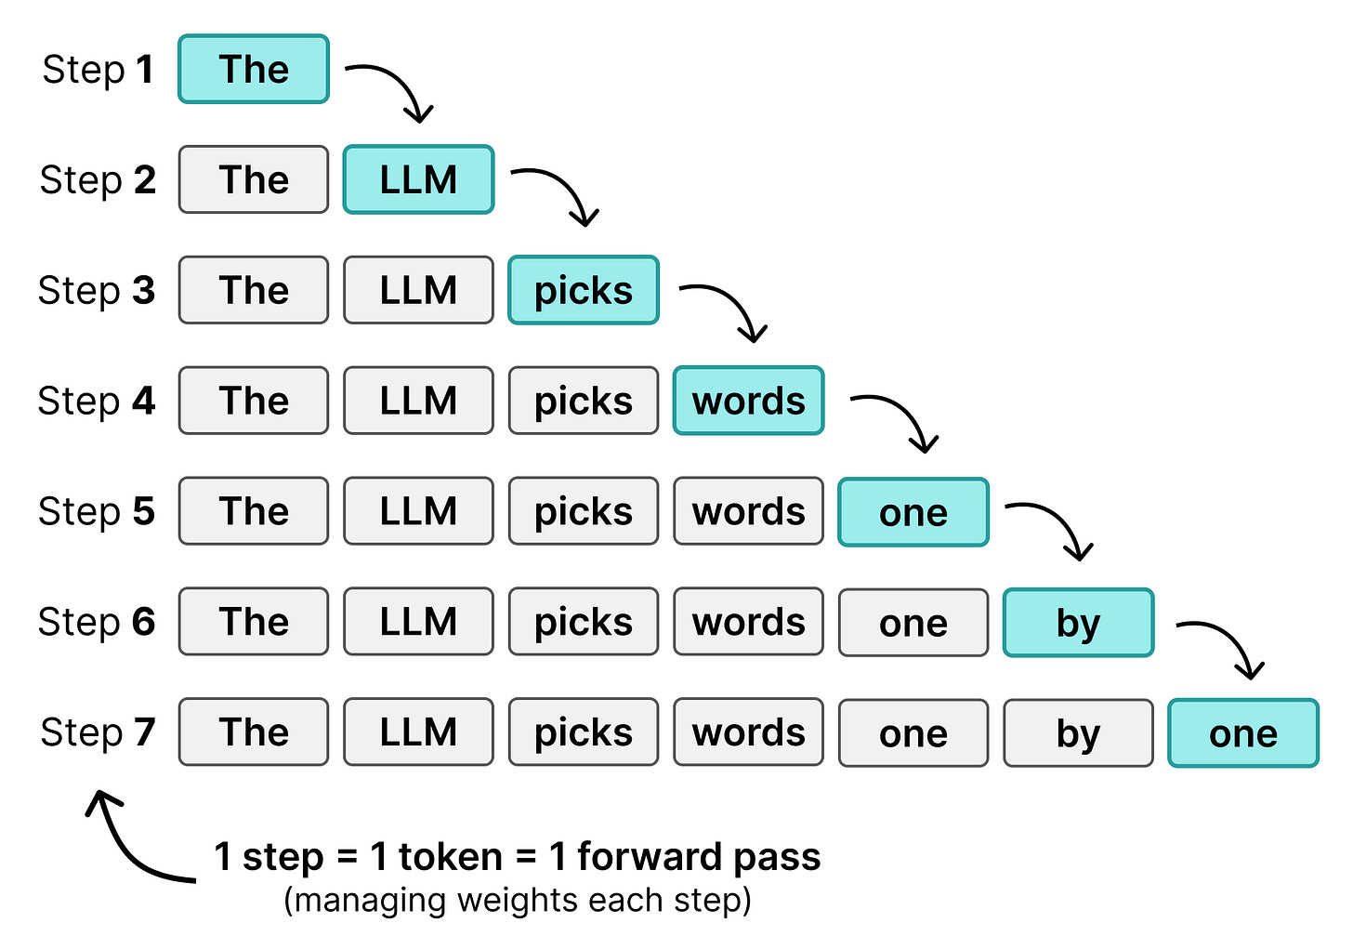
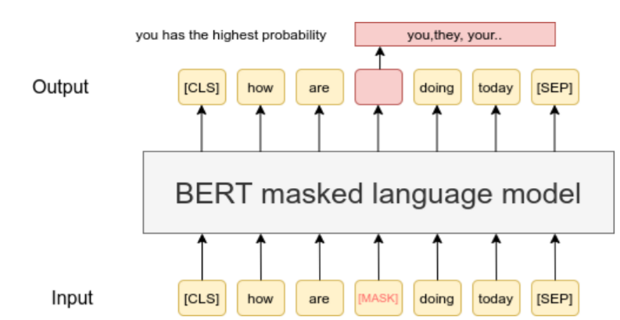
Language models: AR vs MLM
- Autoregressive: predict next token, left→right (GPT)
  · generative; native for de novo design
- Masked (MLM): predict hidden tokens from both sides (BERT)
  · bidirectional; native for representations
- Same backbone, different training objective
From: https://newsletter.maartengrootendorst.com/p/a-visual-guide-to-diffusiongemma
From: https://sbert.net/examples/sentence_transformer/unsupervised_learning/MLM/README.html
Notes:
Keep to ~45s. Set up the two objectives; we use both later.

Slide 3
Protein language models
- Sequence → learned residue embeddings
  · ESM (MLM), ProtT5 (seq2seq)
- Trained on millions of natural sequences
- Downstream: structure, function, mutation effects
Figure: [PLACEHOLDER — ESM/ProtT5 schematic, cite source]
Notes:
Hoksza speaks before me on PLMs, so this is a 30s bridge only.

Slide 4
Chemical language models
- Molecular graph → line notation → tokens → LM
- Alternative to hand-crafted descriptors / fingerprints (ECFP)
- Foundation models: ChemBERTa, MolFormer, …
- Key point: these are SMALL LMs
  · ~1–10M params, ~10^6 molecules
Figures: [PLACEHOLDER — ChemBERTa / MolFormer, cite]
Notes:
Plant the 'small LM' idea early — it is the punchline in part 4.

Slide 5
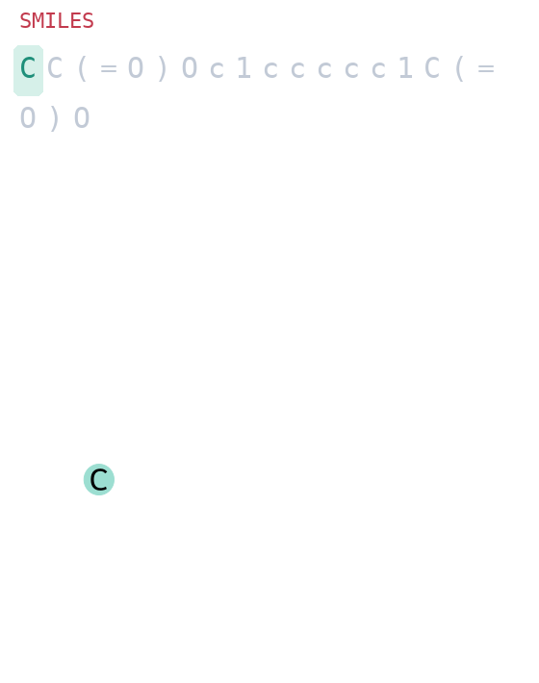
Line notations & what makes one CLM-friendly
- A string that encodes the molecular graph
- Desirable: 100% validity/coverage, compact, robust
  · locality: nearby tokens = nearby atoms
  · learnable token distribution
- Variants: DeepSMILES, SELFIES, SAFE, …
token-by-token build-up (SMILES)
Notes:
The GIFs animate in slideshow. Use one as a live example of 'a string builds a graph'.

Slide 6
Tokenization & canonicalization
- Graph → string is a grammar / traversal choice
- Canonicalization picks one traversal per molecule
- Non-canonical (random) SMILES of the same molecule
  · → very different token sequences
  · → very different embeddings (augmentation / instability)
- Tokenizer (char / atom / BPE) changes everything downstream
Notes:
Motivates why traversal/ordering is the real design lever (returns in BLINCS).

Slide 7
Evaluation sets
- FANG ADMET absorption/metabolism/tox regression
  · ~3.5k molecules from Biogen, 6 endpoints, human and rat liver microsomal stability, MDR1-MDCK efflux ratio, solubility, and human and rat plasma protein binding
  10.1021/acs.jcim.3c00160
- OCELOT QM chromophore properties
  · ~25k molecules, 15 quantum property targets, OoD OLED-type crystalline materials from CSD; QM properties via VASP, ZINDO, Gaussian16 (PBE/6-31g(d,p), LC-wHPBE/Def2SVP)
  10.1063/5.0048714
- Probes: linear (Ridge) and tree (LGBM) on frozen embeddings 5x5CV, mean of metrics reported
- Baseline throughout: ECFP4 fingerprint
Notes:
Two honest, non-MoleculeNet benchmarks. Ridge vs LGBM matters later.

Slide 8
Model architectures
MLMs: 2.2-12M params
  Transformer encoder, 4 layers, 4 heads, d_model 256, FFN 512, GELU, pre-LayerNorm, learned positional embeddings, dropout 0.1, linear LM head; Objective: BERT masking 15% (80% mask / 10% random / 10% keep)
LSTM: vanilla, 3.8M params
  2-layer LSTM, embedding dim 256, hidden 512, dropout 0.2, linear head to vocab; Training: 20 epochs, batch 256, AdamW lr 2e-3 OneCycle (pct_start 0.06), weight decay 0.01, grad-clip 1.
GPTs: vanilla 8-120M params
  768 hidden dimension, 16 layers, 12 heads, feedforward size 3072
  CDDDs: seq2seq according to winter et al 25M params
    RoBERTa-style encoder (hidden 384, 6 layers, 6 heads) paired with a 4-layer Transformer decoder
  Corpus: ChEMBL unless otherwise noted
Notes:
Two honest, non-MoleculeNet benchmarks. Ridge vs LGBM matters later.

Slide 9
Part 1:
BLINCS

Slide 10
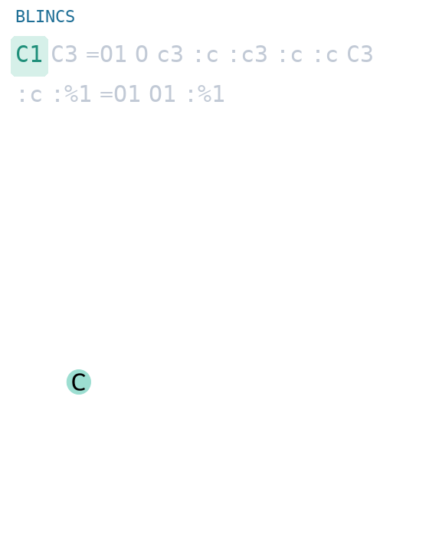
How BLINCS works
- Breadth-first traversal of the molecular graph
  · one token per atom
  · degree sequence encodes topology
  · ring closures written as %n
- pip install blincs · github.com/dehaenw/blincs
BFS build-up: fills breadth-first, not depth-first
Notes:
Contrast the BFS fill here vs the DFS SMILES GIF earlier.

Slide 11
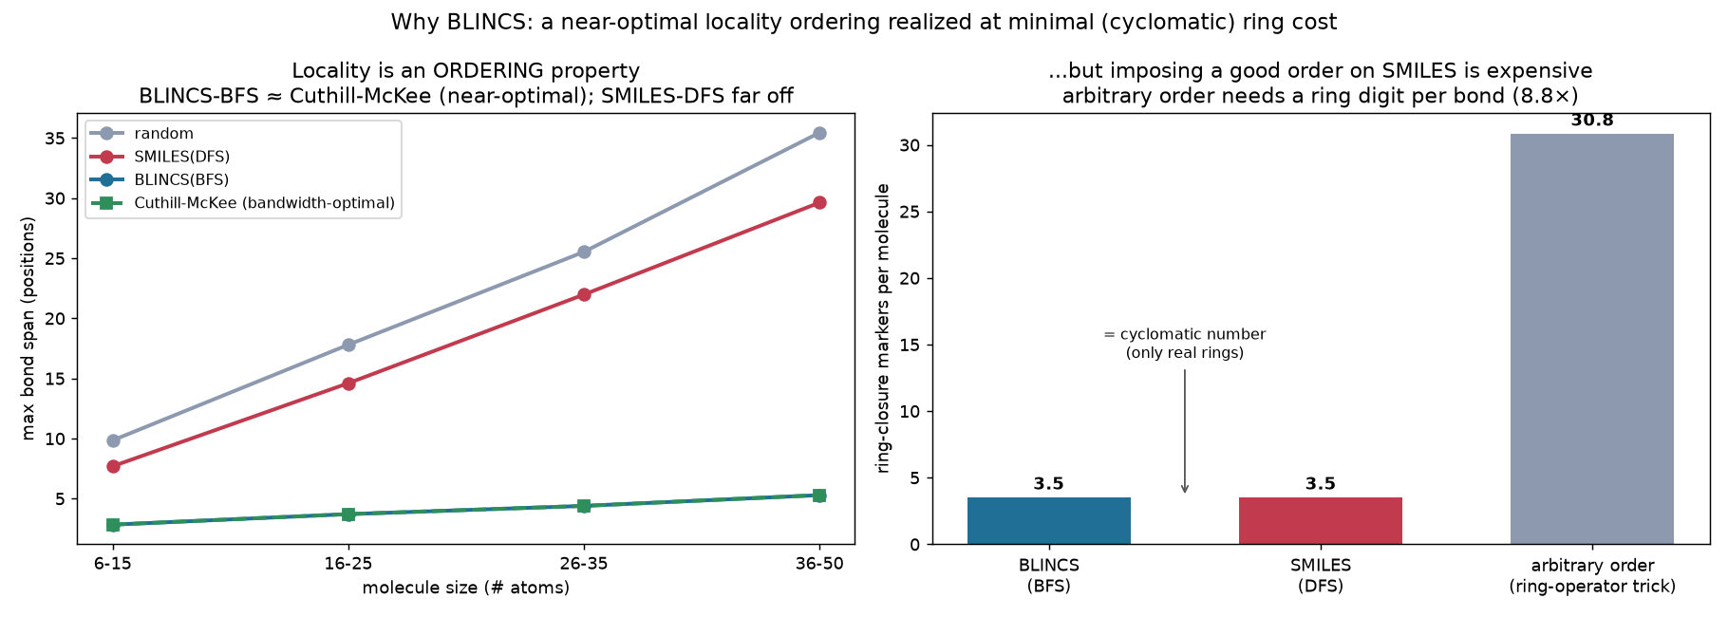
Theoretical properties
​
- Locality: median max bond-span 5 tokens vs 34 (SMILES)
- Near-optimal graph bandwidth ≈ Cuthill–McKee
  · BFS 4.3 ≈ RCM 4.3 ≪ SMILES-DFS 20.4 < random 24
- Advantage SCALES: flat with molecule size (SMILES grows ~linearly)
- Cost: %n markers = cyclomatic number (same as SMILES rings)
- Trade-off: BFS reorders globally → less string smoothness
Notes:
This is the deepest, most robust structural claim. Honest about the smoothness cost.

Slide 12
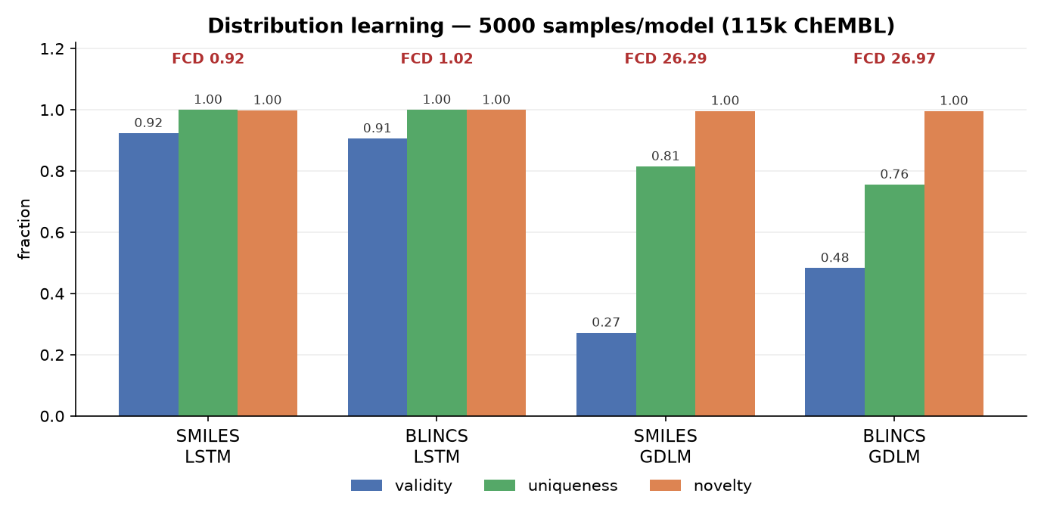
Distribution learning
- Round-trip coverage 99.998% (ChEMBL)
- AR LSTM: near-parity, both strong
  · validity 0.91 vs 0.92, FCD 1.0 vs 0.9, ~100% unique/novel
- Masked-diffusion (GDLM): weak for both, BLINCS higher validity
  · 0.48 vs 0.27: locality easier to fill non-autoregressively
validity/uniqueness/novelty; FCD above each group
Notes:
AR: SMILES a hair ahead. Diffusion: both poor at this scale, but BLINCS's bounded locality helps parallel generation — an honest BLINCS-positive datapoint. FCD via fcd_torch; W-desc (Wasserstein over RDKit descriptors) corroborates: 0.04 AR vs 0.53 GDLM.

Slide 13
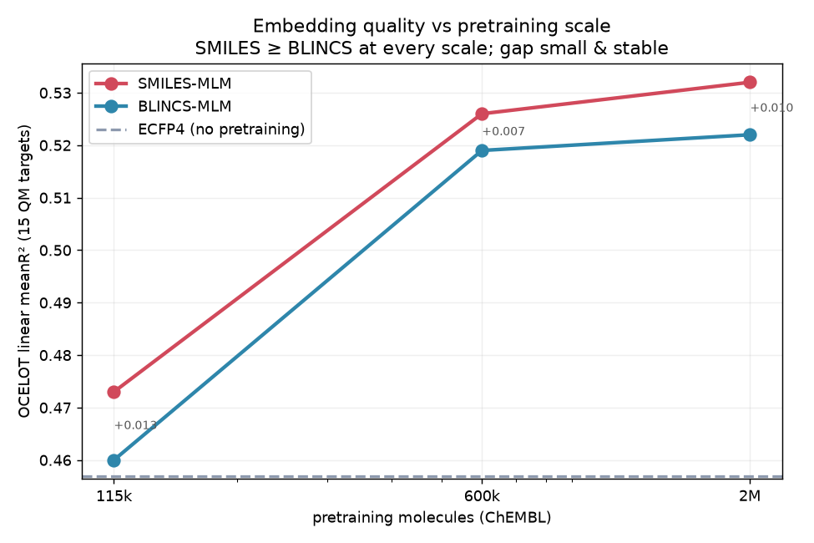
Performance: OCELOT & FANG (MLM, LSTM)
- SMILES ≥ BLINCS, small stable gap (~0.01 R²)
  · holds 115k → 2M pretraining; does not close
- Fine-tuning erases the gap (tie): SMILES 0.525 ≈ BLINCS 0.523
- Structural locality is real but doesn't beat SMILES downstream
  · No learned embedding beats ECFP on LGBM
OCELOT R² vs pretraining size
Notes:
Lead with honesty. The story is 'competitive, not better' — sets up the punchline.

Slide 14
Part 2:
IUPAC names

Slide 15
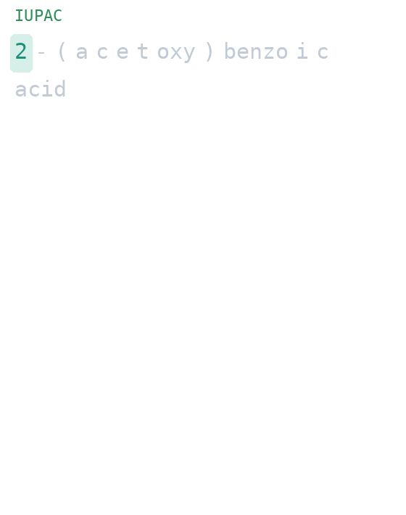
How it works
- Systematic IUPAC name AS the line notation
  · names generated with Openclatura
- Human-readable; morpheme structure carries chemistry
- But string similarity and molecular similarity less correlated: consider n1ccccc1 to c1ccccc1 versus Pyridine to benzene
name → molecule, morpheme by morpheme
Notes:
openclatura namer + iupacformer tokenizer. Cite the openclatura preprint.

Slide 16
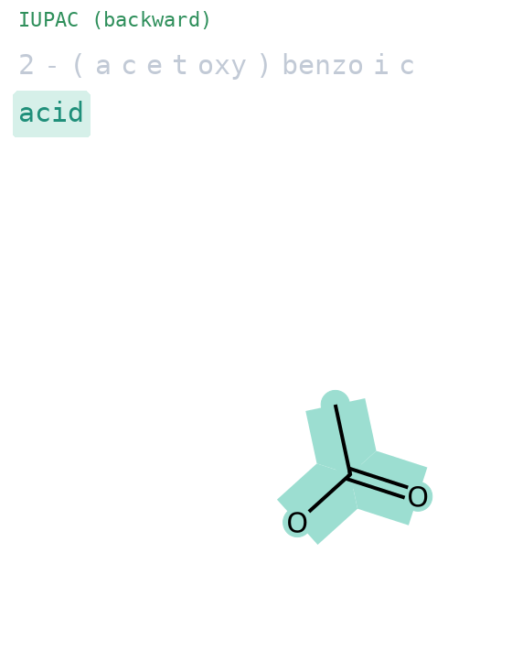
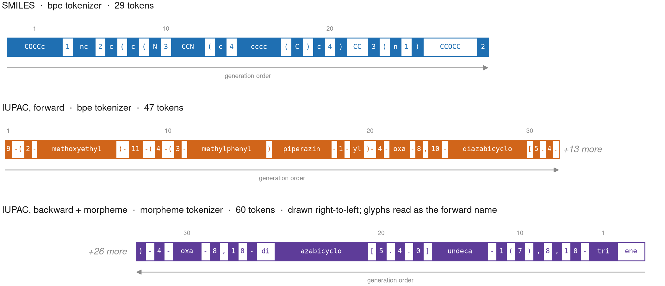
Tokenization tricks
- Morpheme tokenization (greedy longest-match lexicon)
  · meth / benzo / carboxylic / -oate …
- Forward and BACKWARD tokenization
  · backward → parent scaffold first, suffix-driven
backward: name fills right-to-left
Notes:
Show both GIFs (forward on prev slide). Backward enables suffix-first completion.

Slide 17
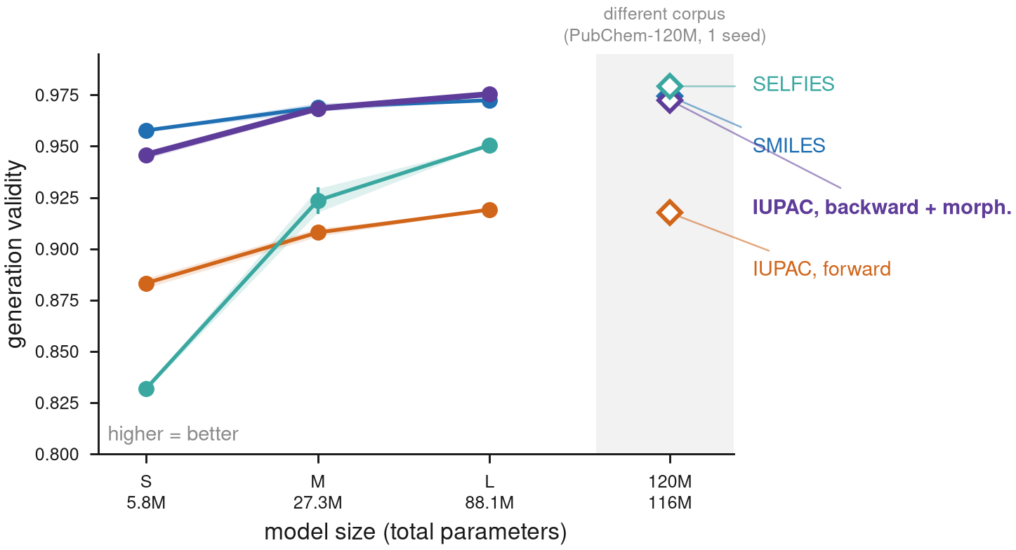
Distribution learning
Notes:
Wim to fill from iupacformer results.

Slide 18
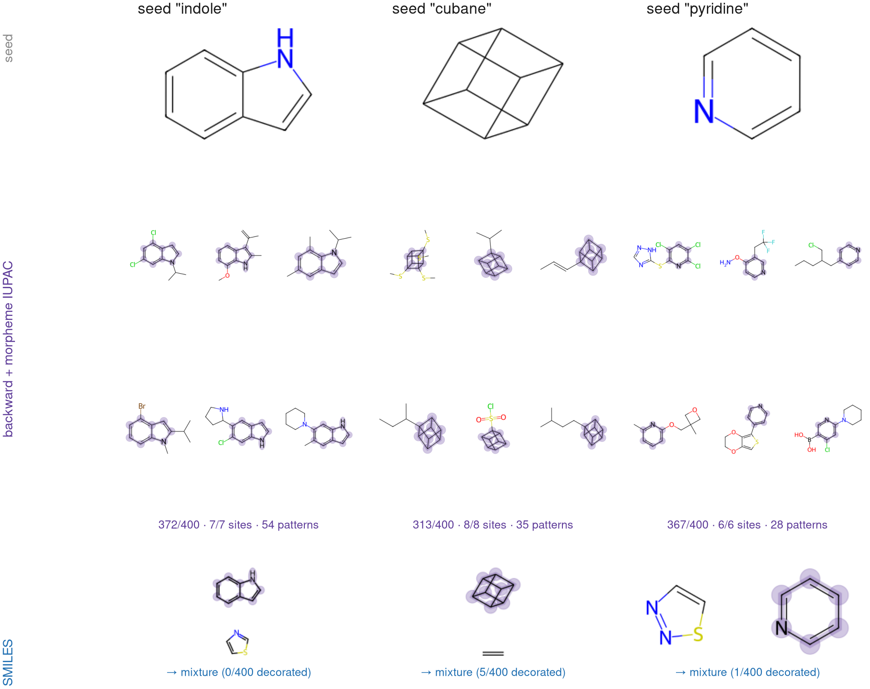
Suffix-first completion
- Novel capacity: condition on the suffix, generate the rest
  · '… -oic acid' → fill scaffold to match
- Not expressible in SMILES (prefix-only grammar)
Notes:
This is the unique selling point of IUPAC-as-notation.

Slide 19
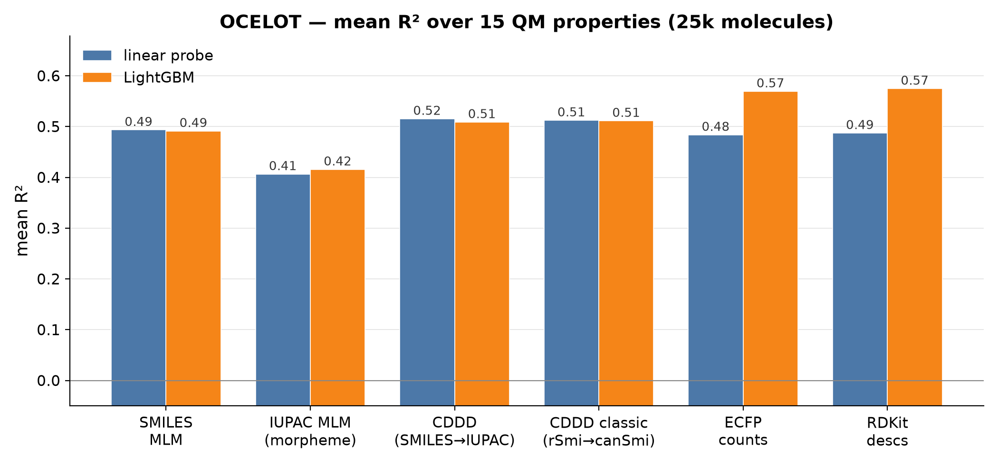
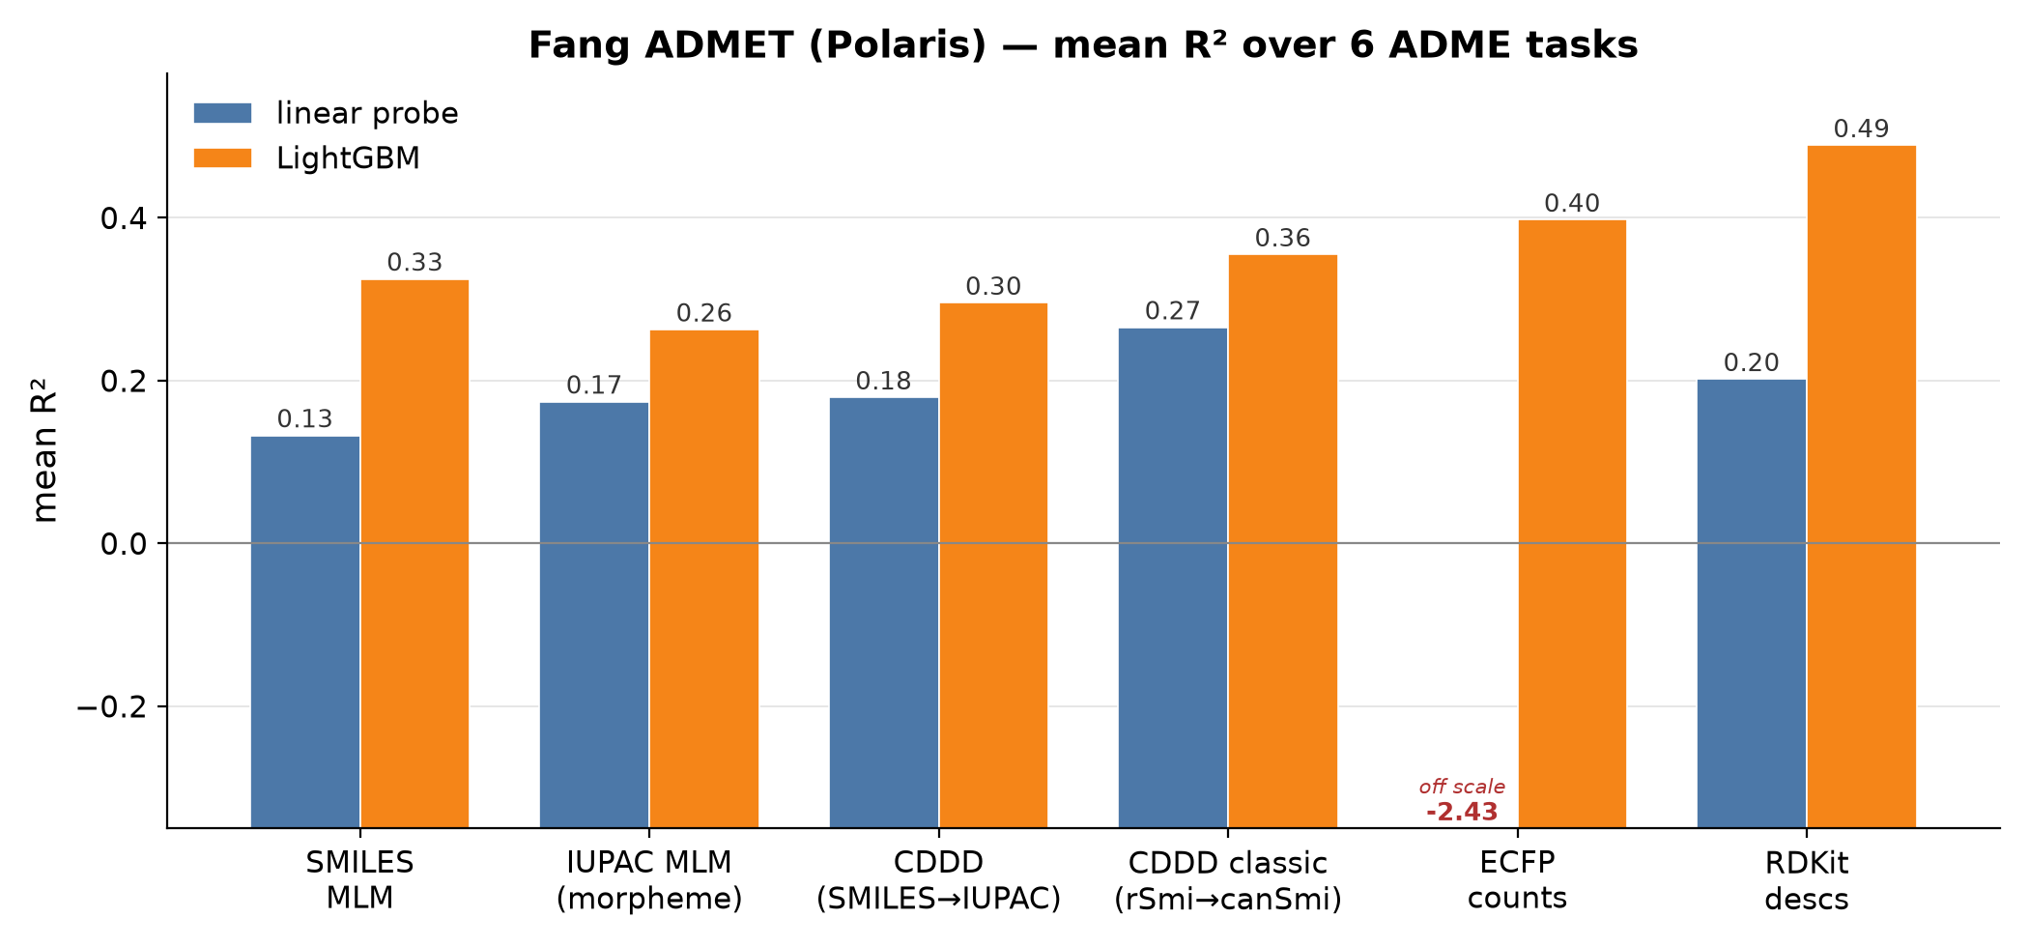
Performance: OCELOT & FANG
- IUPAC MLM (morpheme) trails SMILES MLM; OCELOT 0.42 vs 0.49, Fang 0.26 vs 0.33
- CDDD (SMILES→IUPAC translation) competitive; classic CDDD best learned on Fang (0.36)
- Classical features are the winner (RDKit descs, ECFP counts)
Notes:
Honest: as an embedding source, IUPAC morpheme-MLM is behind SMILES; the CDDD translation embedding is the strong IUPAC-flavoured representation. Figures recreated from reported values.

Slide 20
Part 3:
WLN

Slide 21
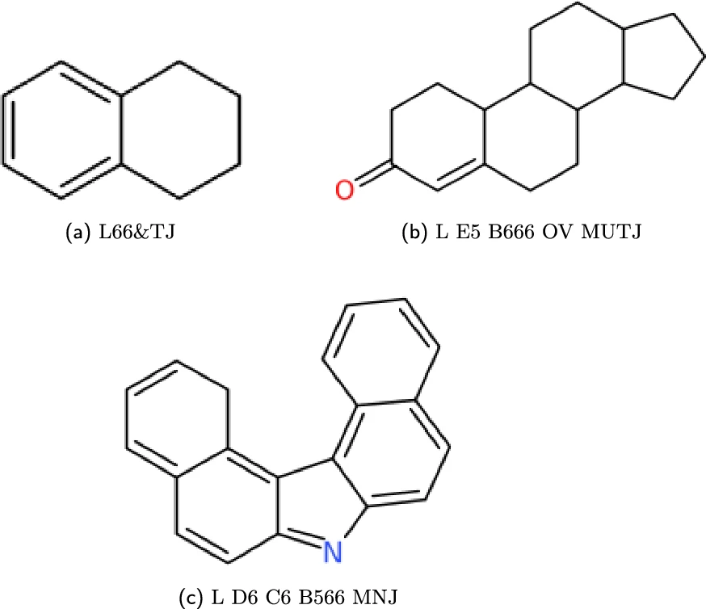
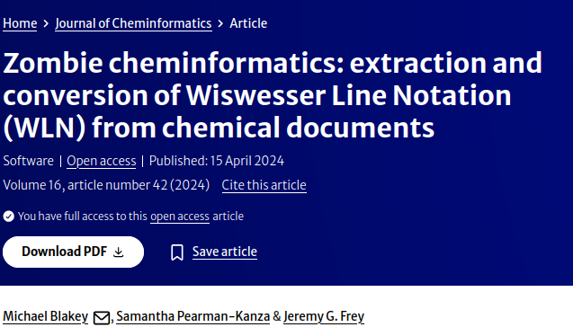
It fails to represent
- Wiswesser Line Notation: the shortest notation (mean 25 chars)
- SMILES→WLN coverage only ~60% (40% fail)
  · ChEMBL 62%, OCELOT 59% vs ~100% for SMILES/BLINCS
- Impractical as a CLM notation: loses 40% of chemistry
- cf. 'zombie cheminformatics': revived legacy notation
Toolkit: wiswesser (github.com/Mblakey/wiswesser).
Notes:
'Zombie cheminformatics' = the paper reviving WLN; add the exact citation.

Slide 22
It fails even where it works
- On the ~60% it CAN encode, still behind:
- n-gram FP + LGBM (OCELOT R²):
  · SMILES 0.604 > BLINCS 0.587 > ECFP4 0.562 > WLN 0.560
- Linear probe: WLN embeddings poor (0.22)
- Carries local info, but weaker and only for 60% of molecules
Notes:
Double failure: coverage AND, conditional on coverage, performance.

Slide 23
Part 4
The punchline: n-grams

Slide 24
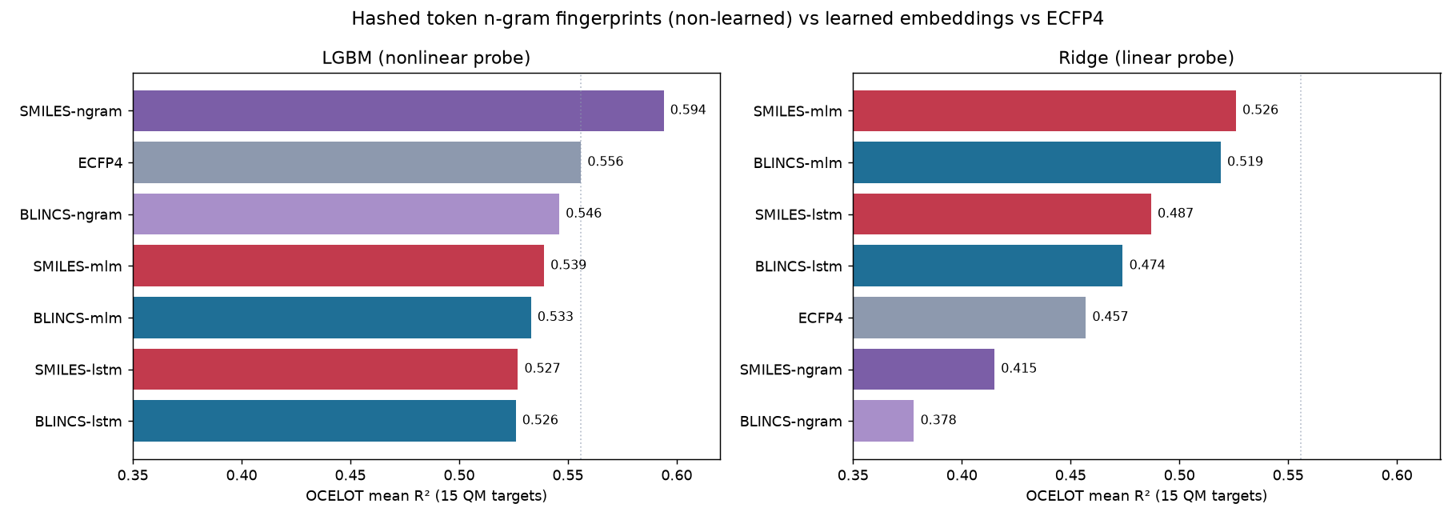
How much are CLMs actually learning?
- Non-learned baseline: hashed string n-gram fingerprint
  · just token n-gram counts, no training
- n-gram FP + LGBM beats pretrained embeddings:
  · OCELOT: SMILES-ngram 0.594 > best 25M embedding 0.539
  · FANG: char/atom n-grams beat ECFP4; BPE hurts
- → small CLMs mostly capture local substring statistics
- Precedent: LINGO (Vidal et al., 2005)
n-gram FP vs learned embeddings
Notes:
The payoff: connects back to 'CLMs are small LMs'. Humbling but honest.

Slide 25
Conclusion
- Notation shapes the representation
traversal & tokenization matter!!
- BLINCS: provably near-optimal locality; competitive, not better
- IUPAC: novel capacities (suffix-first) SMILES can't express
- WLN: cautionary failure; coverage and performance
- n-grams: better than learned: small CLMs learn mostly local string stats
Notes:
Land the through-line: for small CLMs, most signal is local; exotic notations buy structure or capability, rarely raw accuracy.

Slide 26

Acknowledgment slide
Support from my funders
  WD was supported by the Ministry of Education, Youth and Sports of the Czech Republic – National Infrastructure for Chemical Biology (CZ-OPENSCREEN, LM2023052). W.D. was supported by the Ministry of Education, Youth and Sports of the Czech Republic by the project “New Technologies for Translational Research in Pharmaceutical Sciences/NETPHARM”, project ID CZ.02.01.01/00/22_008/0004607, cofunded by the European Union. Computational resources were provided by the e-INFRA CZ project (ID:90254), supported by the Ministry of Education, Youth and Sports of the Czech Republic.
Ing. Jozef Fülöp

