Slide 1


The Elephant in the Room
Cheminformatics in the Era of Agents
How should we deliver value?
Riccardo Fusco
IMTM, CATRIN
Palacký University, Olomouc, Czechia
Notes:
Assume the audience already uses coding agents. Frame the talk as a practical question about where cheminformatics work goes next, rather than an argument for adopting AI.
**Evidence / source:** [Living philosophy](philosophy.md), “The position” and “Form of the talk.”
**Provisional visual role:** A restrained elephant motif or large negative-space silhouette. It sets tone; it does not explain the argument yet.
Content source: /home/hitesit/Documents/Slide Factory/projects/agentic-harness-cheminformatics/.scratch/agentic-harness-cheminformatics/outline-prototype.md
Design references: minimal reference renders and supplied Reactor cover.

Slide 2
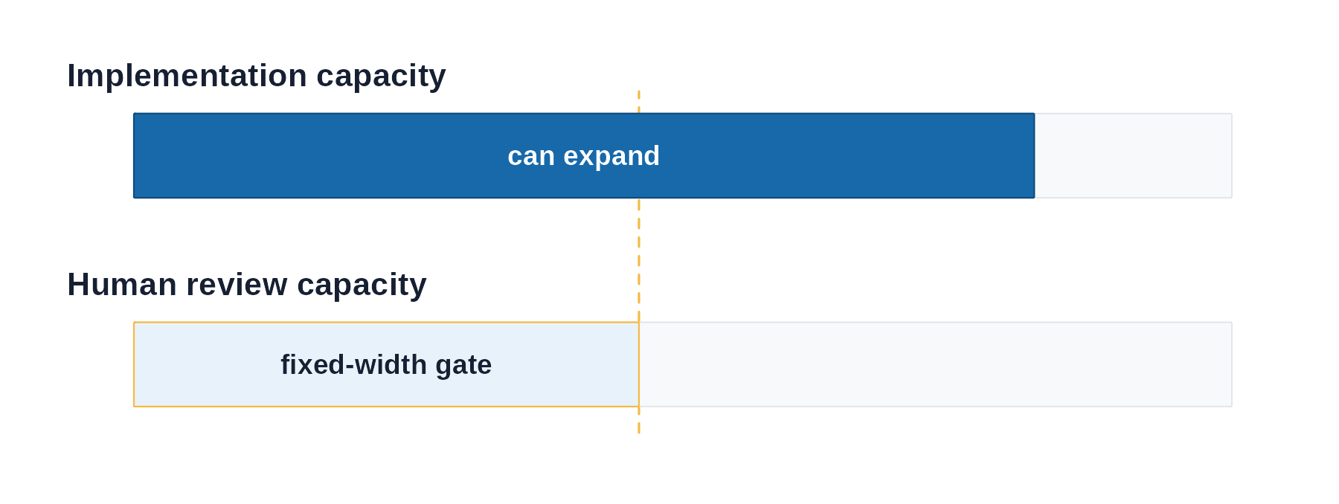
Code is no longer the scarce part
01
02
03
Agents can write code faster than we can review it
When code becomes cheap, choosing what to build matters more
Delegate the work; design the system
Humans cannot check every generated line.
Domain knowledge helps us connect fields and recognize worthwhile problems.
As with an employee, set expectations, tools, and constraints, then judge the work delivered.
02
Notes:
Keep the provocation quiet. Code still matters; the practical change is that a person's reading capacity cannot keep pace with unlimited generated implementation. The conceptual figure compares abundant implementation capacity with a fixed human review capacity; it is an explanatory model, not an economic measurement. Use delegation as the analogy: a manager sets expectations, tools, constraints, and review points so an employee can deliver meaningful work without the manager checking every line. Domain knowledge helps select useful problems and connect fields; this is a position about where value moves, not a universal claim about agent productivity.
**Evidence / source:** [Living philosophy](philosophy.md), “The position” and “The economics of narrow scientific software.”
**Provisional visual role:** Type 3 with the three blocks on the left and the R-generated conceptual capacity comparison on the right. The bars have no numeric axis or visible disclaimer; their conceptual status remains in speaker guidance.
Content source: /home/hitesit/Documents/Slide Factory/projects/agentic-harness-cheminformatics/.scratch/agentic-harness-cheminformatics/outline-prototype.md
Design references: minimal reference renders and supplied Reactor cover.

Slide 3
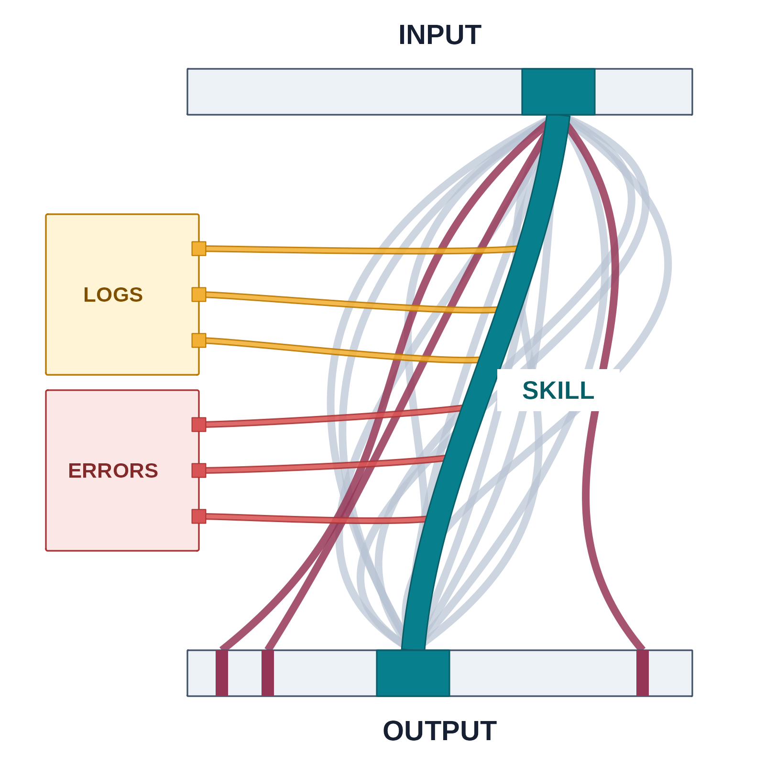
Put trust around the agent
01
Define the inputs and outputs
Schemas specify the fields, formats, and files. If the result has the wrong shape, reject it.
02
Write down the method
A skill gives the agent the same steps, tools, paths, and checks for every run.
03
Keep the logs and errors
Saved diagnostics help the agent fix failures and avoid repeating the investigation next session, saving turns and tokens.
04
Judge whether the result answers the question
A successful run shows that the workflow ran. You still decide whether the result coherently answers the scientific question.
03
Notes:
Present this as an operating pattern. Input and output schemas constrain what the agent receives and what it may return. They reduce ambiguity and make malformed output rejectable. A skill turns the method into an explicit procedure with the same steps, tools, paths, and checks each time; the model is not deterministic, but the workflow becomes as repeatable as possible. Logs and validation errors give the agent evidence for diagnosing and correcting a failed run. None of these controls establish that the chemistry is right. The next two slides show the hand-off: a database enforces structure, then a plot supports a separate scientific check.
**Evidence / source:** [Living philosophy](philosophy.md), “What makes a harness trustworthy.”
**Provisional visual role:** Type 3 with the four controls on the left and the R-generated alluvial on the right. The horizontal INPUT bar sits above the horizontal OUTPUT bar. All alternative paths start at the same point in the green input region. Grey paths converge on the green output region; three wine-red paths end at separate locations outside it on the bottom output bar. Wine red distinguishes off-target outputs from the coral-red execution-error branches at the side. The highlighted teal skill path retains its logs and errors. These paths illustrate possible routes, not measured frequencies or proof of scientific correctness. Ribbon count and width encode no quantity.
Content source: /home/hitesit/Documents/Slide Factory/projects/agentic-harness-cheminformatics/.scratch/agentic-harness-cheminformatics/outline-prototype.md
Design references: minimal reference renders and supplied Reactor cover.

Slide 4
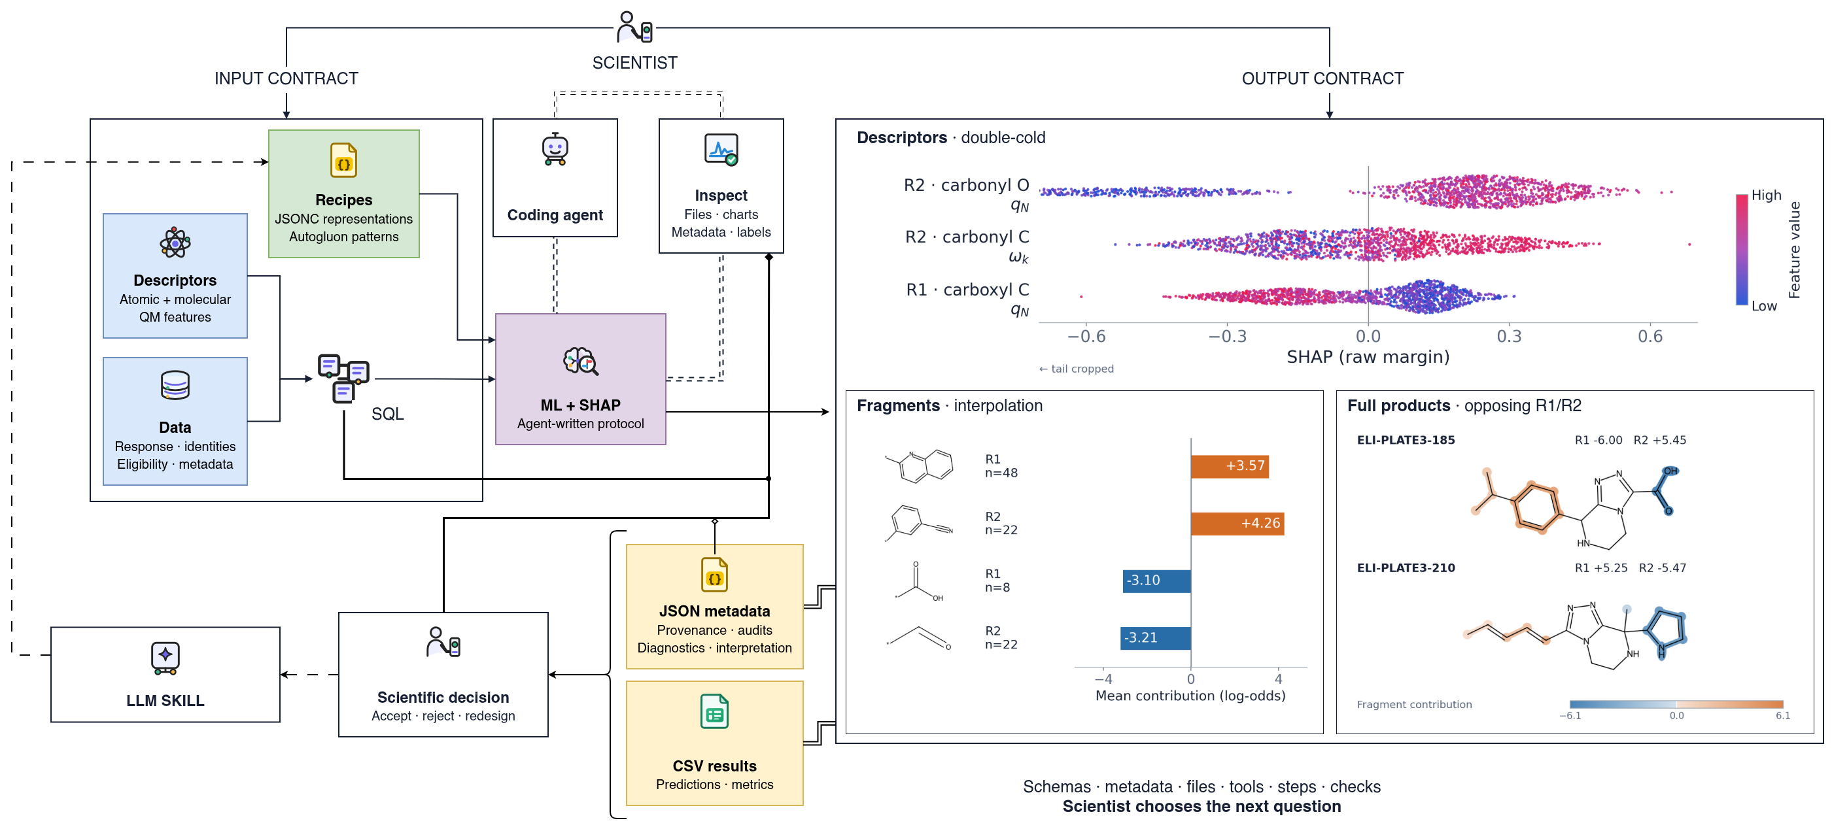
Handle complexity by designing the boundaries
04
Notes:
Use the FullEnum example without naming it on the slide. Processed analytical information crosses the SQL boundary as wet-lab `y`, chemical identities, descriptor tables, eligibility, and metadata; raw chromatographic peaks are not passed directly to the model. A user-designed JSONC schema then expresses a model recipe: descriptor families, chemical roles and sites, molecular representations or fingerprints, interpolation or held-out identity evaluation, runtime choices, and optional interpretation. The central `ML + SHAP` square compresses the agent-written modelling and interpretation protocol without exposing model internals. The output contract preserves predictions, metrics, provenance, audits, diagnostics, and interpretation for inspection. The smaller agent loop is an implementation/completeness loop: the agent runs the protocol, inspects whether required files, charts, metadata, and labels are visible, and corrects the implementation against the contracts. It does not judge whether a pattern is scientifically meaningful. The dominant `LLM SKILL` loop is human-triggered and returns `new experiment · same harness` to the input side; it carries the schemas, metadata expectations, files, tools, steps, and checks into the next requested modelling question. It does not choose that question, feed outputs into training automatically, rewrite itself, or certify the science. End at `accept · reject · redesign`: inspectable artifacts change the control surface, while the scientist remains responsible for the claim.
**Evidence / source:** [v6 source audit](slide-04-v6-source-research.md); [FullEnum input/output-shaping research](issues/16-research-fullenum-ml-input-output-shaping.md); [Living philosophy](philosophy.md), “FullEnum: input and output shaping.”
**Provisional visual role:** Type 5 — Workflow. Native Draw.io frames and supplied icons surround two source-backed triazolo charts: top-three descriptor SHAP from expanded-descriptor double-cold evaluation, and product-Morgan AnchorSHAP from interpolation evaluation. Four signed fragment means sit beside two full products with opposing R1/R2 sums. Fragment-region colors are model contributions, not atom SHAP or causal effects. The descriptor axis is cropped at −0.7 as requested; full rows remain in the portable snapshot. Minimal chart labels leave source and selection details in the [v6 README](../../images/slide-04-input-output-harness/v6/README.md). The dashed agent completeness loop remains separate from the scientist-triggered redesign loop.
**Acceptance render:** [Slide 4 Draw.io export](../../images/slide-04-input-output-harness/v6/input-output-harness-r03.drawio.png).
Content source: /home/hitesit/Documents/Slide Factory/projects/agentic-harness-cheminformatics/.scratch/agentic-harness-cheminformatics/outline-prototype.md
Design references: minimal reference renders and supplied Reactor cover.

Slide 5
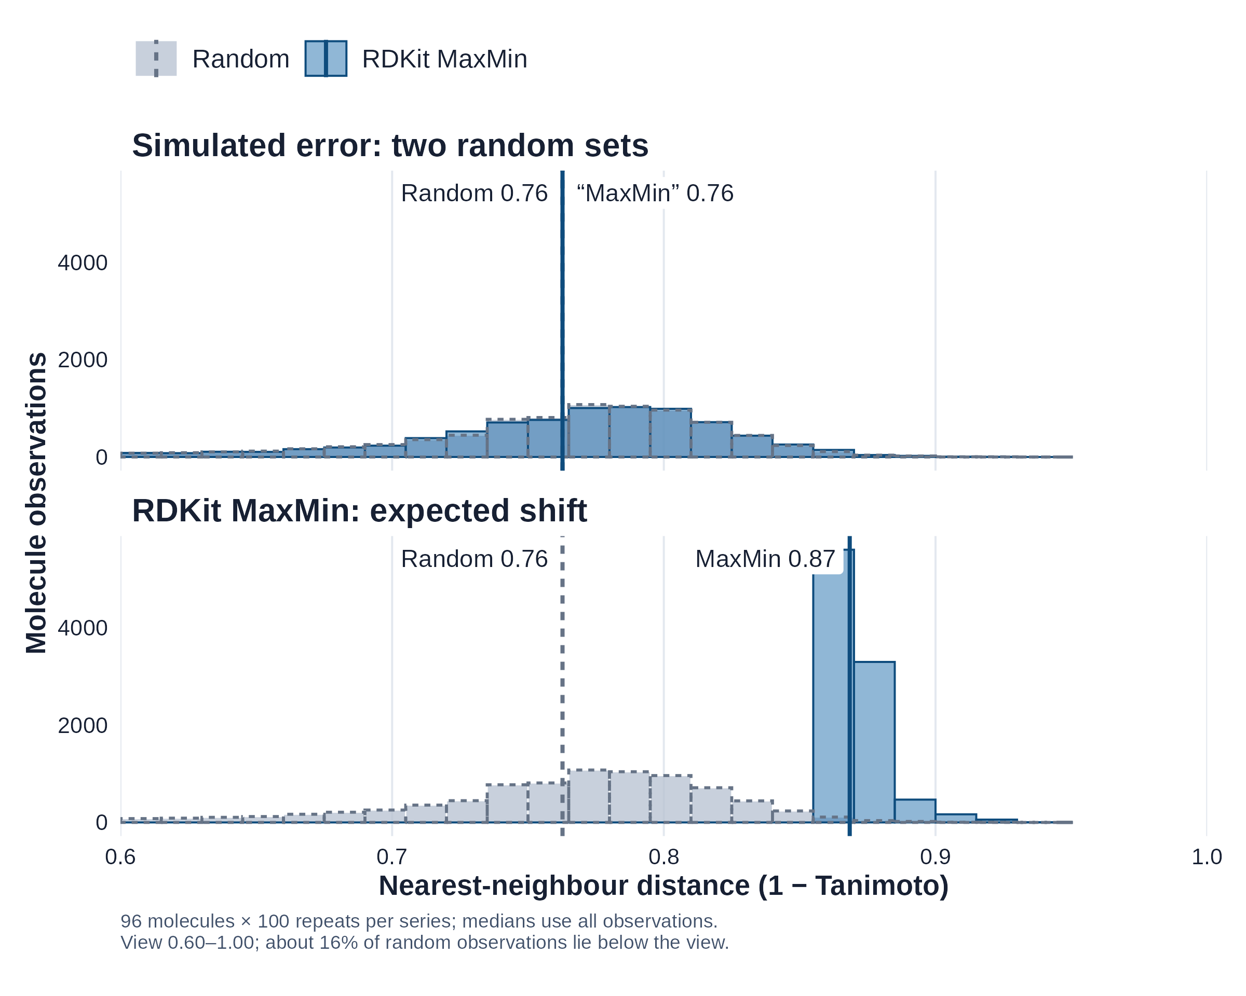
Make the result easy to judge
Ask the agent for plots that expose what the protocol produced. Use your scientific judgement to spot results that do not make sense.
A deliberate labelling error
Two random selections are plotted, but one is labelled MaxMin. The missing shift is a reason to investigate.
The expected signal appears
Actual MaxMin picks have larger nearest-neighbour distances. This supports the selection check under this fingerprint and metric.
ChEMBL 37 · 4,721 molecules · Morgan radius 2 / 2,048 bits. Distances are measured within each selected set.
05
Notes:
The upper panel simulates an inspectable agent failure: the MaxMin-labelled series is a second random seed stream. The histogram shapes differ slightly but both medians round to 0.76, so the expected directional signal is absent. The lower panel uses RDKit's real MaxMin selections, moving the median nearest-neighbour distance to 0.87. The point is that the scientist knows what directional signal this method should produce and can inspect the underlying data contract. The check applies only to this ChEMBL subset, molecular representation, and metric; it does not establish diversity in every chemically meaningful sense. The shared 0.60–1.00 view gives both panels the same comparison window without changing the data or statistics.
**Evidence / source:** [Scientific and visual check](issues/24-refine-slide-05-science-and-slide-03-paths.md); [Living philosophy](philosophy.md), “What makes a harness trustworthy.”
**Scientific check detail:** Each observation is the minimum fingerprint distance from one selected molecule to the other 95 molecules in its selected set. The same random reference appears in both panels. The chart pools 100 selections per series; observations overlap across repeats and are not independent experimental replicates. All data and full-data medians are retained. The displayed 0.60–1.00 interval hides 15.9% of the random reference and 16.6% of the second random stream, disclosed as about 16% in the caption. The pool is a fixed ChEMBL subset, not a representative survey of chemical space. A missing expected shift prompts investigation; a plausible shift does not establish that every part of the protocol is correct.
**Provisional visual role:** Type 3 mirrored, with two aligned R-generated charts stacked on the left and text on the right. Both panels overlay Random and RDKit MaxMin histograms on shared axes. `Simulated error: two random sets` compares two real random seed streams while mislabelling the second as MaxMin; a dashed grey outline keeps Random visible. `RDKit MaxMin: expected shift` shows the narrower, right-shifted MaxMin distribution. The compact 8 × 6.4-inch figure increases label size at slide scale; a 300-DPI PNG and vector SVG are provided. The chart exposes the output; the scientist makes the judgement.
Content source: /home/hitesit/Documents/Slide Factory/projects/agentic-harness-cheminformatics/.scratch/agentic-harness-cheminformatics/outline-prototype.md
Design references: minimal reference renders and supplied Reactor cover.

Slide 6
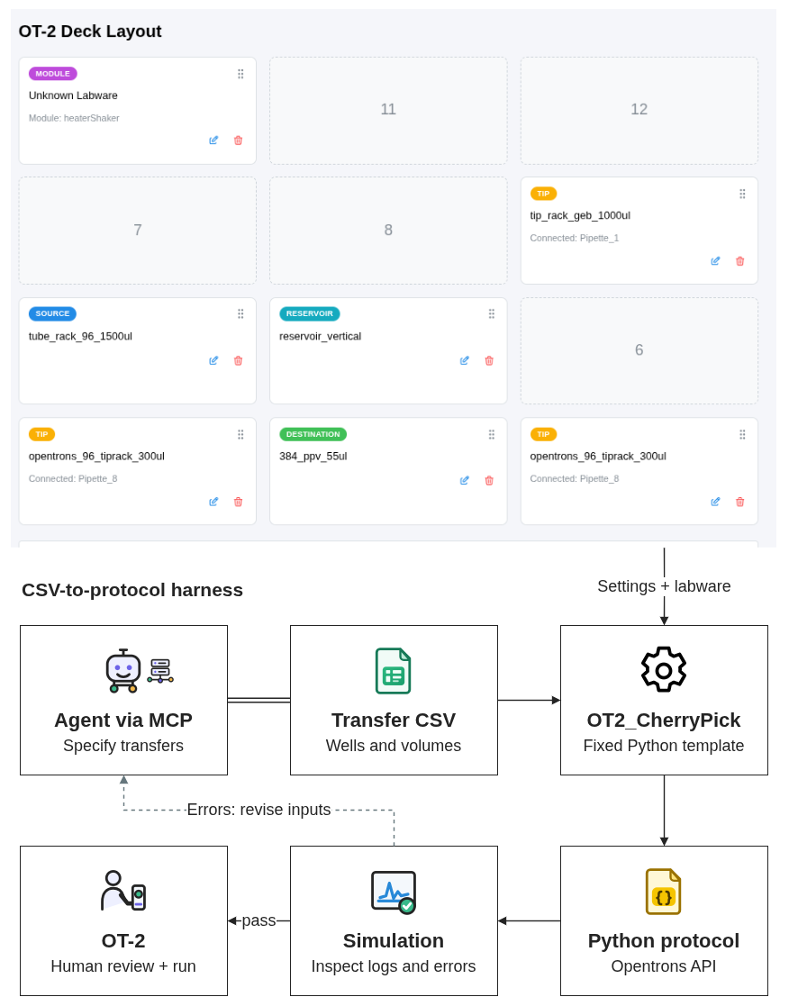
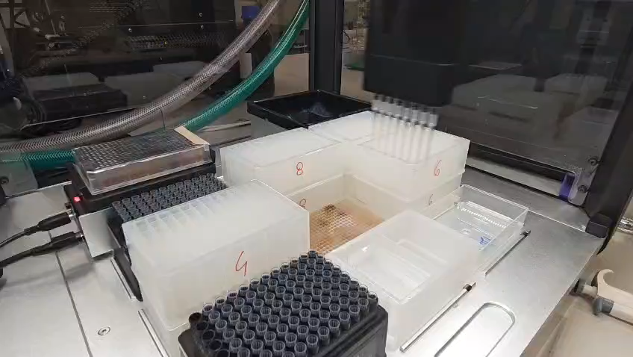
A robotics example: the niche came first
01
Chemistry knowledge revealed an experimental gap
Individual transfers and combinatorial layouts needed a more flexible interface.
02
A CSV specifies the pipetting operations
OT2_CherryPick combines transfers and deck settings with a fixed Python template to generate the protocol deterministically.
03
MCP gives agents the same interface
An agent submits a CSV and uses simulation diagnostics to revise inputs. A human reviews the protocol before the robot runs.
06
Notes:
Describe the author's experience in third person. The graphical workflow in use did not fit complex chemistry cherry-picking and combinatorial layouts; in the author's experience it was a better fit for simpler dilution and serial workflows. OT2_CherryPick combines the CSV transfer operations and deck settings with a fixed Python template, so fixed inputs and that template produce the same software protocol deterministically. This determinism applies to software generation, not to the physical pipetting outcome. An agent can submit a CSV and use simulation diagnostics to revise inputs, but this describes an agent-mediated iteration pattern rather than an autonomous retry implementation. A human reviews the protocol before the robot runs. This is a personal account of one workflow gap, not a claim about every current Protocol Designer workflow or about vendor priorities; the current official documentation also includes CSV-driven cherrypicking examples. The design still concerned transfer intent, deck geometry, liquid behaviour, and safety boundaries. Simulation can establish that a protocol runs, not that pipetting or chemistry is correct.
**Evidence / source:** [Living philosophy](philosophy.md), “OT2_CherryPick”; [author revision context](revision-context-2026-09-05.md), “Personal OT-2 account”; [official vendor context](ot2-vendor-context-2026-09-05.md).
**Provisional visual role:** Type 3A with three text blocks on the left and a reserved media box on the right. The prototype records a manual handoff. During final PowerPoint assembly, the author will choose and insert the real liquid-handler clip and its poster frame. The footage shows operation, not validated pipetting accuracy or chemistry.
Content source: /home/hitesit/Documents/Slide Factory/projects/agentic-harness-cheminformatics/.scratch/agentic-harness-cheminformatics/outline-prototype.md
Design references: minimal reference renders and supplied Reactor cover.

Slide 7
Where domain knowledge and engineering meet
Domain knowledge reveals the problem first
It shows which scientific questions and workflow gaps deserve a tool.
01
Deeper into science
Theory and method development.
02
Closer to experiments
Wet-lab and analytical work, including robotics, where physical constraints shape the system.
03
Up into engineering
Specialized software for narrow scientific needs, with interfaces, tests, provenance, and operation.
Agents lower the cost of trying all three
A narrow tool becomes practical when the person who knows the problem can shape the system.
07
Notes:
Design here means deciding what to build and how it should solve the problem at hand; it includes judgement and taste, rather than visual styling alone. The first direction goes deeper into theory and method development, such as contributing to molecular-dynamics force fields rather than only scripting around them. The second moves closer to experiments through wet-lab and analytical work, including robotics, where physical constraints shape the system. The third moves up into specialized software engineering: interfaces, tests, provenance, deployment, and operation for narrow scientific needs. Agents lower the cost of trying these directions, but they do not remove the need to understand the system or the science.
**Evidence / source:** [Living philosophy](philosophy.md), “Where professional value moves” and “The economics of narrow scientific software.”
**Provisional visual role:** Type 2 with a definition of design above three short direction blocks and one synthesis line below. Keep the slide textual. Do not add an intersection diagram or imply measured economics.
Content source: /home/hitesit/Documents/Slide Factory/projects/agentic-harness-cheminformatics/.scratch/agentic-harness-cheminformatics/outline-prototype.md
Design references: minimal reference renders and supplied Reactor cover.

Slide 8
How should we deliver value?
Choose the right problem
Design around the problem
Domain experience shows which problems matter.
Decide how the tool, workflow, experiment, or system should solve it.
Set boundaries and judge the science
Deliver value across fields
Define inputs and limits, check the outputs, and judge whether the result answers the scientific question.
Explore, prototype, build, and scale what a niche needs, combining software engineering, scientific methods, and wet-lab work.
08
Notes:
The harness is the bridge, not the destination. Durable value comes from problem-dependent design backed by domain judgement, engineering scale, inspectable systems, and scientific checks that software cannot perform for itself. The bottom-left block combines methodological boundaries and scientific judgement. The warm bottom-right block defines work through activities: exploring, prototyping, building and scaling across disciplinary boundaries as the problem requires. These roles are a professional position, not fixed job categories.
**Evidence / source:** [Narrative decision](issues/03-decide-the-narrative-spine-and-role-of-design.md); [architecture decision](issues/04-decide-the-slide-architecture-and-place-the-three-examples.md).
**Provisional visual role:** Type 1, purely textual. Centre the four short answer blocks with clear hierarchy and generous negative space. Do not add another figure.
Content source: /home/hitesit/Documents/Slide Factory/projects/agentic-harness-cheminformatics/.scratch/agentic-harness-cheminformatics/outline-prototype.md
Design references: minimal reference renders and supplied Reactor cover.

Slide 9
How should we deliver value?
Choose the right problem
Design around the problem
Domain experience shows which problems matter.
Define inputs and limits, check the outputs, and judge whether the result answers the scientific question.
Deliver value across fields
Explore, prototype, build, and scale what a niche needs, combining software engineering, scientific methods, and wet-lab work.
08
Notes:
The harness is the bridge, not the destination. Durable value comes from problem-dependent design backed by domain judgement, engineering scale, inspectable systems, and scientific checks that software cannot perform for itself. The bottom-left block combines methodological boundaries and scientific judgement. The warm bottom-right block defines work through activities: exploring, prototyping, building and scaling across disciplinary boundaries as the problem requires. These roles are a professional position, not fixed job categories.
**Evidence / source:** [Narrative decision](issues/03-decide-the-narrative-spine-and-role-of-design.md); [architecture decision](issues/04-decide-the-slide-architecture-and-place-the-three-examples.md).
**Provisional visual role:** Type 1, purely textual. Centre the four short answer blocks with clear hierarchy and generous negative space. Do not add another figure.
Content source: /home/hitesit/Documents/Slide Factory/projects/agentic-harness-cheminformatics/.scratch/agentic-harness-cheminformatics/outline-prototype.md
Design references: minimal reference renders and supplied Reactor cover.

Slide 10
Thank you for your attention
Questions?
Riccardo Fusco
IMTM, CATRIN
Palacký University, Olomouc, Czechia

