Slide 1

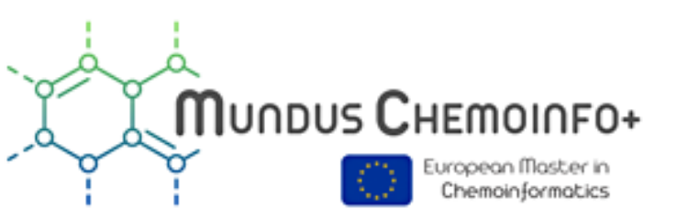
Orange ChemInfWidgets as a data mining tool for Chemoinformatics
Črtomir Podlipnik · Faculty of Chemistry and Chemical Technology, University of Ljubljana, Slovenia

Slide 2

What is Orange ?
Open-Source & Visual: Build workflows with a drag-and-drop interface.
Analysis: Explore data with powerful, interactive widgets.
Versatile: Supports classification, regression, clustering, and more.
Extensible: Add-ons for beginners and experts alike.
Simplifies Complexity: Engaging visual interface for data tasks.

Slide 3
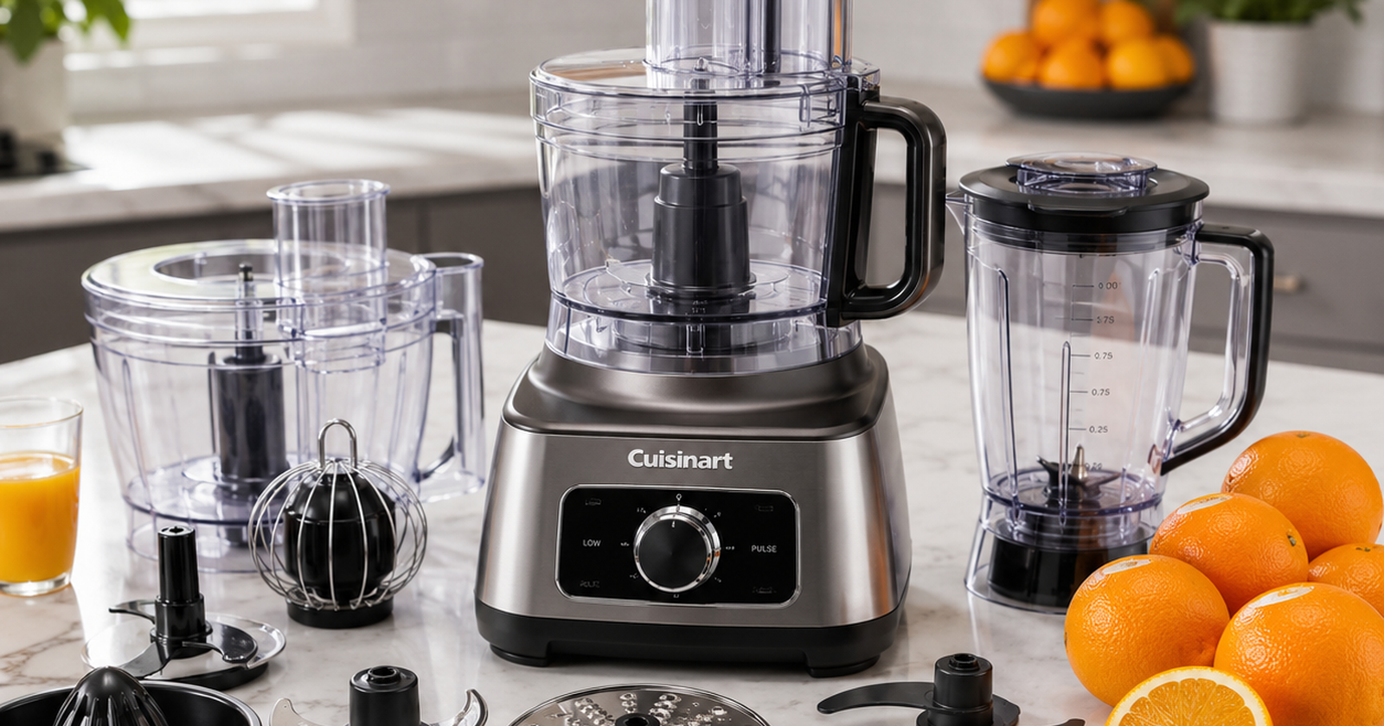
What can I do with Orange?

Slide 4
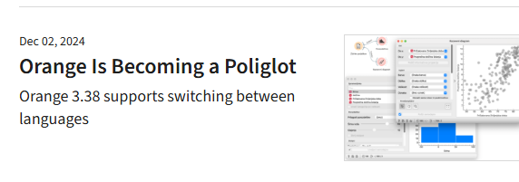
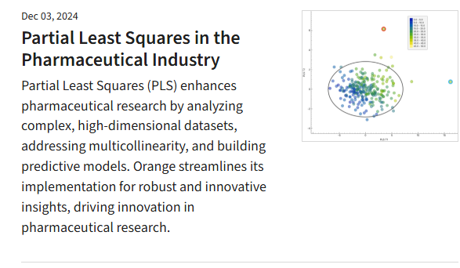
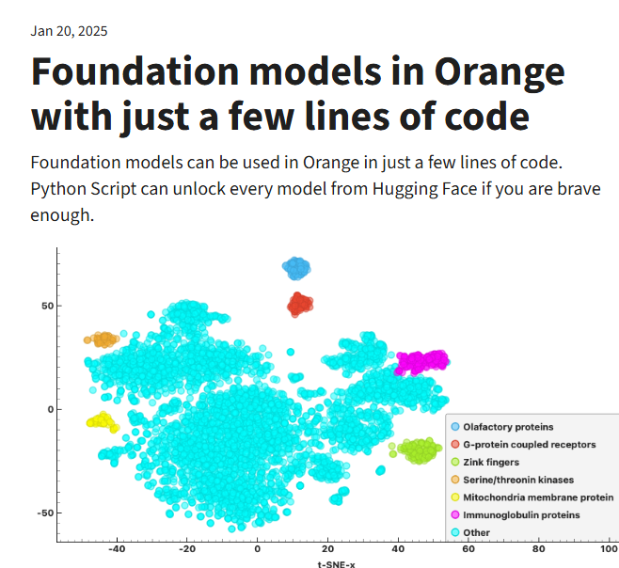
What can I do with Orange?

Slide 5
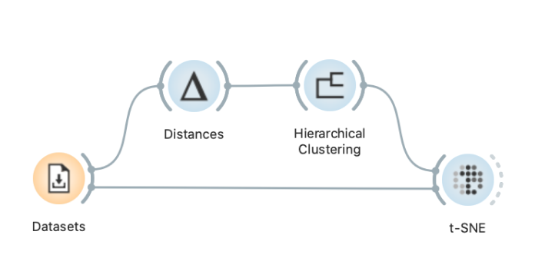
What is Visual Programming?
No coding needed. Place widgets on the canvas, connect them, load your datasets, and harvest the insight! Easy to learn even for complete novice.
Learn more

Slide 6
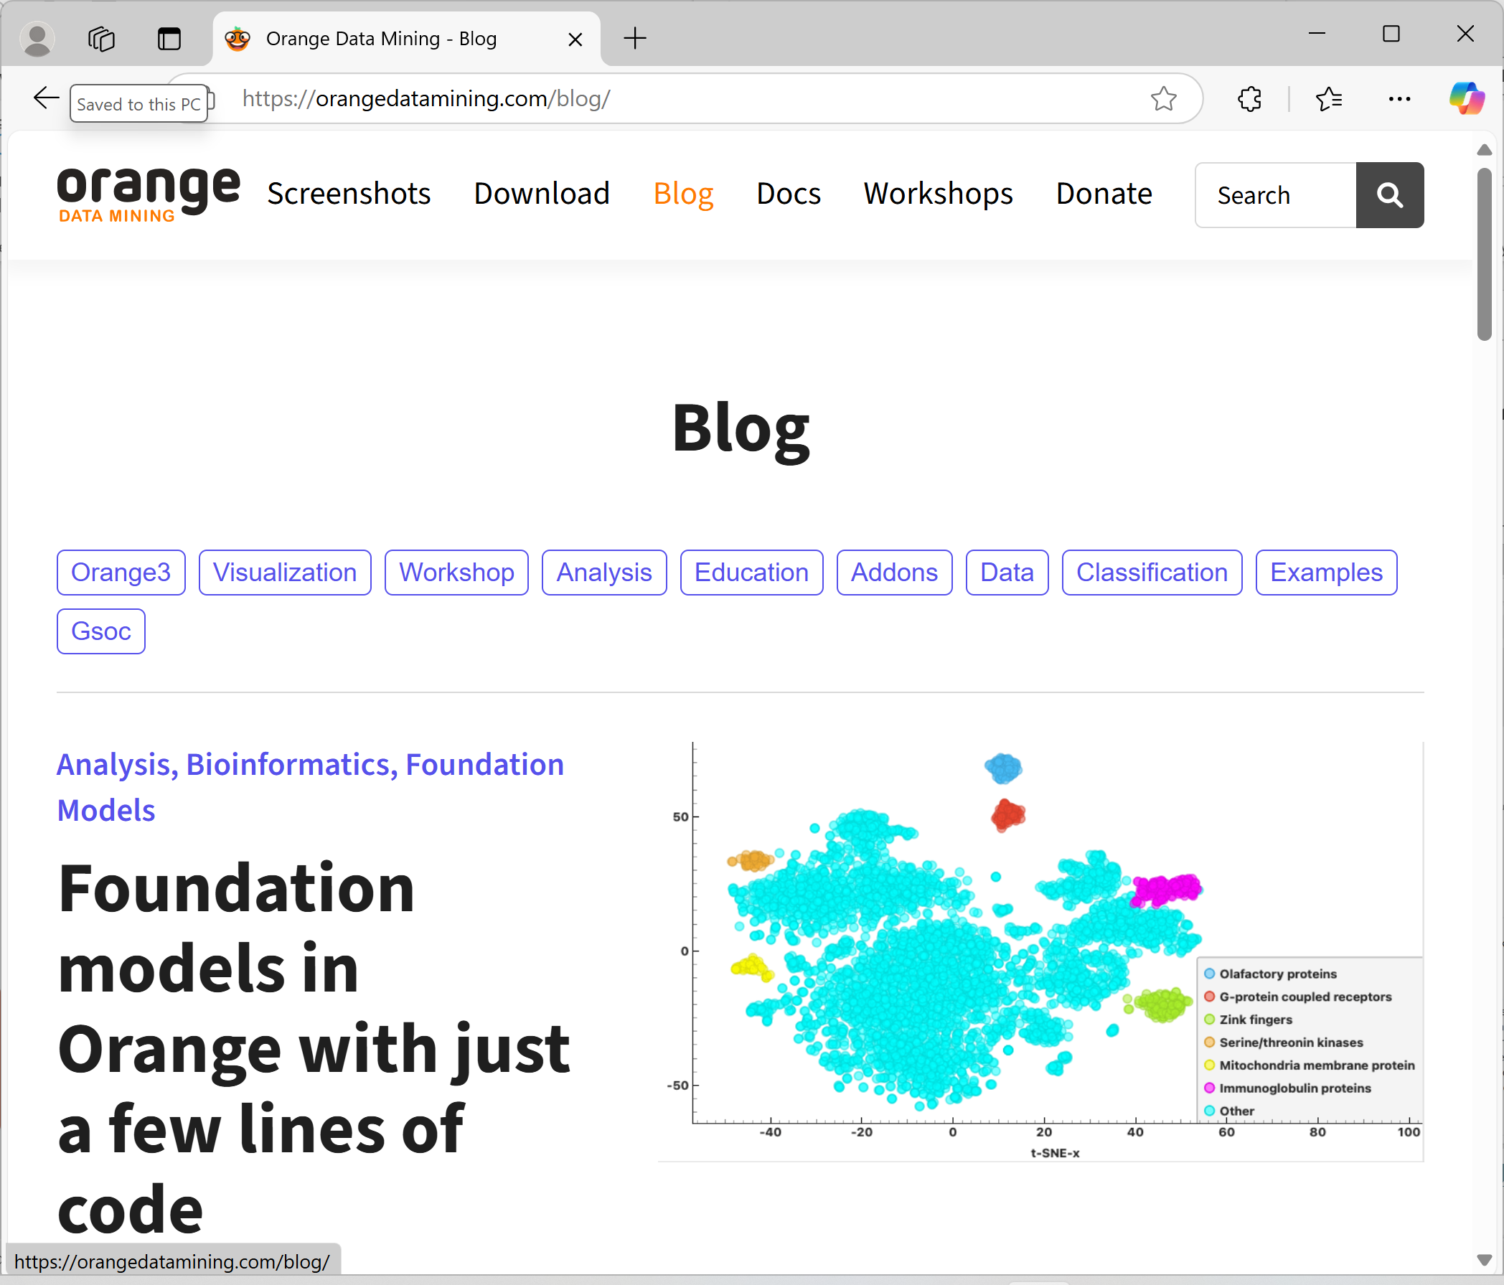
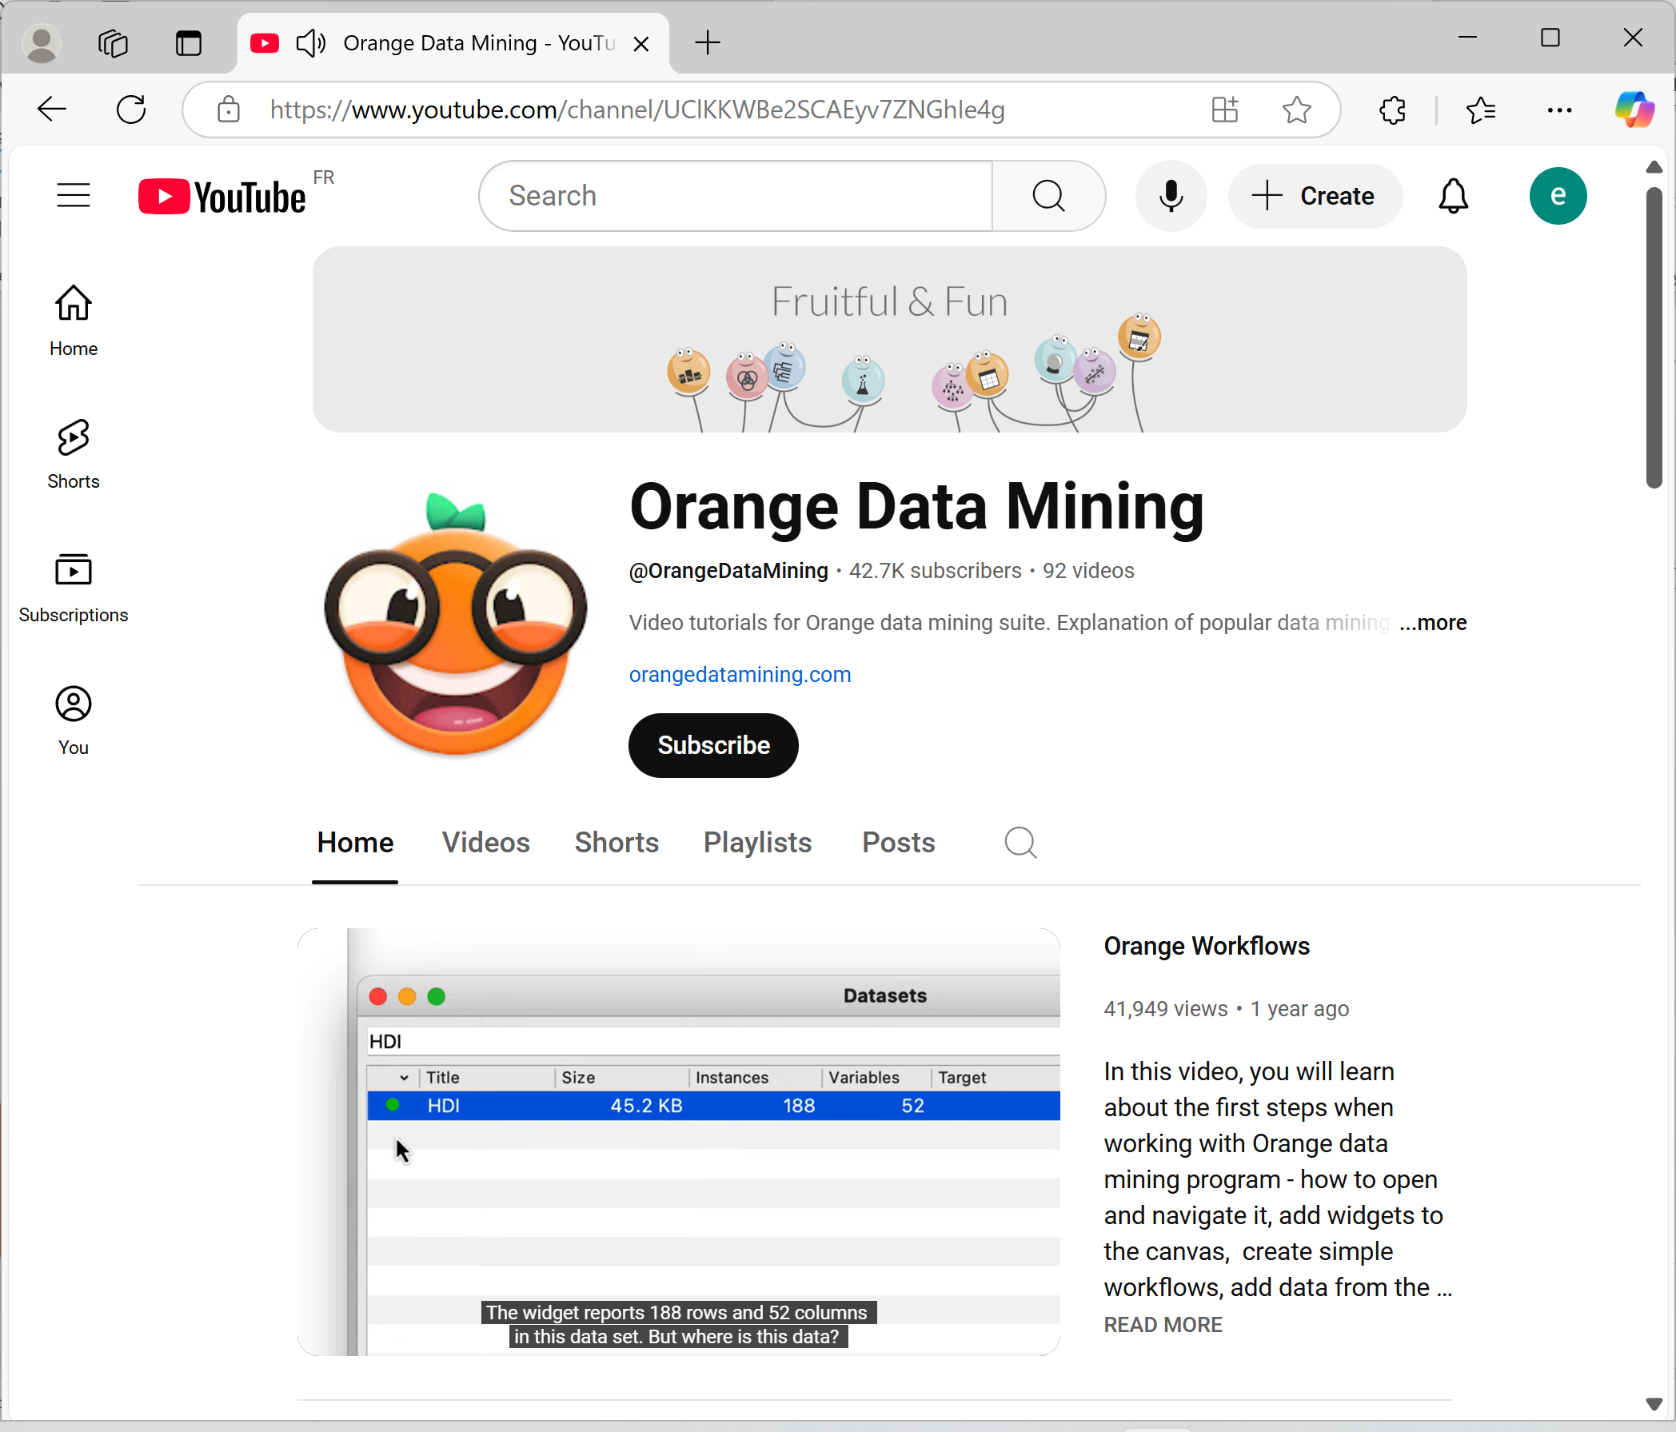
Where I can learn more about Orange?
BLOG
YOUTUBE CHANNEL

Slide 7
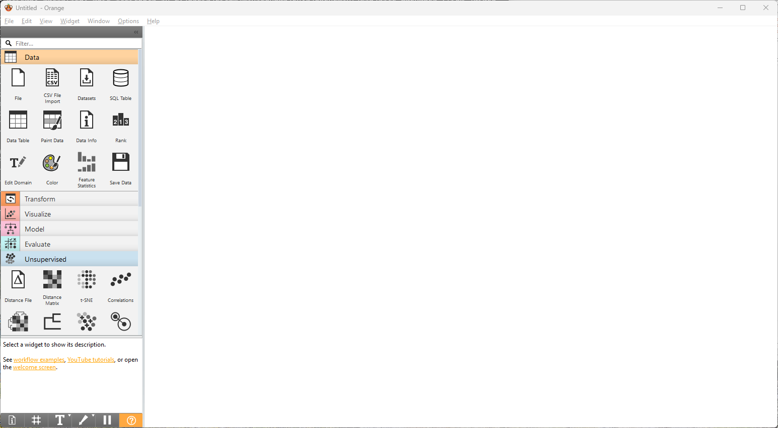
Orange Basic widgets
WIDGET
CANVAS
DATA
MODEL
Load, inspect and save data
Examples: File · Data Table · Rank
Train predictive learners
Examples: Logistic Regression · Random Forest · SVM
TRANSFORM
EVALUATE
TOOLKIT
Select, clean and reshape data
Examples: Select Columns · Impute · Preprocess
Compare and validate models
Examples: Test & Score · ROC Analysis · Confusion Matrix
VISUALIZE
UNSUPERVISED
Explore patterns interactively
Examples: Scatter Plot · Box Plot · Heat Map
Discover structure without labels
Examples: PCA · k-Means · Hierarchical Clustering

Slide 8
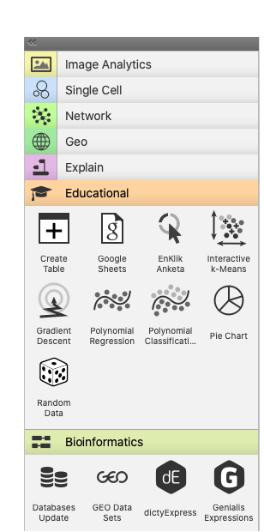
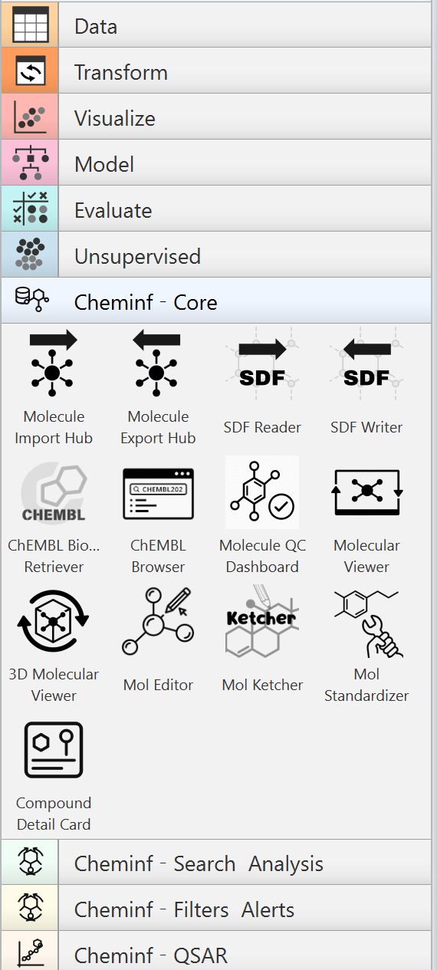
Orange Extensions
Specialised add-ons can perform natural language processing and text mining, conduct network analysis, do association rules mining, or address fairness in machine learning. Some address specialised data, such as time series, survival data sets, spectra, or gene expressions.
We developed Chem-Inf-Widgets special add-on for Chemoinformatics

Slide 9
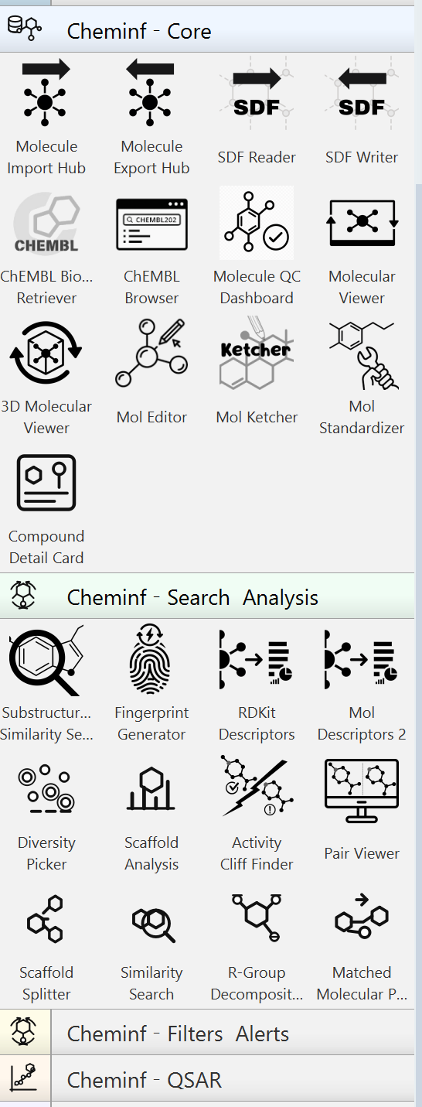
Chem-Inf-Widgets
Chem-Inf-Widgets is a collection of Orange widgets for chemoinformatics, powered by RDKit. They handle SDF file I/O, fetch data from ChEMBL, sketch and view molecules, standardize structures, run substructure searches, assess drug-likeness, predict ADMET, enumerate tautomers, and calculate fingerprints, descriptors, and basic QSAR models.
More will come soon!

Slide 10
Some Examples

Slide 11
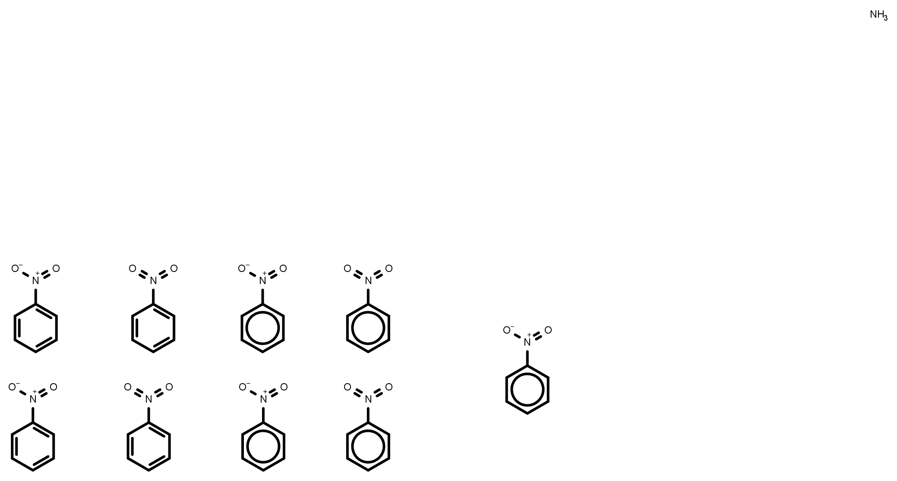
Standardization of molecular structures
No strict convention that defines how to represent chemical structures.
Molecules can be displayed in multiple ways.
Aromatisation; tautomers; mesomers; ionisation states; stereo-chemistry …
Standardized
form
Nitrobenzene can be depicted in many different ways: aromatization; different forms of nitro functional group; hydrogens implicitly or explicitly.

Slide 12
How we can do standardisation with RDkit
def standardize(smiles):
# Convert SMILES string to molecule
mol = Chem.MolFromSmiles(smiles)
# Remove Hs, disconnect metals, normalize, and reionize the molecule
clean_mol = rdMolStandardize.Cleanup(mol)
# If there are multiple fragments, get the "parent" molecule
parent_clean_mol = rdMolStandardize.FragmentParent(clean_mol)
# Neutralize the molecule
uncharger = rdMolStandardize.Uncharger()
uncharged_parent_clean_mol = uncharger.uncharge(parent_clean_mol)
# Return the standardized molecule without tautomer canonicalization
return uncharged_parent_clean_mol
https://github.com/greglandrum/RSC_OpenScience_Standardization_202104/blob/main/MolStandardize%20pieces.ipynb

Slide 13
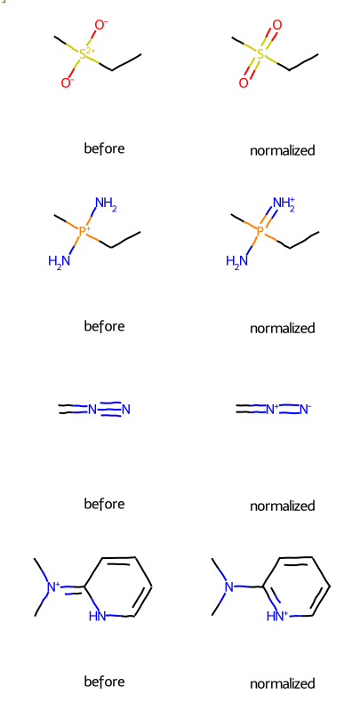
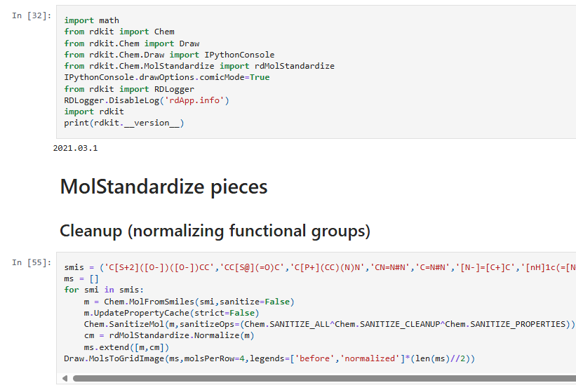

Slide 14
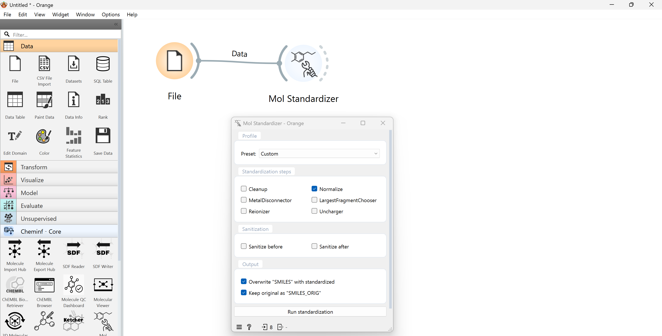
Example 1: Standardisation
Task: normalisation Add Molecular Standardisation widget – and run „Normalisation“
Find widget “Mol Standardisation” and drag’n’drop from the Cheminf Core catalogue to the canvas.
Conect File to Mol Standardisation
Clik Mol Standardisation
Check Normalize
Press Run Standardisation

Slide 15
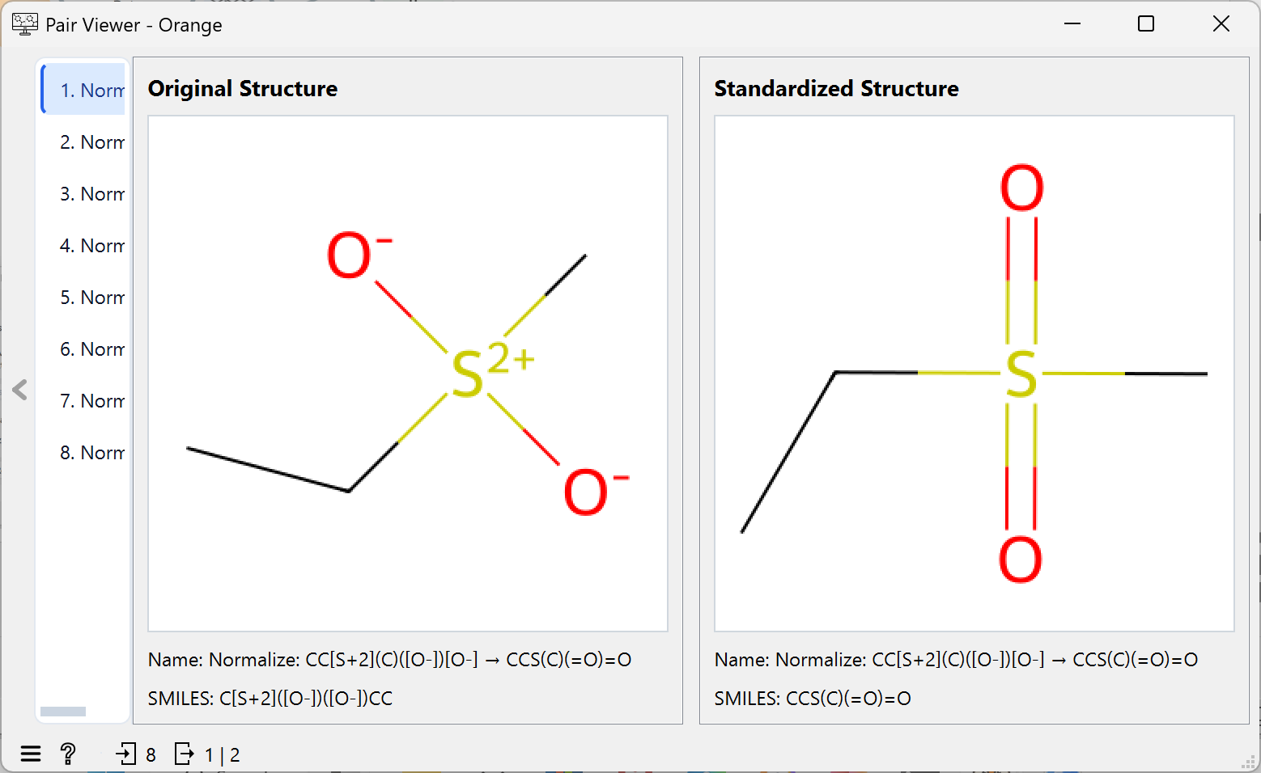
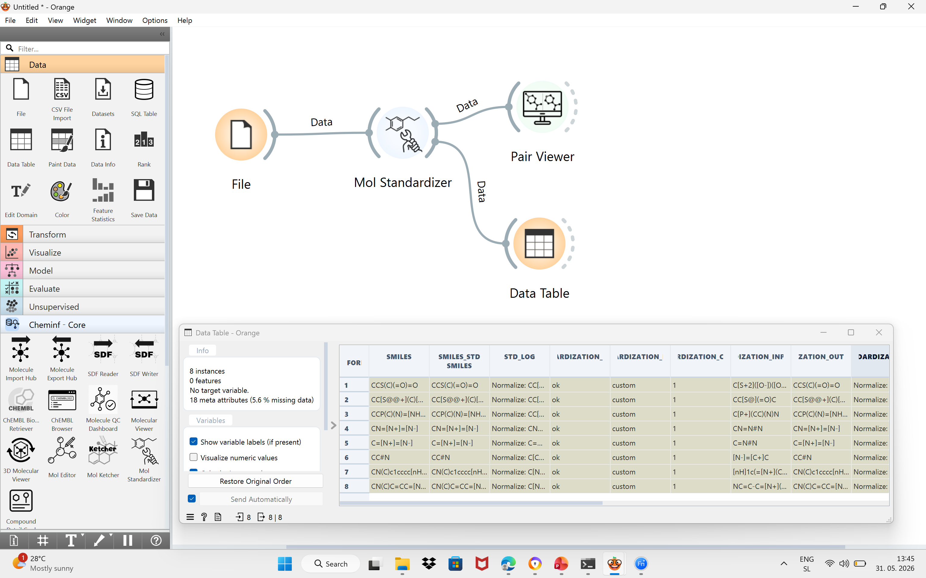
Example 1: Standardisation
Task: normalization: Analyze results
Connect Mol Standardizer with Pair Viewer and Data Table to analyze results

Slide 16
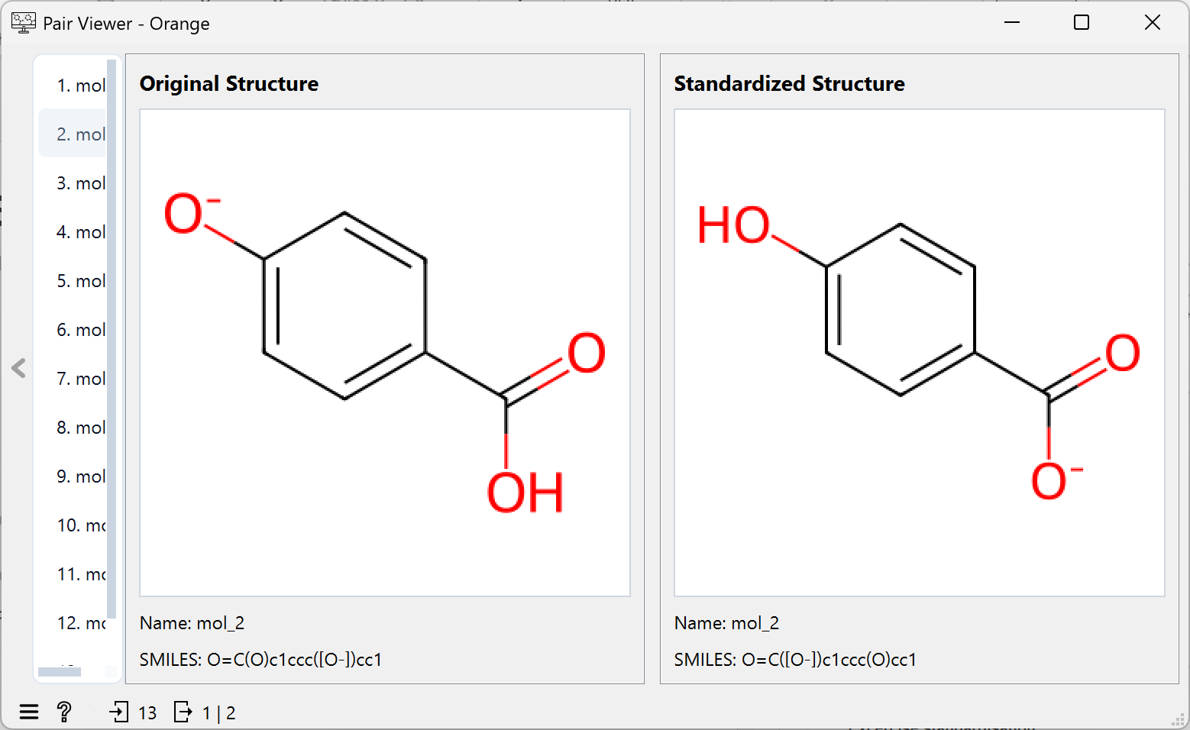
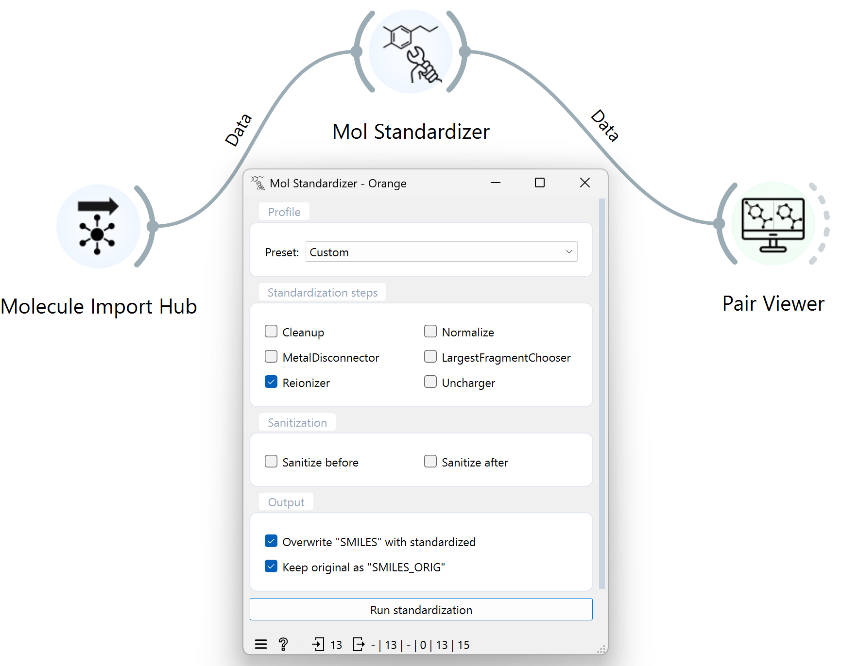
Example 1: Standardisation
Task: reionization (load file reionization.csv; select Reionizer option)
Use Molecule Import Hub for reading molecules
Try Reionizer option in Mol Standardisation
Connect Standardizer output with Pair Viewer input
Explore results

Slide 17
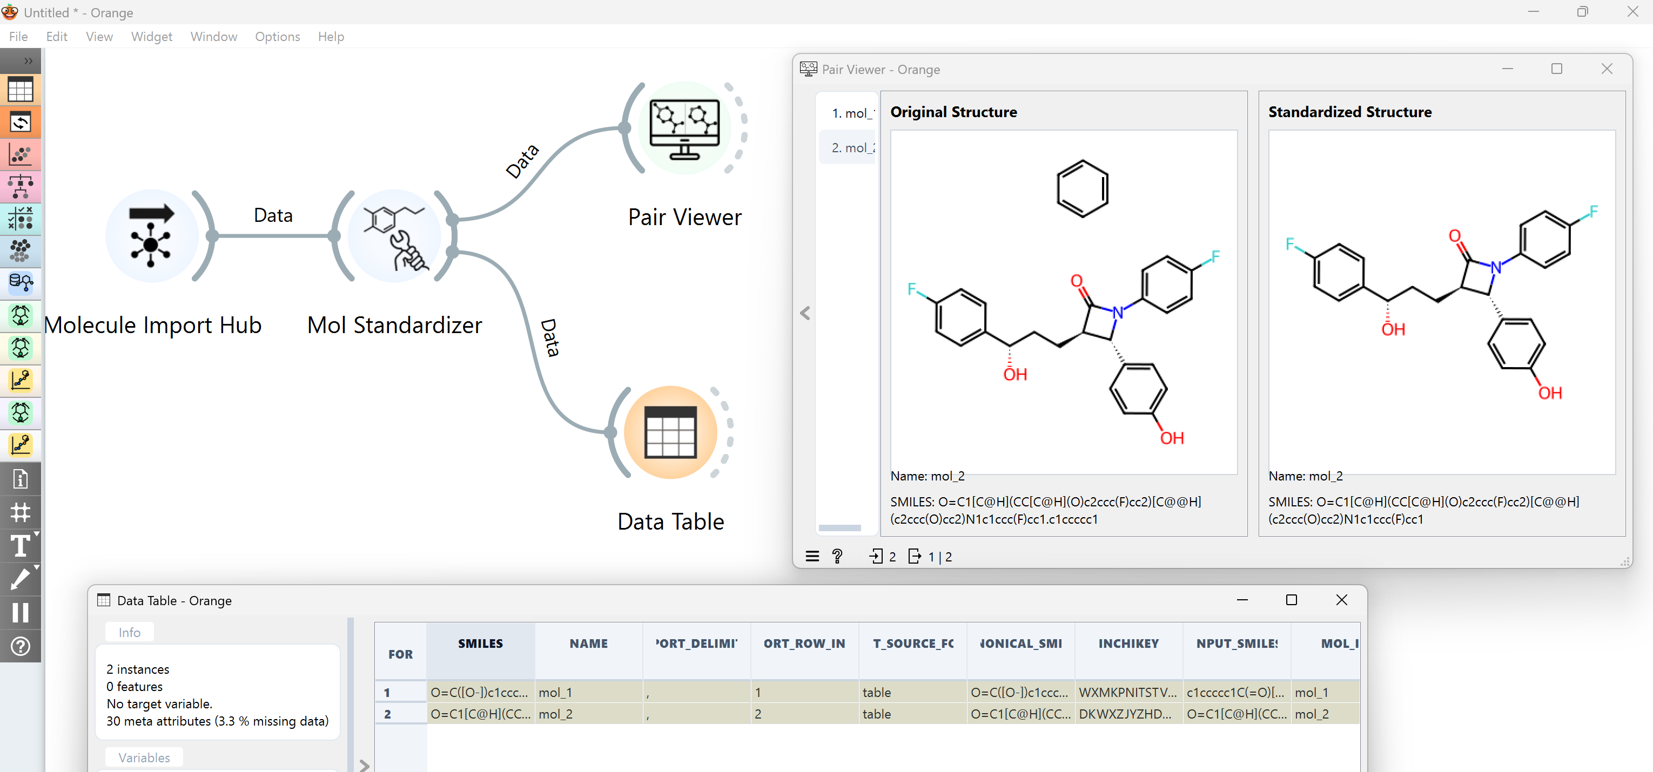
Example 1: Standardisation
Task find parent fragment (load file parent.csv; select LargestFragmentChooser option)

Slide 18
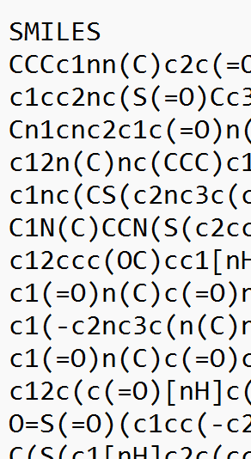
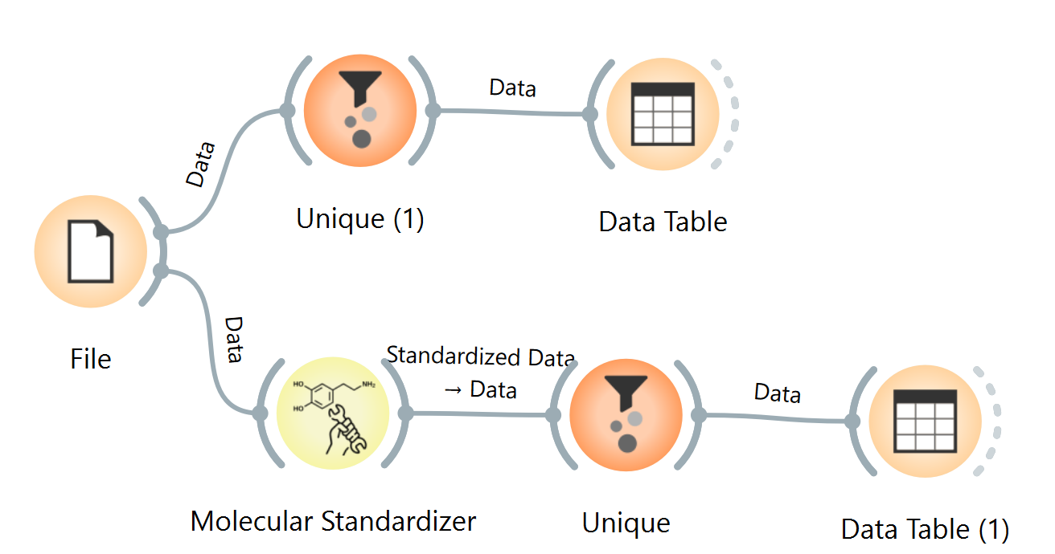
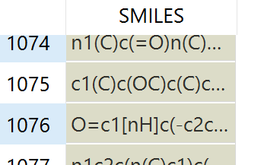
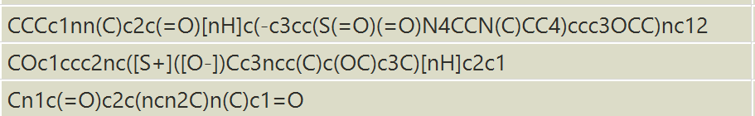
Example 1: Standardisation
Task duplicates (load file duplicates.csv; cleanup)
2500 Entries
1079 Different Smiles Strings
Only 3 Different Compounds
SIMLES IS NOT UNIQUE: “EACH COMPOUND MAY BE REPRESENTED BY DIFERENT SMILES”

Slide 19
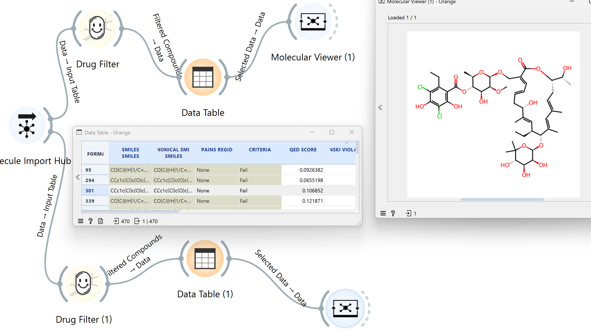
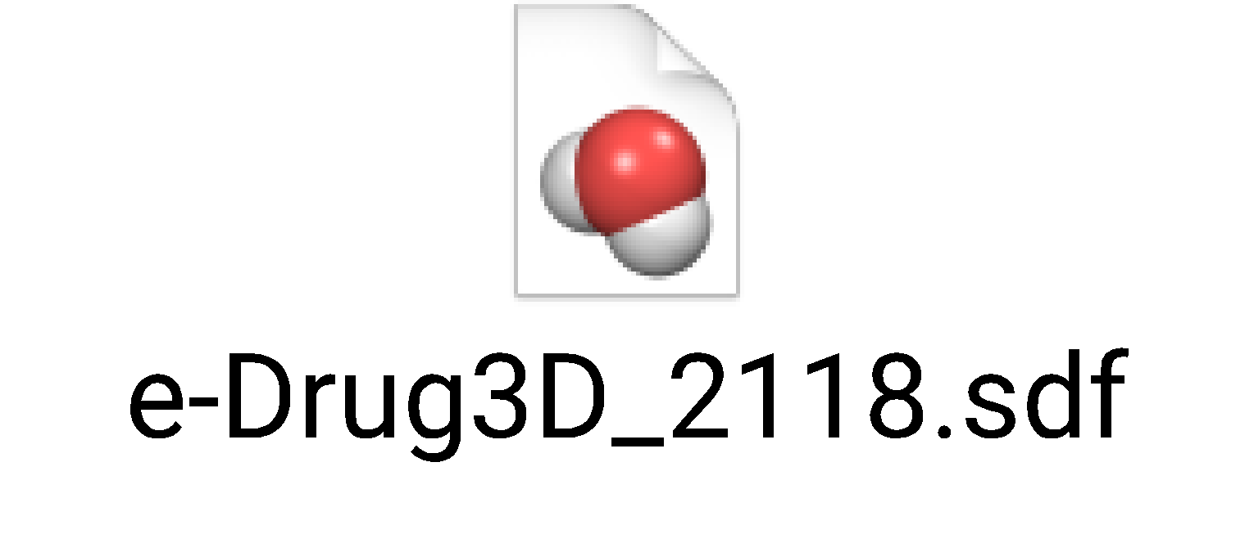
Example 2: Drug Filter Widget
Q: How many compounds deviates from Lipinski rule of 5 in e-Drug3D collection (sdf file)

Slide 20
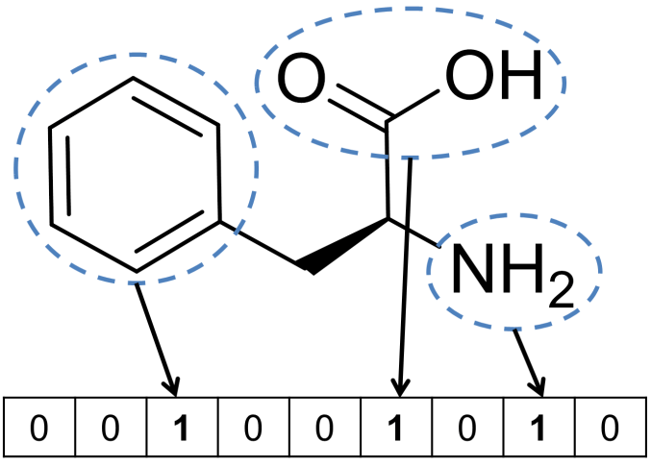
Example 3: Mapping Compounds with
MACCS Fingerpints
Activated bits for molecule:
Bit 54: [!#6;!#1;!H0]~*~*~[!#6;!#1;!H0] Bit 84: [NH2] Bit 90: [$([!#6;!#1; !H0]~*~*~[CH2]~*), $([!#6;!#1;!H0;R]1@[R]@[R]@[CH2;R]1),$([!#6;!#1;!H0]~[R]1@[R]@[CH2;R]1)] Bit 95: [#7]~*~*~[#8] Bit 104: [!#6;!#1;!H0]~*~[CH2]~* Bit 111: [#7]~*~[CH2]~* Bit 131: [!#6;!#1;!H0] Bit 136: [#8]=* Bit 139: [O;!H0] | Bit 140: [#8] Bit 142: [#7] Bit 145: *1~*~*~*~*~*~1 Bit 146: [#8] Bit 151: [#7;!H0] Bit 154: [#6]=[#8] Bit 155: *!@[CH2]!@* Bit 156: [#7]~*(~*)~* Bit 157: [#6]-[#8] Bit 158: [#6]-[#7] Bit 159: [#8] Bit 161: [#7] Bit 162: a Bit 163: *1~*~*~*~*~*~1 Bit 164: [#8] Bit 165: [R]
MACCS Keys are fixed-length binary fingerprints
Representing predefined molecular substructures used
For rapid similarity searching and structural analysis
Definition of MACCS key 166 - SMARTS patterns

Slide 21
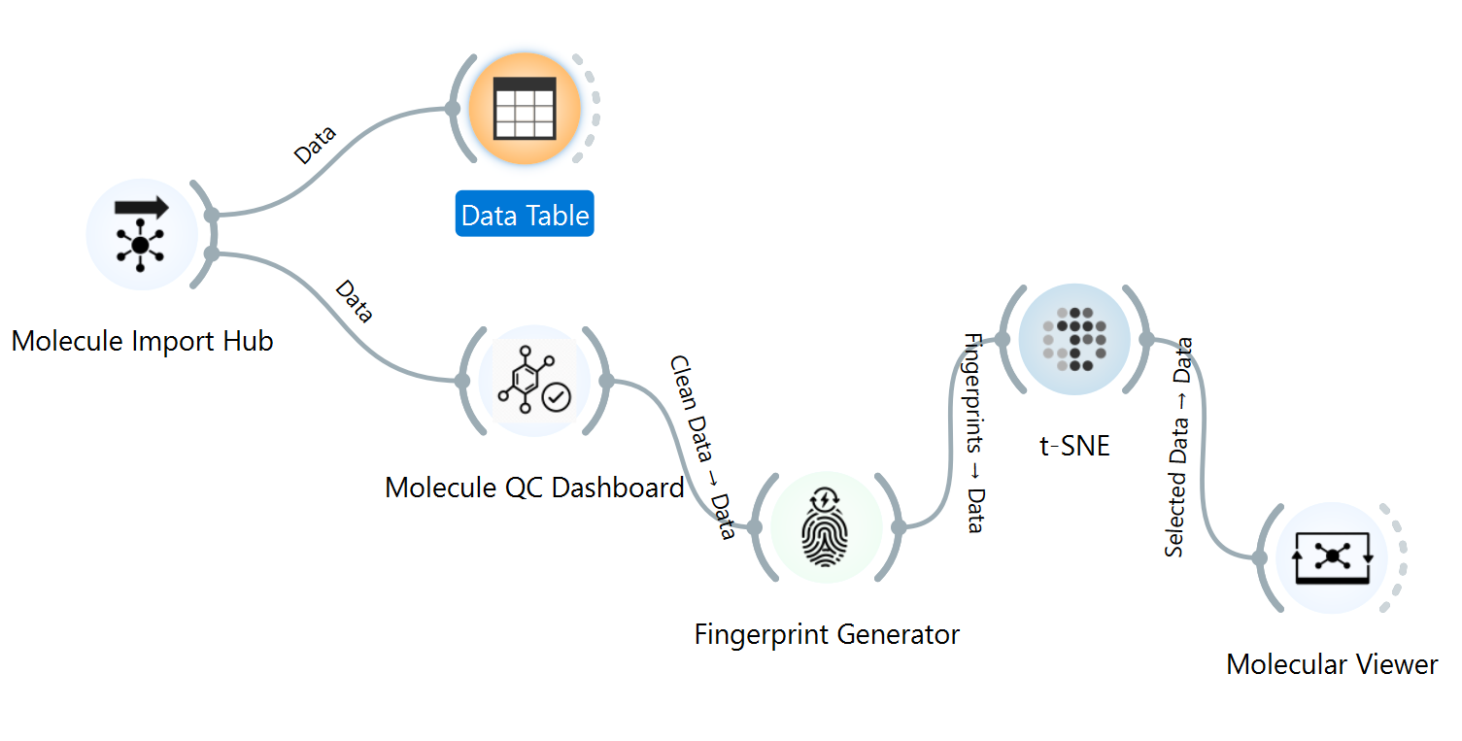
Example 3: Mapping Compounds from eDrugs-3D
MACCS Fingerpints
Typical workflow for clustering the compounds:
Read SDF (or SMILES) file
Calculate fingerprints (MACCS Keys in this case)
Do clustering – here we use t-SNE
Visualization of results

Slide 22
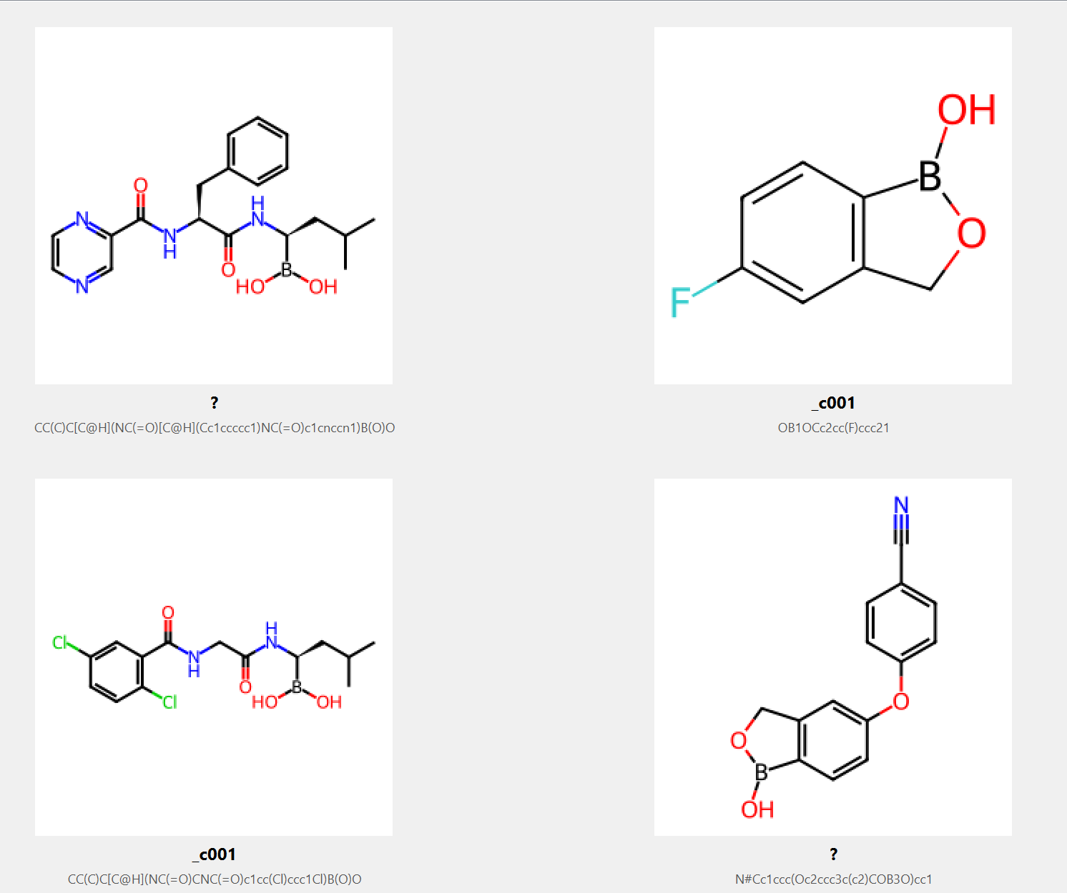
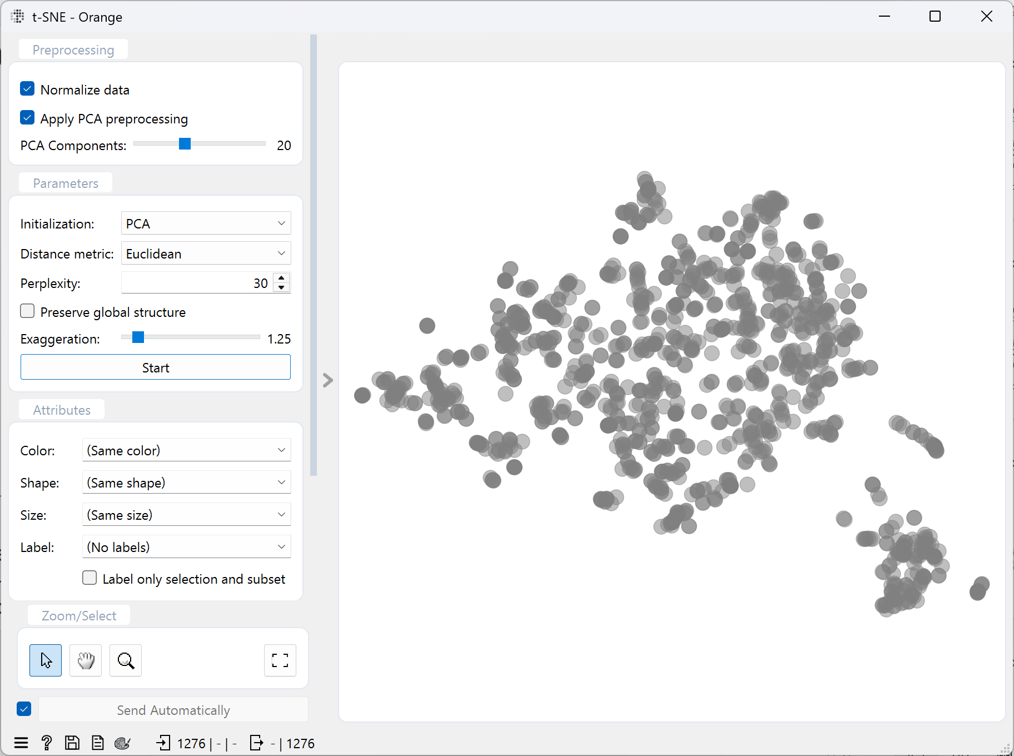
Example 3: Mapping Compounds from eDrugs-3D
MACCS Fingerpints
Typical workflow for clustering the compounds:
Read SDF (or SMILES) file
Calculate fingerprints (MACCS Keys in this case)
Do clustering – here we use t-SNE
Visualization of results
The compounds are NOT structurally similar. The only common feature
among them is a boron (B) atom."

Slide 23
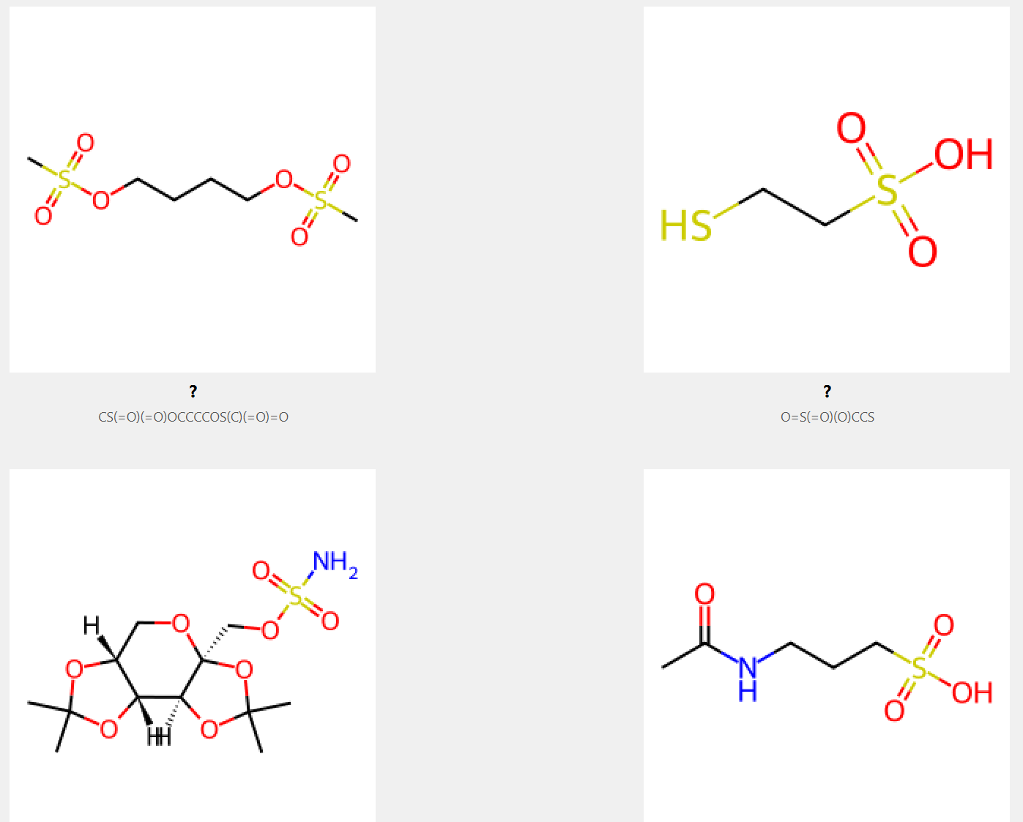
Example 3: Mapping Compounds from eDrugs-3D
MACCS Fingerpints
Typical workflow for clustering the compounds:
Read SDF (or SMILES) file
Calculate fingerprints (MACCS Keys in this case)
Do clustering – here we use t-SNE
Visualization of results
These compounds are structurally diverse; their shared characteristic is a
sulfur-containing functional group.

Slide 24
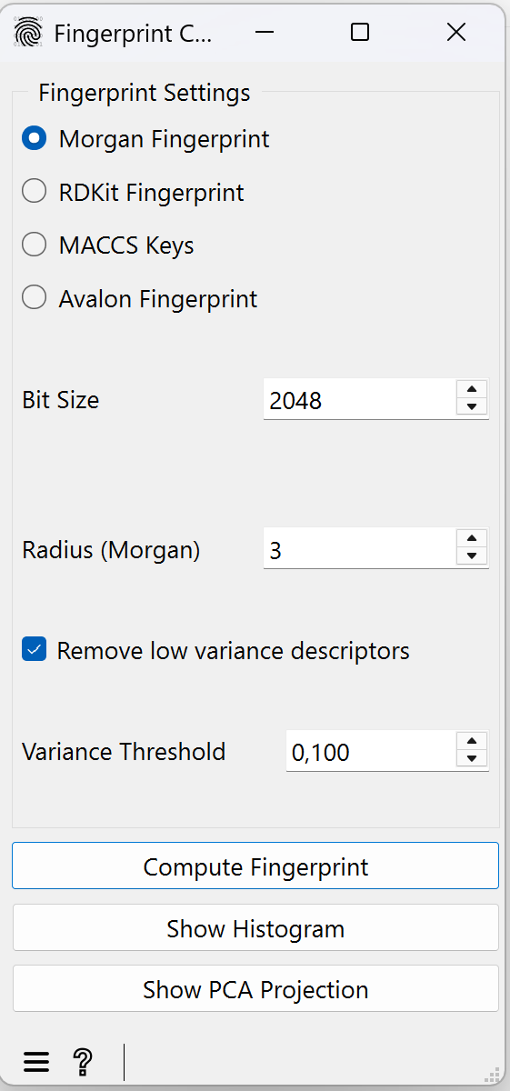
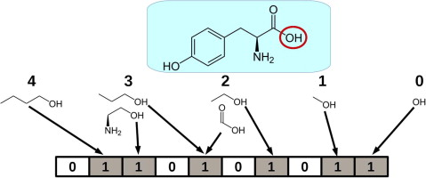
Example 4: Mapping Compounds with
Morgan fingerprints
https://www.sciencedirect.com/science/article/abs/pii/S1046202314002631

Slide 25
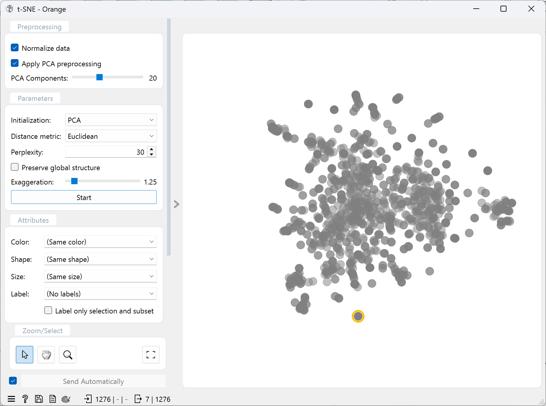
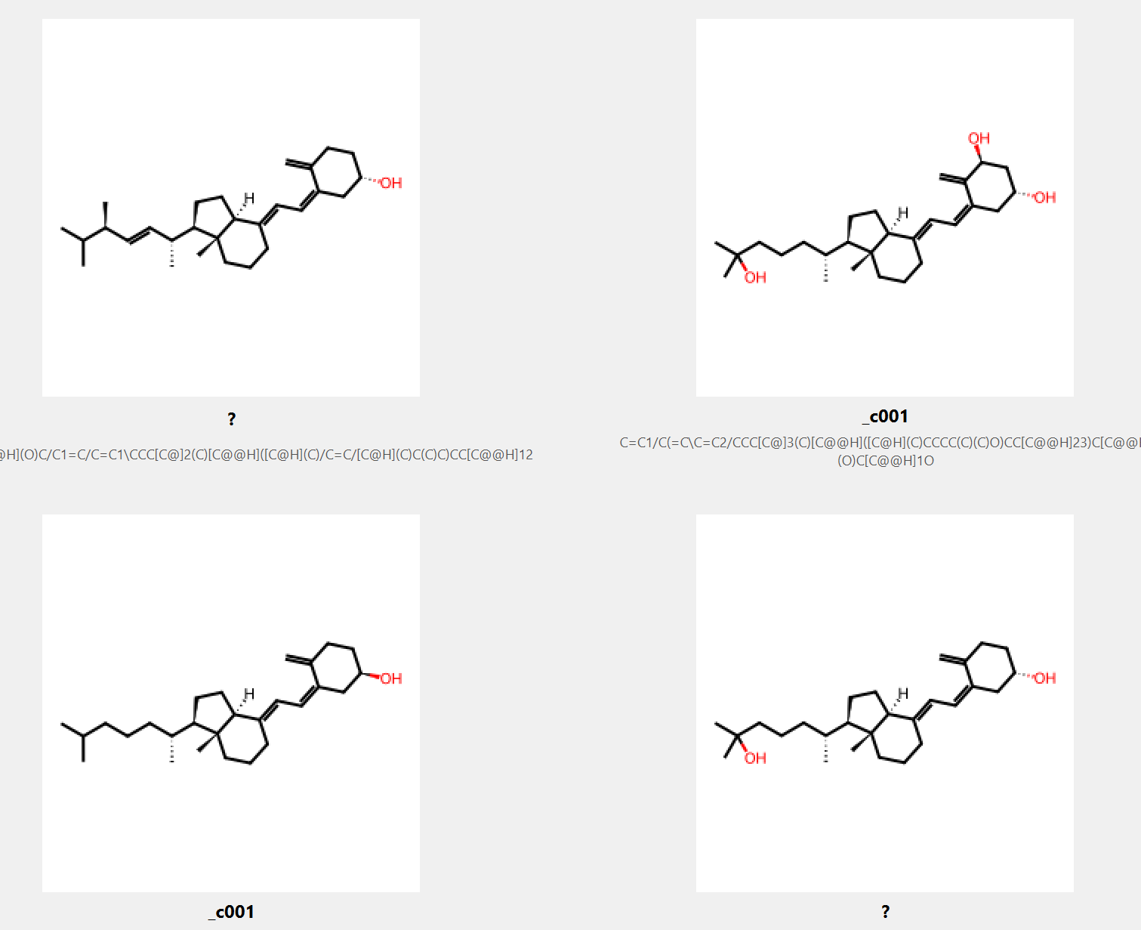
Example 4: Mapping Compounds from eDrugs-3D
Morgan Fingerpints
Typical workflow for clustering the compounds:
Read SDF (or SMILES) file
Calculate fingerprints (MACCS Keys in this case)
Do clustering – here we use t-SNE
Visualization of results
These compounds are structurally similar -> high Tanimoto index

Slide 26
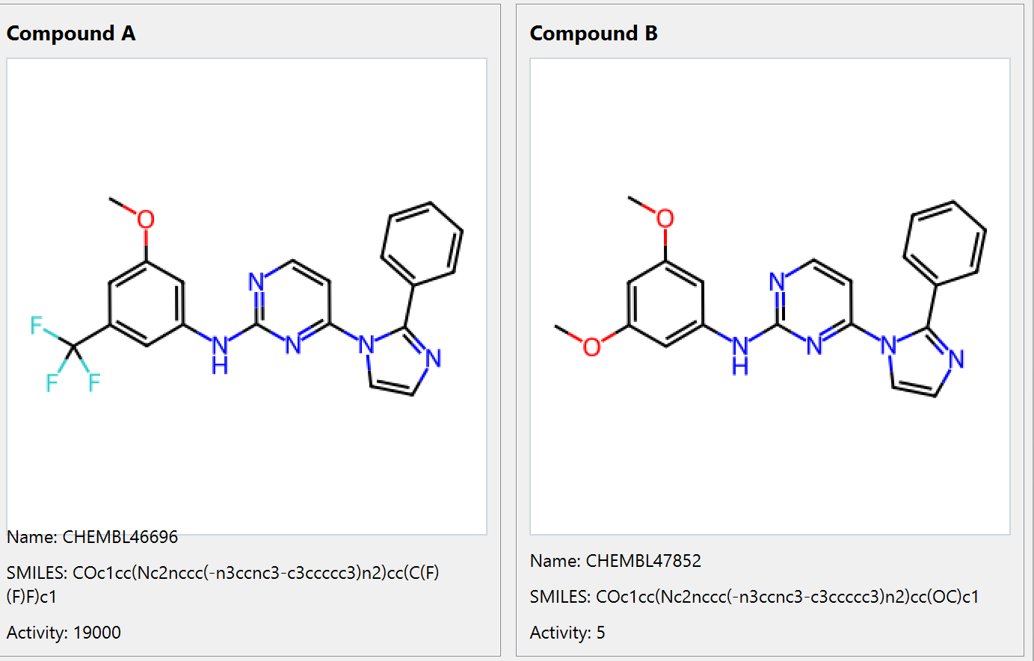
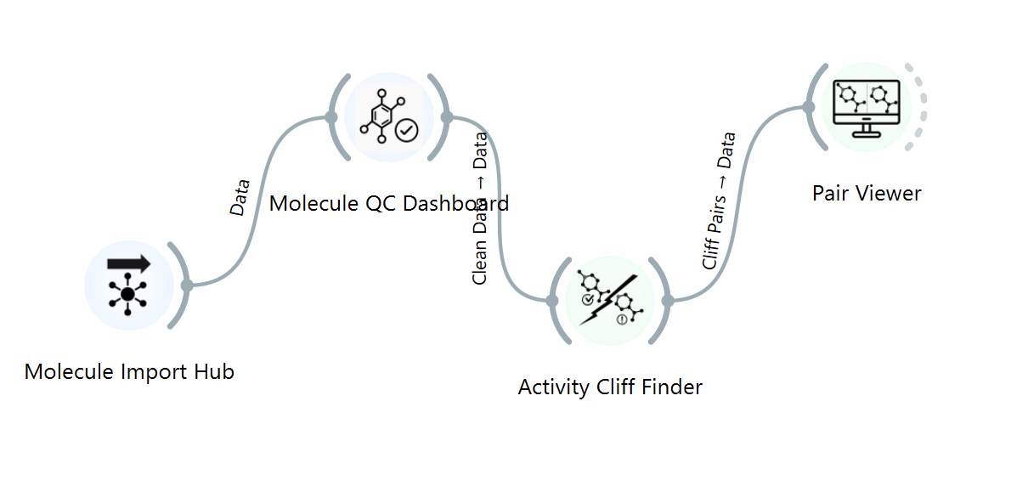
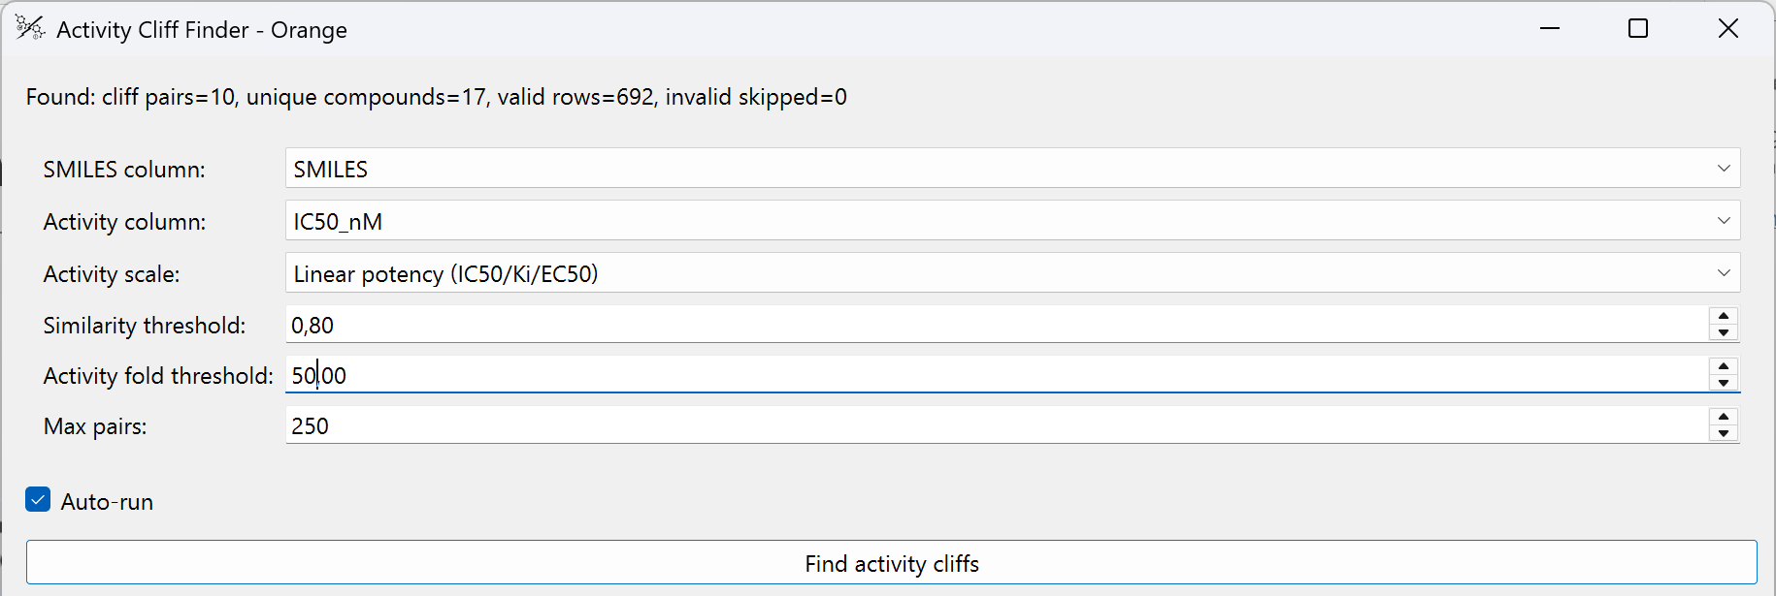
Example 5: Activity Cliffs
ACTIVITY 19000 nM ACTIVITY 5 nM
(WEAK INHIBITOR) (STRONG INHIBITOR)
TANIMOTO SIMILARITY > 0,8

Slide 27
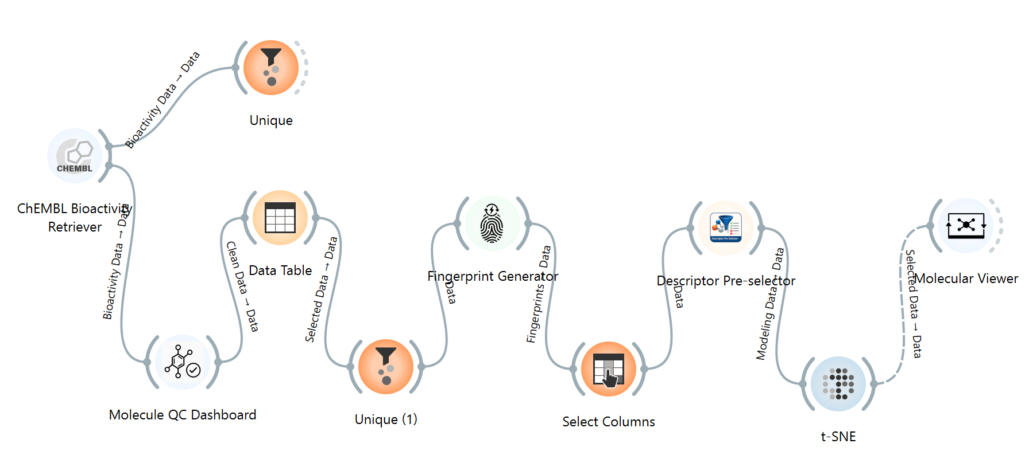
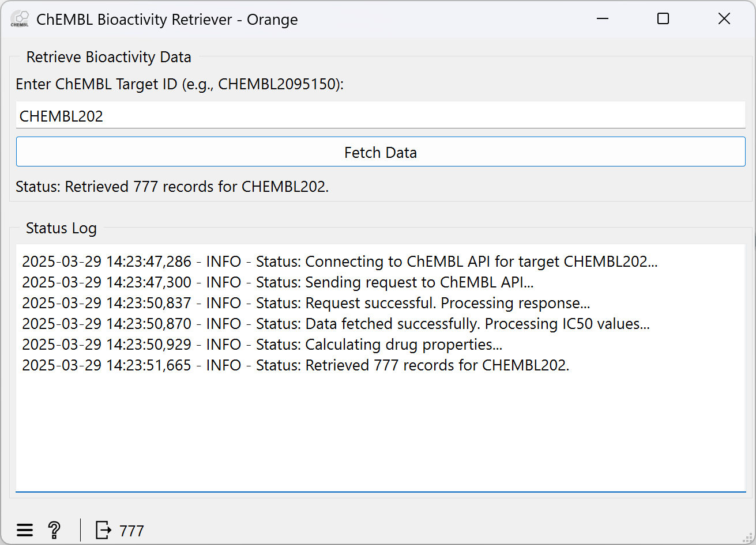
Example 6: Retrieve data from ChEMBL
Explore Inhibitors of Dihidrofolate Reductase (CHEMBL202)

Slide 28
Example 6: Retrieve data from ChEMBL
Explore Inhibitors of Dihidrofolate Reductase (CHEMBL202)

Slide 29
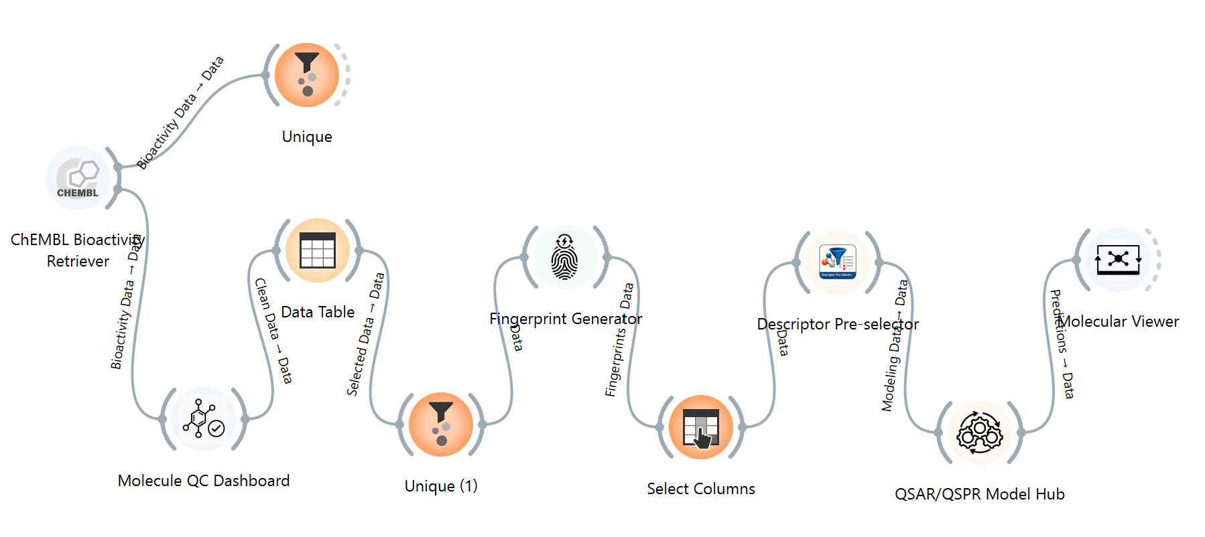
Retrieve data from ChEMBL
Let’s do QSAR

Slide 30
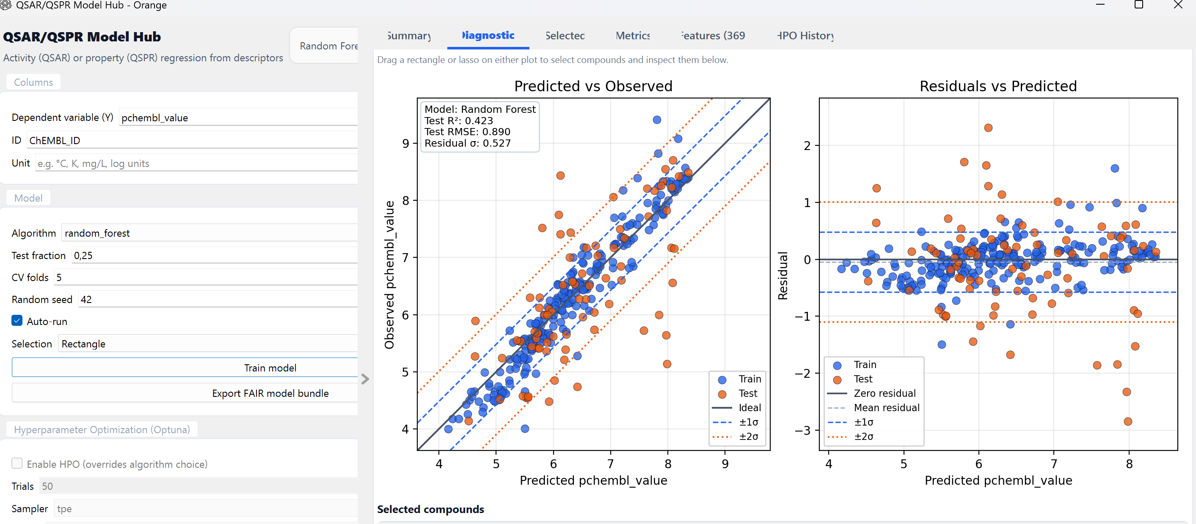
Retrieve data from ChEMBL
Let’s do QSAR

Slide 31
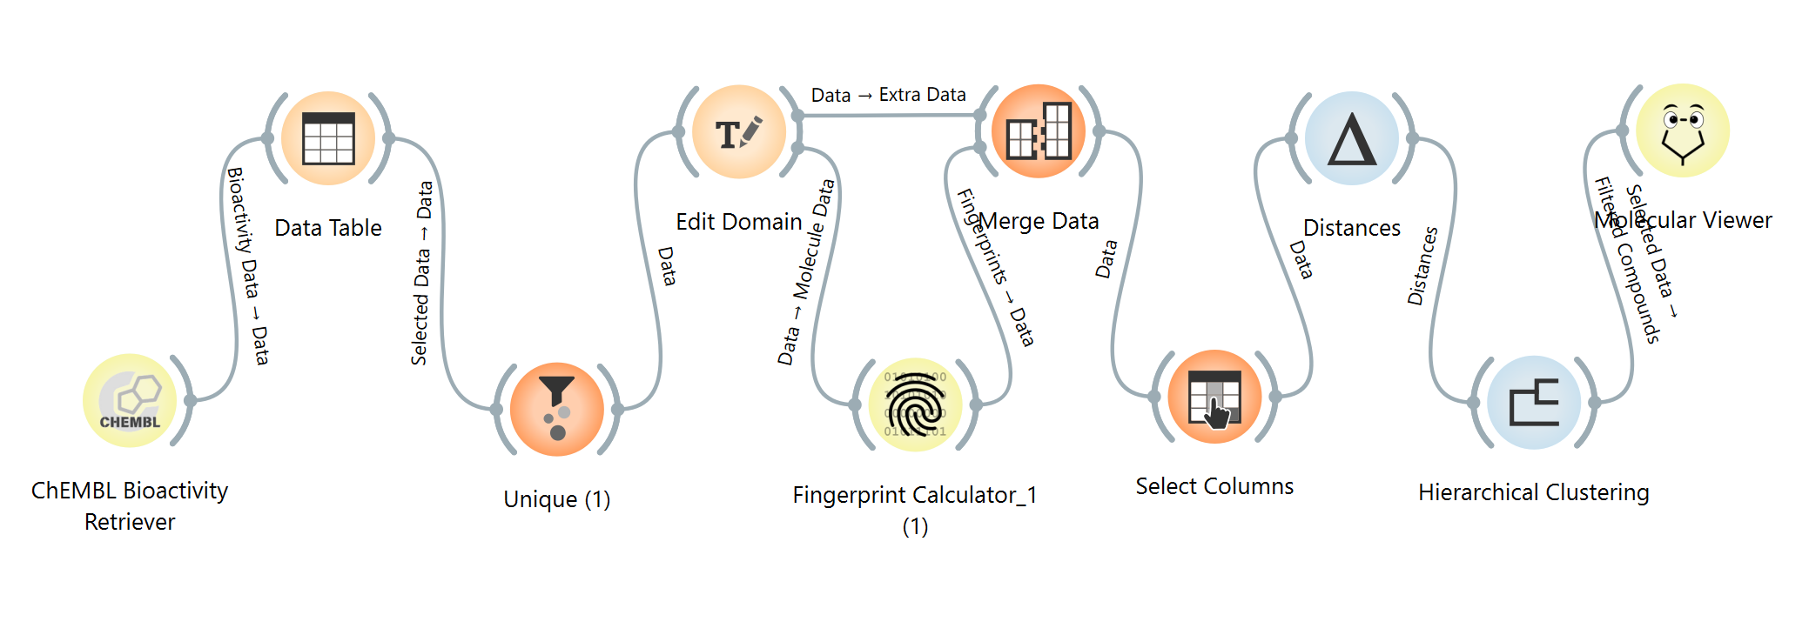
Retrieve data from ChEMBL
How to do hierarcihal clustering?

Slide 32
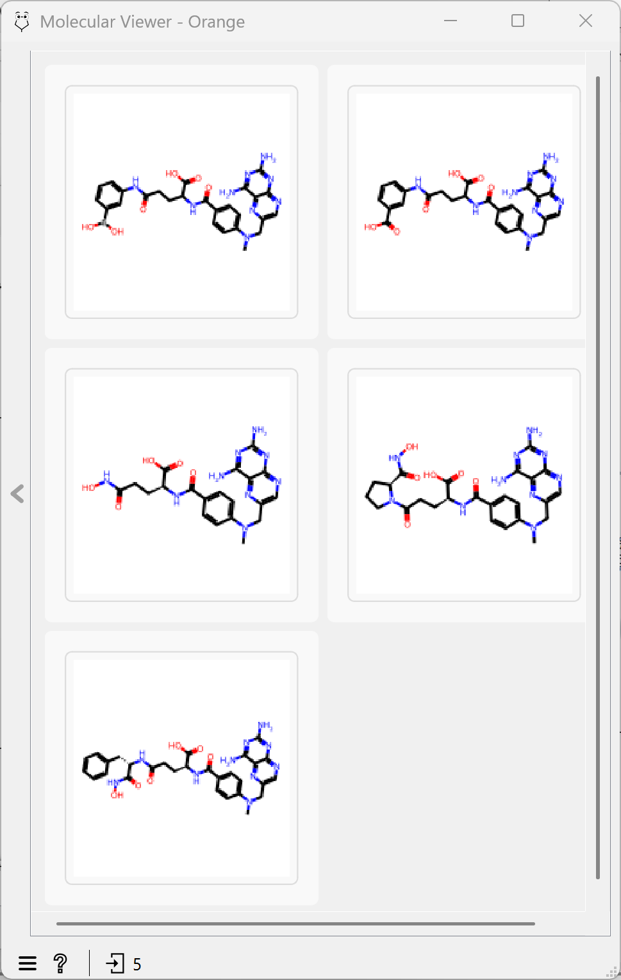
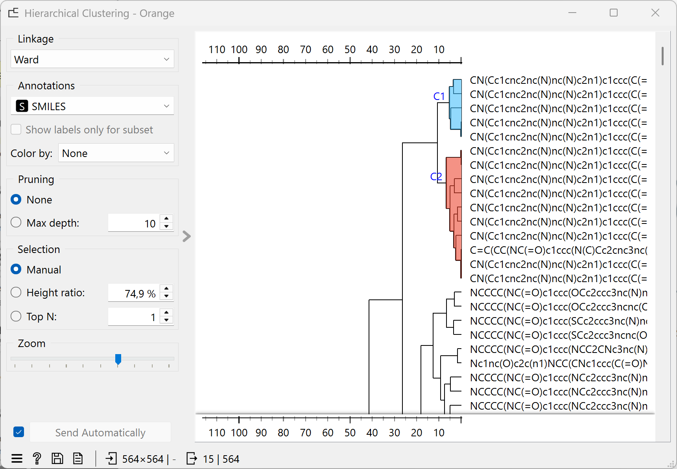
Retrieve data from ChEMBL
How to do hierarcihal clustering?

Slide 33
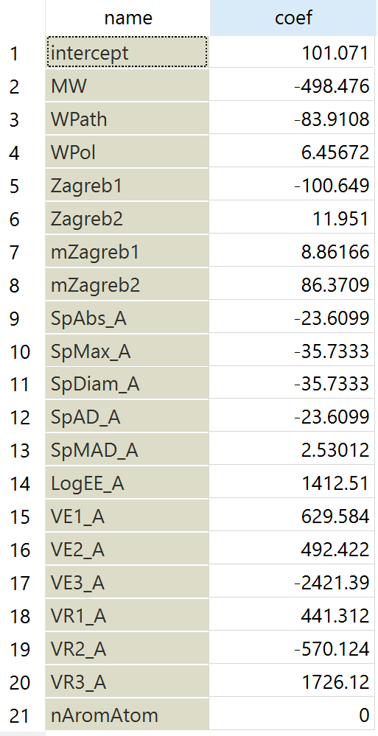
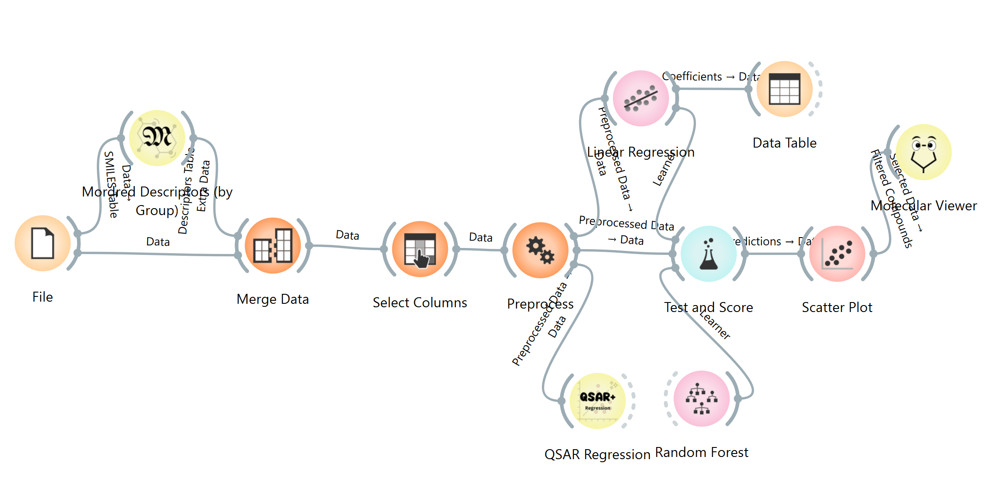
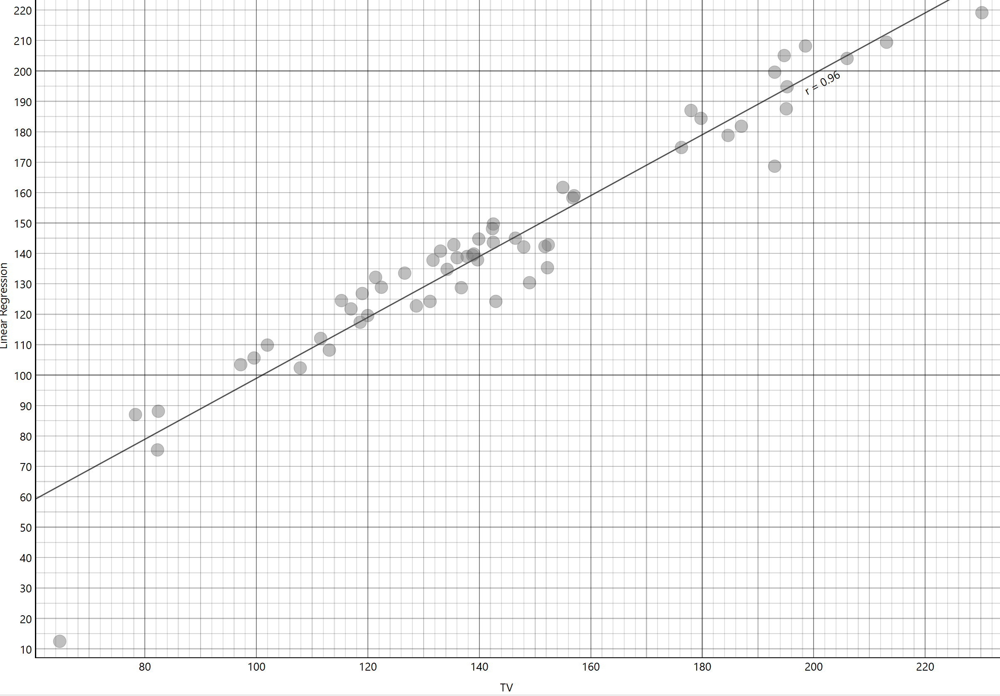
Create QSAR Model
Boiling Points of alcohols
SMILES;TV
CO;64.7
OCC;78.3
CCCO;97.2
CC(C)O;82.3
OCCCC;117
CC(O)CC;99.6
CC(C)CO;107.9
CC(C)(C)O;82.4
CCCCCO;137.8
CC(O)CCC;119
CCC(O)CC;115.3
OCC(C)CC;128.7
CC(C)CCO;131.2
CC(C)(O)CC;102
CC(C)C(C)O;111.5
CC(C)(C)CO;113.1

Slide 34
Where visual workflows are strongest and where code still wins
BALANCE
Orange + ChemInfWidgets is strongest for
Code-first / HPC workflows are stronger for
Rapid prototyping
Production scale
Try alternative curation, descriptors and models quickly.
Very large datasets, batch pipelines and cluster execution.
Interactive interpretation
Bespoke algorithms
Select points and immediately inspect structures.
Research code that needs full low-level control.
Teaching & communication
Automation / CI
The analysis pipeline is visible to students and collaborators.
Headless, scheduled and software-tested workflows.
Mixed workflows
Exact software environments
Packaging, version pinning and long-term computational provenance.
Chemistry widgets connect directly to generic ML and visualization.
The goal is not “visual instead of code” — it is to use the right layer for the right stage of the analysis.
Notes:
TARGET 1:20
This balanced slide prevents overselling and will resonate with a chemoinformatics audience.
Say explicitly that Orange is excellent for exploration, communication and rapid method comparison, while code/HPC remains essential for production and bespoke research methods.

Slide 35
Development directions for ChemInfWidgets
NEXT
Curation
QSAR / AD
Data access
Richer structure-quality checks and transparent standardization recipes.
Stronger validation, applicability-domain analysis and FAIR model export.
More direct chemistry-database retrieval and reusable query workflows.
Docking / VS
QM descriptors
Web & teaching
Connect ligand preparation, docking and post-processing to Orange analysis.
Bring calculated electronic-structure descriptors into the same table/workflow.
Browser-friendly workflows and ready-to-use educational activities.
Community contribution is part of the design: domain widgets should be small, composable and inspectable.
Notes:
TARGET 1:30
Present these as development directions, not promises or a release roadmap.
Choose two or three that best fit the audience: QSAR/AD, docking, QM descriptors, web/teaching.
Invite collaboration on small composable widgets rather than monolithic tools.

Slide 36

Take-home messages
CONCLUSIONS
1
Data quality comes first
Standardization and molecular identity are part of the analysis, not housekeeping.
2
Representation shapes the result
Fingerprints and descriptors define the similarities and patterns that ML can see.
3
Visual workflows make assumptions visible
ChemInfWidgets
GitHub repository
Orange + ChemInfWidgets connects chemistry, exploration and modelling in an inspectable workflow.
github.com/crtomirp/owcheminf
4
Use visual and code - based tools together
Visual programming accelerates exploration and teaching; code/HPC remains essential for scale and bespoke methods.
Thank you — questions and discussion
Notes:
TARGET 1:30
Do not summarize every widget. End on four conceptual messages.
Suggested final sentence: “The value of ChemInfWidgets is not that it hides chemistry or code; it makes the path from molecule to model easier to see, test and discuss.”
Then leave the QR code on screen for questions.

