Slide 1

Development of software tools for the open source cheminformatics ecosystem
Martin Šícho (Martin.Sicho@vscht.cz) – CECEC – 2026-09-07

Slide 2
Cheminformatics Workflows are Complex
Generative Model
Generated Library
Virtual Screening Library
Data Source
Machine Learning
Structure Processing
Exploratory Analysis
QSAR Model
Structure Processing
Tautomers/Protomers
Conformer Generation
Pharmacophore Model
Results Analysis and Processing
Molecular Docking
Tautomers/Protomers
Conformer Generation
Results Analysis and Processing

Slide 3
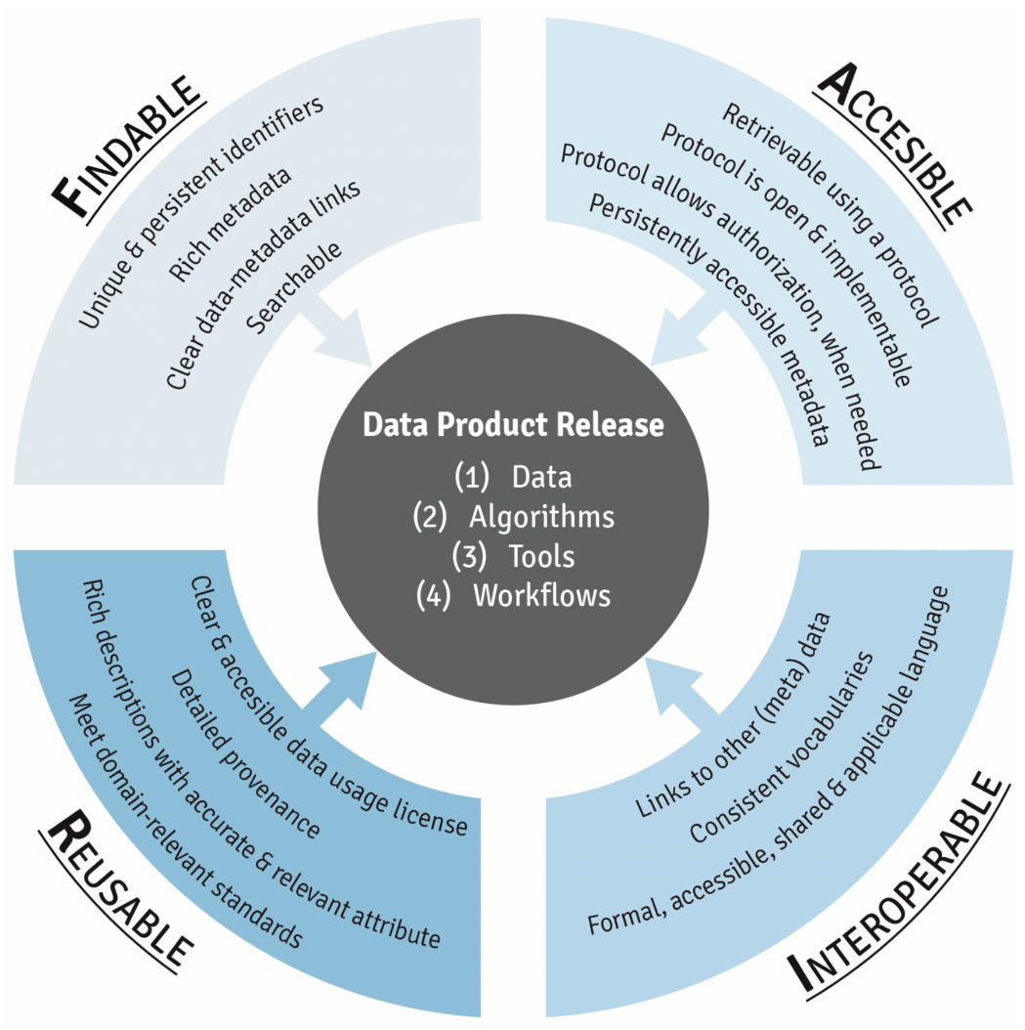

Problems with Scientific Software and Data
Common problems: data management and software development practices
  poorly documented
  poorly structured (i.e. lack of encapsulation, no installable package, no standardized data storage)
  improperly tested (published code contains bugs)
  → not reusable and interoperable
Practical complications
  steep learning curve for newcomers (i.e. students)
  reinventing the wheel (wasted effort/tokens)
  code is isolated and unmaintained
Barker, M., Chue Hong, N.P., Katz, D.S. et al. Introducing the FAIR Principles for research software. Sci Data 9, 622 (2022). https://doi.org/10.1038/s41597-022-01710-x

Slide 4
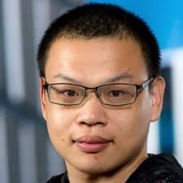

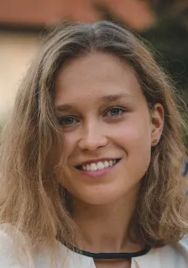


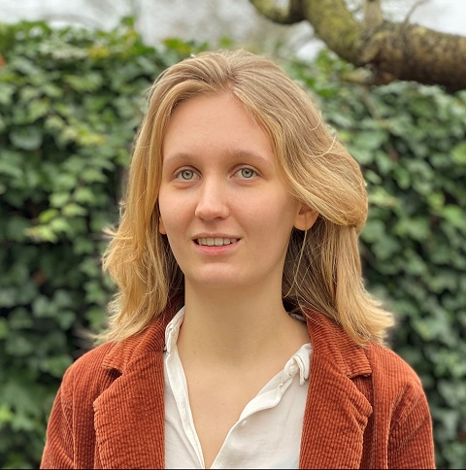

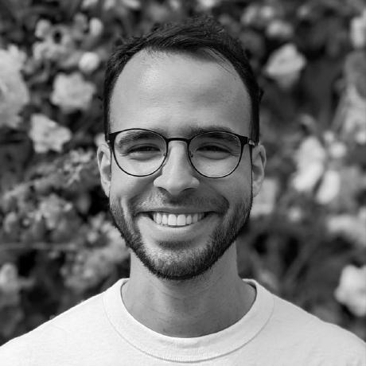
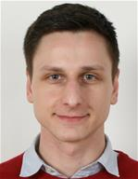
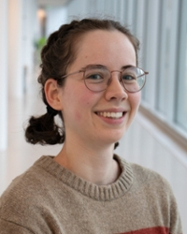
Connecting Our Tools
Public Data
Project #1
DrugEx
DrugEx (Molecular Generation)¹
  https://github.com/CDDLeiden/DrugEx
LED3Score (SA Scoring)²
  https://github.com/AlanHassen/led3_score
QSPRPred (QSPR Modelling)³
  https://github.com/CDDLeiden/QSPRPred
Spock (Molecular Docking/SBDD)⁴
  https://github.com/CDDLeiden/spock
GenUI (GUI)
  https://github.com/martin-sicho/genui
QSPRPred
Central Data Storage
Project #2
Spock
Internal Data
QSPRPred
1. Šícho M, Luukkonen S, van den Maagdenberg HW, Schoenmaker L, Béquignon OJM, van Westen GJP. DrugEx: Deep Learning Models and Tools for Exploration of Drug-Like Chemical Space. J Chem Inf Model. 2023 Jun 26;63(12):3629-3636. doi: 10.1021/acs.jcim.3c00434. Epub 2023 Jun 5. PMID: 37272707; PMCID: PMC10306259.
2. Hassen, A.K., Šícho, M., van Aalst, Y.J. et al. Generate what you can make: achieving in-house synthesizability with readily available resources in de novo drug design. J Cheminform 17, 41 (2025). https://doi.org/10.1186/s13321-024-00910-4
3. van den Maagdenberg, H.W., Šícho, M., Araripe, D.A. et al. QSPRpred: a Flexible Open-Source Quantitative Structure-Property Relationship Modelling Tool. J Cheminform 16, 128 (2024). https://doi.org/10.1186/s13321-024-00908-y
4. In preparation
Notes:
LED3 = Leiden Early Drug Discovery & Development

Slide 5
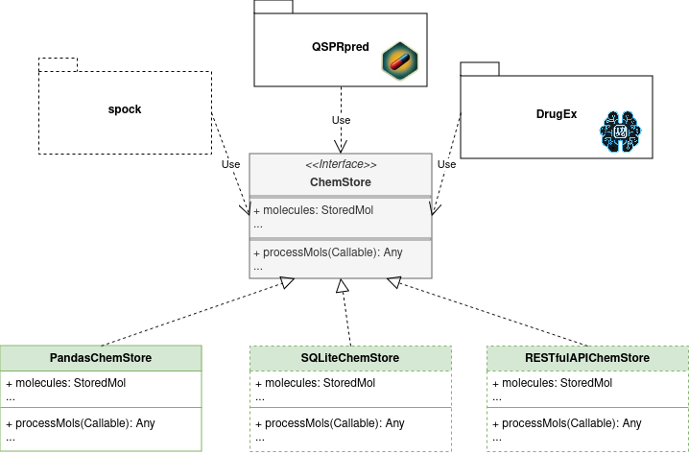
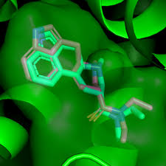

FAIR Features of our Software Stack
https://github.com/CDDLeiden/
Findable
  unique and persistent identifiers
  rich metadata
  searchable
Accessible
  retrievable using a protocol (i.e. JSON for metadata)
  metadata is persistent and always readable
Interoperable
  modular encapsulated code with documented APIs (not only for data access)
Reusable
  installable packages
  automatic and transparent testing (GitHub actions)

Slide 6
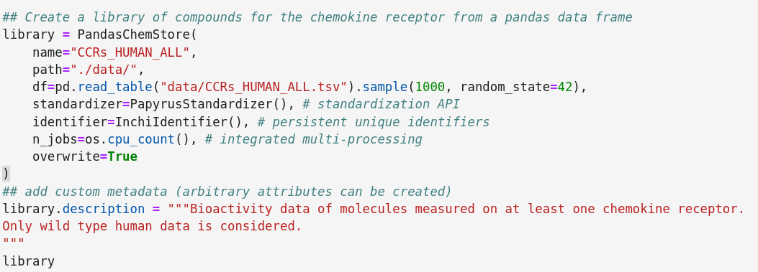
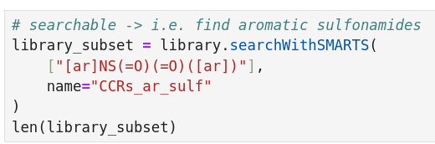
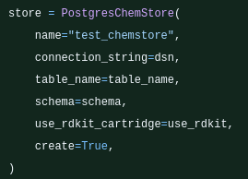
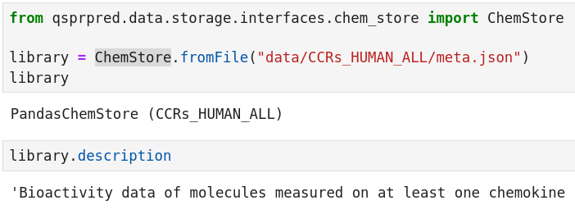
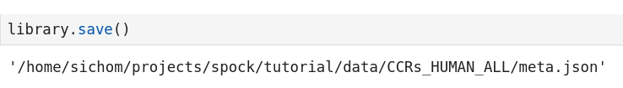
ChemStore Data Storage

Slide 7
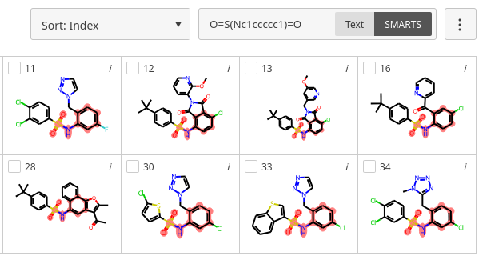
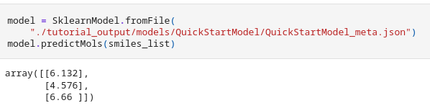
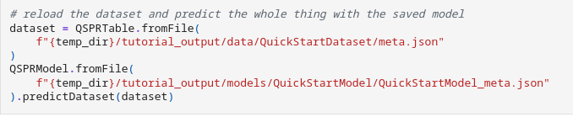
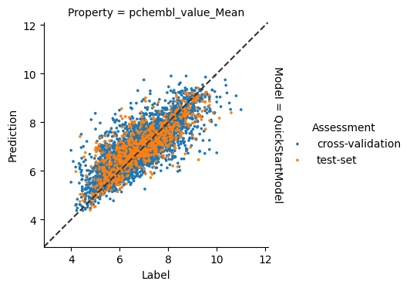
QSPRpred – Main Features
Model training
  Descriptor Calculation
  Full scikit-learn integration
  ChemProp and other deep learning models
  Custom splits
    Time split
    Cluster split
    Scaffold split
Model usage
  Full model serialization
  Applicability domain definition
  Interactive visualization (via scaffviz package)
https://cddleiden.github.io/QSPRpred/docs-dev/features.html

Slide 8
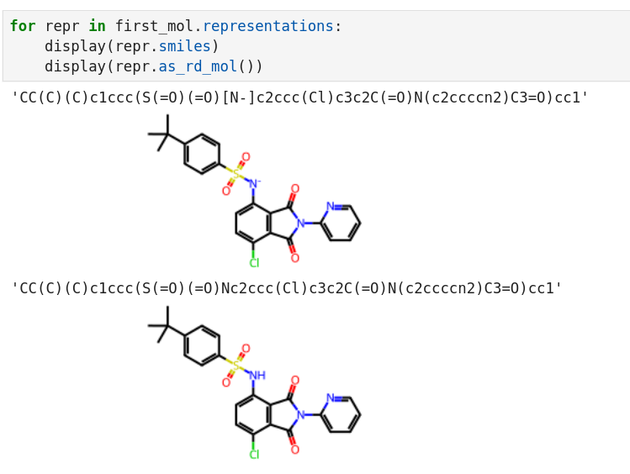
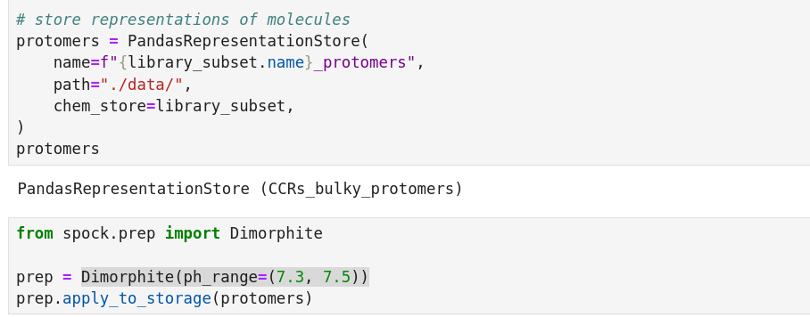
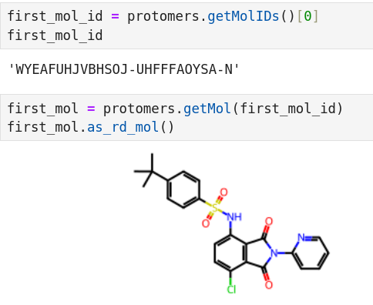
Hierarchical Representations of Molecules

Slide 9
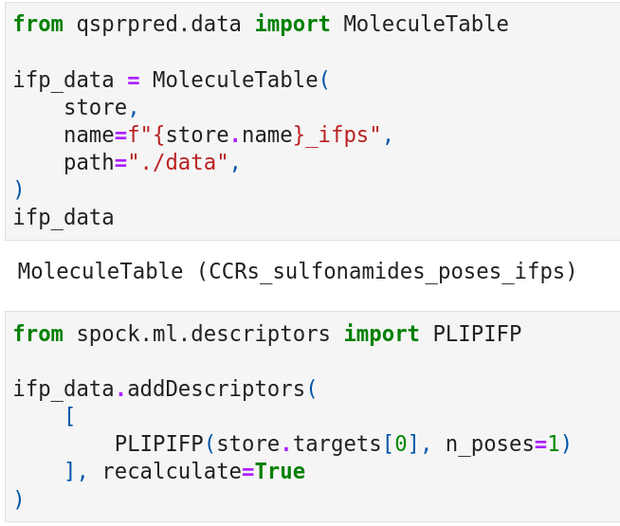
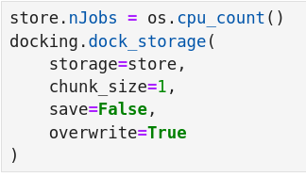
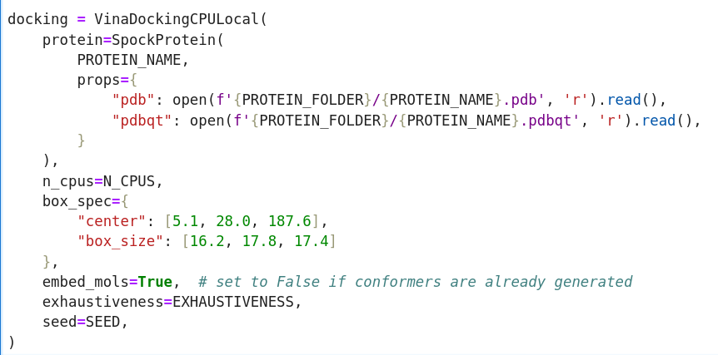
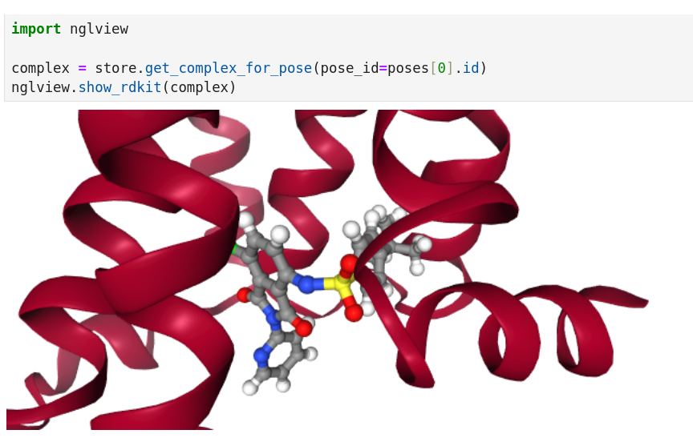
Docking with Spock

Slide 10
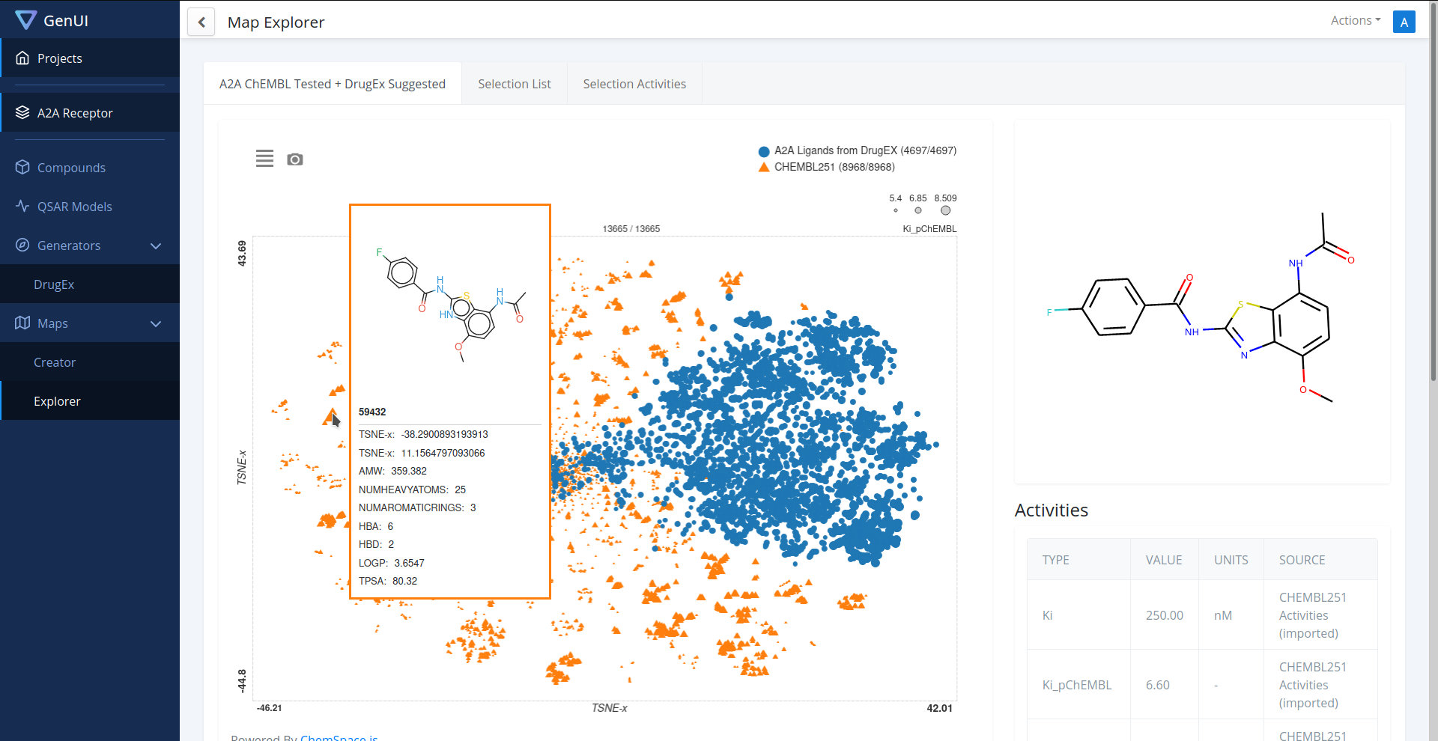
The GenUI Platform

Slide 11



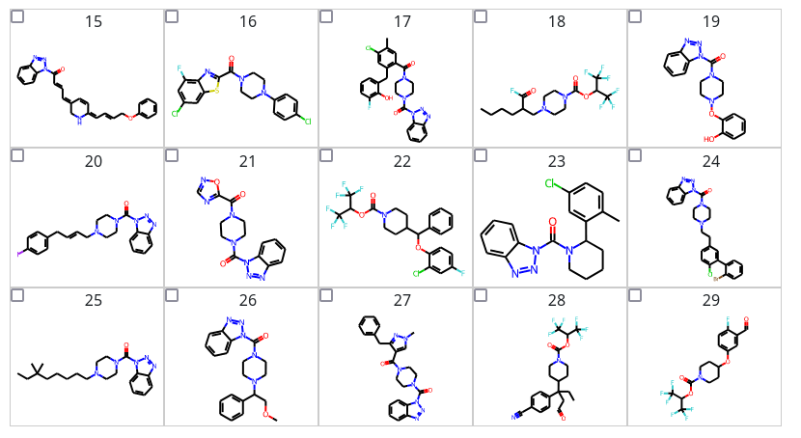




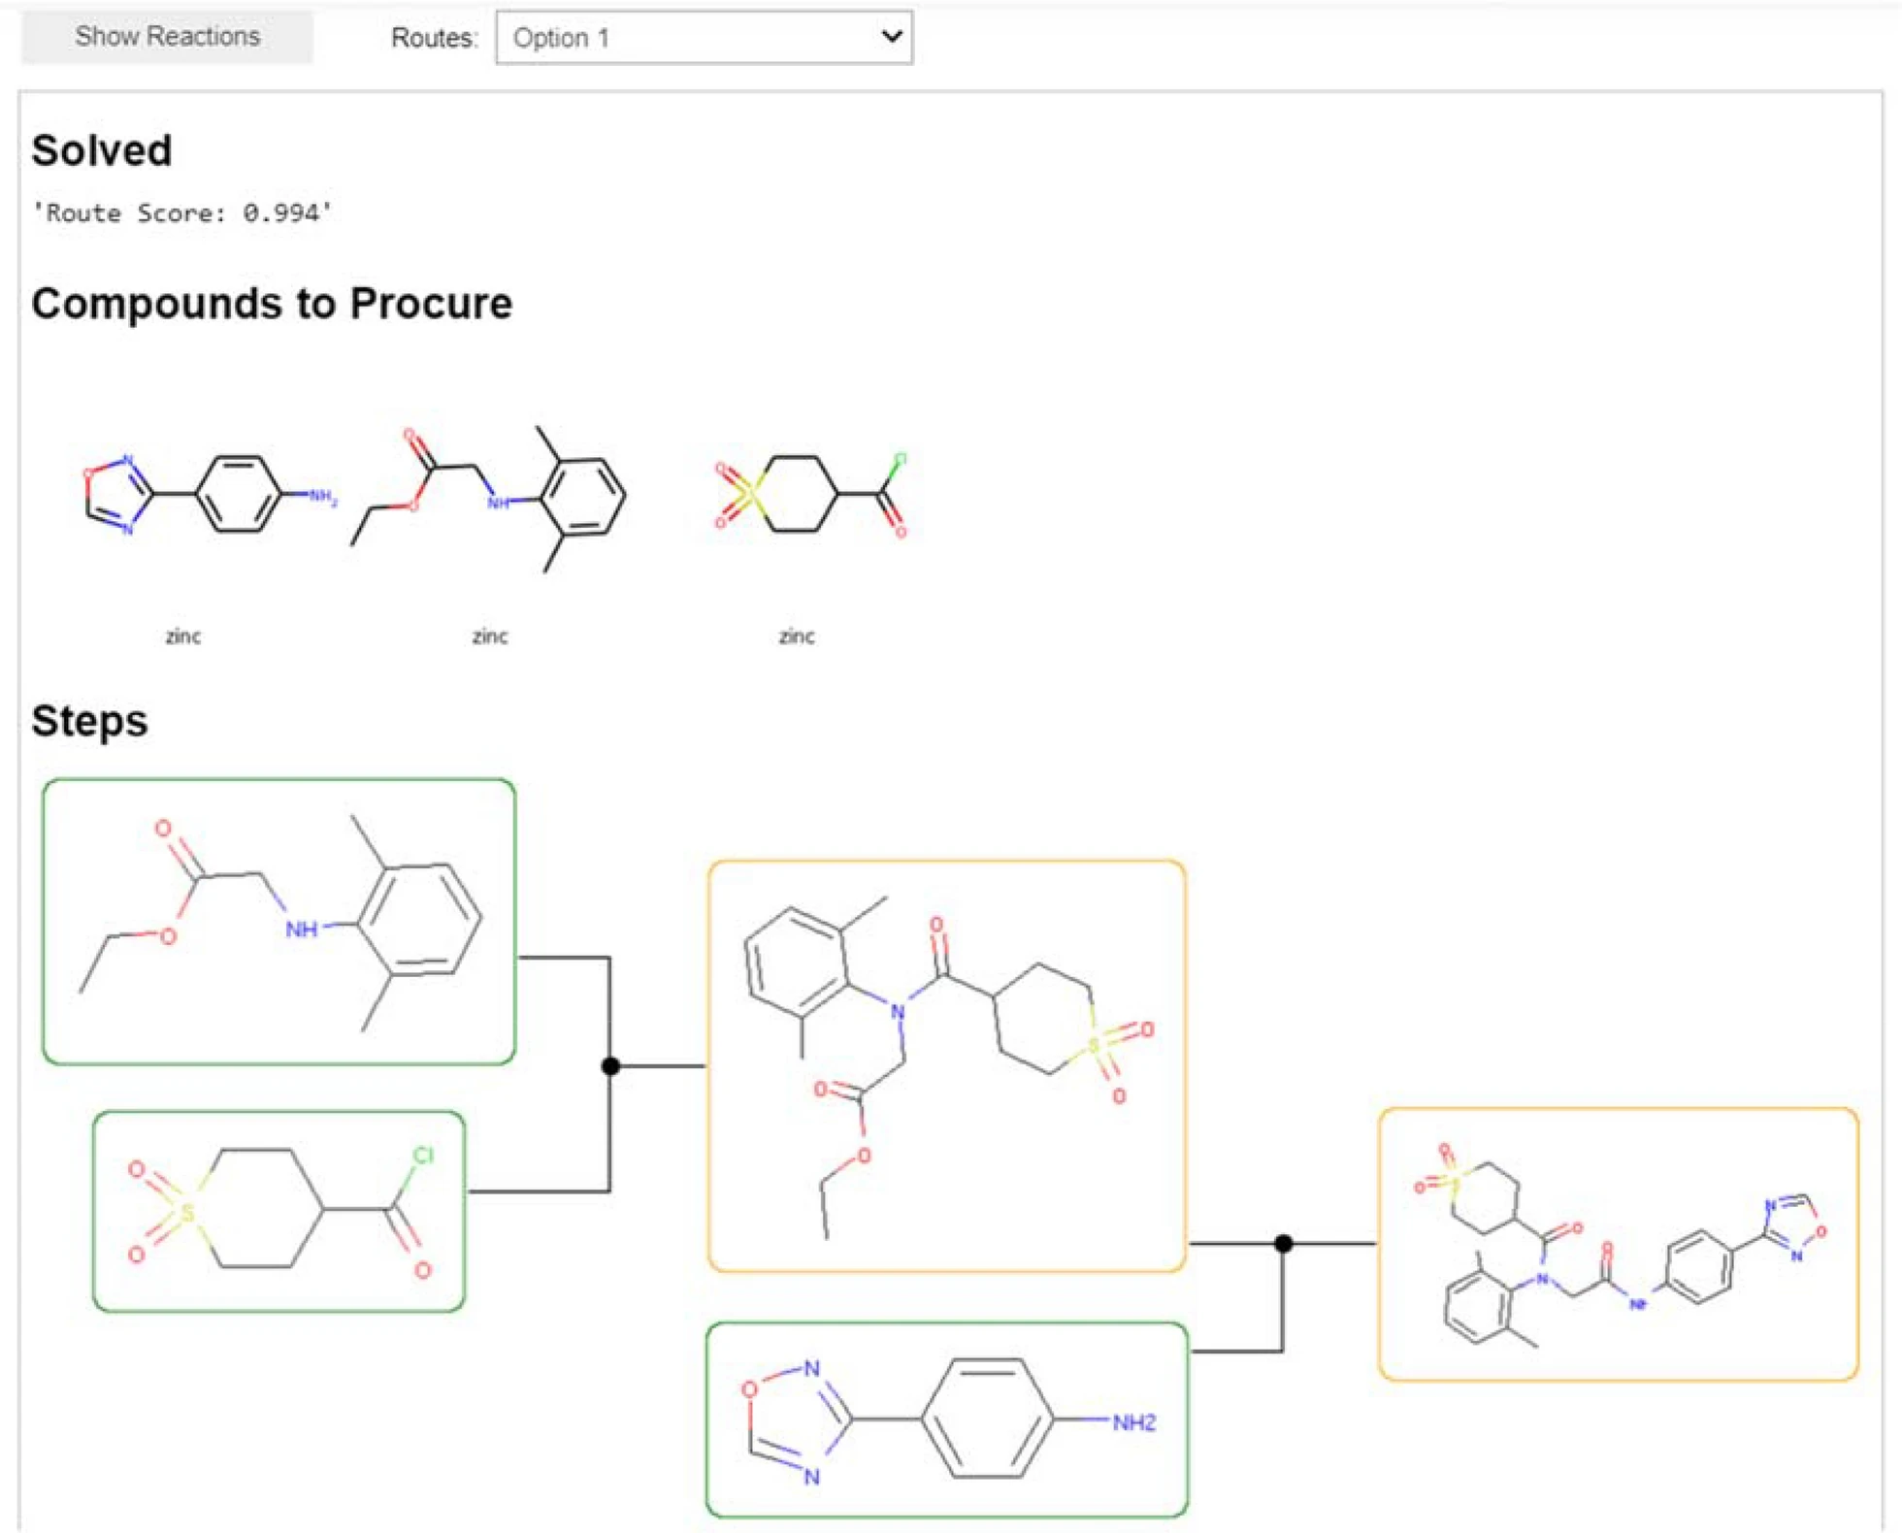
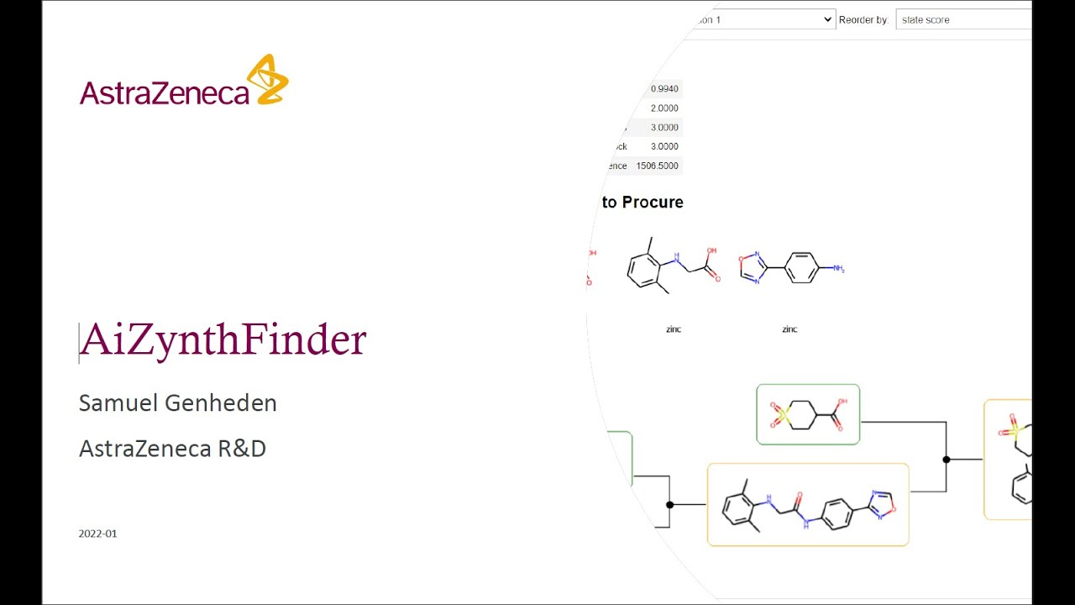
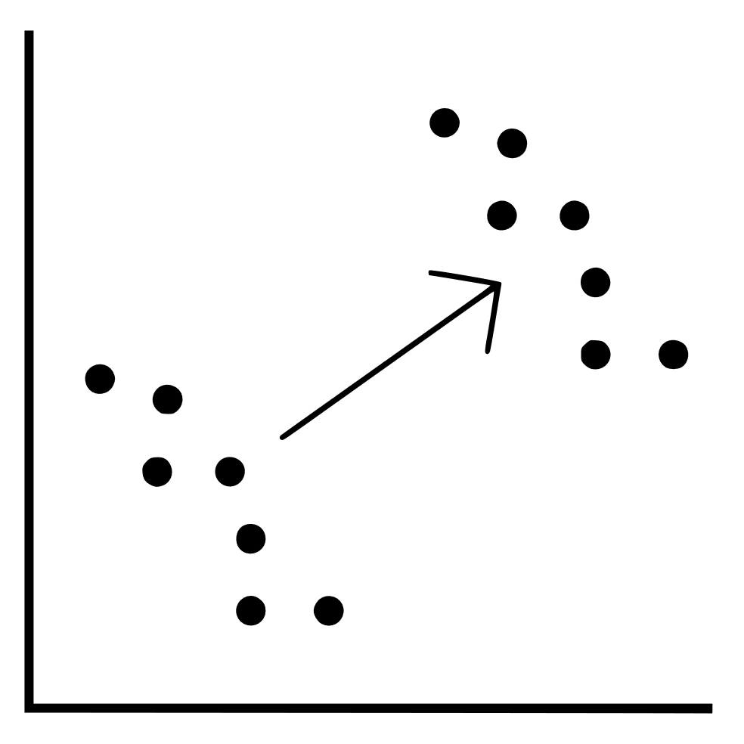
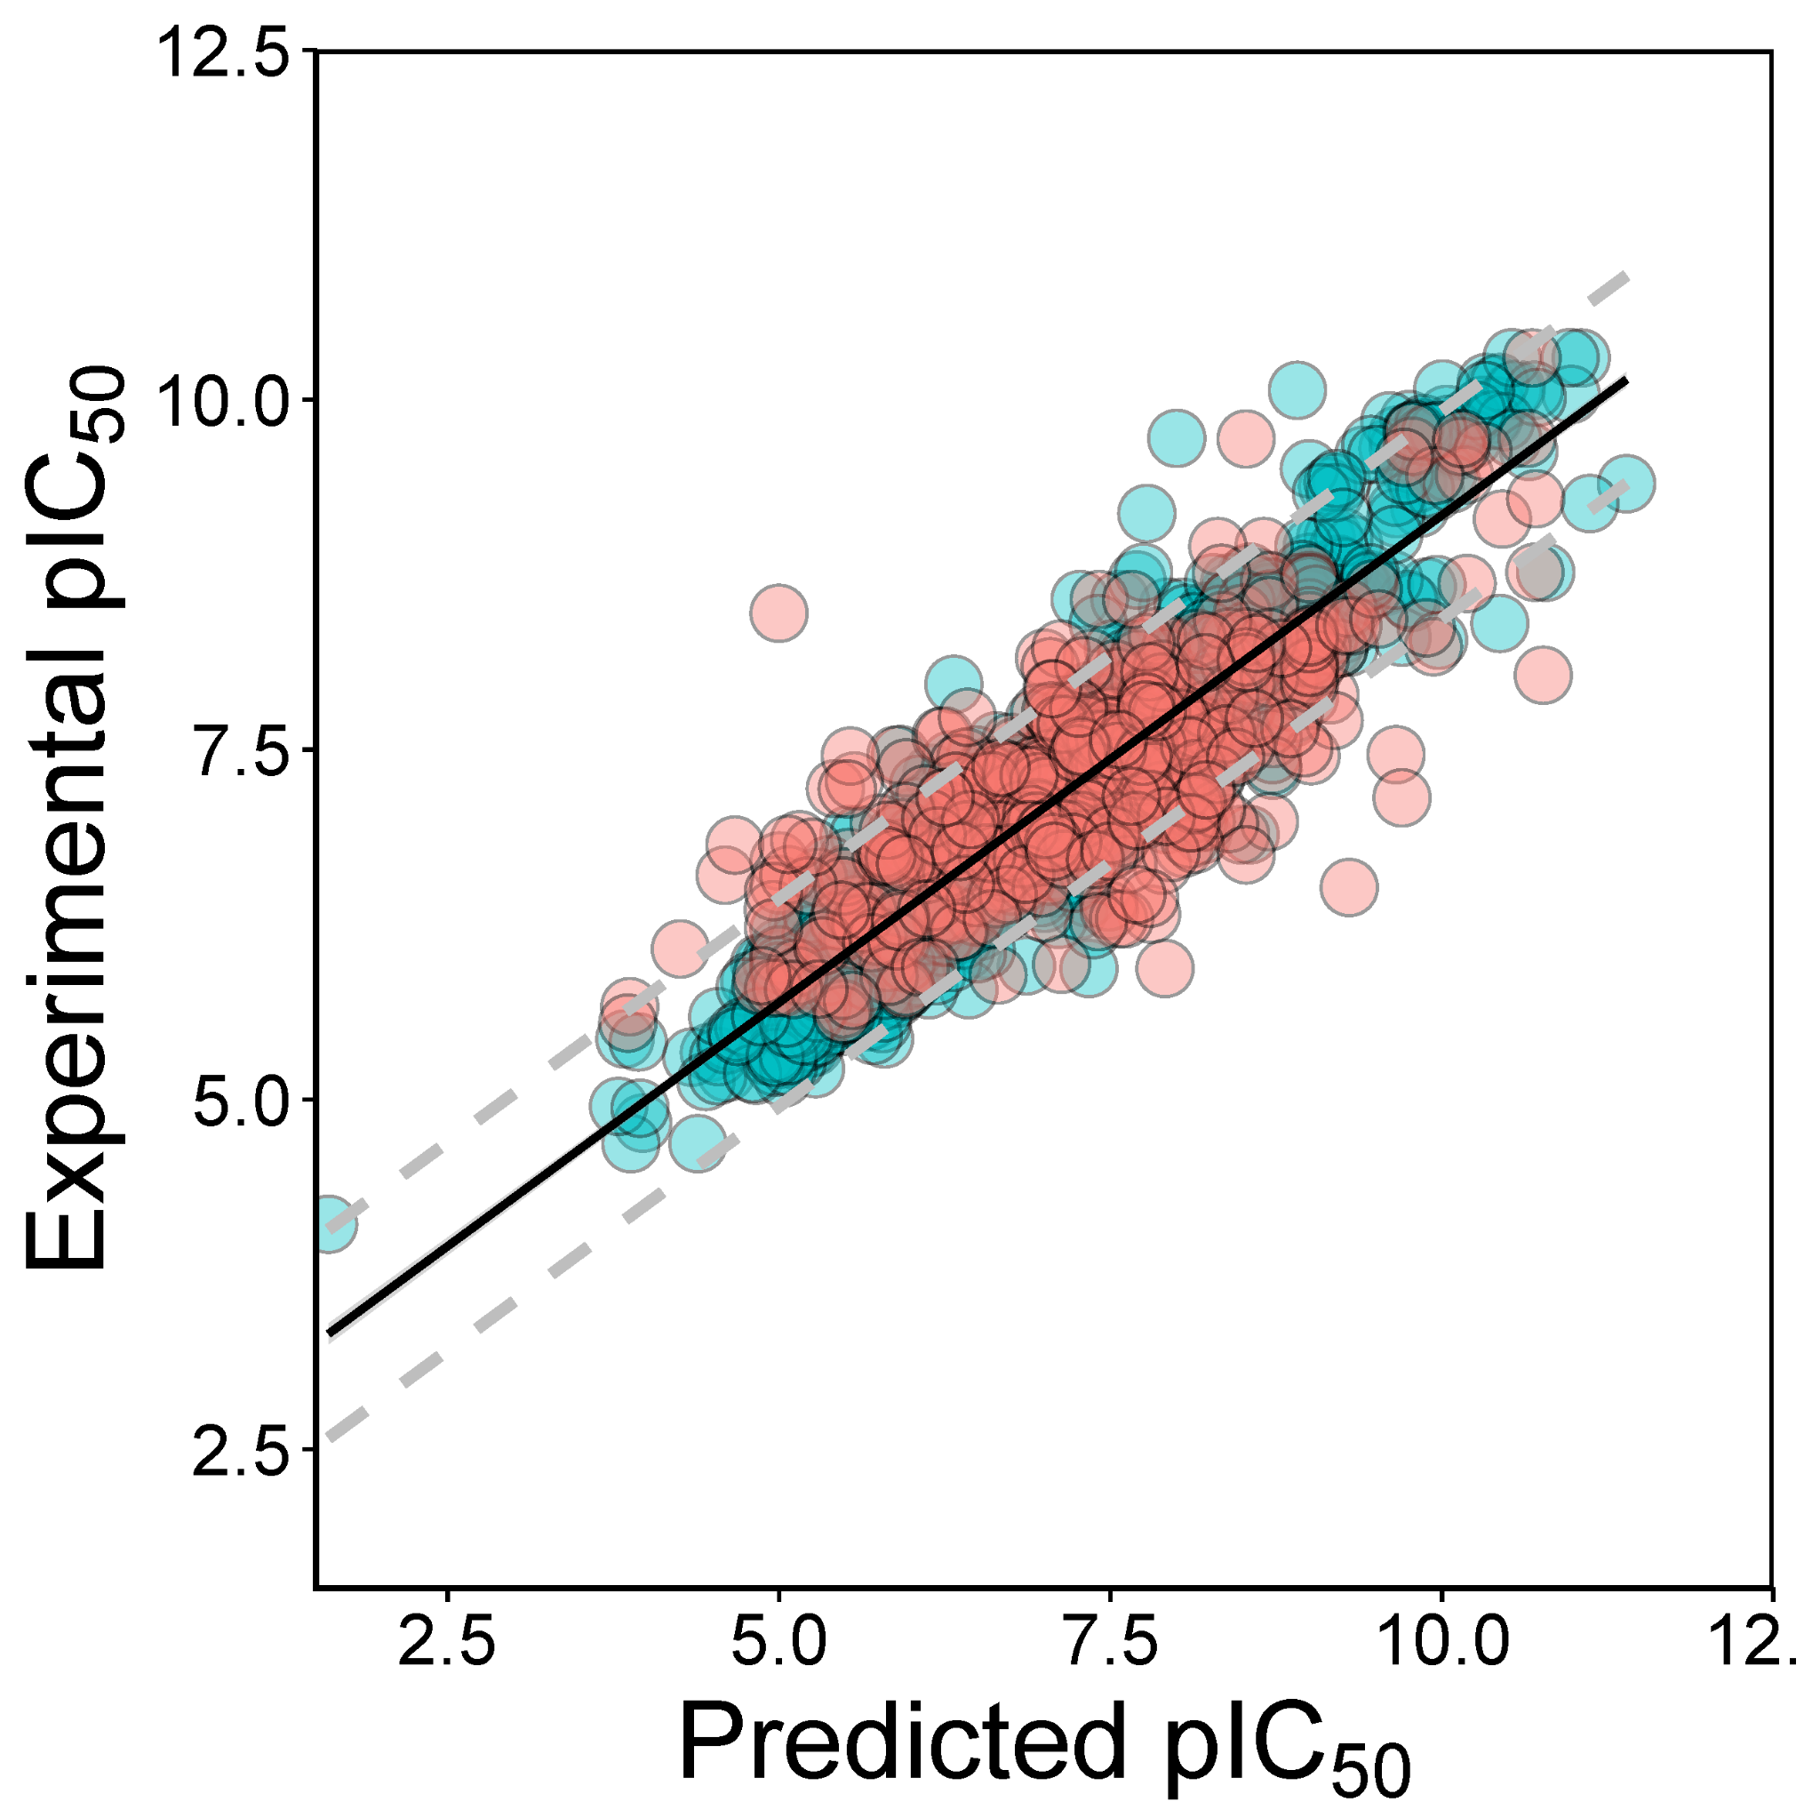
De Novo Drug Design Case Study (Monoglyceride Lipase, MGLL)
LED3Score
Given a set of building blocks, can we find a synthetic route to the given compound?
ε
pretrained
(agent)
finetuned
(prior)
3
DrugEx
QSAR Model
Is the generated compound likely to bind?
Scoring environment
Compounds
Reinforcement Learning Loop
DrugEx: J. Chem. Inf. Model. 2023, 63, 12, 3629–3636
LED3Score: J Cheminform 17, 41 (2025).
QSPRpred: Cheminform 16, 128 (2024).

Slide 12
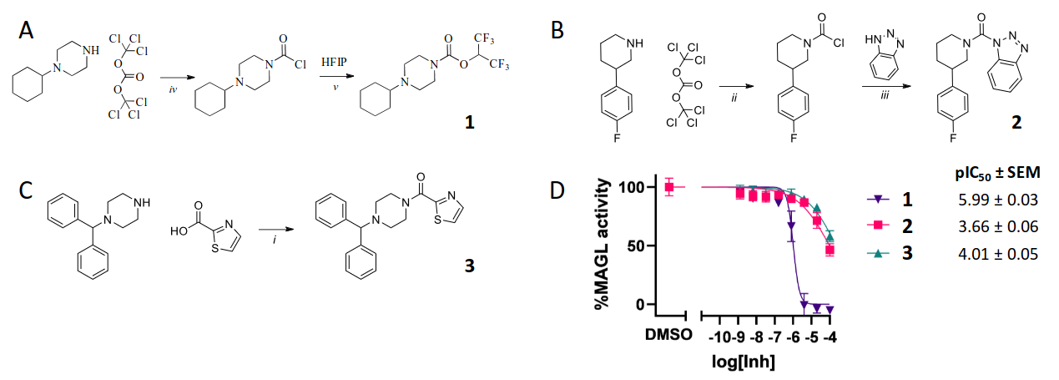
Q3: Experimental Validation

Slide 13
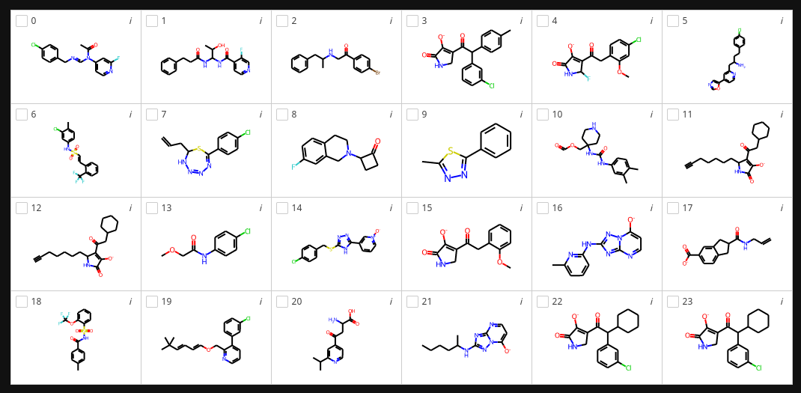
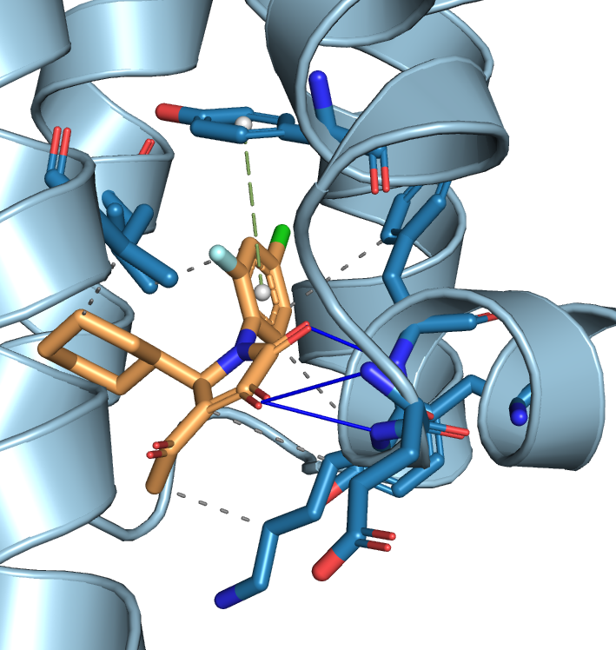
Molecular Docking in De Novo Drug Design Towards Intracellular Allosteric Ligands of CCR2
ZINCScore
Given a set of building blocks, can we find a synthetic route to the given compound?
ε
finetuned
(agent)
pretrained
(mutate)
3
DrugEx
(generative NN)
Molecular Docking
Score on interactions the ligand can make
Scoring environment
Compounds
Reinforcement Learning Loop
DrugEx: J. Chem. Inf. Model. 2023, 63, 12, 3629–3636
LED3Score: J Cheminform 17, 41 (2025).
Spock: In preparation
Notes:
Je moznost vygenerovat.

Slide 14
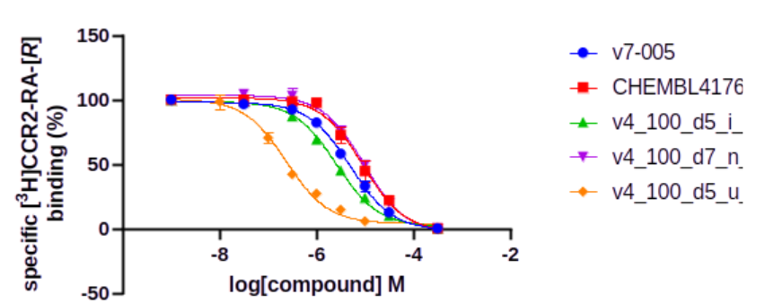
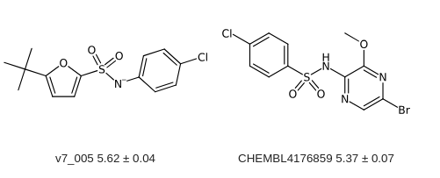
CCR2-RA-[R] Displacement Assay
Figure : Data represent mean ± SEM of three independent experiments performed in duplicate. Total binding (TB) is set to 100% and nonspecific binding (NSB) to 0%. pKi ± SEM was determined from three independent experiments performed in duplicate or % displacement at 10 µM ± SD of two independent experiments performed in duplicate. The compounds were tested at 10 µM on 20 µg U2OS-CCR2 membranes and [3H]CCR2-RA-[R] with a concentration of ~6.5 nM. If [3H]CCR2-RA-[R] displacement is ≥50%, the compounds were tested with ranging concentrations. For pKi calculations a kD value of 6.3 nM was used.
v4_100_d5_u (Ki ~ 100 nM)
v4_100_d5_i (Ki ~ 1 µM)

Slide 15

Conclusions
We have a good basis to start building an integrated ecosystem for:
  Chemical data storage
  QSAR modelling
  de novo molecule generation
  Molecular docking
  Interactive visualization
  Web-based services for the above
Work in Progress and Future Directions
  Centralized data solution via the rdkit-enabled PostgreSQL storage
  Expansion of QSPRpred to more modelling tasks (i.e. multi-instance learning)
Open Questions
  In the era of coding agents, do we need such an ecosystem?
  Why would you use (or not use) such a centralized solution in your group?
  What tools would you like to see integrated in such an ecosystem?

Slide 16

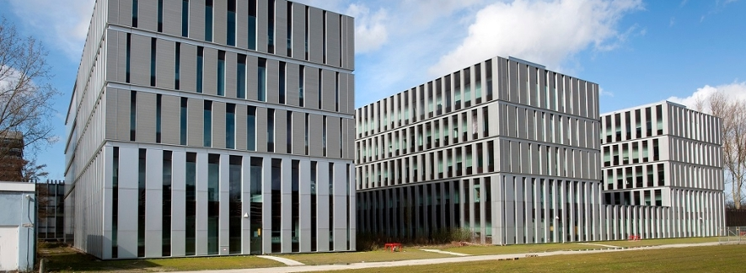




Acknowledgments
LACDR Colleagues
Supervisors & Consultants:
  Gerard van Westen
  Willem Jespers
  Anthe Janssen
  Laura Heitman
Postdocs
  Sohvi Luukkonen
LACDR Students
PhD Students
  Helle van den Maagdenberg
  Olivier Béquignon
  Alan Kai Hassen
  Andrius Bernatavicius
  Yorick van Aalst
  Remco van den Broek
Master Students
  Chara Spyropoulou
  Sem Egbers
VŠCHT DICH
Daniel Svozil
Wim Dehaen
Josef Pavlicek
Valeria Fil
Petr Palivec
Jozef Fulop
Asia Ceklarz
GitHub

Slide 17
Thank you.

