Slide 1


Designing open source wi-fi using fpga

Slide 2


Table Of Contents:-
What is Wi-Fi
Open Wi-Fi Overview
How to implement Open Wi-Fi Using FPGA
Transceiver for Open Wi-Fi

Slide 3
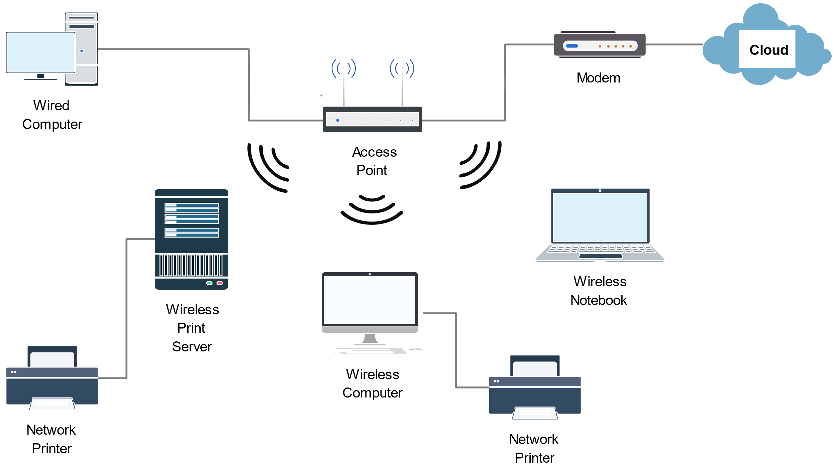
What is Wi-Fi ?
Wi-Fi is a family of wireless protocols based on standards of IEEE 802.11 .
IEEE 802.11 is a part of IEEE 802 set of LAN standards .
It specifies Medial Access Control(MAC) and physical layer protocols for implementing wireless LAN computer communication.
It employs Carrier Sense Multiple Access with Collision Avoidance (CSMA-CA).
Wi-Fi can be addressed directly and exchange data with other devices.

Slide 4
IEEE 802.11
IEEE 802.11 is part of the IEEE 802 set of local area network (LAN) technical standards, and specifies the set of media access control (MAC) and physical layer(PHY) protocols for implementing wireless local area network (WLAN) computer communication.
The standard and amendments provide the basis for wireless network products using the Wi-Fi brand and are the world's most widely used wireless computer networking standards

Slide 5
Types of Transmission and Receiver Techniques
FHSS(Frequency Hopping Spread Spectrum)
DSSS(Discrete Sequence Spread Spectrum)
OFDM(Orthogonal Frequency Division Multiplexing)

Slide 6
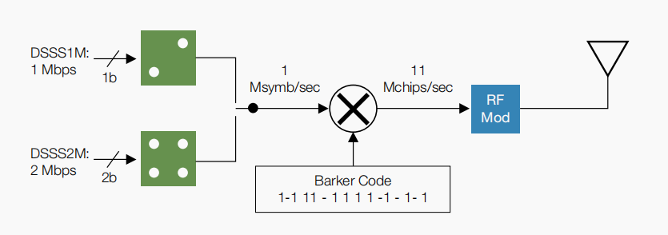
IEEE 802.11b AND MODULATION

Slide 7
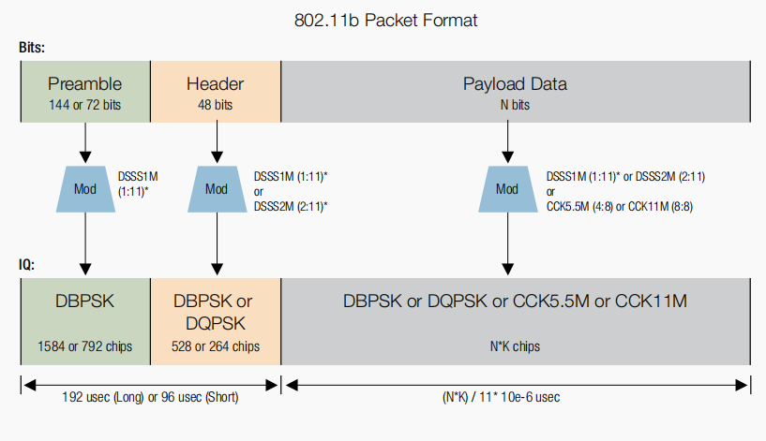
IEEE 802.11b PACKET FORMAT

Slide 8
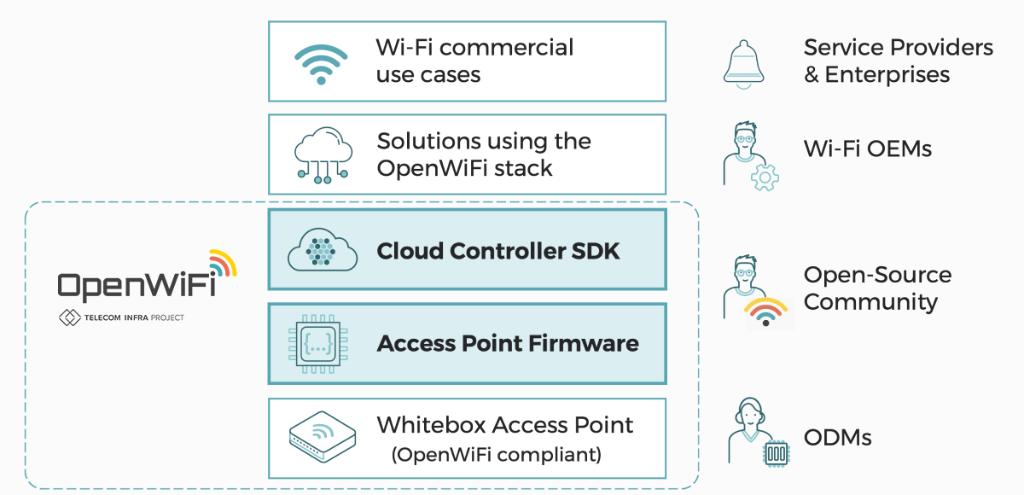
What is Open Wi-Fi ?
Open Wi-Fi is an open sourced, community-developed, disaggregated Wi-Fi software system. The system includes a cloud controller SDK and an Enterprise-grade Access Point (AP) firmware, designed and validated to work seamlessly together.
Open WiFi is an open sourced, community-developed, disaggregated Wi-Fi software system. The system includes a cloud controller SDK and an Enterprise-grade Access Point (AP) firmware, designed and validated to work seamlessly together

Slide 9
The Benefits Of Open Wi-Fi
Lower R&D cost to develop enterprise-grade Wi-Fi solutions
Open Wi-Fi advanced feature set, including Wi-Fi 6, Pass point and Open Roaming capabilities, enable existing and new suppliers to offer Enterprise-grade Wi-Fi products with less development effort
Cloud software OEMs and hardware ODMs are able to reduce R&D expense when by building their solutions on top Open Wi-Fi’s robust, single codebase of common Wi-Fi “plumbing”

Slide 10
Accelerated, open innovation
Open Wi-Fi’s common control, data and management layers allow suppliers and service providers to focus their development and integration efforts on service innovation rather than inventing Wi-Fi “plumbing”
The cloud controller SDK provides open north-bound APIs, so over-the-top Wi-Fi applications can be integrated once and then be used with multiple vendor solutions, saving integration costs and reducing time to market

Slide 11
Favorable economics for Service Providers and Enterprises
Open Wi-Fi’s combination of deployment savings (CAPEX) and automation-driven operational savings (OPEX) brings significant reduction in Total Cost of Ownership (TCO) over current proprietary solutions
Open Wi-Fi’s diverse multi-vendor selection of cloud controllers and access points brings service providers choice and flexibility in enterprise grade Wi-Fi infra

Slide 12
Orthogonal Frequency Division Multiplexing
Orthogonal Frequency Division Multiplexing is a form of multi carrier modulation to overcome the Inter Symbol Interference.
Orthogonal Frequency Division Multiplexing is used for many of the latest wide bandwidth and high data rate wireless systems including Wi-Max,802.11ac, cellular telecommunications(4G,5G).
OFDM uses a large number of carriers, each carrying low bit rate data, means that it is very resilient to selective fading, interference, and multipath effects, as well providing a high degree of spectral efficiency.

Slide 13
Key Features of OFDM
Multiple carriers (called subcarriers) carry the information stream
The subcarriers are orthogonal to each other.
A guard interval is added to each symbol to minimize the channel delay spread and inter-symbol interference

Slide 14
IEEE 802.11 is used in most home and office networks to allow laptops, printers, smartphones, and other devices to communicate with each other and access the Internet without connecting wires.
802.11n
The 802.11n standard was retroactively labelled as Wi-Fi 4 by the Wi-Fi Alliance. The standard added support for multiple-input multiple-output antennas (MIMO). 802.11n operates on both the 2.4 GHz and the 5 GHz bands. Support for 5 GHz bands is optional. Its net data rate ranges from 54 Mbit/s to 600 Mbit/s.

Slide 15
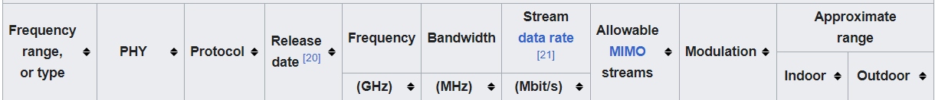
802.11n (Protocol)
1-6 GHz

Slide 16
What is Linux?
Linux is an open source operating system (OS). An operating system is the software that directly manages a system’s hardware and resources, like CPU, memory, and storage. The OS sits between applications and hardware and makes the connections between all of your software and the physical resources that do the work.

Slide 17
How Does Linux Works ?
Every Linux-based OS involves the Linux kernel—which manages hardware resources—and a set of software packages that make up the rest of the operating system. Organizations can also choose to run their Linux OS on a Linux server.
The OS includes some common core components, like the GNU tools, among others. These tools give the user a way to manage the resources provided by the kernel, install additional software, configure performance and security settings, and more. All of these tools bundled together make up the functional operating system.

Slide 18
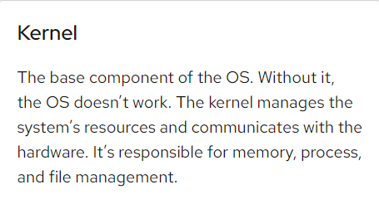
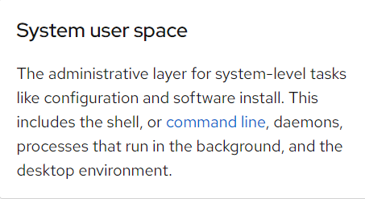
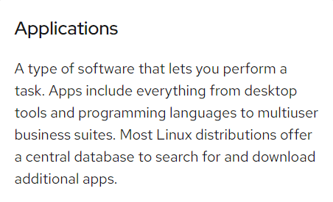
What Does Linux Include ?

Slide 19
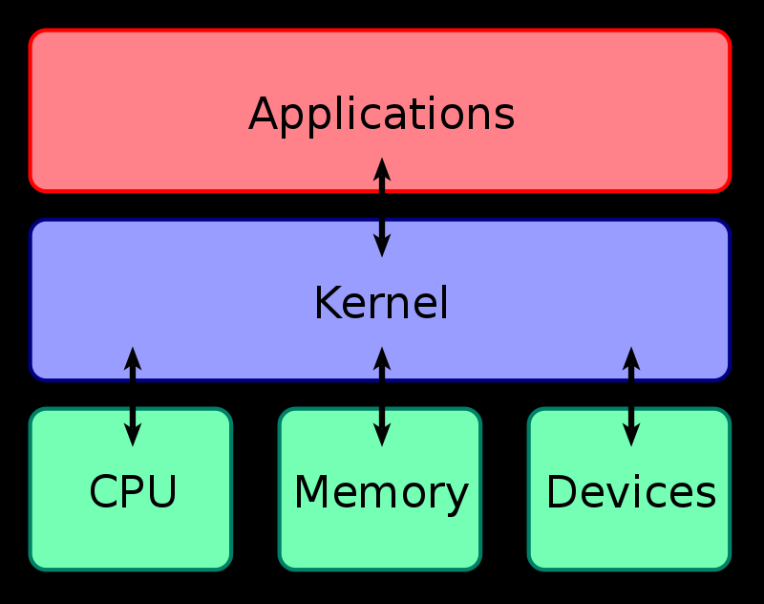
KERNEL DEVELOPMENT
The kernel is the essential foundation of a computer’s operating system(OS). It is the core that provides basic services for all other parts of the OS. It is the main layer between the OS and underlying computer hardware, and it helps with tasks such as process and memory management, file systems, device control and networking.

Slide 20
Tasks By Kernel
1)Loading and managing less-critical OS components, such as device drivers;
2)Organizing and managing threads and the various processes spawned by running applications;
3)Scheduling which applications can access and use the kernel, and supervising that use when the scheduled time occurs;
4)Deciding which nonprotected user memory space each application process uses;

Slide 21
5) Handling conflicts and errors in memory allocation and management;
6) Managing and optimizing hardware resources and dependencies, such as central processing unit (CPU) and cache use, file system operation and network transport mechanisms;
7) Managing and accessing input/output devices such as keyboards, mice, disk drives, USB ports, network adapters and displays; and
8) Handling device and application system calls using various mechanisms such as hardware interrupts or device drivers

Slide 22
A process is a program in the midst of execution.
This process include a set of resources such as open files and pending signals, internal kernel data, processor state, a memory address space with one or more memory mappings, one or more threads of execution, and a data section containing global variables.
Scheduling in Linux deals with the removal of the current process from the CPU and selecting another process for execution.
Process Scheduler chooses a process to be
executed.
System calls provide a layer between the hardware and user-space processes.
It provides an abstracted hardware interface for user space. When reading or writing from a file, for example, applications are not concerned with the type of disk, media, or even the type of filesystem on which the file resides. Second, system calls ensure system security and stability.

Slide 23
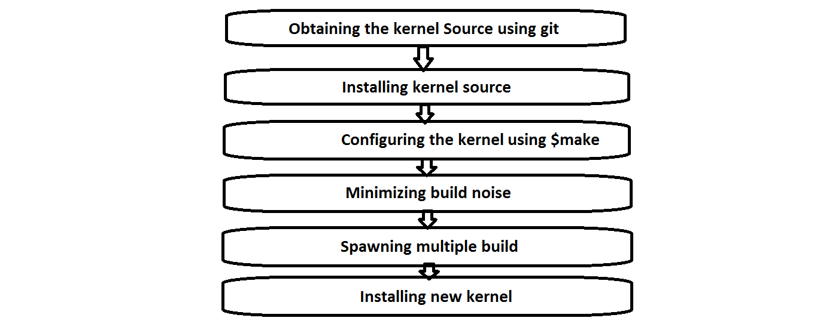
Kernel Implementation Flow

Slide 24
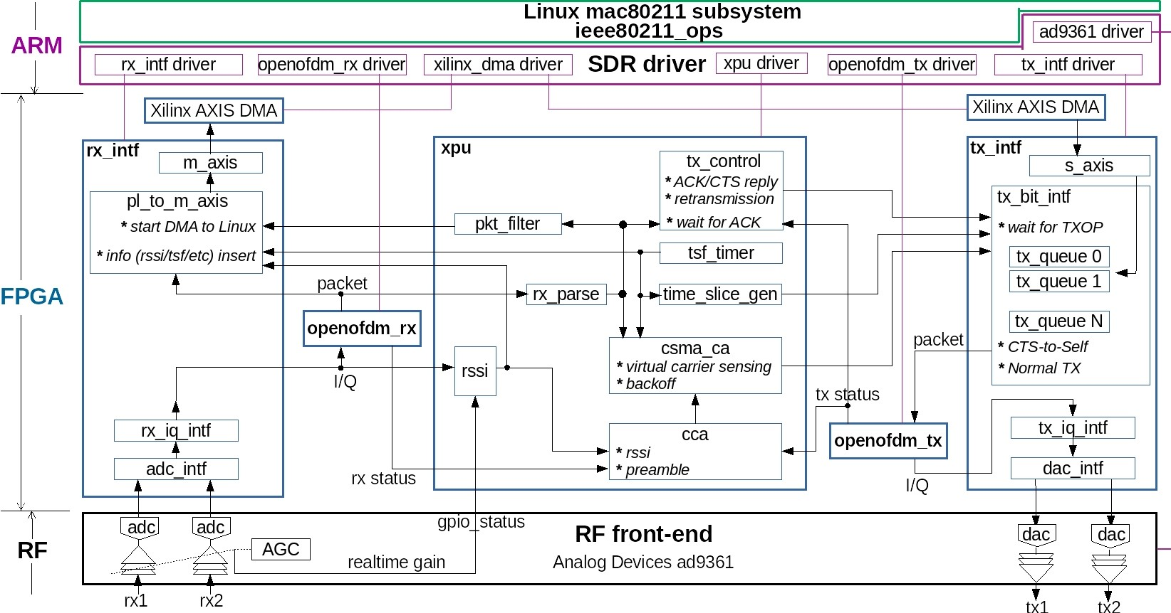
Implementation of open Wi-Fi usingFPGA

Slide 25
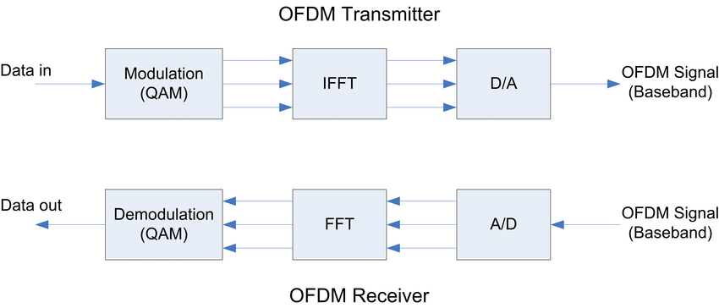
Open OFDM

Slide 26
OFDM Transmitter
The OpenOFDM transmitter is a hardware implementation of the Orthogonal Frequency Division Multiplexing (OFDM) modulation technique used in wireless communication systems.
(i) Data framing and encapsulation: framed into packets and encapsulated with the appropriate header information
(ii) Cyclic prefix insertion: A cyclic prefix is added to each OFDM symbol to mitigate ISI.
(iii) Modulation: using a modulation scheme such as QAM (Quadrature Amplitude Modulation).
(iv) IFFT: applied to the modulated subcarriers to generate the time-domain OFDM symbols.
(v) RF signal generation: The OFDM symbols are upconverted to the carrier frequency and amplified to generate the RF signal

Slide 27
Transmitter Interface(tx_intf)
The "tx_intf" block in the architecture represents the interface between the OpenOFDM transmitter IP core and the rest of the system.
responsible for receiving input data and control signals from the system-level logic .
It is a bridge between them.
The "tx_intf" block provides the processed data from the OpenOFDM transmitter IP core to the system-level logic.
The "tx_intf" block provides status signals to the system-level logic indicating the status of the Open OFDM transmitter IP core.

Slide 28
Cross Bar Processing Unit (XPU)
The XPU (Crossbar Processing Unit) block in the OpenWiFi project is responsible for routing and switching data between different IP blocks in the design.
The XPU block consists of crossbar switch, arbiter, and control logic.
(i) The crossbar switch is responsible for routing data between different IP blocks based on their source and destination addresses.
(ii) The arbiter is responsible for managing access to the crossbar switch, and ensures that multiple data sources do not try to access the same destination at the same time.
(iii) The control logic is responsible for configuring and controlling the operation of the XPU block.

Slide 29
OFDM Receiver
The openofdm_rx (Orthogonal Frequency Division Multiplexing Receiver) block in the Open WiFi project is responsible for receiving and demodulating OFDM signals transmitted over the air.
A brief overview of the functions of the blocks in the openofdm_rx block:
(i) BB: This block stands for Baseband, and is responsible for processing the received signal at baseband frequency. It removes any carrier frequency and converts the signal to the baseband.
(ii) FFT: This block is responsible for converting the signal from the time domain to the frequency domain.
(iii) Demap: This block is responsible for demapping the received signal from its modulation format, such as QPSK or 16-QAM, back into binary data.
(iv) Decoder: This block is responsible for decoding the binary data and reconstructing the original transmitted data. It uses error correction techniques.

Slide 30
Receiver Interface (rx_intf)
The rx_intf block is responsible for receiving data from the physical layer of the wireless communication system.
It interfaces with the receiver digital signal processing (DSP) block and extracts the received bits and channel information from the received signal.
The rx_intf block consists of several submodules, each responsible for a specific task in the reception process.
These sub modules include rx_cfo_est for estimating the carrier frequency offset, rx_fsync for synchronizing the receiver with the frame start marker, rx_sfd for detecting the start of the packet etc.

Slide 31
Openofdm_rx driver
This is a Linux kernel module that provides a driver for a custom hardware design called openofdm_tx. The driver provides an API for accessing the hardware registers and initializing the hardware. The module uses the platform_driver API to register itself with the kernel and handle device probe and removal events.

Slide 32
Header Files:-
bitops.h dmapool.h xilinx_dma.h
init.h
interrupt.h
io.h
iopoll.h
module.h of_address.h of_dma.h of_platform.h of_irq.h
slab.h
clk.h
io-64-nonatomic-lo-hi.h
delay.h
base_addr
Used to store the base address of hardware registers
reg_read and reg_write
{inline functions}
ioread32 and iowrite32 functions to read and write to the hardware registers, respectively.
Functions that write to specific hardware registers
OPENOFDM_TX_REG_MULTI_RST_write
OPENOFDM_TX_REG_INIT_PILOT_STATE_write
OPENOFDM_TX_REG_INIT_DATA_STATE_write

Slide 33
openofdm_tx_driver_api
1)contains function pointers to the functions that implement the driver API
2)EXPORT_SYMBOL macro is used to make the openofdm_tx_api pointer available to other kernel modules
3) module also defines a pointer called openofdm_tx_api that points to an instance of openofdm_tx_api
dev_probe
The module defines a function called dev_probe that is called when the device is probed by the kernel. The function first checks if the device node matches the dev_of_ids table, which contains the compatible string for the device.
Openofdm_tx_api
If the device node matches, the function initializes this pointer with the appropriate function pointers and requests and maps the I/O memory. The function then calls the hw_init function to initialize the hardware

Slide 34
The module defines a function called dev_remove that is called when the device is removed from the system. The function logs a message indicating that the device has been removed.
The module defines a platform_driver struct called dev_driver that contains the driver name, owner, and probe and remove functions. The module_platform_driver macro is used to register the driver with the kernel.

Slide 35
Receiver_driver
base_addr
To store the base address of the custom hardware design. This variable is used to translate virtual addresses to physical addresses in the FPGA design.
reg_read and reg_write
To read and write 32-bit values to registers in the hardware design
Header files are same as transmitter driver.
Module defines an array dev_of_ids that contains a single entry with the compatible string "sdr,openofdm_rx". This array is used to match the module with a device tree node in the system.

Slide 36
hw_init
It initializes the custom hardware design. This function takes an argument mode that specifies the mode of operation for the hardware design. The function sets several registers in the hardware design to configure its operation.
openofdm_rx_driver_api
This structure contains function pointers to the functions provided by the module. This structure is used to export the module's API to other kernel modules.
dev_remove
It is called when the module is unloaded. This function does not perform any actions.

Slide 37
dev_probe
It is called when the module is loaded. This function initializes the openofdm_rx_api structure with pointers to the functions provided by the module, and maps the I/O memory of the custom hardware design to virtual memory using the devm_ioremap_resource function.
platform_driver
This structure dev_driver that contains pointers to the dev_probe and dev_remove functions, and other information about the module. This structure is used to register the module with the kernel.
The module uses several macros to define metadata about the module, including its author, description, and license.

Slide 38
Xilinx_dma driver
What is DMA ?
Direct memory access (DMA) is a method that allows an input/output (I/O) device to send or receive data directly to or from the main memory, bypassing the CPU to speed up memory operations.
The process is managed by a chip known as a DMA controller (DMAC).

Slide 39
DMA channels are used to communicate data between the peripheral device and the system memory.
All four system resources rely on certain lines on a bus.
Some lines on the bus are used for IRQs, some for addresses (the I/O addresses and the memory address) and some for DMA channels.

Slide 40
A DMA channel enables a device to transfer data without exposing the CPU to a work overload.
Without the DMA channels, the CPU copies every piece of data using a peripheral bus from the I/O device.
Using a peripheral bus occupies the CPU during the read/write process and does not allow other work to be performed until the operation is completed.

Slide 41
With DMA, the CPU can process other tasks while data transfer is being performed.
The transfer of data is first initiated by the CPU.
The data block can be transferred to and from memory by the DMAC

Slide 42
The axi_dma_1 device tree node describes an AXI Direct Memory Access (DMA) controller with two channels , one for memory-mapped to stream (MM2S) transfers and one for stream to memory-mapped (S2MM) transfers.
The node specifies the DMA's clock sources, interrupt sources, and register map.

Slide 43
Transceiver
In radio communications, a transceiver is an electronic device which is a combination of a radio transmitter and a receiver, hence the name. It can both transmit and receive radio waves using an antenna, for communication purposes.

Slide 44
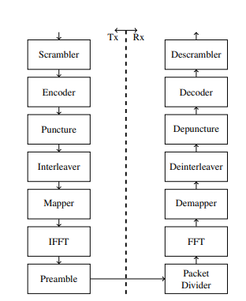
Transmitter
The transmitter includes all blocks from scrambler to preamble. The rest are the receiver chain. Scrambler is responsible for randomizing the MAC layer datain order to prevent the presence of long 1s or 0s sequences. Convolutional encoder with coding rate equals to 1/2 is used for data replication in order to decrease the bit error rate (BER) and enable the decoder to deduce the correct transmitted bits.
Wi-Fi Chain

Slide 45
Puncturing technique of coding rate 3/4 is used to stealing specific encoded bits to increase the coding rate.
Interleaver is used to get rid of burst errors by rearranging the databits. Symbols are then modulated using 16-QAM modulation scheme.
Since Wi-Fi is Orthogonal Frequency Division Multiplexing (OFDM) based, the 128-point IFFT is used to modulate the symbols on several sub-carriers instead of single carrier in order to reduce the channel fading.
The cyclic prefix is added to eliminate the Inter Symbol Interference (ISI).

Slide 46
The packet divider receives the modulated symbols and removes the reserved preamble bits from
the stored data.
The demapper specifies the decision region of the received real and imaginary symbols from the
FFT, then converts the symbols to a stream of bits.
Deinterleaving process is used to repeal the effect of the interleaver at the transmitter side.
The depuncture pads dummy bits in the position of the removed punctured bits.
Viterbi decoder is used because of its ability for error detection and correction.
Descrambler uses the same equation used by the scrambler in the transmitter

Slide 47
USRP AND FPGA INTERFACING
Xilinx Zynq-7000 kit provides two Cortex-A9 processors that share common memory and other peripherals. Asymmetric multiprocessing (AMP) mechanism allows both processors to concurrently run independent OS or bare-metal applications allowing each one to communicate with the other through a shared memory called On-Chip Memory (OCM)

Slide 48
Process of Interfacing USRP with FPGA
Initializing the system.
Controlling CPU1 startup.
Communicating with CPU1 through the OCM.
Running USRP applications using the USRP Hardware Driver (UHD) and GNU Radio installed on the file system.
Interacting with the user through the UART terminal.
The user has the ability to choose to configure the system or testing it.

Slide 49
Thank You
N170349
N171141
N170248
N170273

