Slide 1

Colour DETECTION
-Using Python

Slide 2

Objectives
Introduction
Colour Detection using “Opencv”
Demonstration of Colour Detection
Applications
Conclusion

Slide 3

Introduction
Colour detection is the process of detecting the name of any colour.
Human eyes and brains can work together to translate light into colour.
But it ain’t that easy for computers to detect colours.
So Computers use some values to detect colours.
These values are called RGB values.
Each colour has a unique combination of RGB values.
Using these combinations Computers detect colours.

Slide 4

Colour Detection using “Opencv”
There are many methods to detect a colour. One of them is using “Opencv” python package.
OpenCv is a Computer Vision library developed by Intel.
It is a collection of C functions and a few C++ classes that implement popular Image Processing and Computer Vision algorithms.
Opencv allows the detection of a specific colour in a livestream video content.
OpenCV allows to import and manipulation of images in Python.

Slide 5

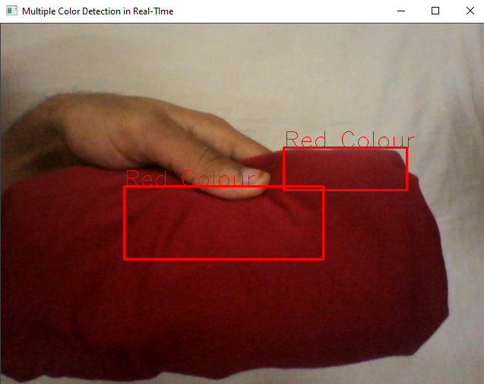
Demonstration of Colour Detection
When we run the code the webcam of the system starts.
If we show any colours,the system detects the colour and identifies its RGB values.
And it displays the colour name corresponding to those RGB values.
Detecting Red Colour

Slide 6

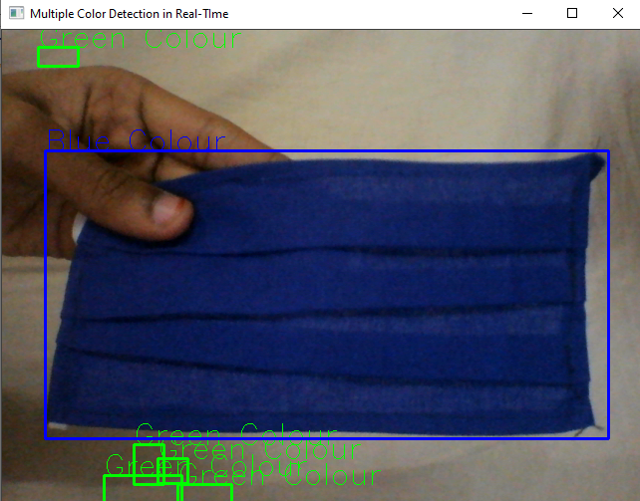
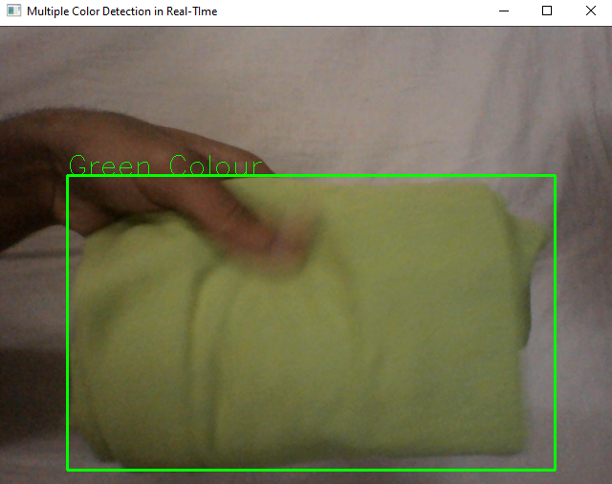
Detecting Blue Colour
Detecting Green Colour

Slide 7
Applications
This can be used in numerous image editing and drawing apps.
Colour detection can be used to recognize objects.
It helps us to know the shade of the colour.

Slide 8

Conclusion
Colour Detection helps in identifying objects.
One of the way to detect a colour is using “Opencv” package in python.

Slide 9

N170281-P. Taraka Sunil Kumar
N170457-S.Durga Prasad
N170085-V.Sri Deepthi
-ECE-02

