Slide 1

SPE GCS ML Challenge Shear Sonic Log Prediction Using Machine Learning
Sri Poludasu

Slide 2
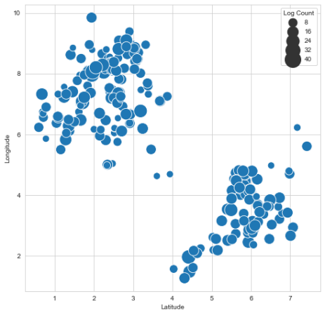
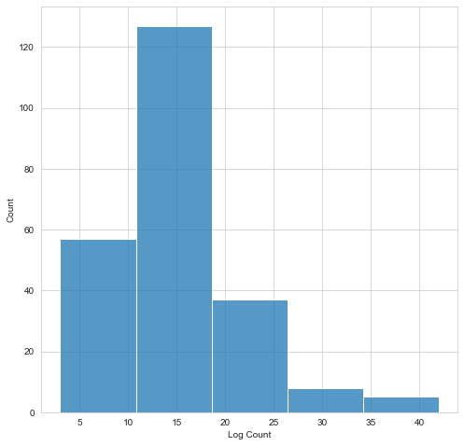
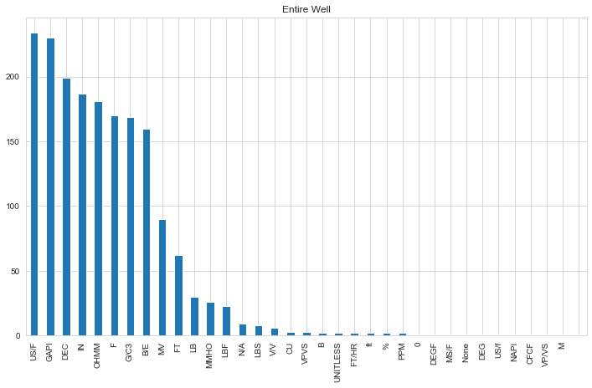
Exploratory Data Analysis
Well logs for 234 wells were provided as part of the training data
The wells are spatially located primarily in two clusters
We need to condition the dataset in order to answer the following questions:
How many logs are available for most or all of the wells?
Are the log mnemonics consistent in all the wells?
Do we need to create a compound feature, combining multiple logs?
What percentage of the logs contain null values?
Are there any outliers in these logs?
Spatial Location
Log Count Histogram
Log Count based on unit count

Slide 3
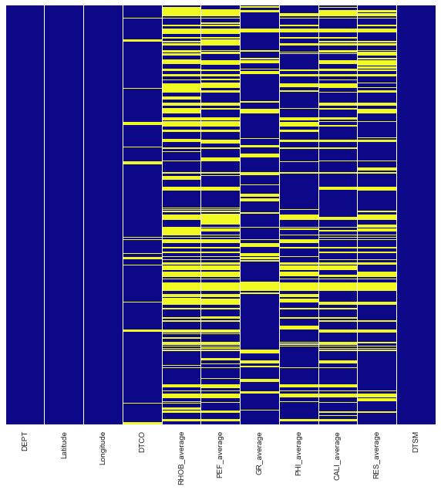
Feature Engineering
Based on the Units and log availability, we can select the following
DEPT: Available for all the wells
LAT, LONG: Relative location to include spatial variation
DTSM: Target variable available for all wells, but nulls and negative values are eliminated from this analysis
DTCO: Available for 223 Wells
RHOB: Available for 169 wells, density correction logs which had the same units are eliminated from this analysis
PEF: Available for 160 wells
GR: Available for 230 wells, spectral gamma ray logs are eliminated from the analysis
NPHI: Available for 199 wells
RES: Available for 181 wells based on the units, but the log mnemonics are not consistent
CALI: Caliper logs are available for 187
Most of the wells have multiple logs with same units, probably the same log derived from different sources.
In order to simplify the feature selection, compound features can be created.
Compound features are created my taking the numerical mean off all the logs of the same unit at a certain depth
For the final model, 10 features are selected including 6 compound features
Null value check on the selected features

Slide 4
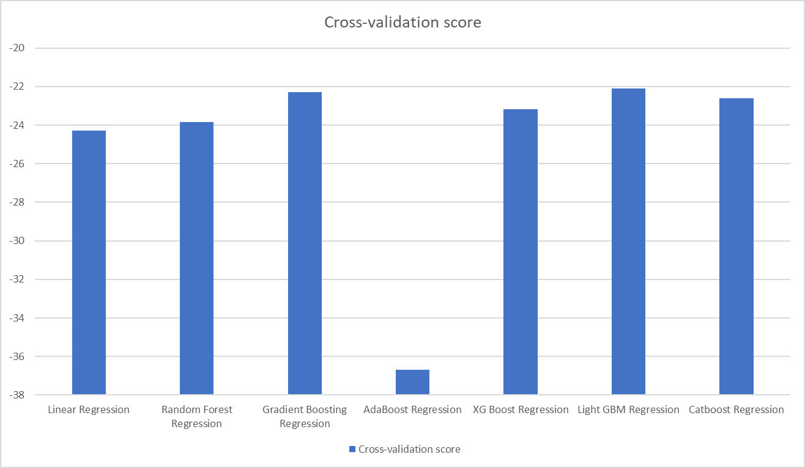
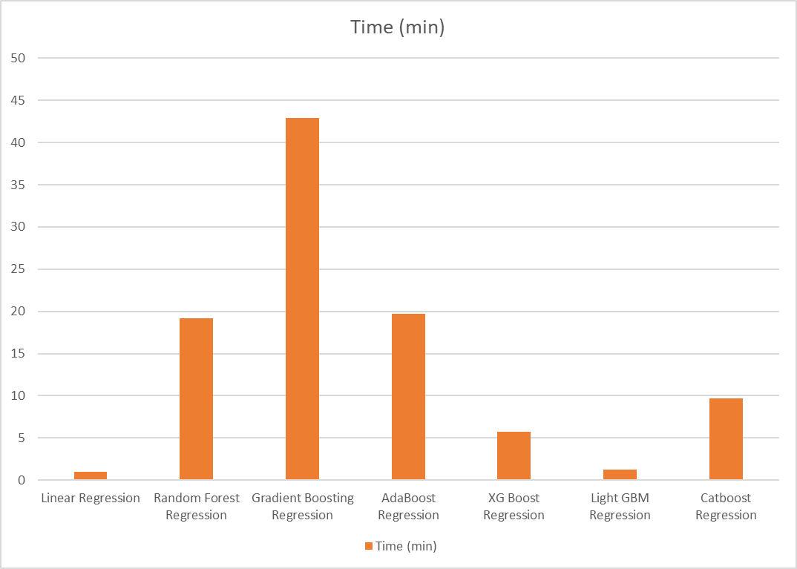
ML Model Selection
Even though most of the ML algorithms are advanced and have the innate capability to handle missing values and outliers, to keep things consistent a ML pipeline was built
Seven different ML algorithms were analyzed using cross-validation scores in order to remove training data bias
The top performing ML algorithms in terms of accuracy and training time are Light GBM and XGBoost
Both of these models are tree-style gradient boosting models, Light GBM has very fast training time whereas XGBoost is known to have higher accuracy
This was confirmed based on the error scores on the leaderboard 2, Light GBM had an error score of 29.66 where as XGboost had 29.49
XGBoost will be used for final predictions based on the error scores
Scaling the magnitude of all the features
Using an Imputer to fill the missing values
ML Algorithm
Cross-validation scores of different ML algorithms
Training time of different ML algorithms

Slide 5
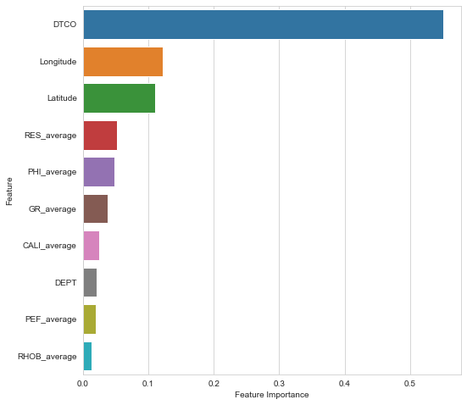
Hyperparameter Tuning and Final Prediction
In order to further increase the prediction accuracy, we can tune the following hyperparameters of the XGBoost model
learning_rate tuned between 0.05 and 0.15
n_estimators tuned between 500 and 1500
max_depth tuned between 5 and 20
min_child_weight tuned between 5 and 10
The hyperparameter tuning has improved the cross validation scores from 23.16 to 21.53 suggesting a robust and accurate model
We can also plot feature importance and we can see that DTCO is the most significant feature followed by spatial location with respect to other wells
We can maybe further improve the prediction accuracy if we can divide the wells into clusters based on geolocation and train two different models based on this clusters.
Feature importance of Final hyperparameter tuned XGBoost model

