Slide 1



Skill Enhancement Workshop
using WordPress

Slide 2
WORKSHOP GOALS
Blog Introduction
Blog Terminology
Why do people blog
Famous Blogs
Basic steps to create Blog
2

Slide 3


Slide 4
What is Blog
A blog (also called a weblog or web log) is a website consisting of entries (also called posts) appearing in reverse chronological order with the most recent entry appearing first (similar in format to a daily journal).
Blogs typically include features such as comments and links to increase user interactivity.
is a web-based journal in which people can publish their thoughts and opinions on the internet.
2

Slide 5
Blog Terminology
We are going to use these terms with alarming frequency, so make sure you understand what they mean before you go on.
Blog (noun) – a journal or diary that is on the Internet.
Blogger (noun) – a person who keeps a blog – Bloggers are revolutionizing the way news is shared.
Blog (verb) – to write a blog – I am going to blog before breakfast this morning.
Blogging (verb) – the action of writing a blog – Blogging is my way of sharing my passions with the world.
2

Slide 6
Why Do People Blog?
So you may be asking why anyone would want to have their own blog. We believe the answer lies in the fact that every human has a voice and wishes their voice to be heard.
The Internet is a medium that is unparalleled in its reach. Never before have average people like you or me been able to reach a global audience with so little trouble.
Bloggers have the opportunity of reaching hundreds or even thousands of people each and every day.

Slide 7
Choose Your topic of blog
Gaming. Nowadays, many people play games. You can write about games you play and post updates and/or cheats/hints.
Politics. Sure, everyone has an opinion about politics, but you may have a unique point of view that needs to be heard.
Fashion/Style/Beauty .Blog about fashion and what new trends are in for fashion.
Food. Who doesn't love good food? Share your recipes, start writing reviews of the local cuisine scene or write about how the food that you ate
Reviews. Reviews of movies, games, products, and anything! It doesn't matter how old it is or what it is, just give your general opinion on whatever your reviewing,

Slide 8
Choose Your topic of blog
Teach something. If you're passionate about a particular subject, and you have a lot of experience in that area, Provide the latest news and trends.
Make people laugh. Are you the funniest person you know?
Inspire others. Have you overcome an obstacle, such as a serious illness or a difficult life experience?
Cars. Are you a car enthusiast? Post pictures of your favorite new models or reports from car shows.
Your business. Your blog doesn't have to be a hobby. A blog can be a fantastic tool for connecting with your customers and for providing them with helpful information

Slide 9
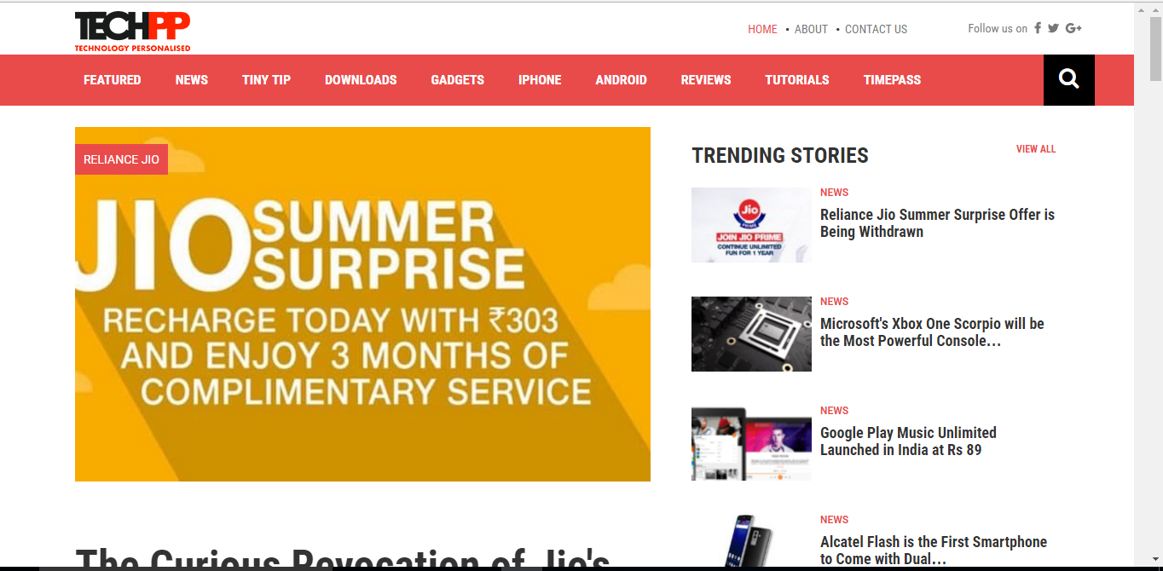

Slide 10
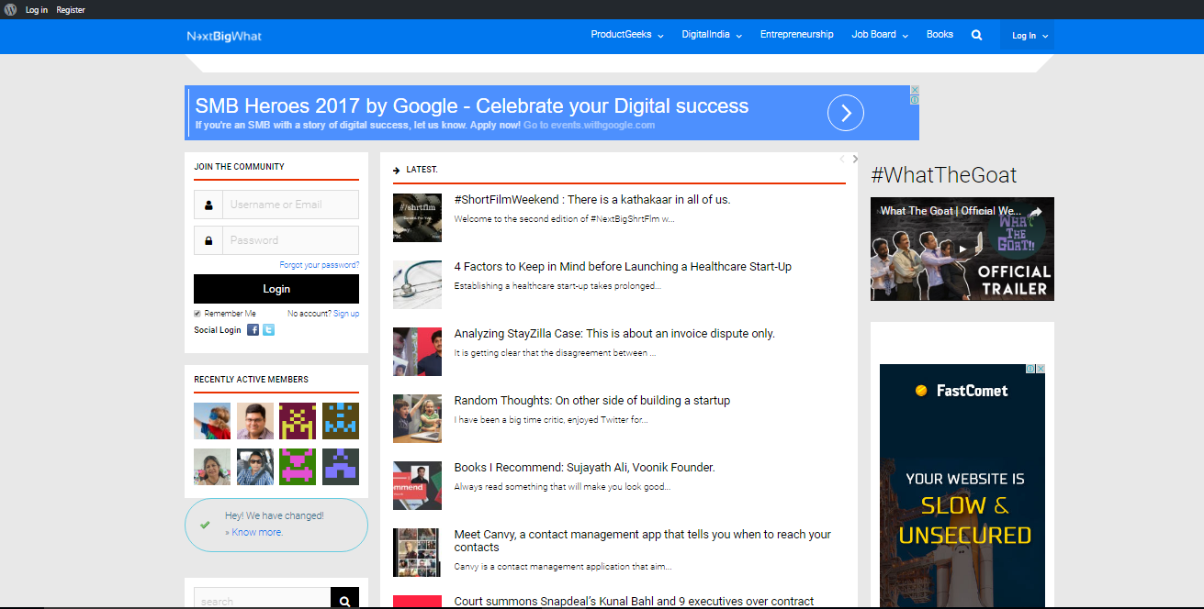

Slide 11
How to write blog post
• Planning a Blog Post
- Things bloggers should do before putting pen to paper – outlining, research etc.
• Writing a Blog Post
- Tips on actually writing a post
• Rewriting a Blog Post
- Editing techniques/things to watch out for/common mistakes
• Optimizing a Blog Post
How to optimize a post for on-page SEO, social shares etc.

Slide 12
There are two ways to start your Blog
WordPress.org
Full control from beginning to end. Set up your own WordPress site through a hosting provider and manage your plugins and software updates.
Wordpress.com
The easiest way to create a website or blog. Choose a design, a custom domain, and a plan with the features you need — all with expert support.

Slide 13
The 6 basic steps to start a blog through Wordpress.com
Decide what to blog about
Choose a blogging platform
Find a host
Pick a domain name
Install WordPress
Design & use your blog!

Slide 14


ANY QUESTIONS?
ANY QUARIES UPTO THIS?
14

