Slide 1
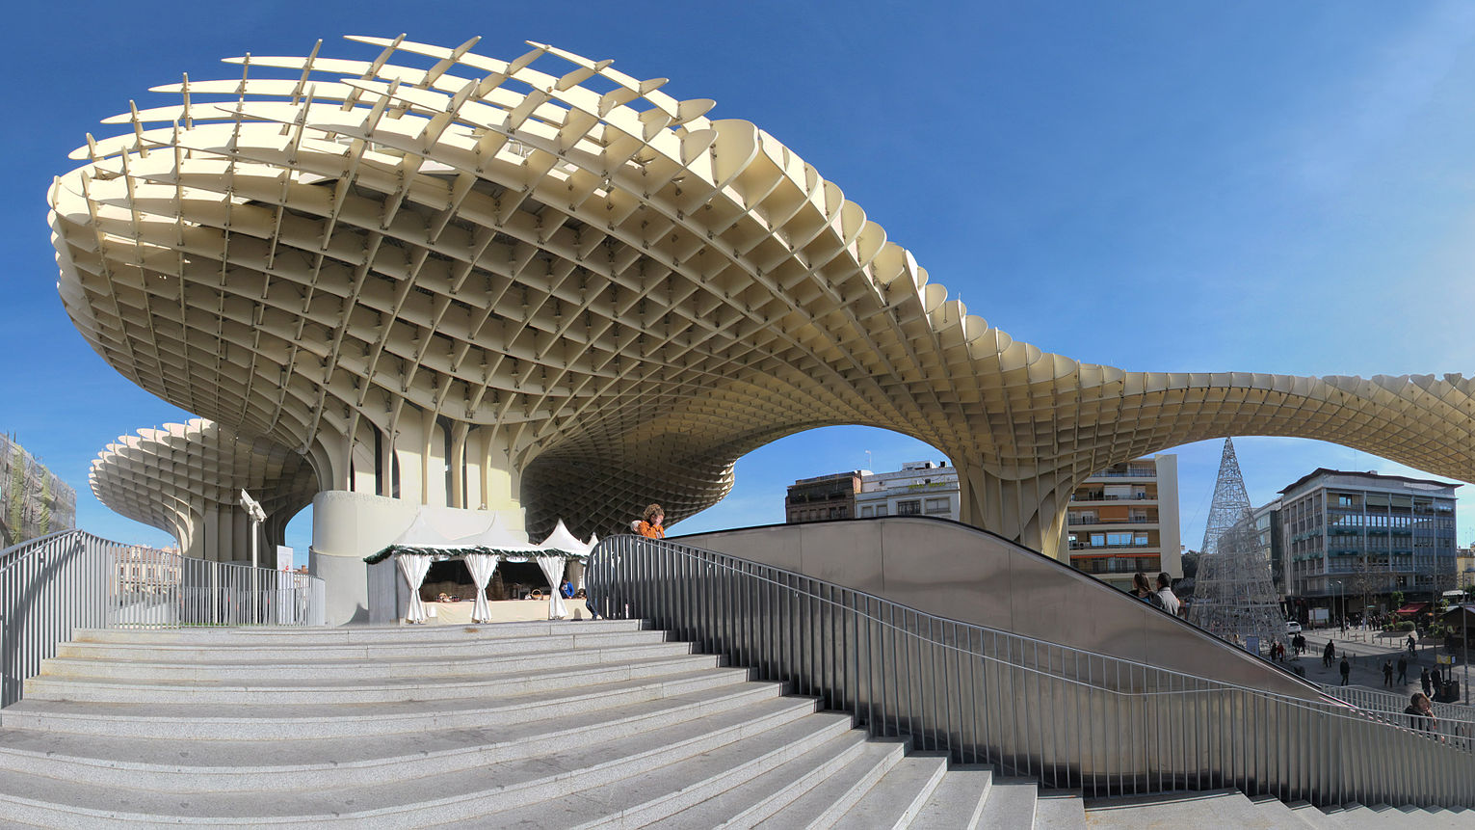

New in .Net Core 2.1 & EF 2.1
Jose Ant. Beltrán @bjabinn

Slide 2



Our Roadmap today
0. Presentación del evento
Novedades .Net Core 2.1
Novedades EF 2.1
.Net Core API and React

Slide 3

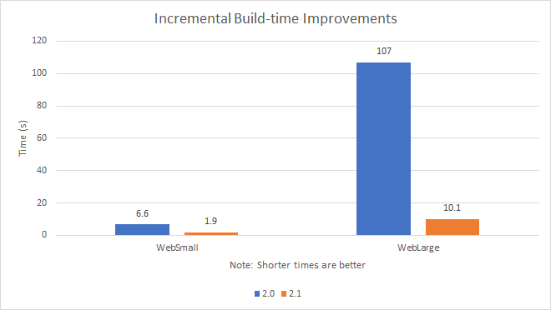
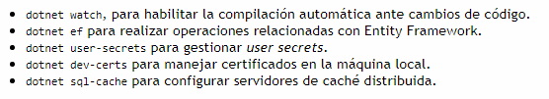
New in .Net Core 2.1
Global tools
Before we have to install every external tools, now we can install globally
dotnet tool install –g SomeTool
So you will not longer need to used DotNetCliReferenceTool in .csproj file
.Net Core 2.1 Perfomance
One of the biggest highlights is perfomance: build and execution time: allocating object in the heap, low-level (IPAddress) and high-level (HttpClient) networking, Guid generation, reducing allocations using Span<T> and Memory<T>
HttpClient
Whole new implementation based on .Net Socket and Span<T>
- New attribute [ApiController]
This way .NET Core identify which objects will be binded from the request
ActionResult<T>
Making easier the autodocumentation, now an action responding an IActionResult or an object T.
Notes:
https://www.campusmvp.es/recursos/post/ya-esta-disponible-net-core-2-1.aspx
https://www.variablenotfound.com/2018/06/novedades-de-aspnet-core-21.html
https://github.com/dotnet/core/blob/master/release-notes/2.1/2.1.0.md

Slide 4
New in .Net Core 2.1
Razor improvements
Razor pages can be compiled and built in libraries been automatically detected as
they were inside /Views or /Pages folder.
These pages will be overwritten creating another view with the same name in the usual folder.
b) Partial views can be included now from another view using the tag helper <Partial> removing using doubts of helpers Html.Partial() and Html.RenderPartial() and their async versions.
From this versión those last helpers will be marked as warnings
c) Areas (fallback) o IPageFilder and IAsyncPageFilter
D
New Microsoft.AspNetCore.App
Microsoft suggests stop using AspNetCore.All. With this new package some connectors have been removed.
GDPR
HTTPS is used by default. Having a specific middleware to force the redirection from HTTP -> HTTPS app.UseHttpsRedirection();
The project templates include a cookies aceptation banner

Slide 5
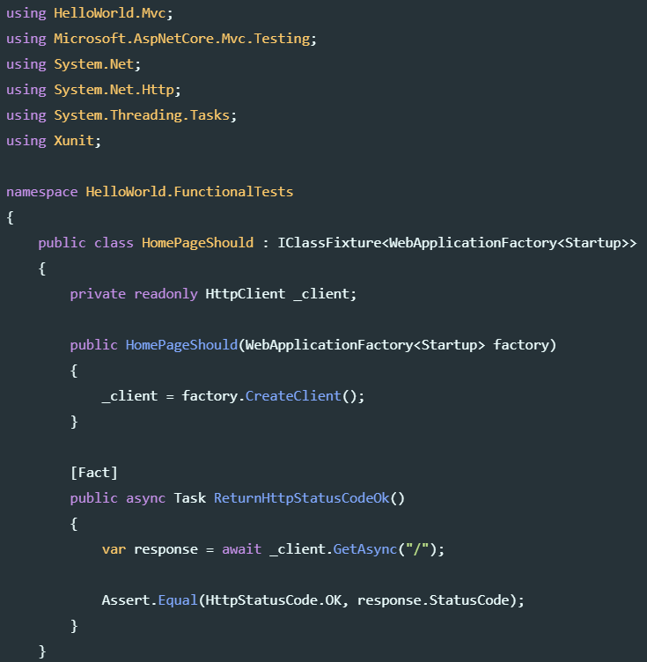
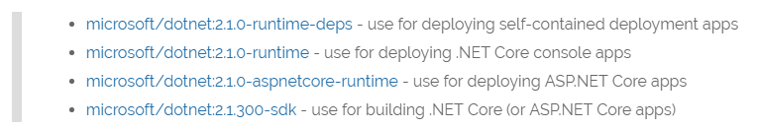
New in .Net Core 2.1
SignalR Core
Finally we have the real time framework for live environments, completely rewritten from scratch, removing jQuery dependencies and using more efficient protocols. But concepts as hubs are back.
New package Microsoft.AspNetCore.Mvc.Testing
To end to end testing in memory
Adaptative (tiered) compilation
On startup it performs a basic compilation(tier 0) but if the method gets used frequently the method is recompiled on the background thread to produce a more optimized version(tier 1) for you to improve the runtime performance
Docker images updates
microsoft/aspnetcore and microsoft/aspnetcore-build have been deprecated. Now we should use microsoft/dotnet:[latest|2.1.0]
Linux installers
From this version we can install .NET SDK and Runtime
with a package management software.
Updated SPA Templates: Angular, React and React with Redux.
How to migrate from ASP.NET Core 2.0 to 2.1

Slide 6
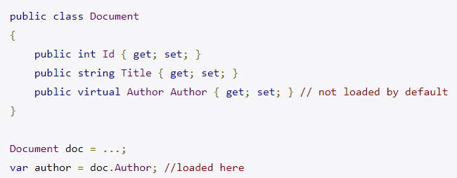
New in Entity Framework 2.1
CosmoDB provider
Finally Microsoft offer a provider for Azure Microsoft no-relational database
(in preview mode)
Lazy loading
Now the related entities will be loaded only if they are actually needed, meaning if any code accesses them.
Server-side grouping
LINQ’s Groupby now can run on the database.
The limitation is we can’t group by a reference property in the server-side
Constructor injection
Used entities by EF Core can now take some parameters in their constructor. It’s not recommended but useful to have read-only properties.
Notes:
https://stackify.com/new-in-net-core-2-1/

Slide 7
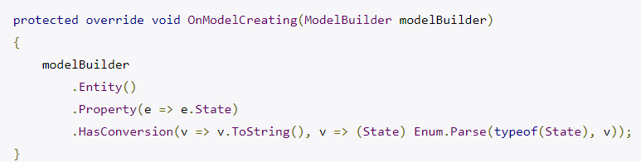
New in Entity Framework 2.1
Value Conversions
Now we can specify how an enumeration should be stored or that a BLOB is an Image
Notice we must supply conversion to / from the database (HasConversion / EnumParse)
Data seeding
Now we can load some data initially from OnModelCreating or from DbContext dependency injector

Slide 8
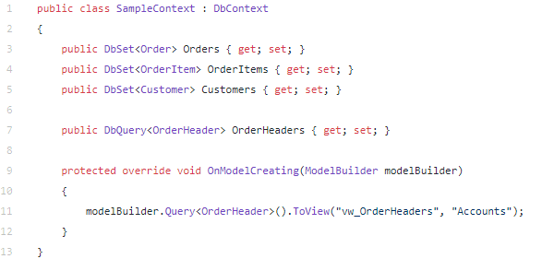
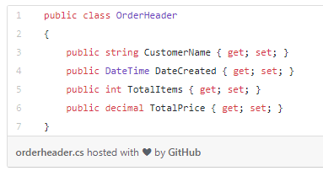
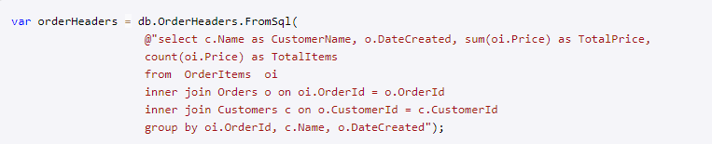

New in Entity Framework 2.1
Query types
It is not a entity types that map to tables or views and can serve as the return type
from FromSql method.
Notes:
https://www.learnentityframeworkcore.com/query-types

Slide 9
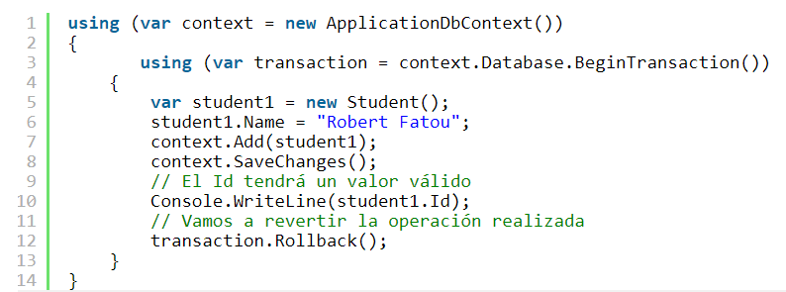
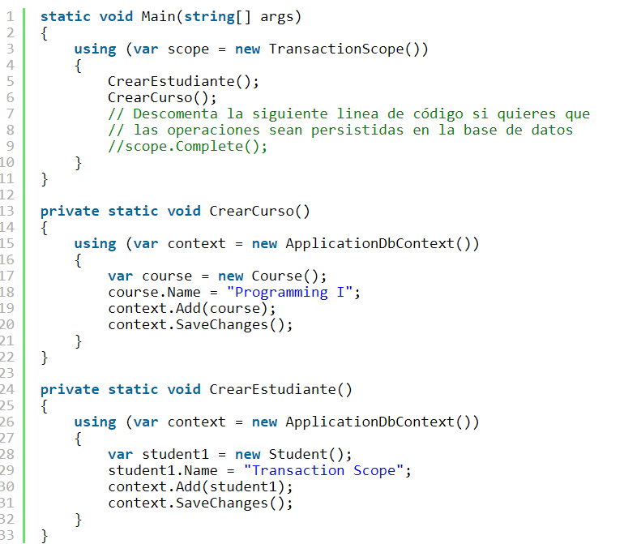
New in Entity Framework 2.1
Column ordering in initial migration
The migration process, based on customer feedback, generate columns in the same order as declared in classes.
Ambient Transactions
We already have transactions
Now we can revert a group of SaveChange, always we don’t call Complete()
Notes:
https://gavilanch.wordpress.com/2018/08/03/entity-framework-core-2-1-transacciones-de-ambiente-nuevo/

