Slide 1
.NET CORE & ON LINUX & BING MAPS

Slide 2

Hello!
I’m Jose Ant. Beltran
Father, husband & Tech lover.
You can find me at @bjabinn
www.joseantoniobeltran.com

Slide 3
1.
What I wanted to show

Slide 4
“Microsoft Application,
C#,
Razor,
Rest Services,
… in a Linux Distribution”

Slide 5



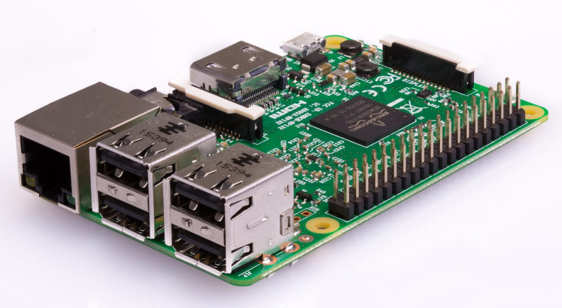


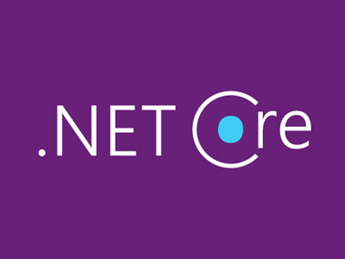

Slide 6
1. Publicamos la solucion
dotnet publish -r linux-arm
2. Instalamos dotnet SDK
https://blogs.msdn.microsoft.com/david/2017/07/20/setting-up-raspian-and-dotnet-core-2-0-on-a-raspberry-pi/
https://www.microsoft.com/net/learn/get-started/linuxdebian
3. Configuramos la Raspberry
https://docs.microsoft.com/es-es/aspnet/core/host-and-deploy/linux-nginx?tabs=aspnetcore2x

Slide 7
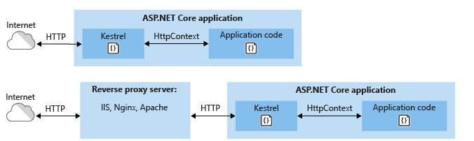
Concept Review

Slide 8
4. Coloca una aplicación existente de ASP.NET Core detrás de un servidor proxy inverso.
Ssh, sftp para transmitir a la raspberry PI 3
Configura el servidor proxy inverso para reenviar las solicitudes al servidor web Kestrel.
6. Ejecutamos la aplicación

Slide 9

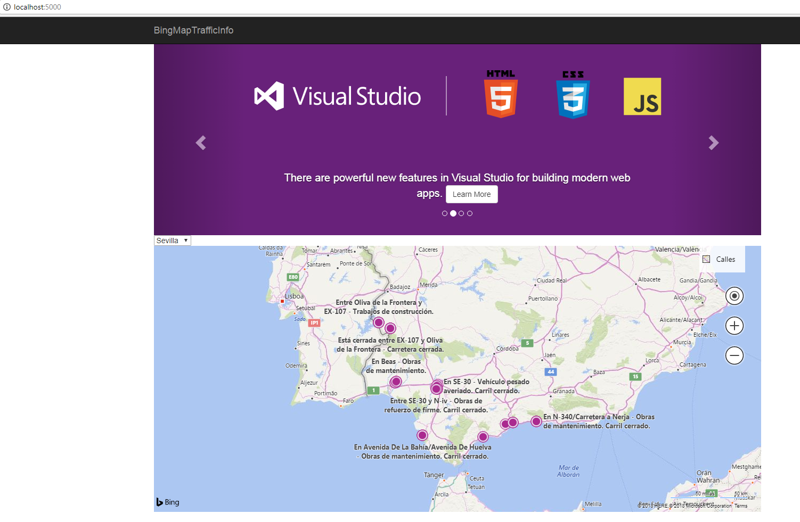

Slide 10

Thanks!
Any questions?
You can find me at:
@bjabinn
Joseantoniobeltran.com

