Slide 1
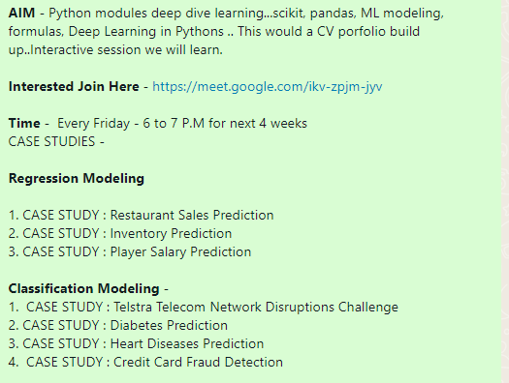
Learn Regression Model
What is classification Model
Know about the case studies
Know about regression metrics in industry used for ML
Know about the python modules to be used
Know about the Test Set and Training data set

Slide 2
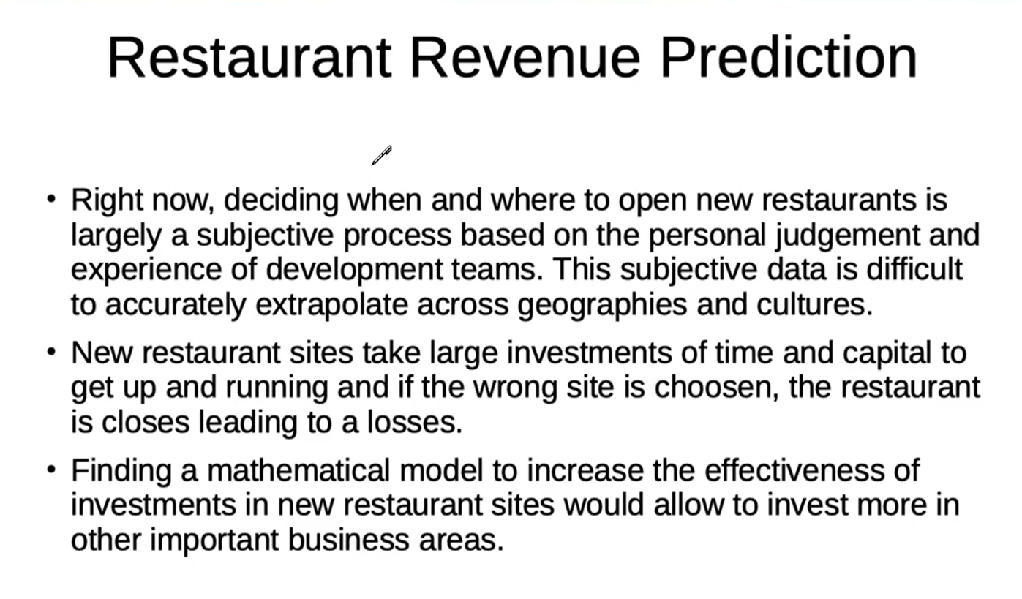

Slide 3
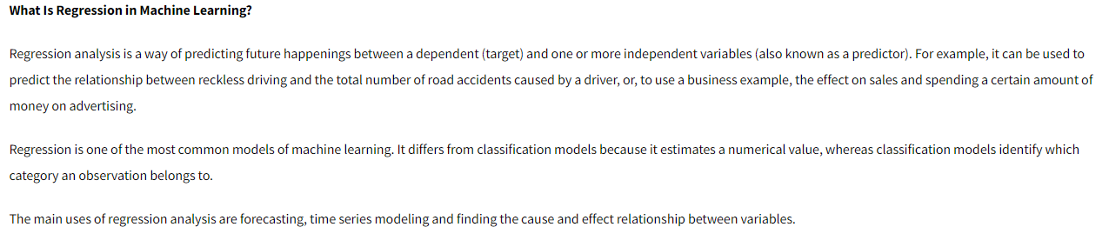

Slide 4
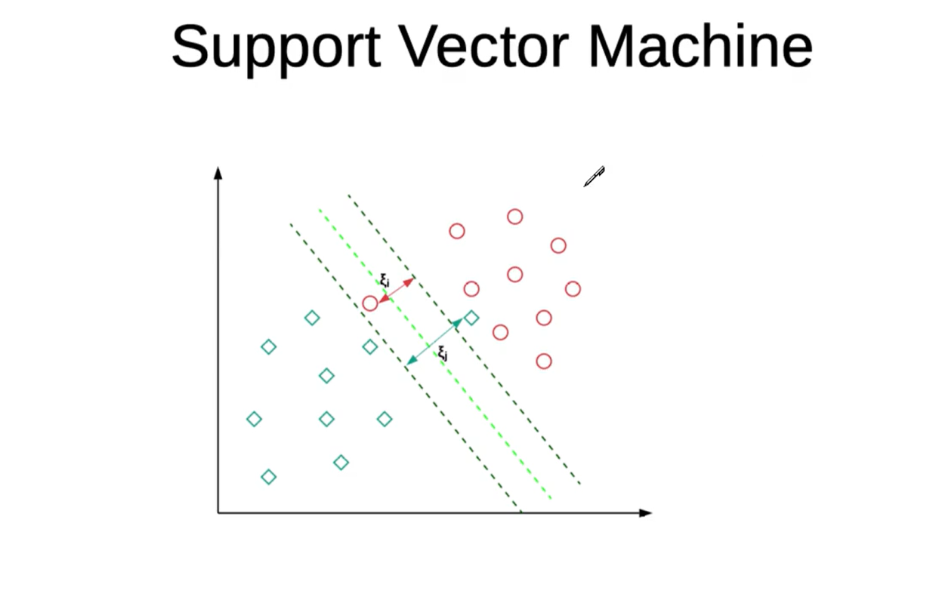
Supervised Learning Model
Used in both regression and Classification models
provide both input and desired output data, which are labeled for classification. The classification provides a learning basis for future data processing.
Support vector machines are used to sort two data groups by like classification. The algorithms draw lines (hyperplanes) to separate the groups according to patterns.

Slide 5
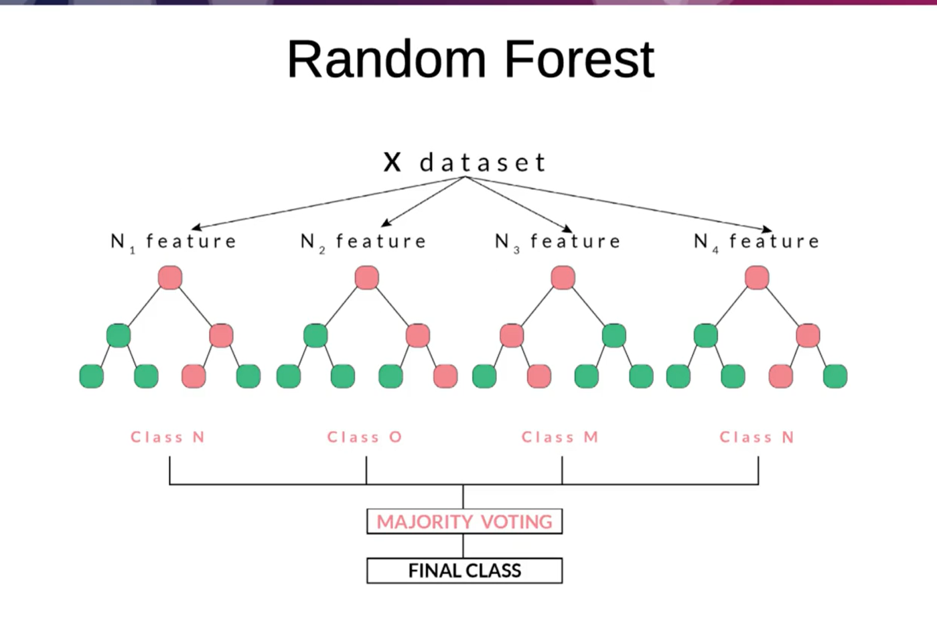

Slide 6
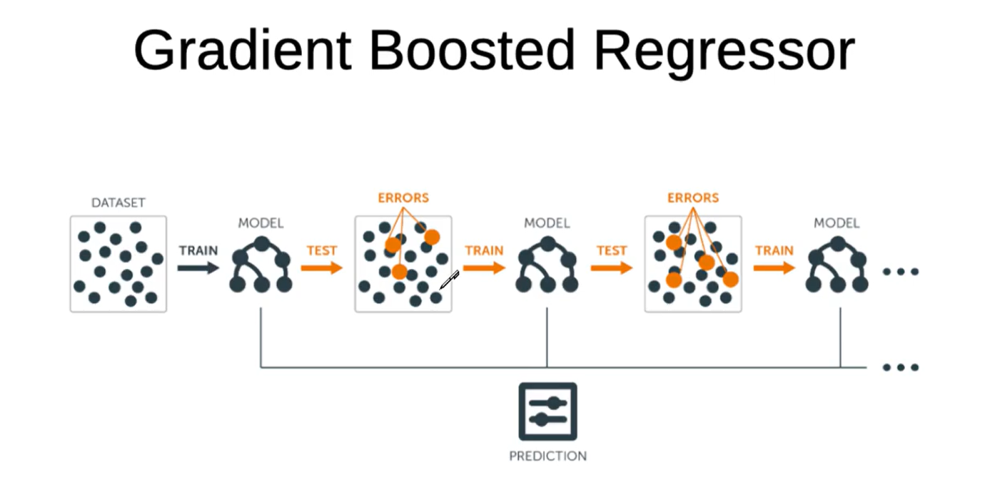

Slide 7
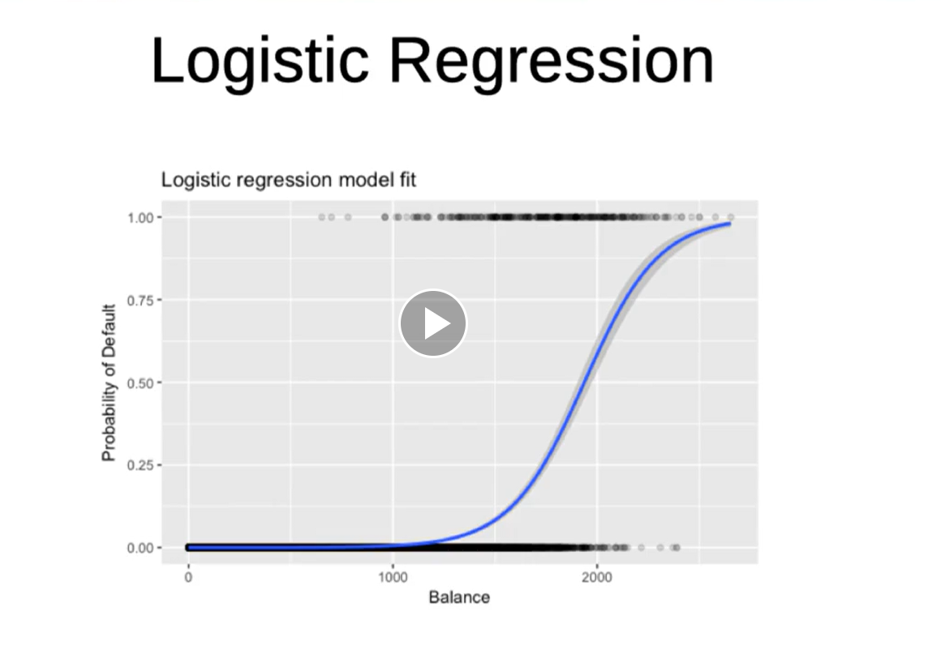

Slide 8
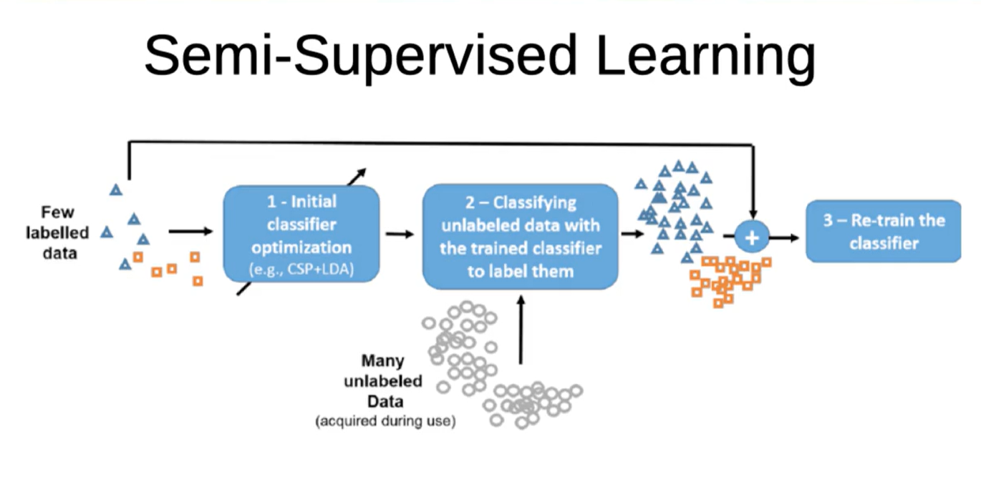

Slide 9
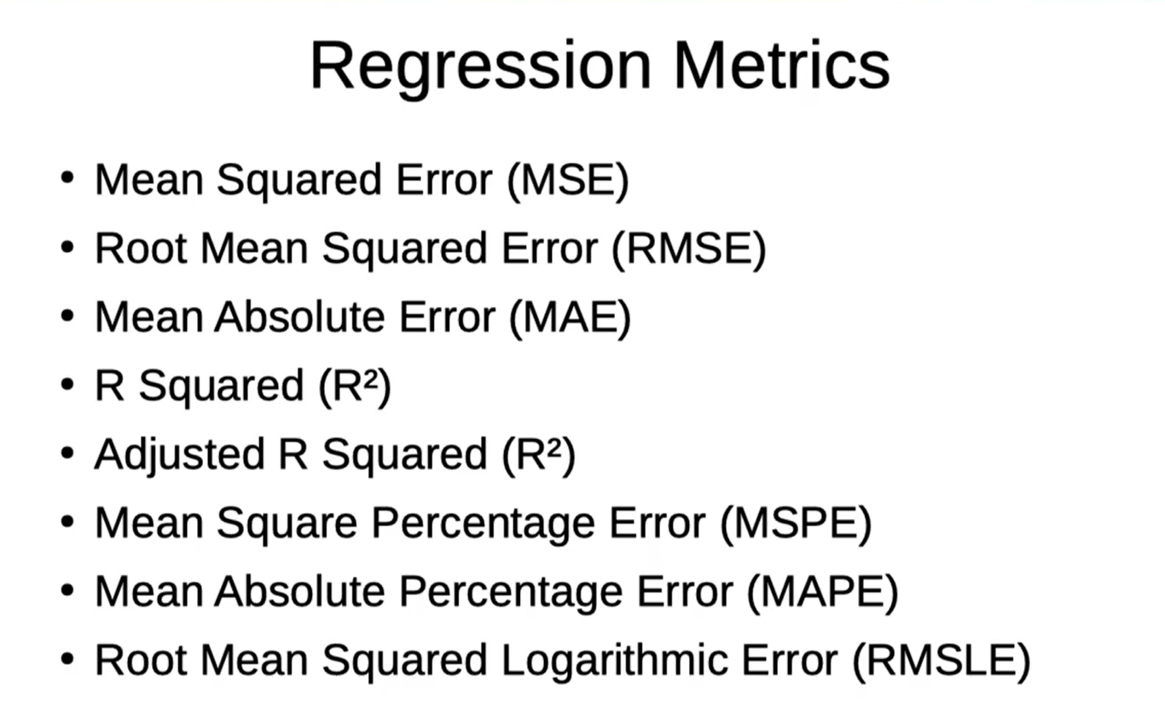

Slide 10
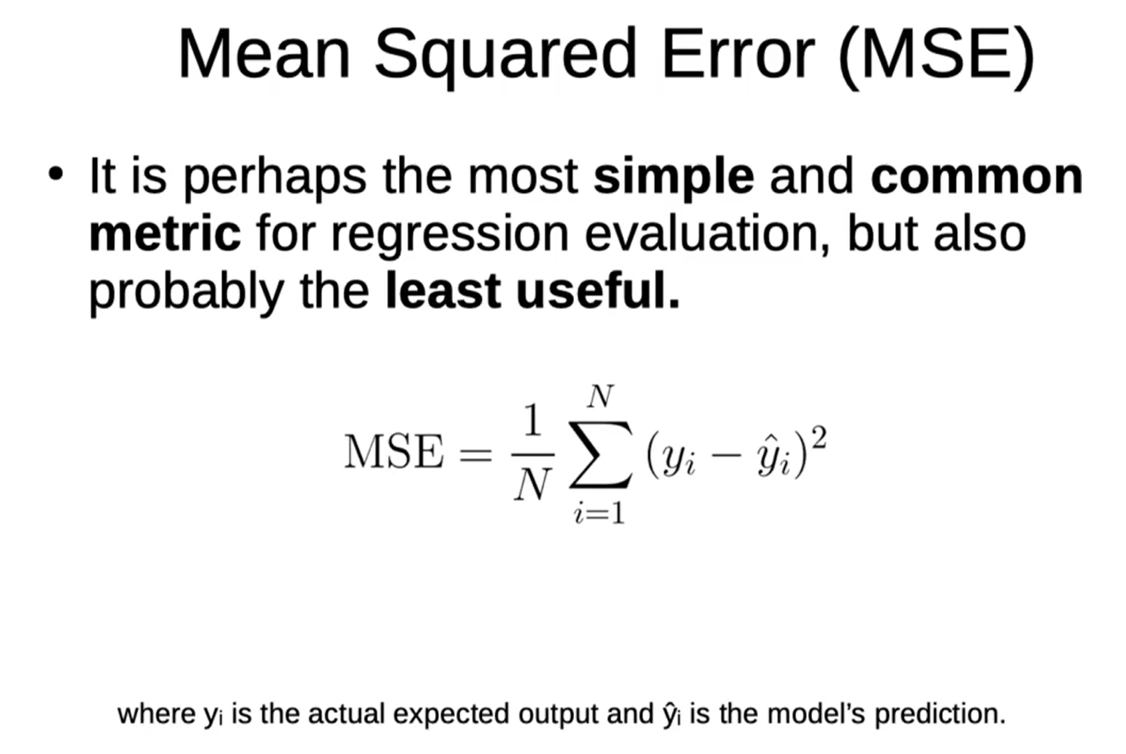

Slide 11
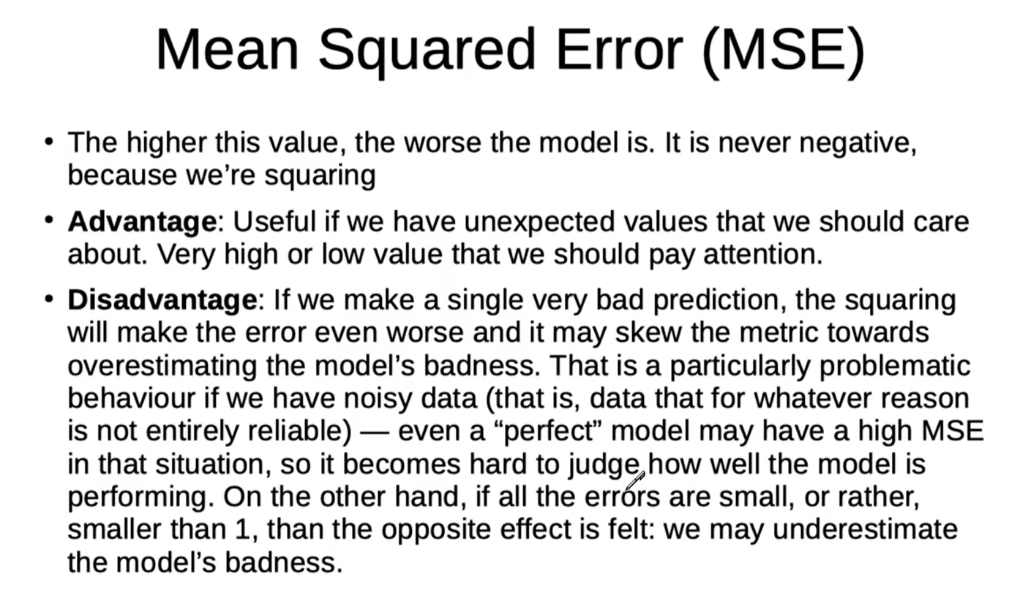

Slide 12
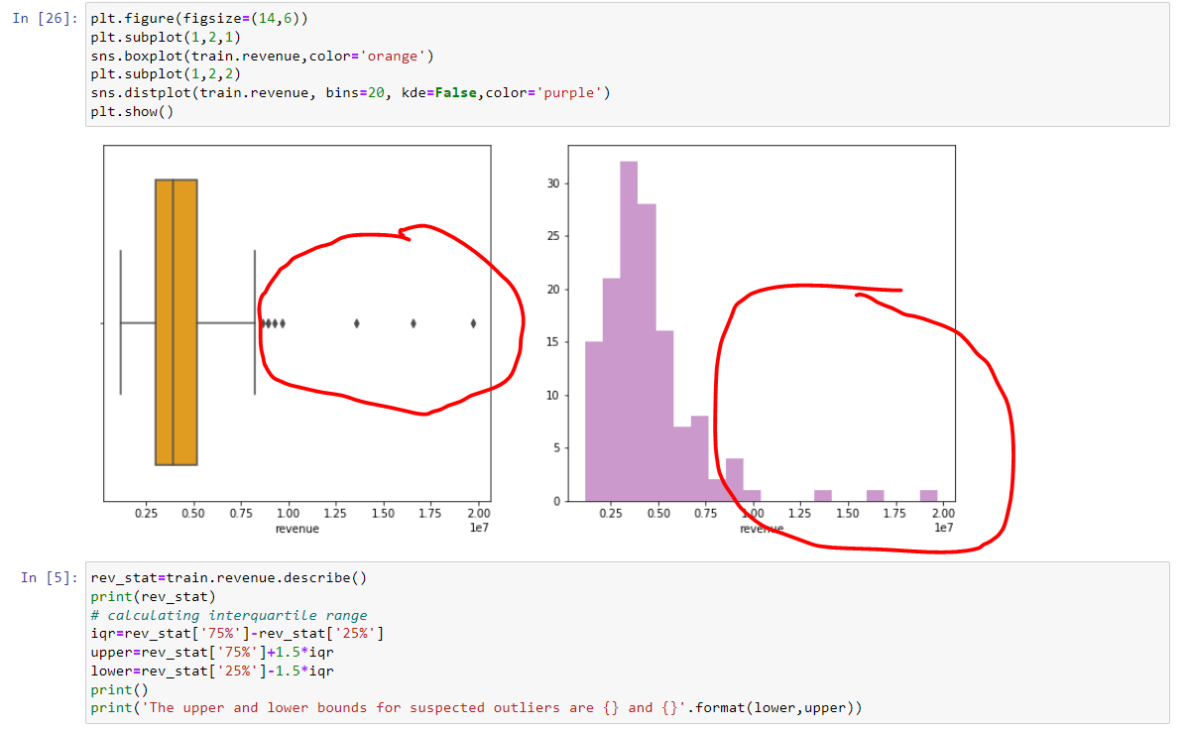
Fix the Outlier

Slide 13
Rest you can see in the code the flow of things and what I have used here in the github
https://github.com/svrajeshkumar/ML_Regression_Modeling_Projects/tree/main/restraunt_revenue_prediction

