Slide 1
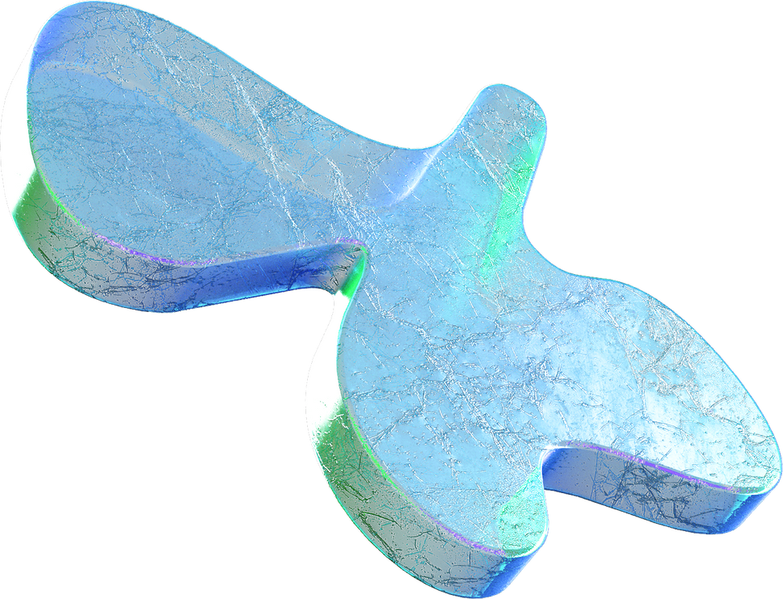
Collaborative filtering and kNN based recommendation to overcome cold start and sparsity issues: A comparative analysis
GROUP-7
Snehashri P G- 20IM10038
Vardhan Reddy-20IM30005

Slide 2



MOTTO
The project aims to improve the effectiveness of Recommender Systems by tackling two critical issues:
Cold Start Problem: Recommender systems often struggle when dealing with new users or items for which there is limited or no historical data. This is known as the "cold start" problem.
Data Sparsity: Recommender systems typically operate on large datasets, and the majority of users have only rated a small fraction of the available items, resulting in data sparsity.

Slide 3

Key Project Objectives and Approaches Used:
User-Item Similarity Matrix: The project's first objective is to create a user-item similarity matrix to capture relationships between users and items based on their historical interactions and ratings.
Prediction Matrix: Another crucial goal is to generate a prediction matrix that can estimate user preferences for unrated items, effectively providing personalized recommendations.
Memory-Based CF Approaches:
The project employs memory-based CF techniques, including KNNBasic, KNNBaseline, KNNWithMeans, SVD, and SVD++, to calculate similarities and make predictions based on user preferences.
Model-Based CF Approach:
In addition to memory-based methods, the project also utilizes a model-based CF approach called Co-Clustering to improve recommendation accuracy.

Slide 4
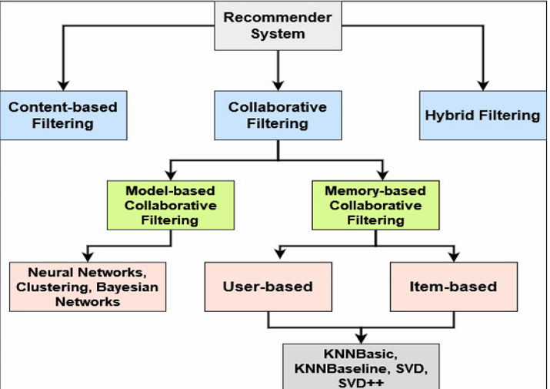

Slide 5
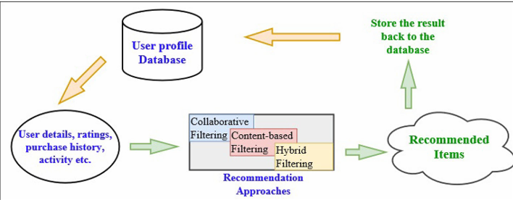
Memory-based CF approach

Slide 6
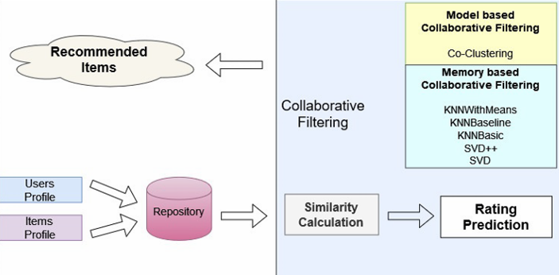
Proposed system

Slide 7

Result
this project focuses on applying collaborative filtering techniques to enhance recommender systems, making them more effective and accurate, especially when dealing with new users and sparse data. The successful implementation of the K-NNBaseline approach demonstrates its capability to mitigate common challenges in recommendation systems, ultimately maximizing the relevance of recommended items to users.

Slide 8

Code Snippets and Results

Slide 9
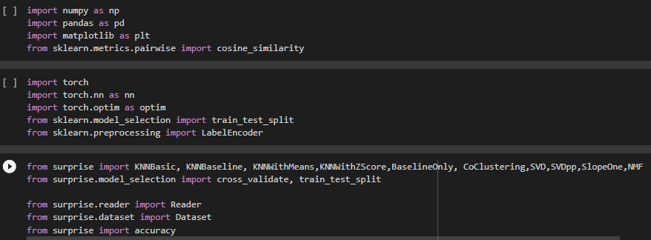
Libraries that we imported

Slide 10
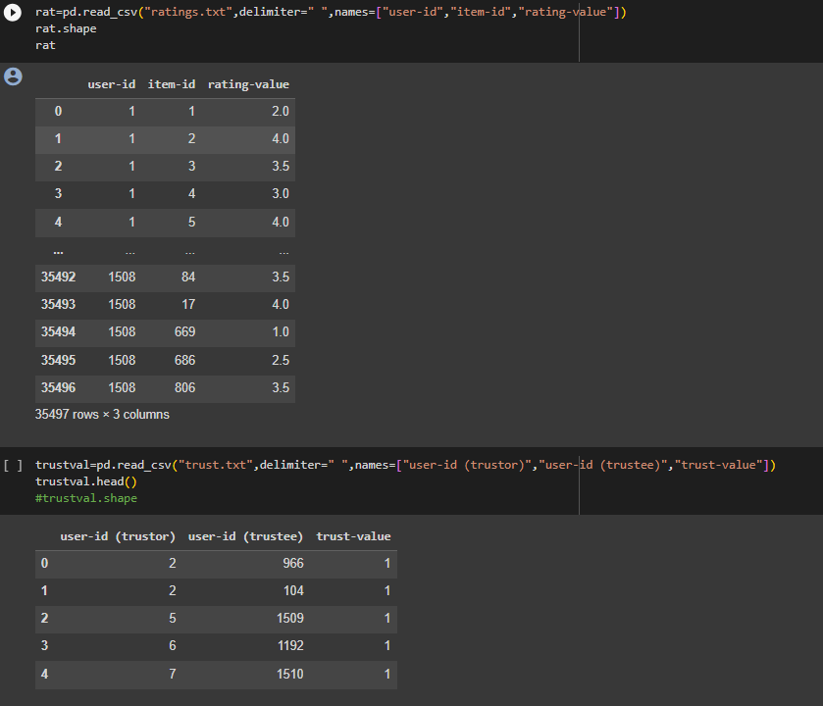

Slide 11
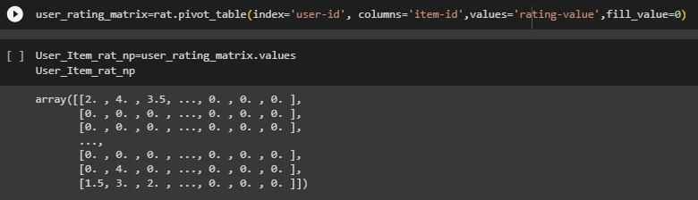
Rating Matrix

Slide 12
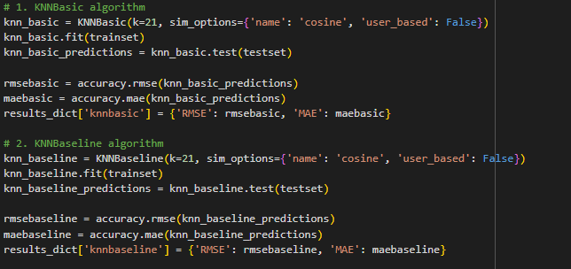

Slide 13
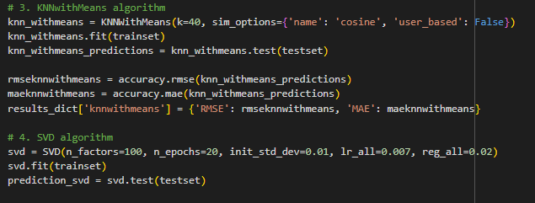

Slide 14
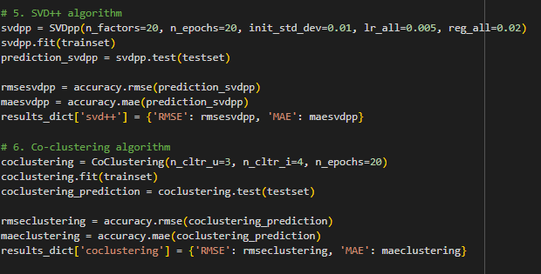

Slide 15
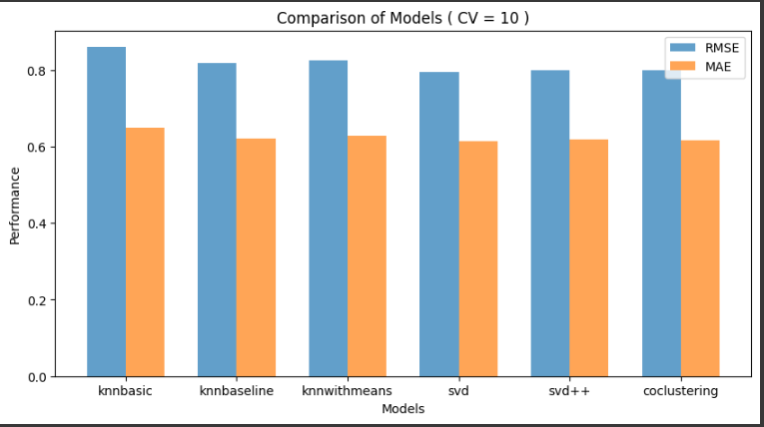

Slide 16
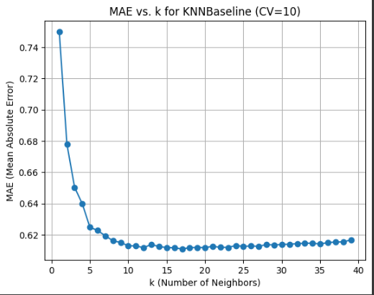

Slide 17
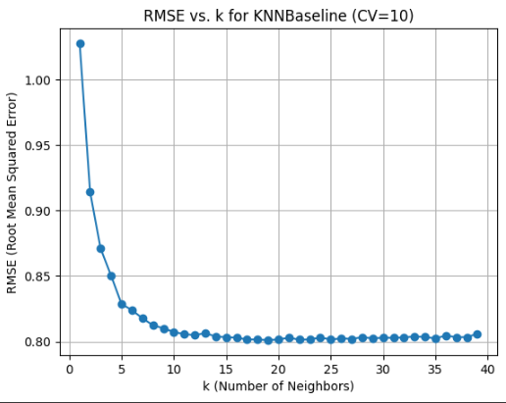

Slide 18
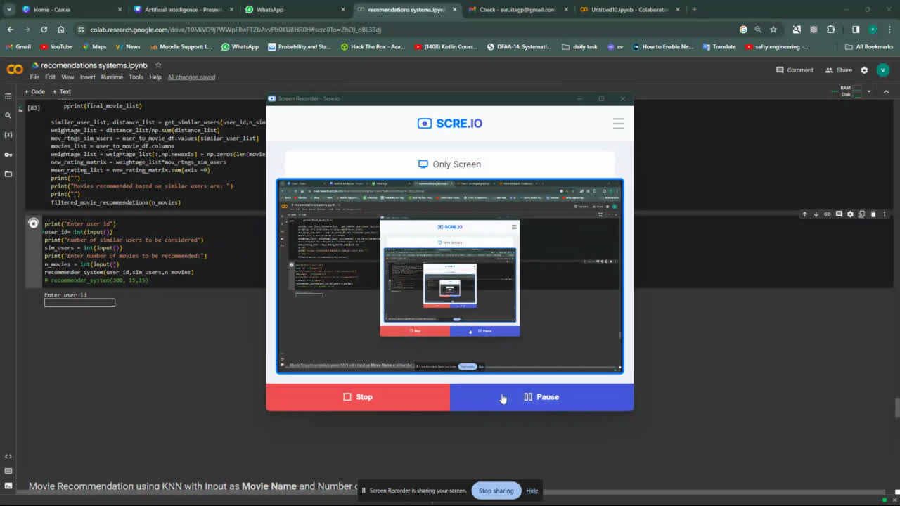

Slide 19
THANK YOU

