Slide 1
Self-taught Learning: Transfer Learning from Unlabeled Data
Rathna Sindura Chikkam
Swetha Vijaya raghavan

Slide 2
agenda
SYNOPSIS
TYPES OF LEARNING
PROBLEM FORMALISM
A SELF-TAUGHT LEARNING ALGORITHM
WHY SPARSE CODING OVER PCA
EXPERIMENT RESULTS
LEARNING A KERNEL VIA SPARSE CODING

Slide 3
SYNOPSIS
New machine learning frame- work called “self-taught learning” for using unlabeled data in supervised classification tasks.
NO Assumption that the unlabeled data follows the same class labels or generative distribution as the labeled data.
Used Large number of unlabeled images (or audio samples, or text documents) randomly downloaded from the Internet to improve performance on a given image (or audio, or text) classification task.
Supervised learning task of interest, Motivated by the observation that even many randomly downloaded images will contain basic visual patterns (such as edges) used to recognize such patterns from the unlabeled data.
Methodologies:
Self-taught learning that uses sparse coding to construct higher-level features using the unlabeled data.
Using an SVM for classification with Fisher kernel can be learned for this representation.
Notes:
Labeled data for machine learning is often very diffi- cult and expensive to obtain, and thus the ability to use unlabeled data holds significant promise in terms of vastly expanding the applicability of learning meth- ods.
We describe an approach to self-taught learning that uses sparse coding to construct higher-level fea- tures using the unlabeled data. These features form a succinct input representation and significantly improve classification performance.

Slide 4
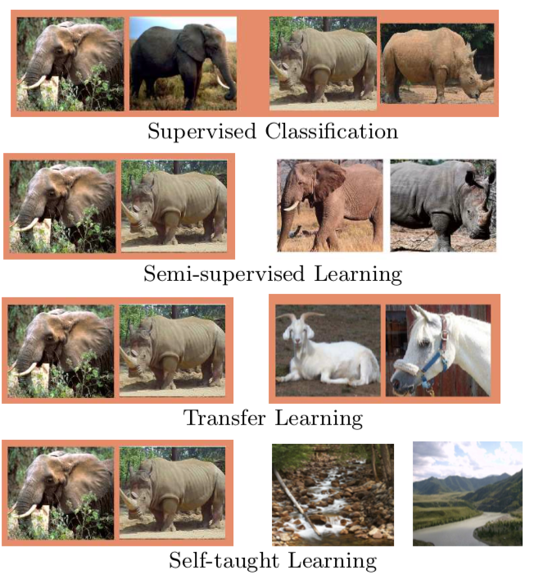
TYPES OF LEARNING
orange background are labeled; others are unlabeled.
Supervised classification uses labeled examples of elephants and rhinos;
Semi-supervised learning uses additional unlabeled examples of elephants and rhinos;
Transfer learning uses additional labeled datasets;
Self-taught learning just requires additional unlabeled images, such as ones randomly down- loaded from the Internet.

Slide 5
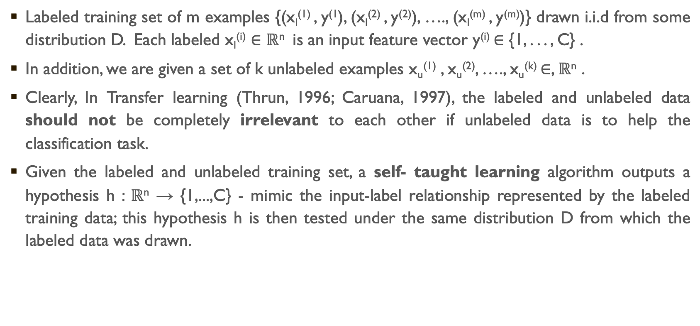
Problem formalism
Labeled training set of m examples {(x_{l}⁽¹⁾ , y⁽¹), (x_{l}⁽²⁾ , y⁽²⁾), …., (x_{l}^{(m)} , y^{(m)})} drawn i.i.d from some distribution D. Each labeled x_{l}^{(i)} $∈$ $ℝ$^{n} is an input feature vector y^{(i)} ∈ {1, . . . , C} .
In addition, we are given a set of k unlabeled examples x_{u}⁽¹⁾ , x_{u}⁽²⁾, …., x_{u}^{(k)} ∈, $ℝ$^{n} .
Clearly, In Transfer learning (Thrun, 1996; Caruana, 1997), the labeled and unlabeled data should not be completely irrelevant to each other if unlabeled data is to help the classification task.
Given the labeled and unlabeled training set, a self- taught learning algorithm outputs a hypothesis h : $ℝ$^{n} → {1,...,C} - mimic the input-label relationship represented by the labeled training data; this hypothesis h is then tested under the same distribution D from which the labeled data was drawn.
Notes:
In self taught learning we are given a labeled training set
Independent and identically distributed random variables: if each random variable has the same probability distribution as the others and all are mutually independent.
Crucially, we do not assume (j)
that the unlabeled data xu was drawn from the same distribution as, nor that it can be associated with the same class labels as, the labeled data.
For example, we would typically expect that x_{l}^{(i)} and x_{u}^{(j)} come from the same input “type” or “modality,” such as images, audio, text, etc.

Slide 6
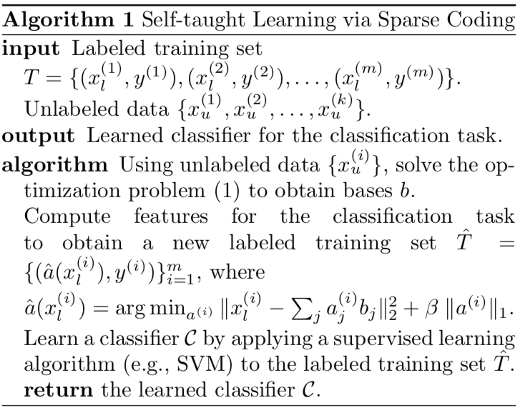
A SELF-TAUGHT LEARNING ALGORITHM
Obtain a higher level representation of the labeled data.
An easier supervised learning task. for most of its elements to be zero.
The optimization objective function balances two terms:
(i) The first quadratic term encourages each input x_{u}^{(i)} to be reconstructed as a weighted linear combination of the bases b_{j} (with corresponding weights given by the activations a_{j}^{(i)}); and
(ii) It encourages the activations to have low L₁ norm. The latter term therefore encourages the activations a to be sparse—in other words, for most of its elements to be zero.
Notes:
For example, if the inputs x_{u}^{i} (and x_{l}^{j} ) are vectors of pixel intensity values that represent images, our algorithm will use x_{u} to learn the “basic elements” that comprise an image. For example, it may discover (through examining
the statistics of the unlabeled images) certain strong correlations between rows of pixels, and therefore learn that most images have many edges.
Through this, it then learns to represent images in terms of the edges that appear in it, rather than in terms of the raw pixel intensity values. This representation of an image in terms of the edges that appear in it—rather than the
raw pixel intensity values—is a higher level, or more abstract, representation of the input.

Slide 7
WHY SPARSE CODING OVER PCA
PCA has two limitations.
PCA results in linear feature extraction, in that the features a_{j}^{(i)} are simply a linear function of the input..
since PCA assumes the bases b_{j} to be orthogonal, the number of PCA features cannot be greater than the dimension n of the input.
Sparse coding does not have either of these limitations. Its features aˆ(x) are an inherently nonlinear function of the input x, due to the presence of the L1 term in objective function.
Sparse coding can use more basis vectors/features than the input dimension n.
Notes:
When compared with sparse coding as a method for constructing self-taught learning features, PCA has two limitations.
The covariance matrix is symmetric and eigenvectors of (real) symmetric matrices are orthogonal
By learning a large number of basis vectors but using only a small number of them for any particular input, sparse coding gives a higher-level representation in terms of the many possible “basic patterns,” such as edges, that may appear in an input

Slide 8
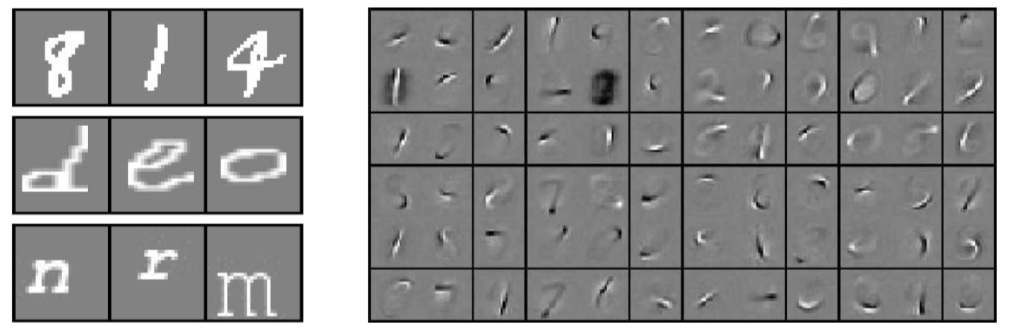
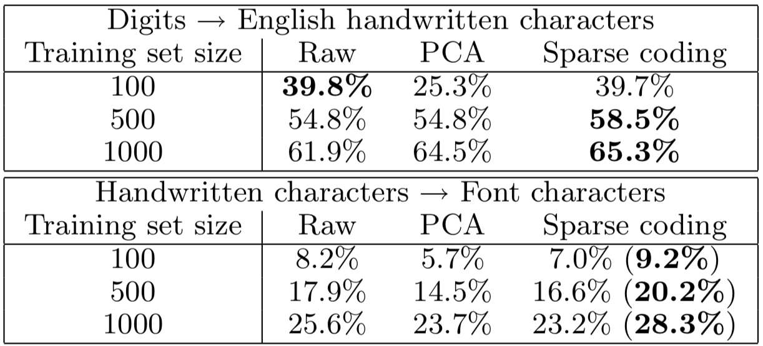
EXPERIMENT RESULTS
Here, sparse coding features alone do not perform as well as the raw features, but perform significantly better when used in combination with the raw features.
Notes:
Example images from the handwritten digit dataset (top), the handwritten character dataset (middle) and the font character dataset (bottom). Right: Example sparse coding bases learned on handwritten digits.
Classification accuracy on 26-way handwrit- ten English character classification, using bases trained on handwritten digits. Bottom: Classification accuracy on 26-way English font character classification, using bases trained on English handwritten characters.

Slide 9
LEARNING A KERNEL VIA SPARSE CODING
A fundamental problem in supervised classification is defining a “similarity” function between two input examples.
Sparse coding model also suggests a specific specialized similarity function (kernel) for the learned representations. The sparse coding model can be viewed as learning the parameter b of the linear generative model, that posits Gaussian noise on the observations x and a Laplacian (L1) prior over the activations.
Once the bases b have been learned using unlabeled data, we obtain a complete generative model for the input x.
Thus, we can compute the Fisher kernel to measure the similarity between new inputs. (Jaakkola & Haussler, 1998)
In detail, given an input x, we first compute the corresponding features aˆ(x) by efficiently solving optimization problem. Then, the Fisher kernel implicitly maps the input x to the high- dimensional feature vector Ux = ∇b log P (x, aˆ(x)|b), where we have used the MAP approximation aˆ(x) for the random variable a.
Importantly, for the sparse coding generative model, the corresponding kernel has a particularly intuitive form, and for inputs x(s) and x(t) can be computed efficiently as:
Summary: Using the Fisher kernel derived from the generative model described, obtain a classifier customized specifically to the distribution of sparse coding features.
Notes:
In the experiments described above, we used the regular notions of similarity (i.e., standard SVM kernels) to allow a fair comparison with the baseline algorithms.
In Bayesian statistics, a maximum a posteriori probability (MAP) estimate is an estimate of an unknown quantity, that equals the mode of the posterior distribution. The MAP can be used to obtain a point estimate of an unobserved quantity on the basis of empirical data. It is closely related to the method of maximum likelihood (ML) estimation, but employs an augmented optimization objective which incorporates a prior distribution (that quantifies the additional information available through prior knowledge of a related event) over the quantity one wants to estimate. MAP estimation can therefore be seen as a regularization of ML estimation.

Slide 10

Reference : Self-taught Learning: Transfer Learning from Unlabeled Data
Computer Science Department, Stanford University, CA 94305 USA

