Slide 1
Node Js
Swetha Vijaya Raghavan
1001551229

Slide 2
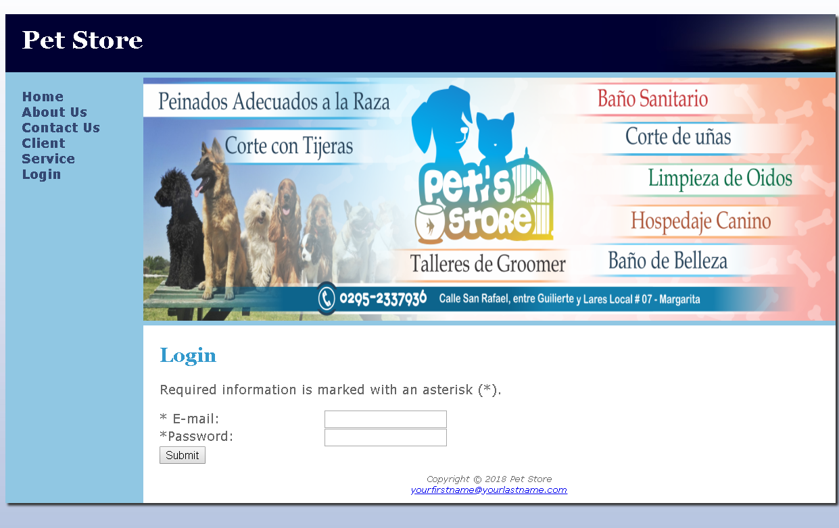
Login Page

Slide 3
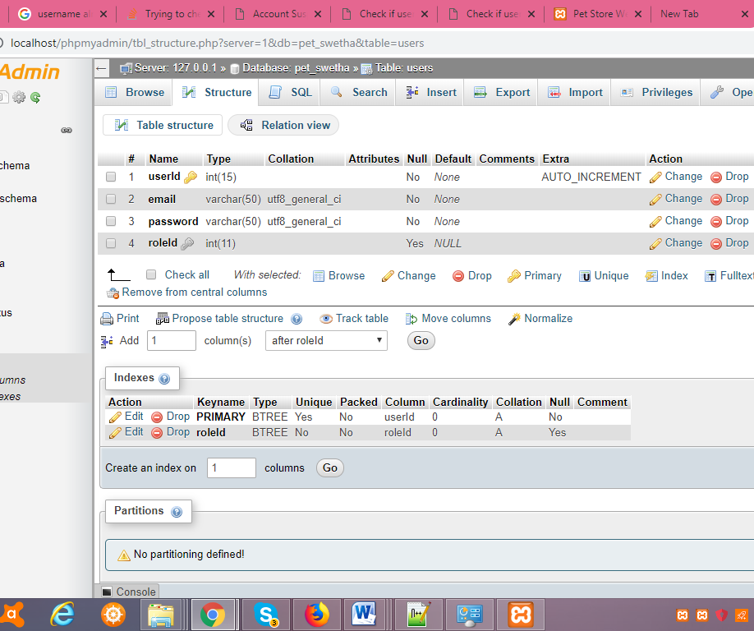
Users Table

Slide 4
Objective
For the Login.html, we can authenticate the email id and store the password for the client or service in a secure manner.
All passwords must be secure – We can use hashing the password and generating a JSON Web token through which the user is authenticated the next time he logs in.

Slide 5
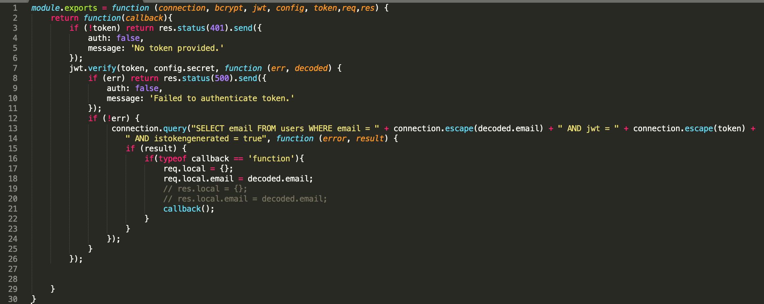

Slide 6
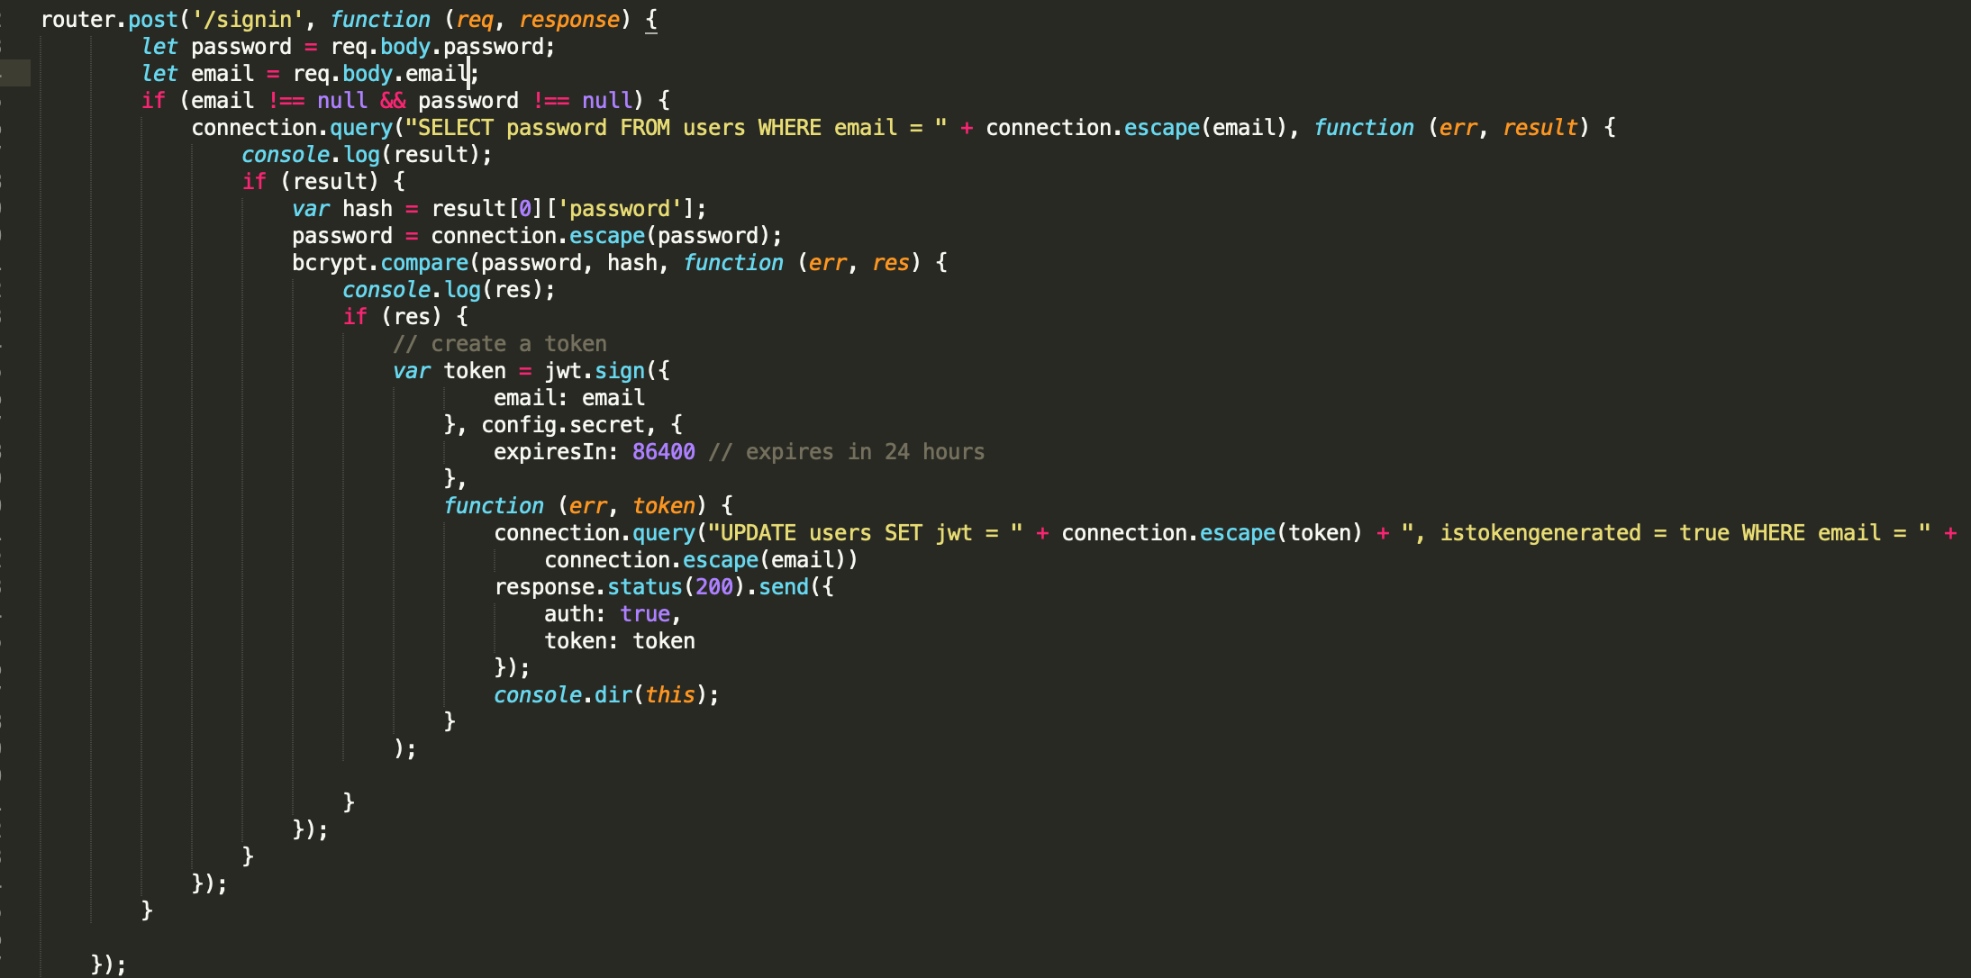

Slide 7
Why Node Js?
Lightweight.
Single Page Application.
Express-sanitizer or DOMpurify or any other modules that promises you to prevent xss attacks .

Slide 8
Thank you ☺

