Slide 1


Smt. Kamala & Sri. Venkappa M. Agadi College
of Engineering & Technology, Laxmeshwar-582116
(Approved by AICTE, New Delhi & Affiliated to VTU, Belagavi Karnataka, ISO:9001-2015)
DEPARTMENT OF COMPUTER SCIENCE AND ENGINEERING
“Chatura Suraksha Kavacha”
-The Smart Safety Helmet For Mine Workers
Under the Guidance :
Mr. Nagaraj Telkar
Project Coordinator :
Mr. Arun Kumar Joshi
Team Associates :
Ms. Bhuvaneshwari B S 2KA19CS010
Mr. Jagadish K Arali 2KA19CS018
Mr. Ravindragouda B 2KA19CS043
Mr. Shantaveeresh V S 2KA19CS048

Slide 2
CONTENTS
01
04
07
Abstract
Problem Statement
Requirements
02
05
08
Introduction
Objectives
Experimental Results
03
06
09
Literature Survey
Proposed Methodology
Conclusion

Slide 3
ABSTRACT
The underground mines all over the world are adversely affected by various hazards including gaseous explosions, landslides, fire hazards, etc. This leads to the significance of safety for the mine workers. The proposed work talks about safety helmet which is used to avoid the accidents which will cause in the work space with a low-cost sensor. The smart helmet has been produced to assist miners operating in the mining industry. Many risky incidents commonly occur in the mining sector, many of which result in life-threatening injuries or death. A miner's helmet is one of the most regularly used safety equipment for mine workers hence it must be loaded with some more advanced features. With the use of different sensors, the smart helmet will be able to identify catastrophic situations such as hazardous gases like Carbon-Monoxide, CH4, LPG, and natural gases. Whether the miner is wearing his helmet or not is detected by an infrared sensor. Each sensor has a critical value that, if exceeded, causes the buzzer to activate and the LEDs to illuminate, signaling the miners and supervisors. Using ESP32 Cam to monitor the mine worker continuously. Furthermore, a Emergency Button has been implemented, which, when pressed, sends an emergency signal via Blynk app to higher authorities outside the mines. A mobile application has also been created to display all of the data supplied wirelessly from the sensors. As a result, the proposed smart helmet protects miners from any upcoming accidents.
Keywords— Internet of things, Blynk, ESP-8266, ESP32 CAM module, DHT11, MQ6, helmet.

Slide 4
INTRODUCTION
In the 21st century, the mining industry has become one of the most dominant sectors of the economy because of the increasing need for metals and other geological materials.
In our project, Multiple sensors are mounted on the smart helmet that will help to detect any change in environmental parameters and is also capable to monitor the mine workers location continuously using ESP32 Cam.
The presence of helmet on the workers head is identified by the IR sensor mounted on the helmet and is notified to the supervisor through the Blynk app.
In the proposed safety helmet, there are three salient features. First is detecting the presence of hazardous gases , the second is helmet removal by the miners, and the third one is the emergency button pressed in any adverse situation and the fourth one is to continuously monitor the worker’s location using ESP-32 cam.
Since the cost of fitting and maintaining the cabling is high, We are using wireless communication system.

Slide 5
LITERATURE SURVEY
SL.No | Method/Tool | Author names | Year of Publication | Advantages | Disadvantages
1
Mining Worker Safety Helmet Using Iot
(RF Technology) [1]
Ms. Rakshitha.N and Ms. Vaishnavi.R
June-2022
One of the main advantages of this system is that it does not need any line-of-sight communication
Materials like metal & liquid can impact signal which may lead to miscommunication.
Smart Helmet-Based Personnel Proximity Warning System for
Improving Underground Mine Safety
(Bluetooth Technology)[2]
May-2021
Bluetooth technology is used in this method which is a common low-power, low-cost wireless technology.
The main difficulty of this system is that the Bluetooth is short distance wireless technology
2
Yeanjae Kim and Jieun Baek
Arduino Based Smart Helmet for Coal Mine Safety
(Arduino Technology) [3]
Suraj C. Godse and Pradeep C. Sawant
2020
This system addresses a cost-effective, high accuracy, smooth control and reliability.
This system does not store the data which can be used in future for research.
3
An Intelligent Helmet for Miners with Air Quality and Destructive Event Detection using Zigbee
(Zigbee Technology)[4]
Dr.B. Paulchamy and Dr.C. Natarajan
April-2018
This system uses a Zigbee technology and addresses a wireless and cost-effective system
Zigbee is a short distance wireless communication network.
4

Slide 6
PROBLEM STATEMENT
According to The World Counts reports More people are killed or injured in the mining industry and More than 15,000 miners are killed every year. How can we help the mine workers to operate in mining industry safely ?
“ Chatura Suraksha Kavacha ” -The Smart Safety Helmet For Mine Workers

Slide 7



OBJECTIVES
1
2
3
4
To detect the presence of Hazardous gases like Methane(CH4),Carbon-Monoxide,LPG, and other natural gases.
To detect The existence of the helmet on the worker’s head .
Emergency button is provided which need to be pressed in any adverse situation.
To monitor the mine worker’s location continuously using ESP32 Cam.

Slide 8
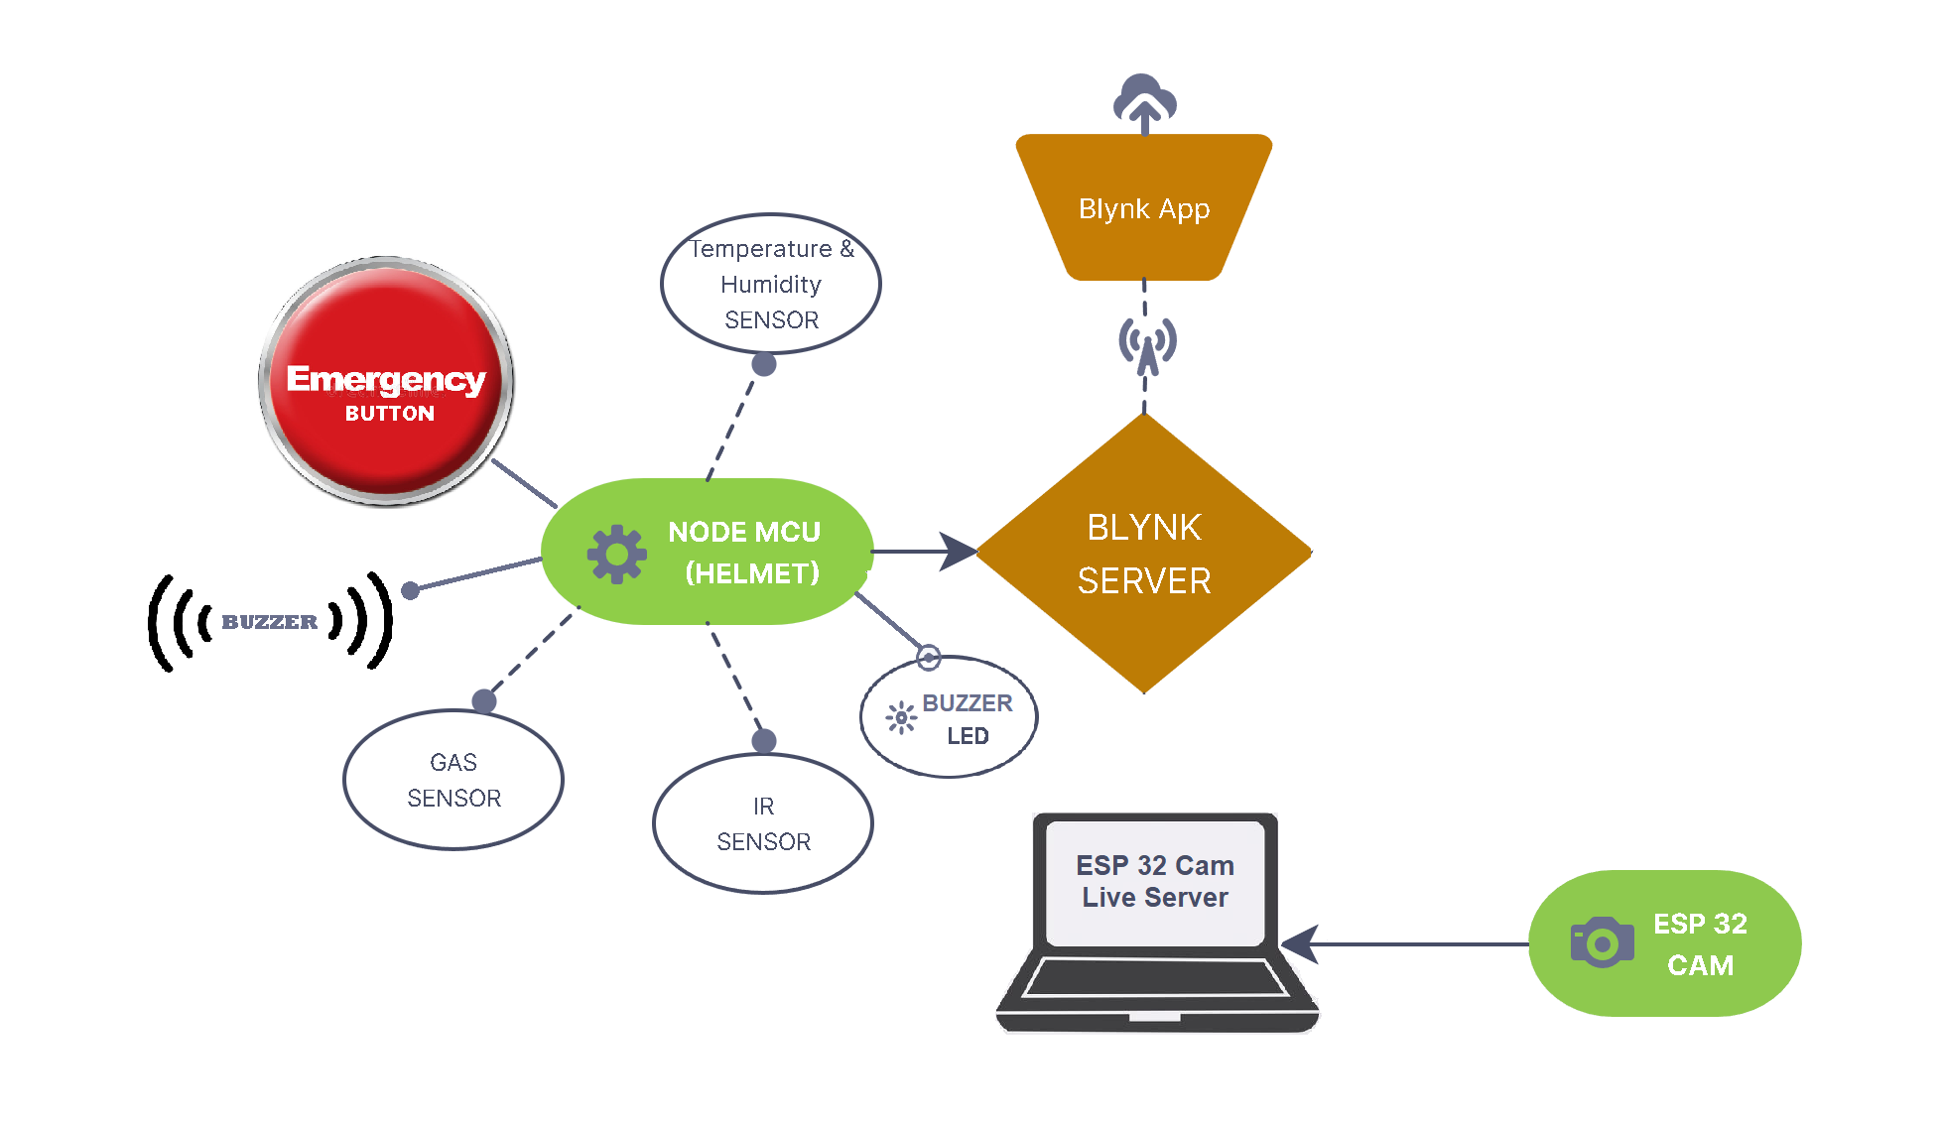
PROPOSED METHODOLOGY

Slide 9
In the proposed work we are going to implement :
The temperature sensor(DHT-11) to sense the temperature of the surroundings and Humidity sensor to check the humidity.
Gas sensor(MQ-6) is used to check whether any hazardous gas came out during coal mining.
An ESP32 camera module is also installed which will send a live video stream to the Blynk server.
IR sensor to detect whether the worker is wearing the helmet or not.
An Emergency button is provided in case of any emergency.
When the information is gathered they are monitored by using node MCU, IOT(BLYNK server) etc.

Slide 10
REQUIREMENTS
Hardware Requirements :
Micro controller (ESP8266 (Node-MCU))
DHT-11 Sensor
MQ-6 Gas sensor
IR Sensor
ESP32 Cam
Software Requirements :
BLYNK IOT Cloud for mobile app

Slide 11
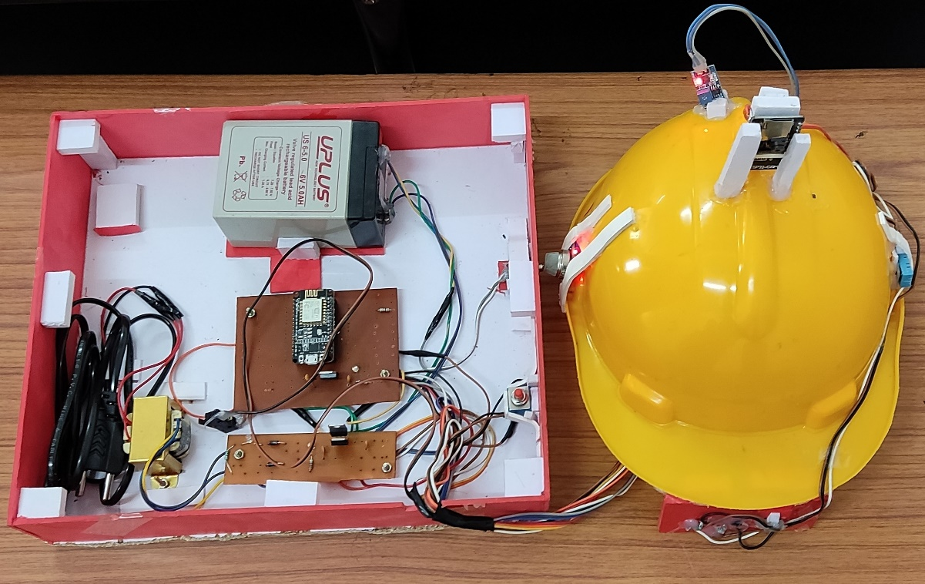
EXPERIMENTAL RESULTS
In this project, the smart safety helmet for mine workers, there are four main objectives. First objective is to detect the presence of Hazardous gases like Carbon-Monoxide, Methane, LPG, and other natural gases, the second objective is about helmet removal by the miners, the third objective is the emergency button pressed in any adverse situation and the last objective is to monitor the miners continuously using esp32 cam.

Slide 12
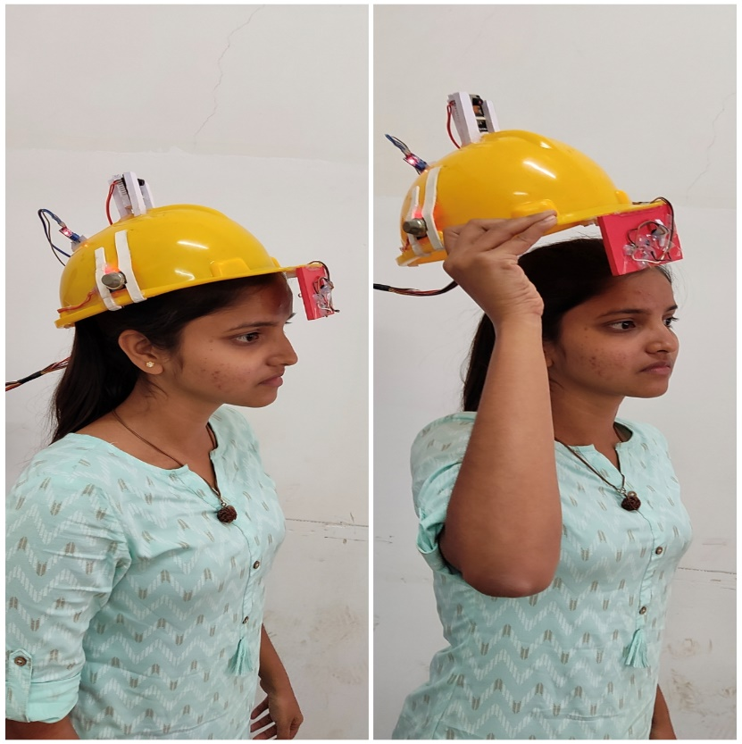
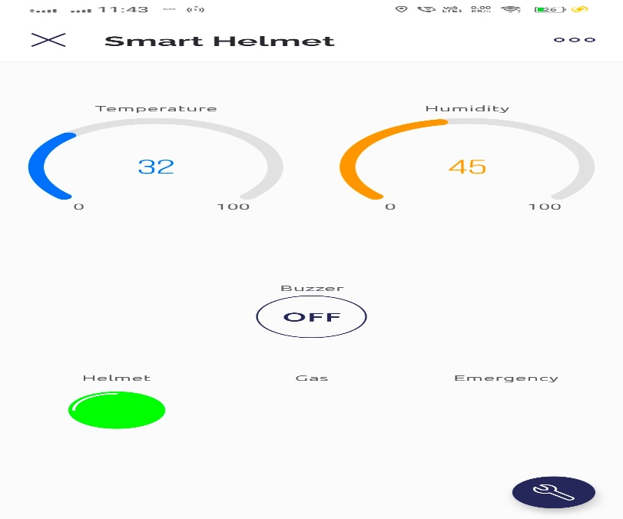
Alert About Helmet Removal in Blynk App

Slide 13
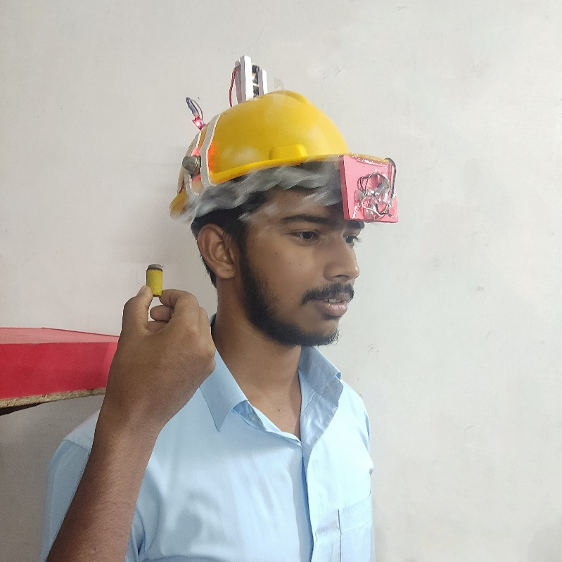
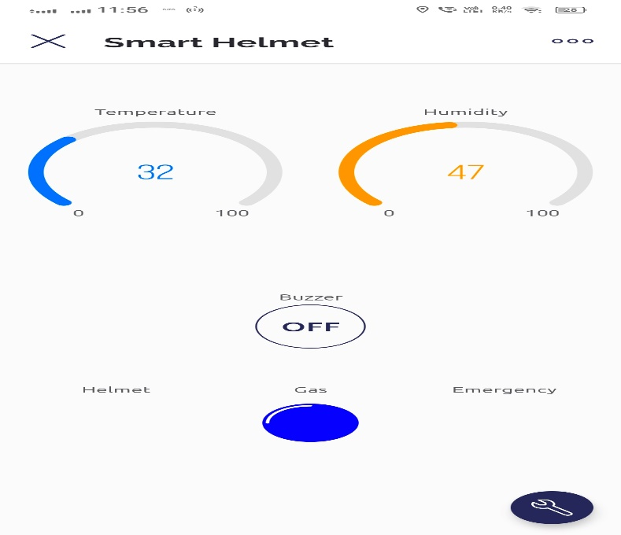
Gas Alert in Blynk App

Slide 14
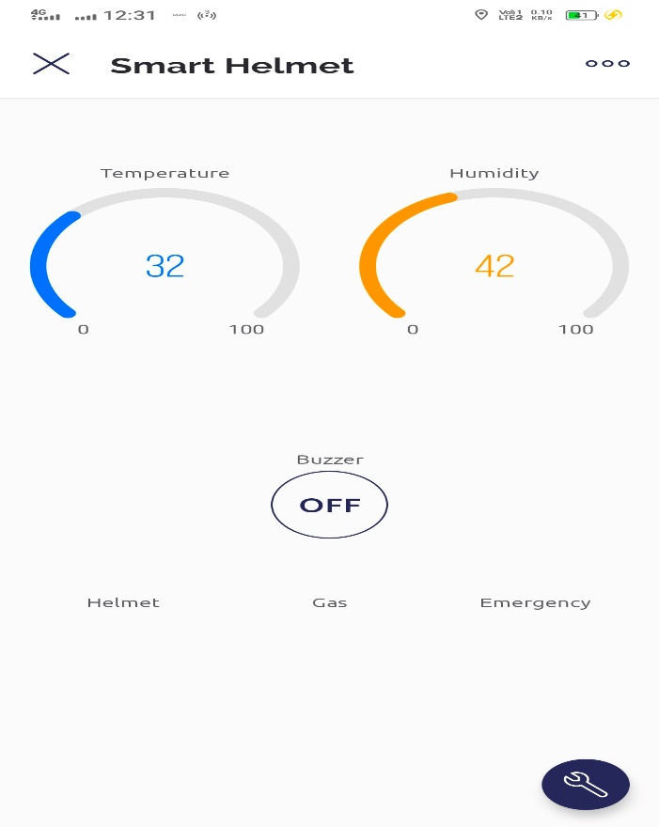
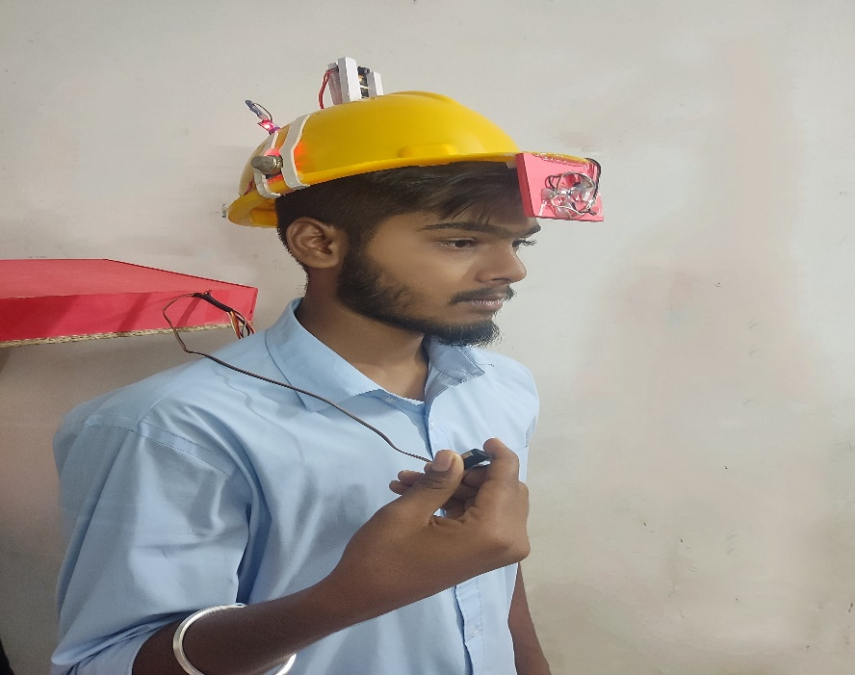
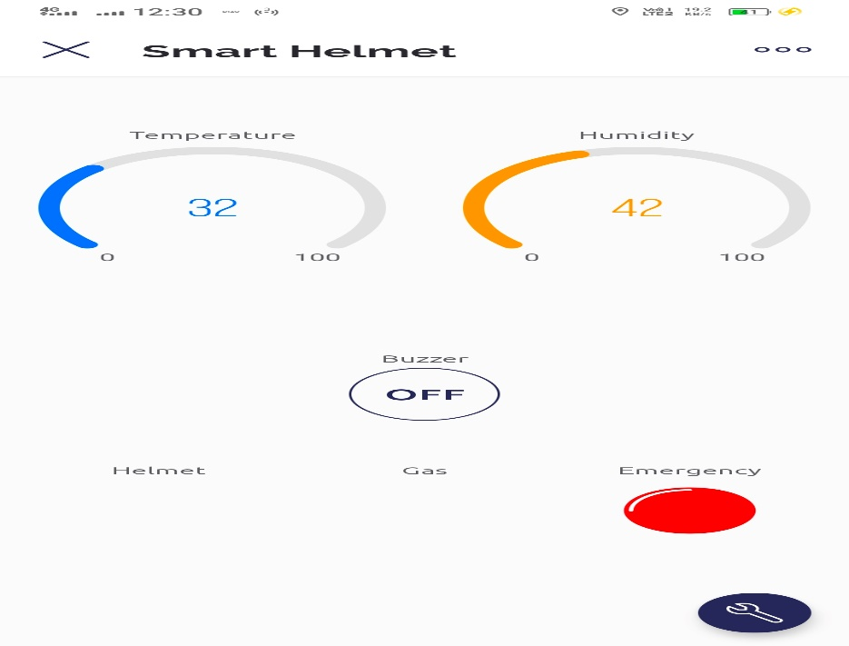
Emergency Signal in Blynk App
Temperature and Humidity Readings in Blynk app

Slide 15
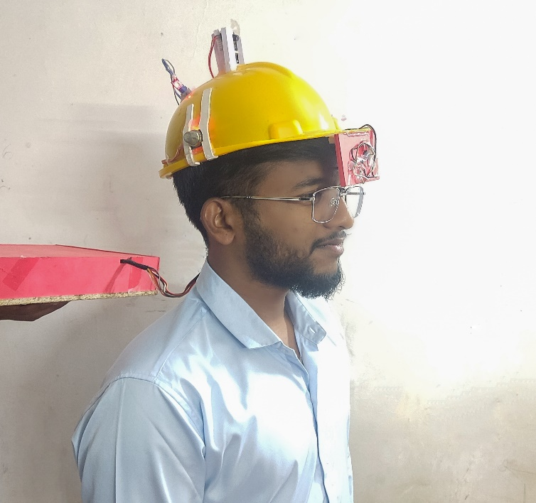
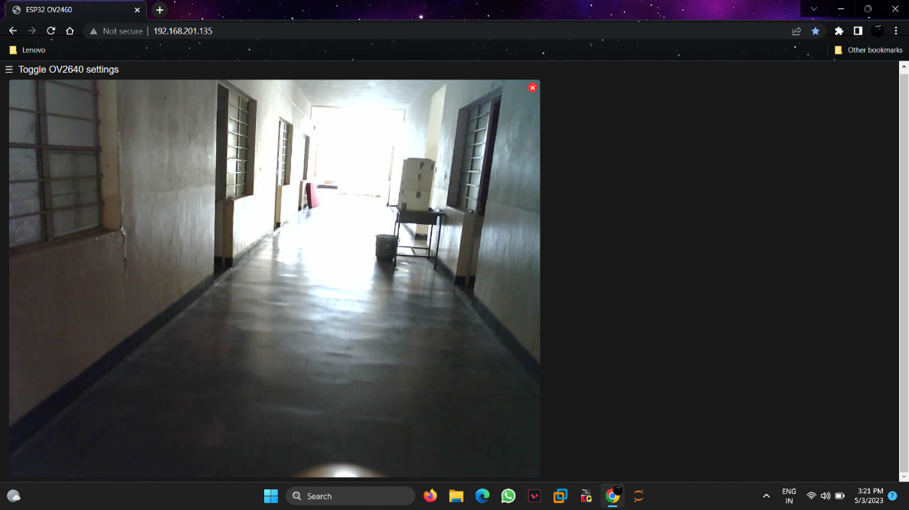
ESP-32 Cam Live Server :
Live Video Streaming of Mine Worker

Slide 16
CONCLUSION
The mining industry all over the world is adversely affected by various hazards including gaseous explosions, landslides, fire hazards, etc. Many risky incidents commonly occur in the mining sector, many of which result in life-threatening injuries or death.
This leads to the significance of safety for the mine workers. A miner's helmet is one of the most regularly used safety equipment for mine workers hence it must be loaded with some more advanced features
A Wi-Fi based smart helmet has been designed for coal miners which is capable of detecting threatening events like the increase in the level of harmful gases inside the mine.
This smart helmet is also capable of sending real time temperature and humidity levels to the servers thereby keeping the concerned authorities always updated about the mine conditions.

Slide 17
CONCLUSION (Continued)
The presence of an emergency button in the smart helmet helps the miners to send signals easily just with a press of a single button that indicates the rescue team that the worker needs to be rescued.
The helmet removal notified feature helps the authorities to get informed if any miner tries to remove the helmet.
We have provided an esp32 camera to monitor the mine worker’s location continuously. This low-cost, reliable and efficient prototype has been designed and tested with software and hardware debugging.
Placement of each module and sensors has also been done carefully thus resulting in the best working of the product.

Slide 18
REFERENCES :
[1] Suraj C. Godse and Pradeep C. Sawant- Arduino Based Smart Helmet for Coal Mine Safety. https://papers.ssrn.com/sol3/papers.cfm?abstract_id=3645335
[2] Yeanjae Kim and Jieun Baek- Smart Helmet-Based Personnel Proximity Warning System for Improving Underground Mine Safety. https://www.mdpi.com/2076-3417/11/10/4342
[3] G Pradeepkumar and S Sanjay Rahul- Retraction: A Smart Helmet for the Mining Industry using LoRaWAN. https://iopscience.iop.org/article/10.1088/1742-6596/1916/1/012089/meta
[4] Dr.B. Paulchamy and Dr.C. Natarajan- An Intelligent Helmet for Miners with Air Quality and Destructive Event Detection using Zigbee. https://grdjournals.com/uploads/article/GRDJE/V03/I05/0055/GRDJEV03I050055.pdf
[5] Ms. Rakshitha.N and Ms. Vaishnavi.R- Mining Worker Safety Helmet Using Iot. https://www.researchgate.net/publication/340261013_Iot_Based_Smart_Helmet_for_Mining_Industry_Application

Slide 19
Thank You

