Slide 1
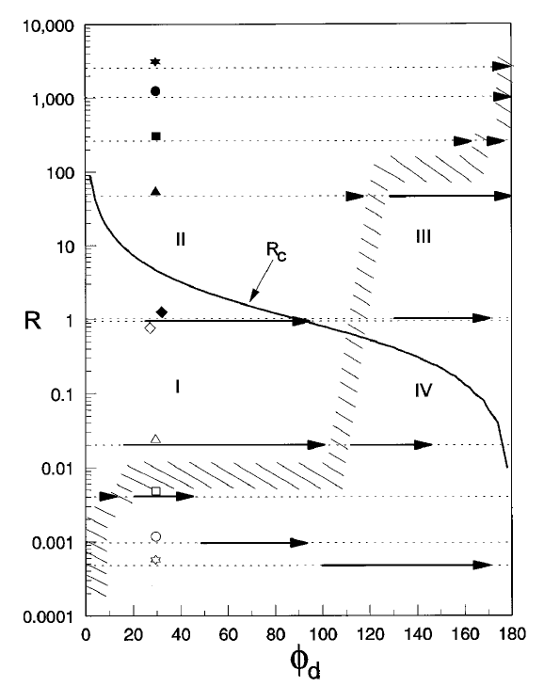
10cst silicone oil/sugar-water mixture experiments
5cst silicone oil/sugar-water mixture experiments
Air- Toluene experiments
Air-water experiments
Air-10cst silicone oil experiments
Air-20cst silicone oil experiments

Slide 2
10cst silicone oil/sugar-water mixture experiments
5cst silicone oil/sugar-water mixture experiments
Air- Toluene experiments
Air-water experiments
Air-10cst silicone oil experiments
Air-20cst silicone oil experiments

Slide 3
Silicone oil experiments data

Slide 4
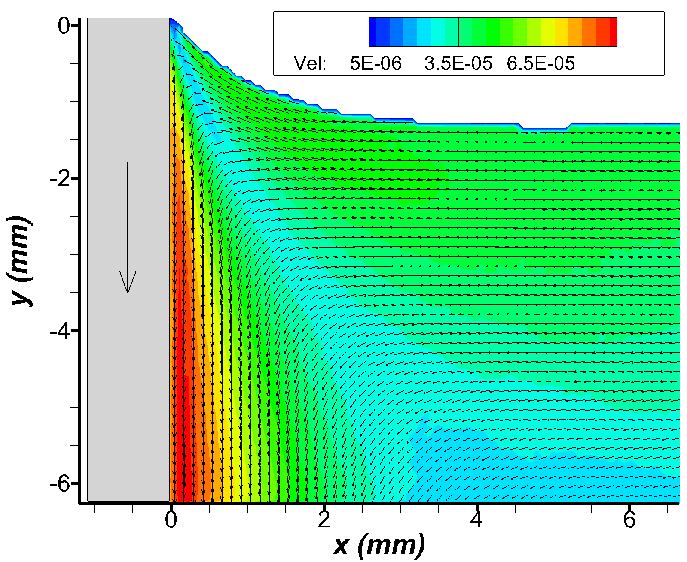
10cst silicone oil
100 microns/sec
Re= 0.016
Ca= 4.19e-5
Oh= 5.1e-2
Lc = 1.51mm
Contact angle ~ 50
Rolling motion
Theory: Rolling motion

Slide 5
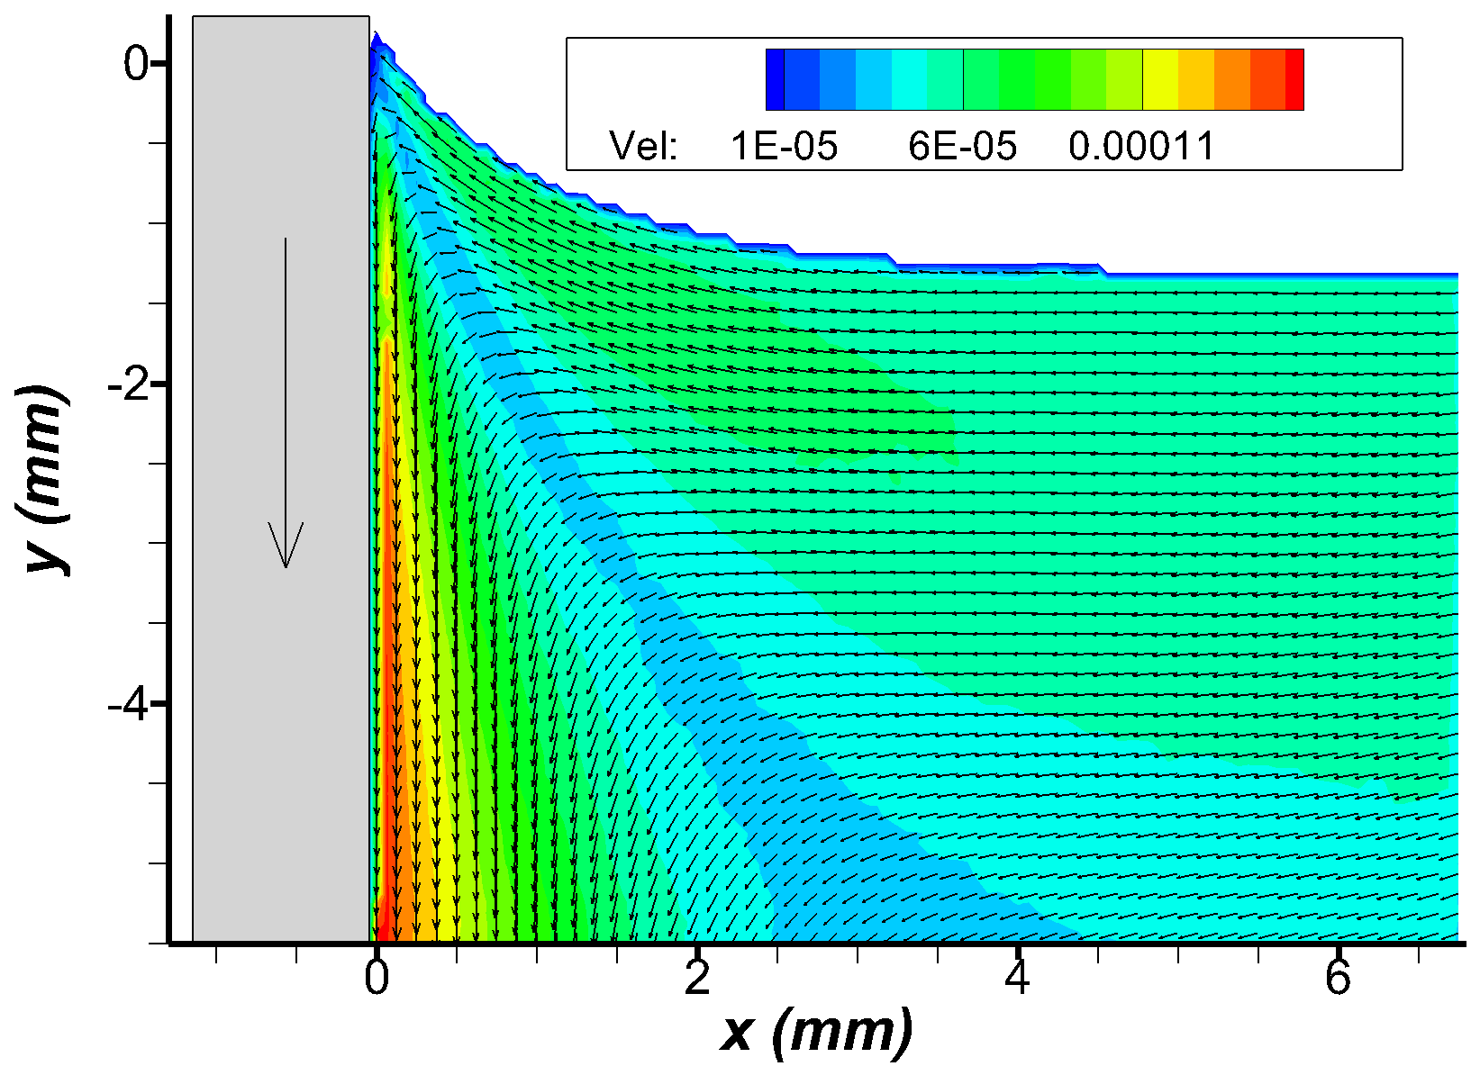
10cst silicone oil
150 microns/sec
Re= 0.024
Ca= 6.28e-5
Oh= 5.1e-2
Lc = 1.51mm
Contact angle ~ 40
Rolling motion
Theory: Rolling motion

Slide 6
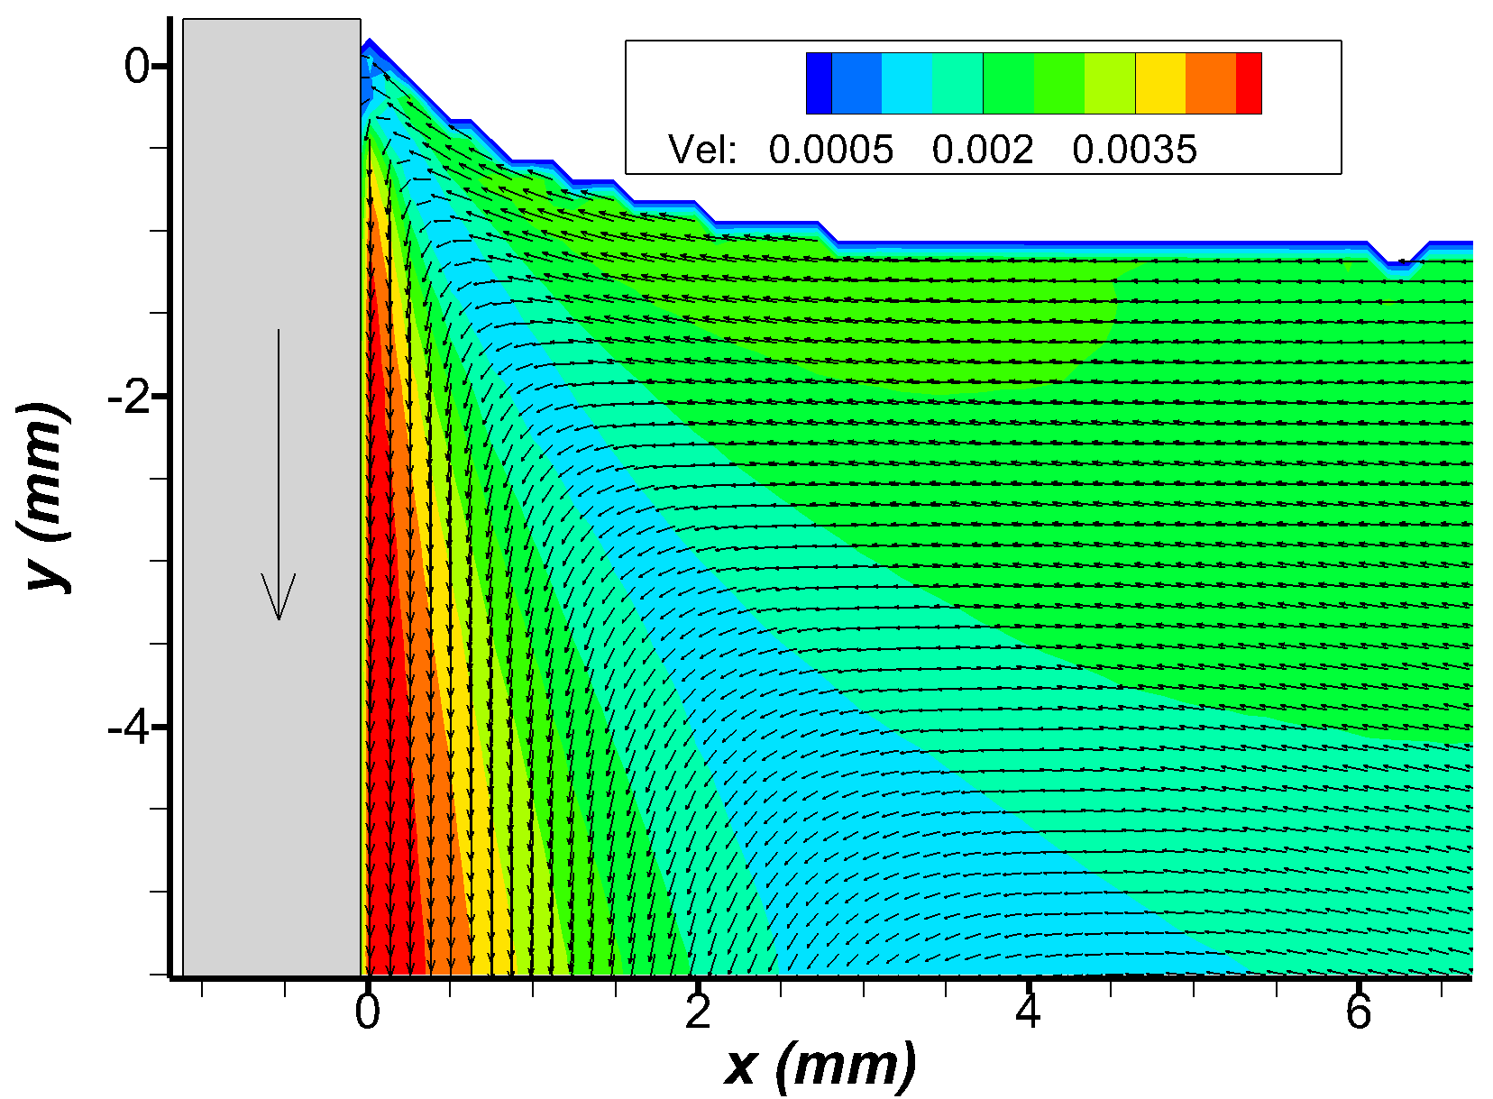
10cst silicone oil
5 mm/sec
Re= 0.8
Ca= 2.1e-3
Oh= 5.1e-2
Lc = 1.51mm
Contact angle ~ 60
Rolling motion
Theory: Rolling motion

Slide 7
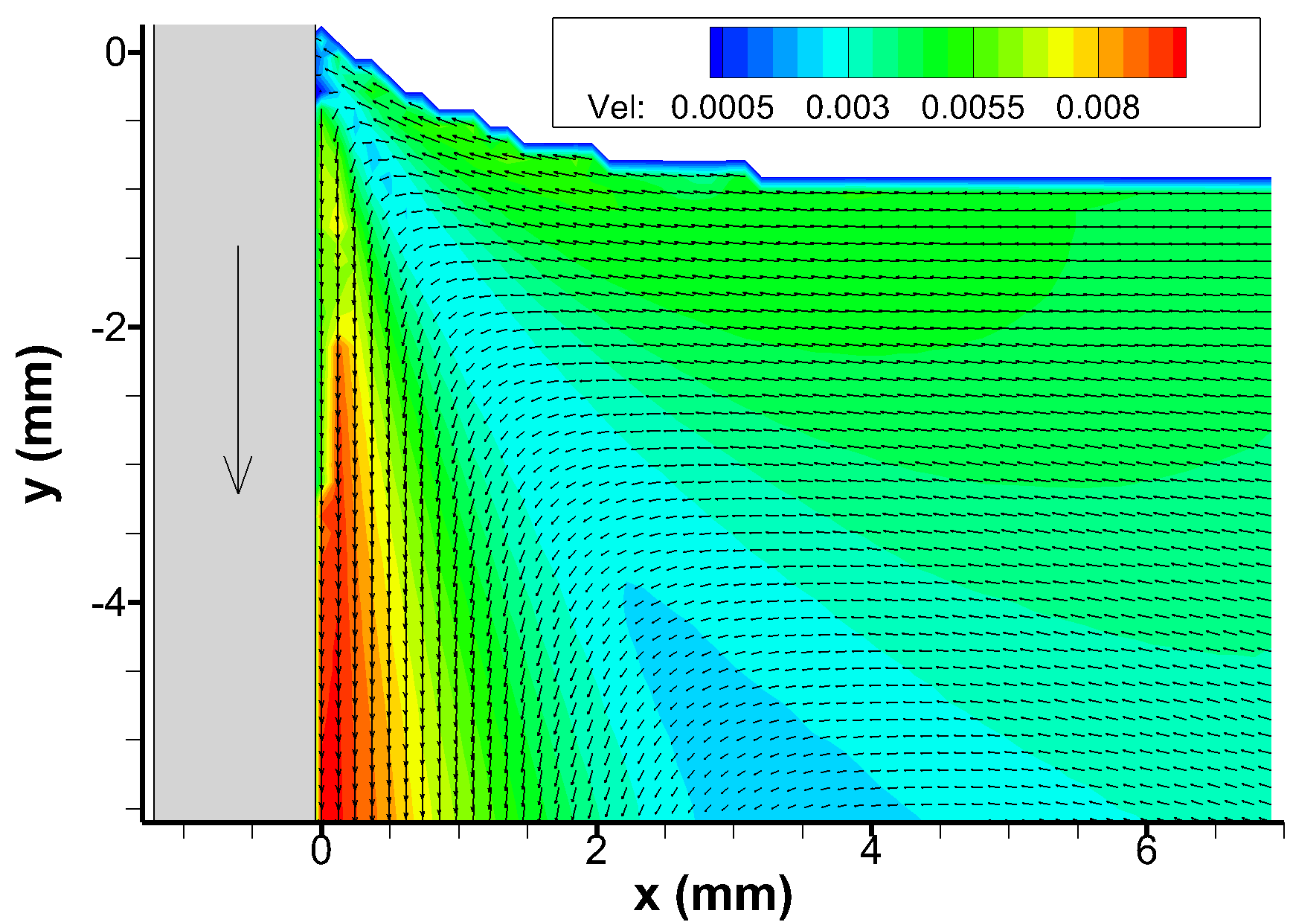
10cst silicone oil
1 cm/sec
Re = 1.61
Ca = 4.19e-3
Oh=5.1e-2
Lc = 1.51mm
Contact angle ~ 65
Rolling motion
Theory: Rolling motion

Slide 8
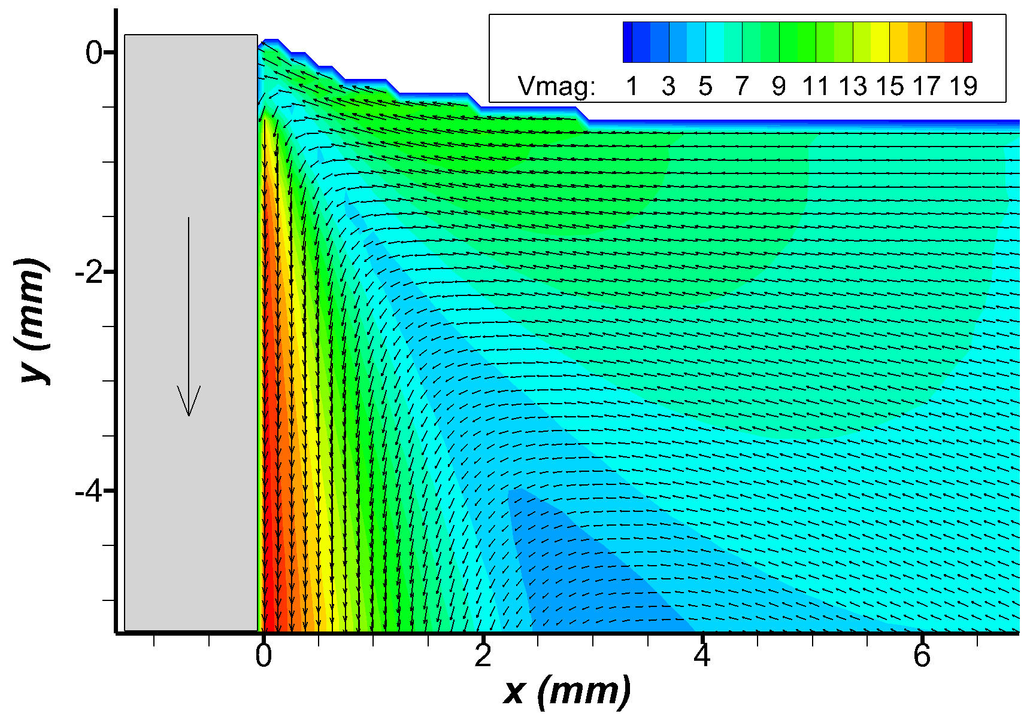
10cst silicone oil
2 cm/sec
Re = 3.23
Ca= 8.38e-3
Oh = 5.1e-2
Lc = 1.51mm
Contact angle ~ 70
Rolling motion
Theory: Rolling motion

Slide 9
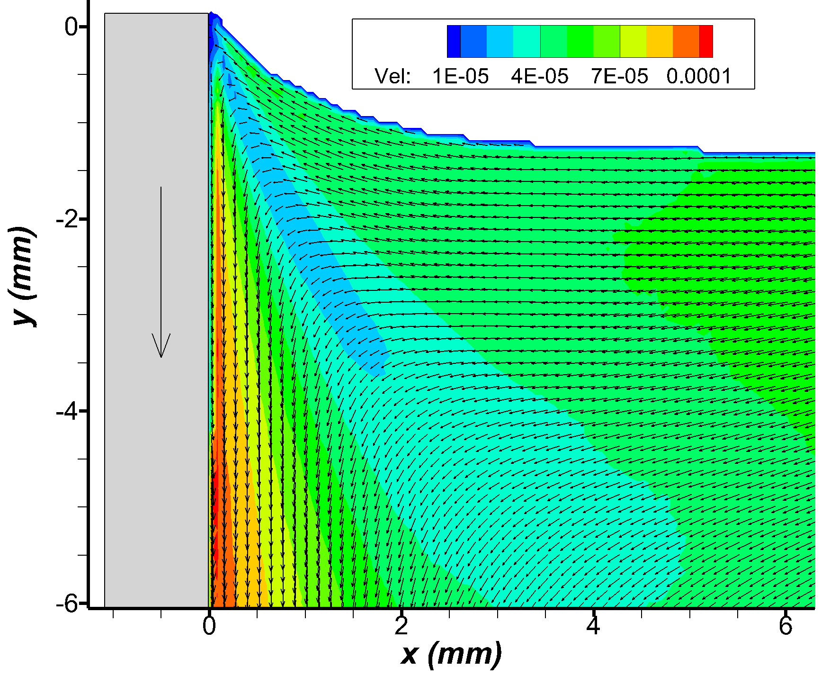
20cst silicone oil
100 microns/sec
Re: 7.5e-3
Ca: 9.04e-5
Oh: 1.09e-1
Lc: 1.50 mm
Contact angle ~ 60
Rolling motion
Theory: Rolling motion

Slide 10
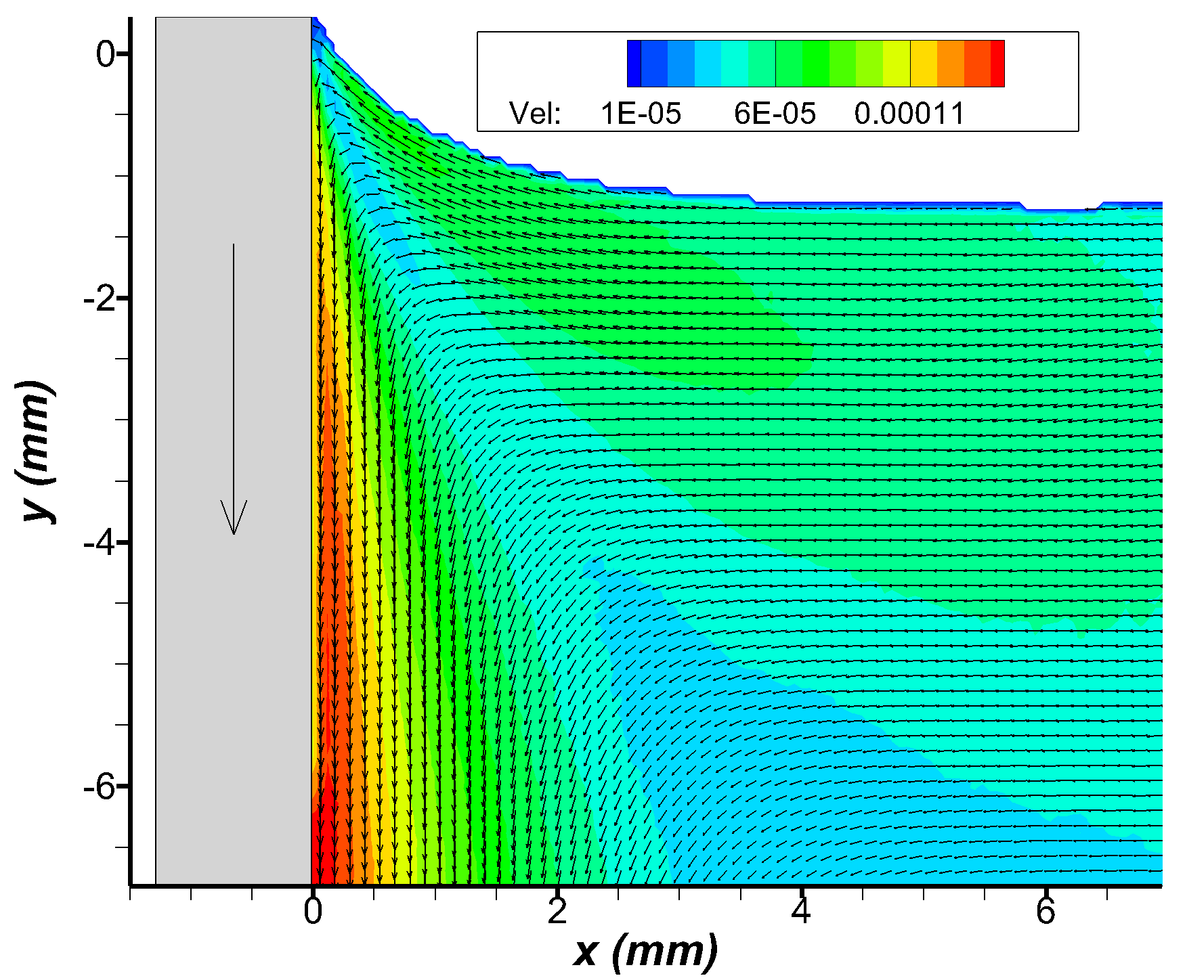
20cst silicone oil
150 microns/sec
Re: 1.12e-2
Ca: 1.35e-4
Oh: 1.09e-1
Lc: 1.50 mm
Contact angle ~ 50
Rolling motion
Theory: Rolling motion

Slide 11
Water experiments data

Slide 12
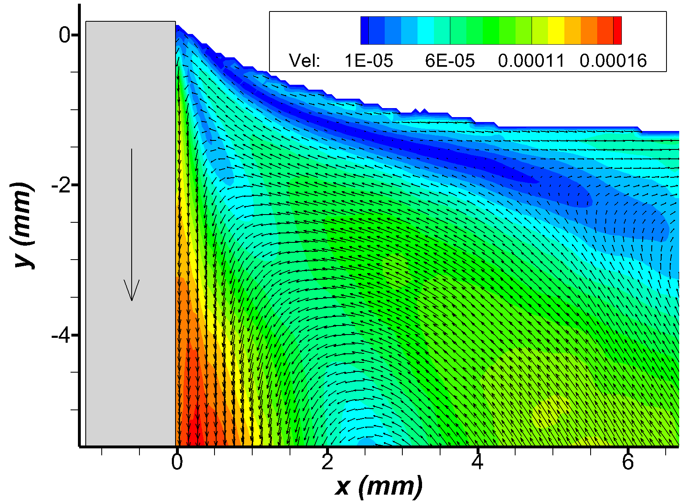
Air-Water experiments
150 microns/sec
Re: 0.45
Ca: 1.85e-6
Oh: 2.02e-3
Lc: 2.71 mm
Contact angle ~ 60
Viscosity ratio: 0.02
Split streamline motion
Theory: Rolling motion

Slide 13
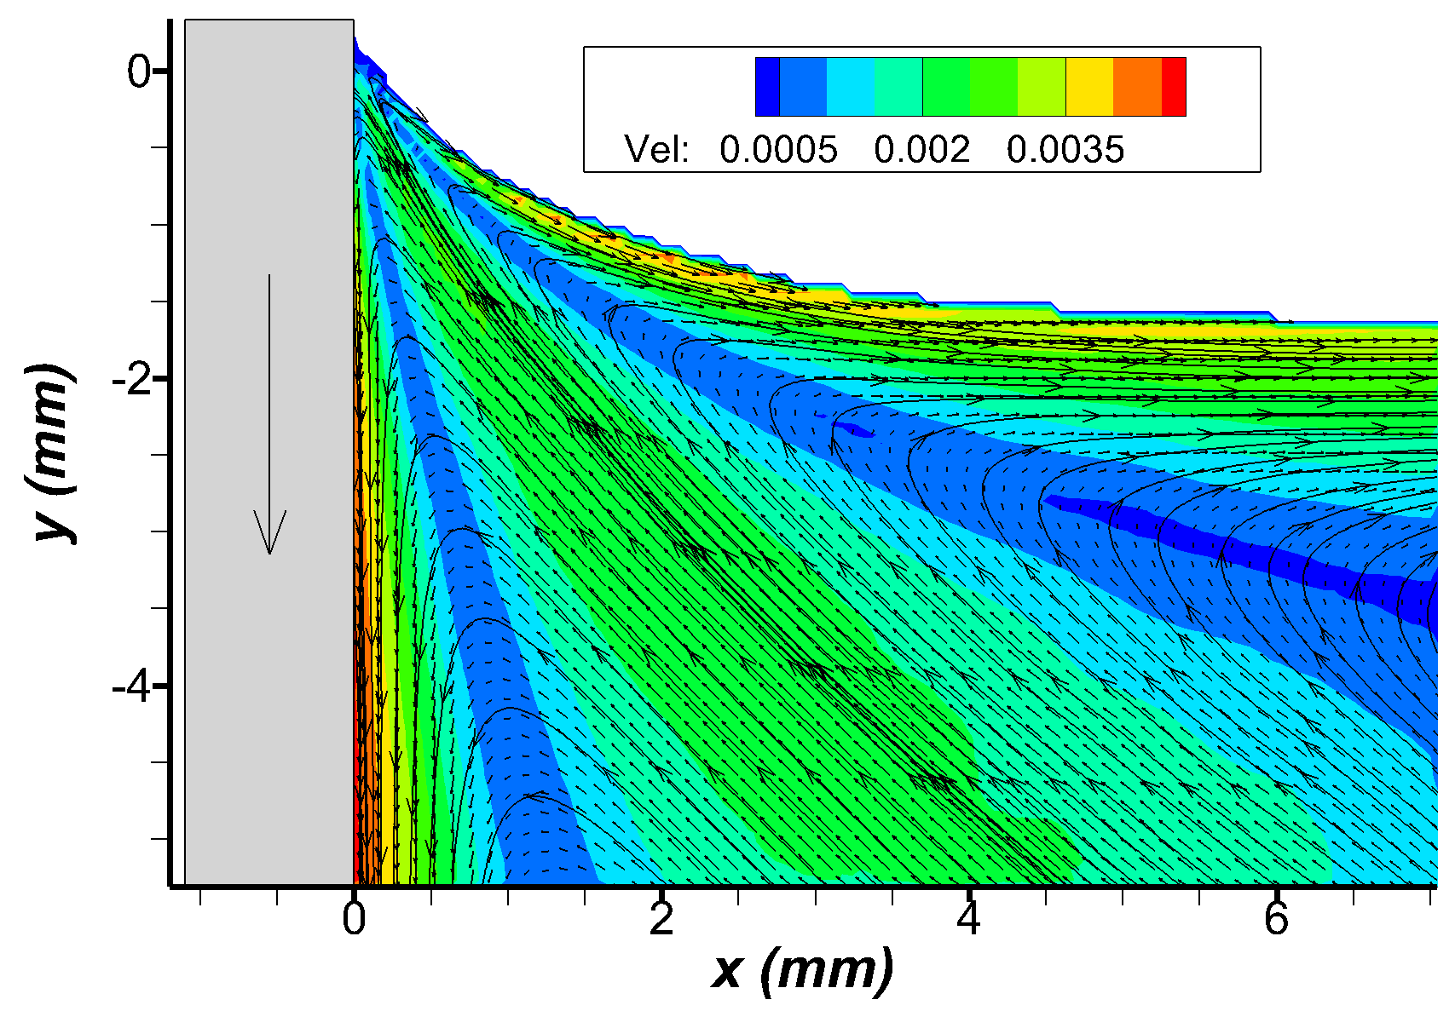
Air-Water experiments
5 mm/sec
Re: 15.16
Ca: 6.18e-5
Oh: 2.02e-3
Lc: 2.71 mm
Contact angle ~ 40
Viscosity ratio: 0.02
Split streamline motion
Theory: Rolling motion

Slide 14
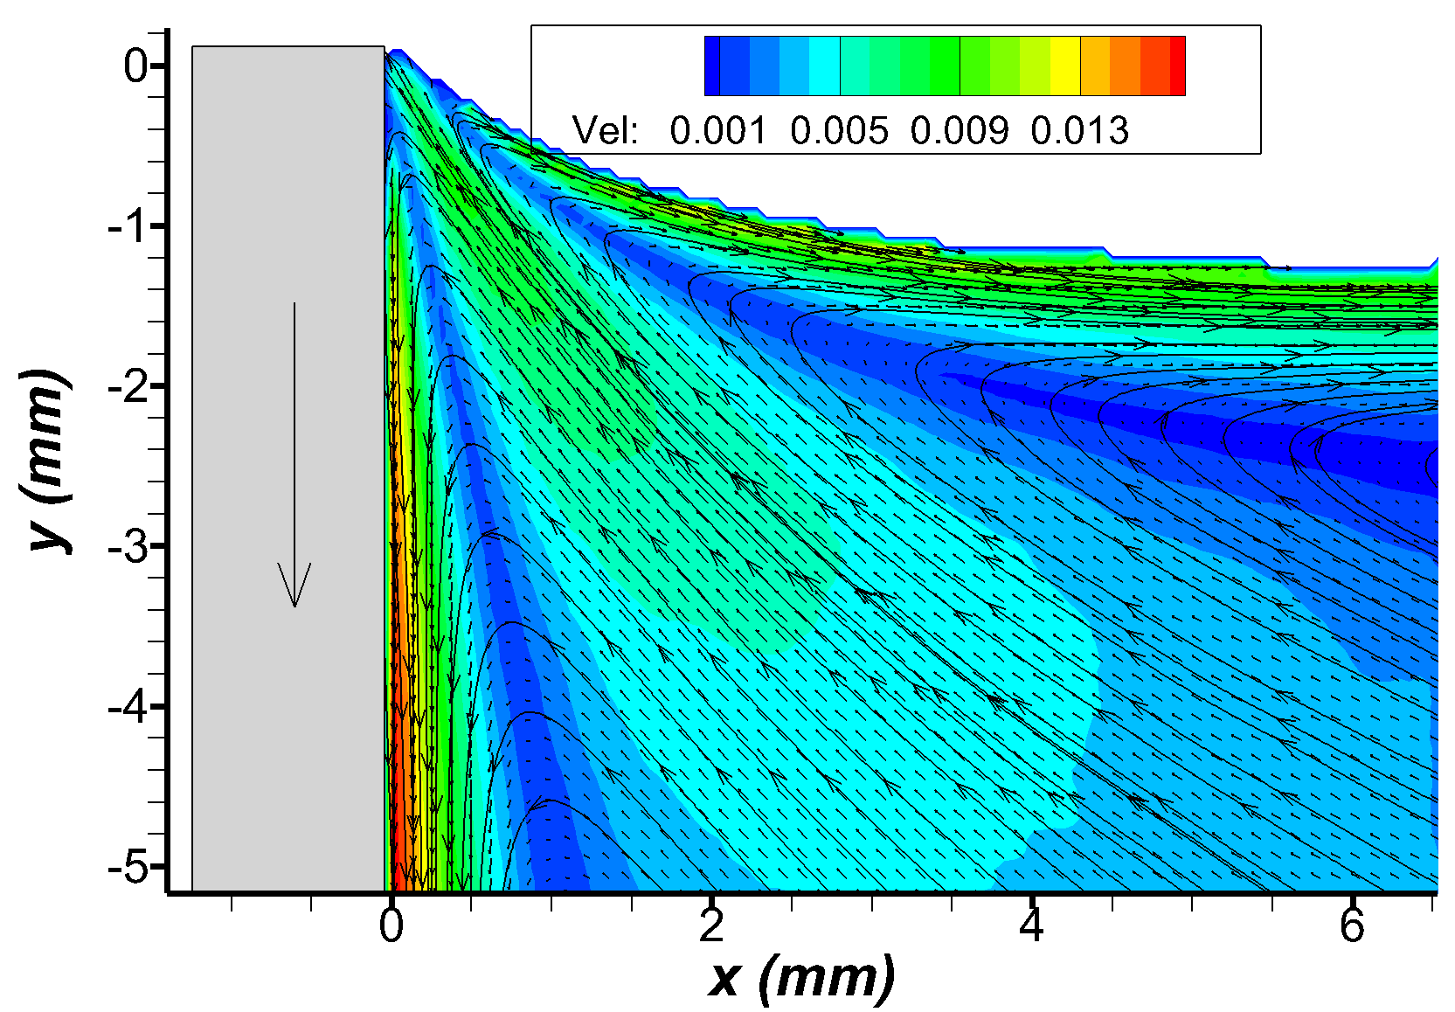
Air-Water experiments
2 cm/sec
Re: 60.65
Ca: 2.47e-4
Oh: 2.02e-3
Lc: 2.71 mm
Contact angle ~ 60
Viscosity ratio: 0.02
Split streamline motion
Theory: Rolling motion

Slide 15
Two phase experiments data

Slide 16
10cst silicone oil/sugar-water mixture experiments

Slide 17
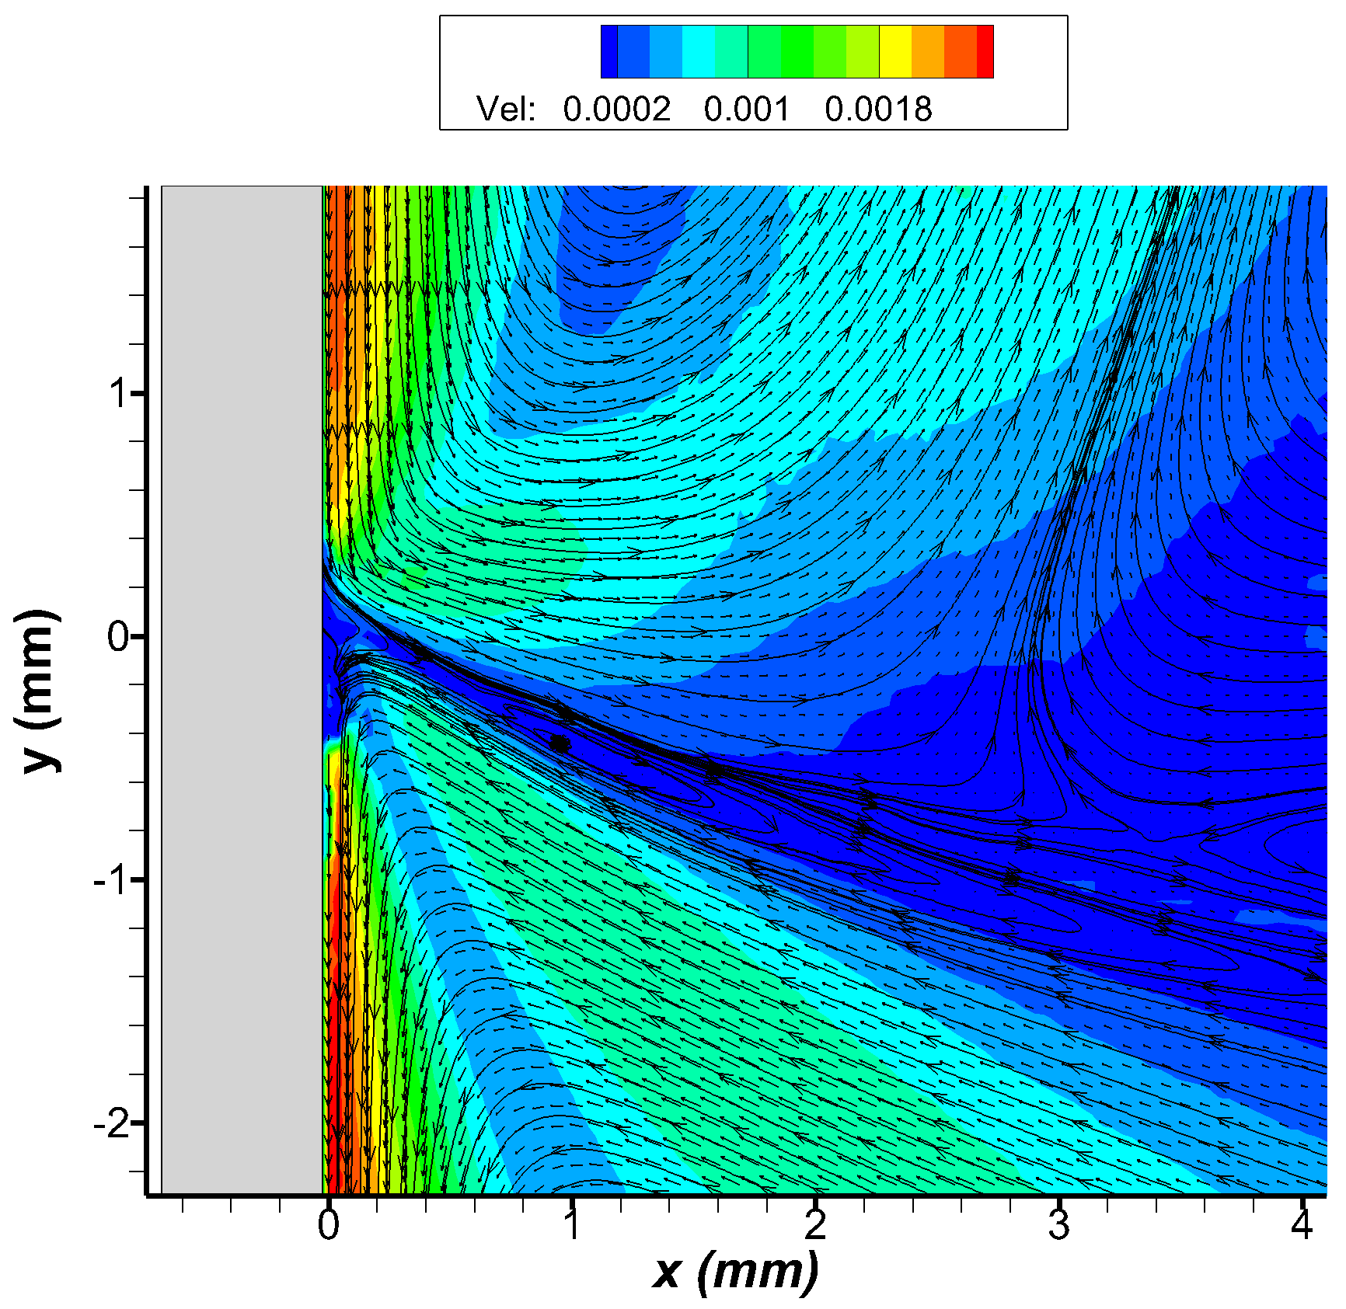
10cst silicone oil with sugar water mixture
500microns/sec (no coating of plate)
500 microns/sec
Re_sugar= 0.44
Ca_sugar= 8e-5
Oh_sugar = 1.34e-2
Lc = 3.63 mm
Re_Si = 0.193
Ca_Si= 1.46e-4
Oh_Si= 2.75e-2
Contact angle ~ 65
Viscosity ratio: 1.9
Split streamline motion at the bottom and rolling motion at the top
Theory: Split streamline motion in fluid at the bottom and rolling motion at the top

Slide 18
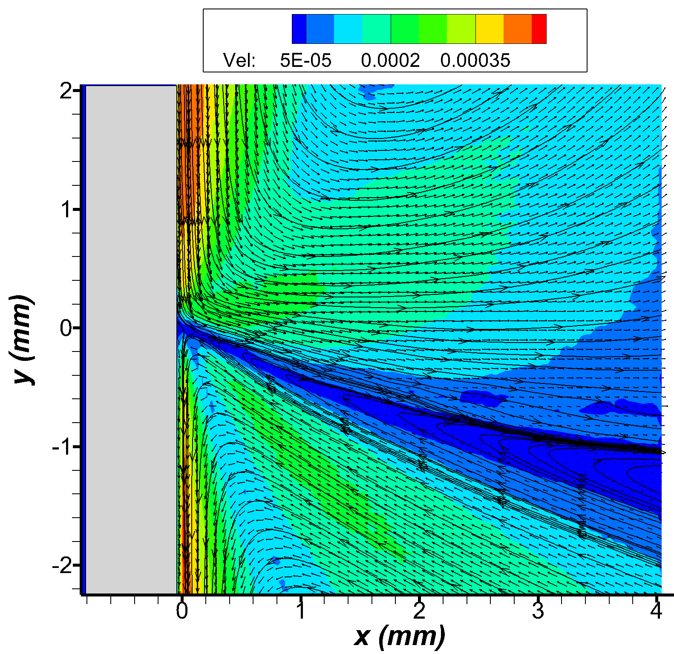
10cst silicone oil with sugar water mixture
500microns/sec (hydrophilic coating of plate)
500 microns/sec
Re_sugar= 0.44
Ca_sugar= 8e-5
Oh_sugar = 1.34e-2
Lc = 3.63 mm
Re_Si = 0.193
Ca_Si= 1.46e-4
Oh_Si= 2.75e-2
Contact angle ~ 70
Viscosity ratio: 1.9
Split streamline motion at the bottom and rolling motion at the top
Theory: Split streamline motion in fluid at the bottom and rolling motion at the top

Slide 19
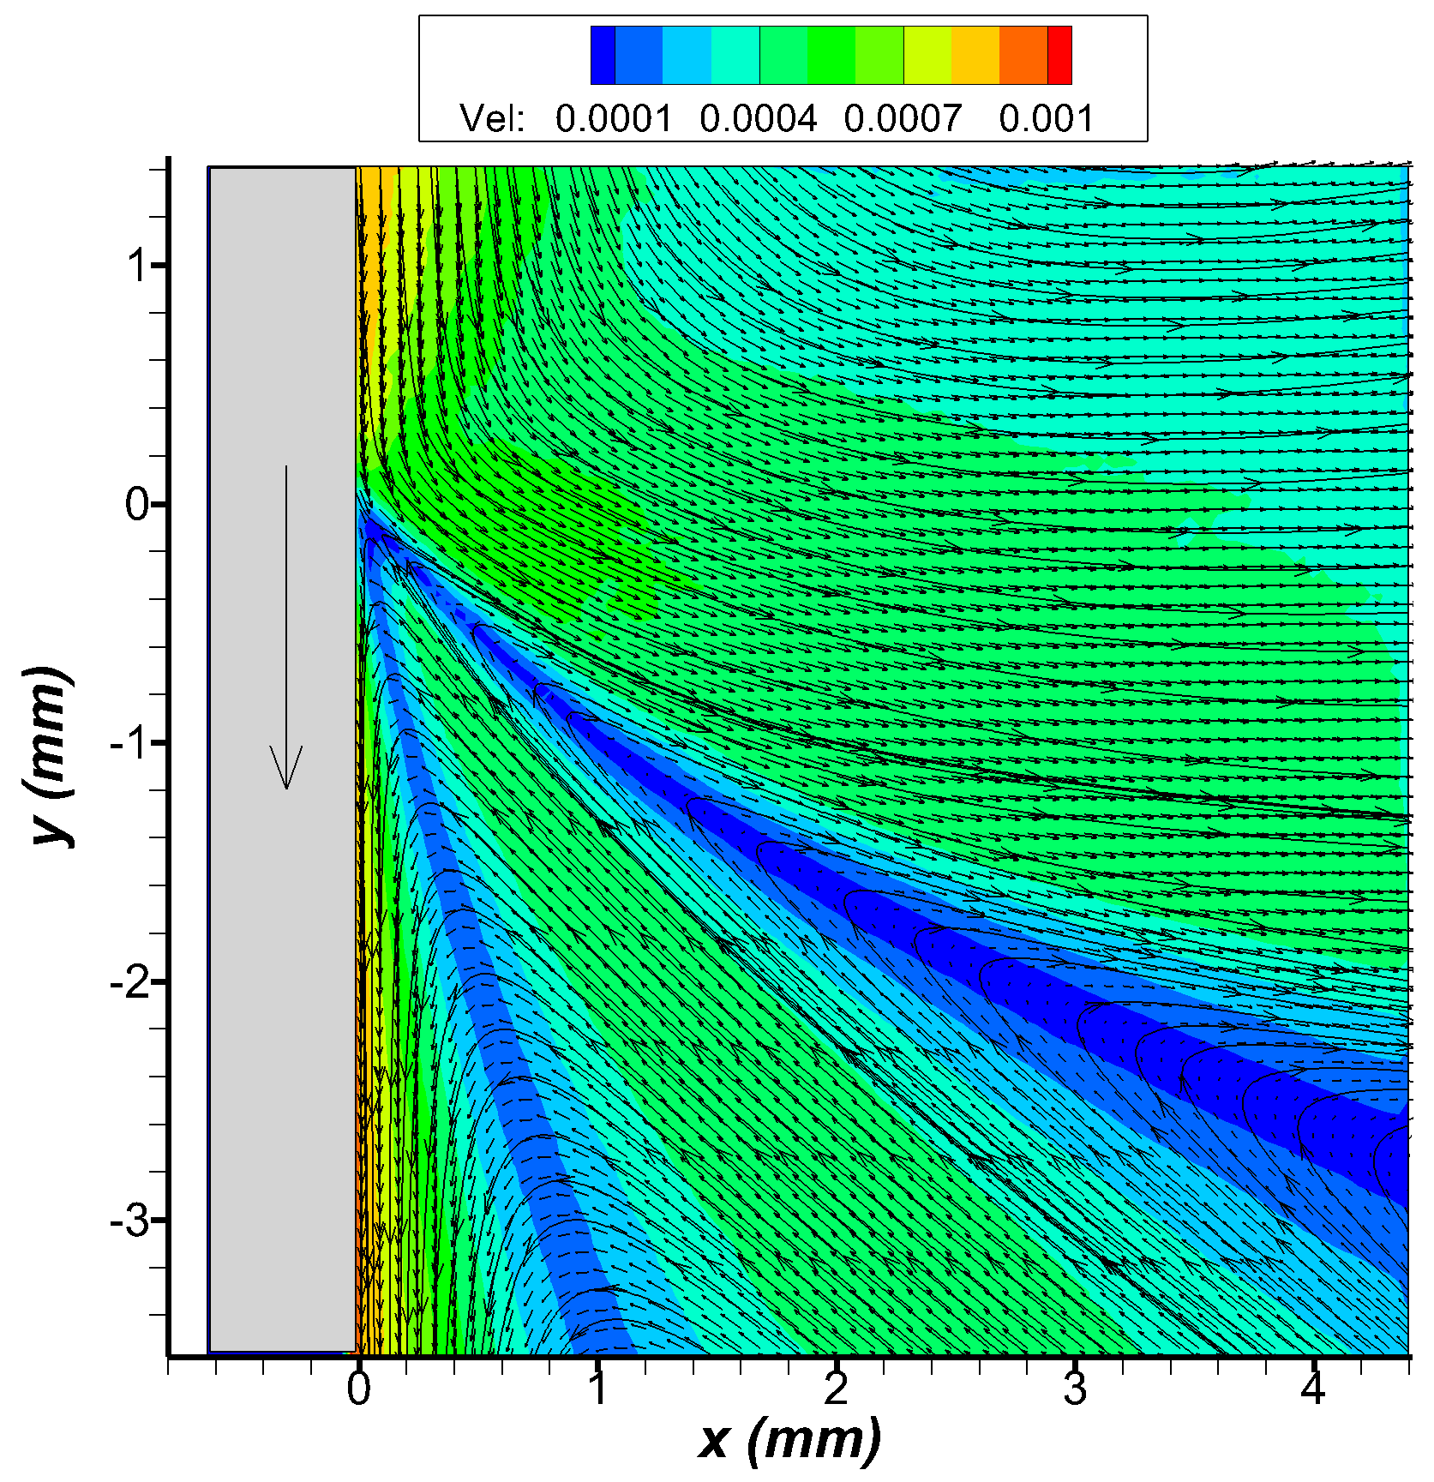
10cst silicone oil with sugar water mixture
1mm/sec (no coating of plate)
1 mm/sec
Re_sugar= 0.88
Ca_sugar= 1.6e-4
Oh_sugar = 1.34e-2
Lc = 3.63 mm
Re_Si = 0.387
Ca_Si= 2.93e-4
Oh_Si= 2.75e-2
Contact angle ~ 60
Viscosity ratio: 1.9
Split streamline motion at the bottom and rolling motion at the top
Theory: Split streamline motion in fluid at the bottom and rolling motion at the top

Slide 20
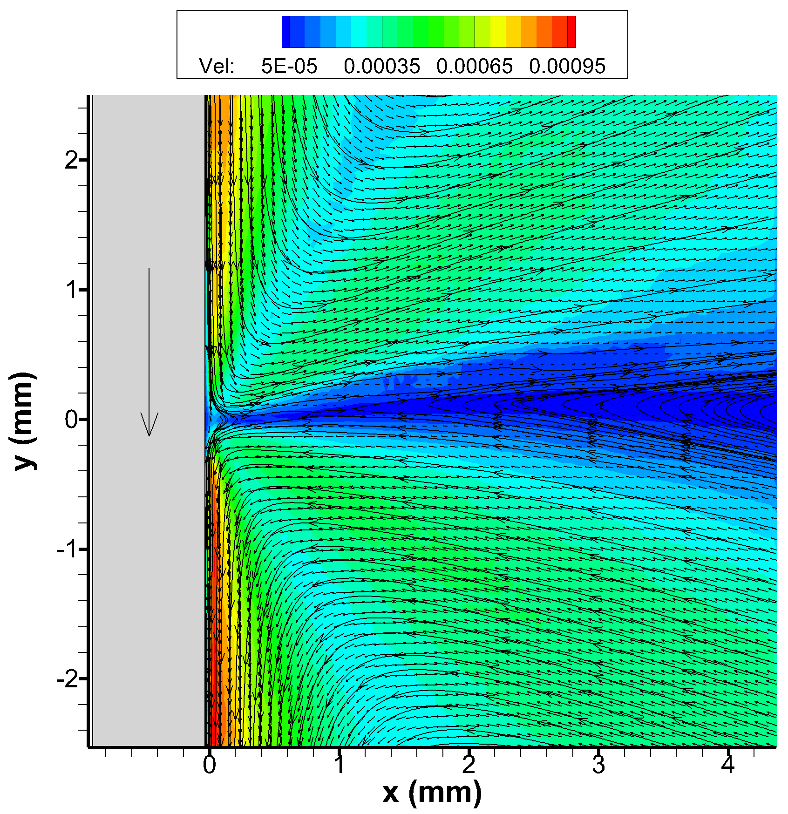
10cst silicone oil with sugar water mixture
1mm/sec (hydrophilic coating coating of plate)
1 mm/sec
Re_sugar= 0.88
Ca_sugar= 1.6e-4
Oh_sugar = 1.34e-2
Lc = 3.63 mm
Re_Si = 0.387
Ca_Si= 2.93e-4
Oh_Si= 2.75e-2
Contact angle ~ 95
Viscosity ratio: 1.9
Split streamline motion at the bottom and rolling motion at the top
Theory: Split streamline motion in fluid at the bottom and rolling motion at the top

Slide 21
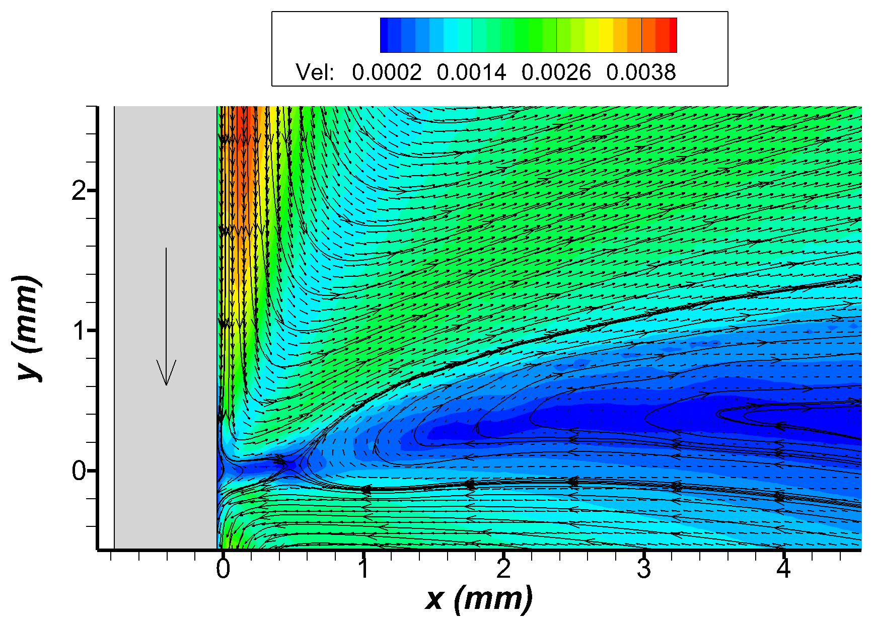
10cst silicone oil with sugar water mixture
5mm/sec (no coating of plate)
5 mm/sec
Re_sugar= 4.42
Ca_sugar= 8e-4
Oh_sugar = 1.34e-2
Lc = 3.63 mm
Re_Si = 1.93
Ca_Si= 1.46e-3
Oh_Si= 2.75e-2
Contact angle ~ 115
Viscosity ratio: 1.9
Split streamline motion at the bottom and rolling motion at the top
Theory: Split streamline motion in fluid at the bottom and rolling motion at the top

Slide 22
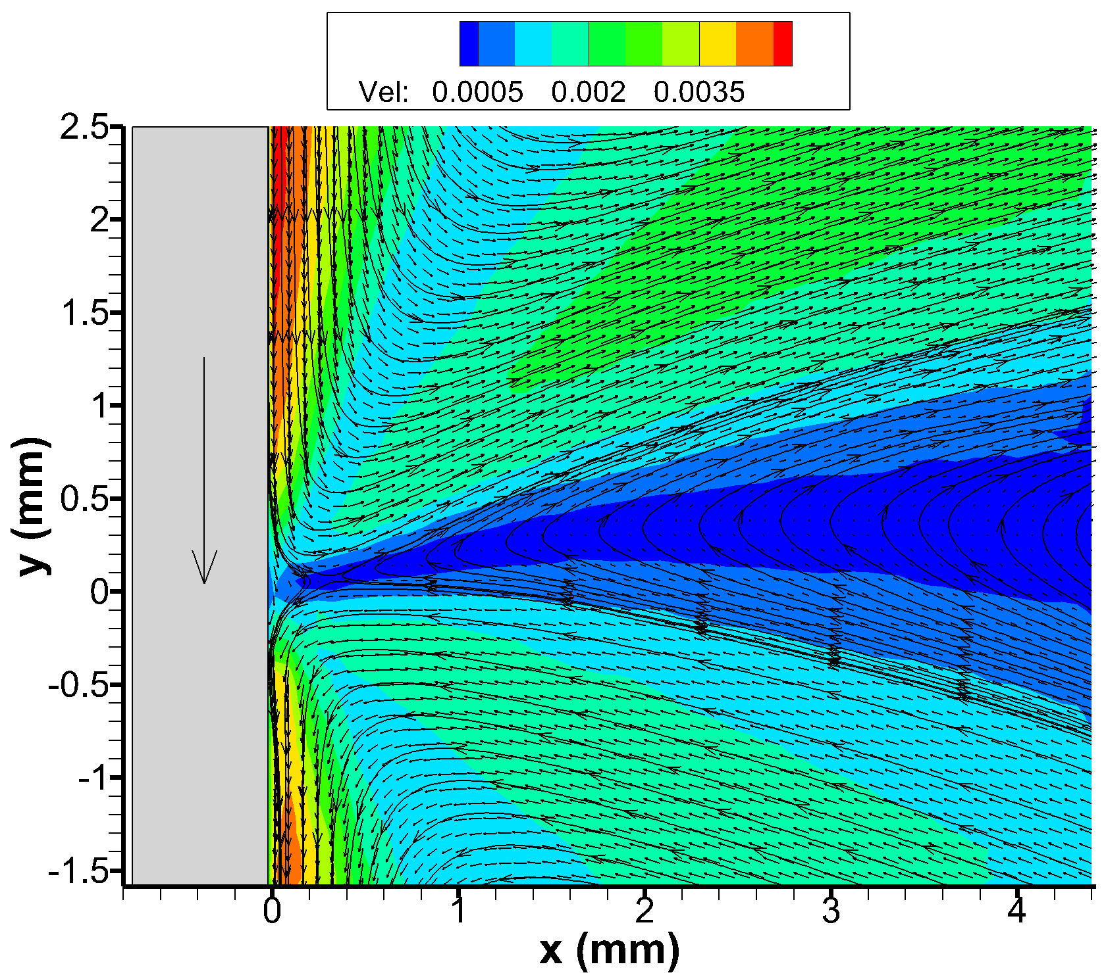
10cst silicone oil with sugar water mixture
5mm/sec (hydrophilic coating coating of plate)
5 mm/sec
Re_sugar= 4.42
Ca_sugar= 8e-4
Oh_sugar = 1.34e-2
Lc = 3.63 mm
Re_Si = 1.93
Ca_Si= 1.46e-3
Oh_Si= 2.75e-2
Contact angle ~ 110
Viscosity ratio: 1.9
Split streamline motion at bottom and rolling motion at the top
Theory: Split streamline motion in fluid at the bottom and rolling motion at the top

Slide 23
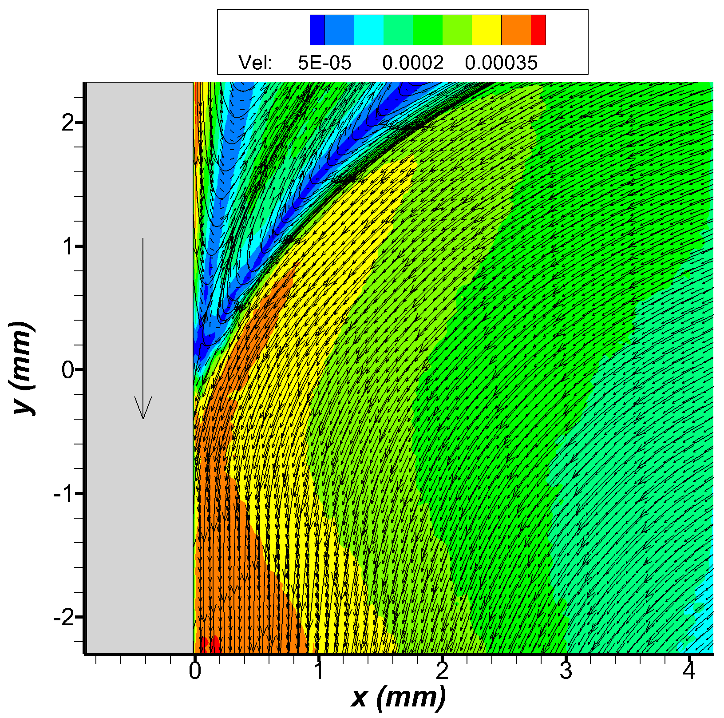
10cst silicone oil with sugar water mixture
500 microns/sec (hydrophobic coating coating of plate)
500 microns/sec
Re_sugar= 0.44
Ca_sugar= 8e-5
Oh_sugar = 1.34e-2
Lc = 3.63 mm
Re_Si = 0.193
Ca_Si= 1.46e-4
Oh_Si= 2.75e-2
Contact angle ~ 160
Viscosity ratio: 1.9
Rolling motion at bottom and split stream line at top
Theory: Split streamline motion in fluid at the bottom and rolling motion at the top

Slide 24
5cst silicone oil/sugar-water mixture experiments

Slide 25
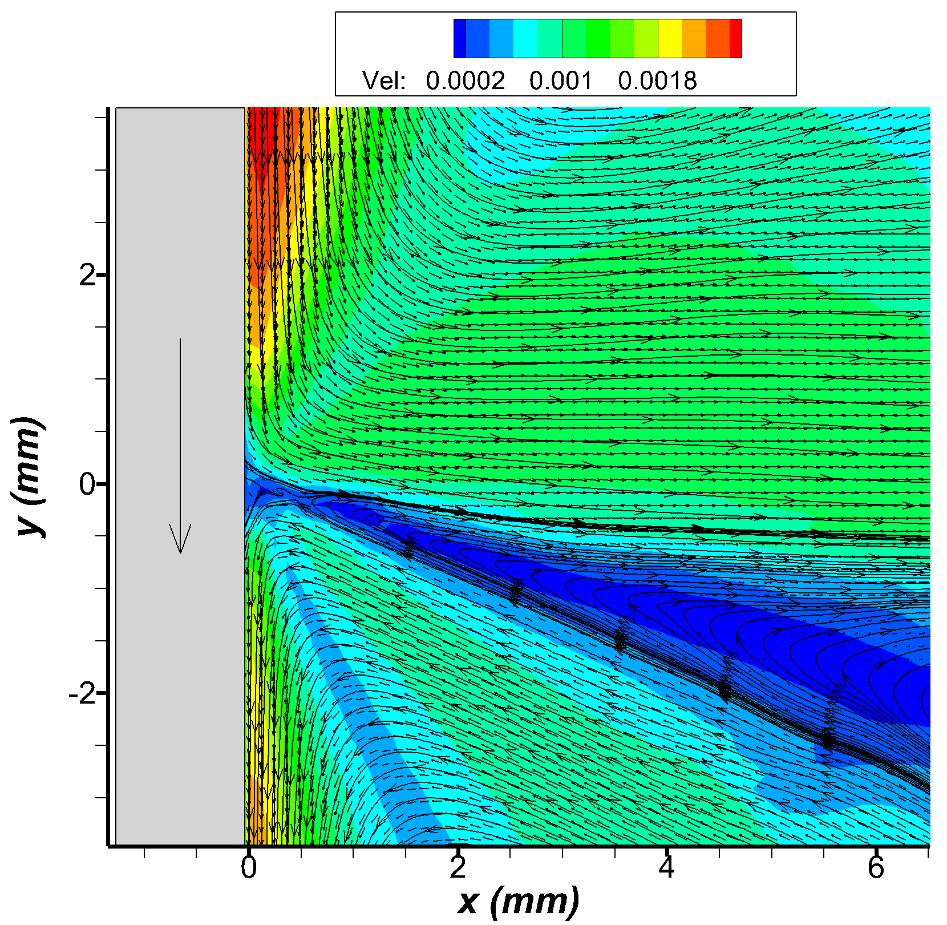
5cst silicone oil with sugar water mixture
500 microns/sec (hydrophilic coating of plate)
500 microns/sec
Re_sugar= 0.419
Ca_sugar= 8e-5
Oh_sugar = 1.38e-2
Lc = 3.44 mm
Re_Si = 0.34
Ca_Si= 7.6e-5
Oh_Si= 1.48e-2
Contact angle ~ 85
Viscosity ratio: 0.95
Split streamline motion at bottom and rolling motion at the top
Theory: Split streamline motion in fluid at the bottom and rolling motion at the top

Slide 26
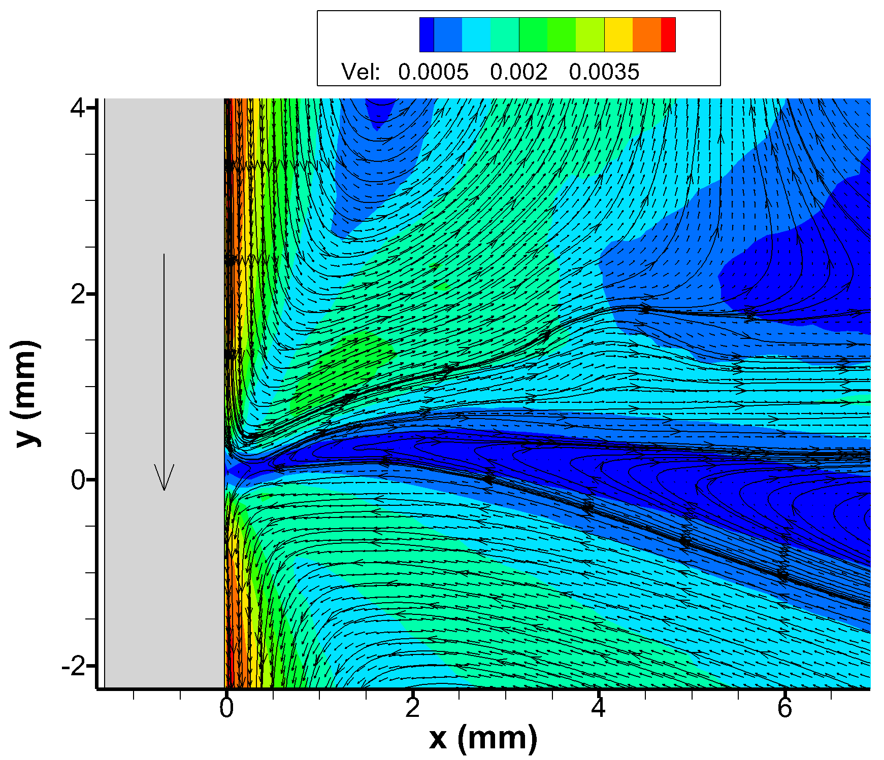
5cst silicone oil with sugar water mixture
1mm/sec (hydrophilic coating of plate)
1 mm/sec
Re_sugar= 0.839
Ca_sugar= 1.6e-4
Oh_sugar = 1.38e-2
Lc = 3.44 mm
Re_Si = 0.688
Ca_Si= 1.52e-4
Oh_Si= 1.48e-2
Contact angle ~ 110
Viscosity ratio: 0.95
Split streamline motion at bottom and rolling motion at the top
Theory: Split streamline motion in fluid at the bottom and rolling motion at the top

Slide 27
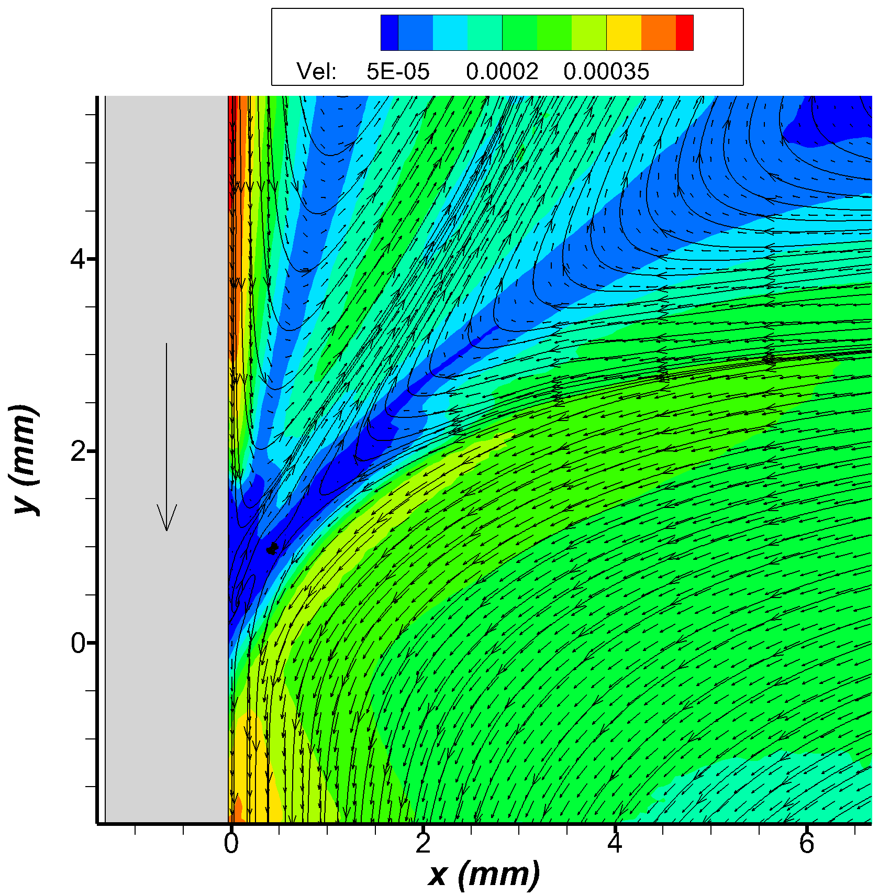
5cst silicone oil with sugar water mixture
500 microns/sec (hydrophobic coating of plate)
500 microns/sec
Re_sugar= 0.419
Ca_sugar= 8e-5
Oh_sugar = 1.38e-2
Lc = 3.44 mm
Re_Si = 0.34
Ca_Si= 7.6e-5
Oh_Si= 1.48e-2
Contact angle ~ 150
Viscosity ratio: 0.95
Rolling motion at bottom and split streamline motion at the top
Theory: Split streamline motion in fluid at the bottom and rolling motion at the top

Slide 28
Air-Toluene experimental data

Slide 29
Air- Toluene experiments

Slide 30
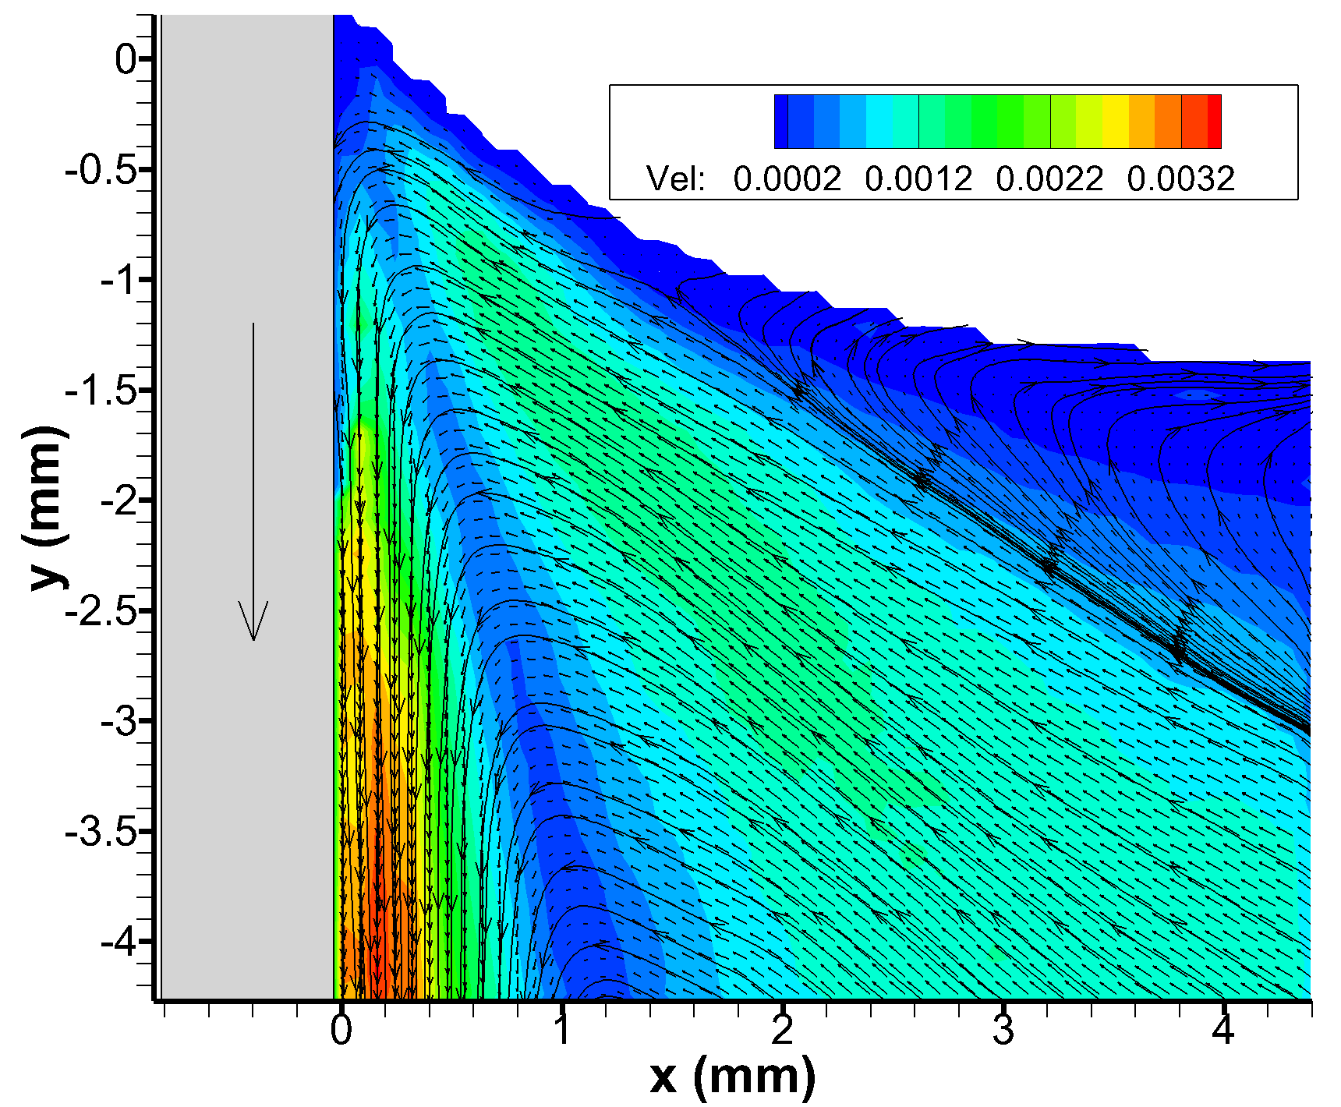
Air-Toluene experiments
5 mm/sec
Re: 14.34
Ca: 9.64e-5
Oh: 2.59e-3
Lc: 1.83 mm
Contact angle ~ 60
Viscosity ratio: 0.03
Split streamline motion
Theory: Rolling motion

Slide 31
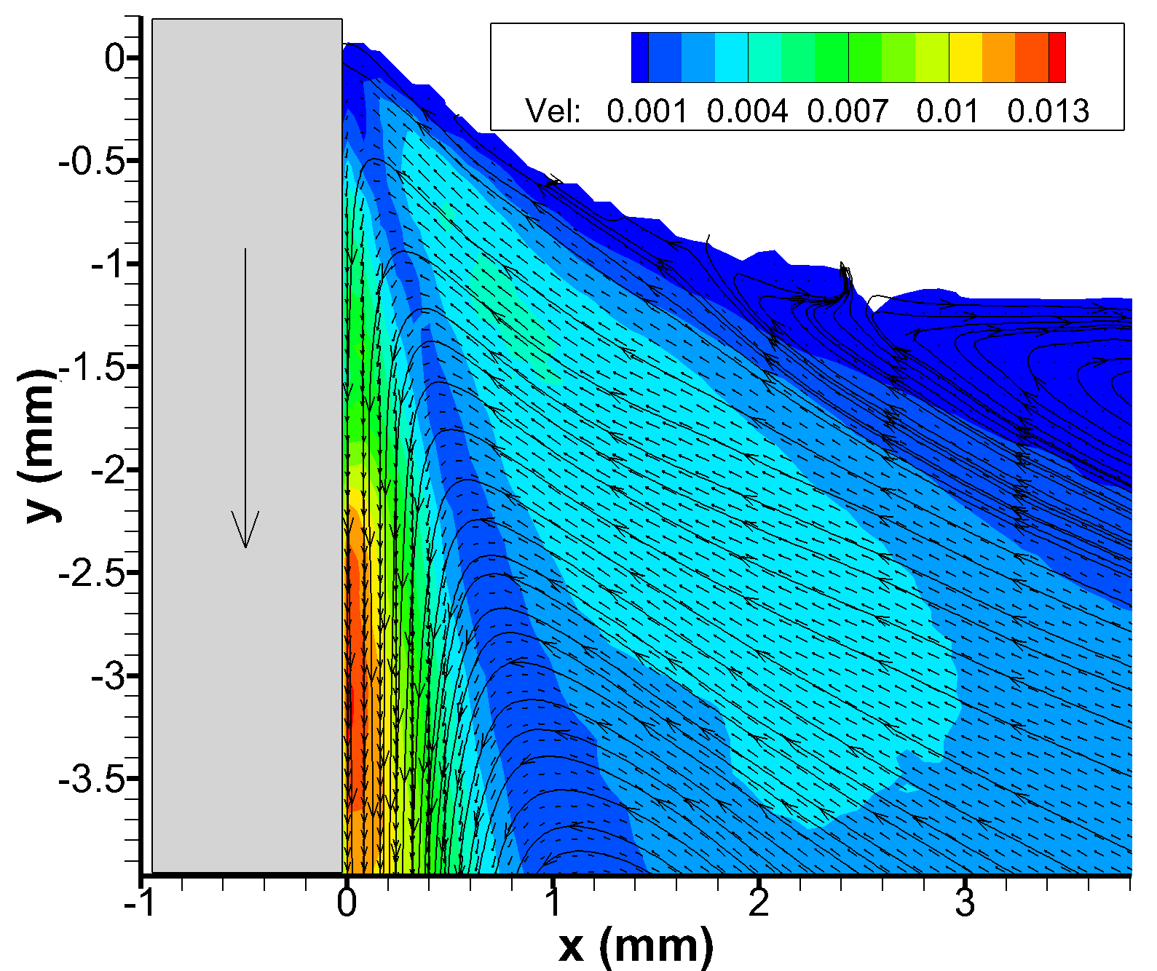
Air-Toluene experiments
2 cm/sec
Re: 57.36
Ca: 3.85e-4
Oh: 2.59e-3
Lc: 1.83 mm
Contact angle ~ 70
Viscosity ratio: 0.02
Split streamline motion
Theory: Rolling motion

Slide 32
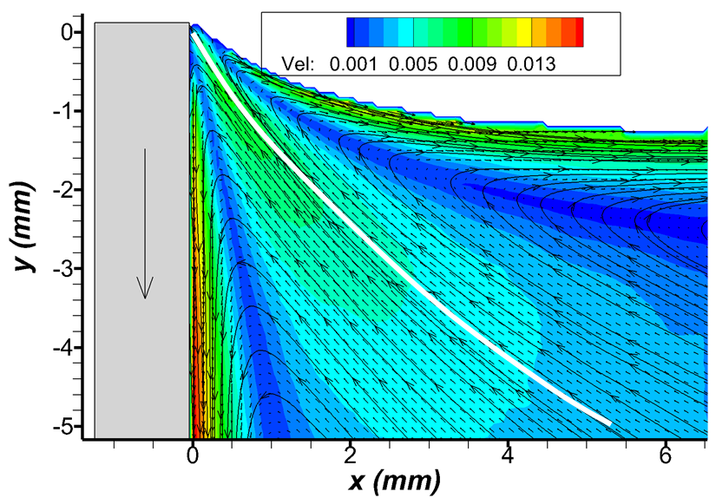
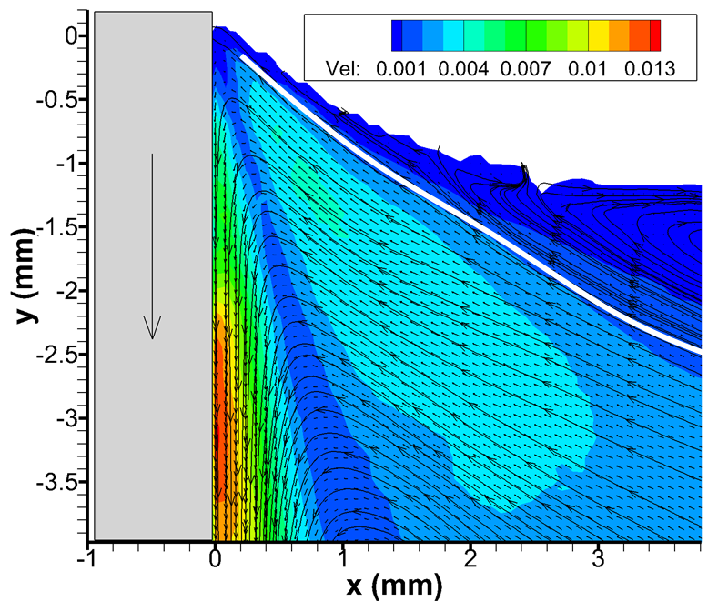
2 cm/sec
Re: 60.65
Ca: 2.47e-4
Oh: 0.00202
Lc: 2.71 mm
We: 0.015
2 cm/sec
Re: 57.36
Ca: 3.85e-4
Oh: 0.00259
Lc: 1.83 mm
We: 0.0221
2 cm/sec
Re = 3.23
Ca= 8.38e-3
Oh = 0.051
Lc = 1.51mm
We: 0.0271

Slide 33
Appendix

Slide 34
Properties of liquids:
Silicone oil 10cst:
Density: 940 kg/m3
Viscosity: 8.8e-3 kg/m-s
Surface tension: 21 mN/m
Capillary length: 1.509 mm
Silicone oil 20cst:
Density: 950 kg/m3
Viscosity: 19e-3 kg/m-s
Surface tension: 21 mN/m
Capillary length: 1.50 mm

Slide 35
Air -Toluene :
Density: 862 kg/m3
Viscosity: 5.6e-4 kg/m-s
Surface tension: 28.5 mN/m
Capillary length: 1.83 mm
10cst silicone oil + sugar water mix:
Si_Density: 940kg/m3
Viscosity: 8.8e-3 kg/m-s
Capillary length: 3.63 mm
interfacial tension: 30 mN/m (Assume)
Sugar_Density : 1171 kg/m3
Viscosity: 4.8e-3 kg/m-s
5cst silicone oil + sugar water mix:
Si_Density: 913kg/m3
Viscosity: 4.56e-3 kg/m-s
Capillary length: 3.44 mm
interfacial tension: 30 mN/m (Assume)
Sugar_Density : 1171 kg/m3
Viscosity: 4.8e-3 kg/m-s

