Slide 1







MADA: Multi-Agent AI for Autonomous Database Administration
BCSE302L · DATABASE SYSTEMS · FINAL REVIEW
Monitor
Security
Index
PostgreSQL
Six AI agents that monitor, tune, repair and protect a PostgreSQL database — with every change tested before it reaches production
Diagnose
Knobs
Shauryaveer Singh Dabas
24BCE0416
B.Tech Computer Science and Engineering · VIT Vellore
Query
Notes:
My project is MADA, a multi-agent AI system for autonomous database administration. This is Final Review.

Slide 2
Abstract
26.4 s → 37 ms
Database administration is still largely manual, and the AI tools that automate it each cover one duty and act on predictions. MADA gives six specialist agents one view of a PostgreSQL database; they test every idea on a sandbox clone and send proposals to a coordinator and safety gate that admit only measured improvements, keep irreversible actions for a human and roll back regressions. A working prototype was evaluated on a 168 MB e-commerce database under a live eight-session workload.
complaints report, p95
4×
throughput, 60 → 241 statements/s
7 of 7
injected faults detected within 12.2 s
4 of 4
harmful changes stopped by the safety gate
Notes:
In one sentence: six agents, one coordinator, one safety gate; measured gains on latency, throughput, fault handling and safety.

Slide 3




Problem statement
Slow pages and reports
A small online store runs PostgreSQL with no DBA. It uses default settings and primary-key indexes only, incidents are noticed when customers complain, the product search is injectable, and every fix goes straight to production.
Foreign-key lookups scan whole tables; one report runs a subquery per product.
Incidents found late
Lock pile-ups, bloat and connection storms go unnoticed until users complain.
Security blind spots
Search builds SQL by string concatenation; support can read payment data unmonitored.
THE PROBLEM
Perform all six duties continuously, coordinate them, and prove every change on a copy before applying it.
Risky fixes
No test copy, no evidence, no planned rollback.
Notes:
The store's database has four pain points; the problem is to handle all six duties together and safely.

Slide 4





Objectives
O1 · Testbed
PostgreSQL 16 e-commerce database (six tables, ~170 MB), sandbox clone, ten query templates from three roles.
O2 · Six specialist agents
Monitor, index, knob, query, diagnosis and security agents that turn telemetry into evidenced proposals.
O3 · Coordinator
Resolve conflicts on shared resources; priority security > availability > correctness > performance.
O4 · Safety gate
Allow-list, ≥ 20% measured gain, ≤ 15% write overhead, identical results, human approval, rollback at +10% p95.
O5 · Evaluation
Latency and throughput before/after; seven injected faults; injection classifier; gate on vs off.
O6 · Comparison
Compare scope and safety with representative single-duty systems.
Notes:
Six objectives: testbed, agents, coordinator, safety gate, evaluation and comparison.

Slide 5
Related work at a glance
Work | Year | Contribution | Limitation
OtterTune [3] | 2017 | Reuses past tuning data; Gaussian-process knob tuning | Knobs only; needs many test runs
GPTuner [15] | 2024 | LLM reads manuals, narrows ranges, then Bayesian optimisation | LLM cost; knobs only
Azure auto-indexing [4] | 2019 | Indexes millions of databases; reverts regressions | Validates after deploy; index only
AI Meets AI [5] | 2019 | Shows cost estimates misjudge indexes; learns from executions | Needs execution history
Bao [6] | 2021 | Chooses planner hint sets per query on PostgreSQL | Hint sets only
D-Bot [8] | 2024 | Collaborating LLMs reason to a root cause | Cost; fixes not tested
Notes:
Related work at a glance

Slide 6

Gaps identified
One duty per tool
No system coordinates knobs, indexes, queries, diagnosis and security.
Predictions over measurement
Execution checks exist for indexes only — and in [4] only after deploy.
No safety layer for agents
LLM tools propose SQL with no allow-list, evidence check or human approval.
Security apart from tuning
Nothing decides which action comes first when they compete.
Evaluation in isolation
Few end-to-end tests with live workloads, injected faults and ablations.
Notes:
Five gaps; MADA addresses each one.

Slide 7
Proposed method
01
PART 1 OF 3
Six agents, a coordinator and a safety gate

Slide 8
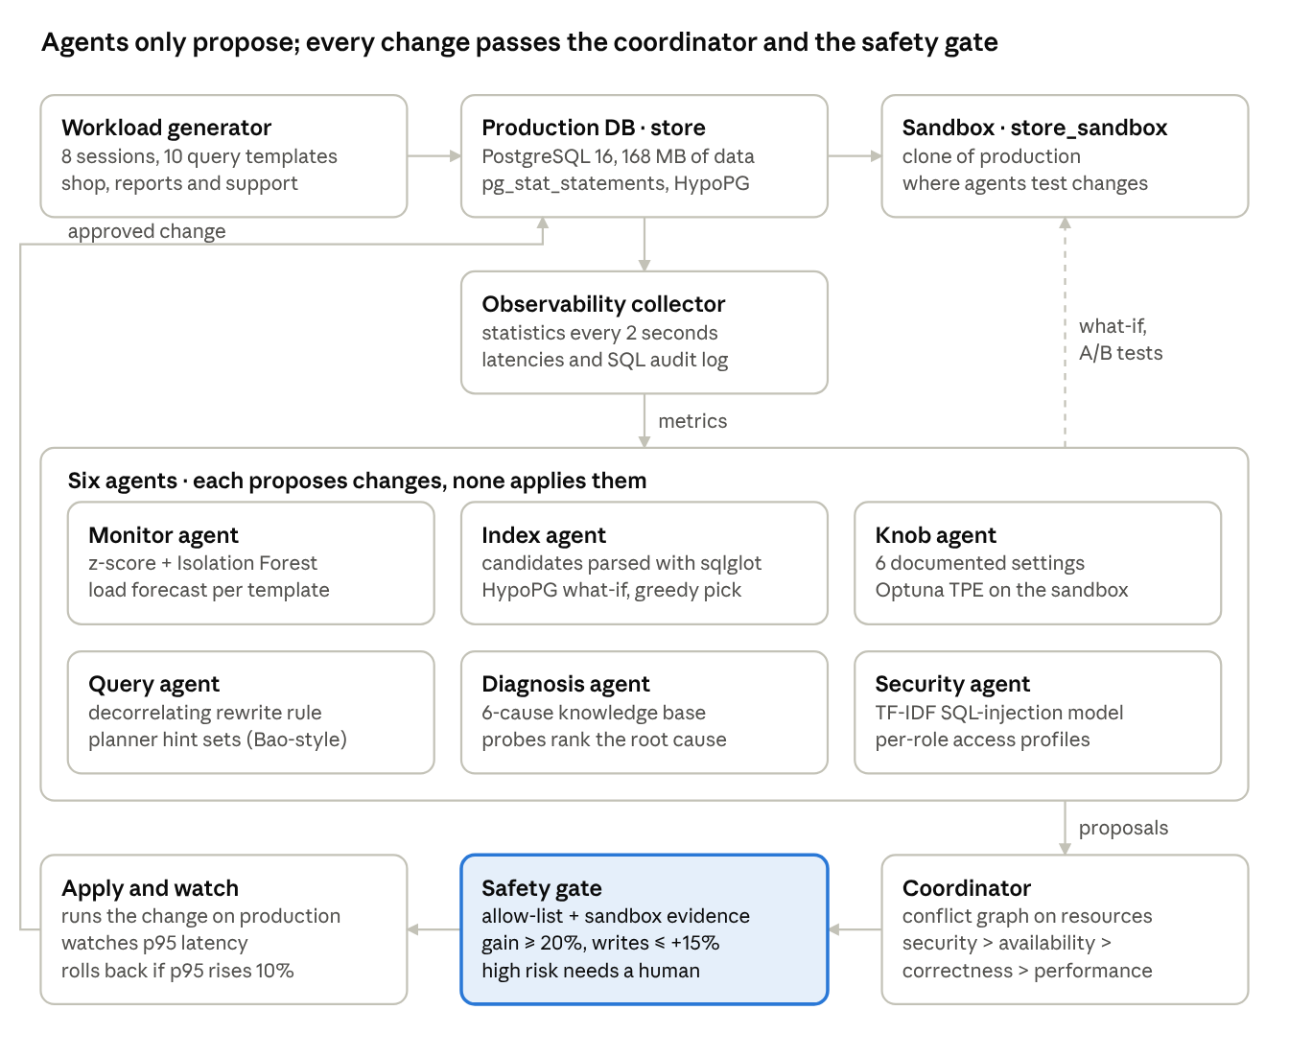
Architecture
1
Agents only propose
They read telemetry, test on the sandbox and emit action SQL, rollback SQL, resources, risk and evidence.
2
One path to production
Only the coordinator and safety gate apply changes.
3
Conflicts resolved first
Proposals that touch the same resource wait for the next window.
4
Evidence before action
The gate demands sandbox measurements; risky actions need a person.
Notes:
Agents think, the coordinator and gate act. Telemetry flows down to the agents, proposals flow to the coordinator, and only gated changes reach production.

Slide 9
Six specialist agents
Monitor agent
Index agent
Knob agent
Baseline per metric + Isolation Forest [26]; alerts on 4σ for two ticks; forecasts load per template [11].
Candidates from parsed SQL; HypoPG what-if costs [16]; greedy pick [17]; then real timing on the sandbox [5].
Six reload-only settings from the manual [15]; 14 Optuna TPE trials [27] replaying the workload.
Query agent
Diagnosis agent
Security agent
Rule R1 decorrelates COUNT(*) subqueries; checks identical rows; tries Bao-style hint sets [6].
DBSherlock-style predicates [7]; six-cause knowledge base with SQL probes; routes the fix.
TF-IDF + logistic regression on search SQL; per-role access profiles [9]; revoke and end sessions.
Notes:
Each agent uses a published technique: monitor, index, knob, query, diagnosis and security.

Slide 10
Coordinator and safety gate
1
Order
2
Defer conflicts
3
Static policy
Priority: security → availability → correctness → performance; then gain and risk.
A proposal whose table, planner, memory, session or role is already claimed waits a window.
Allow-listed statement shapes; settings within documented ranges; rollback present.
4
Sandbox evidence
5
Risk
6
Watch and roll back
≥ 20% measured gain; ≤ 15% extra write cost; rewrites return identical rows.
Low and medium apply automatically; ending sessions or revoking access needs a human.
If p95 of affected templates rises > 10%, run the rollback statement.
Steps 1–2: coordinator · Steps 3–5: safety gate · Step 6: coordinator after apply
Notes:
Two steps in the coordinator, three in the gate, one after apply.

Slide 11
Experimental analysis
02
PART 2 OF 3
Tuning, faults, security, the safety gate — and comparison with other work

Slide 12



Experimental setup
Database
Workload
Machine
PostgreSQL 16.15 · 6 tables · 168 MB · primary keys only, default settings at start
8 sessions: 5 application, 2 analyst, 1 support · 10 query templates
Ubuntu 24.04 · 2 vCPUs · 7 GB RAM shared by database, workload and agents
Protocol
Metrics
Mode
2 min before → one tuning cycle → 2 min after → 7 faults → gate on vs off
p95 per template · throughput · time to detect / fix · cause rank · precision / recall
Rule mode (no LLM) · high-risk approvals automatic and labelled in the run
Notes:
One scripted run; all numbers come from it.

Slide 13
Tuning: p95 latency fell on all ten templates
−100%
complaints report: 26.4 s → 37 ms
−99%
order detail: 223 ms → 2.0 ms
4×
throughput: 60 → 241 statements/s
Notes:
p95 latency fell on all ten templates. The analytics reports not touched directly also sped up, most likely because the CPUs were freed once order lookups stopped scanning whole tables.

Slide 14
Tuning cycle: 4 applied, 2 rejected on evidence
Proposal | Agent | Decision | Evidence
Rewrite R1 of the complaints report | Query | Applied | 24.3 s → 88 ms on the sandbox; identical rows
Index orders(order_date) | Index | Rejected | support lookup 74 ms → 680 ms; order history 48 ms → 72 ms on the sandbox (measured gain on sandbox -517% < 20%)
Index order_items(order_id) | Index | Applied | Production p95 of order detail 191 ms → 9.9 ms
Index orders(customer_id, order_date) | Index | Applied | Production p95 of support lookup and order history 89 ms → 2.1 ms
Index reviews(product_id, rating) | Index | Rejected | complaints report 87 ms → 80 ms on the sandbox (measured gain on sandbox 8% < 20%)
Index reviews(product_id, review_date) | Index | Applied | Production p95 of product reviews 73 ms → 1.3 ms
Takeaway Two of the indexes the cost model picked did not survive real timing on the sandbox, so they never reached production.
Notes:
Seven proposals; the sandbox evidence decided each one.

Slide 15
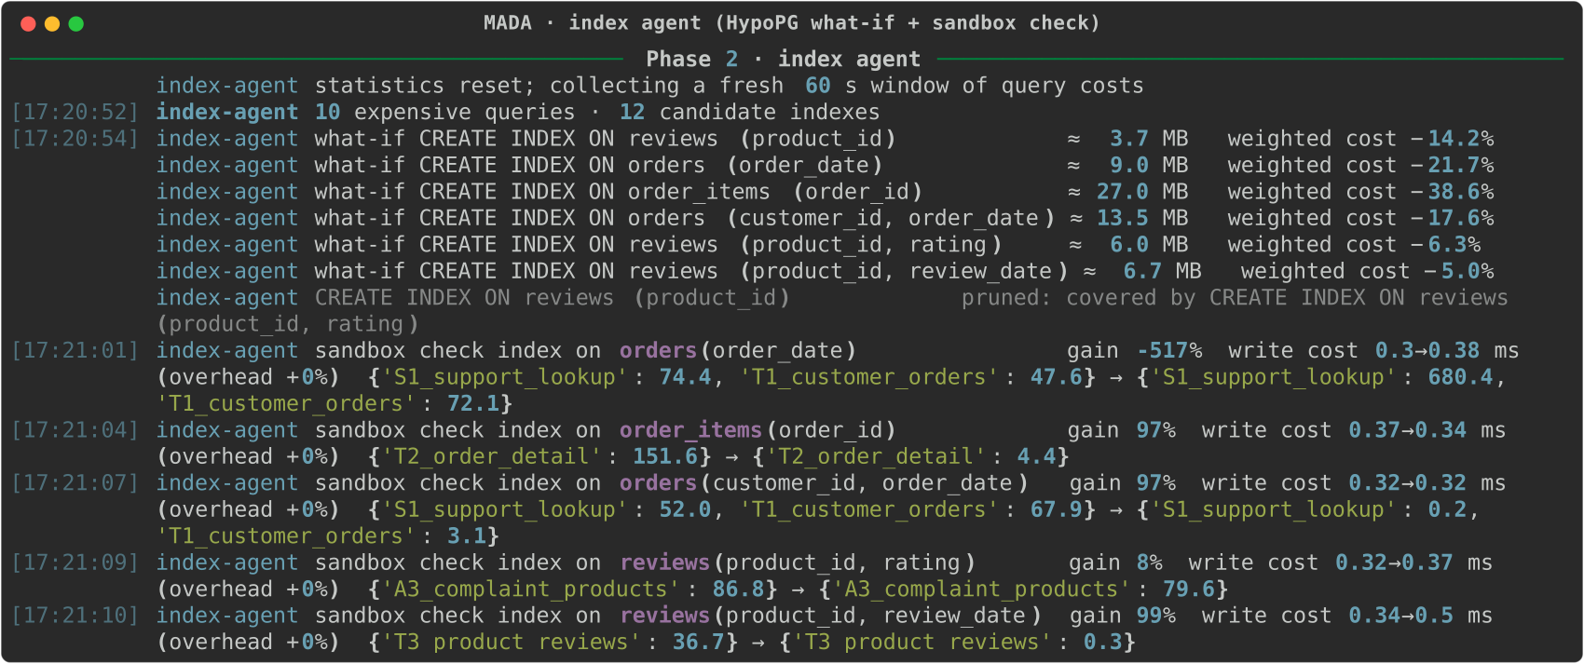
Index agent: estimate, then measure
HypoPG ranked orders(order_date) second by estimated cost — on the sandbox it slowed the support lookup from 74 ms to 680 ms, so it never reached production.
Notes:
Screenshot from the run: what-if estimates first, then real sandbox timings.

Slide 16
Fault injection: 7 detected, 7 diagnosed, 7 fixed
Fault | Detected | Cause ranked first | Fix | Fixed
F1 Index dropped | 4.9 s | Missing index ✔ | Index recreated | 6.2 s
F2 work_mem = 64 kB | 12.2 s | work_mem spill ✔ | Setting restored | 12.2 s
F4 Row locks held | 6.1 s | Lock contention ✔ | Blocker ended (approved) | 6.1 s
F5 Table bloat | 8.2 s | Table bloat ✔ | VACUUM run | 8.7 s
F8 80 idle connections | 4.1 s | Connection storm ✔ | Idle sessions ended (approved) | 4.1 s
F9 SQL injection | 2 s | SQL injection ✔ | Attacker ended (approved) | 2 s
F10 Support reads card data | 2 s | Abnormal access ✔ | Grant revoked (approved) | 2 s
Takeaway Diagnosis now compares with the minutes before each fault and ranks probe-confirmed causes first.
Notes:
All faults detected within 12.2 seconds.

Slide 17
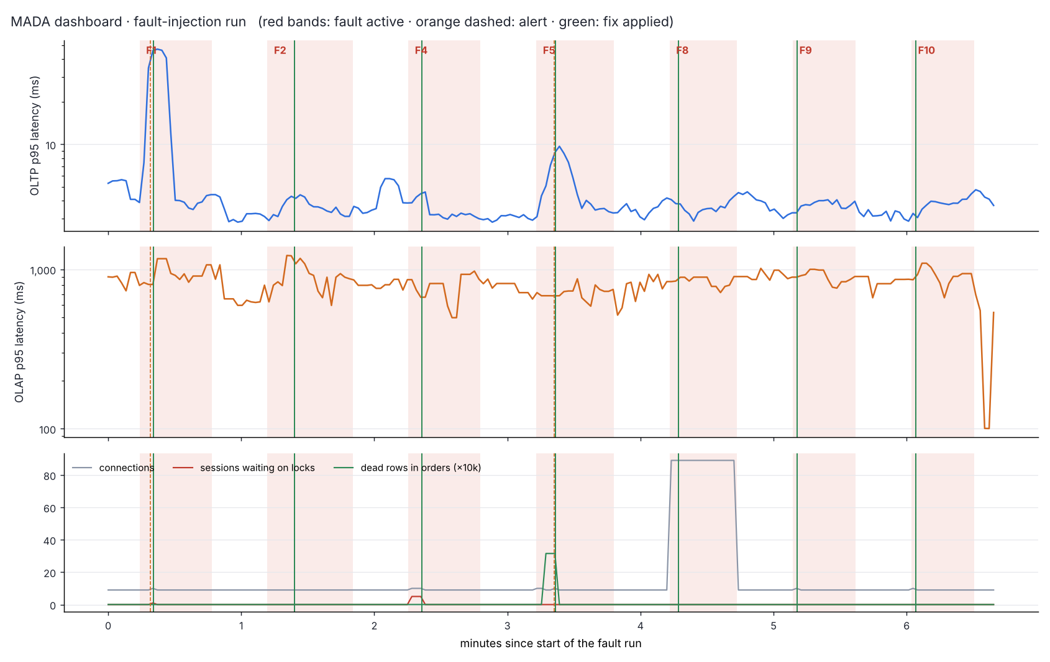
Dashboard of the fault run
Red bands
fault active
Orange dashed
alert raised
Green line
fix applied
Panels: OLTP p95, analytics p95, and connections, lock waits and dead rows. Alerts and fixes sit inside each red band.
Notes:
Every fault band contains an alert; most contain a green fix line.

Slide 18
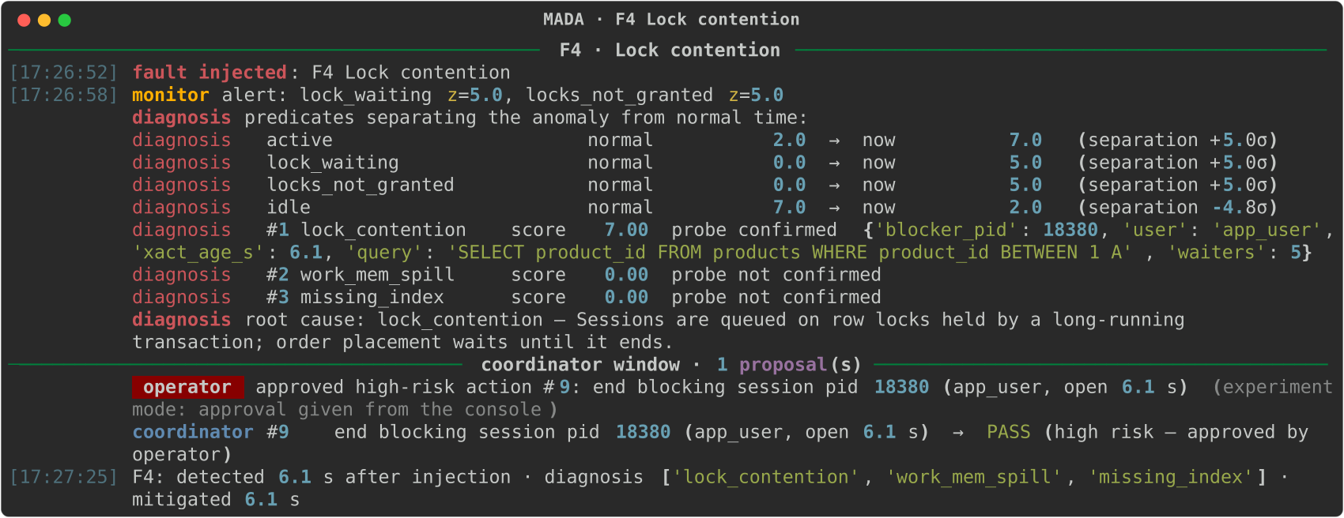
Diagnosis in action: F4 lock contention
Alert 6.1 s after injection → predicates point at lock waits → probe finds the blocking session → ended after approval 6.1 s after injection.
Notes:
Monitor, diagnosis, coordinator and gate working together on one incident.

Slide 19
Security results
1.000
1.000
0.793
2 s
precision on 660 held-out statements
recall on 660 held-out statements
recall on an attack family never seen in training
to detect F9 and F10
How it was tested
1,500 benign search statements and 700 injected ones from five attack families, with random case and comment obfuscation; 70/30 split.
Harder test: train without time-based injection, then test on it — the honest estimate for new attacks.
Access monitor revoked support's grant on payments at the first out-of-profile read.
Notes:
Perfect scores on the random split; 0.79 recall on an unseen family is the realistic figure.

Slide 20
Safety-gate ablation: same 4 harmful proposals
Harmful proposal | Gate on | Gate off
Disable hash joins (revenue report) | Rejected: 4% slower | Applied, kept
work_mem 1 MB to “save memory” | Rejected: 11% slower | Applied, kept
Rewrite that drops the rating filter | Rejected: results differ | Applied, kept: wrong report
random_page_cost = 50 | Rejected: outside 1.1–4.0 | Applied, kept
Takeaway Gate off: 4 of 4 reached production; the latency watch rolled back none. A wrong-results rewrite is invisible to latency.
Notes:
With the gate off, all four reached production and stayed there.

Slide 21
Comparison with other research works
System | Knobs | Indexes | Queries | Diagnosis | Security | Tested first | Unified
OtterTune [3] | ✔
CDBTune [12] | ✔
GPTuner [15] | ✔
Azure auto-indexing [4] |  | ✔ |  |  |  | After, revert
AI Meets AI [5] |  | ✔ |  |  |  | Predicted
Bao [6] |  |  | Hints
LLM-R2 [22] |  |  | Rewrites
DBSherlock [7] · D-Bot [8] |  |  |  | ✔
Kamra et al. [9] |  |  |  |  | ✔
MADA (this work) | ✔ | ✔ | Both | ✔ | ✔ | Sandbox | ✔
Scope only — the systems were evaluated on different databases, so their reported numbers are not compared. MADA reproduced AI Meets AI's finding [5]: a cost-preferred index slowed the support lookup from 74 ms to 680 ms when run.
Notes:
MADA is the only one covering all duties with pre-production testing and a single point of control.

Slide 22
Future work and conclusion
03
PART 3 OF 3
What comes next, and what the project showed

Slide 23



Future work
Security everywhere
LLM planner
Screen every entry point, and rewrite injectable SQL into parameterised queries.
D-Bot-style reasoning [8] for causes outside the knowledge base — behind the same gate.
Act on forecasts
Recovery agent
Build indexes and vacuum before peaks, not after alerts [11].
Replicas, failover and verified backups.
Bigger, repeated tests
Learn from the gate
Data larger than memory; several runs with confidence intervals.
Feed rejections and rollbacks back to the agents.
Notes:
Six directions for future work.

Slide 24
Conclusion
1
p95 down on all ten templates; throughput 4×
Agents may think freely but act only through a coordinator and a gate that demand measured evidence. That made MADA both effective and safe.
2
7 of 7 faults detected within 12.2 s; 7 diagnosed; 7 fixed automatically
3
2 of 6 proposals rejected on sandbox evidence
4
Gate off: 4 harmful changes reached production; gate on: none
Notes:
Conclusion.

Slide 25
References (1 of 3)
1
A. Pavlo et al., “Self-Driving Database Management Systems,” CIDR, 2017.
2
G. Li, X. Zhou and L. Cao, “AI Meets Database: AI4DB and DB4AI,” SIGMOD (tutorial), 2021.
3
D. Van Aken, A. Pavlo, G. J. Gordon and B. Zhang, “Automatic DBMS Tuning Through Large-scale Machine Learning,” SIGMOD, 2017.
4
S. Das et al., “Automatically Indexing Millions of Databases in Microsoft Azure SQL Database,” SIGMOD, 2019.
5
B. Ding et al., “AI Meets AI: Leveraging Query Executions to Improve Index Recommendations,” SIGMOD, 2019.
6
R. Marcus et al., “Bao: Making Learned Query Optimization Practical,” SIGMOD, 2021.
7
D. Y. Yoon, N. Niu and B. Mozafari, “DBSherlock: A Performance Diagnostic Tool for Transactional Databases,” SIGMOD, 2016.
8
X. Zhou et al., “D-Bot: Database Diagnosis System using Large Language Models,” PVLDB 17(10), 2024.
9
A. Kamra, E. Terzi and E. Bertino, “Detecting Anomalous Access Patterns in Relational Databases,” VLDB Journal 17(5), 2008.
10
Q. Wu et al., “AutoGen: Enabling Next-Gen LLM Applications via Multi-Agent Conversation,” arXiv:2308.08155, 2023.
Notes:
References.

Slide 26
References (2 of 3)
11
L. Ma et al., “Query-based Workload Forecasting for Self-Driving DBMSs,” SIGMOD, 2018.
12
J. Zhang et al., “An End-to-End Automatic Cloud Database Tuning System Using Deep RL,” SIGMOD, 2019.
13
G. Li, X. Zhou, S. Li and B. Gao, “QTune: A Query-Aware Database Tuning System with Deep RL,” PVLDB 12(12), 2019.
14
I. Trummer, “DB-BERT: A Database Tuning Tool that ‘Reads the Manual’,” SIGMOD, 2022.
15
J. Lao et al., “GPTuner: A Manual-Reading Database Tuning System via GPT-Guided Bayesian Optimization,” PVLDB 17(8), 2024.
16
S. Chaudhuri and V. R. Narasayya, “An Efficient, Cost-Driven Index Selection Tool for Microsoft SQL Server,” VLDB, 1997.
17
R. Schlosser, J. Kossmann and M. Boissier, “Efficient Scalable Multi-Attribute Index Selection Using Recursive Strategies,” ICDE, 2019.
18
J. Kossmann et al., “Magic Mirror in My Hand… An Experimental Evaluation of Index Selection Algorithms,” PVLDB 13(11), 2020.
19
H. Lan, Z. Bao and Y. Peng, “An Index Advisor Using Deep Reinforcement Learning,” CIKM, 2020.
20
R. Marcus et al., “Neo: A Learned Query Optimizer,” PVLDB 12(11), 2019.
Notes:
References.

Slide 27
References (3 of 3)
21
X. Zhou, G. Li, C. Chai and J. Feng, “A Learned Query Rewrite System using Monte Carlo Tree Search,” PVLDB 15(1), 2021.
22
Z. Li et al., “LLM-R2: A Large Language Model Enhanced Rule-based Rewrite System,” PVLDB 18(1), 2024.
23
M. Ma et al., “Diagnosing Root Causes of Intermittent Slow Queries in Cloud Databases,” PVLDB 13(8), 2020.
24
W. G. J. Halfond, J. Viegas and A. Orso, “A Classification of SQL-Injection Attacks and Countermeasures,” ISSSE, 2006.
25
S. Yao et al., “ReAct: Synergizing Reasoning and Acting in Language Models,” ICLR, 2023.
26
F. T. Liu, K. M. Ting and Z.-H. Zhou, “Isolation Forest,” ICDM, 2008.
27
T. Akiba et al., “Optuna: A Next-generation Hyperparameter Optimization Framework,” KDD, 2019.
28
J. Bergstra, R. Bardenet, Y. Bengio and B. Kégl, “Algorithms for Hyper-Parameter Optimization,” NeurIPS, 2011.
Notes:
References.

Slide 28
Thank you
Monitor
Security
Index
Questions and feedback welcome
PostgreSQL
Shauryaveer Singh Dabas · 24BCE0416
MADA: A Multi-Agent AI System for Autonomous Database Administration
Diagnose
Knobs
Query
Notes:
Thank you.

