Slide 1







MADA: Multi-Agent AI for Autonomous Database Administration
BCSE302L · DATABASE SYSTEMS · REVIEW I
Monitor
Security
Index
PostgreSQL
Six AI agents that monitor, tune, repair and protect a PostgreSQL database — with every change tested before it reaches production
Diagnose
Knobs
Shauryaveer Singh Dabas
24BCE0416
B.Tech Computer Science and Engineering · VIT Vellore
Query
Notes:
My project is MADA, a multi-agent AI system for autonomous database administration. This is Review I.

Slide 2
Abstract
6
Database administration is still largely manual, and the AI tools that automate it each cover one duty and act on predictions. MADA will give six specialist agents one view of a PostgreSQL database; they will test every idea on a sandbox clone and send proposals to a coordinator and safety gate that admit only measured improvements, keep irreversible actions for a human and roll back regressions. A working prototype will be built and evaluated on an e-commerce database under a live multi-role workload.
specialist agents
1
coordinator that resolves conflicts
1
safety gate in front of production
7
fault types planned for evaluation
Notes:
In one sentence: six agents, one coordinator, one safety gate.

Slide 3
What a database administrator does
Monitoring
Indexing
Why automating it is hard
The duties interact: an index changes plans, memory and write cost
Existing AI tools each own one duty and can undo each other
Optimiser estimates often mispredict real run time [5]
An agent with credentials can run a wrong statement on production
Watch metrics, locks and slow queries around the clock
Create indexes the workload actually needs
Configuration
Query tuning
Tune memory, planner and parallelism settings
Rewrite or re-plan slow statements
Troubleshooting
Security
Find the root cause of slowdowns and outages
Spot SQL injection and abnormal access
Notes:
Six duties; they interact; existing tools each own one; estimates mislead; and an unsupervised agent is risky.

Slide 4




Problem statement
Slow pages and reports
A small online store runs PostgreSQL with no DBA. It uses default settings and primary-key indexes only, incidents are noticed when customers complain, the product search is injectable, and every fix goes straight to production.
Foreign-key lookups scan whole tables; one report runs a subquery per product.
Incidents found late
Lock pile-ups, bloat and connection storms go unnoticed until users complain.
Security blind spots
Search builds SQL by string concatenation; support can read payment data unmonitored.
THE PROBLEM
Perform all six duties continuously, coordinate them, and prove every change on a copy before applying it.
Risky fixes
No test copy, no evidence, no planned rollback.
Notes:
The store's database has four pain points; the problem is to handle all six duties together and safely.

Slide 5





Objectives
O1 · Testbed
PostgreSQL 16 e-commerce database (six tables, ~170 MB), sandbox clone, ten query templates from three roles.
O2 · Six specialist agents
Monitor, index, knob, query, diagnosis and security agents that turn telemetry into evidenced proposals.
O3 · Coordinator
Resolve conflicts on shared resources; priority security > availability > correctness > performance.
O4 · Safety gate
Allow-list, ≥ 20% measured gain, ≤ 15% write overhead, identical results, human approval, rollback at +10% p95.
O5 · Evaluation
Latency and throughput before/after; seven injected faults; injection classifier; gate on vs off.
O6 · Comparison
Compare scope and safety with representative single-duty systems.
Notes:
Six objectives: testbed, agents, coordinator, safety gate, evaluation and comparison.

Slide 6



Scope and tools
In scope
One PostgreSQL 16 server · reload-only settings · B-tree indexes · rule-based rewrites and hints · six known root causes · injection on search and out-of-profile access
Database
PostgreSQL 16 · pg_stat_statements · HypoPG
Agents
Python 3 · psycopg 3 · sqlglot
Learning and search
Out of scope
Replication, failover and backup · settings needing a restart · schema redesign · production deployment. An LLM back-end is optional.
scikit-learn · Optuna
Reporting
rich console logs · matplotlib dashboard
Notes:
What is in and out of scope, and the tools used.

Slide 7
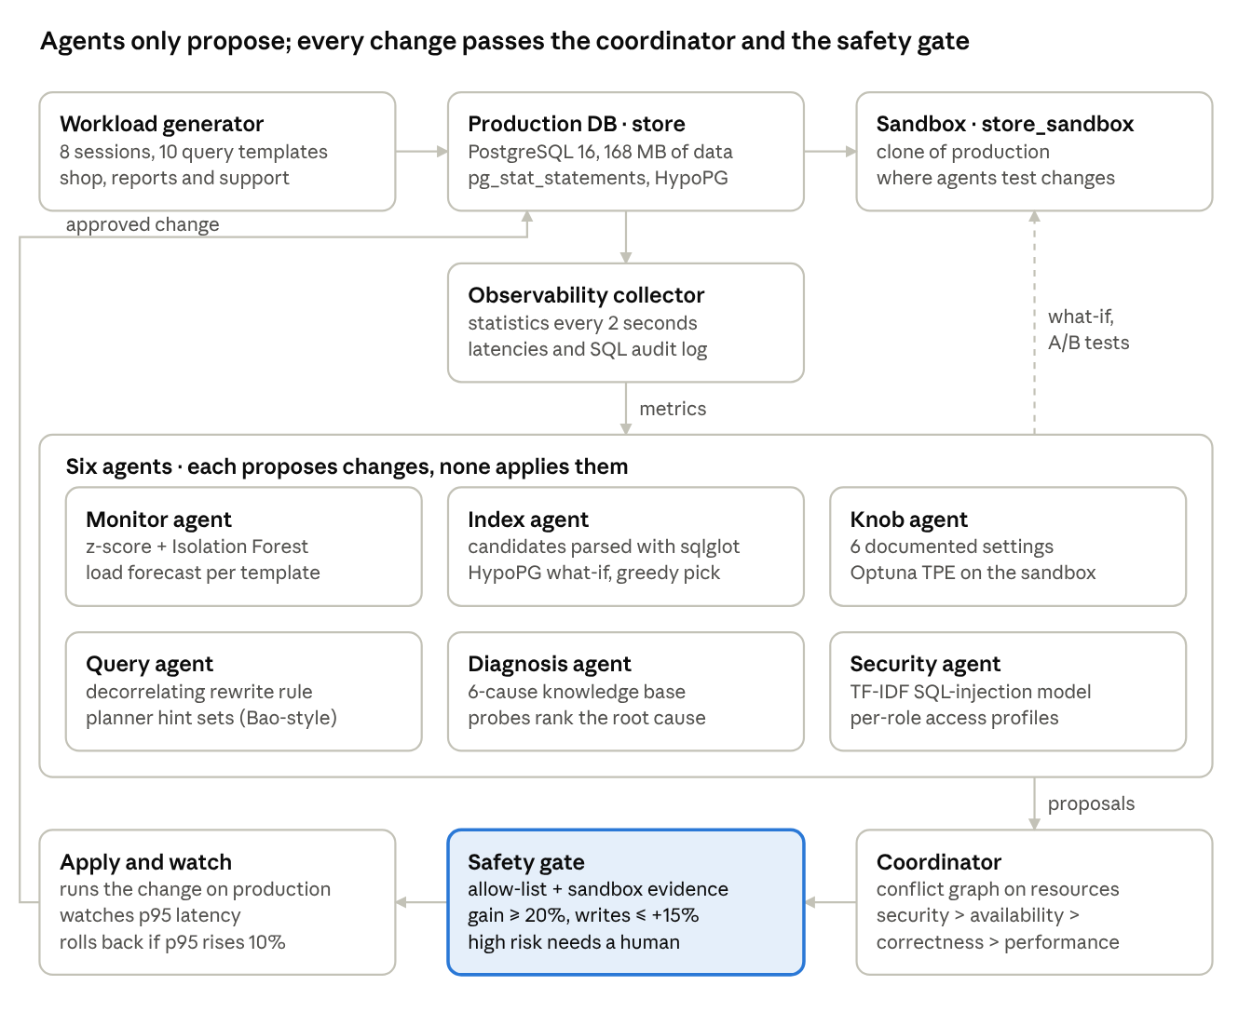
Planned architecture
1
Agents only propose
They read telemetry, test on the sandbox and emit action SQL, rollback SQL, resources, risk and evidence.
2
One path to production
Only the coordinator and safety gate apply changes.
3
Conflicts resolved first
Proposals that touch the same resource wait for the next window.
4
Evidence before action
The gate demands sandbox measurements; risky actions need a person.
Notes:
Agents think, the coordinator and gate act. Telemetry flows down to the agents, proposals flow to the coordinator, and only gated changes reach production.

Slide 8
Six specialist agents
Monitor agent
Index agent
Knob agent
Baseline per metric + Isolation Forest [26]; alerts on 4σ for two ticks; forecasts load per template [11].
Candidates from parsed SQL; HypoPG what-if costs [16]; greedy pick [17]; then real timing on the sandbox [5].
Six reload-only settings from the manual [15]; 14 Optuna TPE trials [27] replaying the workload.
Query agent
Diagnosis agent
Security agent
Rule R1 decorrelates COUNT(*) subqueries; checks identical rows; tries Bao-style hint sets [6].
DBSherlock-style predicates [7]; six-cause knowledge base with SQL probes; routes the fix.
TF-IDF + logistic regression on search SQL; per-role access profiles [9]; revoke and end sessions.
Notes:
Each agent uses a published technique: monitor, index, knob, query, diagnosis and security.

Slide 9
Coordinator and safety gate
1
Order
2
Defer conflicts
3
Static policy
Priority: security → availability → correctness → performance; then gain and risk.
A proposal whose table, planner, memory, session or role is already claimed waits a window.
Allow-listed statement shapes; settings within documented ranges; rollback present.
4
Sandbox evidence
5
Risk
6
Watch and roll back
≥ 20% measured gain; ≤ 15% extra write cost; rewrites return identical rows.
Low and medium apply automatically; ending sessions or revoking access needs a human.
If p95 of affected templates rises > 10%, run the rollback statement.
Steps 1–2: coordinator · Steps 3–5: safety gate · Step 6: coordinator after apply
Notes:
Two steps in the coordinator, three in the gate, one after apply.

Slide 10

Expected outcomes
Working prototype
Measured tuning gains
Six agents, coordinator and gate running end to end on a live database.
Before-and-after p95 latency and throughput for every query template.
Incident handling
Proof of safety
Time to detect, cause accuracy and time to fix for seven fault types.
An ablation showing what the gate prevents.
Notes:
Four outcomes to deliver by the final review.

Slide 11
References
1
A. Pavlo et al., “Self-Driving Database Management Systems,” CIDR, 2017.
2
G. Li, X. Zhou and L. Cao, “AI Meets Database: AI4DB and DB4AI,” SIGMOD (tutorial), 2021.
3
D. Van Aken, A. Pavlo, G. J. Gordon and B. Zhang, “Automatic DBMS Tuning Through Large-scale Machine Learning,” SIGMOD, 2017.
4
S. Das et al., “Automatically Indexing Millions of Databases in Microsoft Azure SQL Database,” SIGMOD, 2019.
5
B. Ding et al., “AI Meets AI: Leveraging Query Executions to Improve Index Recommendations,” SIGMOD, 2019.
6
R. Marcus et al., “Bao: Making Learned Query Optimization Practical,” SIGMOD, 2021.
7
D. Y. Yoon, N. Niu and B. Mozafari, “DBSherlock: A Performance Diagnostic Tool for Transactional Databases,” SIGMOD, 2016.
8
X. Zhou et al., “D-Bot: Database Diagnosis System using Large Language Models,” PVLDB 17(10), 2024.
9
A. Kamra, E. Terzi and E. Bertino, “Detecting Anomalous Access Patterns in Relational Databases,” VLDB Journal 17(5), 2008.
10
Q. Wu et al., “AutoGen: Enabling Next-Gen LLM Applications via Multi-Agent Conversation,” arXiv:2308.08155, 2023.
Notes:
References.

Slide 12
Thank you
Monitor
Security
Index
Questions and feedback welcome
PostgreSQL
Shauryaveer Singh Dabas · 24BCE0416
MADA: A Multi-Agent AI System for Autonomous Database Administration
Diagnose
Knobs
Query
Notes:
Thank you.

