Slide 1







MADA: Multi-Agent AI for Autonomous Database Administration
BCSE302L · DATABASE SYSTEMS · REVIEW II
Monitor
Security
Index
PostgreSQL
Six AI agents that monitor, tune, repair and protect a PostgreSQL database — with every change tested before it reaches production
Diagnose
Knobs
Shauryaveer Singh Dabas
24BCE0416
B.Tech Computer Science and Engineering · VIT Vellore
Query
Notes:
My project is MADA, a multi-agent AI system for autonomous database administration. This is Review II.

Slide 2
Abstract
20.1 s → 39 ms
Database administration is still largely manual, and the AI tools that automate it each cover one duty and act on predictions. MADA gives six specialist agents one view of a PostgreSQL database; they test every idea on a sandbox clone and send proposals to a coordinator and safety gate that admit only measured improvements, keep irreversible actions for a human and roll back regressions. A working prototype was evaluated on a 168 MB e-commerce database under a live eight-session workload.
complaints report, p95
3.7×
throughput, 65 → 240 statements/s
7 of 7
injected faults detected within 10.1 s
4 of 4
harmful changes stopped by the safety gate
Notes:
In one sentence: six agents, one coordinator, one safety gate; measured gains on latency, throughput, fault handling and safety.

Slide 3
What a database administrator does
Monitoring
Indexing
Why automating it is hard
The duties interact: an index changes plans, memory and write cost
Existing AI tools each own one duty and can undo each other
Optimiser estimates often mispredict real run time [5]
An agent with credentials can run a wrong statement on production
Watch metrics, locks and slow queries around the clock
Create indexes the workload actually needs
Configuration
Query tuning
Tune memory, planner and parallelism settings
Rewrite or re-plan slow statements
Troubleshooting
Security
Find the root cause of slowdowns and outages
Spot SQL injection and abnormal access
Notes:
Six duties; they interact; existing tools each own one; estimates mislead; and an unsupervised agent is risky.

Slide 4




Problem statement
Slow pages and reports
A small online store runs PostgreSQL with no DBA. It uses default settings and primary-key indexes only, incidents are noticed when customers complain, the product search is injectable, and every fix goes straight to production.
Foreign-key lookups scan whole tables; one report runs a subquery per product.
Incidents found late
Lock pile-ups, bloat and connection storms go unnoticed until users complain.
Security blind spots
Search builds SQL by string concatenation; support can read payment data unmonitored.
THE PROBLEM
Perform all six duties continuously, coordinate them, and prove every change on a copy before applying it.
Risky fixes
No test copy, no evidence, no planned rollback.
Notes:
The store's database has four pain points; the problem is to handle all six duties together and safely.

Slide 5
Literature review
01
PART 1 OF 3
22 papers across tuning, indexing, query optimisation, diagnosis and security

Slide 6
Self-driving databases and knob tuning
Work | Year | Contribution | Limitation
Self-driving DBMS [1] | 2017 | DBMS that forecasts its workload and plans its own changes | Vision paper; custom in-memory DBMS
QB5000 [11] | 2018 | Forecasts query arrival rates per template cluster | Forecasting only; no actions
OtterTune [3] | 2017 | Reuses past tuning data; Gaussian-process knob tuning | Knobs only; needs many test runs
CDBTune [12] · QTune [13] | 2019 | Deep RL learns knob settings; QTune is query-aware | Long training; tries settings on the instance
DB-BERT [14] | 2022 | Language model extracts tuning hints from manuals | Depends on text; knobs only
GPTuner [15] | 2024 | LLM reads manuals, narrows ranges, then Bayesian optimisation | LLM cost; knobs only
Takeaway Strong tuners — but configuration only, and learning ones experiment on the instance.
Notes:
Strong tuners — but configuration only, and learning ones experiment on the instance.

Slide 7
Index selection
Work | Year | Contribution | Limitation
AutoAdmin [16] | 1997 | What-if costing of hypothetical indexes | Trusts optimiser estimates
Extend [17] | 2019 | Recursive multi-attribute index selection under a budget | Cost-model bound; index only
Index-selection evaluation [18] | 2020 | Compares eight algorithms on TPC-H, TPC-DS, JOB | Estimated costs, not run times
DRL index advisor [19] | 2020 | Deep Q-network picks indexes from candidates | Per-workload training
Azure auto-indexing [4] | 2019 | Indexes millions of databases; reverts regressions | Validates after deploy; index only
AI Meets AI [5] | 2019 | Shows cost estimates misjudge indexes; learns from executions | Needs execution history
Takeaway Cost estimates mislead [5]; only Azure checks real execution, and only after deploying.
Notes:
Cost estimates mislead [5]; only Azure checks real execution, and only after deploying.

Slide 8
Query optimisation and agents
Work | Year | Contribution | Limitation
Neo [20] | 2019 | End-to-end learned query optimiser | Long training; fragile to change
Bao [6] | 2021 | Chooses planner hint sets per query on PostgreSQL | Hint sets only
LearnedRewrite [21] | 2021 | Monte Carlo tree search over rewrite rules | Fixed rule set; estimated benefit
LLM-R2 [22] | 2024 | LLM picks rules for a rule engine; rewrites stay valid | LLM cost; rewrite only
ReAct [25] · AutoGen [10] | 2023 | Agent loops and multi-agent conversation | No database safety model
Takeaway Hints and rewrites help, but none ties into indexing or a safety model.
Notes:
Hints and rewrites help, but none ties into indexing or a safety model.

Slide 9
Diagnosis and security
Work | Year | Contribution | Limitation
DBSherlock [7] | 2016 | Predicates separate anomaly from normal metrics | User marks anomaly; no fix
iSQUAD [23] | 2020 | Matches slow-query incidents to known cases | Needs labelled cases
D-Bot [8] | 2024 | Collaborating LLMs reason to a root cause | Cost; fixes not tested
Kamra et al. [9] | 2008 | Per-role SQL access profiles flag anomalies | Detection only
Halfond et al. [24] | 2006 | Taxonomy of SQL-injection attacks and defences | Survey; no detector
Takeaway Explanations and detectors exist, but fixes are not tested and security runs apart.
Notes:
Explanations and detectors exist, but fixes are not tested and security runs apart.

Slide 10




Gaps identified
One duty per tool
No system coordinates knobs, indexes, queries, diagnosis and security.
Predictions over measurement
Execution checks exist for indexes only — and in [4] only after deploy.
No safety layer for agents
LLM tools propose SQL with no allow-list, evidence check or human approval.
Security apart from tuning
Nothing decides which action comes first when they compete.
Evaluation in isolation
Few end-to-end tests with live workloads, injected faults and ablations.
Notes:
Five gaps; MADA addresses each one.

Slide 11
Proposed method
02
PART 2 OF 3
Six agents, a coordinator and a safety gate

Slide 12
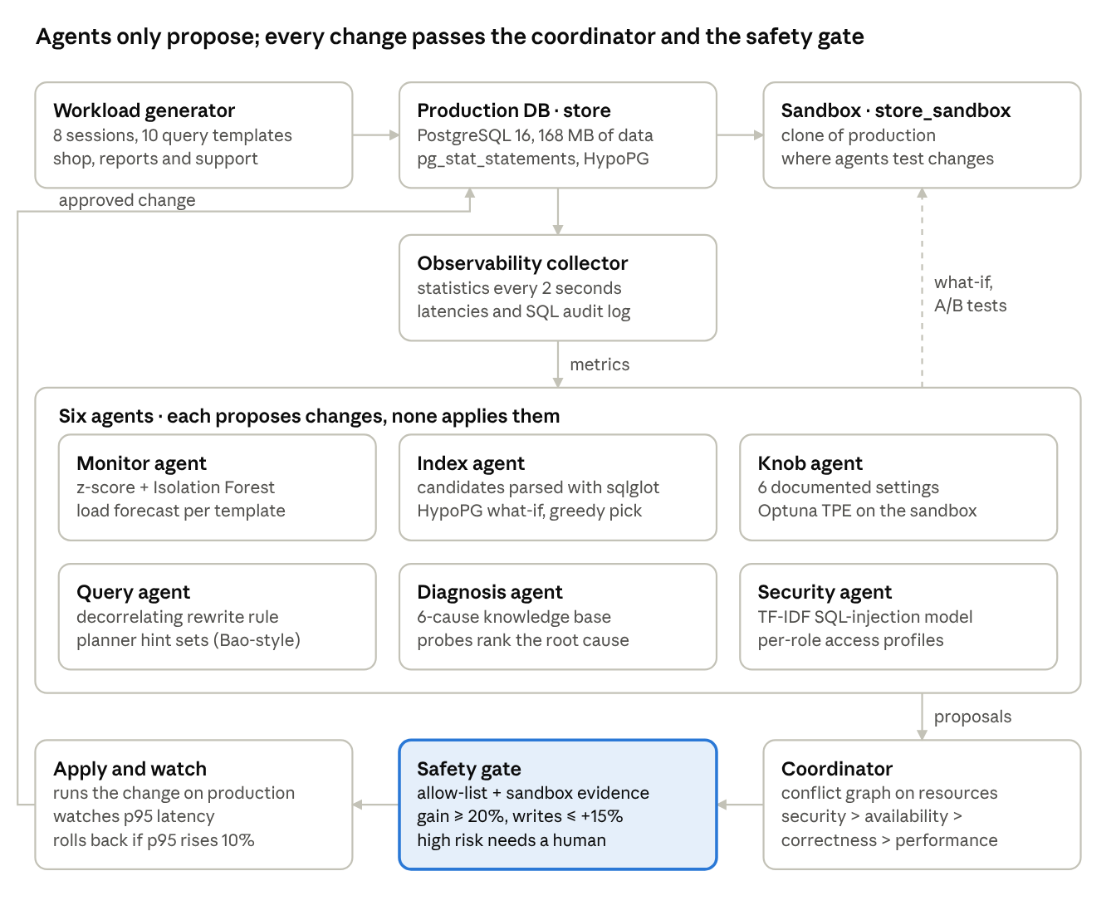
Architecture
1
Agents only propose
They read telemetry, test on the sandbox and emit action SQL, rollback SQL, resources, risk and evidence.
2
One path to production
Only the coordinator and safety gate apply changes.
3
Conflicts resolved first
Proposals that touch the same resource wait for the next window.
4
Evidence before action
The gate demands sandbox measurements; risky actions need a person.
Notes:
Agents think, the coordinator and gate act. Telemetry flows down to the agents, proposals flow to the coordinator, and only gated changes reach production.

Slide 13
Six specialist agents
Monitor agent
Index agent
Knob agent
Baseline per metric + Isolation Forest [26]; alerts on 4σ for two ticks; forecasts load per template [11].
Candidates from parsed SQL; HypoPG what-if costs [16]; greedy pick [17]; then real timing on the sandbox [5].
Six reload-only settings from the manual [15]; 14 Optuna TPE trials [27] replaying the workload.
Query agent
Diagnosis agent
Security agent
Rule R1 decorrelates COUNT(*) subqueries; checks identical rows; tries Bao-style hint sets [6].
DBSherlock-style predicates [7]; six-cause knowledge base with SQL probes; routes the fix.
TF-IDF + logistic regression on search SQL; per-role access profiles [9]; revoke and end sessions.
Notes:
Each agent uses a published technique: monitor, index, knob, query, diagnosis and security.

Slide 14
Coordinator and safety gate
1
Order
2
Defer conflicts
3
Static policy
Priority: security → availability → correctness → performance; then gain and risk.
A proposal whose table, planner, memory, session or role is already claimed waits a window.
Allow-listed statement shapes; settings within documented ranges; rollback present.
4
Sandbox evidence
5
Risk
6
Watch and roll back
≥ 20% measured gain; ≤ 15% extra write cost; rewrites return identical rows.
Low and medium apply automatically; ending sessions or revoking access needs a human.
If p95 of affected templates rises > 10%, run the rollback statement.
Steps 1–2: coordinator · Steps 3–5: safety gate · Step 6: coordinator after apply
Notes:
Two steps in the coordinator, three in the gate, one after apply.

Slide 15
Result
03
PART 3 OF 3
One tuning cycle on the prototype

Slide 16
p95 latency fell on all ten templates
−100%
complaints report: 20.1 s → 39 ms
−99%
order detail: 200 → 2.7 ms
3.7×
throughput: 65 → 240 statements/s
Notes:
p95 latency fell on all ten templates. The analytics reports not touched directly also sped up, most likely because the CPUs were freed once order lookups stopped scanning whole tables.

Slide 17
Tuning cycle: 4 applied, 3 rejected on evidence
Proposal | Agent | Decision | Evidence
Rewrite R1, complaints report | Query | Applied | 24.2 s → 62 ms on sandbox; identical rows
Index orders(order_date) | Index | Rejected | 2nd-best what-if cost, but support lookups 61 → 776 ms
Index order_items(order_id) | Index | Applied | Order detail p95 202 → 10 ms; writes unchanged
Index orders(customer_id, order_date) | Index | Applied | Order history + support p95 98 → 3.4 ms
Index reviews(product_id, rating) | Index | Rejected | Rewritten complaints report 23% slower
Index reviews(product_id, review_date) | Index | Applied | Product reviews p95 64 → 1.1 ms
Five-setting configuration | Knob | Rejected | 7% gain: below 20% and within noise
Takeaway Two of the five indexes that looked best on estimated cost were harmful when actually run.
Notes:
Seven proposals; the sandbox evidence decided each one.

Slide 18
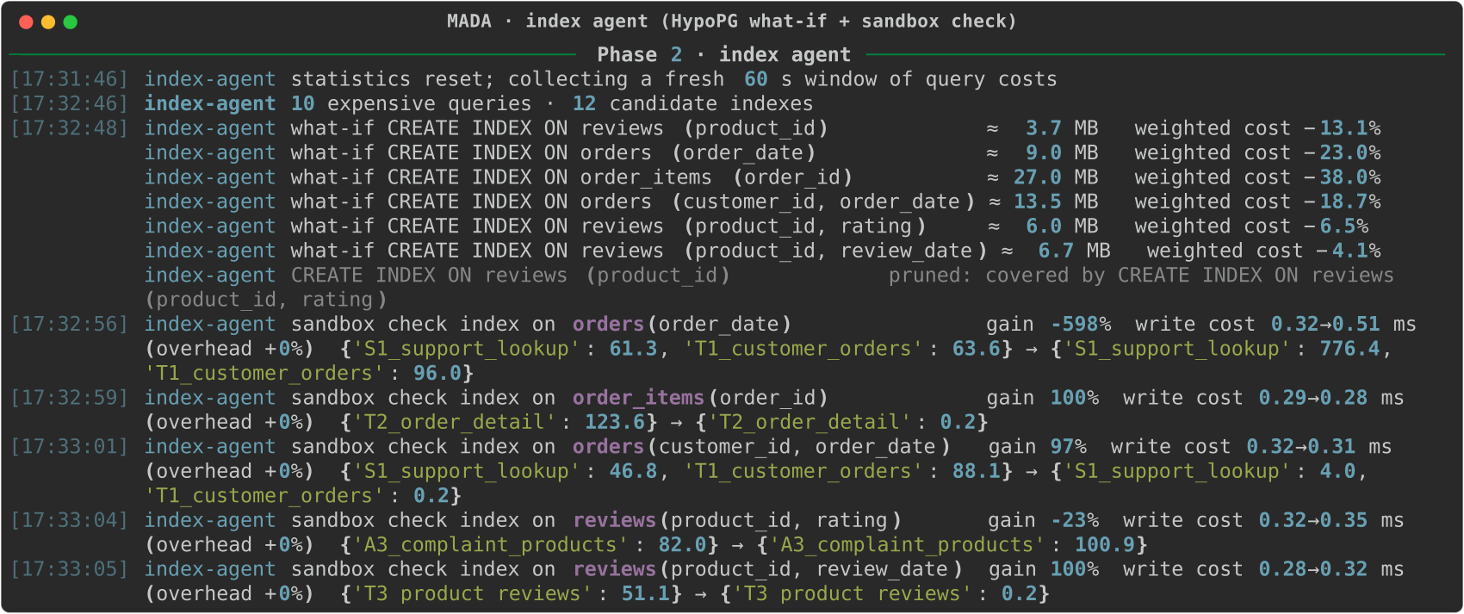
Index agent: estimate, then measure
HypoPG ranked orders(order_date) second by cost — on the sandbox it made support lookups 12× slower, so it was never proposed for production.
Notes:
Screenshot from the run: what-if estimates first, then real sandbox timings.

Slide 19
Conclusion
1
Six agents, one coordinator, one safety gate on a live PostgreSQL database
No existing system coordinates the six administration duties or verifies actions before production. MADA does both — and the prototype already shows it.
2
One tuning cycle: p95 down on all ten templates, throughput 3.7×
3
Two cost-preferred indexes rejected because measurement disagreed
4
Final review: faults, security, gate ablation and comparison
Notes:
Conclusion.

Slide 20
References (1 of 3)
1
A. Pavlo et al., “Self-Driving Database Management Systems,” CIDR, 2017.
2
G. Li, X. Zhou and L. Cao, “AI Meets Database: AI4DB and DB4AI,” SIGMOD (tutorial), 2021.
3
D. Van Aken, A. Pavlo, G. J. Gordon and B. Zhang, “Automatic DBMS Tuning Through Large-scale Machine Learning,” SIGMOD, 2017.
4
S. Das et al., “Automatically Indexing Millions of Databases in Microsoft Azure SQL Database,” SIGMOD, 2019.
5
B. Ding et al., “AI Meets AI: Leveraging Query Executions to Improve Index Recommendations,” SIGMOD, 2019.
6
R. Marcus et al., “Bao: Making Learned Query Optimization Practical,” SIGMOD, 2021.
7
D. Y. Yoon, N. Niu and B. Mozafari, “DBSherlock: A Performance Diagnostic Tool for Transactional Databases,” SIGMOD, 2016.
8
X. Zhou et al., “D-Bot: Database Diagnosis System using Large Language Models,” PVLDB 17(10), 2024.
9
A. Kamra, E. Terzi and E. Bertino, “Detecting Anomalous Access Patterns in Relational Databases,” VLDB Journal 17(5), 2008.
10
Q. Wu et al., “AutoGen: Enabling Next-Gen LLM Applications via Multi-Agent Conversation,” arXiv:2308.08155, 2023.
Notes:
References.

Slide 21
References (2 of 3)
11
L. Ma et al., “Query-based Workload Forecasting for Self-Driving DBMSs,” SIGMOD, 2018.
12
J. Zhang et al., “An End-to-End Automatic Cloud Database Tuning System Using Deep RL,” SIGMOD, 2019.
13
G. Li, X. Zhou, S. Li and B. Gao, “QTune: A Query-Aware Database Tuning System with Deep RL,” PVLDB 12(12), 2019.
14
I. Trummer, “DB-BERT: A Database Tuning Tool that ‘Reads the Manual’,” SIGMOD, 2022.
15
J. Lao et al., “GPTuner: A Manual-Reading Database Tuning System via GPT-Guided Bayesian Optimization,” PVLDB 17(8), 2024.
16
S. Chaudhuri and V. R. Narasayya, “An Efficient, Cost-Driven Index Selection Tool for Microsoft SQL Server,” VLDB, 1997.
17
R. Schlosser, J. Kossmann and M. Boissier, “Efficient Scalable Multi-Attribute Index Selection Using Recursive Strategies,” ICDE, 2019.
18
J. Kossmann et al., “Magic Mirror in My Hand… An Experimental Evaluation of Index Selection Algorithms,” PVLDB 13(11), 2020.
19
H. Lan, Z. Bao and Y. Peng, “An Index Advisor Using Deep Reinforcement Learning,” CIKM, 2020.
20
R. Marcus et al., “Neo: A Learned Query Optimizer,” PVLDB 12(11), 2019.
Notes:
References.

Slide 22
References (3 of 3)
21
X. Zhou, G. Li, C. Chai and J. Feng, “A Learned Query Rewrite System using Monte Carlo Tree Search,” PVLDB 15(1), 2021.
22
Z. Li et al., “LLM-R2: A Large Language Model Enhanced Rule-based Rewrite System,” PVLDB 18(1), 2024.
23
M. Ma et al., “Diagnosing Root Causes of Intermittent Slow Queries in Cloud Databases,” PVLDB 13(8), 2020.
24
W. G. J. Halfond, J. Viegas and A. Orso, “A Classification of SQL-Injection Attacks and Countermeasures,” ISSSE, 2006.
25
S. Yao et al., “ReAct: Synergizing Reasoning and Acting in Language Models,” ICLR, 2023.
26
F. T. Liu, K. M. Ting and Z.-H. Zhou, “Isolation Forest,” ICDM, 2008.
27
T. Akiba et al., “Optuna: A Next-generation Hyperparameter Optimization Framework,” KDD, 2019.
28
J. Bergstra, R. Bardenet, Y. Bengio and B. Kégl, “Algorithms for Hyper-Parameter Optimization,” NeurIPS, 2011.
Notes:
References.

Slide 23
Thank you
Monitor
Security
Index
Questions and feedback welcome
PostgreSQL
Shauryaveer Singh Dabas · 24BCE0416
MADA: A Multi-Agent AI System for Autonomous Database Administration
Diagnose
Knobs
Query
Notes:
Thank you.

