Slide 1
19ECE457- Wavelets and Application
Group NO: 13
Wavelet-Based Image Compression Using EZW algorithm
Team mates:
CB.EN.U4ECE21201 | - | Achanta Kiran Sai Pavan
CB.EN.U4ECE21205 | - | B Raj Ganesh
CB.EN.U4ECE21256 | - | Sivaraju Venkata Sai Karthik

Slide 2
Objective:
Use the Embedded Zero Tree Wavelet (EZW) method to compress and decompress images, applying wavelet transforms and zero-tree encoding method for efficient data reduction.
The decompression process reconstructs the image using inverse EZW operations, and the system evaluates the compression effectiveness.
Steps in EZW for image compression:
Apply Discrete Wavelet Transform (DWT)
Coefficient thresholding
Zero-tree Structure
Progressive encoding
Entropy coding
Decoding

Slide 3
Libraries used:
PIL
Numpy
Bitarray
Utils
Pywt(pywavelets)

Slide 4
EZW Coding:
It is a quantization method
Compressing an image into an array of bitstream
EZW uses wavelet transforms to break down an image into hierarchical subbands
Using DWT (Discrete Wavelet Transform), image is divided into subbands.
The 4 subbands: 1.) LL: Low-frequency components
2.) LH: Vertical high-frequency
3.) HL: Horizontal high-frequency
4.) HH: Diagonal high-frequency
Result of the wavelet transform is a set of coefficients representing different frequency details
Multi-level decomposition: Perform wavelet decomposition on the LL subband to further break down the approximation

Slide 5
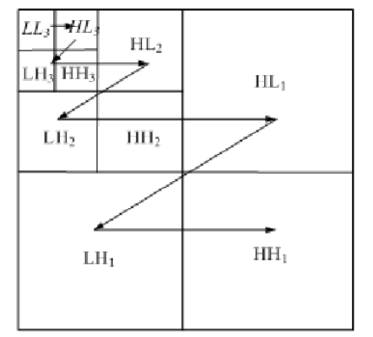
Zerotree Structure:
Hierarchical Tree Representation:
Coefficients are highly significant in lower frequency subbands

Slide 6
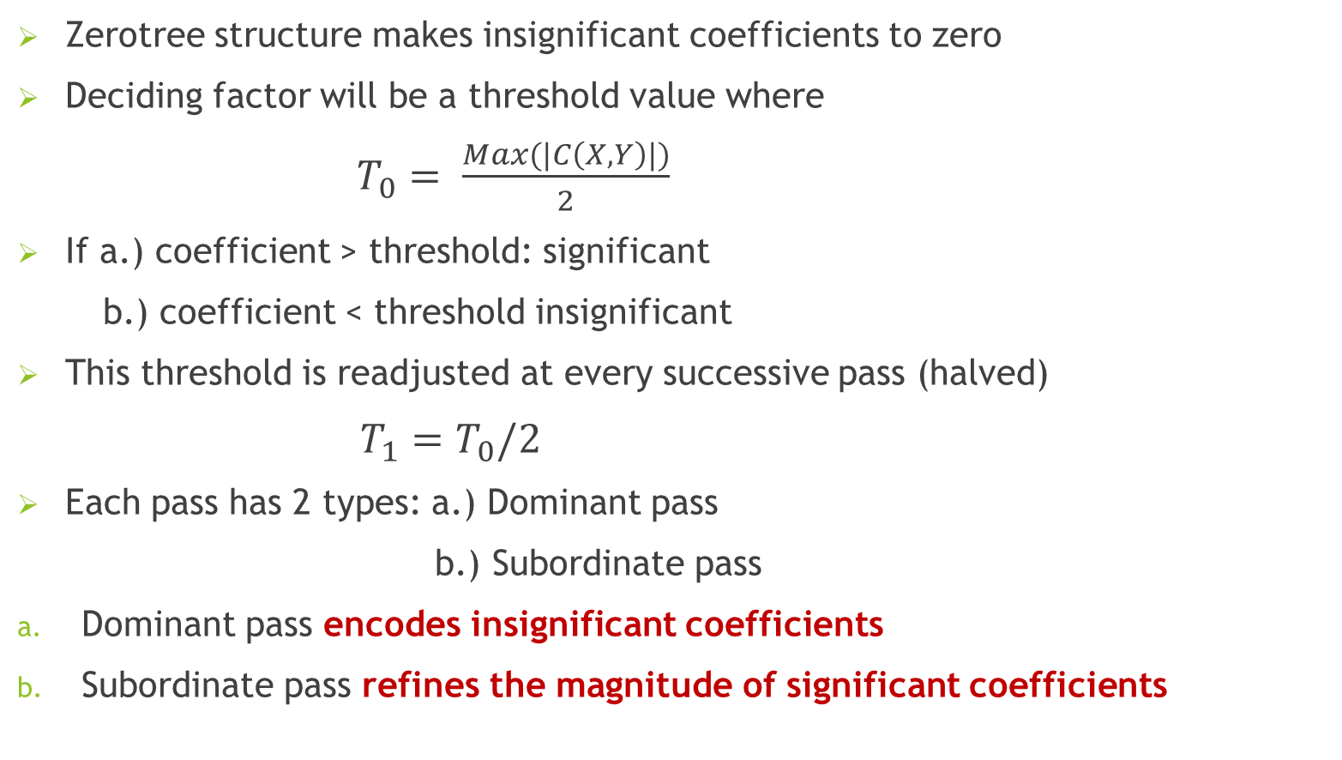
Zerotree structure makes insignificant coefficients to zero
Deciding factor will be a threshold value where
$T_{0}= \frac{Max(|C\left(X,Y\right)|)}{2}$
If a.) coefficient > threshold: significant
b.) coefficient < threshold insignificant
This threshold is readjusted at every successive pass (halved)
$T_{1}=T_{0}/2$
Each pass has 2 types: a.) Dominant pass
b.) Subordinate pass
Dominant pass encodes insignificant coefficients
Subordinate pass refines the magnitude of significant coefficients

Slide 7
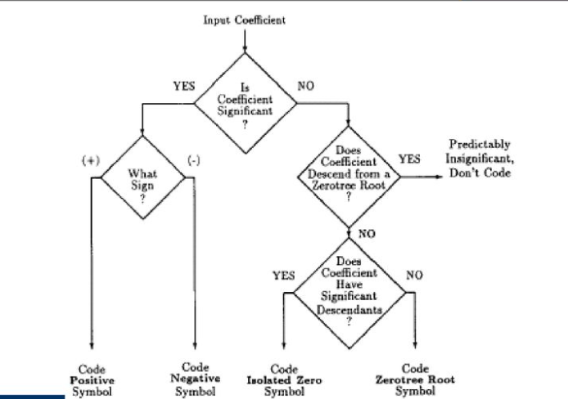
Flowchart for encoding a coefficient of the significance map:

Slide 8
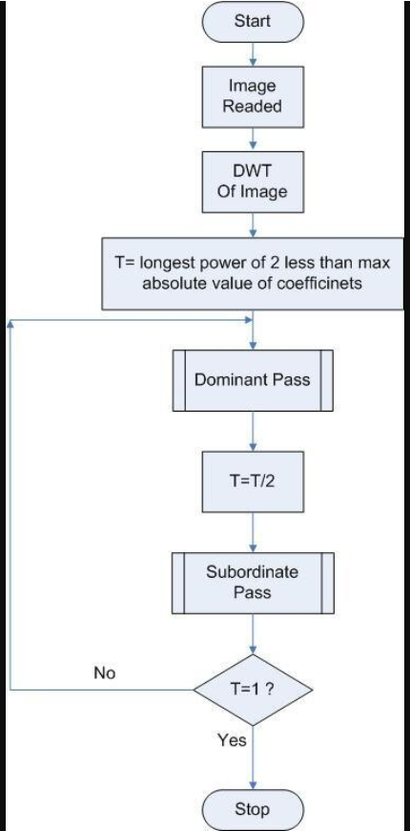
Overall flow:

Slide 9
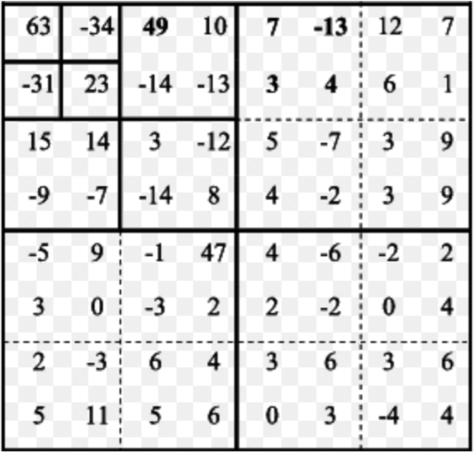
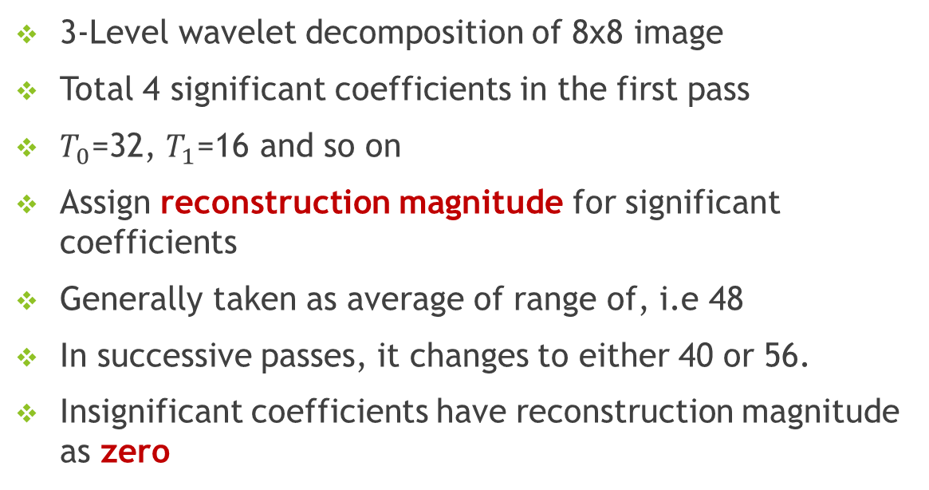
Example:
3-Level wavelet decomposition of 8x8 image
Total 4 significant coefficients in the first pass
$T_{0}$=32, $T_{1}$=16 and so on
Assign reconstruction magnitude for significant coefficients
Generally taken as average of range of, i.e 48
In successive passes, it changes to either 40 or 56.
Insignificant coefficients have reconstruction magnitude as zero

Slide 10
Limitations:
EZW assumes that you are splitting only the LL subband
Neighbourhood similarity between coefficients are not explicitly mentioned
To overcome these limitations, EBCOT (EMBEDDED BLOCK CODING WITH OPTIMIZED TRUNCATION) is proposed
Here truncation of bitstream is specified at point where trade off between quality and bitrate occurs.

Slide 11
THANK YOU

