Slide 1
PCA based feature selection model to predict the insurance fraud detection

Slide 2
Abstract
The ultimate focus of the insurance agency is the management of financial risks, since it includes a sizable amount of daily transactions. It is mandatory for the insurance industry to develop the capability of identifying the fraudulent activities with increased accuracy in order to minimize the excessive unwarranted loss due to claim leakage. Initially, many fraud detecting techniques has been introduced and it relies on the heuristics around fraud indicators, also on the checklist prepared about frauds. However, the above mentioned traditional techniques highly relies on the manual intervention. Therefore, for eliminating the above mentioned issues, the insurance companies are looking towards machine learning based fraud detection techniques. In this project, initially a block chain technique is presented as a secure network by the insurance agencies to detect, store and share different customer informations. Then, a PCA based feature selection model PC-RFC algorithm is used for classifying the insurance frauds. Additionally, to analyse the working of the proposed work, it is implemented in Python software.

Slide 3
Proposed System:
To successfully create a model that uses ML Algorithms that ultimately aid in detecting fraud insurance claims effectively and efficiently and help the insurance industries. Globally, there are over a thousand companies in the insurance market, and they gather premiums of over one trillion dollars annually. The most common insurance fraud is fabricating accident claims, which may be done with a vehicle. Utilizing machine learning techniques, this research aims to detect car insurance fraud.

Slide 4
Implementation:
Data collection
Data Preprocessing
Data cleaning
Oversampling
Data Analysis

Slide 5
Data collection: Gathering data from publically available sources for training a machine learning model is the initial stage in a machine learning pipeline. Data collection involves gathering information from diverse sources to address pertinent questions. The accuracy of the predictions generated by a model is inherently tied to the quality of the data used for its training. Challenges during data collection include unreliable data, missing data, and data imbalance.To mitigate these problems, data preprocessing is conducted on the collected data.
Data Preprocessing: Because they are fragmentary, inconsistent, and devoid of specific behavioral patterns, raw data from the real world are probably not dependable. Thus, pre-processing is done after data collection to clean up the data and prepare it for machine-learning model construction.
Data cleaning: Erroneously added or classified data can be removed manually or automatically. Imputation of data: Standard deviation, mean, and median are three common methods most machine-learning systems use to balance or fill in missing values

Slide 6
Oversampling: Biased or unbalanced datasets can be added to the underrepresented classes after being corrected using strategies like oversampling and repetition. Exploratory
Data Analysis: Exploratory Data Analysis, abbreviated as EDA, fundamentally serves as a form of storytelling that enables the revelation of concealed insights and patterns, the identification of outliers and anomalies, and the validation of underlying structures

Slide 7
1. In the initial step, we import the packages
2. Upload the CSV file (data sets)
3. We can use functions like describe and info functions tothe dataset
4. Data pre-processing i. Missing values (visualizing the missing values) ii. Handling missing values
5. Displaying correlation between features
6. Dropping the columns which are not necessary for prediction
7. Masking Multicollinearity
8. Separating the feature and target columns
9. Encoding Categorical columns
➢ Extracting categorical columns
➢ Drop Dummies
➢ Extracting the numerical columns
➢ Combining the Numerical and Categorical data frames to get the final dataset
10. Outliers Detection

Slide 8
11. Splitting data into training sets and test sets.
12. Scaling the numeric values in the dataset
13. Models creation and training
14. Model Performance Comparison

Slide 9
Literature Survey:
Rama Devi Burri et all [1] presented several machine learning techniques to analysis insurance claims efficiently. They also mentioned three ways to transform machine learning techniques into insurance industry. Additionally they specified different resistances for adapting machine learning to classify claims and challenges in implementing machine learning. Also they evaluated the performance of different algorithms for claim predictions.
Pinak Patel et all [2] proposed a fraud detection framework for health care industry. They classified the fraudulent behaviour in two categories period based claim anomalies and disease based anomalies. Their framework was evaluated on real world medical data which showed efficient results to determine fraud claims.

Slide 10
Sunita Mall et all [3] proposed a study to identify important triggers of fraud and to predict the fraudulent behavior of customers using those identified triggers. They used statistical techniques to identify and predict the triggers.
Najmeddine Dhieb et all [4] evaluated the performance XGBoost algorithm for detecting and classifying different types of auto insurance fraud claims. They compared the proposed algorithm with other state-of-the-art solutions. Also they evaluated the algorithms for several metrics by applying data analysis and exploration techniques.
Shimin LEI et all [5] presented an XGBoost based system for financial fraud detection. They divided system into two parts as automatic part and manual part. The automatic part used large database to train model and manual part is used to monitor the transactions. Then for making final decision they combined machine scoring and manual feedback

Slide 11
Requirements
Operating system : Windows 10/11.
Coding Language : Python.

Slide 12

PCA
The main guiding principle for Principal Component Analysis is FEATURE EXTRACTION i.e. “Features of a data set should be less as well as the similarity between each other is very less.” In PCA, a new set of features are extracted from the original features which are quite dissimilar in nature. So, an n-dimensional feature space gets transformed into an m-dimensional feature space., where the dimensions are orthogonal to each other.
Concept of Orthogonality: (In order to understand this topic, we have to go to the vector space concept in linear algebra) Vector Space is a set of vectors. They can be represented as a linear combination of the smaller set of vectors called BASIS VECTORS.

Slide 13
where a represent ‘n’ scalars and u represents the basis vectors. Basis vectors are orthogonal to each other. Orthogonality of vectors can be thought of an extension of the vectors being perpendicular in a 2-D vector space. So our feature vector (data-set) can be transformed into a set of principal components (just like the basis vectors).
Objectives of PCA:
The new features are distinct i.e. the covariance between the new features (in case of PCA, they are the principal components) is 0.
The principal components are generated in order of the variability in the data that it captures. Hence, the first principal component should capture the maximum variability, the second one should capture the next highest variability etc.
The sum of the variance of the new features / the principal components should be equal to the sum of the variance of the original features.

Slide 14
PCA works on a process called Eigenvalue Decomposition of a covariance matrix of a data set. The steps are as follows:
First, calculate the covariance matrix of a data set.
Then, calculate the eigenvectors of the covariance matrix.
The eigenvector having the highest eigenvalue represents the direction in which there is the highest variance. So this will help in identifying the first principal component.
The eigenvector having the next highest eigenvalue represents the direction in which data has the highest remaining variance and also orthogonal to the first direction. So, this helps in identifying the second principal component.
Like this, identify the top ‘k’ eigenvectors having top ‘k’ eigenvalues to get the ‘k’ principal components.

Slide 15
Random Forest is a popular machine learning algorithm for several reasons:
High accuracy: Random Forest has been shown to be highly accurate in a wide range of applications, particularly when compared to single decision trees.
Robustness: Random Forest is less sensitive to noise and outliers in the data, as it aggregates the predictions of many individual decision trees, rather than relying on a single tree.
Scalability: Random Forest can handle large datasets with many features and observations, making it suitable for a wide range of applications.
Interpretability: Random Forest provides information on the relative importance of different features in the data, making it easier to interpret and understand the model.
Flexibility: Random Forest can be used for both classification and regression tasks, and can handle both categorical and continuous data.
Easy to use: Random Forest is relatively easy to implement and does not require much data preprocessing or feature engineering.

Slide 16
Overall, Random Forest is a versatile and powerful machine learning algorithm that can be applied to a wide range of applications, making it a popular choice for both academic research and industry applications.

Slide 17
The Random Forest algorithm can be summarized in the following steps:
Select a random sample of the data from the dataset. This is known as a bootstrap sample, and it is used to train a single decision tree.
Randomly select a subset of features from the dataset. The number of features to select is a hyperparameter that can be set by the user.
Use the selected features to train the decision tree on the bootstrap sample.
Repeat steps 1–3 multiple times to create a collection of decision trees, each trained on a different bootstrap sample and subset of features.
To make a prediction for a new data point, pass the data point through all the decision trees in the collection and obtain a prediction from each tree.
For classification tasks, use majority voting to obtain the final prediction. For regression tasks, use averaging to obtain the final prediction.

Slide 18
Applications of Random Forest
Random Forest algorithm has been applied to a wide range of applications in various fields, including:
Image Classification: Random Forest has been used for image classification tasks, such as recognizing handwritten digits and identifying objects in images.
Fraud Detection: Random Forest can be used to identify fraudulent transactions in banking and finance.
Medical Diagnosis: Random Forest has been used to diagnose various medical conditions, such as predicting the risk of heart disease and detecting breast cancer.
Natural Language Processing: Random Forest can be used for various NLP tasks, such as sentiment analysis, text classification, and language modeling.
Recommendation Systems: Random Forest has been used to build recommendation systems, such as predicting user preferences for movies, music, or products.
Financial Modeling: Random forests can be used for financial modeling tasks, such as predicting stock prices or identifying investment opportunities.
Environmental Monitoring: Random Forest has been used to analyze environmental data, such as predicting the occurrence of wildfires or detecting changes in land use.

Slide 19
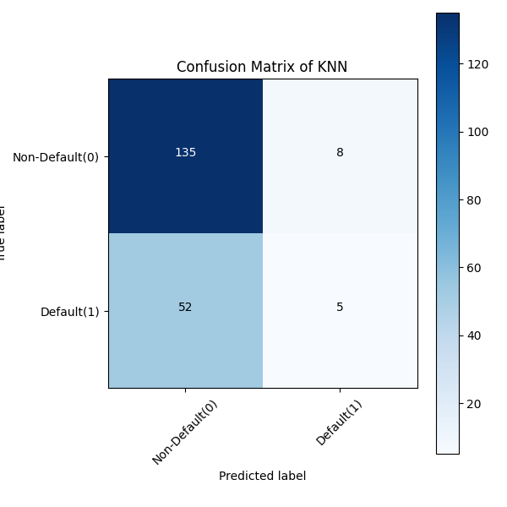
Outputs:

Slide 20
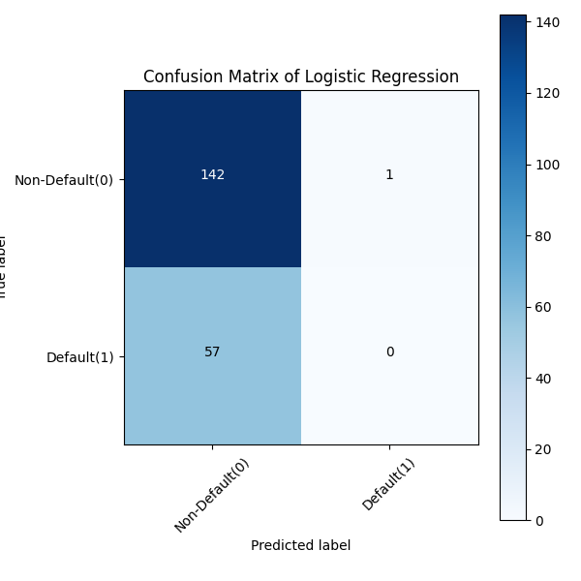

Slide 21
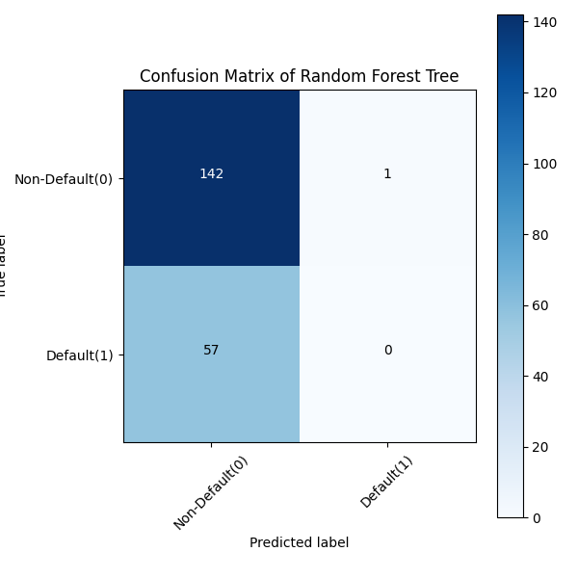

Slide 22
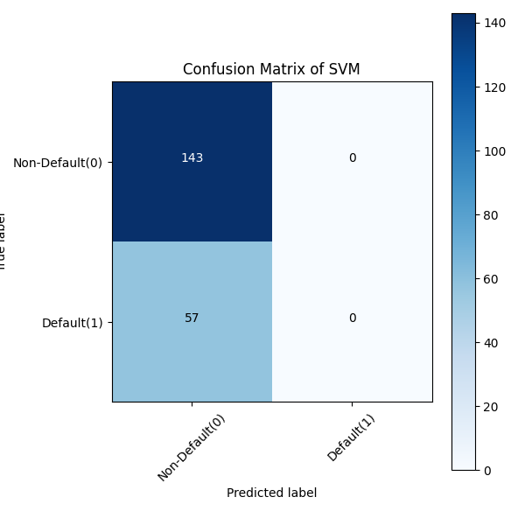

Slide 23
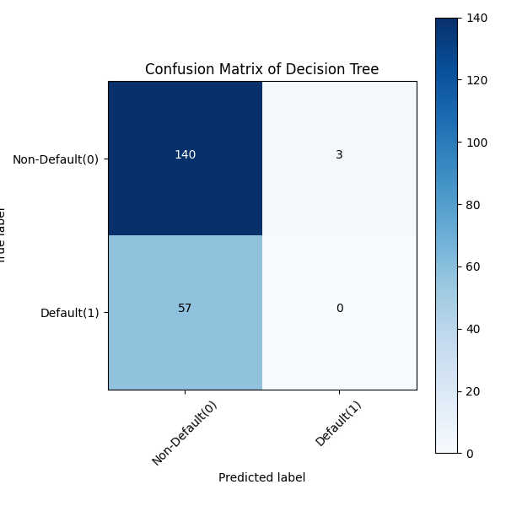

Slide 24


Slide 25
Conclusion
The pursuit of effective fraud detection in insurance claims has been significantly enhanced by the integration of machine learning methodologies. Through this research, a profound exploration into the application of diverse machine learning models for fraud identification in insurance claims has been undertaken, yielding several pivotal insights and implications. The findings underscore the capability of machine learning models to discern fraudulent activities amidst complex and diverse insurance claim datasets. Various models exhibited substantial performance, as evidenced by robust metrics such as accuracy, precision, recall, F1-score, and Accuracy The identification of influential features elucidated crucial patterns and attributes crucial for distinguishing fraudulent from legitimate claims, augmenting the interpretability of model decisions. However, amidst the accomplishments, challenges emerged. The intricacies of handling imbalanced datasets, the delicate balance between model complexity and interpretability, and ethical considerations regarding fairness and privacy necessitate continued attention and refinement in future endeavors.

Slide 26
References:
[1]” Insurance Claim Analysis Using Machine Learning Algorithms” – Rama Devi Burri et all, IJITEE 2019 https://www.ijitee.org/wpcontent/uploads/papers/v8i6s 4/F11180486S419.pdf
[2]” A Survey Paper on Fraud Detection and Frequent Pattern Matching in Insurance claims using Data Mining Techniques” – Pinak Patel et all, IRJET 2019 https://www.irjet.net/archives/V6/i1/IRJET-V6I1104.pdf
[3]” Management of Fraud: Case of an Indian Insurance Company” – Sunita Mall et all, Accounting and Finace Research 2018 http://www.sciedu.ca/journal/index.php/%20afr/article /download/13474/8333 [4]” Extreme Gradient Boosting Machine Learning Algorithm for Safe Auto Insurance operations” – Najmeddine Dhieb, et all, LCVES 2019 https://www.researchgate.net/publication/337508754_E xtreme_Gradient_Boosting_Machine_Learning_Algorithm_F or_Safe_Auto_Insurance_Operations
[5]” An XGBoost Based System for Financial Fraud Detection” – Shimin Lei, et all, E3S Web of Conferences 2020 https://www.e3sconferences.org/articles/e3sconf/pdf/2 020/74/e3sconf_ebldm2020_02042.pdf

