Slide 1
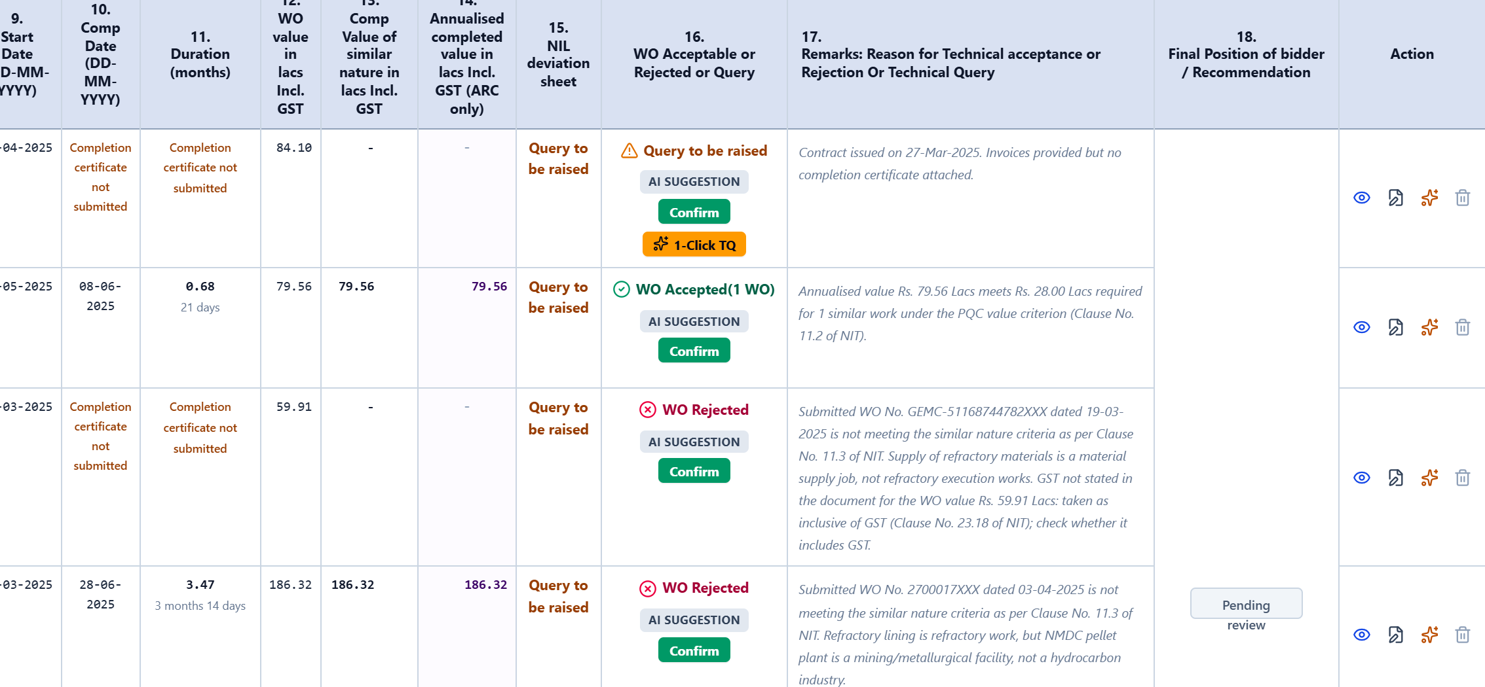
TECHNICAL BID ANALYSIS · NIT / PQC COMPLIANCE
AI Tender Qualification Assistant
From the NIT and the bidders’ dossiers to the committee’s 18-column TBA sheet, with every figure traced back to the page it came from.
Live at tender-scrutiny-assistant.web.app
Feature walkthrough for the department
Notes:
Introduce the tool: it prepares the Technical Bid Analysis for service and works tenders. It reads the NIT and each bidder’s documents, fills the committee’s 18-column sheet, and shows where every figure came from. The engineer stays in charge: nothing is final until confirmed.

Slide 2
WHY WE BUILT IT
Every tender costs the same two to three days of reading
The TBA is built by hand: each work order checked against the NIT, one page at a time.
300–400
16–24 h
896
service and works tenders a year at Paradip Refinery, with purchase tenders on top
engineer-hours per tender to read the dossiers and prepare the TBA sheet by hand
pages in a single tender’s bidder dossiers: work orders, completion certificates, invoices
For every work order the engineer decides:
Similar nature?
Completion proof?
Value incl. GST
ARC annualisation
7-year window
Clause in the remark
AI Tender Qualification Assistant · tender-scrutiny-assistant.web.app
2
Notes:
Scale of the problem. 300 to 400 service and works tenders a year at Paradip alone, 2 to 3 working days each. The six checks at the bottom are what the engineer repeats for every single work order.

Slide 3





HOW IT WORKS
Four steps from NIT to a signed-off sheet
The AI does the reading. The engineer makes every decision.
1
2
3
4
Upload the NIT
Upload dossiers
AI drafts the TBA
Engineer confirms
Qualifying values, similar-nature definition, ARC flag and experience window are read with their clause numbers.
Upload each bidder’s PDFs in any order. Scanned pages are read directly, with no separate OCR step.
All 18 columns filled, each row with its reason, its NIT clause and the page it came from.
Confirm or override each row, raise technical queries, export to Excel and PDF.
Documents are read by Google Gemini’s multimodal model, which reads text and page images, including scans.
AI Tender Qualification Assistant · tender-scrutiny-assistant.web.app
3
Notes:
The whole flow in one slide. The following slides walk through each step on a real tender: 9070C25XXX, refractory repair and maintenance at Paradip, an ARC tender with 3 bidders and 15 work orders.

Slide 4
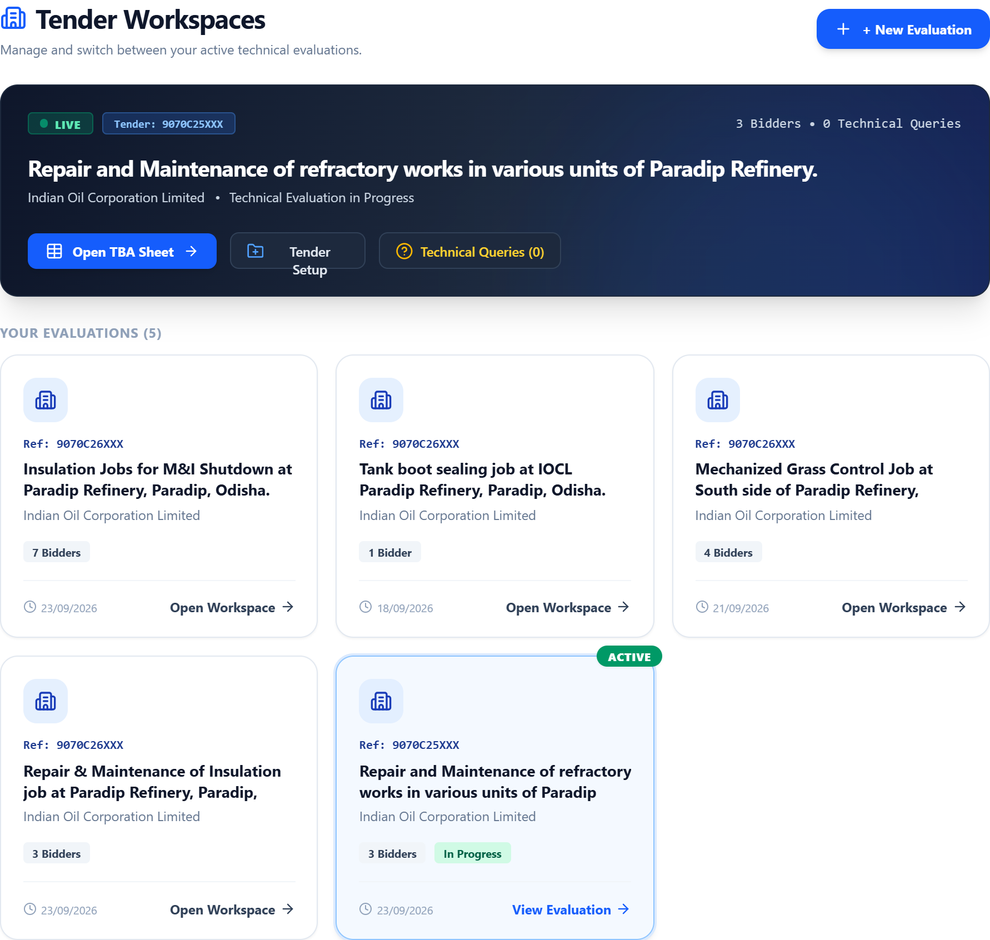




THE WORKSPACE
Each tender is a shared workspace
All evaluations in one place
The live tender sits in the banner with its bidder and query counts. Other evaluations running in parallel are one click away.
Synced for the whole team
Sign in with Google and the tender syncs to the cloud, so colleagues open the same sheet from their own desks.
One editor at a time
An edit lock shows who is working on the sheet, so two people cannot overwrite each other.
Committee set once
Signatories and review panel are configured per tender and print on the exported TBA.
AI Tender Qualification Assistant · tender-scrutiny-assistant.web.app
4
Notes:
Home screen. Each card is a tender evaluation. Real tender reference numbers are masked in these screenshots because the evaluations are still open.

Slide 5
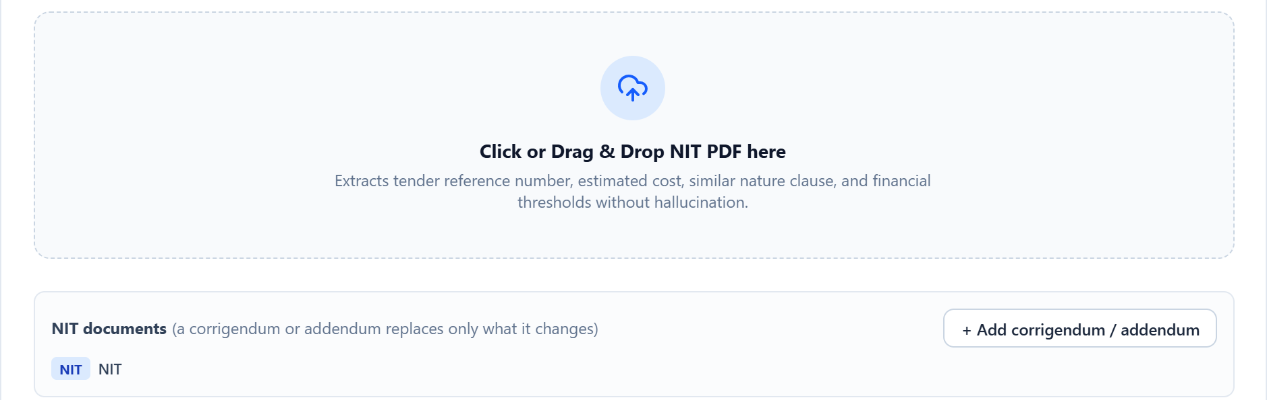
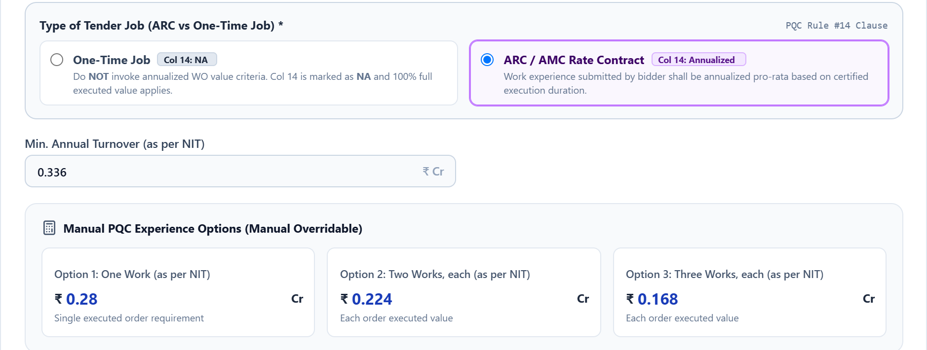
STEP 1 · TENDER SETUP
The NIT is the configuration
Upload the NIT PDF, paste its text, or fill the fields by hand.
Nothing is hard-coded. Qualifying values, similar-nature definition and ARC flag come from this tender’s NIT, so the next tender needs no software change.
Corrigenda and addenda are uploaded on top and replace only what they change.
The original bid-submission date anchors the 7-year experience window. An extension never moves it.
ARC or one-time job decides whether work-order values are annualised (column 14).
AI Tender Qualification Assistant · tender-scrutiny-assistant.web.app
5
Notes:
Tender Setup. The engineer uploads the NIT and verifies what was extracted. The PQC values here (28.00 / 22.40 / 16.80 lakh) and the ARC rule all came from the NIT itself.

Slide 6
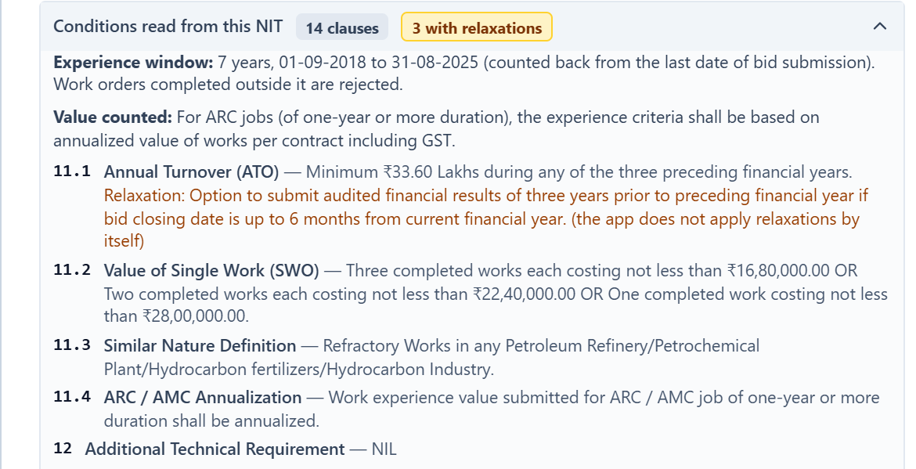

STEP 1 · WHAT THE APP READ
Every condition, with the clause it came from
14
clauses read from this NIT, each kept against its clause number
3
relaxations found and shown to the engineer. None is applied silently.
Matched by subject, not number
A NIT that numbers its value criterion 10.2 instead of 11.2 works unchanged.
AI Tender Qualification Assistant · tender-scrutiny-assistant.web.app
6
Notes:
The experience window (01-09-2018 to 31-08-2025) is counted back from the last date of bid submission. Relaxations are highlighted in orange; the app never applies one by itself.

Slide 7
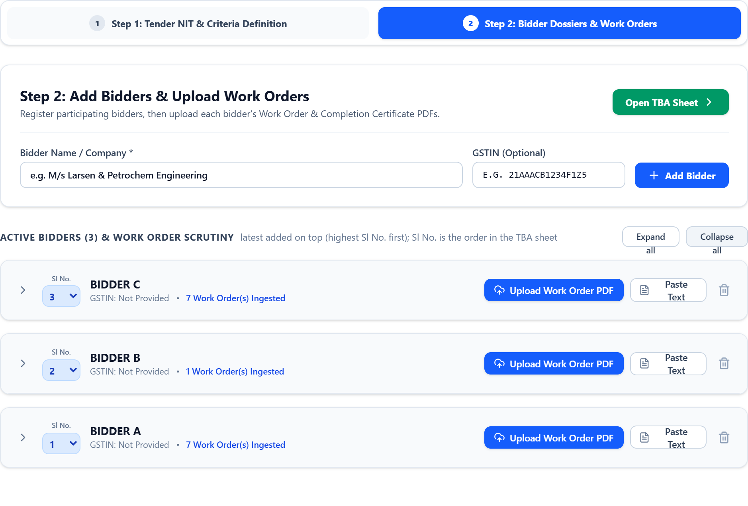
STEP 2 · BIDDER DOSSIERS
Add each bidder once, then upload their documents
Any order, any mix
Work orders, completion certificates, performance statements and CA certificates, in whatever order the bidder sent them.
Scans welcome
Scanned pages are read directly. No separate OCR step.
The committee’s order
The Sl No. selector sets the bidder order in the TBA sheet. Long dossiers collapse out of the way.
AI Tender Qualification Assistant · tender-scrutiny-assistant.web.app
7
Notes:
Bidders are shown as Bidder A, B, C because the evaluation is still open. Bidder A has 7 work orders, B has 1, C has 7.

Slide 8
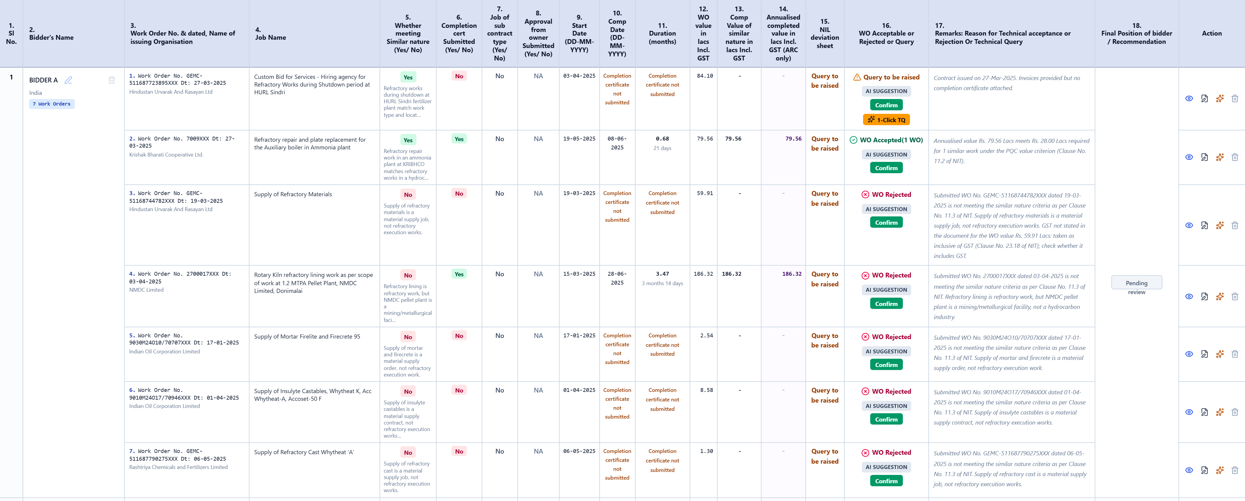
STEP 3 · THE TBA SHEET
The committee’s 18-column TBA, drafted in minutes
3 bidders, 15 work orders. Every column the committee’s format requires, exported to Excel and PDF in the same layout.
AI Tender Qualification Assistant · tender-scrutiny-assistant.web.app
8
Notes:
The whole sheet. The next two slides zoom into the left and right halves.

Slide 9

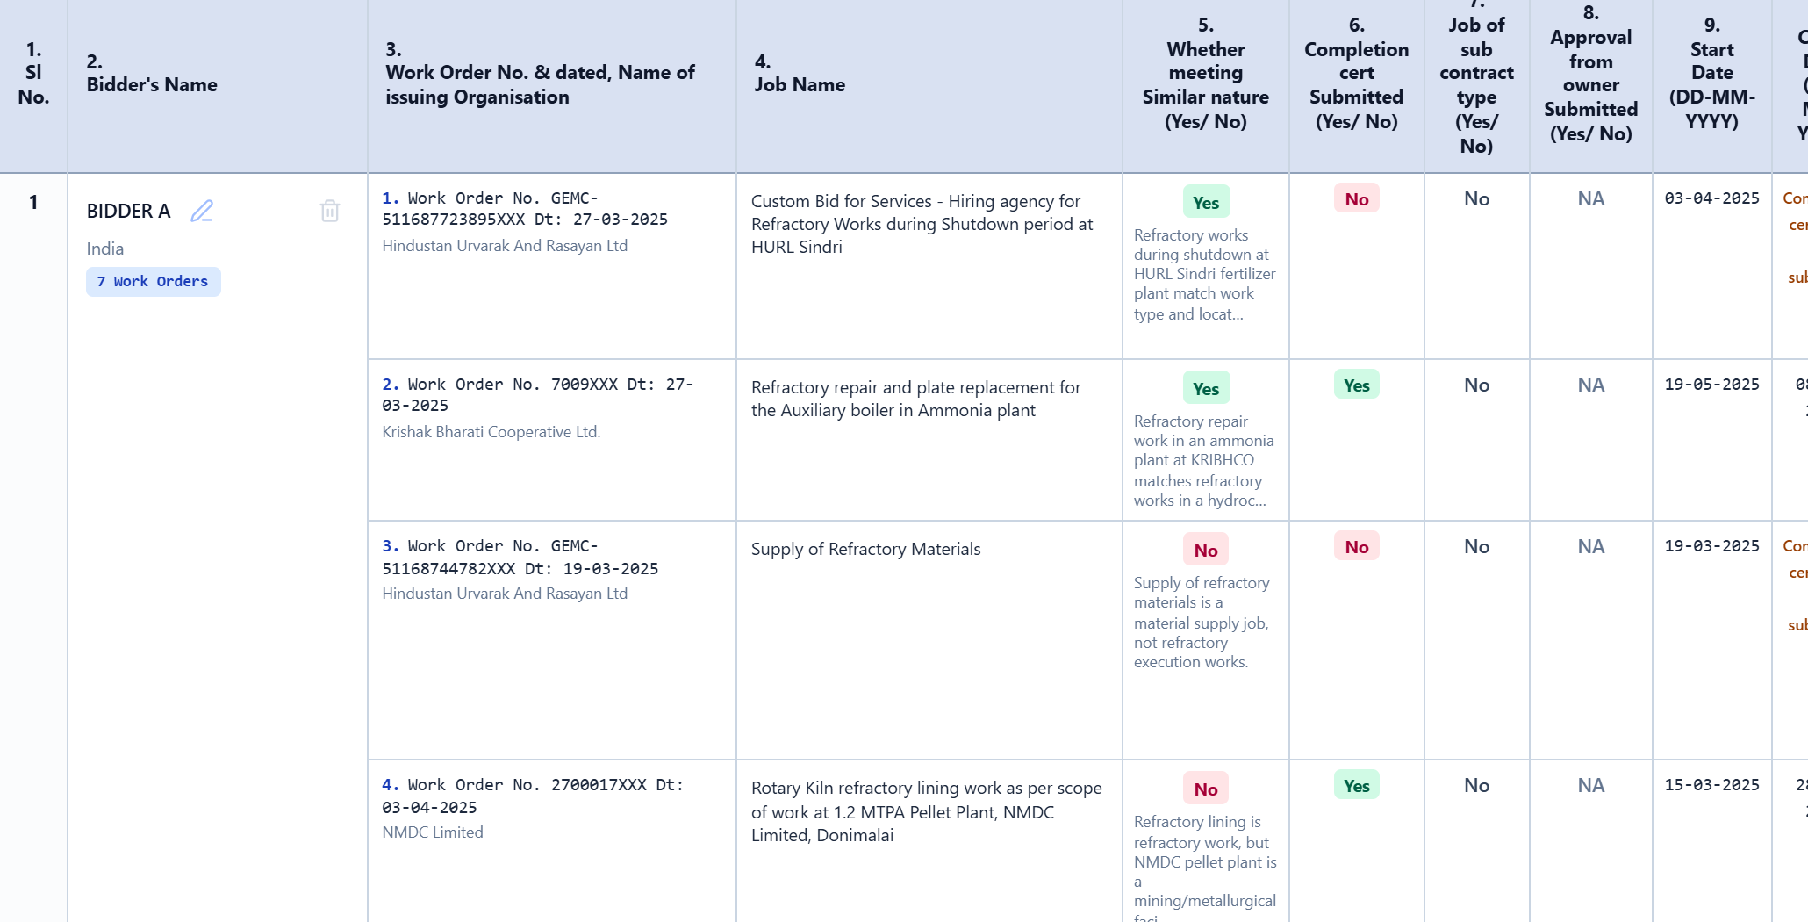
STEP 3 · COLUMNS 1–9
Similar nature comes with its reason
Supply of refractory materials is a material supply job, not refractory execution works.
Column 5, Bidder A, work order 3
Yes / No on similar nature, explained in the words of the job itself.
Work orders numbered within each bidder, so a multi-page printout still says which order is which.
Sub-contract jobs flagged for the engineer to check (column 7).
AI Tender Qualification Assistant · tender-scrutiny-assistant.web.app
9
Notes:
Column 5 is where most of the judgement lies. The app does not just say No: it gives the reason. The NMDC pellet plant example is refractory work but not in a hydrocarbon facility, so it fails the NIT’s definition.

Slide 10



STEP 3 · COLUMNS 10–18
Every remark cites the clause it rests on
No guessed dates
Without a completion certificate, the sheet says so rather than borrowing a date from elsewhere.
Clause in every remark
“…meets Rs. 28.00 Lacs required for 1 similar work (Clause No. 11.2 of NIT).”
Assumptions flagged
If GST basis isn’t stated, the remark says what was assumed and asks for a check.
AI SUGGESTION until confirmed
The engineer presses Confirm on each row.
AI Tender Qualification Assistant · tender-scrutiny-assistant.web.app
10
Notes:
Right half of the sheet: completion value, annualised value for ARC jobs, the accept / reject / query decision, and the remark. Point out the AI SUGGESTION badge and the Confirm button on every row.

Slide 11
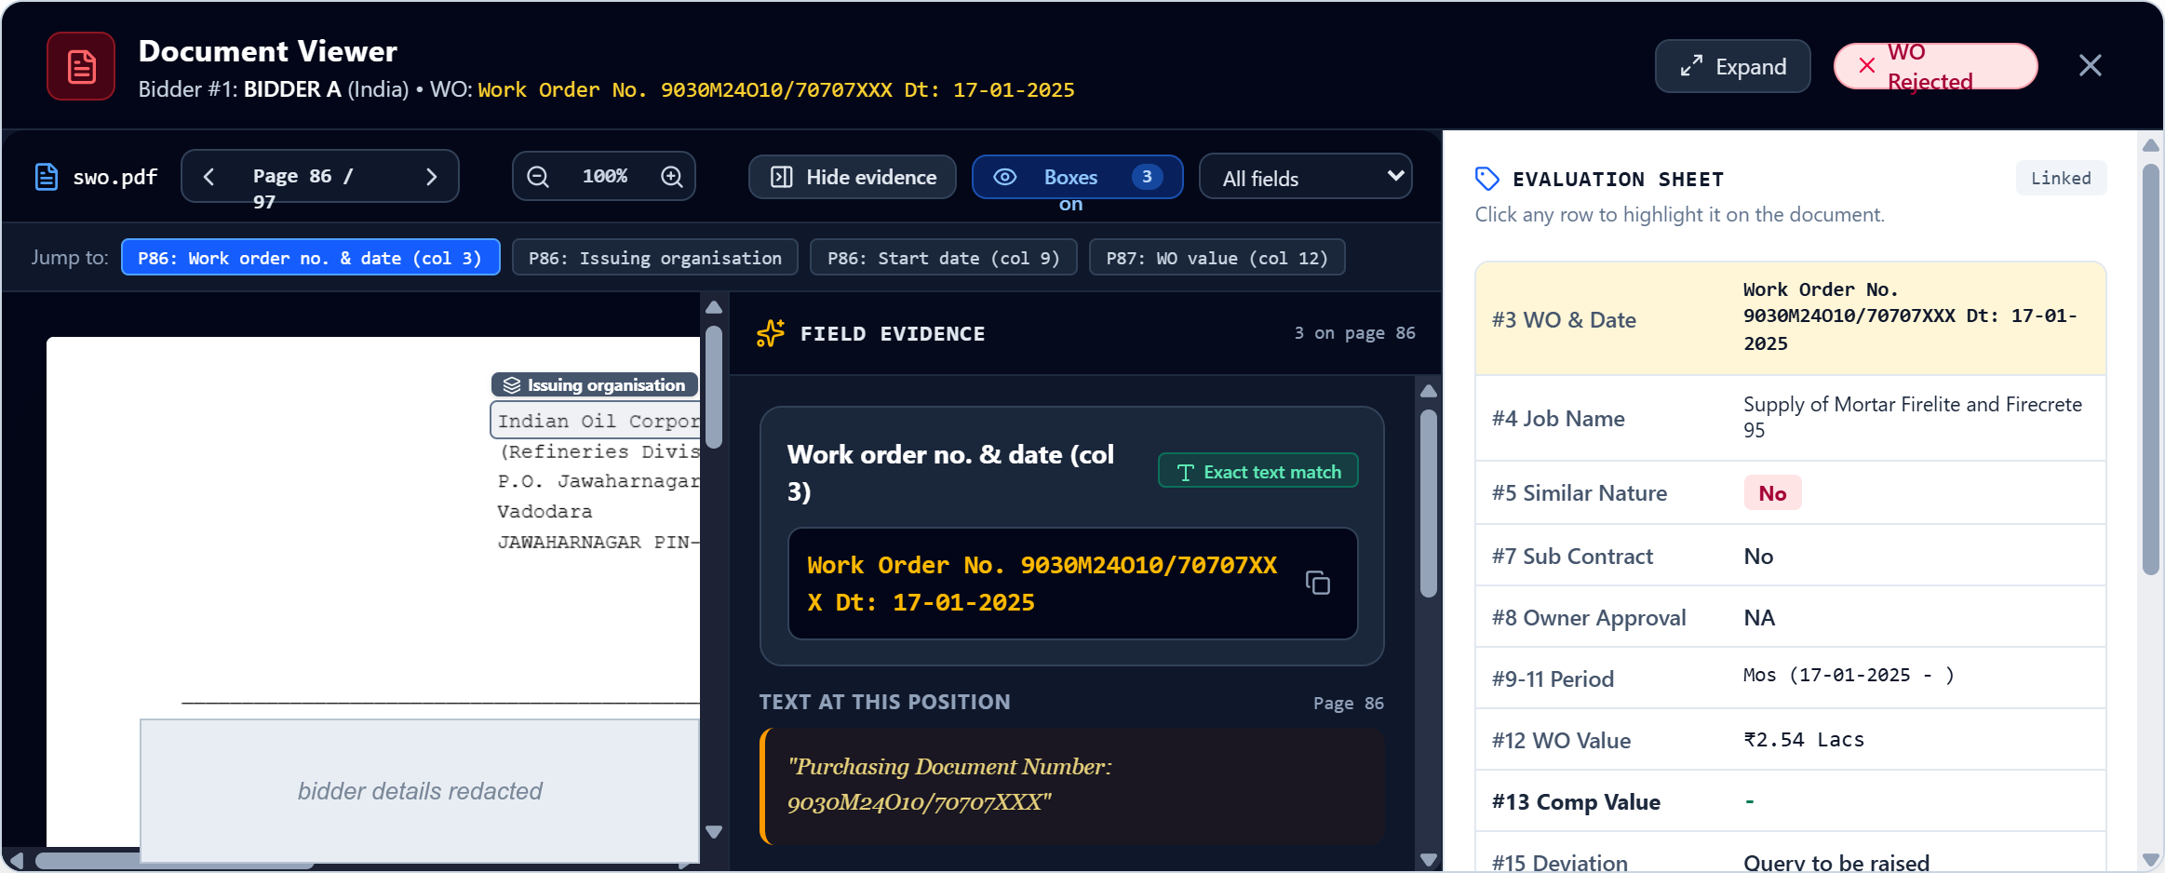
TRACEABILITY
Click any figure to open the page it came from
The original PDF opens at that page with the value boxed. Months after award, the evidence is still one click away.
AI Tender Qualification Assistant · tender-scrutiny-assistant.web.app
11
Notes:
Here: page 86 of a 97-page dossier. The panel on the right is the row being evaluated; the chips along the top jump to each field found for this work order.

Slide 12
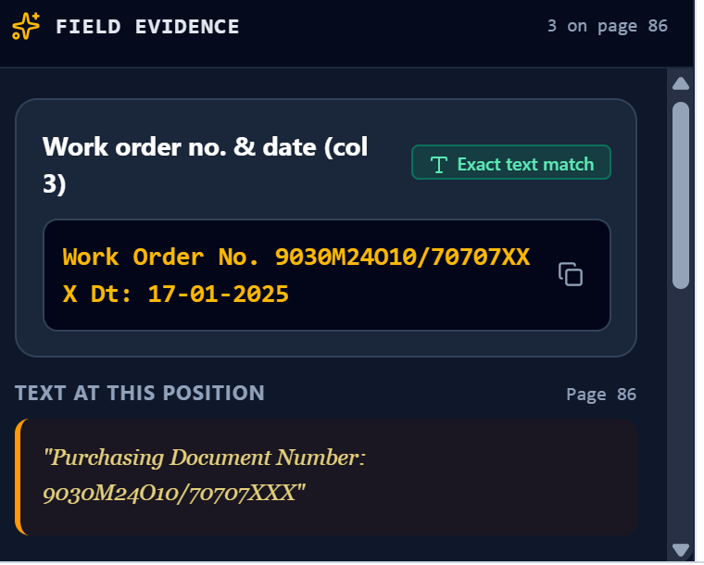
TRACEABILITY
The value, the exact quote, and the page
Exact text kept for every field
The app stores the words it read and the page number, and marks whether the quote is an exact match.
Boxes are found, never guessed
The value is located through the PDF’s text layer, or on the page image with the quote verified. If it cannot be found, no box is drawn.
Originals kept safely
Uploaded PDFs are stored by content fingerprint, so the same file is never duplicated and always reopens.
AI Tender Qualification Assistant · tender-scrutiny-assistant.web.app
12
Notes:
Column 3 work-order number is backed by the quote “Purchasing Document Number: 9030M24O10/70707XXX” on page 86. The app does not assert a figure it cannot show.

Slide 13



STEP 4 · QUERIES & OUTPUT
Technical queries drafted from what is actually missing
1-Click TQ
Excel, committee format
On any row marked “Query to be raised”, one click drafts the query: the deficiency observed, the NIT clause, and the response deadline. It goes into the tender’s official TQ register and prints as a clarification letter.
The 18-column TBA exactly as the committee files it.
Draft
Issued to bidder
Response received
Closed / accepted
Print-ready PDF
The same layout for signature, with signatories and review panel.
Every query is tracked from draft to closure in the Technical Queries tab.
Custom queries too
Recommendation summary
Draft a query for any bidder or work order and edit its wording before issue.
Technically acceptable, not acceptable, and query counts per tender.
AI Tender Qualification Assistant · tender-scrutiny-assistant.web.app
13
Notes:
Technical queries are generated from the actual deficiency (for example, missing completion certificate) and tracked through to closure. Output is the committee’s own Excel format and a print-ready PDF.

Slide 14

BUILT FOR ACCOUNTABILITY
The sheet is signed by the engineer, not by the model
AI suggests, engineer confirms
Override with a reason
Every row carries an AI SUGGESTION badge until an engineer presses Confirm.
Any row can be changed. Accepting a rejected work order asks the engineer to state why.
Relaxations are never silent
No figure without a source
NIT relaxations are shown to the engineer, who decides whether they apply.
If a value can’t be shown on its page, the app doesn’t assert it.
AI Tender Qualification Assistant · tender-scrutiny-assistant.web.app
14
Notes:
This is the key message for the department: the tool drafts, the engineer decides. It is a reading assistant, not an evaluator.

Slide 15
RESULTS
Checked by hand against a real 896-page dossier
2 min 8 s
27 of 28
0
5
to read all 896 pages
work orders found
values invented
undocumented claims caught
Per tender
A year, at one refinery
2–3 days → 2–3 hours
4,200–8,400
of engineer review, instead of 16–24 engineer-hours of reading
engineer-hours freed across 300–400 tenders
AI Tender Qualification Assistant · tender-scrutiny-assistant.web.app
15
Notes:
Accuracy from a hand-check of the full dossier. One work order was missed, which is why every row still needs the engineer’s confirmation.

Slide 16


TRY IT TODAY
Open it in any browser
tender-scrutiny-assistant.web.app
Try the demo
Sign in for real tenders
Click “Try the demo without an account” on the sign-in page. It opens a sample tender evaluation, with 3 PDF extractions a day.
Sign in with Google to evaluate real tenders, share them with the team, claim the edit lock and confirm TBA rows under your own name.
Questions and feedback welcome.
AI Tender Qualification Assistant · tender-scrutiny-assistant.web.app
16
Notes:
Invite the department to try the demo during or after the session. Screens in this deck are from a live evaluation, with bidder names and the last digits of reference numbers masked.

