Slide 1

Starting Soon Free to Play, Great Prizes !
Please See your Host to sign up

Slide 2
How to Play
Sign up your team (unlimited but every person after the 5th causes a 5 pt score deducton)
No Smartphones – we play with our noggins around here.
Don’t Yell out the Answers
Reinforcing teaching through audience participation
Introduction to subject matter
Recreational gatherings

Slide 3
Question 1
CAT_1
QSTN_1

Slide 4
Question 2
CAT_2
QSTN_2

Slide 5
Question 3
CAT_3
QSTN_3

Slide 6
Question 4
CAT_4
QSTN_4

Slide 7
Question 5
CAT_5
QSTN_5

Slide 8
Answers 1-5
1.
2.
3.
4.
5.
ANSWR_1
ANSWR_2
ANSWR_3
ANSWR_4
ANSWR_5

Slide 9










Speed Round
1
2
QSTN_6
3
4
5
6
7
8
9
10

Slide 10
Speed Round Answers
QSTN_6
ANSWR_6
ANSWR_11
ANSWR_7
ANSWR_12
ANSWR_8
ANSWR_13
ANSWR_9
ANSWR_14
ANSWR_10
ANSWR_15

Slide 11
Question 6
CAT_7
QSTN_7

Slide 12
Question 7
CAT_8
QSTN_8

Slide 13
Question 8
CAT_9
QSTN_9

Slide 14
Question 9
CAT_10
QSTN_10

Slide 15
Question 10
CAT_11
QSTN_11

Slide 16
Answers 6-10
1.
2.
3.
4.
5.
ANSWR_16
ANSWR_17
ANSWR_18
ANSWR_19
ANSWR_20

Slide 17
Half Time

Slide 18
Question 11
CAT_12
QSTN_12

Slide 19
Question 12
CAT_13
QSTN_13

Slide 20
Question 13
CAT_14
QSTN_14

Slide 21
Question 14
CAT_15
QSTN_15

Slide 22
Question 15
CAT_16
QSTN_16

Slide 23
Answers 11-15
1.
2.
3.
4.
5.
ANSWR_21
ANSWR_22
ANSWR_23
ANSWR_24
ANSWR_25

Slide 24



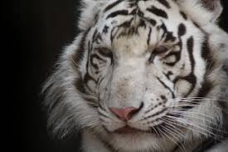

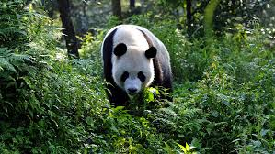
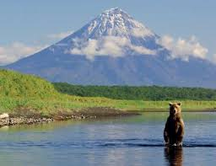
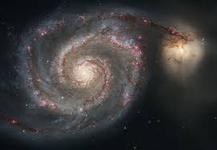


Speed Round
1
2
QSTN_17
3
4
5
6
7
8
9
10

Slide 25
Speed Round Answers
QSTN_17
ANSWR_26
ANSWR_31
ANSWR_27
ANSWR_32
ANSWR_28
ANSWR_33
ANSWR_29
ANSWR_34
ANSWR_30
ANSWR_35

Slide 26
Question 16
CAT_18
QSTN_18

Slide 27
Question 17
CAT_19
QSTN_19

Slide 28
Question 18
CAT_20
QSTN_20

Slide 29
Question 19
CAT_21
QSTN_21

Slide 30
Question 20
CAT_22
QSTN_22

Slide 31
Answers 16-20
16.
17.
18.
19.
20.
ANSWR_36
ANSWR_37
ANSWR_38
ANSWR_39
ANSWR_40

Slide 32
Wager Round
ANSWR_41
ANSWR_46
QSTN_23
ANSWR_42
ANSWR_47
ANSWR_43
ANSWR_48
ANSWR_44
ANSWR_49
ANSWR_45
ANSWR_50

Slide 33
Answer all 5 to
win the JACKPOT!
1. QSTN_24
2. QSTN_25
3. QSTN_26
4. QSTN_27
5. QSTN_28

Slide 34
Congratulations to our Top Teams

Slide 35

Thank You for Playing
Come Back Next Time!
Follow us on Facebook
For Hints

