Slide 1
Local Coffee Report

Slide 2
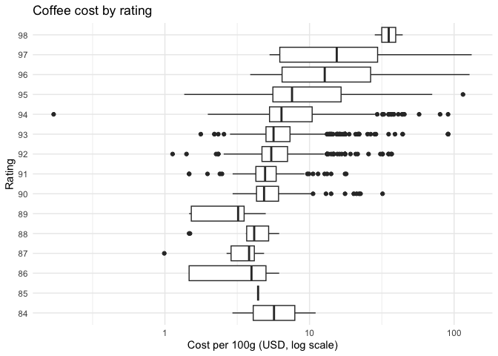
Cost vs Rating
Higher ratings cluster at higher cost, with broad overlap in the mid-range.
However, the primary concern for a coffee entrepreneur should be value.
Cost and rating.

Slide 3
Defining a Value Metric
Value = rating ÷ cost per 100g — rating earned per dollar spent
Value ranges 0.7-81.4 (mean 15.4, median 16.0)
Cost is right-skewed; ratings are tightly clustered (84-98)
variable | mean | median | sd | min | max
cost_per_100g | 9.1 | 5.9 | 10.3 | 1.1 | 132.3
rating | 93.1 | 93.0 | 1.6 | 84.0 | 98.0
value | 15.4 | 16.0 | 7.6 | 0.7 | 81.4

Slide 4
Top Value Roasters
roaster | n | median_cost | median_rating | median_value
Mr. Chao Coffee | 5 | 3.67 | 92 | 24.80
El Gran Cafe | 29 | 3.82 | 91 | 23.56
Jackrabbit Java | 23 | 4.12 | 92 | 22.33
Coffee By Design | 7 | 4.08 | 93 | 22.30
Kakalove Cafe | 142 | 4.25 | 94 | 22.00
Mystic Monk Coffee | 9 | 4.11 | 91 | 21.90
Propeller Coffee | 10 | 4.32 | 93 | 21.67
San Francisco Bay Coffee | 9 | 4.17 | 90 | 21.10
Espresso Republic | 11 | 4.41 | 90 | 20.63
Creation Food Co. | 5 | 4.51 | 91 | 19.96
Minimum 5 coffees required to qualify, to avoid lucky outliers
Mr. Chao Coffee, El Gran Cafe, and Jackrabbit Java lead with median values around 22-25 — well above the sample median of 16.0

Slide 5
Indicators of Good Coffee
Stellenbosch students’ top keywords for good coffee:
Sweet
Finish
Mouthfeel
Structure
Aroma
Chocolate
Toned

Slide 6
Value + Keyword Tradeoff
roaster | n | median_cost | median_rating | median_value | total_keywords_mean
Mr. Chao Coffee | 5 | 3.67 | 92 | 24.80 | 8.20
El Gran Cafe | 29 | 3.82 | 91 | 23.56 | 8.59
Jackrabbit Java | 23 | 4.12 | 92 | 22.33 | 8.65
Coffee By Design | 7 | 4.08 | 93 | 22.30 | 9.29
Kakalove Cafe | 142 | 4.25 | 94 | 22.00 | 8.61
Mystic Monk Coffee | 9 | 4.11 | 91 | 21.90 | 11.33
Propeller Coffee | 10 | 4.32 | 93 | 21.67 | 9.00
San Francisco Bay Coffee | 9 | 4.17 | 90 | 21.10 | 9.11
Espresso Republic | 11 | 4.41 | 90 | 20.63 | 9.36
Creation Food Co. | 5 | 4.51 | 91 | 19.96 | 10.60
Adding average keyword count per roaster reveals a tradeoff: the highest-rated roasters (e.g. Kakalove Cafe) are pricier and not necessarily richer in desirable keywords
Mystic Monk Coffee and Creation Food Co. stand out with high keyword averages

Slide 7
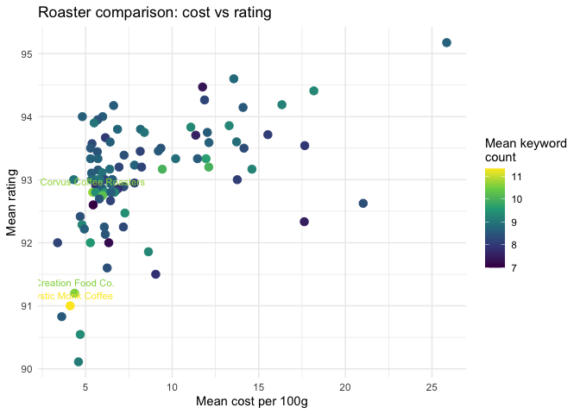
Which Roaster is the Best?
Rating and cost are positively related across roasters
Mystic Monk Coffee, Creation Food Co., and Corvus Coffee Roasters most often use desirable keywords
Of these, Mystic Monk Coffee and Creation Food Co. also rank in the top value table — making them the strongest overall picks

