Slide 1
QR Based Ordering In Restaurants
Batch no:17CSEC011
Supervisor
Dr.K.Subhash Bhagavan
Associate Professor
Department of CSE
Team members
R.J.R.Lakshmi 17K61A0590
S.Yamini 17K61A0597
D.Rohit 17K61A0522
L.R.M.Asritha 17K61A05E7

Slide 2
Contents
Abstract
Analysis
Modules Split-up and Gantt Chart
Problem statement
Aim and Objective of project
Literature review
Detail design
Module detail explanation
Experimental Results
Result Analysis
Comparison with Existing system
Conclusions and scope for future work
Contribution of the candidate
References

Slide 3
Abstract
In the traditional ordering system, when the customer enters the restaurant, then he/she needs to wait for the waiter to order the food after selecting the food items from the menu card which was placed on the customer's table. Therefore,"QR based ordering" gave the best solution for this problem and provides cost and time efficiency benefits easy for management and the customer. In this automated system the customer doesn't need to wait for the waiter to place the order. Because the customer placed the order through their mobile phones by scanning the QR code which was placed on the customer table. It doesn't require any menu cards and a waiter to place the order. After the customer places the order, then the order will be redirected to the kitchen for the food preparation. Then the waiter serves the food to the customer. In this system there is no need for the waiter to give the bill to the customer and collect the payment from the customer. Because the bill will be automatically generated on the customer's phone and the customer will make the payment online.
Keywords:Restaurant Management, QR based ordering, Android and iOS phones, Digital Ordering.

Slide 4
Analysis
Modules Split-up
Customer web app
Sync Menus/categories
Cart
Checkout
Call for assistance
Payment
Restaurant App(Client)
Login/Signup
Add/update Tables
Add/update menus
View Orders

Slide 5
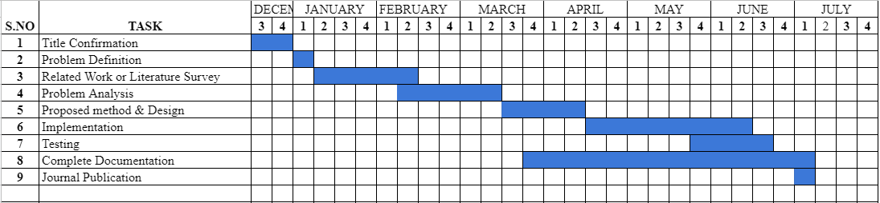
Gantt Chart

Slide 6
Problem Statement
In the restaurant’s, the traditional menu cards are paper based. Waiters normally use paper & pen to write the order of customers. The records are stored on paper. There is wastage of time, money, and paper. As they have used paper-based menu cards, if they wish to make any changes in that menu card, they must print and get the updated menu card as the earlier was of no use. As it will require re-printing of all the menu cards. From the customer’s point of view, this system is time consuming. The customer doesn’t get a good service as he needs to call the waiter several times till he notices, and this leads to dissatisfaction for the customer. As you have not entertained correctly, this creates confusion between the customer and the waiter as he notes down the order and could serve the customer with the wrong dish or another customer’s dish.

Slide 7
Aim and Objective of project
The main objective of our project is to increase the customer's dining experience by fastening the existing restaurant services
To simplify the ordering and bill payment systems
To minimize the workload of the restaurant and hotel owners.
To reduce staff cost, reduce food wastage and increase average order value for restaurant.

Slide 8
Literature Review
Title | Concept
[1] M. Kousalya , ELakshi ,R.K. Mukesh Khanna, G. Pravin, T. Prabhu, “Automatic Restaurant Food Ordering Menu Card” ,International Research Journal on Advanced Science Hub (IRJASH) ,Vol.3,Issue 03S,pp.7-12,March 2021. | Problem Statement: The food ordering procedure as actually given in the menu card format in restaurant, then the customer will have to choose the food item, so the server would have to come back and take their orders, which is really a long method of processing. Proposed Method: The customer table have the touch screen menu information in this process.The ordering information from a table is transferred then forwarded to the manager or cash counter and displayed on the LCD display in the kitchen for food preparation.Payment can be made with the QR code after completion of their meals from their reserved seat. Result: The bill will be automatically generated in this wireless menu ordering system and customers will pay directly from the reserved seat. Merit: It's easy to use and user-friendly. Demerit: In this system the bill have to be paid separately by using another QR code and every table should have a touch screen which is very expensive.

Slide 9
[2] Nimesh Tembhekar, Pragati Singh , Kunjal Gurve, Prof. Mrunmayee Rahate, “SMART FOOD ORDERING SYSTEM FOR RESTAURANT” ,International Research Journal of Engineering and Technology (IRJET), Vol.07,Issue 02, Pp.72-74, Feb 2020. | Problem Statement:Traditional ordering system which is currently carried out in majority of the restaurants.The system that is being used by most of the restaurants is the manual ordering system which means all work and procedures are recorded manually and it also includes huge amount of paperwork that is not effective and efficient. Proposed Method:In this system customer orders the food by using android based touchpad. Customer first orders the food from the touchpad looking at various combination of food which is further carried to the kitchen for fulfilling the order and the same is passed for billing at the each customer’s touchpad. Result:This system will minimize the number of employees at the back of the counter. Also, the system will help to reduce the cost of labor and errors. Merit:It will a provide quality of service and customer satisfaction. Demerit:There is no facility of online payment.

Slide 10
[3] Diogo Davidson Albuquerque , Vinod Kumar Shukla , Amit Verma “Enhancing Sustainable Customer Dining Experience Through QR Code and Geo-Fencing”, International Research Journal of Engineering and Technology ,2020. | Problem Statement : The Customer now a days , is looking for more detailed information like food being organic,sustainable etc. Proposed Method : In this paper we are discussing a concept of mobile application, which will work with QR code technology and in a coordinated way with Geo-Fencing technology Which will enhance the guest experience in a farm to table . Result : The proposed model has not only counted the supply chain of the industry to adhere to the technology enabled food product but at the same time has included the receiving area and the processing. Such capability will enhance the customer experience as well will assist to deploy a unique selling proposition to the restaurant as well. Merit: It is a user friendly and affordable technology. Demerit: The major disadvantages of the technology are the privacy issue and the service is only activated once the user allows it on his phone to consume more battery and disclose the details.
[4] Syed Rameez C R, Sreerag M,Urmila PIllai L V,Anjaly J,Abitha Abbas,”QR CODE BASED SMART DINING SYSTEM”,Journal of Engineering Science, volume 11, PP.433-438, 2020.. | Problem Statement: The traditional method that is used commonly in hotels is by taking the customer’s orders and writing it down on a piece of paper and then giving the order in the kitchen section. Proposed Method: The method proposed in this paper is that accessing the QR code for the ordering of the food in the restaurant. Result: It increase the customer's dining experience by fastening the existing restaurant services. Merit: This system will help in reducing the waiting time of customers in the restaurant. Demerit: The main demerit here is that the QR need to be reprinted everytime when the menu item or price is updated. Also in this system customer needs to pay the bill manually.

Slide 11
[5] Renjith V Ravi,Amrutha N R, Amritha E,Haneena.P,Jaseena.T, “An Android Based Restaurant Automation System with Touch Screen “, IEEE International Conference on Inventive Systems and Control, PP.438-442, 2019. | Problem Statement:In most of the restaurants, the ordering of food items are done manually, the disadvantage is huge time consumption. Proposed Method:Here the individual tables in the restaurant are provided with a touch screen, represent each individual digital menu, and it facilitates the ordering. The customer can see all the available food items with its cost in the digital menu and can select the item. Result:The android based food ordering system helps the people to select the food items from the touch screen placed in the table and to see the cost of items. Merit: It reduce the need for the printing of many copies of the menu card. Demerit: Touch screens are Costly to install in every table and it consumes more power.
[6] Utkarsh Ravekar, Shashank Singh, “Data Centric Smart Restaurant Management System” ,International Research Journal of Engineering and Technology (IRJET) ,Vol.06,Issue 07, pp.1425-1427,July 2019. | Problem Statement:The traditional method that is used commonly in restaurants is by taking the customer’s orders and writing it down on a piece of paper and then giving the order in the kitchen section. Proposed Method:Every customer who enters the restaurant needs to have the restaurant’s app installed on their phone which can be downloaded by scanning a QR code in the restaurant. The entire menu will be available on the app of the user from which the users can select the dishes they’d like to order. The ordered food items will be displayed to the kitchen staff over on a kitchen screen. After finishing their meals, e-bill will be displayed on the app. The customers will pay it at the counter. Result:This system provides an efficient way of handling and managing a restaurant and its customers by providing customized services to the users Merit:It provides real-time status updates about their orders to the customers . Demerit:Customer needs to install an android application and pay the bill manually

Slide 12
[7] Akash Patil, Rinkesh Kalani, Bhavesh Patil,Sachin Shinde, Prof. S. M.Shedole , ”SMART RESTAURANT SYSTEM USING ANDROID”, International Journal of Technical Research and Applications, volume 5, pp.78-80, 2017. | Problem Statement:Customers first browse through the menu of the restaurant and then wait for a waiter to come and take orders. Proposed Method:This paper proposes an digital system that uses wireless communication, a centralized database and an android application to place the order without even waiting for waiter.The android application installed in the device, contain all the menu details with picture of items. Result: This will remove the manual process of food ordering . Merit:This system will help in reducing the waiting time of customers in the restaurant. Demerit:The customer needs to install the android application.
[8] Shraddha S. Dhoke, Tanvi K. Mhatre, Prof. Prashant H. Rathod ”Smart Restaurant Using QR Code”, International Journal of Advance Research in Engineering, Science & Technology, volume 4, 2017. | Problem Statement: The food ordering system looks simple,it may increase the workload of waiters,or may also be prone to human errors in noting down the orders when the number of customers increases during peak hours. Proposed Method: In this proposed method it mainly aims in designing completely automated menu in restaurants with the help of smartphone using WIFI module and a LCD to provide a user -friendly environment. Result: In this Smart Restaurant Management system is convenient,effective and easy which improves the restaurant’s performance,quality service and customer satisfaction and this is a fabulous system for the restaurant sector made by combining the QR code and Wireless technology. Merit: There is no need of a person to take the order from the table. Demerit: There is no facility for online payment and LCD screens to be placed on every table will cost high.

Slide 13
Detailed Design
Architecture diagram
Data Flow diagram
UML diagram

Slide 14
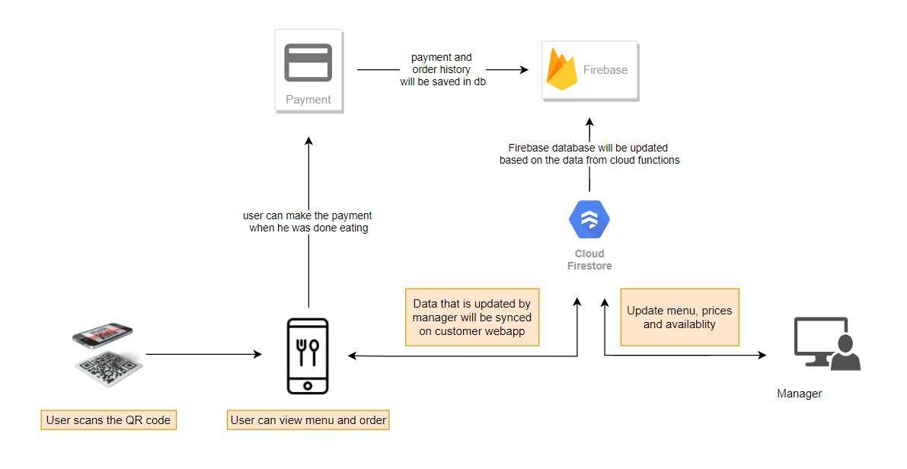
Architecture diagram

Slide 15
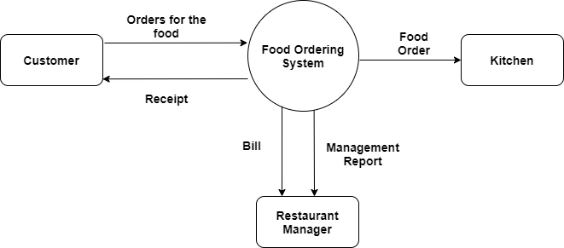
Data Flow diagram(Level 0)

Slide 16
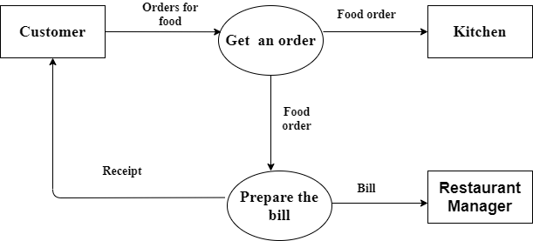
Data Flow diagram(Level 1)

Slide 17
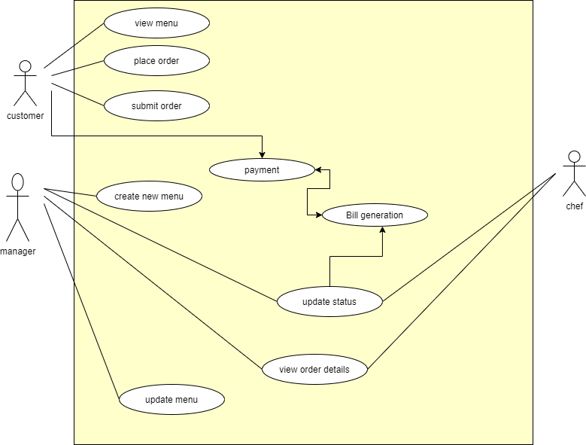
UML diagram

Slide 18
Module detail explanation
Customer web app
Customer scans the QR Code on the table and an attractive interface of the different
platters in different sections (i.e. Appetizers, Breads, Main-Course, Dessert,
Beverages, etc.) will be available for them in the menu.
Customers can search a particular food item according to name, category, etc.
There are images of every food item which will make the view of the customer good
The description of the dishes will give a brief idea of how the food tastes, color and they could also add their favorites desire.
If the customer wishes to replace the ordered food, remove the ordered food or to add
new dish they could be able to do it efficiently by adding or removing it from the cart.
After having meal, the bill details are on the customer’s screen and manager’s app,
the customer could pay through any payment mode.
Customer can call for assistance.

Slide 19
Restaurant app
The manager controls the functioning of the whole restaurant from the manager’s App.
The manager has the authority to make changes in the menu hence, the menu is dynamically designed.
The manager can do periodic updates by changing the prices of the particular item, adding or removing particular item as per availability or designing their own customized menu.
The manager will receive the ordered lists and bill details from the customers with their respective table no’s.

Slide 20
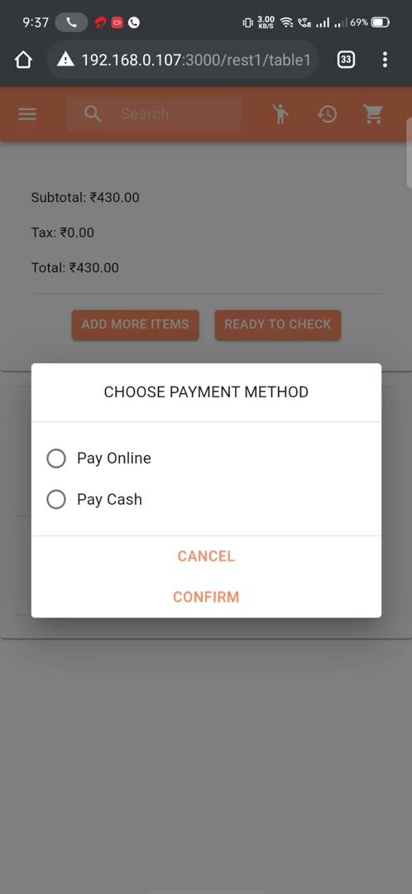

Experimental Results
Manager App
Customer WebApp

Slide 21
Result Analysis
This system is user-friendly and also ensures good quality of service and customer satisfaction. It will bring lots of convenience to the restaurant employees when they perform their duty within the restaurant as well as improve the consumer dining experience. A better and easier management for the store in busy times and avoid congestion at the checkout counter. The menu prices and items can be easily updated any time and the feedback from the customers can be taken easily as a result Food wastage can be minimized by the insights provided from the previous orders.

Slide 22
Comparison with existing system
System | Online ordering | Menu management | Online payment | Call for Assistance | Dynamic Pricing | Portability
Existing System | Yes | Yes | Only card | No | No | Yes
Proposed System | Yes | Yes | Card,wallets & UPI | Yes | Yes | Yes

Slide 23
Conclusions and scope for future work
Conclusion
In this paper, we present QR Based Ordering System for Restaurant which uses QR Code stand in every customer’s table where the customer will be making food orders from the table via their phones. This system is convenient, effective and easy thereby improving the performance of restaurant staff and providing customer satisfaction. This system would serve to the needs of a variety of customers, attract potential customers and ultimately improve a restaurant’s business. It maintains customer’s database and improve the food ordering services in Restaurants.

Slide 24
Scope for Future Work
In the future, The system can implement a feature in mobile applications that may implement some mini games that are able to entertain customers while they are waiting for the food to be served. And we can also introduce some chat features for the customers that are currently in the restaurant. Lastly, provide customizable menus to the system where guests can add some notes on how they want their food, for example if guests want to add more spicy on their food they can simply add notes through the system before order.

Slide 25
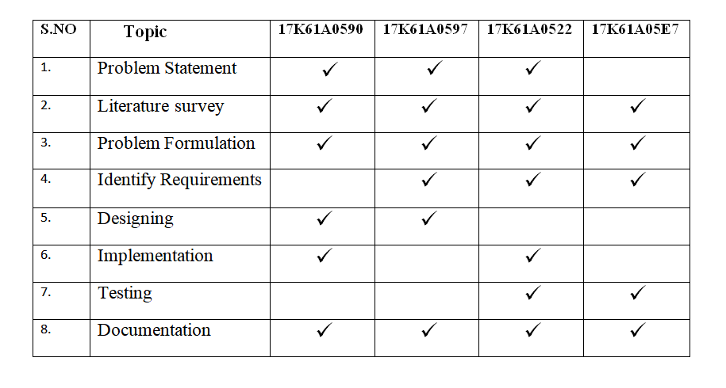
Contribution of the candidate

Slide 26
References
[1] M. Kousalya , ELakshi ,R.K. Mukesh Khanna, G. Pravin, T. Prabhu, “Automatic Restaurant Food Ordering Menu Card” ,International Research Journal on Advanced Science Hub (IRJASH) ,Vol.3,Issue 03S,pp.7-12,March 2021.
[2] Nimesh Tembhekar, Pragati Singh , Kunjal Gurve, Prof. Mrunmayee Rahate, “SMART FOOD ORDERING SYSTEM FOR RESTAURANT” ,International Research Journal of Engineering and Technology (IRJET), Vol.07,Issue 02,Pp.72-74, Feb 2020.
[3] Diogo Davidson Albuquerque ,Vinod Kumar Shukla , Amit Verma “Enhancing Sustainable Customer Dining Experience Through QR Code and Geo-Fencing”, International Research Journal of Engineering and Technology ,2020.
[4] Syed Rameez C R, Sreerag M,Urmila PIllai L V,Anjaly J,Abitha Abbas,”QR CODE BASED SMART DINING SYSTEM”,Journal of Engineering Science, volume 11, PP.433-438, 2020

Slide 27
[5] Renjith V Ravi,Amrutha N R,Amritha E,Haneena.P,Jaseena.T,“An Android Based Restaurant Automation System with Touch Screen “, International Conference on Inventive Systems and Control, PP.438-442, 2019.
[6] Utkarsh Ravekar, Shashank Singh, “Data Centric Smart Restaurant Management System” ,International Research Journal of Engineering and Technology (IRJET) ,Vol.06,Issue 07, pp.1425-1427,July 2019.
[7] Akash Patil, Rinkesh Kalani,Bhavesh Patil,Sachin Shinde, Prof. S. M. Shedole , ”SMART RESTAURANT SYSTEM USING ANDROID”, International Journal of Technical Research and Applications, volume 5, pp.78-80, 2017.
[8] Shraddha S. Dhoke, Tanvi K. Mhatre, Prof. Prashant H. Rathod,”Smart Restaurant Using QR Code”,International Journal of Advance Research in Engineering, Science & Technology, volume 4, 2017.

Slide 28
Thank You…..
Any Questions

