Slide 1
QR Based Ordering In Restaurants
Batchno:20CSEC011
Supervisor
Dr.K.Subhash Bhagavan
Associate Professor
Department of CSE
Team members
R.J.R.Lakshmi 17K61A0590
S.Yamini 17K61A0597
D.Rohit 17K61A0522
L.R.M.Asritha 17K61A05E7

Slide 2
Contents
Abstract
Methodology
Module split-up
Gantt chart
Block Diagram
Design and Softwares
Expected outcomes
Plan of action of the project
References

Slide 3
Abstract
In the traditional ordering system, when the customer enters the restaurant, then he/she needs to wait for the waiter to order the food after selecting the food items from the menu card which was placed on the customer's table. Therefore,"QR based ordering" gave the best solution for this problem and provides cost and time efficiency benefits easy for management and the customer. In this automated system the customer doesn't need to wait for the waiter to place the order. Because the customer placed the order through their mobile phones by scanning the QR code which was placed on the customer table. It doesn't require any menu cards and a waiter to place the order. After the customer places the order, then the order will be redirected to the kitchen for the food preparation. Then the waiter serves the food to the customer. In this system there is no need for the waiter to give the bill to the customer and collect the payment from the customer. Because the bill will be automatically generated on the customer's phone and the customer will make the payment online.

Slide 4
Methodology
Our automation system uses QR codes to launch the web application. The web application is developed in Reactjs and Firebase. The QR codes are unique for every table at the restaurant. The user can scan the QR code with their devices to launch the web application from there the user can access the menu and can order. As soon as the customer orders from the application the order will be notified in the manager app with red color in the table field from which the customer orders. The manager can view the tables which needs to be served and which table needs assistance. And he can create/update the menu,availability of items and categories of items.

Slide 5
Module split-up
Customer web app
Sync Menus/categories
Cart
Checkout
Call for assistance
Payment
Restaurant App(Client)
Login/Signup
Add/update Tables
Add/update menus
View Orders

Slide 6
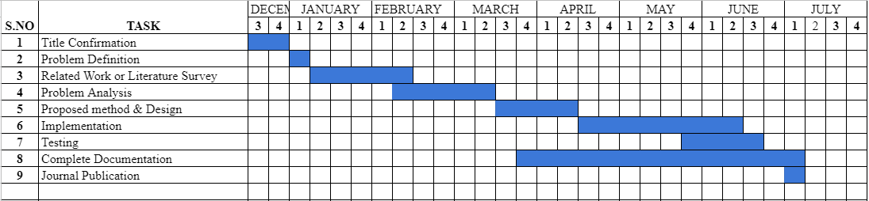
Gantt chart

Slide 7
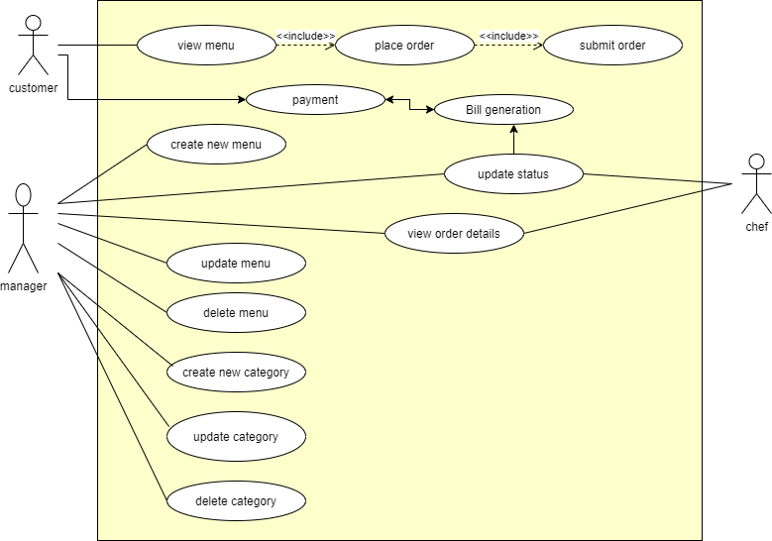
Use case diagram

Slide 8
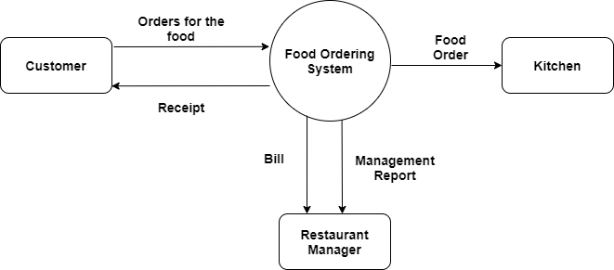
Data Flow diagram(level 0)

Slide 9
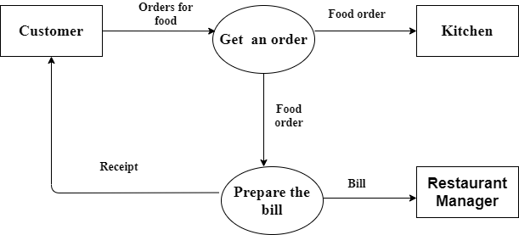
Data Flow diagram(level 1)

Slide 10
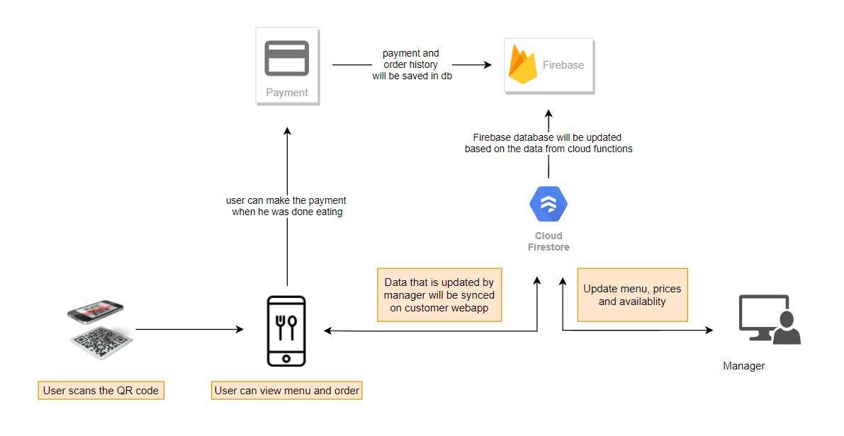
Architecture Diagram

Slide 11
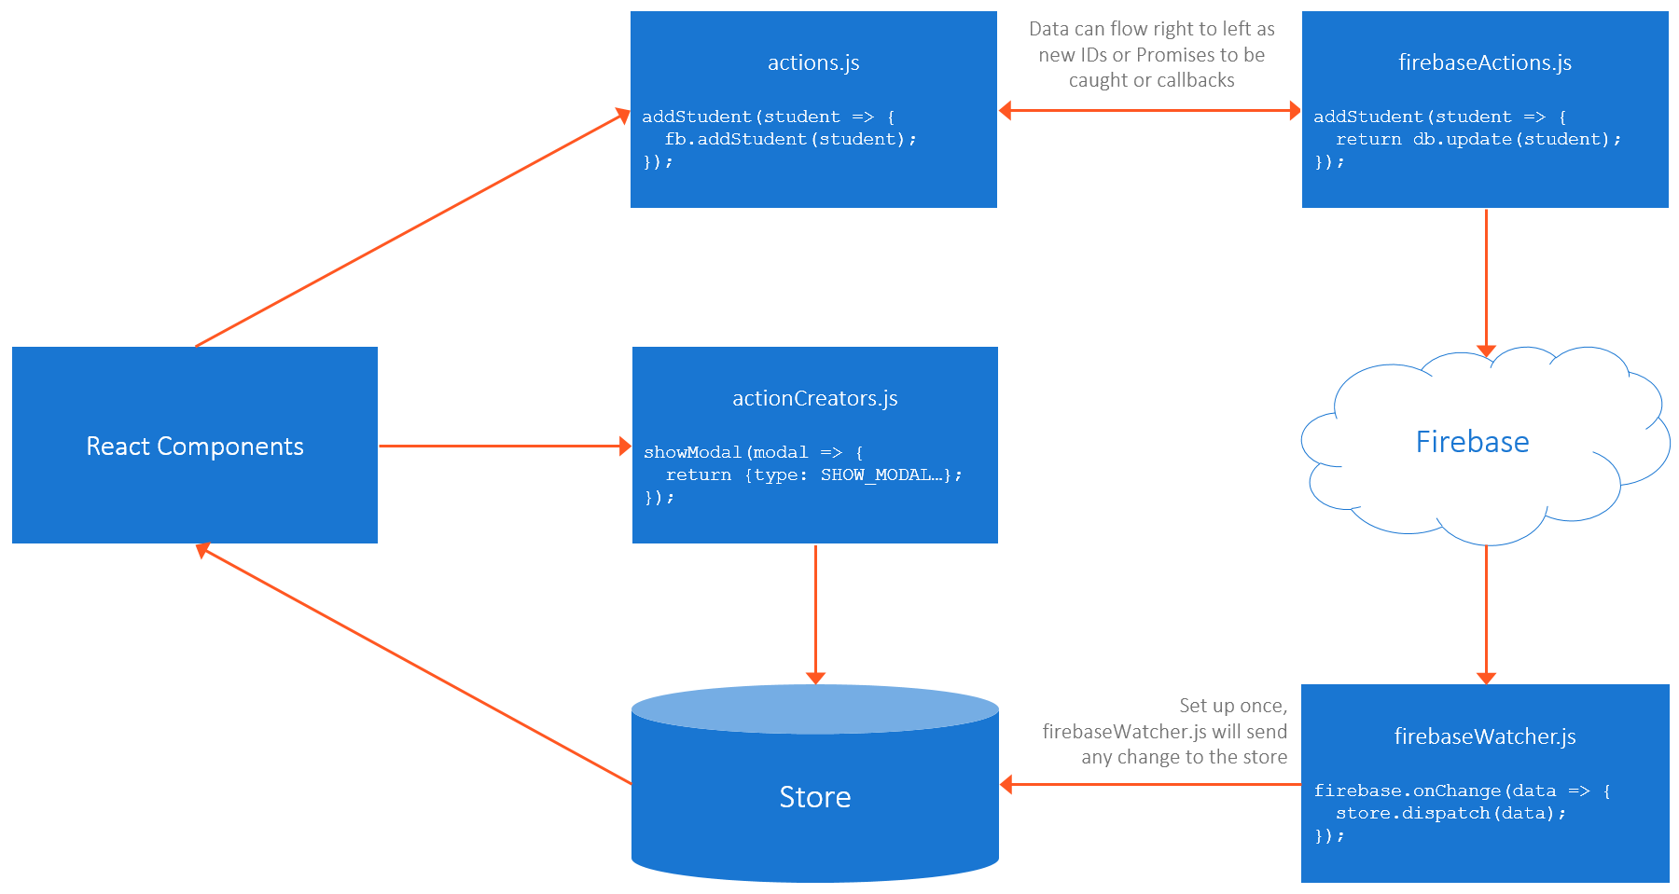
Architecture Diagram

Slide 12
Design and Softwares
Software requirements
Programming Language: JavaScript, HTML, CSS
Development Frameworks: React.js,React Native, Firebase
Operating System: Windows
Development Environment: Visual Studio Code
UML Diagrams: draw.io
Hardware requirements
Display unit- Laptop Display Minimum of 4GB RAM Requires i3 processor and A handheld smartphone with internet access.

Slide 13
Expected Outcome
The proposed system provides a low cost, efficient, convenient and easy to use system for placing orders for food in hotels and restaurants. Now a day’s people are very familiar with touch screen interface due to greater advancements in the field of technology. It will be easier for the users to navigate through the web pages by simply touching the display screen. The chances of errors are reduced and updating of menu and its prices can be done easily. It will be much comfortable and easier for the customers to place orders of their wish. This system is user-friendly and also ensures good quality of service and customer satisfaction.

Slide 14
Plan of action of the project
TASK | DUE DATE
Title Confirmation | 15-12-2020 TO 25-12-2020
Literature Survey | 16-01-2021 TO 15-02-2021
Proposed method and Design | 20-03-2021 TO 10-04-2021
Implementation | 11-04-2021 TO 16-05-2021
Testing | 19-05-2021 TO 02-06-2021
Completion of project | 05-06-2021 TO 30-06-2021
Journal Publication | 01-07-2021 TO 10-07-2021

Slide 15
References
[1] M. Kousalya , ELakshi ,R.K. Mukesh Khanna, G. Pravin, T. Prabhu, “Automatic Restaurant Food Ordering Menu Card” ,International Research Journal on Advanced Science Hub (IRJASH) ,Vol.3,Issue 03S,pp.7-12,March 2021.
[2] Nimesh Tembhekar, Pragati Singh , Kunjal Gurve, Prof. Mrunmayee Rahate, “SMART FOOD ORDERING SYSTEM FOR RESTAURANT” ,International Research Journal of Engineering and Technology (IRJET), Vol.07,Issue 02,Pp.72-74, Feb 2020.
[3] Diogo Davidson Albuquerque ,Vinod Kumar Shukla , Amit Verma “Enhancing Sustainable Customer Dining Experience Through QR Code and Geo-Fencing”, International Research Journal of Engineering and Technology ,2020.
[4] Syed Rameez C R, Sreerag M,Urmila PIllai L V,Anjaly J,Abitha Abbas,”QR CODE BASED SMART DINING SYSTEM”,Journal of Engineering Science, volume 11, PP.433-438, 2020.

Slide 16
[5] Renjith V Ravi,Amrutha N R,Amritha E,Haneena.P,Jaseena.T,“An Android Based Restaurant Automation System with Touch Screen “, International Conference on Inventive Systems and Control, PP.438-442, 2019.
[6] Utkarsh Ravekar, Shashank Singh, “Data Centric Smart Restaurant Management System” ,International Research Journal of Engineering and Technology (IRJET) ,Vol.06,Issue 07, pp.1425-1427,July 2019.
[7] Akash Patil, Rinkesh Kalani,Bhavesh Patil,Sachin Shinde, Prof. S. M. Shedole , ”SMART RESTAURANT SYSTEM USING ANDROID”, International Journal of Technical Research and Applications, volume 5, pp.78-80, 2017.
[8] Shraddha S. Dhoke, Tanvi K. Mhatre, Prof. Prashant H. Rathod,”Smart Restaurant Using QR Code”,International Journal of Advance Research in Engineering, Science & Technology, volume 4, 2017.

Slide 17
Thank You….

