Slide 1
COVID-19 Cases Impact and Hospital Distribution

Slide 2
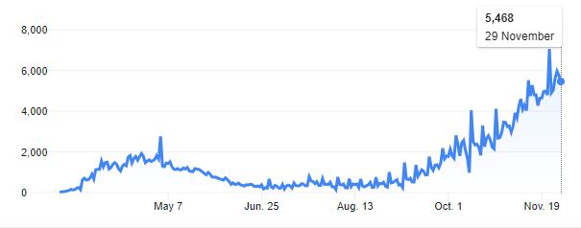
Covid cases in Canada
Cases are low in this country compared to other countries of same size, but considering health and social impact, the cases are huge here also.
Looking at overall cases, starting from January 2020, the cases were decreasing slow until June. But there seems to be a steady increase in it, which is rather called as second wave.

Slide 3
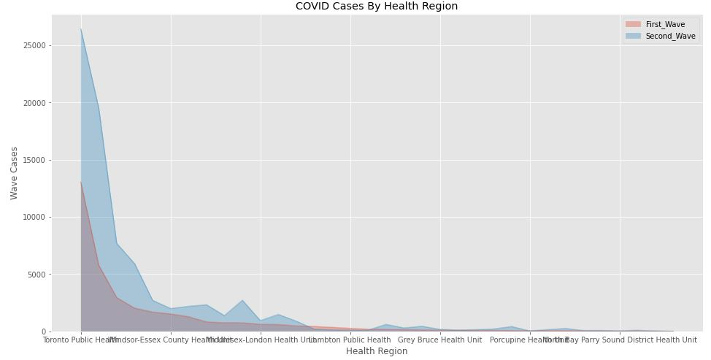
Comparison of Cases in First wave and Second wave

Slide 4
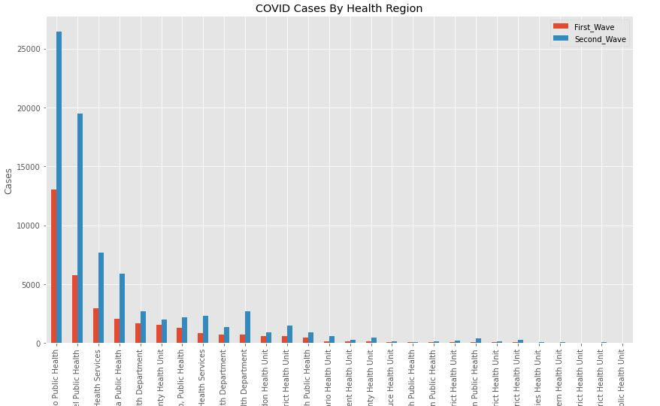
Health Regions with more cases in Second wave than First wave

Slide 5
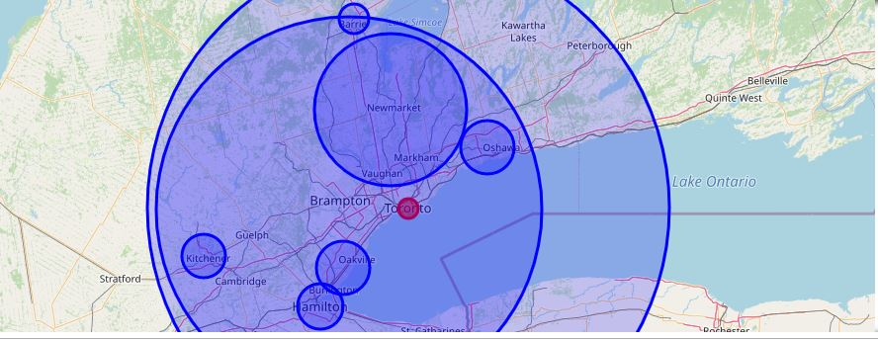
Impact circle with Cases as Radius

Slide 6
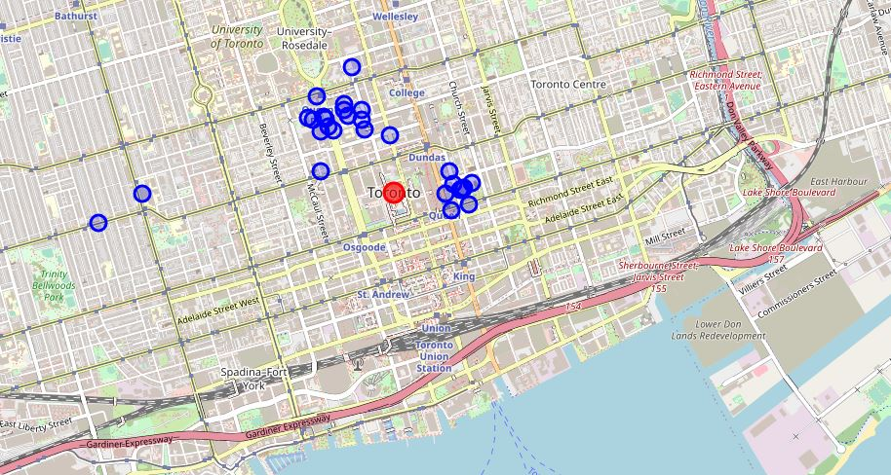
Distribution of Hospitals around Toronto Health Region

Slide 7
Conclusion
With available data and analysis, we can conclude that the South and South-West of Toronto Health regions need more medical facilities.
Setting up new hospitals/ temporary health centers will help providing medical services to Elderly/vulnerable group who stay away from the main health center.

