Slide 1
CONNEXA EVENTS
THE B2B EVENT PLATFORM PITCH
Connexa Events
Registration, structured B2B matchmaking, exhibitor floor plans, budget
tracking, and event communications — one connected platform.
PREPARED FOR A PROSPECTIVE PARTNER · CONFIDENTIAL
CONNEXA EVENTS
1

Slide 2






THE PROBLEM
Event tech is a five-tool tax on every event team
Most B2B event platforms force a choice: pay enterprise prices for matchmaking, or stitch together point solutions yourself.
+
+
+
+
Registration
ticketing tool
Separate B2B
matchmaking vendor
Spreadsheet for
floor plan / booths
Spreadsheet for
budget & payments
Mailchimp or similar
for comms
The result: disconnected attendee data, manual reconciliation between systems, no single view of an event's health, and license fees for matchmaking sophistication that most mid-market teams can't justify — before a single attendee has registered.
CONNEXA EVENTS
2

Slide 3
CONNEXA EVENTS
THE PITCH
One platform that runs the entire lifecycle of a B2B event — from registration through structured buyer-supplier matchmaking, exhibitor floor plans, and budget close-out — deployed on infrastructure you already own, at a fraction of what enterprise event platforms charge for the same sophistication.
1
Days
Google
Workspace
platform replacing 5+
point solutions
to deploy — not the
months enterprise tools need
native — your data,
your infrastructure
CONNEXA EVENTS
3

Slide 4








PLATFORM OVERVIEW
One system, every event workflow
Every module shares the same event, attendee, and company data — nothing to reconcile between tools.
Flexible Event
Architecture
Registration &
Ticketing
B2B
Matchmaking
Milestones &
Task Tracking
Umbrella events nesting curated sessions, exhibitions & B2B meetings — each with its own capacity & pricing.
Batch multi-attendee registration, dynamic fields, company auto-fill, dietary tracking.
Ranked buyer/supplier preferences, automatic allocation, per-attendee meeting itinerary.
Configurable pre-event tasks with deadline reminders and completion dashboards.
Floor Plan &
Exhibitors
Budget &
Revenue
Communications
Engine
Admin Command
Center
Drag-and-drop booth designer, tiered asset pricing, bulk seat generation.
Auto-generated order ledger, planned-vs-actual budget lines, payment status.
Branded templates, merge-tag personalization, automated & audience-targeted sends.
Real-time KPIs across every event — registrations, revenue, milestone health.
CONNEXA EVENTS
4

Slide 5
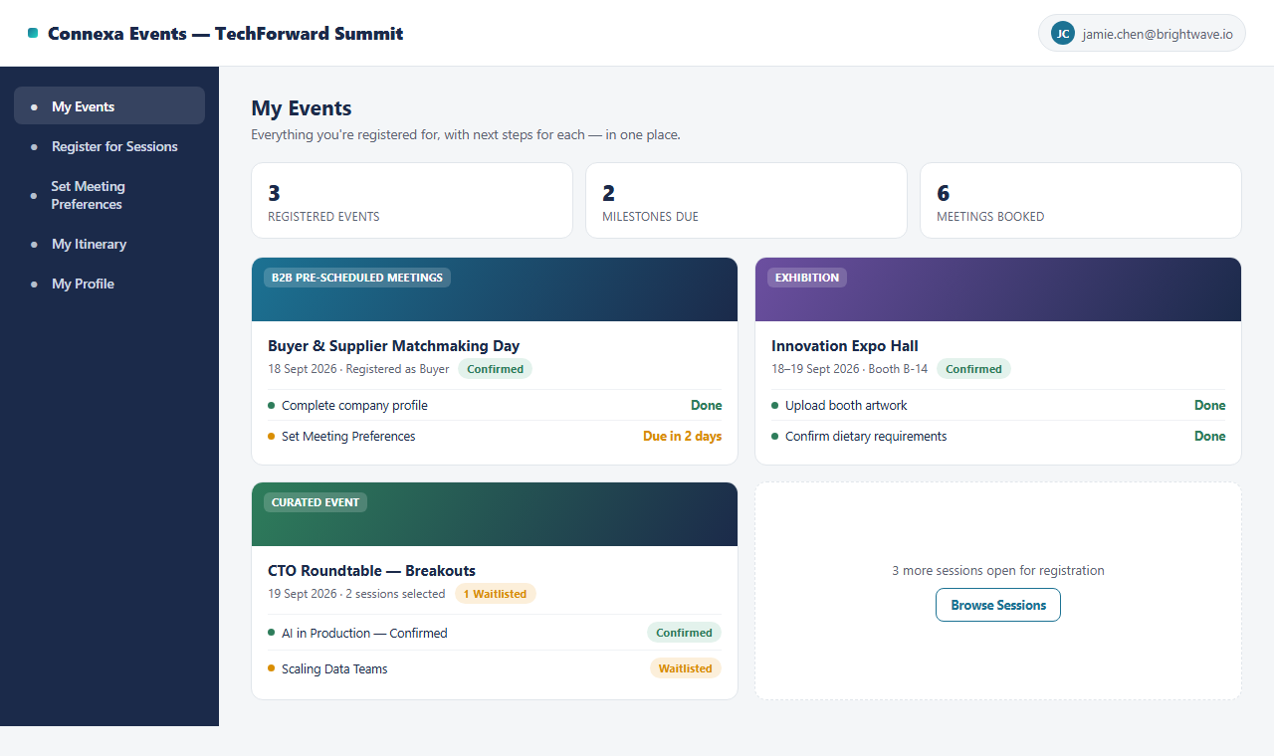
FEATURE WALKTHROUGH
An attendee experience people don't need onboarding for
One "My Events" home for every event, sub-session, and booth an attendee is part of
Batch registration — register yourself and colleagues in one pass, with live company auto-fill
Milestones (upload files, confirm info, set preferences) tracked with due dates, right where attendees already are
Umbrella events group curated sessions & exhibitions under one registration, each with independent capacity
CONNEXA EVENTS
5

Slide 6
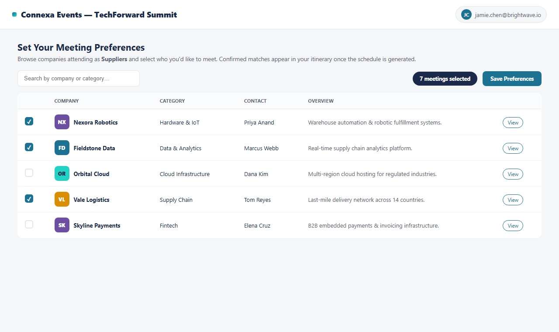
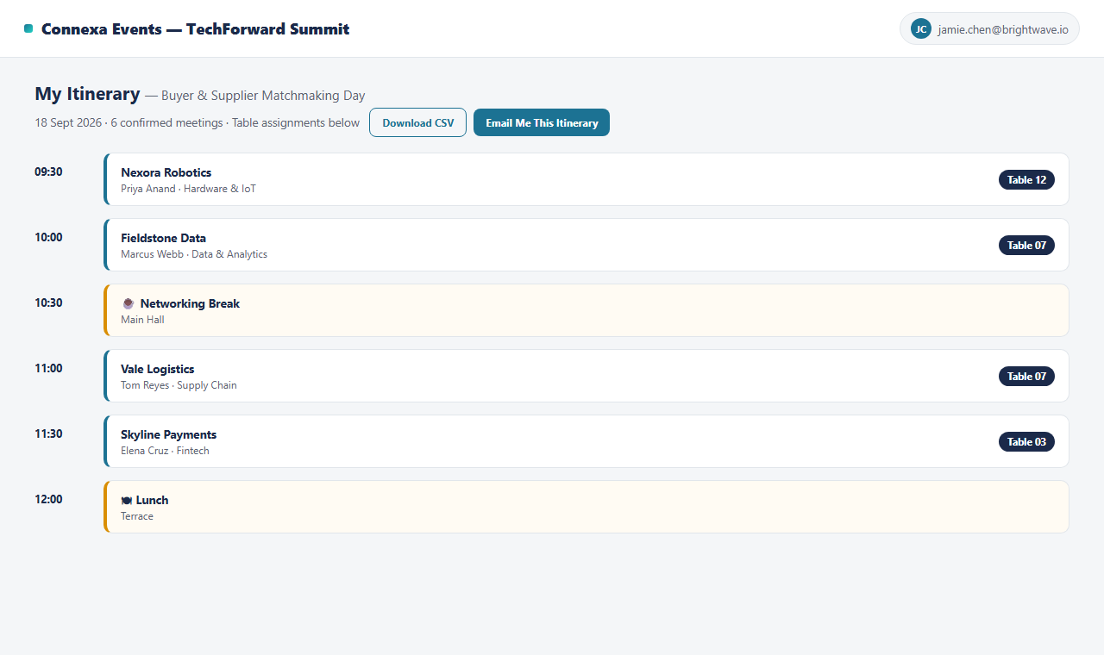
FEATURE WALKTHROUGH
Structured B2B matchmaking, built in — not bolted on
1. SET PREFERENCES
2. GET YOUR ITINERARY
Attendees browse the opposite side of the market (buyers see suppliers, and vice versa) and rank who they want to meet
Server-side allocation runs under a lock per entity — no two attendees can ever be double-booked into the same slot
Confirmed meetings resolve into a personal itinerary with table assignments, exportable as CSV or emailed on request
The matchmaking sophistication of enterprise platforms, without a separate vendor or a five-figure license
CONNEXA EVENTS
6

Slide 7
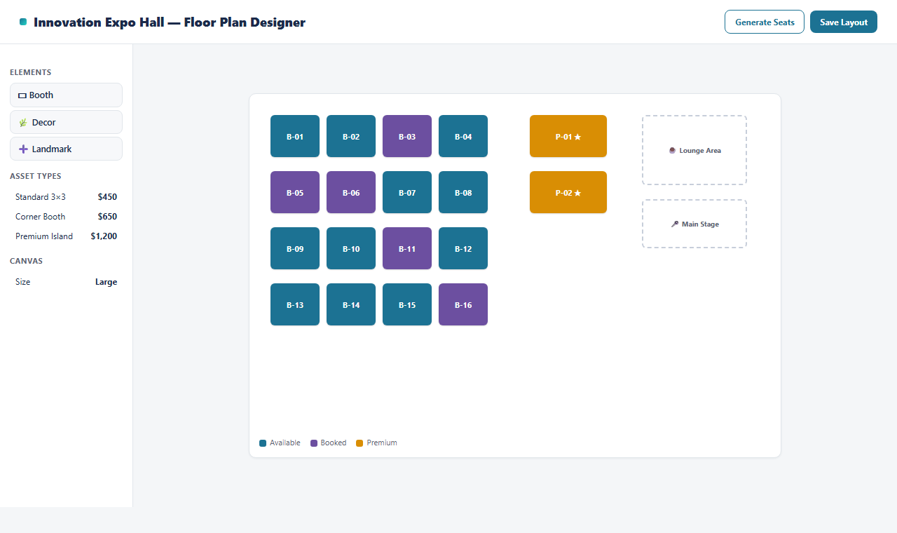
FEATURE WALKTHROUGH
A real floor plan designer, not a seating spreadsheet
Drag-and-drop booth, decor, and landmark placement on a to-scale canvas
Tiered Asset Types (Standard, Corner, Premium Island) with their own pricing, applied automatically at booking
Bulk "Generate Seats" lays out a full grid of booths in one action for large expo halls
Booth availability is derived live from actual registrations — never a layout that drifts from reality
CONNEXA EVENTS
7

Slide 8
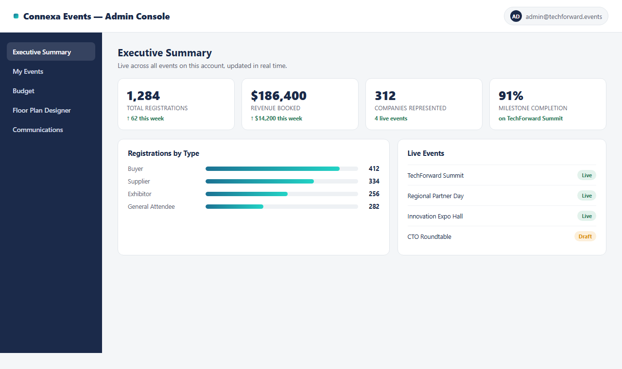
FEATURE WALKTHROUGH
A live command center across every event you run
Registrations, revenue, companies represented, and milestone completion — updated in real time, no exports needed
Per-event drill-down into registration types, sub-event capacity, and B2B preference submission rates
One console for every live and draft event on the account — no switching tools to see the whole portfolio
CONNEXA EVENTS
8

Slide 9
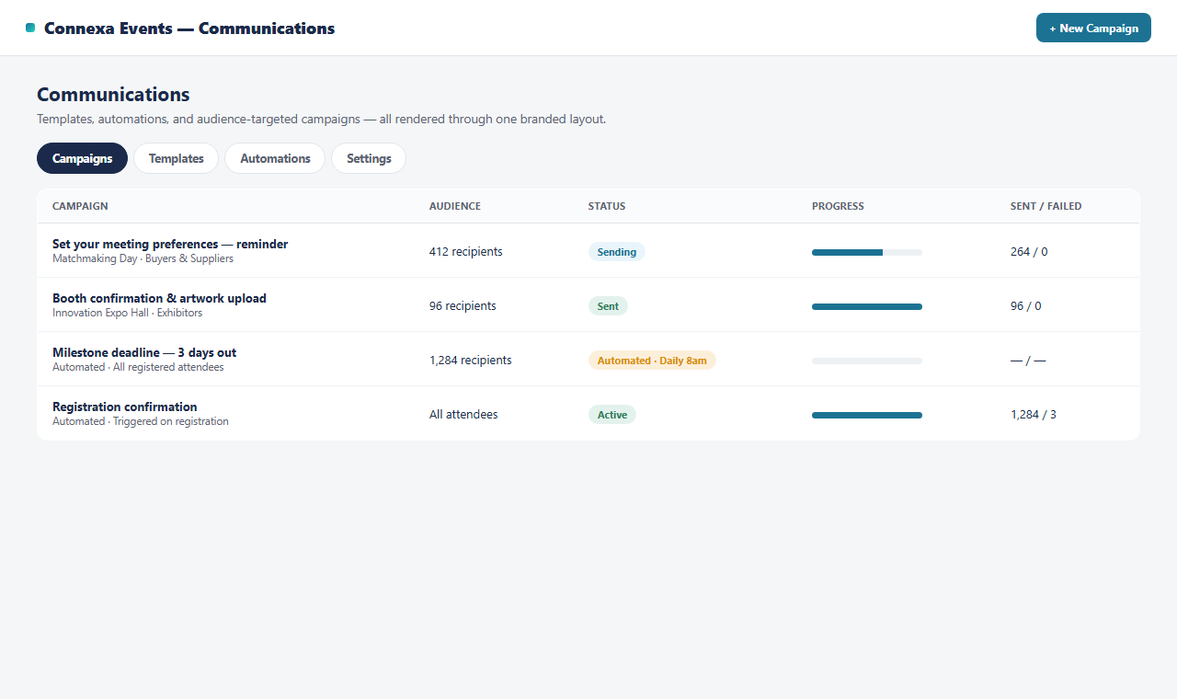
FEATURE WALKTHROUGH
A communications engine that never over-sends
One branded template renderer powers previews, test sends, automations, and live campaigns identically
Audience-targeted campaigns with registration-type, sub-event, and opt-out-aware filters
Automated triggers: registration confirmation, milestone deadline reminders, all de-duplicated automatically
A resumable send queue respects daily quota limits and reserves headroom for critical transactional email
Every send — automated or campaign — lands in one audit log
CONNEXA EVENTS
9

Slide 10

FEATURE WALKTHROUGH
Budget tracking that reconciles itself
Auto-Generated Orders
Planned vs. Actual
Payment Status
Portfolio Rollups
Every priced registration or allocation writes a payable order automatically — nothing to enter twice.
Cost and income budget lines sit alongside real order data, so variance is visible the moment it happens.
Mark orders paid as funds land — the revenue rollup on your dashboard updates immediately.
Roll every event's budget into one view for the whole season, not just a single event.
CONNEXA EVENTS
10

Slide 11
COMPETITIVE LANDSCAPE
How Connexa compares
Based on publicly available product & pricing information as of August 2026 — enterprise vendors quote scope-specific terms.
Connexa Events
Cvent
Grip
Swapcard
Brella
Whova
B2B Matchmaking
Included
Add-on module
Included
Included
Included
Not offered
Exhibitor Floor Plan
Included
Add-on module
Limited
Not offered
Not offered
Not offered
Budget & Revenue Tracking
Included
Separate module
Not offered
Not offered
Not offered
Not offered
Typical Deployment
Days
~4 months
Weeks
Weeks
Weeks
Weeks
Pricing Transparency
Published tiers
Sales-quoted only
Sales-quoted only
Sales-quoted only
Quote per event
Quote per event
Data Ownership
Your Workspace
Vendor-hosted
Vendor-hosted
Vendor-hosted
Vendor-hosted
Vendor-hosted
CONNEXA EVENTS
11

Slide 12
INVESTMENT
Recommended pricing, benchmarked against the market
Reference figures compiled from public pricing pages, analyst pricing guides, and vendor review sites as of August 2026.
PROVIDER
REFERENCE PRICING
WHAT IT BUYS YOU
Cvent
$19,550–$79,000+/yr
+ $7–12 per registrant
+ $5K–50K implementation
Enterprise event management; matchmaking is a separate priced module
Grip
Custom — high five-figure
annual license
AI-driven matchmaking only; ~4-month implementation
Swapcard
From $610/event (engagement)
+ custom (registration & mgmt)
Matchmaking & networking; full reg+mgmt platform quoted separately
Brella
Custom — per-attendee
+ consulting fees
Matchmaking, priced per event; portfolio discounts at scale
Whova
$500–$1,000+ base/event
+ 3% + $0.99 per paid ticket
All-in-one event app; no structured B2B matchmaking
Eventbrite
3.7% + $1.79 + 2.9%
per paid ticket
Ticketing only — no matchmaking, floor plan, or budget tools
CONNEXA EVENTS — RECOMMENDED PRICING
Starter
Growth
Portfolio
$1,500 / event
$4,500 / event
From $15,000 / yr
Up to 300 attendees
Registration, milestones, comms
Up to 1,000 attendees
+ B2B matchmaking, floor plan
Unlimited attendees, 6+ events
Dedicated support
CONNEXA EVENTS
12

Slide 13



SUMMARY
Why teams choose Connexa
Matchmaking sophistication, mid-market price
One system, not five
You own the data
The buyer/supplier matching enterprise platforms charge five-figure licenses for, at a fraction of the cost.
Registration, matchmaking, floor plan, budget, and comms share one data model — nothing to reconcile.
Runs natively on the Google Workspace you already have — full export, no vendor lock-in.
Days to deploy
Built to your event's structure
One command center
No months-long enterprise implementation cycle — configure your event types and go live.
Umbrella events, curated sessions, exhibitions & B2B tracks configure independently — not a rigid template.
Every event, every KPI, one real-time dashboard — for the organizer and the sponsor alike.
CONNEXA EVENTS
13

Slide 14
CONNEXA EVENTS
Let's design your next event
on Connexa
We'll configure your event structure, matchmaking flow, and floor plan together — and have a working pilot ready to walk through live.
1 Scoping call
2 Working pilot on your first event
3 Go live
CONNEXA EVENTS
14

