Slide 1
IMDB Movie Analysis
- By Sumit Vishwakarma

Slide 2
Project Description
The objective of this project is to analyze the factors that influence the success of movies on IMDB, where success is measured by high IMDB scores. By exploring a dataset containing movie-related attributes such as genre, budget,duration, director, release year, and more, we aim to uncover key trends and correlations that contribute to a movie's popularity and critical reception.

Slide 3
Approach
-For this project, I used Microsoft Excel for data cleaning and analysis and PowerPoint for presenting insights. My approach was simple and structured
I started by cleaning the data, removing duplicates, handling missing values, and standardizing formats. Then, I analyzed the data using Pivot Tables, formulas (AVERAGE, COUNTIF, CORREL), and charts to find trends in movie ratings based on factors like budget, genre, and director.

Slide 4
Tech-Stack
I am using Excel for data analysis and visualization due to its powerful built-in functions, user-friendly interface, and ability to handle structured data efficiently.
I created a presentation slides with clear visuals and key insights to showcase my findings in a simple and structured way.
For My presentation I am using Microsoft Powerpoint to present my insights .
I am using Excel version 2021
Hyperlink of the dataset
https://drive.google.com/file/d/1XpGThHzLnXxL_7aQo2sCpYL3SeB18MMB/view

Slide 5
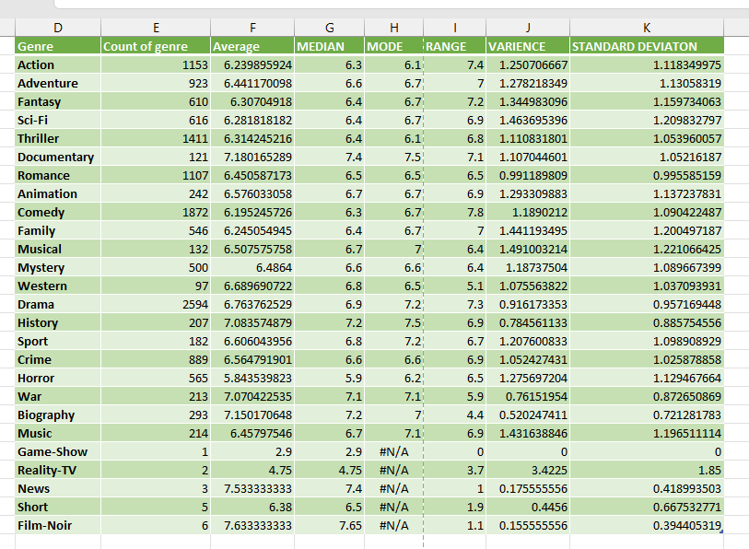
A. Movie Genre Analysis: Analyze the distribution of movie genres and their impact on the IMDB score. Task: Determine the most common genres of movies in the dataset. Then, for each genre, calculate descriptive statistics (mean, median, mode, range, variance, standard deviation) of the IMDB scores. Hint: Use Excel's COUNTIF function to count the number of movies for each genre. You might need to manipulate the 'genres' column to separate multiple genres for a single movie. Use Excel's functions like AVERAGE, MEDIAN, MODE, MAX, MIN, VAR, and STDEV to calculate descriptive statistics. Compare the statistics to understand the impact of genre on movie ratings.
Insights
The most frequent genres in the dataset are:
Drama (2594 movies)
Comedy (1872 movies)
Thriller (1411 movies)
Action (1153 movies)
Romance (1107 movies)
Data Story
Drama, Crime, and Romance tend to receive higher ratings on average.
Horror and Comedy movies often receive lower ratings.

Slide 6
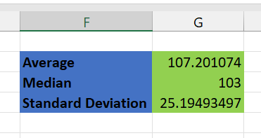
B. Movie Duration Analysis: Analyze the distribution of movie durations and its impact on the IMDB score. Task: Analyze the distribution of movie durations and identify the relationship between movie duration and IMDB score. Hint: Calculate descriptive statistics such as mean, median, and standard deviation for movie durations. Use Excel's functions like AVERAGE, MEDIAN, and STDEV. Create a scatter plot to visualize the relationship between movie duration and IMDB score. Add a trendline to assess the direction and strength of the relationship.
Insights
Most movies fall within a 90-150 minute range.
Data Story
Extremely long or short movies generally receive mixed ratings, indicating that duration alone doesn’t determine a movie’s success.

Slide 7
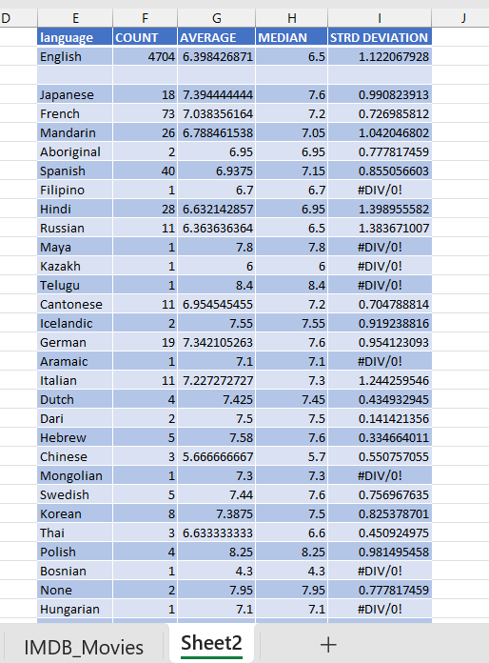
C. Language Analysis: Situation: Examine the distribution of movies based on their language. Task: Determine the most common languages used in movies and analyze their impact on the IMDB score using descriptive statistics. Hint: Use Excel's COUNTIF function to count the number of movies for each language. Calculate the mean, median, and standard deviation of the IMDB scores for each language. Compare the statistics to understand the impact of language on movie ratings.
Data Story
The analysis shows that English is the most common language in movies. The average IMDB score varies by language, showing that some languages have consistently high-rated movies. A higher standard deviation means more variation in ratings, while a lower standard deviation indicates consistent ratings.
This helps understand how language influences movie ratings.Languages with fewer movies (like Polish, Hebrew, Portuguese, and Danish) generally have higher ratings..

Slide 8
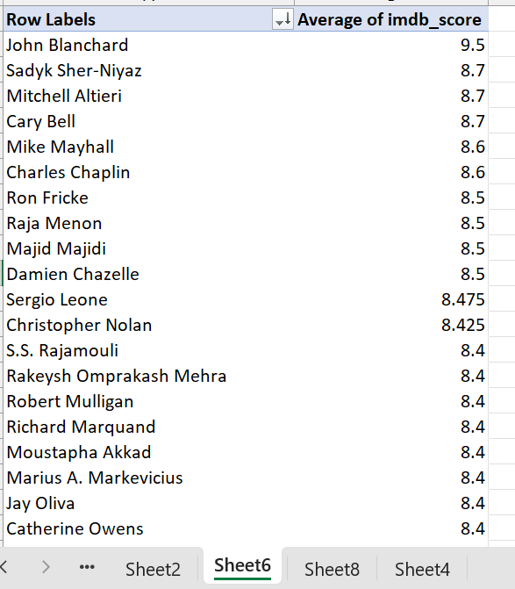
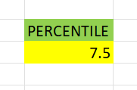
D. Director Analysis: Influence of directors on movie ratings. Task: Identify the top directors based on their average IMDB score and analyze their contribution to the success of movies using percentile calculations. Hint: Calculate the average IMDB score for each director. Use Excel's PERCENTILE function to identify the directors with the highest scores. Compare the scores of these directors to the overall distribution of scores.
Data Story
Top Directors Have Higher Ratings
The 90th percentile of directors' average IMDB scores is 7.5, meaning the highest-rated directors generally have an IMDB score of 7.5 or above.
FORMULA USED FOR PERCENTILE---
=PERCENTILE(B4:B2402, 0.9)
Directors with scores close to the mean (around 6-7) have an average impact.
Directors below the median (around 6) might not have as much influence on high ratings.

Slide 9
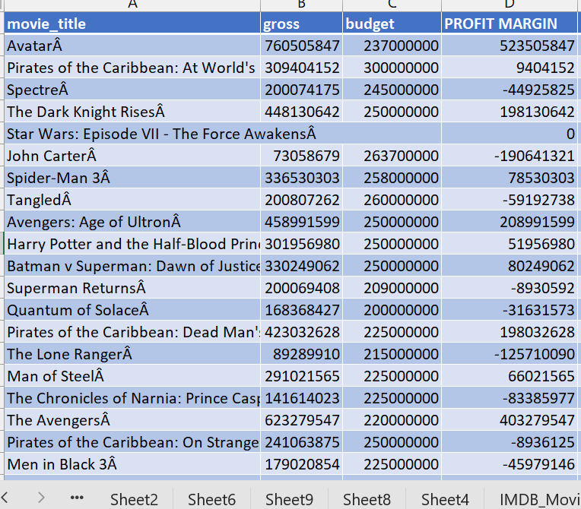
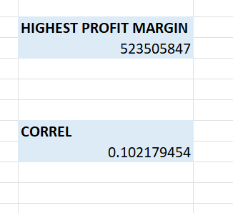
E. Budget Analysis: Explore the relationship between movie budgets and their financial success. Task: Analyze the correlation between movie budgets and gross earnings, and identify the movies with the highest profit margin. Hint: Calculate the correlation coefficient between movie budgets and gross earnings using Excel's CORREL function. Calculate the profit margin (gross earnings - budget) for each movie and identify the movies with the highest profit margin using Excel's MAX function.
Insights
Correlation between budget and gross earnings: 0.102
Movie with the Highest Profit Margin:
Director: James Cameron
Gross Earnings: $760,505,847
Budget: $237,000,000
Profit Margin: $523,505,847
Data-Story
Higher-budget movies usually earn more, but a big budget alone doesn’t guarantee success.

Slide 10
Insights
We analyzed genres and found that drama and comedy are common. English dominates as the primary language in movies. However, foreign-language films tend to have higher IMDb ratings on average, indicating a strong impact of storytelling. James Cameron’s Avatar ($760M) is the highest-grossing movies in the dataset. However, having a high budget does not guarantee success, as the correlation between budget and revenue is weak (0.10).

Slide 11
Result
This project helped me improve my Excel skills in many ways. I learned how to clean and filter data, use important formulas like AVERAGE, MEDIAN, COUNTIF, and PERCENTILE, and create Pivot Tables to summarize information. I also made charts and scatter plots to see patterns in the data. By analyzing movie budgets, IMDb scores, and genres, I understood how to find useful insights from raw data. Overall, this project has made me more confident in using Excel for data analysis.

Slide 12

This Photo by Unknown Author is licensed under CC BY-SA

