Slide 1
Instagram User Analytics
-By Sumit Vishwakarma

Slide 2
Project Description
This is Sumit Vishwakarma Presenting Instagram User Analytics.
The purpose of this project is to analyze user interactions and engagement with the Instagram app to provide actionable insights that can help the business grow.
These insights will help the company to take better decisions which will enhance user experience..

Slide 3
Approach
To get the better insights first we will understand the aim of the project.
Then we will work on the basis of tasks provided by the team heads
And with the help of SQL we will explore the data and identify trends and patterns which can help to improve user engagement.

Slide 4
Tech-Stack Used
I have used MySQL for this project as it is very helpful for data analysis for large dataset and huge database. It is easy to use and easy to understand.
I have written some queries as per the required task and extract the data .
I am using MySQL version 8.0.40.

Slide 5
Marketing Analysis:

Slide 6

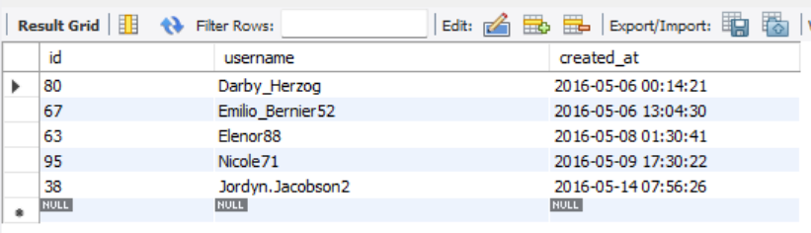
AIM- Loyal User Reward: The marketing team wants to reward the most loyal users, i.e., those who have been using the platform for the longest time. Your Task: Identify the five oldest users on Instagram from the provided database.

Slide 7

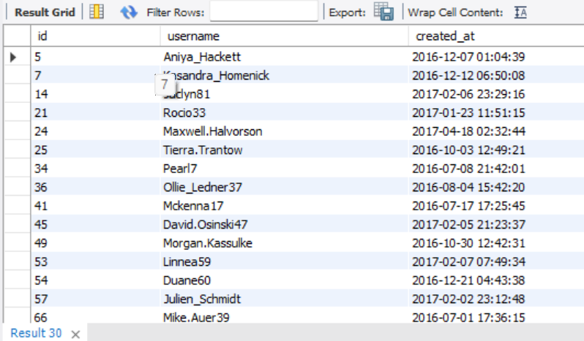
AIM-Inactive User Engagement: The team wants to sending them promotional emails. Your Task: Identify users who have never posted a single photo on encourage inactive users to start posting by Instagram.

Slide 8
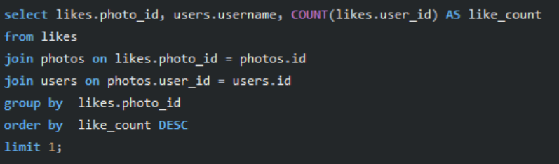

AIM-Contest Winner Declaration: The team has organized a contest where the user with the most likes on a single photo wins. Your Task: Determine the winner of the contest and provide their details to the team.

Slide 9
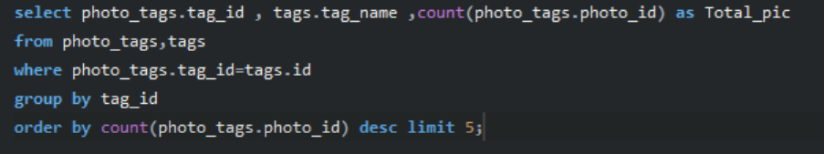
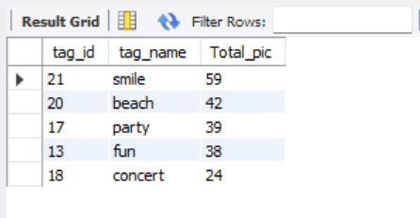
AIM-Hashtag Research: A partner brand wants to know the most popular hashtags to use in their posts to reach the most people. Your Task: Identify and suggest the top five most commonly used hashtags on the platform.

Slide 10
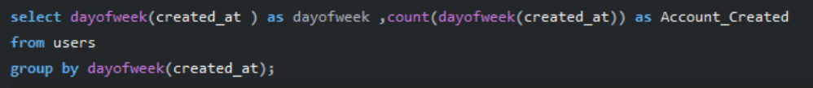
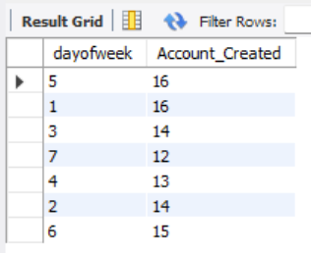
AIM-Ad Campaign Launch: The team wants to know the best day of the week to launch ads. Your Task: Determine the day of the week when most users register on Instagram. Provide insights on when to schedule an ad campaign.

Slide 11
Investor Metrics:

Slide 12
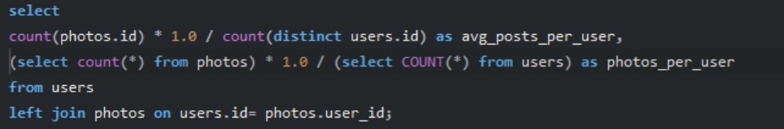

AIM-User Engagement: Investors want to know if users are still active and posting on Instagram or if they are making fewer posts. Your Task: Calculate the average number of posts per user on Instagram. Also, provide the total number of photos on Instagram divided by the total number of users.

Slide 13
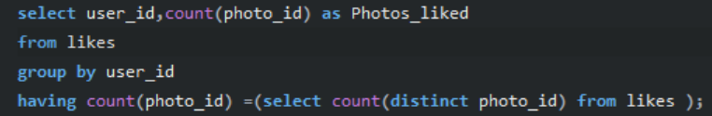
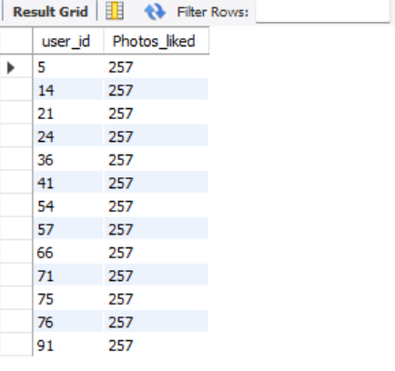
AIM-Bots & Fake Accounts: Investors want to know if the platform is crowded with fake and dummy accounts. Your Task: Identify users (potential bots) who have liked every single photo on the site, as this is not typically possible for a normal user.

Slide 14
Insights
From this analysis, i have learned about user patterns, such as their most-liked posts, their favorite day of the week and the most popular hashtags they frequently use.
I have also identified some users who haven’t posted anything yet and others who could potentially be bots. This information can be helpful for the team to email inactive users and remove bots to enhance the platform's real performance.
Active users (those with posts) contribute significantly more than the overall user base, highlighting the need to convert inactive users into active ones.

Slide 15
Key Achievements
I strengthened my skills in writing complex SQL queries, such as using joins, aggregations, and subqueries to analyze data effectively.
This project has boosted my confidence in working with databases and extracting meaningful insights.
I was able to analyze and understand user patterns, such as their most-liked posts, the most popular hashtags they use, and their preferred days of the week for engagement.
This data analyzation can help to improve the platform by re-engaging inactive users and removing bots to enhance overall authenticity and performance.

