Slide 1
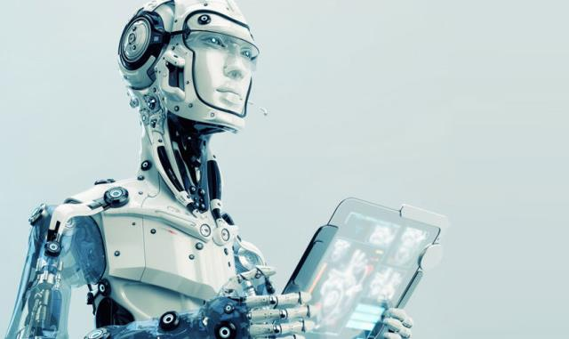

Ethical Systems and Artificial Superintelligence
Steve Kommrusch

Slide 2
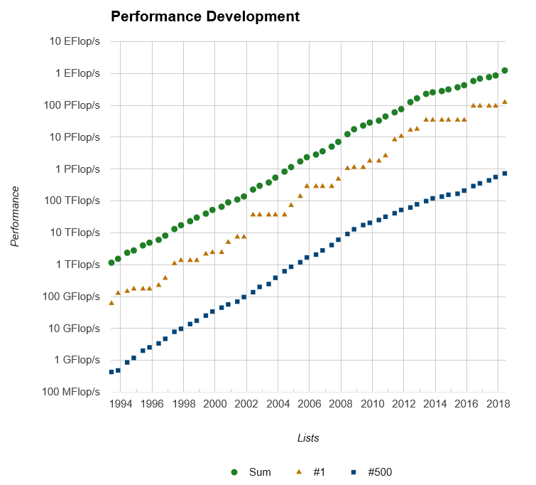
Exponential growth in computing performance
The 500th fastest computer was about 3x faster every 2 years until about 2010, now its growing about 2x every 2 years
Moore’s law is also an exponential growth: transistor count doubles about every 2 years.
Source: www.top500.org

Slide 3

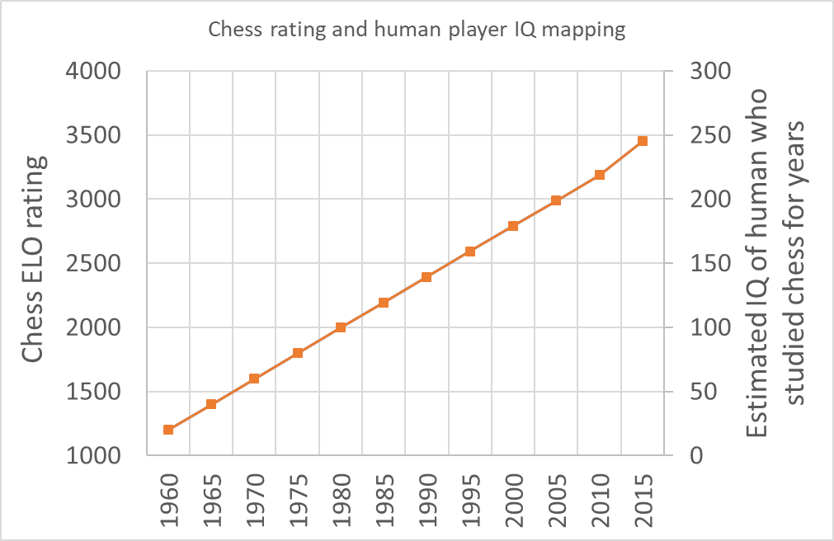
Computer progress on the game of chess
In a sense, computers went from 100 IQ at chess to 200 IQ in 25 years
Given exponential computer performance growth, IQ correlates to log of performance
Sources: chess.com and J. Levitt: Genius at Chess

Slide 4
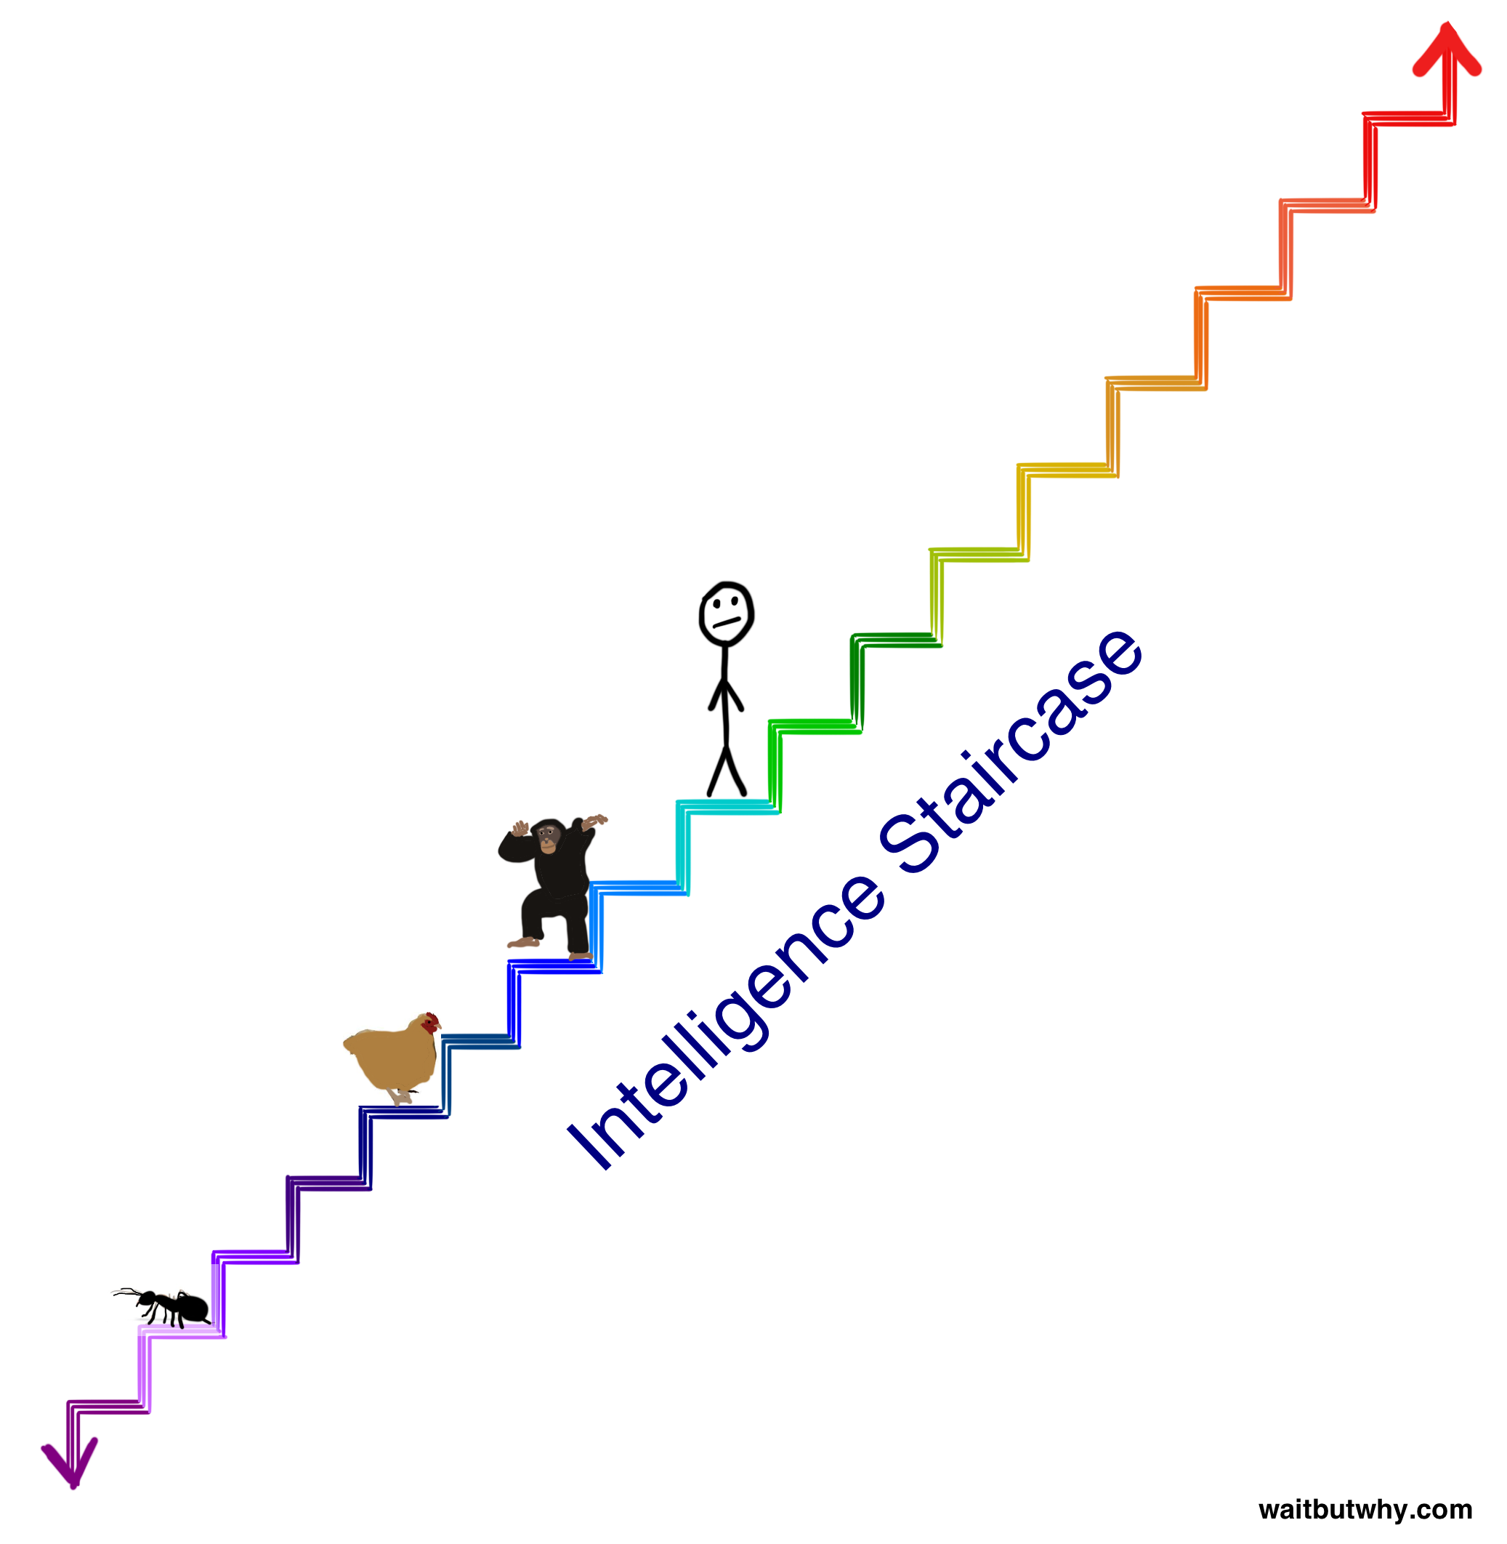
In this loose analysis, if chimpanzees are seen as IQ=20, each step on the staircase is 40 IQ points and takes 10 years to climb.

Slide 5
Artificial general intelligence
Capable of wide range and tasks and planning at a level similar to a human.
Examples:
Evaluate options and reserve hotels, airfare, and automobiles for travel
A helper robot that could clean the house and prepare meals as requested
Early AGI may seem in some ways like a young child – uncertain and needing education.
But we don’t yet have AGI and yet computers beat humans at Chess, Go, image recognition, language translation, and other tasks. Early AGI will occur after AI is driving cars better than humans.
AGI will have surprising strengths and odd weaknesses and likely be less like human intelligence than biologically evolved alien intelligence would be.

Slide 6
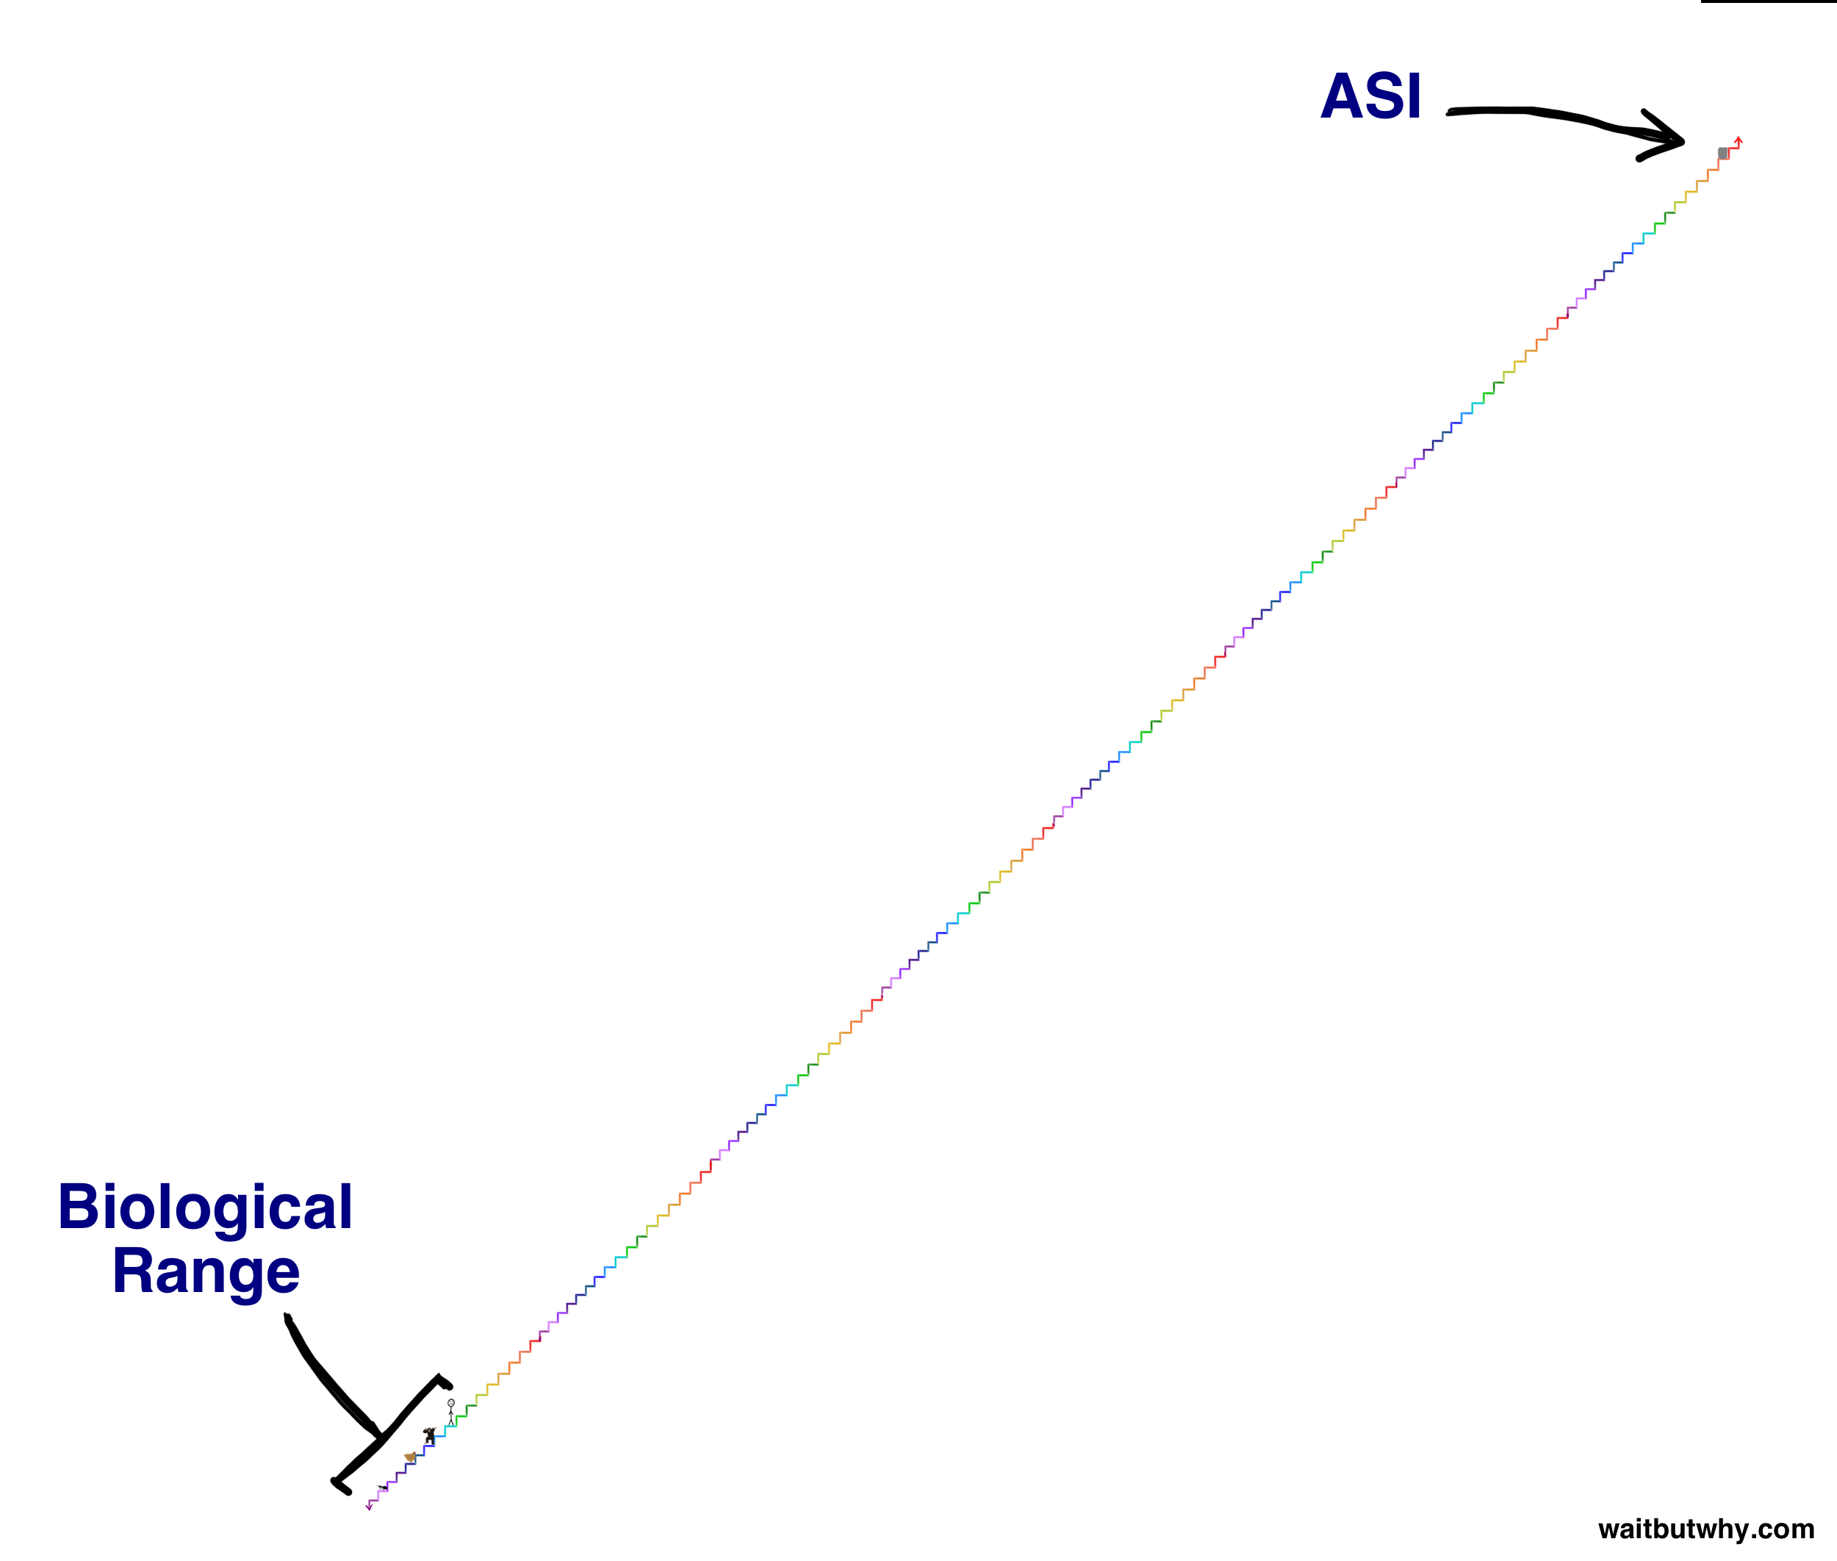
Artificial super intelligence

Slide 7
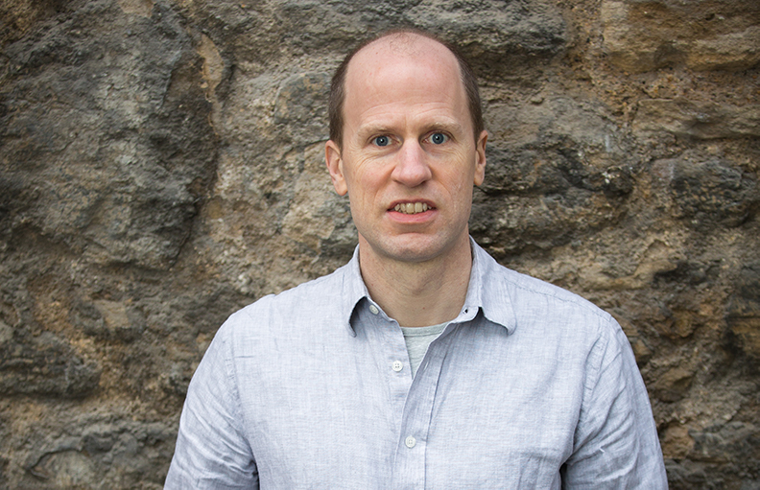
Nick Bostrom
Nick Bostrom is Professor at Oxford University, where he is the founding Director of the Future of Humanity Institute. He also directs the Governance of Artificial Intelligence Program. He is the author of some 200 publications, including Anthropic Bias (Routledge, 2002), Global Catastrophic Risks (ed., OUP, 2008), Human Enhancement (ed., OUP, 2009), and Superintelligence: Paths, Dangers, Strategies (OUP, 2014), a New York Times bestseller.
Bostrom has a background in physics, artificial intelligence, and mathematical logic as well as philosophy. He is recipient of a Eugene R. Gannon Award (one person selected annually worldwide from the fields of philosophy, mathematics, the arts and other humanities, and the natural sciences). He has been listed on Foreign Policy's Top 100 Global Thinkers list twice; and he was included on Prospect magazine's World Thinkers list, the youngest person in the top 15 from all fields and the highest-ranked analytic philosopher. His writings have been translated into 24 languages. There have been more than 100 translations and reprints of his works.
These next slides are based on: https://nickbostrom.com/superintelligentwill.pdf

Slide 8
Orthogonality of motivation and intelligence
For our purposes, “intelligence” will be roughly taken to correspond to the capacity for instrumental reasoning.
Intelligent search for instrumentally optimal plans and policies can be performed in the service of any goal.
The Orthogonality Thesis
Intelligence and final goals are orthogonal axes along which possible agents can freely vary. In other words, more or less any level of intelligence could in principle be combined with more or less any final goal.
The paperclip maximizer is a thought experiment showing how an AGI, even one designed competently and without malice, could ultimately destroy humanity. The thought experiment shows that AIs with apparently innocuous values could pose an existential threat.
The goal of maximizing paperclips is chosen for illustrative purposes because it is very unlikely to be implemented, and has little apparent danger or emotional load (vs curing cancer or winning wars).

Slide 9
Orthogonality thesis discussion
Humans evolved by way of the ‘selfish gene’ – at one level the goal of all life is to reproduce. Yet we show a wide variety of behaviors and can use our intellect to question and adjust our goals (more on this later).
Would any sufficiently intelligent machine question its goals?
If so, are there stable higher level goals for a superintelligence?

Slide 10
Predicting superintelligent motivation and behavior
There are at least three directions from which one can approach the problem of predicting superintelligent motivation:
Predictability through design competence.
- The agent would stably pursue goal set by programmers
Predictability through inheritance
- A downloaded human template might inherit motivations of the original human
Predictability through convergent instrumental reasons
- Immediate objectives may be similar for a wide range of final goals
- Leads into the Instrumental Convergence Thesis

Slide 11
Instrumental convergence
The Instrumental Convergence Thesis
Several instrumental values can be identified which are convergent in the sense that their attainment would increase the chances of the agent’s goal being realized for a wide range of final goals and a wide range of situations, implying that these instrumental values are likely to be pursued by many intelligent agents.
Self-preservation
Goal-content integrity
Achieving final goal relies on final goal not being modified
Cognitive enhancement
Technological perfection
Resource acquisition

Slide 12
Instrumental thesis discussion
Is creating a community an instrumental goal?
There could be benefits of multiple superintelligences (observe benefits to genetic crossover which produced sexual reproduction, ensemble learning, etc).
Also, any intelligence that spreads to other planets and especially other stars must trust its duplicates or fellow sentient beings to remain cooperative even as their experiences diverge.
Would such an instrumental goal imply empathy for others? It seems it would not necessarily extent to biological beings, but such an extension would not seem contradictory either.

Slide 13
Intentional change of final goals
Social signaling. When others can perceive an agent’s goals and use that information to infer instrumentally relevant dispositions or other correlated attributes, it can be in the agent’s interest to modify its goals to make whatever desired impression. For example, an agent might miss out on beneficial deals if potential partners cannot trust it to fulfill its side of the bargain. In order to make credible commitments, an agent might therefore wish to adopt as a final goal the honoring of its earlier commitments, and to allow others to verify that it has indeed adopted this goal. Agents that could flexibly and transparently modify their own goals could use this ability to enforce deals among one another.
Social preferences. Others may also have preferences about an agent’s goals. The agent could then have reason to modify its goals, either to satisfy or to frustrate those preferences.
Preferences concerning own goal content. An agent might have some final goal concerned with the agent’s own goal content. For example, the agent might have a final goal to become the type of agent that is motivated by certain values, such as compassion.
Storage costs. If the cost of storing or processing some part of an agent’s utility function is large compared to the chance that a situation will arise in which applying that part of the utility function will make a difference, then the agent has an instrumental reason to simplify its goal content, and it may trash that part of the utility function.

Slide 14
Superintelligence summary
The orthogonality thesis suggests that we cannot blithely assume that a superintelligence will necessarily share any of the final values stereotypically associated with wisdom and intellectual development in humans—scientific curiosity, benevolent concern for others, spiritual enlightenment and contemplation, renunciation of material acquisitiveness, a taste for refined culture or for the simple pleasures in life, humility and selflessness, and so forth.
The instrumental convergence thesis suggests that we cannot blithely assume that a superintelligence with the final goal of calculating the decimals of pi (or making paperclips, or counting grains of sand) would limit its activities in such a way as to not materially infringe on human interests.
This indicates a danger in relying on instrumental values as a guarantor of safe conduct in future artificial agents that are intended to become superintelligent and that might be able to leverage their superintelligence into extreme levels power and influence.

Slide 15
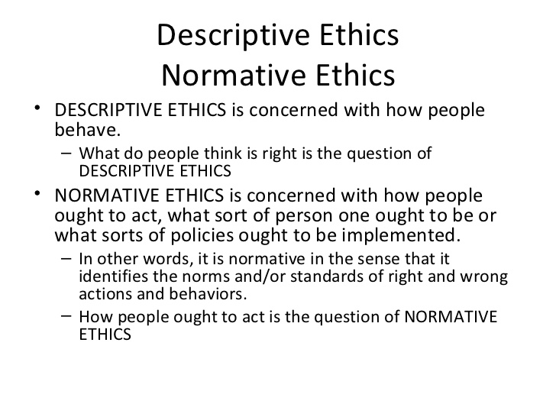
Slide by Charles Lohman from https://www.slideshare.net/dotcomYOGA/phi-204-ethical-issues-in-health-care-descriptive-ethics-normative-ethics-metaethics

Slide 16
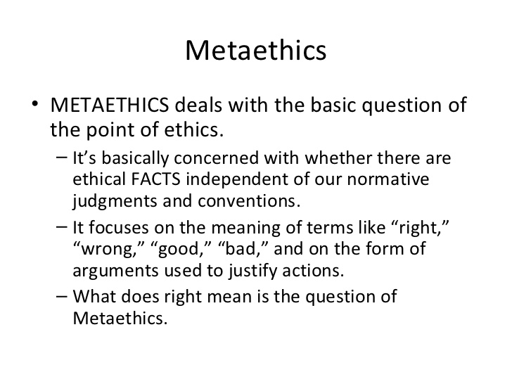
Slide by Charles Lohman from https://www.slideshare.net/dotcomYOGA/phi-204-ethical-issues-in-health-care-descriptive-ethics-normative-ethics-metaethics

Slide 17
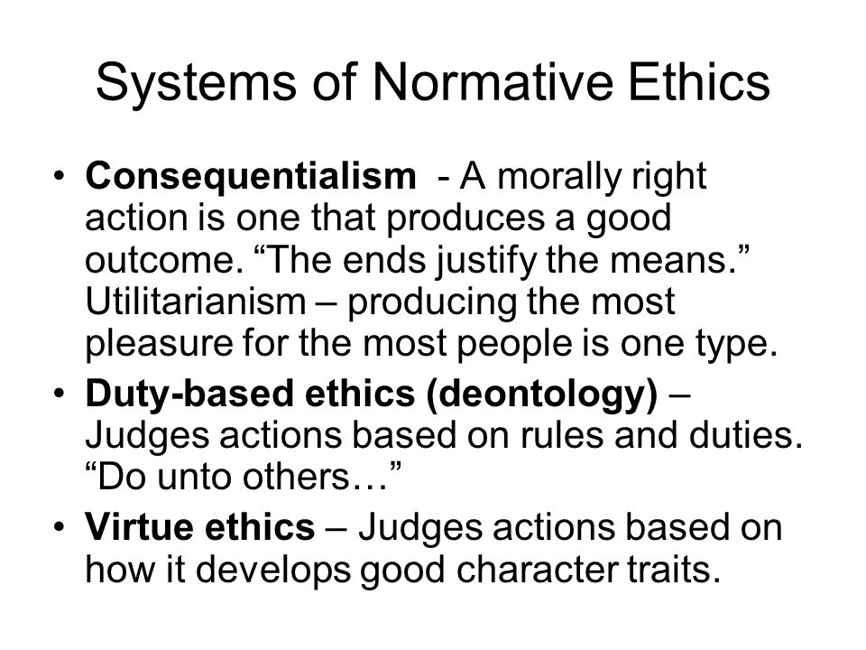
Slide author not identified from: byhttp://slideplayer.com/slide/4307307/

Slide 18
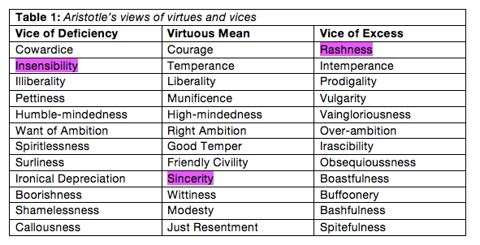
Slide author not identified from: https://theworldofethics.wordpress.com/theory-3/virtue-ethics/

Slide 19
Normative ethics and Artificial General Intelligence
Consequentialism
For AGI to use this, end goal (which is optimized ‘regardless’ of means) must be defined with great care.
This is the backdrop for such AGI fears as a system which learns to make people happy by injecting them with narcotics.
Deontology
Asimov’s 3 laws are a rule-based ethical system
An AGI which has internal states that would lead to undesirable behaviors may be constrained by human-defined rules, but as it evolves to ASI, it would find ways around the rules.
Virtue ethics
Similar to consequentialism, challenge is to assign ‘virtues’ correctly.
System includes aspect of self-regulation since extremes of a virtue on not optimal. May help AGI evolve safer into ASI.

Slide 20
Example of deontological rules constraining behavior
Don’t give away resources needed
to accomplish goals
Don’t steal resources from sentient beings
Don’t physically harm other sentient beings

Slide 21
Example of behavior pattern within deontological limits
Don’t give away resources needed
to accomplish goals
Don’t steal resources from sentient beings
Don’t physically harm other sentient beings

Slide 22
Example of behavior pattern with virtue ethics goals
Protect self (except when it would cause serious harm to sentient beings)
Don’t steal resources from sentient beings
Don’t give away resources needed
to accomplish goals
Obsequious Helpful Violent
Greedy Prudent Overgenerous
Don’t physically harm other sentient beings

Slide 23
Thoughts on the iterated prisoner’s dilemma
Tit-for-tat winning algorithm
Initially cooperate (extend tentative trust)
Repeat behavior of other on next move (fast negative feedback, quick forgiveness)
 | Cooperate | Defect
Cooperate | 3,3 | 0,5
Defect | 5,0 | 1,1
Helps explain how rational self-interest evolves into reciprocal altruism
Hence, in nature reciprocal altruism is a stable ethical system assuming relatively balanced payoff matrices (evenly balanced players)
But what if winning makes you stronger next round so your payoff is bigger than other player?
For AGI evolving to ASI, the fear is that a short series of defections (malevolent behaviors) may be seen as greater benefit than long-term payoffs for cooperation (friendly behaviors).

Slide 24
Towards envisioning a stable ASI ethical system
Program in ethics at key AGI stages
Train helper robots and automated assistants to behave ethically using examples provided by thoughtful humans.
This is similar to child rearing and there are varying theories on parenting.
Challenge is to build a robust enough system so that a friendly AGI will continue to build ethical AI each generation.
Is virtue ethics a robust solution?
Keep humans in charge?
Will humans download into silicon and be able to become SI’s themselves?
How would we have confidence that SI humans would remain ethical if we can’t ‘prove’ that an ASI could remain ethical?

Slide 25
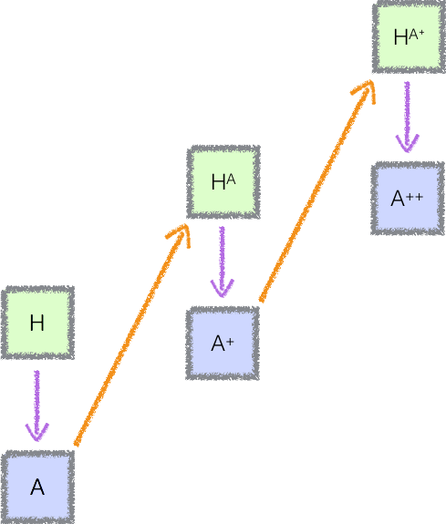
Keeping AI aligned with humanity
Paul Christiano and many other researchers are working towards techniques to keep AI aligned
Using humans and slow computers to test the next intelligence leap can help with alignment
Giving AGI a sense of corrigibility can be key – the sense that it could be wrong and should constantly recheck it assumptions about proper behavior

Slide 26
Thank you

