Slide 1
FINAL YEAR PROJECT : PART 1
TOPIC : SYNTHETIC UNIT HYDROGRAPH (SYNOPSIS)
DEPARTMENT : B. TECH. CIVIL ENGINEERING DEPARTMENT
SECTION : B
SWAPNANEEL GHOSH : 13001319052
SAYANTI SAHU : 13001320085

Slide 2
-:NECESSITIES OF SYNTHETIC UNIT HYDROGRAPH:-
There are many basins, especially in developing countries, which are not gauged; but for which, unit graphs may be required. For such basins, the unit hydrographs are synthesised from the known unit hydrograph of a meteorologically homogeneous basin. Therefore, for those ungauged basins Synthetic Unit Hydrograph is necessary.

Slide 3
-:METHODS AND EQUATIONS THAT WE HAVE USED TO STUDY SYNTHETIC UNIT HYDROGRAPH:-
Snyder (1938), based on a study of a large number of catchment basins in the Appalachian Highlands of Eastern United States, developed a set of empirical equations, connecting the basin characteristics with the unit graph characteristics.
- The basin characteristics used in these empirical relations were L, Lc, A, and coefficients Ct, and Cp; whereas the unit graph characteristics were tp, B and Qp. These relations in the form of empirical equations are known as Snyder Method.
Indian Equations for Synthetic Unit Hydrograph. The Central Water Commission, after making a study on a large number of Indian catchments of sizes ranging between 25 to 500 km², has also recommended relations for developing synthetic unit hydrographs.

Slide 4
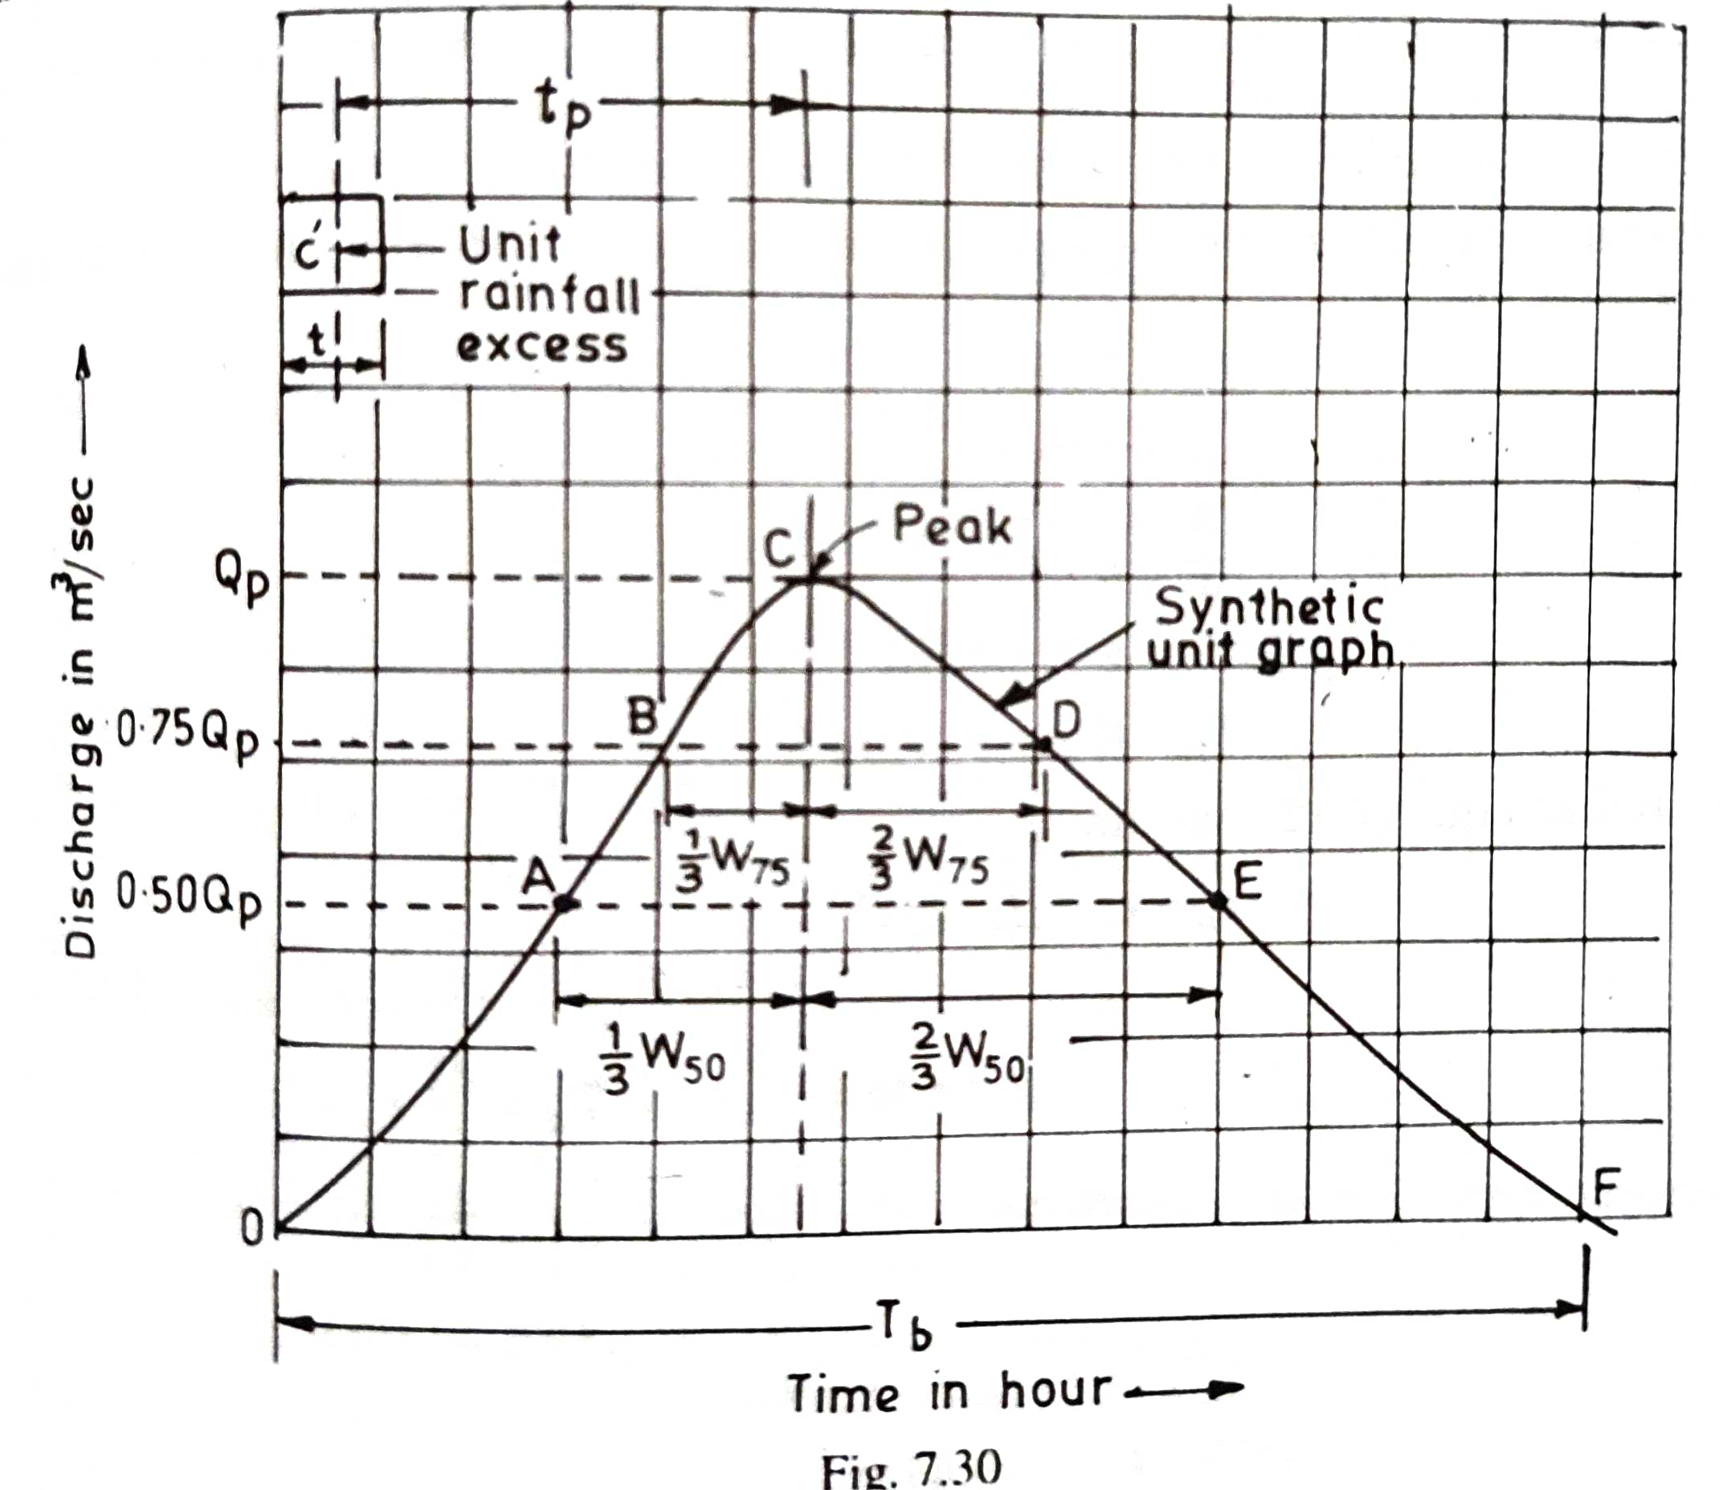
-:GRAPH USED FOR SYNTHETIC UNIT HYDROGRAPH:-

Slide 5
-:USES OF SYNTHETIC UNIT HYDROGRAPH:-
A synthetic unit hydrograph is derived from theory and experience, and its purpose is to simulate basin diffusion by estimating the basin lag based on a certain formula or procedure.
A synthetic unit hydrograph retains all the features of the unit hydrograph, but does not require rainfall-runoff data.
It is very beneficial in developing countries where it may be required.

Slide 6
-:BIBLIOGRAPHY:-
Hydrology and water Resources Engineering by Santosh Kumar Garg and Applied Hydrology by Ven Te Chow.

