Slide 1
50 Years of Data Science by dr.David donoho.
Daviel Garcia

Slide 2
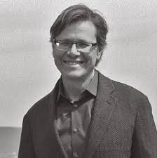
David Donoho
Born:1957 (Age: 67), Los Angeles
Academic advisors: John Tukey, Peter J. Huber
Affiliation: Stanford University

Slide 3
Introduction
What is this about?
Reflection on 50 years of progress in data science.
Focus on its evolution as a distinct discipline.
Author's Key Question:
How can data science unify statistical theory, computation, and real-world practice?

Slide 4
Historical Context
Roots in Statistics and Computer Science:
Inspired by John Tukey’s focus on exploratory data analysis (1960s).
Growth driven by computational advancements.
A Field Beyond Statistics:
Data science as broader, practical, and interdisciplinary.

Slide 5
What is “Greater Data Science”?
Donoho outlines six key areas:
1. Data Exploration and Preparation: Cleaning and understanding data.
2. Data Representation and Transformation: Structuring data for analysis.
3. Computing with Data: Leveraging algorithms and computation.
4. Data Modeling: Building predictive and inferential models.
5. Data Visualization and Presentation: Communicating insights effectively.
6. Science about Data Science: Meta-analysis of tools, methods, and ethics.

Slide 6
Why Data Science is Different
Emphasis on Large-Scale Data:
Handling massive datasets beyond traditional statistical methods.
Machine Learning:
Focus on predictive modeling and automated insights.
Interdisciplinary Collaboration:
Integration with domain-specific expertise.

Slide 7
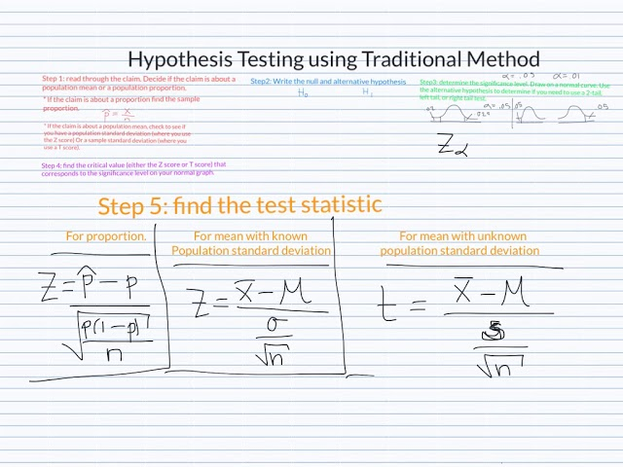
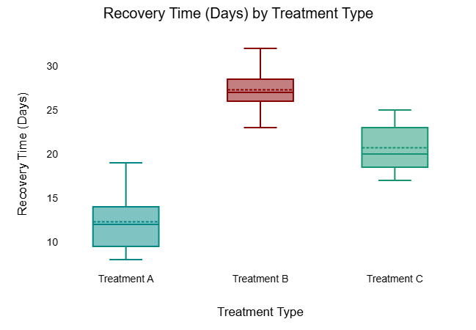
examples

Slide 8
Challenges in the Field
Reproducibility Issues:
Ensuring results can be replicated.
Ethical Concerns:
Addressing biases and data misuse.
Educational Gaps:
Need for curricula combining statistics, computation, and domain knowledge.

Slide 9
Opportunities for Growth
Unifying Statistical Rigor and Practical Tools:
Bridging gaps between theory and application.
Innovation in Education:
Training data scientists with a holistic approach.
Driving Interdisciplinary Solutions:
Tackling real-world problems with cross-domain expertise.

Slide 10
Conclusion
Data science is a distinct, growing field that transcends traditional boundaries.
Donoho calls for:
Recognition of data science as a unified discipline.
Integration of computational and statistical practices.
A focus on ethical, reproducible, and impactful applications.

Slide 11
citation
https://www.tandfonline.com/doi/full/10.1080/10618600.2017.1384734#d1e296

