Slide 1
SW360 Information Slides
1. Vision
2. History
3. Basics
4. Integration
5. REST API
6. Hands-on
7. Community
Siemens Corporate Technology
CC-BY-SA-4.0 © Siemens AG 2014 - 2018

Slide 2
SW360 - Vision
Siemens Corporate Technology
CC-BY-SA-4.0 © Siemens AG 2014 - 2018

Slide 3
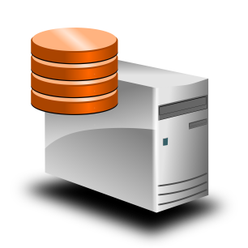
Handling of Software Components
IT today talks about components
Involving different systems
Project BOM Management
License Scanner
Code Quality Checker
Source Code Scanner
Artefact Repository

Slide 4
Problem
Todays IT talks about components
Involving different systems
License Scanner
Code Quality Checker
Components
Apache Tomcat 7.0.54
Java-17.0.54
Libelf-0.8.9
Components
Tomcat-7.0.23
Oracle Java 1.7.0_64
Mr 511‘S Libelf 0.8.9
Each system uses different names for components: Mapping Effort required

Slide 5
Problem 2: not 1-to-1 but many-to-many
Mapping effort for all component managing systems
Will multiply for new systems
Project BOM Management
License Scanner
Code Quality Checker
Source Code Scanner
Artefact Repository

Slide 6

Solution: Centralise mappings
  “Phonebook for Components”
  Central database for names for
  software components
  Systems to talk to each other
  Like person directory
  for IT systems
  in company
  already
Project BOM Management
License Scanner
Code Quality Checker
Source Code Scanner
Artefact Repository

Slide 7
Solution: Centralise mappings
  “Phonebook for Components”
  Central database for names for components
  Systems to talk to each other
  Like person directory
  for IT systems
  in company
  already
Project BOM Management
License Scanner
Code Quality Checker
Source Code Scanner
Artefact Repository

Slide 8

Similar Problem: Licenses
  100s of different licenses exist
  Storing reference texts and interpretation
  Systems can identify and exchange
  licenses
Project BOM Management
License Scanner
Code Quality Checker
Source Code Scanner
Artefact Repository

Slide 9
Similar Problem: Licenses
  Industry standard is there, but
  systems integration requires a service
  Such service must
  be implemented
  and operated
  in own IT
  landscape
To be built vendor independently
Open Source
Project BOM Management
License Scanner
Code Quality Checker
Source Code Scanner
Artefact Repository

Slide 10
SW360 - History
Siemens Corporate Technology
CC-BY-SA-4.0 © Siemens AG 2014 - 2018

Slide 11
Input from Requirements Engineering
Requirements collected from potential users
Activity and liveness of the OSS project
OSS licenses and license obligations
Available Intranet information for use
Known vulnerabilities
News about the project, for example recently released version
Documentation about the project
OSS clearing status at Siemens
End of live warning
Suitability for validation
Which products use which OSS
Source code versions archived

Slide 12
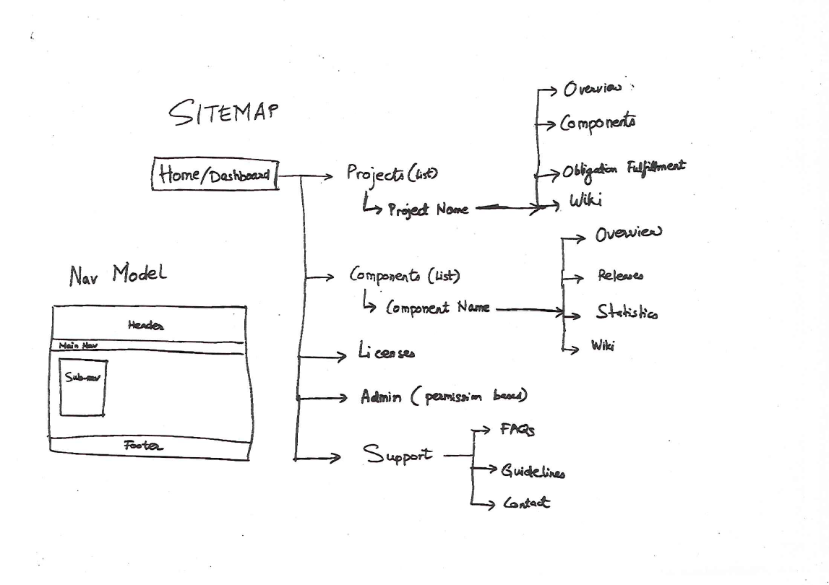
Concepts and Ideas: Contents

Slide 13
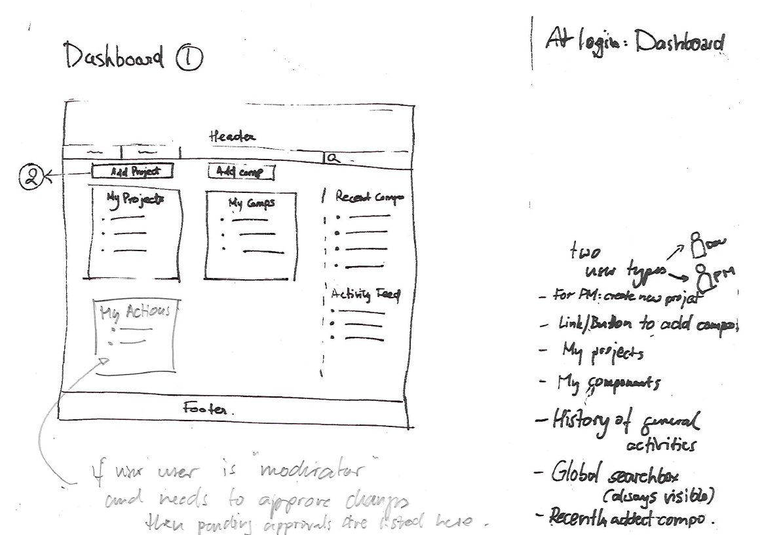
Concepts and Ideas: A Dashboard for Users

Slide 14
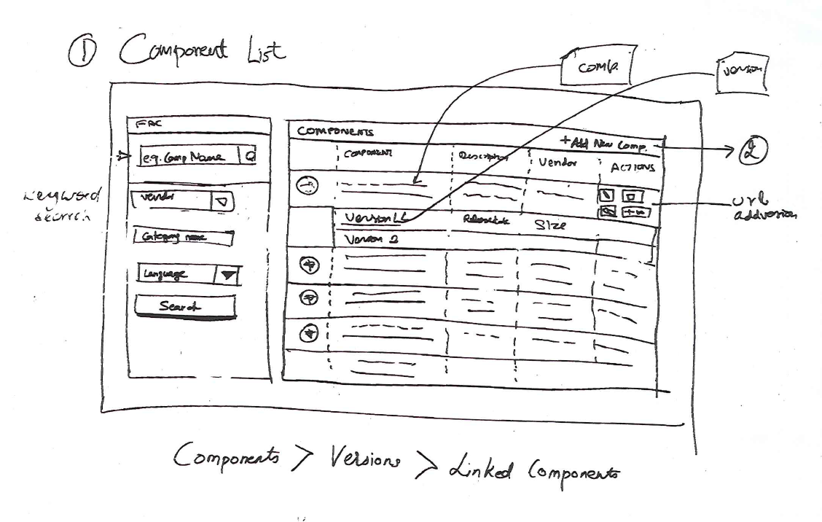
Concepts and Ideas: A Catalogue for Components

Slide 15
Next Iteration of Interface Design: Dashboard
Add Project
Add Components
Recent Components
My Projects
My Components
Activity Feed
My Tasks

Slide 16
Next Interation of Interface Design: Projects
Project Name (Edit Information)
Members
Created by: Name Created on: date
Description
Sub-Projects
Components
Attachments
Admin Data

Slide 17
Next Interation of Interface Design: Catalogue
Search keyword
Components
Add Component
Search
 | Component name | Description | Vendor | Actions
 | Release 1
 | Release 2
Refine Search
Vendor
Category
Language
Search

Slide 18
Next Interation of Interface Design: Components Info
Component Name
Release Name
Subscribe
3
4
Projects
Subscribers
Linked Components
Basic Details
Contacts / Committers
Licenses
Attachments
Repositories
Moderators

Slide 19
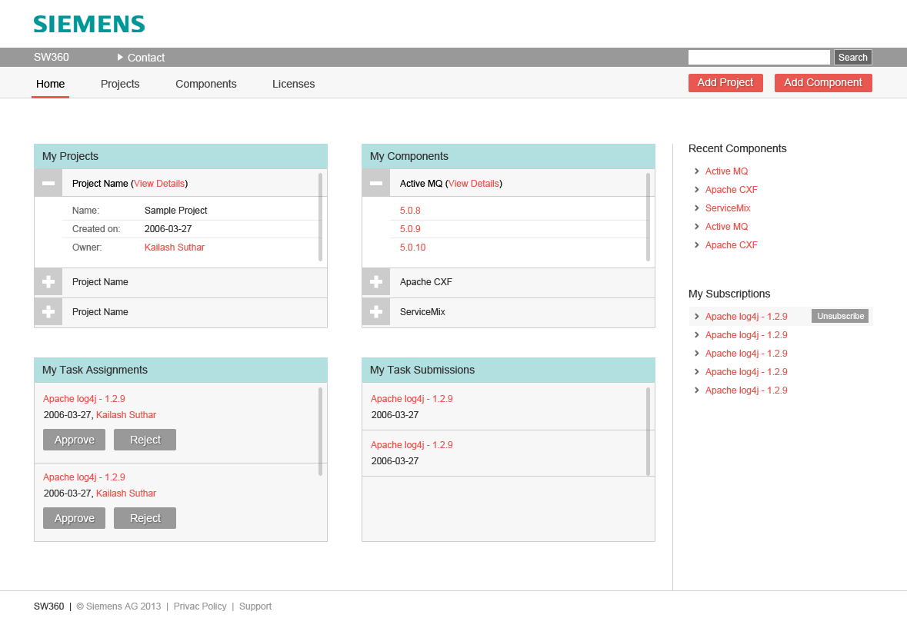
Next Evolution: Design – Dashboard

Slide 20
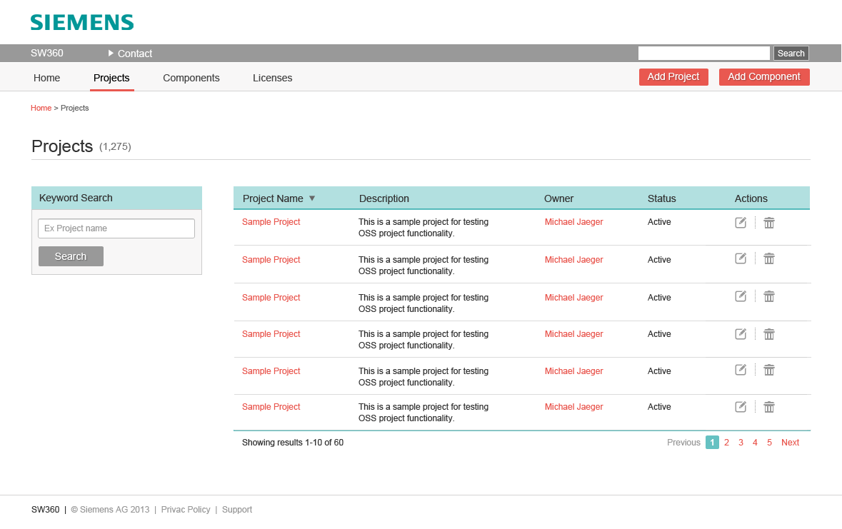
Next Evolution: Design – Projects

Slide 21
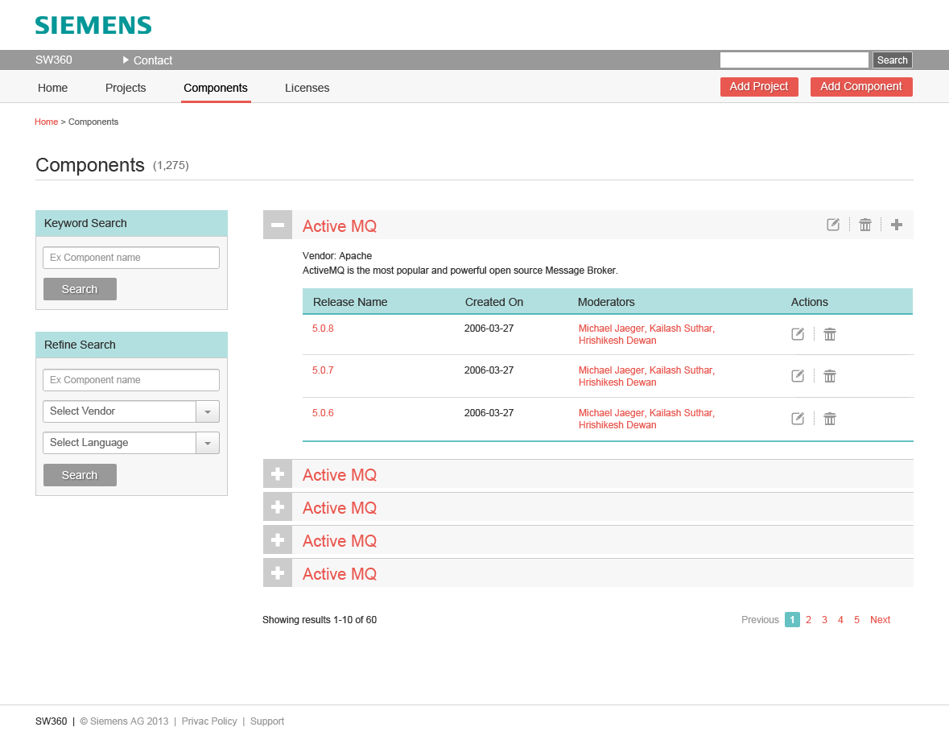
Next Evolution: Design – Components Catalogue

Slide 22
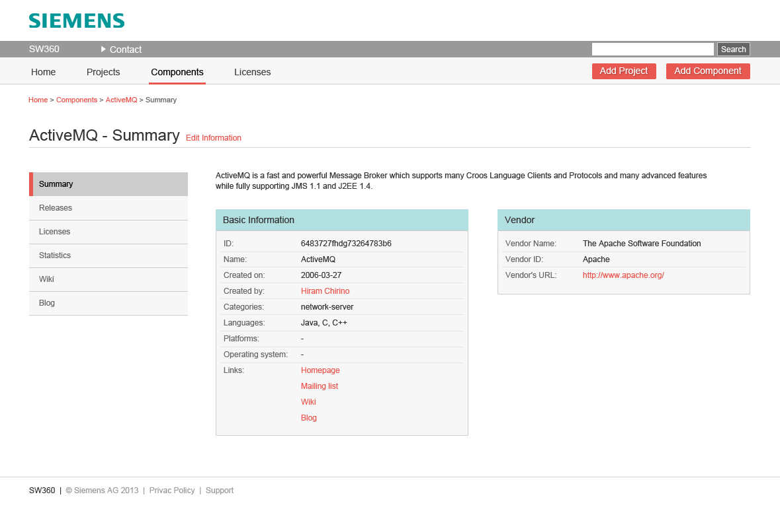
Next Evolution: Design – Components Info

Slide 23
SW360 - Basics
Siemens Corporate Technology
CC-BY-SA-4.0 © Siemens AG 2014 - 2018

Slide 24
Introduction
SW360 is a 3rd party software component catalogue
Assigns 3rd party components to products or projects
Goals and Benefits
Reuse information about components
Coordinate product documentation process
Support software clearing
A
B
C
D
E
F
G
H
I
J
…
Product A
Product B
Project 1
A
B
C
E
H
I
C
G
J

Slide 25
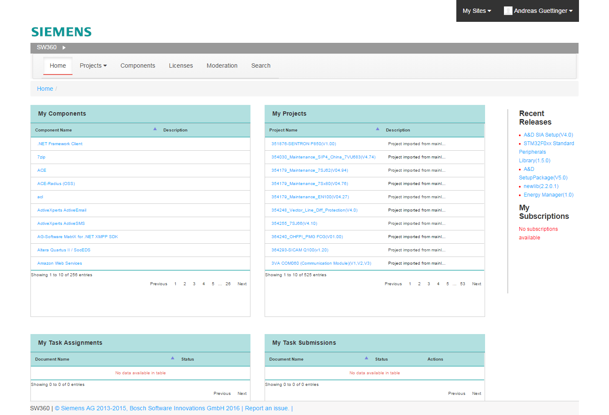
Summary
SW360 has three main sections
  Projects: Managing bill of material
  Components: Managing the (analysis) information about components
  Licenses: Repository of licenses with listing their obligations / “To Dos”
  Furthermore: Vulnerabilities
  Search, lists, approval workflow

Slide 26
Facts and Figures
Stack
  Java, Maven, Tomcat, Liferay, Servlets
  Couchdb for storing OSS packages, Thrift for integration with FOSSology
Open Source Development
  On github.com/sw360 since Sept. 2015
  Transparent development, discussion features, disclosure of issues, wiki
Siemens Internal Fork
  Forked from public project for integration with internal proprietary IT-Systems

Slide 27
SW360 and Liferay Portal Community Edition
SW360 is an application based on Liferay Portal Community Edition
  SW360 uses Liferay Portal CE as portal server
  Liferay Portal community edition, LGPL-2.1.-or later
  Currently at 6.X, upgrade to 7.X planned
Advantages
  Many Liferay-based solutions exist
  Proven user, session and data management
  Further technologies ready for future adoption:
    Mobile device support
    Marketplace of add-ons
    Collaboration and Social tools

Slide 28
Main Use Case 1: Component Inventory Database
Collect Information about Components
  It is about Components in use: for all others, Internet can do better
  OSS Licensing: collect analysed licensing information (and reuse analyses)
  Not OSS only: internal components, commercial, freeware
  More information: ECC, vulnerabilities, statistics, static code analyses, etc.

Slide 29
Main Use Case 2: Bill-of-Material Management
BOM. Inventory Management
  Understand which software component is used in which products
  Product / Project: holds relation to releases of components
  Component Catalogue: captures organisation information of components and releases

Slide 30
Main Use Case 3: Product Documentation
Readme OSS / NOTICE Generation
  Create Component Releases
  Upload SPDX file: exchange file for Licenses, Copyrights and Acknowledgements
  Create Project: and add the component releases
  Generate documentation: For all linked releases, license information is collected for generation

Slide 31
Basic Data Model
Goals and Motivation
  Clean Component Catalogue: Reduction of duplicate entries.
  Separating vendor and version from the name of the components brings clarity to component identification.
  Interoperation with other systems: support the CPE standard which also implement this 3-parts separation.
  Having the clear modeling of
  data enables better search and
  filtering abilities.
Component
Project (Product)
Release (Version)
Vendor

Slide 32
Thinking a Little Bit Further
Connecting
Components
with Products
My HMI Display
4000 Series
Project or Product
Owner
Display 4050X
Release
Business Responsible
Component Line can map to releases of a component, even with changing vendors
Usage
Uses in Redistribution
Apache
Vendor
Direct Relation from Release to Usage cannot hold different usage types. You will need this for OSS clearing.
Tomcat
Component
Release
Releases can contain other releases
Tomcat 7.0.57

Slide 33
Main Access Model: No Groups for Components
Component Information shall be freely shared
  No special visibility restriction for attachments
  Everyone shall see the same information for components and releases
  This means also license clearing information and the “mainline status”
  Attachment usage locks after approval of attachments
However, not every one can change everything
  User can create, edit delete all own records, but cannot change records of others
  Other records: creation of Moderation Requests
  Clearing Admins can edit all components and approve moderation requests

Slide 34
Main Access Model: Projects can be sensitive
Projects can have four visibility settings
  Just me
  Just me and selected users
  All users of my group
  Everyone who is logged in
And changing these is similar to components
  User can create, edit delete all own records, but cannot change records of others
  Creation of Moderation requests
  Clearing Admins can edit all projects and approve moderation requests

Slide 35
SW360 – Integration
Siemens Corporate Technology
CC-BY-SA-4.0 © Siemens AG 2014 - 2018

Slide 36

XML Formats for Open Interconnectivity
SPDX
Tool X
Goals and Benefits
Tool integration: exchange clearing information
Open to partners
Maximize reuse of available clearing information
SPDX
SPDX
sw360
SPDX
SPDX
SPDX
SPDX
…
A
SPDX
SPDX
SPDX
SPDX
SPDX
SPDX
J
B
C
H
I
D
E
F
G

Slide 37
SW360 – How to Connect and Interoperate
  Importing Component License Information
    SPDX RDF upload available
      use SPDX Tools to convert into SPDX
    Legacy CLI Format (Proprietary XML example) upload available
    Both can be used for creating README_OSS or other product Information
  SW360 has open interfaces
    Using published interface descriptions for internal services

Slide 38

SW360 & Vulnerabilities Overview
Vulnerability Sources
CVE-search
(OSS Vulnerability Server)
SW360
User
via Web UI
List of Vulnerabilities
Per Component
List of Vulnerabilities
Per Release
Matching of Releases with Vulnerabilities
List of Vulnerabilities
Per Project

Slide 39
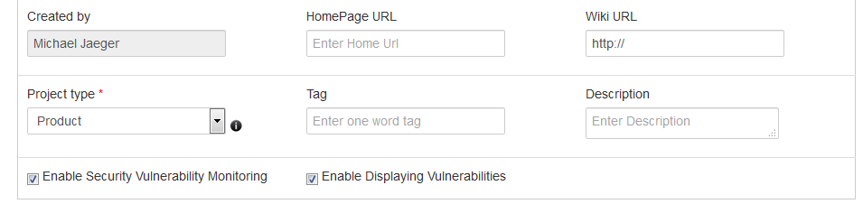
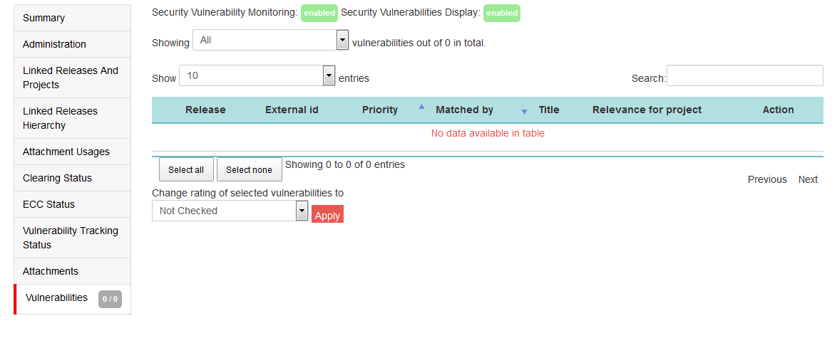
SW360: Vulnerability Handling
Vulnerabilities per Project
  And vulnerabilities are available:
    Listing in per project view
    Projects can set the relevance
  Notice:
    Requires sync
    Requires cleaning the first wave

Slide 40
With BOM Management and REST API you can do even more …
Know who is using what from your internal sources
  Understand usage of artifacts provided by your own
  Provide statistics who has provided the most popular component
Integration with git servers for example
  Link creating of git server with creation of records in SW360
External Ids at records help mapping
  Components and releases can have external Ids, for example Maven-id
  Also Projects can have external
Product A
A
A
B
C
B
Product B
C
C
E
G
D
E
Project 1
H
I
C
F
…

Slide 41
SW360 and Codescoop
What does it do for you?
  Using the OSS Project Analyses from Codescoop
  to support the selection of OSS component for your project
How does it work?
  See component lists from Codescoop UI
  Use Codescoop analyses and data for identifying your pick
  Filling out new component
  Filling out new release
  Searching for releases
(requires Codescoop account)

Slide 42
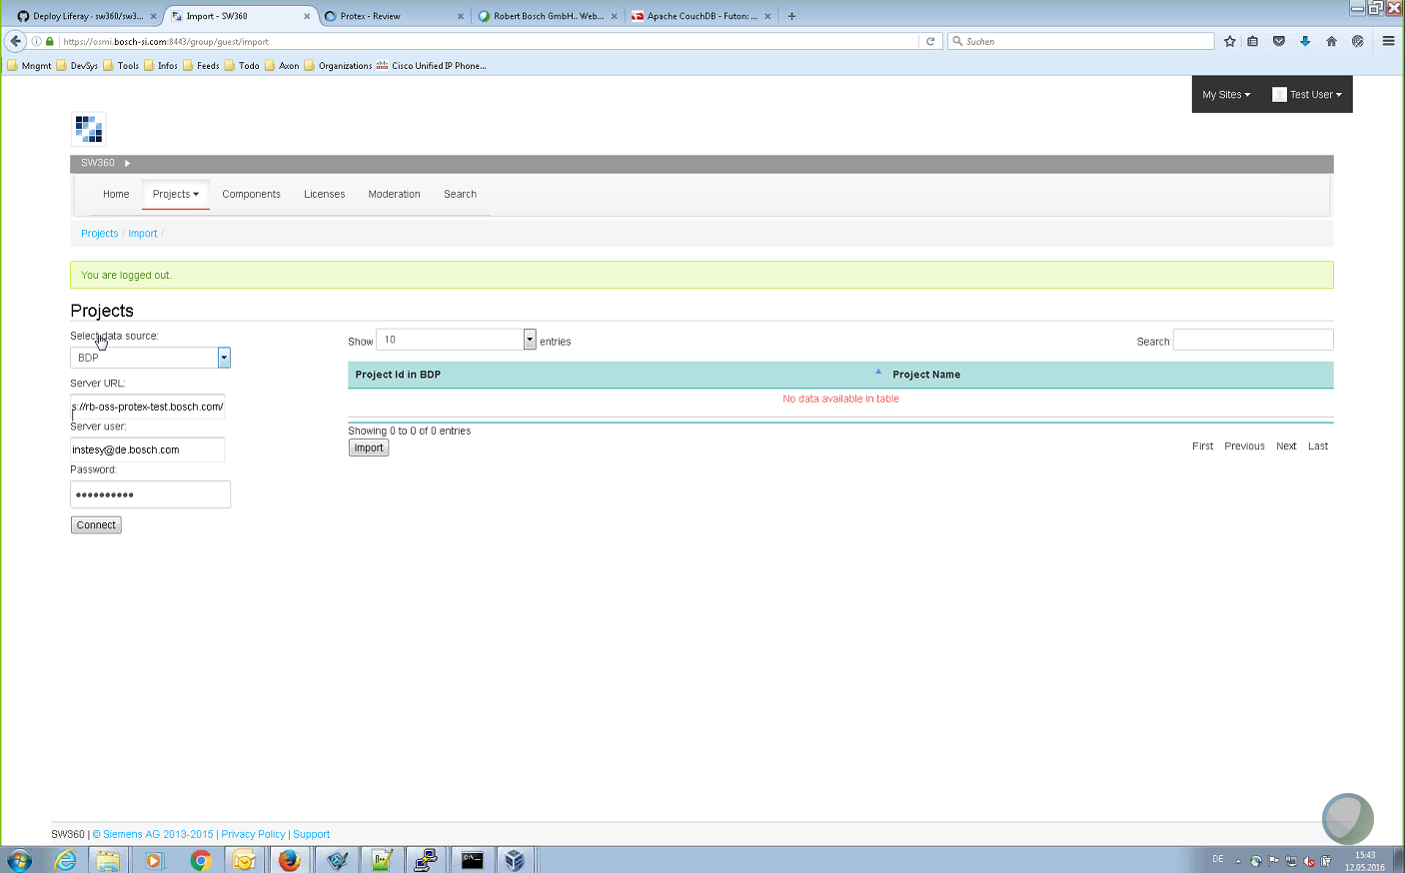
SW360 and BDP
What does it do for you?
  Using the Software Composition and License Analysis Data from BDP when it has processed a projects
How does it work?
  Enter credentials for accessing a BDP server via its REST API
  Get a list of available projects / products
  Pick one projects
  Import metadata, including license analysis data and BOM as identified by BDP

Slide 43
SW360 and WS
What does it do for you?
  Using the Software Composition Analysis from WS
  when it has processed a projects
How does it work?
  Enter credentials for accessing a WS server via its REST API
  Get a list of available projects / products
  Pick one projects
  Import metadata and BOM as identified by WS

Slide 44
SW360 – REST API
Siemens Corporate Technology
CC-BY-SA-4.0 © Siemens AG 2014 - 2018

Slide 45
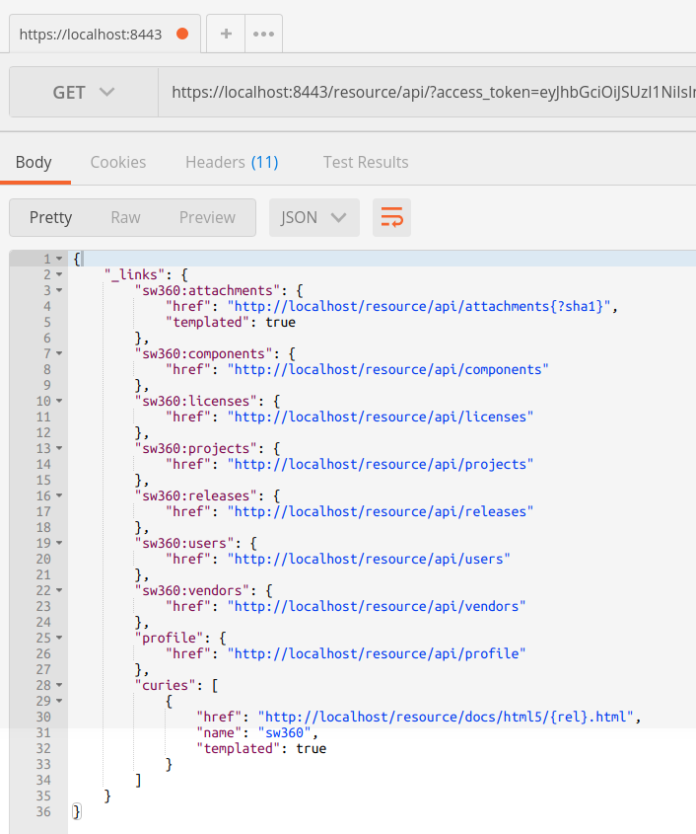
SW360 – REST API
Interoperation with other systems and automation:
You want to have a REST API
for easy and universal access
  A RESTful Spring Boot Application which is fully
  integrated into the SW360 stack
  The REST API is Hypermedia-style, using
  HAL (Hypertext Application Language)
  Supports Resource Server and Authorization Server
  with OAuth2 and Access Tokens
  … or

Slide 46
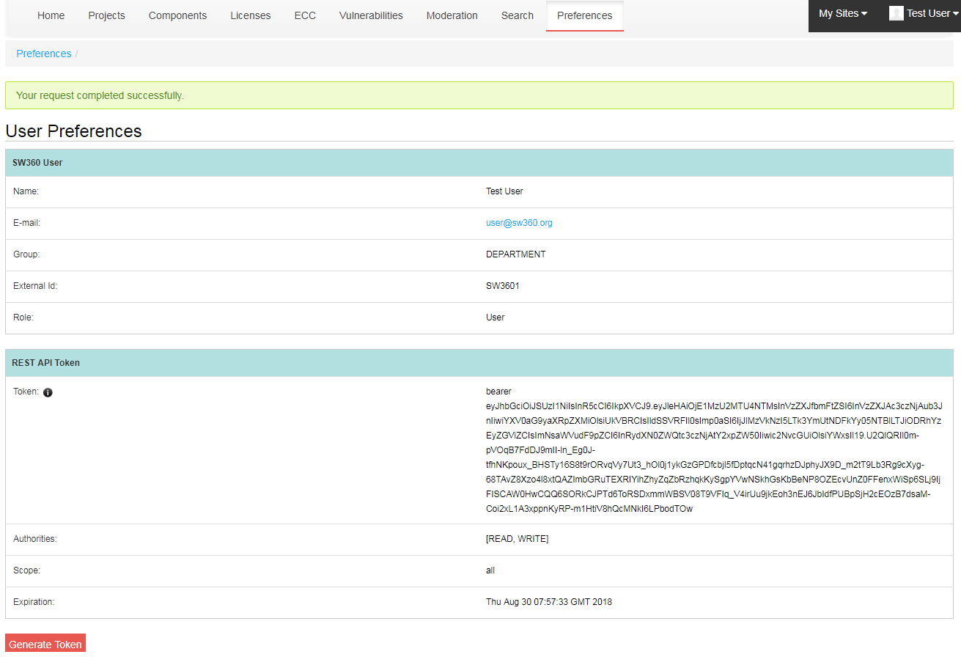
SW360 REST API: Token Generator!
Every user can generate a token
  Two problems:
    Usually in IT, application accounts
    are used for running a service
    (e.g. “web” for httpd)
    Obtaining tokes is difficult
    to implement for clients
  Solution is to have tokens being
  generated from the SW360 UI
  with users permissions
  Token can used for clients directly

Slide 47
REST API Integration Advice 1: Security
Problem
Security for state-of-the-art Web apps is highly developed
REST API needs to have same security strength as browser login
Part of the Problem:
State of the art using spring-security and Oauth legacy workflow
Authorization server based auth is good for security but not quick
Clumsy to implement in small scripts
Solution
Change to token vending approach
Allow for less restricted READ access for component catalogue: property for setting long validation times
(ie. licensing information)

Slide 48
REST API Integration Advice 2: Endpoints
Problem
Designing good endpoints is hard
Actually use cases: you understand them when programming then
Otherwise, clients query a lot of information
E.g. getting all components and iterating by them one by one
➔ a lot of load on the servers
Solutions
Optimize use cases with REST API users
The endpoints added to the project all have a real use case – no design “it would be nice to have”
Filtering, querying, paging, optimizing the returned data
Buffering in REST endpoint implementation on Web server

Slide 49
REST API Integration Advice 3: Data Hygiene
Problem
Field entry is not uniform
Different users, different data
Referencing info (e.g. Maven id)
Expressing approvals
What is a component actually
  (folder from an OSS project …)
A client querying the REST API and
process the results will quickly break with non-uniform data entered
Solution
Education and documentation
Admin UI for data hygiene
Merge feature to merge duplicate data sets
More constraints on data entry
Provide drop down lists with data as desired

Slide 50
REST API Integration Advice 4: Roll Out
Problem
REST API = code from others that access your system
How to prevent client from entering bad data
Or, compromising the system because of programming mistakes
Solution
Dev: playground as self service
Stage: guided testing of solutions
Productive: after “probation”
➔ Operations needs to know what clients do

Slide 51
SW360 – First Hands-On
Siemens Corporate Technology
CC-BY-SA-4.0 © Siemens AG 2014 - 2018

Slide 52
How it works 1 - Create a Component Entry
Create
Component
Entry
Add
Release
Entry
Add
Package
(Upload) to Release
  A component is a container for releases
  Just creating a component alone creates an empty container entry with no releases in it.
  Projects cannot reference a component, but a release
  Release = Version
  A component can have multiple releases
  It make sense to group them
  Now a vendor can be assigned
  Multiple open source packages of the same releases: should be multiple releases actually
  There should be just one source code upload per release

Slide 53
Hands-On: Create components and releases
Functionality
Example
  Creating first component
    In the basic list view, click on add component
    Perform the mandatory entries
  Create a release entry
    Release corresponds to a version number
    Review fields
    Upload source file with source file attachment type
  Repeat for second and third component and release
    Repeating the same steps
  Create zlib entry as new component
    Click “Add” in component list
    Enter required information, for example “library” as type
    Add a release, version 1.2.8
    Update the release
    Go to attachments
    Upload source file
  Create common collections 3.2.2
    Apply same steps
  Create jquery 1.12.1
    Apply same steps

Slide 54
How it works 2 - Create a Project Entry
Create
Project
Entry
Add
Releases,
Subprojects
Send
to Clearing
  A project in sw360 can be also called “product”. It is a structure to maintain a Bill-of-Material of software components
  In fact, can represent product, service, delivery
  Release = Version
  Projects can contain other projects
  Allows for building blocks
  Send to clearing if no clearing report exists
  Integration with another tool, Fossology

Slide 55
Hands-On: Create projects
Functionality
Example
  Create a project entry
    Review the fields
    Link two releases to project
  Create second project entry
    Link the other release to it
  Link a sub project
    For the first project, link the second project
    Review the project hierarchy in linked projects
  Click “Add project” on main view
    Button is on the top right
    Enter a simple name, for example “project-main”
    Click on “Add projects”
    (this creates the data structure)
    Add the two releases
      For example, zlib and commons collections
  Go on for the second project
    Choose a simple name, auch as “project-sub”
    Click on save project
    Add the remaining releas, following the example: jquery

Slide 56
Hands-On: FOSSology Link
Functionality
Example
  Transfer source code attachments to FOSSology
    For the project, select clearing information
    See the clearing status, send the files to FOSSology
    (works only with FOSSology integrated)
  Do the license analysis work in FOSSology
    (Assuming the work done in FOSSology)
  Upload clearing information to release
    Go to the release, attach the information
  Check the sending to FOSSology button
    In the project view, it is the FOSSology icon
    Check if the transfer is successfully
    Note that this requires a running FOSSology
    Could be done manually, then there are no status updates
  After FOSSology work (assumed) upload information
    Go to components
    Select the release
    Go in Edit mode
    Upload attachments (CLI)

Slide 57
Hands-On: Create README_OSS
Functionality
Example
  Go to project main view
    Select the project from the list
    View the details
  Create the README_OSS
    Go to clearing information
    Hit the generation button
  Review the generated README_OSS
    (remove inappropriate licenses)
  Go to the main project that was created first
  Go linked releases and projects
  Click download the README_OSS to review files in desktop

Slide 58
It is an ongoing circle …
Create components with releases
Update existing components
Maintain Component and
Release Information
Create components with releases
Update existing components
Component
Analyses (Licenses, etc.)
Maintain Project
Information
Using a separate tool
Used by clearing experts

Slide 59
The Big Picture
Create Components and Releases
Create entries or use existing ones
Consider the import from Mainline Portal
Project or Product: An entity for product clearing
Usually for the proprietary part that imports
Create Project
Record
Select the releases from the database
Also sub projects can be selected
Link Releases
Create License Analysis
FOSSology: Component Clearing
Upload clearing report and component license information (XML)
Create README_OSS
Create Project Documentation

Slide 60
SW360 – Community
Siemens Corporate Technology
CC-BY-SA-4.0 © Siemens AG 2014 - 2018

Slide 61
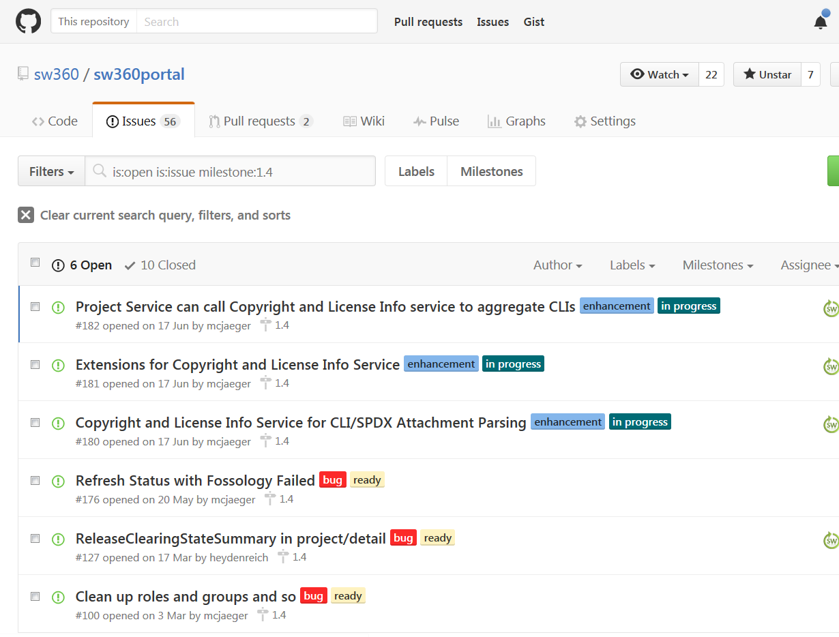
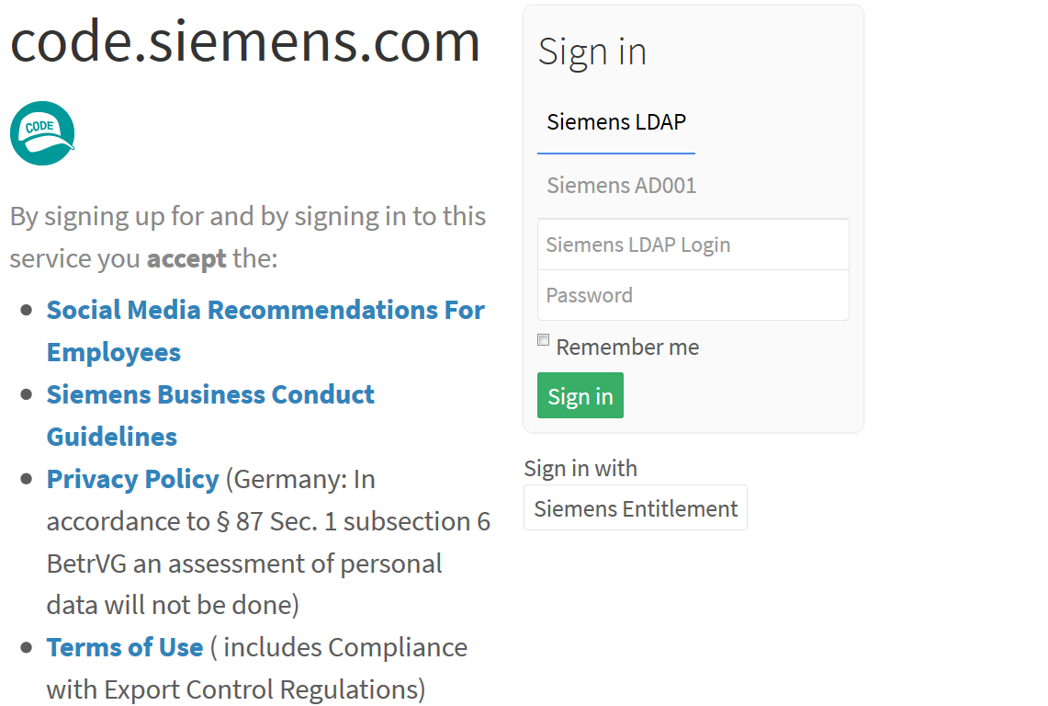
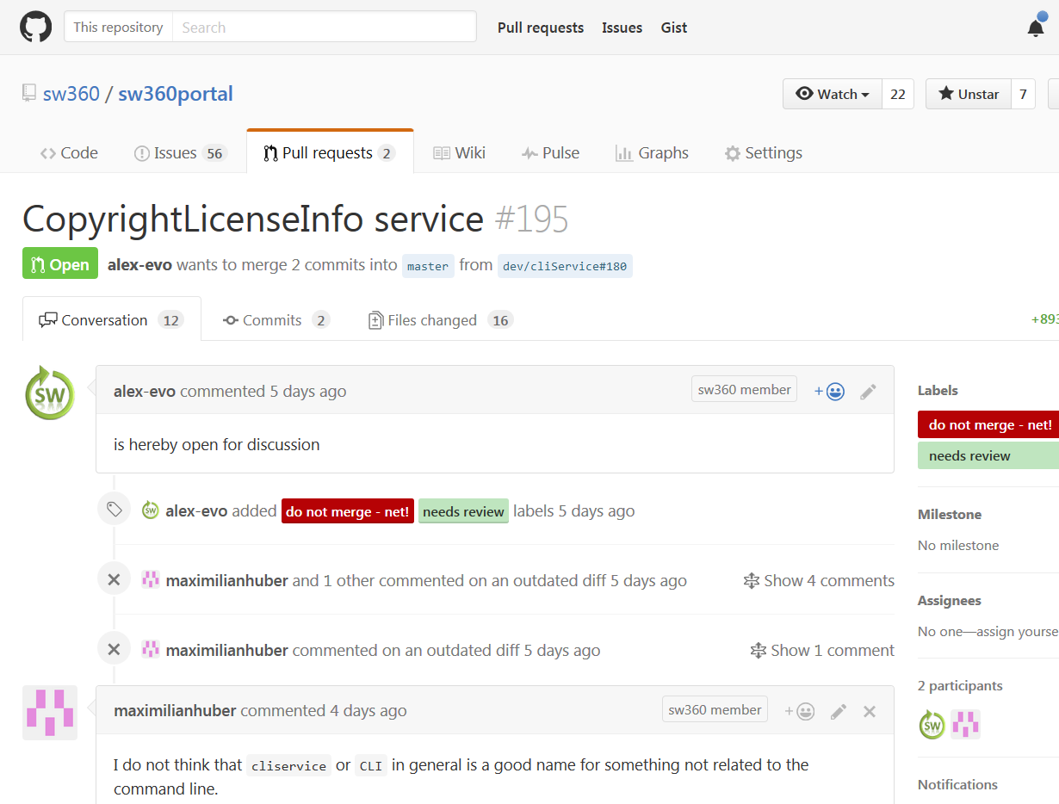
Joint Venture = Shared Work
SW360 is an Open Source Project
  Bosch-SI has joined the project too
  Their case integration of dev ops tooling
Topcis which are advantages for both
  Importer for external system for analyzed projects
  *.XHTML and *.DOCX product documentation
  Subproject sw360chores: docker and packaging
  Improving moderation and license handling
  Integrating CVE-search: open source vulnerability management

Slide 62
com.siemens.sw360.*
com.bosch.osmi.*
org.eclipse.sw360.*

Slide 63

SW360 is an Eclipse Foundation Incubator Project
Benefits
Critics
Status
  Standardized governance
  Standardized operations
  Project infrastructure
  IP process for contributions
  Reputation and visibility
More work asked by the EF
  Nothing you would not do anyways, maybe done differently
Overhead with external contributors
  Actually we want more external contributors
Slowing down getting code into master
  So far: higher quality by peer-reviews and clean ops
Incubation status
  Onboarding to EF operations
  Learning how the EF works
  Feedback and reception
  Initial contribution: V 1.5/2.2
(see the Eclipse Pages for more)

Slide 64
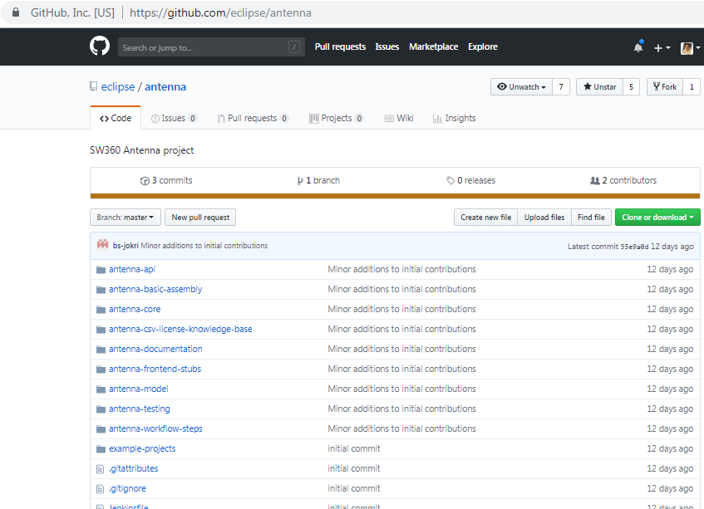
SW360 Ecosystem: SW360Antenna
https://github.com/eclipse/antenna
Complement to SW360
  Uses SW360 REST API
  A couple of build tool modules
    Maven and Gradle and NPM
    … to upload information to SW360
  Please feedback if you are interested
  Initial contribution by Bosch-SI

Slide 65
SW360 Ecosystem: There is more …
  Using docker deployment with sw360chores
    Standard containers in a composed setup
    https://github.com/sw360/sw360chores
  Using vagrant with sw360vagrant
    Use hypervisor (VirtualBox, AWS) to setup an entire SW360
    https://github.com/sw360/sw360vagrant
  Use LDAP-based authentication and map its groups to SW360 groups
    https://github.com/sw360/ldapOrganizationMappingExt

Slide 66
Thank you for your attention … questions?
License: CC-BY-SA-4.0
Michael C. Jaeger
Siemens Corporate Technology
Otto-Hahn-Ring 6
81793 Munich City
E-mail:
michael.c.jaeger@siemens.com
Homepage
https://www.eclipse.org/sw360
Github
https://github.com/eclipse/sw360portal
More links
https://github.com/fossology/fossology

Slide 67
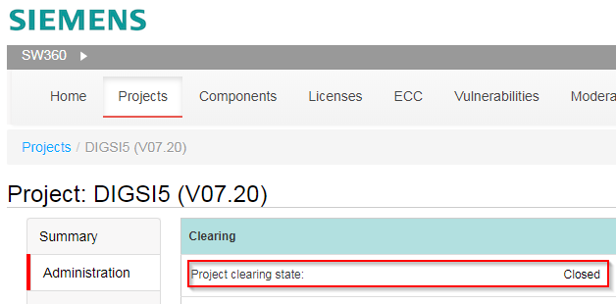
SW360 Tips and Ticks
Clearing Status Locks the Project
Clearing Status = Closed
  Only Clearing Admins can
  change the project
  No creators, no moderators
  Apparently this causes confusion

Slide 68
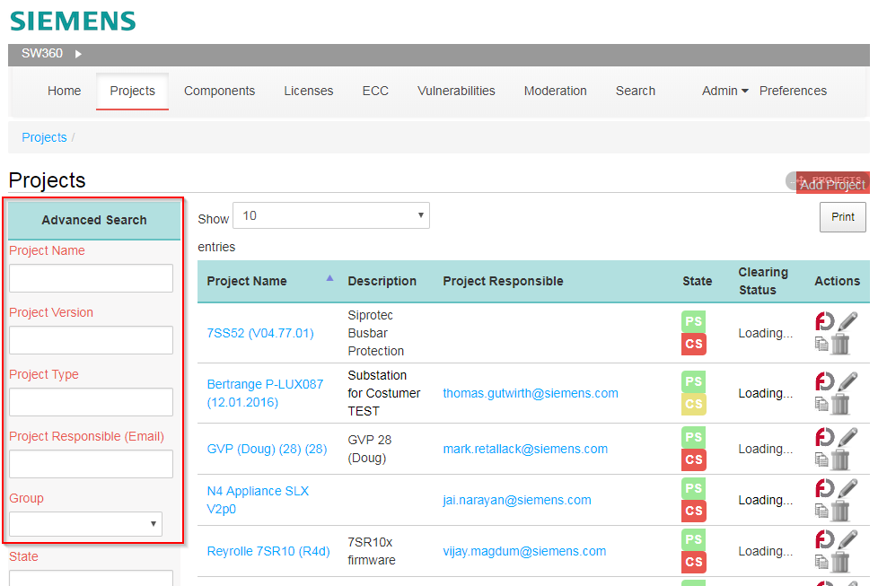
SW360 Search
Looking for Components and Projects Changed
  Search improved: now also special chars are in
  No Quick Filer
  But search and browsing is a lot faster
  Paging loads quicker
  Paging reduces load on server
Known Issues
  Limit to 25 results in linking releases to projects
  Search for version is missing

