Slide 1
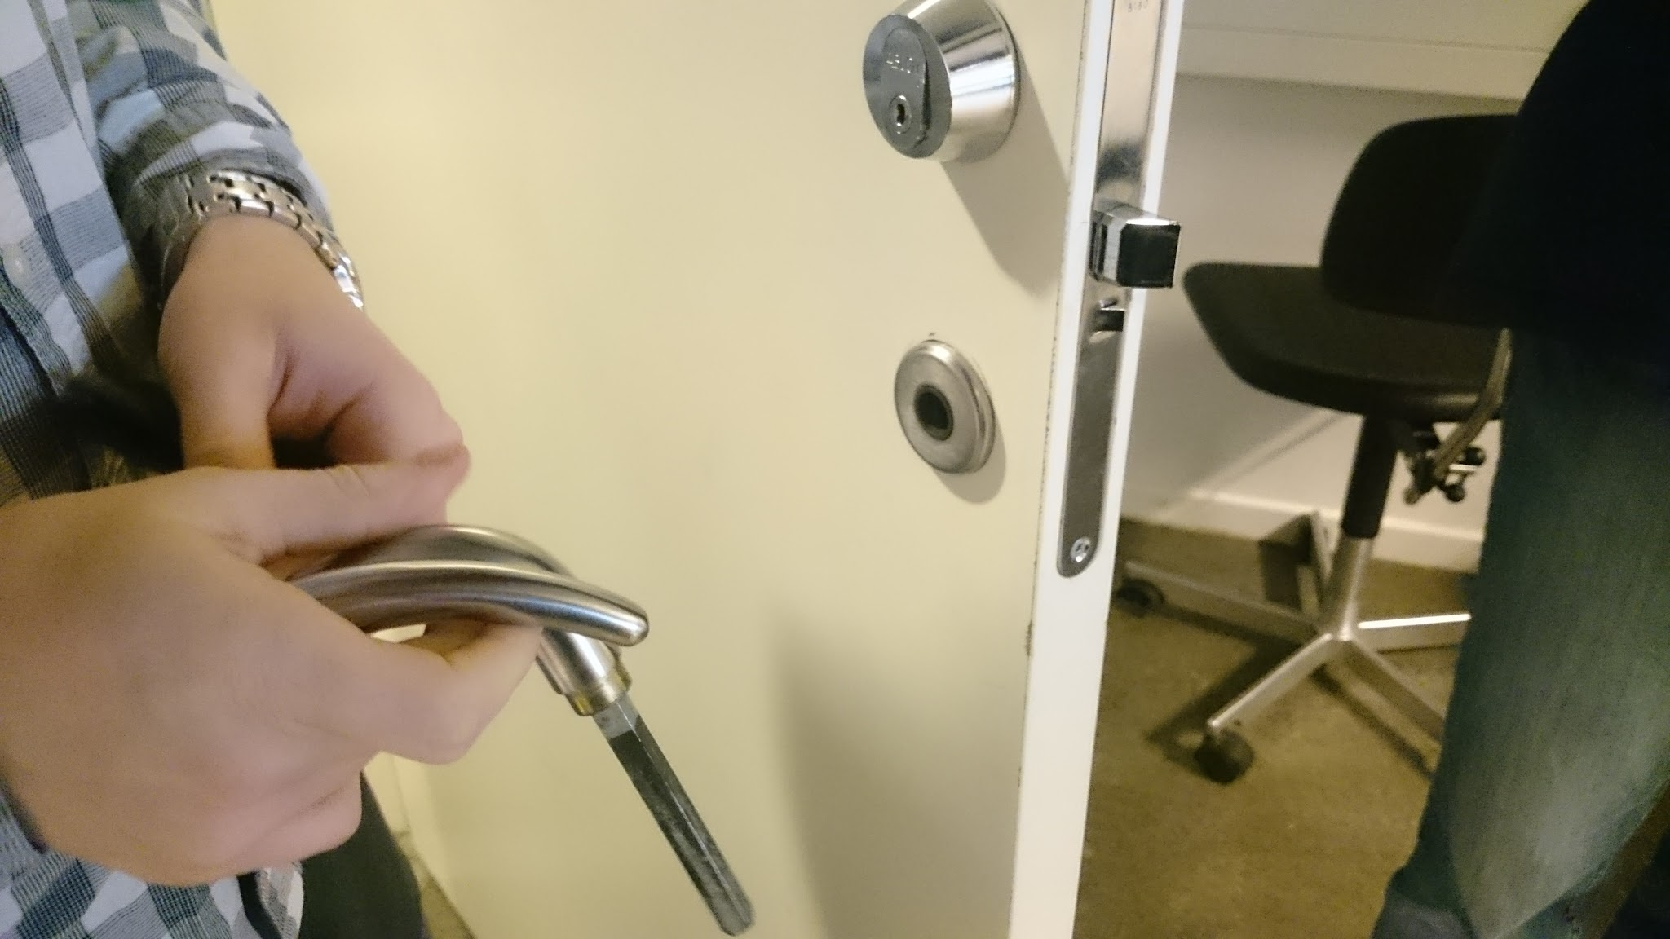
RideShare
Username | UrMomIsNice
Password | ●●●●●●●●●●
Login
or
Register
An aSTEP product

Slide 2
Register
First Name: | [enter name]
Last Name: | [enter name]
I own a car
1 | 🔻
Free seats
I’m interested in getting a BJ
I’m interested in giving a BJ
A short description of you...
Finish

Slide 3
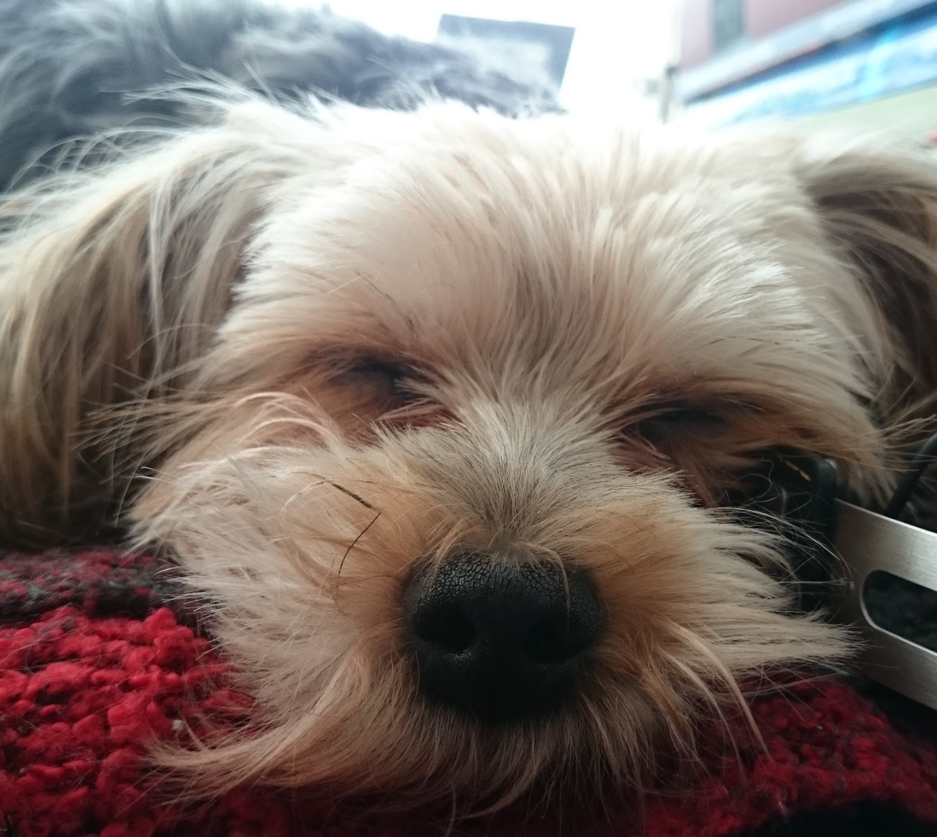
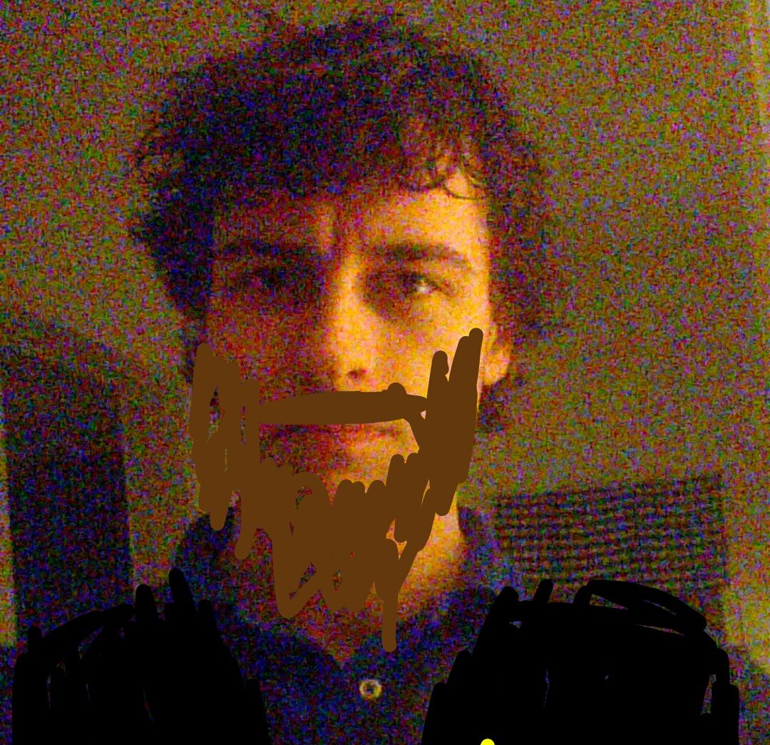
≡ Ride suggestions 🔎
 | Susie Dog SuperUser ★★★★☆ Departure: 07:45 Arrival: 08:00 M T W T F S S | RideScore 97 Contact
C
 | Bjørn Human User ★☆☆☆☆ Departure: 07:45 Arrival: 08:00 M T W T F S S | RideScore 69 Contact
C

Slide 4
≡ Settings 🔎
I dispose a car with
1 | 🔻
Free seat(s)
✓
I’m interested in getting a lift
I’m interested in giving a lift

