Slide 2
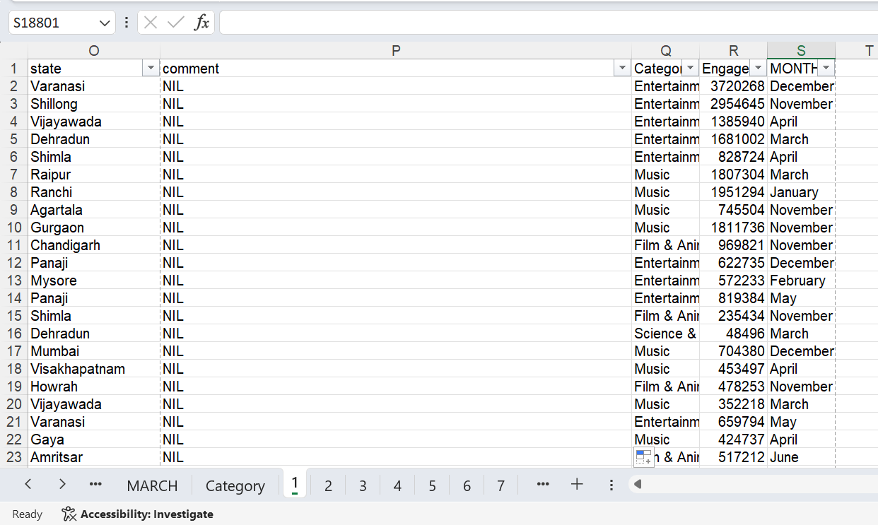
Q1
INFERENCE:
STEPS:converted null comments into text “NIL”
FORMULA:

Slide 3
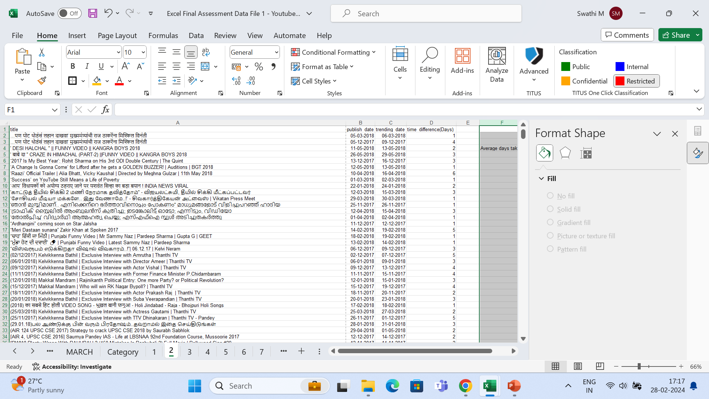
Q2
INFERENCE:
Average days taken: 2 days
STEPS:calculate time difference between publish time and trending date
FORMULA:=$C2-$B2

Slide 4
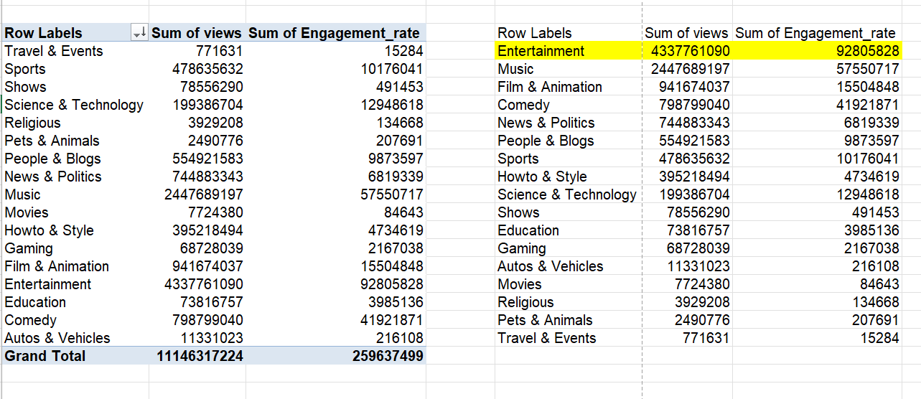
Q3
INFERENCE:entertainment has more engagement rate
STEPS:
FORMULA:

Slide 5
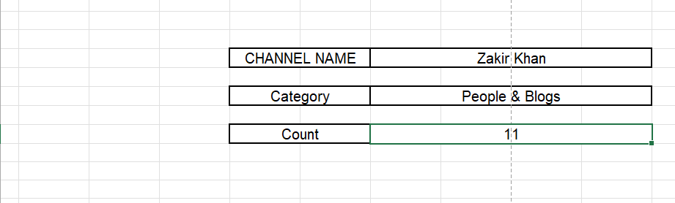
Q4
INFERENCE:
STEPS:
FORMULA:=XLOOKUP(I4,'YouTube data'!D:D,'YouTube data'!Q:Q,"no")

Slide 6
Q5
INFERENCE:
STEPS:
FORMULA:

Slide 7
Q6
INFERENCE:
STEPS:
FORMULA:

Slide 8
Q7
INFERENCE:
STEPS:
FORMULA:

Slide 9
Q8
INFERENCE:
STEPS:
FORMULA:

Slide 10
Q9
INFERENCE:
STEPS:
FORMULA:

Slide 11
Q10
INFERENCE:
STEPS:
FORMULA:

Slide 12
Q11
INFERENCE:
STEPS:
FORMULA:

Slide 13
Q12
INFERENCE:
STEPS:
FORMULA:

Slide 14
Q13
INFERENCE:
STEPS:
FORMULA:

Slide 15
Q14
INFERENCE:
STEPS:
FORMULA:

Slide 16
Q15
INFERENCE:
STEPS:
FORMULA:

Slide 17
Q16
INFERENCE:
STEPS:
FORMULA:

Slide 18
Q17
INFERENCE:
STEPS:
FORMULA:

Slide 19
Q18
INFERENCE:
STEPS:
FORMULA:

Slide 20
Q19
INFERENCE:
STEPS:
FORMULA:

Slide 21
Q20
INFERENCE:
STEPS:
FORMULA:

