Slide 1
EXCEL

Slide 2
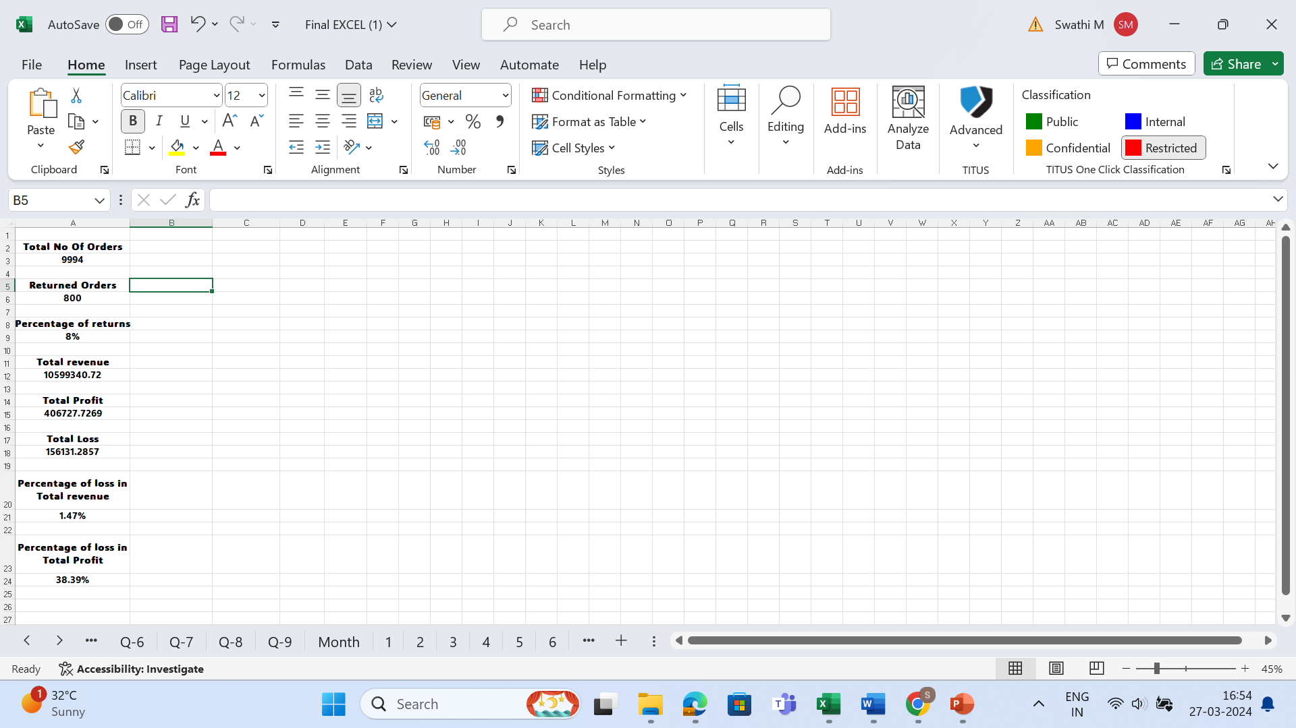
Q1
Formula:
Total No Of Orders-COUNTA('Orders - copy'!A2:A9995)
Returned Orders -COUNTIF('Orders - copy'!Y2:Y9995,"Yes")
Percentage of returns -A6/A3
Total Loss -ABS(SUMIFS('Orders - copy'!X2:X9995,'Orders - copy'!X2:X9995,"<0"))
Percentage of loss in Total revenue –A18/A12

Slide 3
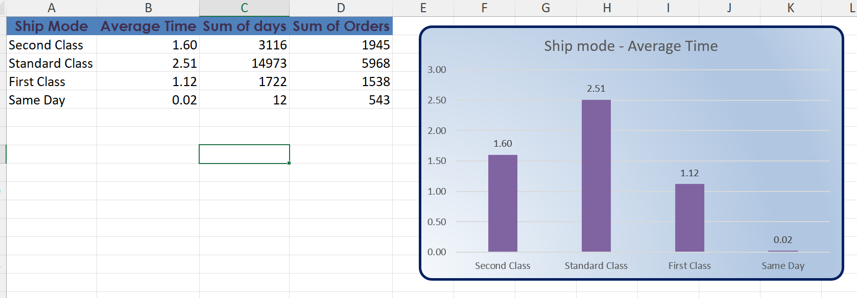
Q2
Inference: Fastest delivery-Same day
Slow delivery- Standard Class

Slide 4
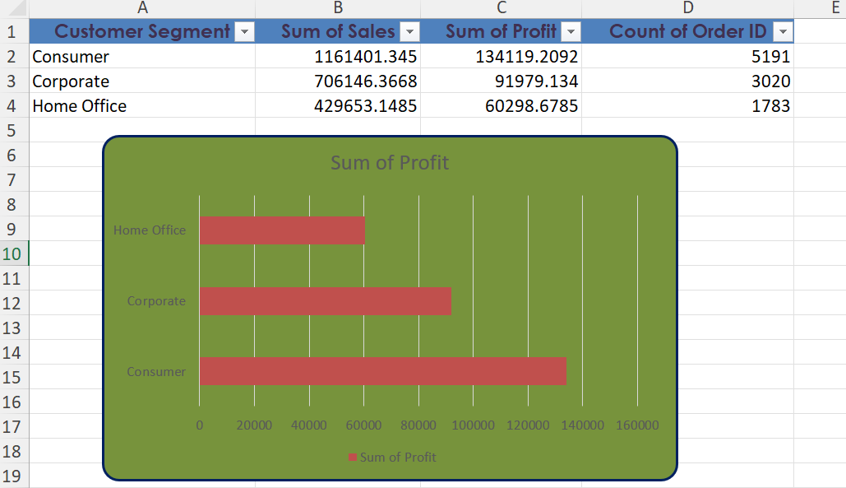
Q3

Slide 5
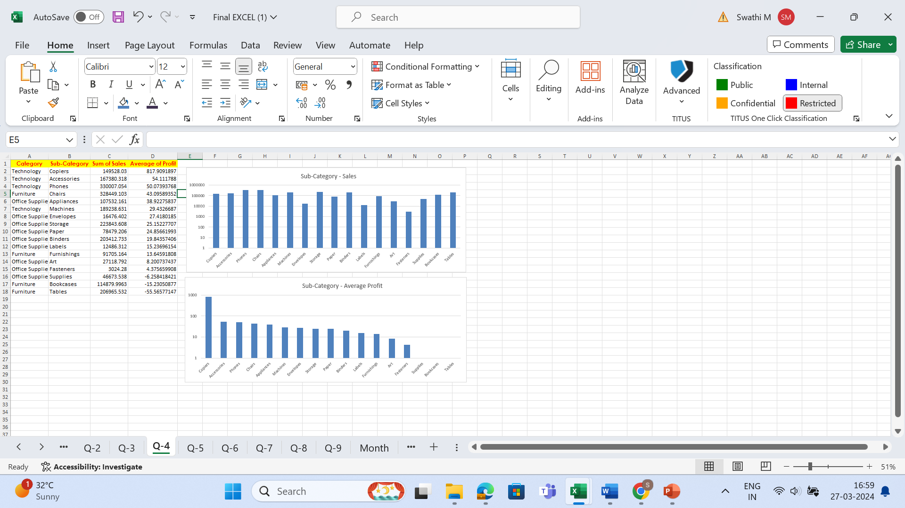
Q4
INFERENCE:
Category: Technology
Sub-Category: Copiers

Slide 6
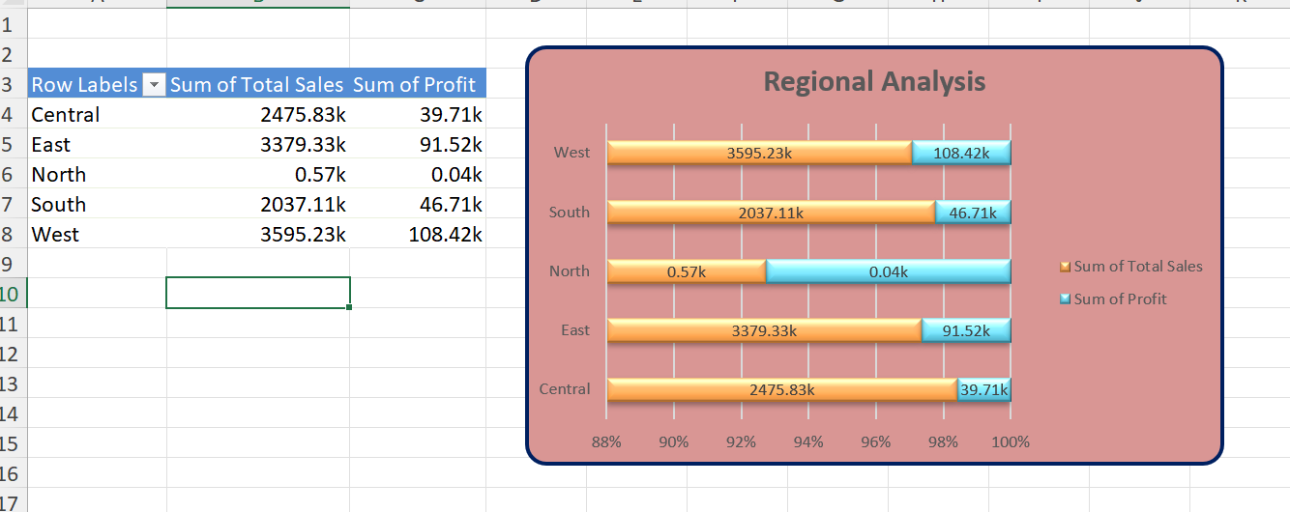
Q5
INFERENCE:
WEST has more number of sales
South has less sales
WEST has high profit
North has low profit

Slide 7
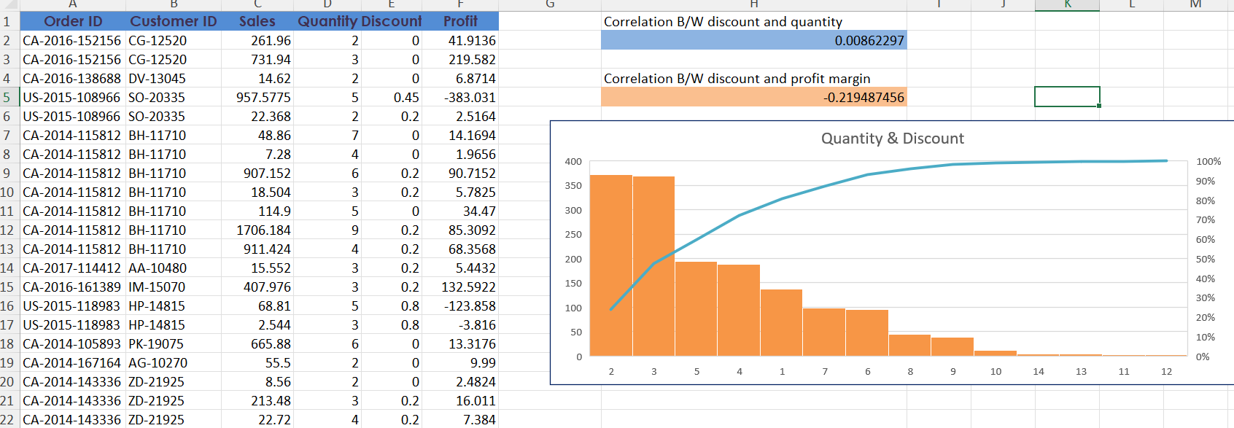
Q6

Slide 8
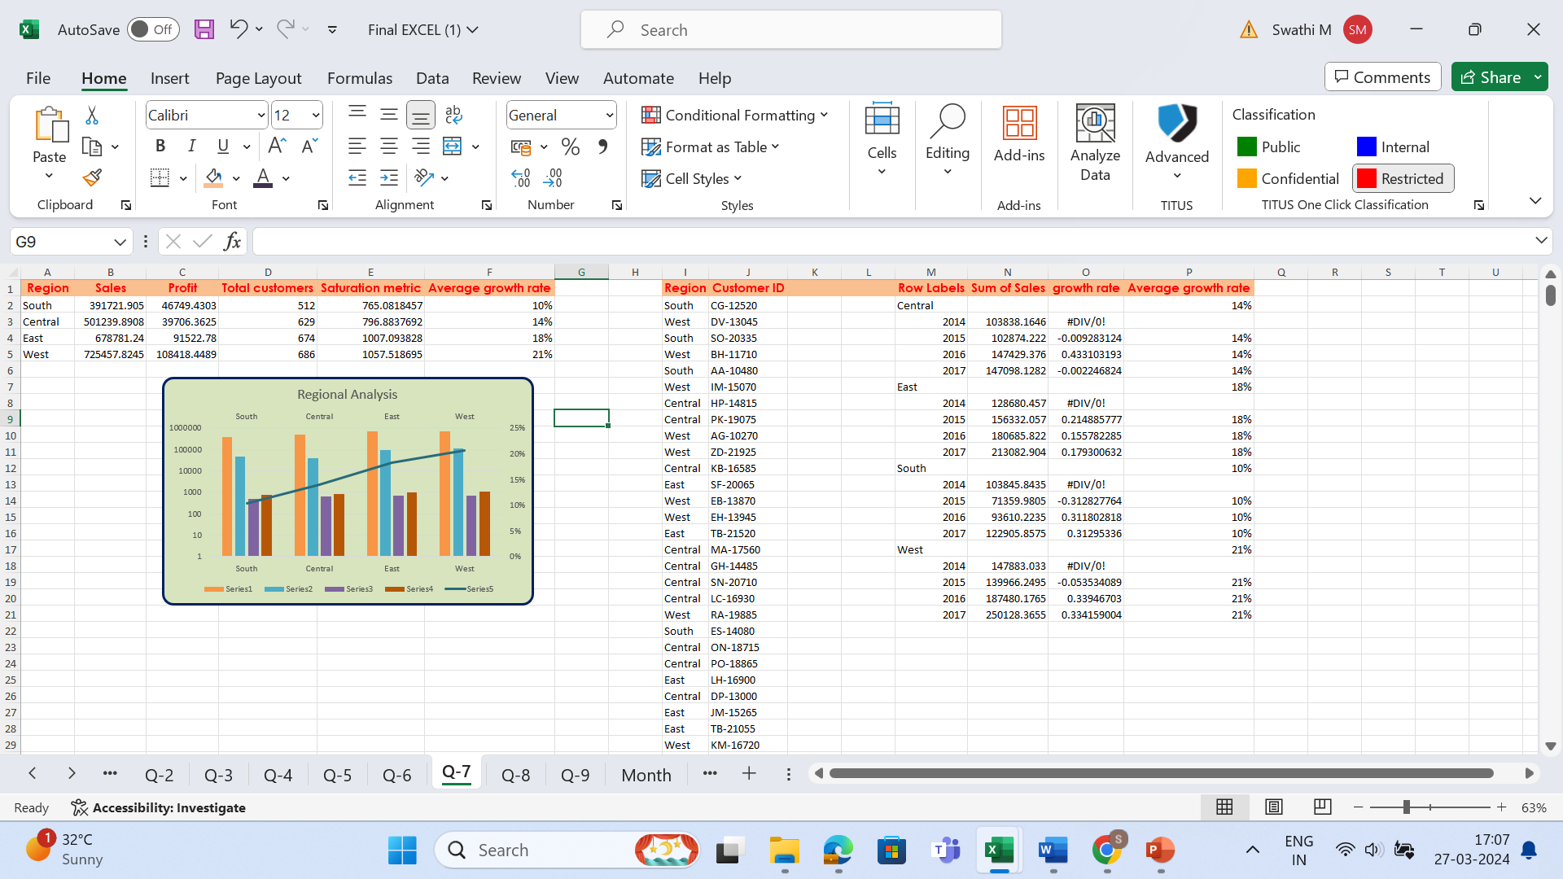
Q7
Formula:
growth rate is (current sales - previous sales)/previous sales
Inference:
saturation metric is total sales divided by number of customers in that region
South has the lowest saturation metric

Slide 9
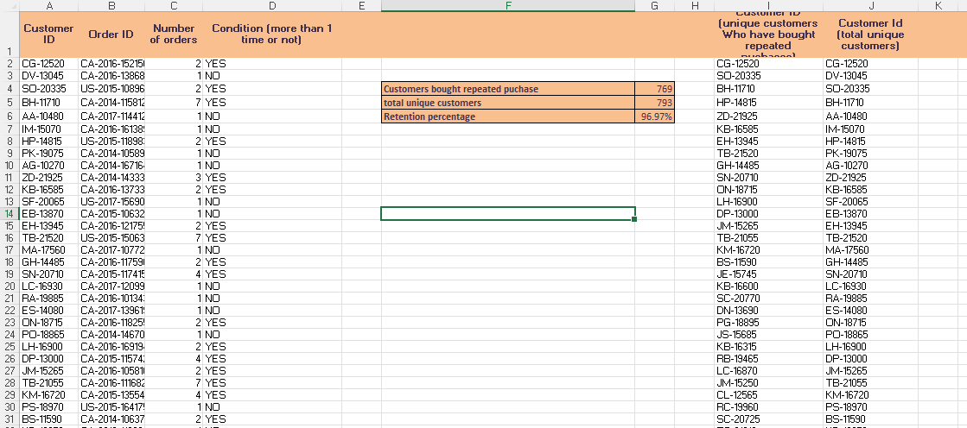
Q8
Inference:
Customers bought repeated puchase | 769
total unique customers | 793
Retention percentage | 96.97%

Slide 10
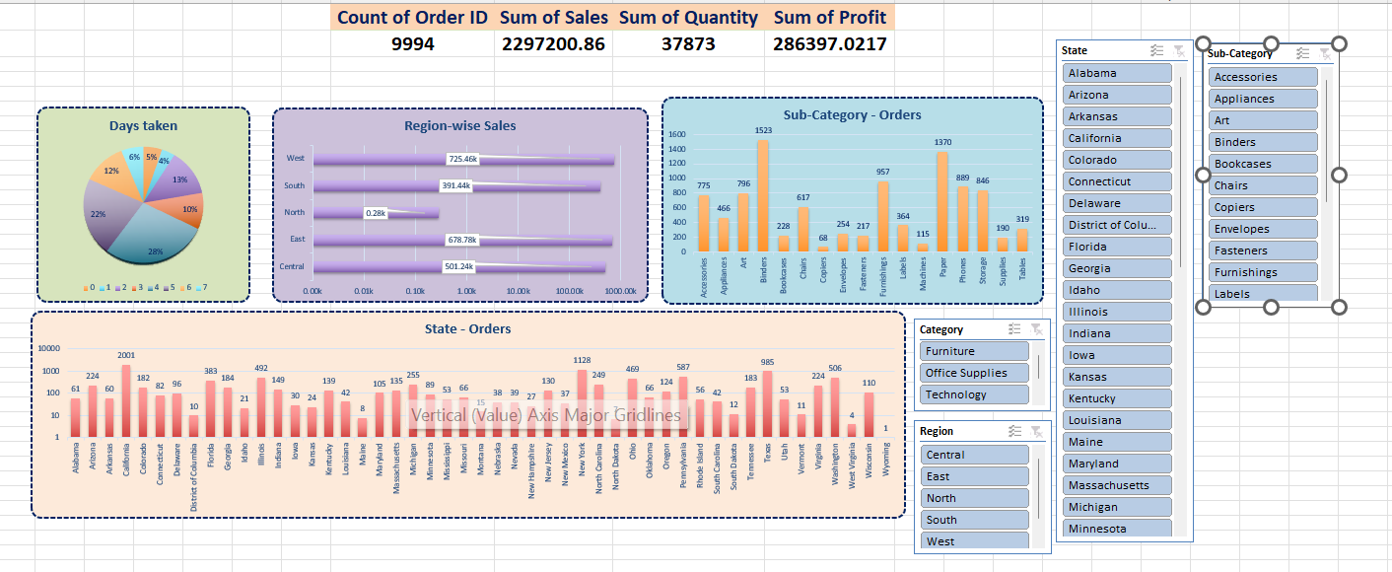
Q9

