Slide 1
Hyper Text Markup Language
(HTML)

Slide 2
What is HTML?
HTML is a language use for designing web pages.
HTML stands for Hyper Text Markup Language
Based upon SGML

Slide 3
HTML Tags
HTML is written in the forms of “tags” that are surrounded by angle brackets.
HTML tags are keywords
HTML tags generally comes in pairs like <html> and </html>
The first tag is known as start tag or the opening tag, while the second tag is known as end tag or closing tag.

Slide 4
HTML Document
HTML document is also called web page.
Web browser reads HTML documents and display then as web pages.
HTML tags are used to interpret the content of the page.

Slide 5
What do you need?
Plain text editor to write the HTML tags and content e.g.
  Notepad
Browser to test the page e.g.
  Internet Explorer

Slide 6
First Web page
Type the following code in notepad
<html>
<head>
<title>First Page</title>
</head>
<body>
My First Web Page
</body>
</html>
Save this file with extension .html like
“First.html”

Slide 7
The <p> tag
<p> tag is use for starting new paragraph and paragraph ends with closing of </p> tag.
Align is an attribute using which we can center align the text.

Slide 8
HTML elements
HTML elements means start tag + content + end tag e.g. <p>My first web page</p>

Slide 9
HTML Attributes
Attributes provide additional information about the element.
HTML elements can have attributes.
Attributes are always provide in the start tag.
Attributes come in name/value pair like name=“value” e.g. align=“center”.

Slide 10
The <br> tag
<br> tag is used for line break.
It is an empty tag so we can write it like
<br></br>
or
<br/>

Slide 11
The <body> tag
<body> tag is used for display page content.</body>
Attributes of the body tags
Background Color
  <body bgcolor=“yellow”> …</body>
  or
  <body bgcolor=“#ffff00”> … </body>
Background Image
  <body background=“river.bmp”> … </body>
Text Color
  <body text=“red”> … </body>

Slide 12
HTML Comments
Comments can be inserted in the HTML code to make it more readable and understandable.
Comments are ignored by the browser and are not displayed.
<!– This is a comment -->

Slide 13
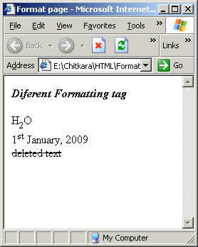
Format Tag Example

Slide 14
Formatting tags
Bold text
  <b> content </b>
Italics
  <i> content </i>
Sub script
  <sub> content <sub>
Super script
  <sup> content </sup>
Deleted text (strike through)
  <del> content </del>
Horizontal Ruler
  <hr/>

Slide 15
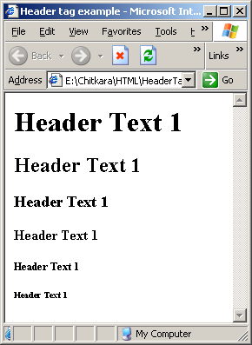
Header Tag Example

Slide 16
Header tags
<h1> defines the largest heading.
<h6> defines the smallest heading.
Browsers automatically adds an empty line before and after headings.
h1 headings should be used as main headings, followed by h2 headings, then less important h3 headings, and so on.
  <h1>Header Text 1 </h1>
  <h2>Header Text 1 </h2>
  <h3>Header Text 1 </h3>
  <h4>Header Text 1 </h4>
  <h5>Header Text 1 </h5>
  <h6>Header Text 1 </h6>

Slide 17
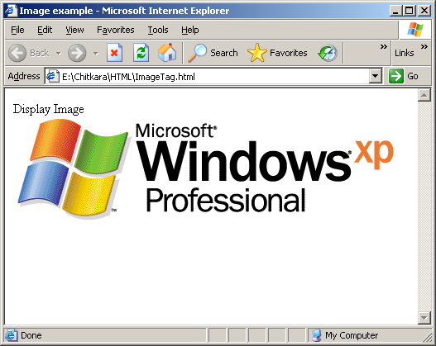
Image Tag Example

Slide 18
The image tag
To display the image on the page, you need to use <img> tag with src attribute. src stands for source.
The alt attribute is used to define an “alternate text” for an image.
  <img src="winxp.gif" alt="Windows XP" > </img>

Slide 19
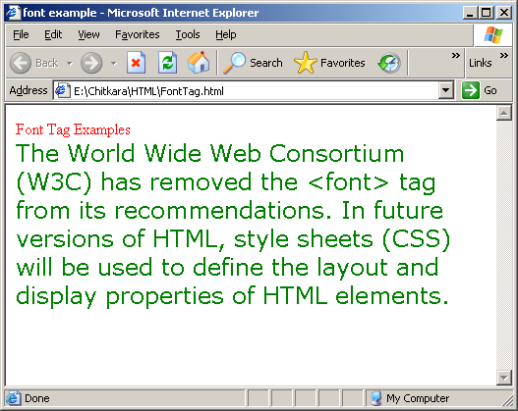
The font tag example

Slide 20
The <font> tag
The <font> tag in HTML is deprecated. It is supposed to be removed in a future version of HTML.
Even if a lot of people are using it, you should try to avoid it, and use styles instead.
  <font size="5" color="green" face="verdana">
  Content
  </font>

Slide 21
HTML Entities
Reserved characters in HTML must be replaced with character entities.
Some characters are reserved in HTML. For example, you cannot use the greater than or less than signs within your text because the browser could mistake them for markup.
If we want the browser to actually display these characters we must insert character entities in the HTML source.
A character entity looks like this: &entity_name; To display a less than sign we must write: &lt;

Slide 22
Commonly Used Character Entities
Result | Description | Entity Name
 | Non breaking space | &nbsp;
< | Less then | &lt;
> | Greater then | &gt;
& | Ampersand | &amp;
‘ | Apostrophe | &apos;
“ | Quotation Mark | &quot;

Slide 23
The List Tag
List tag is used for organizing the information
List divided into two categories
  Order List : used for indicating a sequence of events or priorities.
  Unordered List: used to display a group of items that are related to each other.

Slide 24
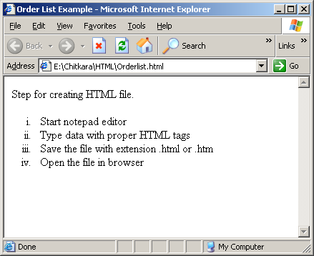
Order List Example

Slide 25
The <ol> tag
<ol>
<li>Start notepad editor </li>
<li>Type data with proper HTML tags</li>
<li>Save the file with extension .html or .htm </li>
<li>Open the file in browser</li>
</ol>

Slide 26
type attribute for <ol> tag
Value | Style | Example | Output
1 | Arabic (default) | <ol> … </ol> or <ol type=“1”> … </ol> | 1,2,3,…
A | Uppercase Alpha | <ol type=“A”> … </ol> | A,B,C,…
a | Lowercase alpha | <ol type=“a”> … </ol> | a,b,c,…
I | Uppercase Roman | <ol type=“I”> … </ol> | I,II,III,…
i | Lowercase Roman | <ol type=“i”> … </ol> | i,ii,iii,…
<ol type=“A”>
<li>Start notepad editor </li>
</ol>

Slide 27
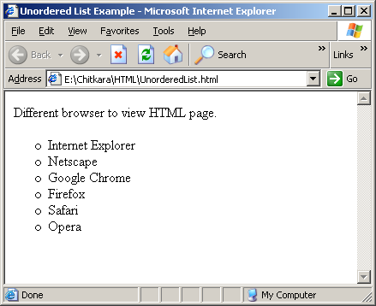
The unordered list example

Slide 28
The <ul> tag and type attribute
<ul>
<li>Internet Explorer</li>
<li>Google Chrome</li>
<li>Firefox</li>
<ul>
Value | Example
disc (default) | <ul type=“disc”> … </ul>
square | <ul type=“square”> … </ul>
circle | <ul type=“circle”> … </ul>

Slide 29
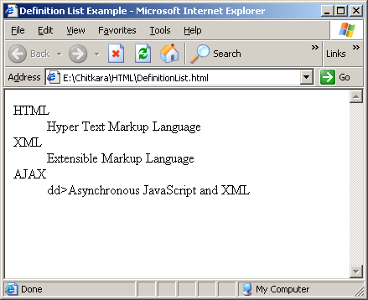
The Definition List Example

Slide 30
Definition List tag
A definition list is a list of items (terms), with a description of each item (term).
A definition list starts with a <dl> tag (definition list).
Each term starts with a <dt> tag (definition term).
Each description starts with a <dd> tag (definition description).

Slide 31
Definition tag Example
<html>
<head>
<title>Definition List Example</title>
</head>
<body>
<dl>
<dt>HTML</dt>
<dd>Hyper Text Markup Language</dd>
<dt>XML</dt>
<dd>Extensible Markup Language</dd>
<dt>AJAX</dt>
<dd>Asynchronous JavaScript and XML</dd>
<dl>
</body>
</html>

Slide 32
Hyperlink
In web terms, a hyperlink is a reference (an address) to a resource on the web.
An anchor is a term used to define a hyperlink destination inside a document.
The HTML anchor element <a>, is used to define both hyperlinks and anchors.
The target attribute defines where the linked document will be opened.

Slide 33
Link Example
<html>
<head>
<title>Hyperlink Example</title>
</head>
<body>
Link example <br/>
<a href="http://www.chitkara.edu.in/dnn">Visit Chtkara Website</a>
<br/><br/>
<a href="http://www.chitkara.edu.in/dnn" target="_blank"> Visit Chtkara Website </a>
</body>
</html>

Slide 34
Link within a web page
When the name attribute is used, the <a> element defines a named anchor inside a HTML document.
<a name="top">Link within a page</a>
The # in the href attribute defines a link to a named anchor.
<a href="#top">Top</a>
<body>
<a name="top">Link within a page</a>
<ol>
<li>New Line </li>
</ol>
<a href="#top">Top</a>
</body>

Slide 35
Image Link
<body>
<a href="http://www.pragatisoftware.com">
<img src="pragatilogo.jpg" alt="Pragati Software"/>
</a>
</body>

Slide 36
Image Map
<p> Click on one of the planets to know about it: </p>
<img src="planets.gif" width="145" height="126" usemap="#planetmap">
<map id="planetmap" name="planetmap">
<area shape="rect" coords="0,0,82,126" alt="Sun" href="sun.html">
<area shape="circle" coords="90,58,3" alt="Mercury" href="mercury.html">
<area shape="circle" coords="124,58,8" alt="Venus" href="venus.html">
</map>
</img>
<p><b>Note:</b> The "usemap" attribute in the img element refers to the "id" or "name" (browser dependant) attribute in the map element, therefore we have added both the "id" and "name" attributes to the map element.</p>
</body>

Slide 37
The <table> tag
Use of the <table> tag to define the data in row and column format.
<table>
<tr>
<th>Student No</th>
<th>Student Name</th>
</tr>
<tr>
<td>1</td>
<td>Amit</td>
</tr>
<tr>
<td>2</td>
<td>Reena</td>
</tr>
<tr>
<td>3</td>
<td>Swati</td>
</table>

Slide 38
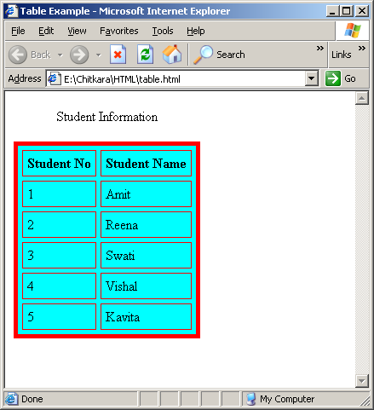
Simple Table

Slide 39
The <table> tag attributes
border attribute for the table
  <table border=“1”> … </table>
Border color attribute
  <table border=“1” bordercolor=“red”> … </table>
Background color for the table
  <table bgcolor=“cyan”> … </table>
Caption for the table
  <table> <caption>Student Information</caption> … </table>
Cell padding
  <table cellpadding=“5”> … </table>
Cell spacing
  <table cellspacing=“5”> … </table>

Slide 40
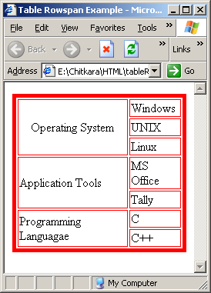
Table with Rowspan

Slide 41
The row span Attribute Example
<table border="5" bordercolor="red" >
<tr >
<td rowspan="3" align="center">Operating System</td>
<td>Windows</td>
</tr>
<tr>
<td>UNIX</td>
</tr>
<tr>
<td>Linux</td>
</tr>

Slide 42
The row span Attribute Example
<tr>
<td rowspan="2">Application Tools</td>
<td>MS Office</td>
</tr>
<tr>
<td>Tally</td>
</tr>
<tr>
<td rowspan="3">Programming Languagae</td>
<td>C</td>
</tr>
<tr>
<td>C++</td>
</tr>
</table>

Slide 43
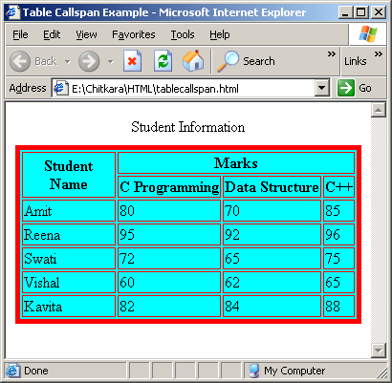
Table with Colspan and Rowspan

Slide 44
Table with Colspan and Rowspan
<table border="5" bordercolor="red" bgcolor="cyan">
<tr>
<th rowspan="2">Student Name</th>
<th colspan="3">Marks</th>
</tr>
<tr>
<th>C Programming</th>
<th>Data Structure</th>
<th>C++</th>
</tr>
<tr>
<td >Amit</td>
<td>80</td>
<td>70</td>
<td>85</td>
</tr>

Slide 45
Table with Colspan and Rowspan
<tr>
<td>Reena</td>
<td>95</td>
<td>92</td>
<td>96</td>
</tr>
<tr>
<td>Swati</td>
<td>72</td>
<td>65</td>
<td>75</td>
</tr>

Slide 46
Table with Colspan and Rowspan
<tr>
<td>Vishal</td>
<td>60</td>
<td>62</td>
<td>65</td>
</tr>
<tr>
<td>Kavita</td>
<td>82</td>
<td>84</td>
<td>88</td>
</tr>
</table>

Slide 47
The <form> tag
HTML Forms are used to adding different kinds of user input.
A form is an area that can contain form elements.
Form elements are elements that allow the user to enter information (like text fields, textarea fields, drop-down menus, radio buttons, checkboxes, etc.) in a form.
A form is defined with the <form> tag.
<form>
input elements
</form>

Slide 48
The <input> tag
The most used form tag is the <input> tag. The type of input is specified with the type attribute.
<input type=“elementtype” name=“fieldname” />
.

Slide 49
The commonly used input types
Type | Description
text | One line text field
password | One line text field where the input is masked with asterisks
checkbox | Select one or more option (Yes / No field)
radio | Select one of the choice
textarea | Multi line text input control
Select | Selectable list
button | User action
submit | Submit the data to the specified page
reset | Clear the value of the form elements

Slide 50
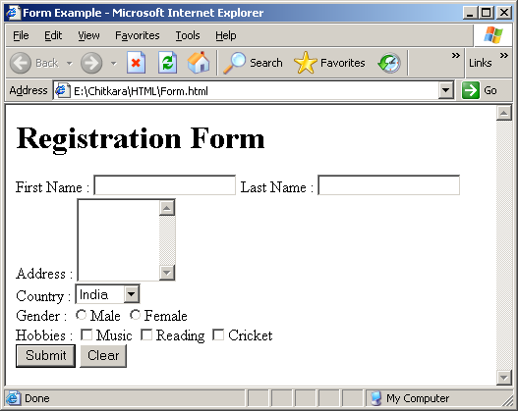
Registration Form

Slide 51
The <input> tag Example
<h1>Registration Form</h1>
<form>
First Name : <input type="text" name="fname" value="" />
Last Name : <input type="text" name="lname" /> <br/>
Address : <textarea rows="5" cols="10" > </textarea> <br/>
Country :
<select name="country">
<option value="France">France</option>
<option value="India" selected="selected">India</option>
<option value="USA">USA</option>
<option value="UK">UK</option>
</select> <br/>

Slide 52
The <input> tag Example
Gender :
<input type="radio" name="gender" value="male" />Male
<input type="radio" name="gender" value="female" />Female <br/>
Hobbies :
<input type="checkbox" name="hobbies" value="music" />Music
<input type="checkbox" name="hobbies" value="reading" />Reading
<input type="checkbox" name="hobbies" value="cricket" />Cricket
<br/>
<input type="submit" value="Submit"/>
<input type="reset" value="Clear" />
</form>

Slide 53
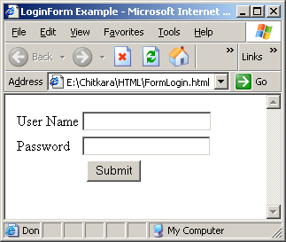
Login Form

Slide 54
The <input> tag Example
<form>
<table> <tr>
<td>User Name</td>
<td><input type="text" name="uname" /> </td>
</tr>
<tr>
<td>Password</td>
<td> <input type="password" name="pwd" /> </td>
</tr>
<tr>
<td colspan="2" align="center"> <input type="submit" value="Submit" /> </td>
</tr>
</form>

Slide 55
Frames
With frames, you can display more than one Web page in the same browser window.
Each HTML document is called a frame.
Each frame is independent of the others.
If a frame has visible borders, the user can resize it by dragging the border. To prevent a user from doing this, you can add noresize="noresize" to the <frame> tag.

Slide 56
The frameset and frame tags
frameset tag
  The <frameset> tag defines how to divide the window into frames
  Each frameset defines a set of rows or columns
  The values of the rows/columns indicate the amount of screen area each row/column will occupy
frame tag
  The <frame> tag defines what HTML document to put into each frame

Slide 57
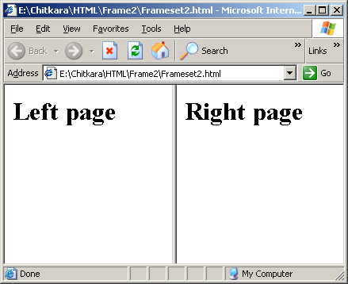
Divide Frame Vertically

Slide 58
Frame Example Vertical
Divide frame in two equal vertical part
<html>
<frameset cols="50%,*">
<frame src="left.html" />
<frame src="right.html" />
</frameset>
</html>

Slide 59
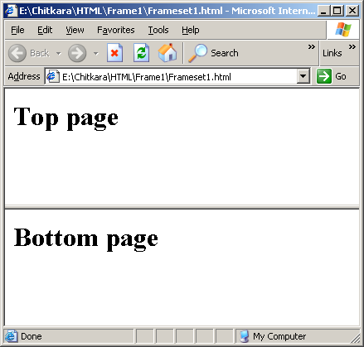
Divide Frame Horizontally

Slide 60
Frame Example Horizontal
Divide frame in two equal horizontal part
<html>
<frameset rows="50%,*">
<frame src="top.html" />
<frame src="bottom.html" />
</frameset>
</html>

