Slide 1
Blog Platform with AI Content Moderation
Developed by Swaan Maharjan
A Django-based web application with AI-driven content moderation
December 2025

Slide 2
Project Overview
A blog platform enabling users to create, view, and manage posts
Features AI-powered content moderation to flag inappropriate content
Built with Django, Bootstrap, and Python
Focus on user experience, security, and scalability

Slide 3
Problem Statement
Implementing ai content moderation system for autonomous moderation.
Implementing collaborative recommendation system using cosine similarity algorithm.
Implementing slug uniqueness handling to avoid repeating titles.

Slide 4
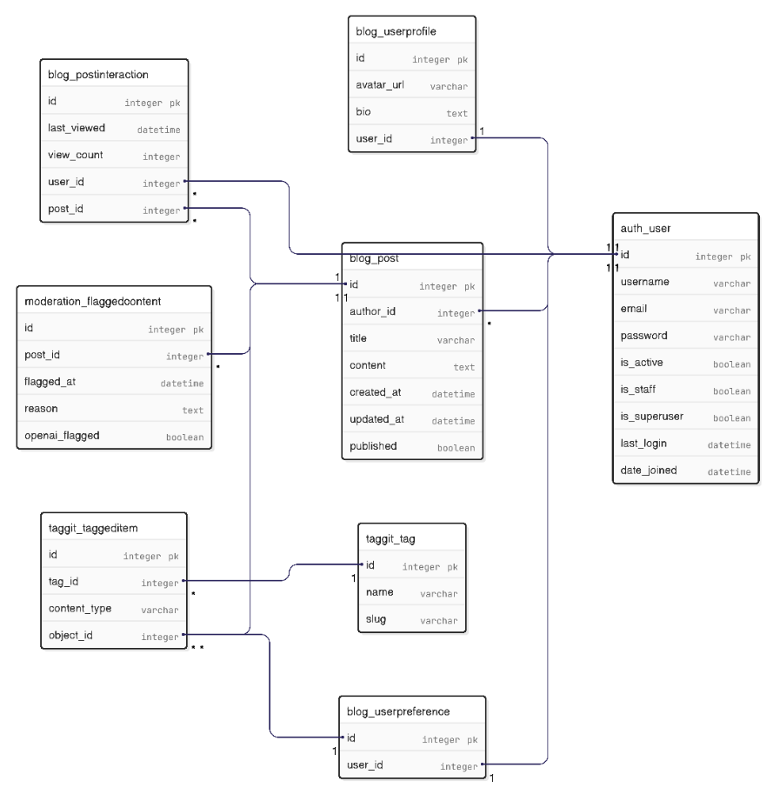
Class Diagram

Slide 5
Content Moderation
OpenAI based content moderation
Flagging system with confidence scores (e.g., 0.9)
Custom moderation dashboard (/admin/moderation/)
Stores flagged content with reasons and user details

Slide 6
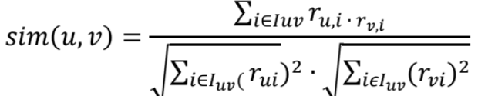
Collaborative Filtering using Cosine Similarity
User Similarity Calculation (using Cosine Similarity): Each user's ratings are
treated as a vector in an n-dimensional space (where n is the number of items).
Cosine similarity then measures the cosine of the angle between two users' vectors.
The formula for cosine similarity between two users, u and v
, across common items Iuv,

Slide 7
Slug uniqueness
The base slug is generated by the folowing code :
base_slug = normalize_and_slugify(title)
max_length = 60
if len(base_slug) > max_length:
base_slug = truncate_to_last_word_boundary(base_slug, max_length)
then the following code is used for uniqueness verification loop:
candidate_slug = base_slug
counter = 1
while slug_exists_in_database(candidate_slug) do:
if updating_existing_post and candidate_slug == post.current_slug:
return candidate_slug # Allow post to keep its own slug
suffix = "-" + str(counter)
if length(base_slug) + length(suffix) > max_length:
# Truncate base to fit suffix
truncated = base_slug[0:(max_length - length(suffix))]
truncated = remove_trailing_hyphen(truncated)
candidate_slug = truncated + suffix
else:
candidate_slug = base_slug + suffix
counter = counter + 1
return candidate_slug

Slide 8
Lessons Learned
Importance of precise implementation of OpenAI moderation API for moderation
Need for thorough URL pattern validation
Effective use of Django forms and widgets
Value of responsive design for user accessibility
Git best practices for managing project size

Slide 9
Conclusion
A robust blog platform with AI moderation
Enhanced user experience and admin functionality
Scalable foundation for future features
Ready for further development and deployment
Thank you for your attention!

