Slide 1


K.RAMAKRISHNAN COLLEGE OF TECHNOLOGY
(AUTONOMOUS), TRICHY
ONLINE SURVEY FORM
PRESENTED BY SUPERVISOR
SWAATHI S Mrs.A.Malarmanna M.E.,
2303811710422164 AP/CSE.

Slide 2
PRESENTATION OVERVIEW
Objective
Project Introduction
Problem Statement
Methodologies (Programming concepts relevant to problem statement)
Architecture of the proposed system
List of Modules
7. Merits
8. Results and Discussion
9. Queries

Slide 3
OBJECTIVE
The Role-Based User Authentication System aims to create a secure and user-friendly platform for managing users with role-based access control (RBAC). It enables ADMIN users to manage surveys and USER roles to participate in them. Built using Java with a Swing-based GUI, the system ensures intuitive interaction and dynamic data handling with Java collections, offering scalability and efficiency. This project highlights RBAC principles and demonstrates Java’s capabilities in building robust, interactive applications.
2/7/20

Slide 4
PROJECT INTRODUCTION
In modern applications, user authentication and role management are critical for ensuring secure and tailored access to resources. This project implements a basic role-based authentication system in Java, focusing on core features such as registration, login, and role-specific actions. The system distinguishes between ADMIN and USER roles, enabling each to perform actions pertinent to their responsibilities. By leveraging Java's object-oriented capabilities, the system demonstrates how to build a scalable and functional authentication mechanism for small-scale applications.
2/7/20

Slide 5
PROBLEM STATEMENT
Managing user access and permissions in applications often lacks flexibility and security, leading to inefficiencies and vulnerabilities. Traditional systems fail to adequately differentiate user roles, resulting in unauthorized access or limited functionality. The challenge lies in developing a robust solution that securely authenticates users, assigns roles, and enforces permissions based on these roles. Additionally, ensuring scalability, seamless interaction, and dynamic data management remains critical. This project addresses these issues by implementing a Role-Based User Authentication System, providing secure user management, role-specific functionality, and an intuitive GUI for efficient interaction.
2/7/20

Slide 6
METHODOLOGIES
Object-Oriented Programming (OOP):
Classes (User, UserManager) and objects are used to model users and manage system operations.
Encapsulation is implemented by defining private fields and public getter methods.
Collections Framework:
ArrayList is used to store registered users.
HashMap maps surveys to their responses, ensuring efficient data access.
Control Structures:
do-while loops and switch statements are used to implement interactive menu navigation.
Conditional checks (if-else) ensure role-based behavior.
2/7/20

Slide 7
METHODOLOGIES
String Manipulation:
User inputs are normalized (e.g., converting roles to uppercase).
Input validation prevents invalid entries during registration.
Java I/O:
Scanner is used for interactive input and output handling in the command-line interface.
2/7/20

Slide 8
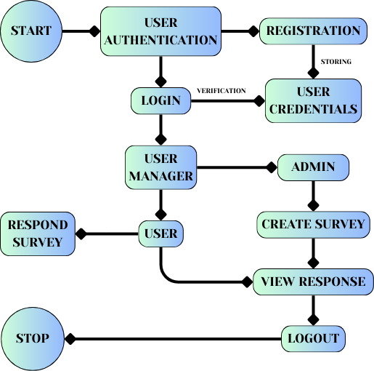
ARCHITECTURE OF THE PROPOSED SYSTEM
2/7/20

Slide 9
LIST OF MODULES
User Registration Module
Login Module
Admin Module
User Module
Survey Management Module
2/7/20

Slide 10
MERITS
Secure Authentication: Ensures user credentials are validated effectively to prevent unauthorized access.
Role-Based Access Control (RBAC): Provides tailored functionalities based on user roles, enhancing system efficiency and security.
Scalability: Dynamic data handling using Java collections allows the system to adapt to an increasing number of users and surveys.
User-Friendly Interface: A GUI built with Java Swing offers an intuitive and interactive experience for users.
Modular Design: Clearly defined modules improve code maintainability, readability, and ease of future enhancements.
2/7/20

Slide 11
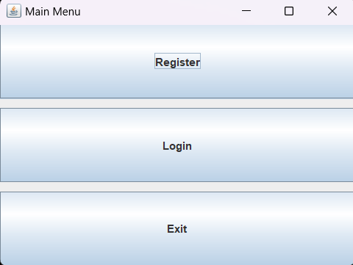
RESULTS AND DISCUSSION
1.USER INTERFACE
This is the main menu or main page were user can register or login or exit according to their requirements.
2/7/20

Slide 12
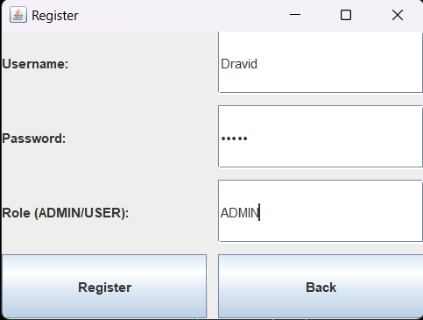
RESULTS AND DISCUSSION
2.USER REGISTRATION
The registration panel allows users to create an account by providing a username, password, and role (ADMIN or USER). The system validates inputs and displays success or error messages accordingly. This ensures secure and structured user registration.
2/7/20

Slide 13
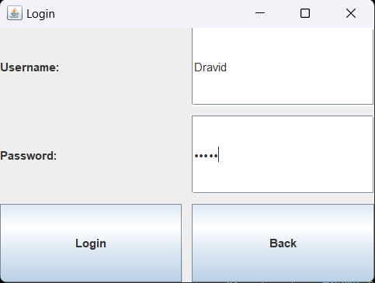
RESULTS AND DISCUSSION
3. LOGIN PAGE
The login panel requires users to enter their credentials. Successful authentication redirects users to their respective role-specific dashboards, while invalid credentials display an error message. This module demonstrates secure authentication.
2/7/20

Slide 14
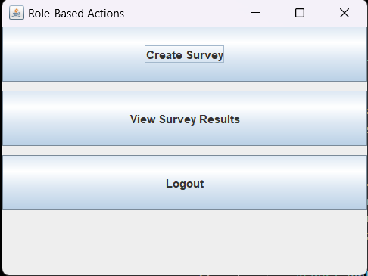
RESULTS AND DISCUSSION
4. ADMIN DASHBOARD
Upon login, ADMIN users are presented with options to create surveys and view survey results. This role-specific access ensures that only authorized users can manage surveys.
2/7/20

Slide 15
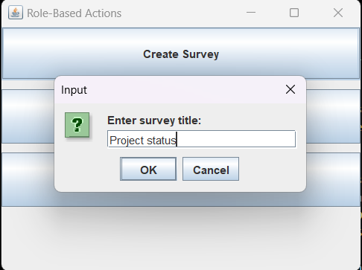
RESULTS AND DISCUSSION
5. SURVEY CREATION
ADMIN users can create surveys by entering a title and question. The created survey is stored dynamically, demonstrating the system's ability to handle data efficiently.
2/7/20

Slide 16
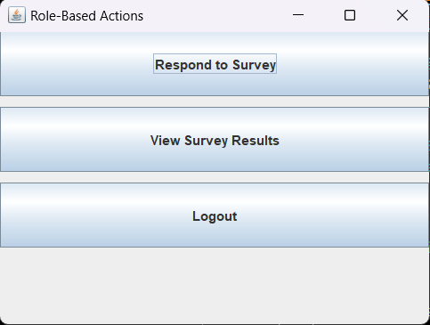
RESULTS AND DISCUSSION
6. USER DASHBOARD
USER roles have access to respond to surveys and view existing results. The options are restricted to their role, highlighting the role-based access control implemented in the system.
2/7/20

Slide 17
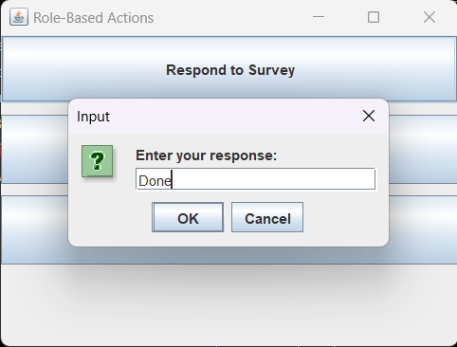
RESULTS AND DISCUSSION
7. SURVEY RESPONDING
USER roles can view available surveys and submit their responses. This feature ensures seamless interaction with the surveys
2/7/20

Slide 18
ANY QUERIES ??
2/7/20

Slide 19
THANK YOU
2/7/20

