Slide 1
Asteroid composition
Surface composition detection using digital images

Slide 2

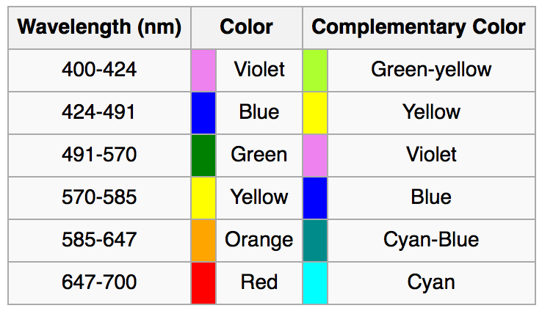
Visible Wavelengths
Human visible light wavelengths range from 380 nm to 760 nm
https://en.wikipedia.org/wiki/Electromagnetic_spectrum#Visible_radiation_.28light.29
http://www.midnightkite.com/color.html

Slide 3
Meteorite Composition
Iron meteorites
Iron: 91 percent
Nickel: 8.5 percent
Cobalt: 0.6 percent
Stony meteorites
Oxygen: 36 percent
Iron: 26 percent
Silicon: 18 percent
Magnesium: 14 percent
Aluminum: 1.5 percent
Nickel: 1.4 percent
Calcium: 1.3 percent
http://www.space.com/51-asteroids-formation-discovery-and-exploration.html

Slide 4
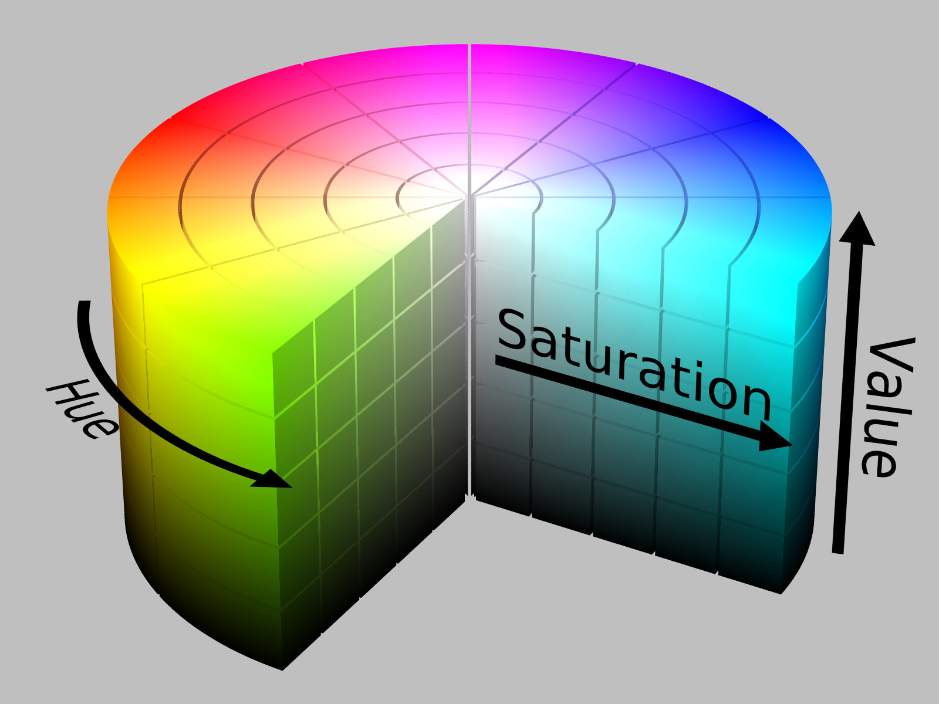
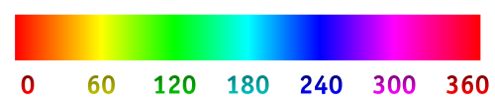
Problem: Recover wavelengths from RGB Space
This is technically impossible since an infinitely many combinations of wavelengths can produce the same perceived color to the human vision system.
RGB is an approximation of real color by adding three primary colors from the red, green, and blue wavelengths.
We can approximate wavelengths from RGB by converting to hue, saturation, and value (HSV) format.
The hue value which ranges from 0 to 360 degrees can be used to estimate wavelength.

Slide 5

OpenCV hue to Wavelength Conversion Approximation
OpenCV stores hue values for 8-bit images in the range of 0 to 179 as opposed to 0 to 359 to fit the entire range into the 8-bit field.
http://docs.opencv.org/3.1.0/de/d25/imgproc_color_conversions.html
So we can normalize the range from 0 to 359 by multiplying values by two and perform the approximation conversion given by the following equation:
$l=620−\frac{170}{270}∗270∗h$
Where: $l$ is wavelength in nm and $h$ is the hue value from 0 to 359.
http://stackoverflow.com/questions/11850105/hue-to-wavelength-mapping

Slide 6
Problem: Light signals are noisy
Measurements taken by cameras are inherently noisy.
For most images we don’t know how well the camera was calibrated
We don’t know the albedo (ratio of surface reflectance) for the asteroid.
High albedo surfaces will have lots of specular reflection meaning that they will tend to look dark if the reflected light is not at the same angle as the camera lens
We don’t know the albedo of the surface because we don’t know what the surface composition is but we’re trying to use light emissions to estimate surface composition.

Slide 7
Problem: Surface light can be affected by other physical factors
Asteroid surfaces have craters which appear darker
Cratered surfaces also have slightly different surface composition because the impact that produced the crater adds heat and pressure to the surface which changes the chemical composition.
Objects impacting the asteroid surface also deposits foreign materials on the surface.

Slide 8
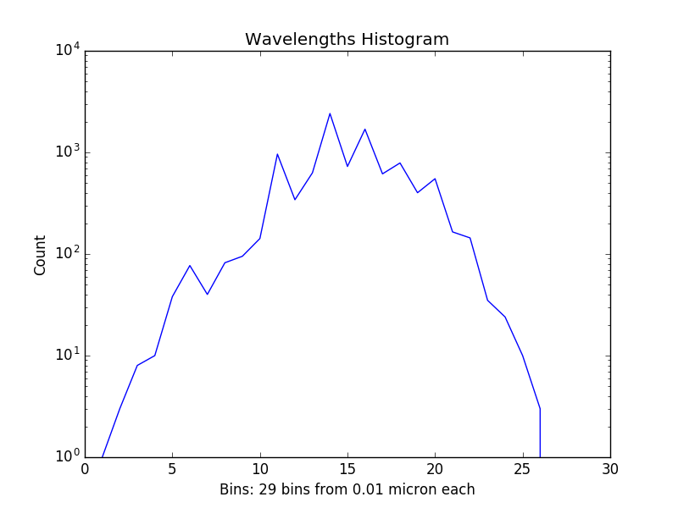


Sample Data:
Patch:
$μ=0.599023$
$σ=0.00205689$

Slide 9
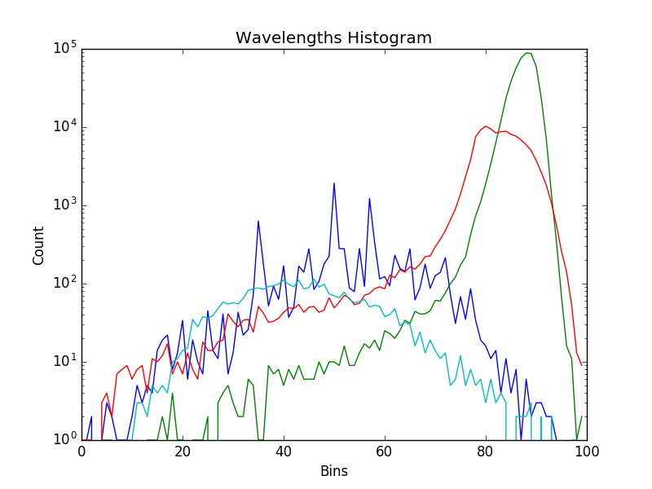
All Wavelength Histograms
Blue: Ida
Green: Olivite
Red: Chondrite
Light blue: Eros

