Slide 1
Asteroid composition
Surface composition detection using digital images

Slide 2

Visible Wavelengths
380 nm and 760 nm
https://en.wikipedia.org/wiki/Electromagnetic_spectrum#Visible_radiation_.28light.29
http://www.midnightkite.com/color.html

Slide 3
Meteorite Composition
Iron meteorites
Iron: 91 percent
Nickel: 8.5 percent
Cobalt: 0.6 percent
Stony meteorites
Oxygen: 36 percent
Iron: 26 percent
Silicon: 18 percent
Magnesium: 14 percent
Aluminum: 1.5 percent
Nickel: 1.4 percent
Calcium: 1.3 percent
http://www.space.com/51-asteroids-formation-discovery-and-exploration.html

Slide 4
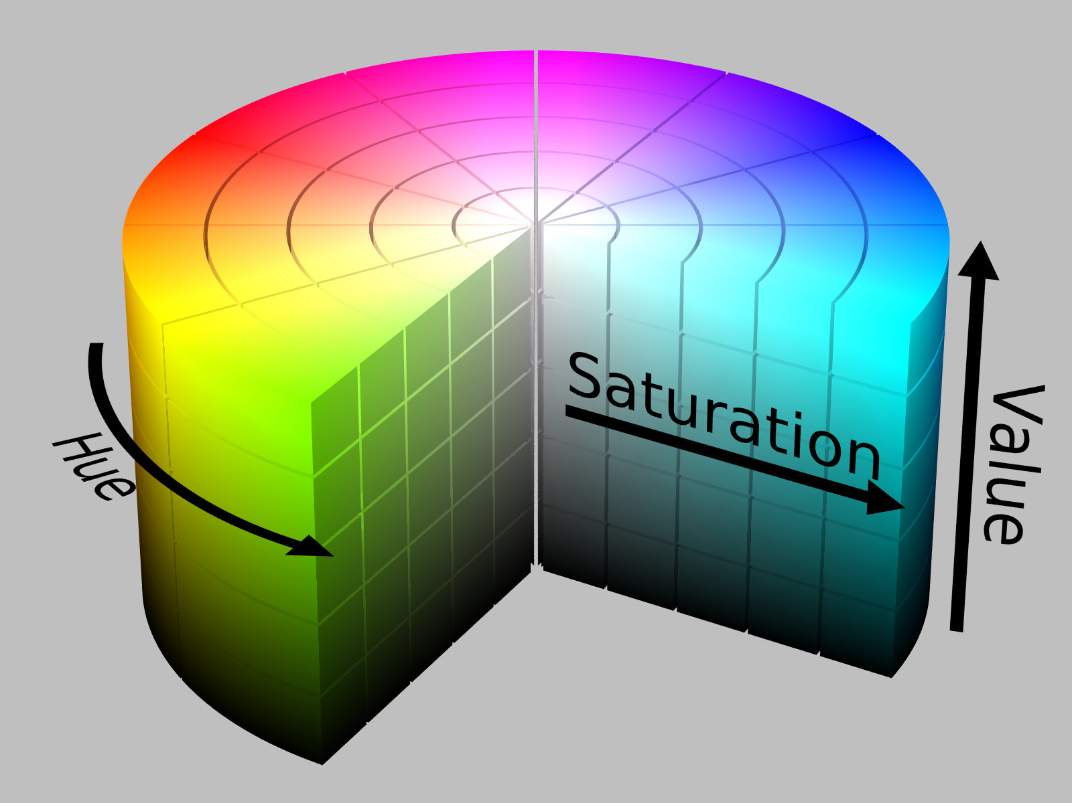
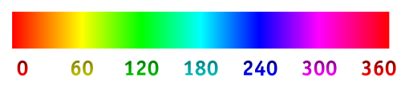
Problem: Recover wavelengths from RGB Space
This is technically impossible since an infinitely many combinations of wavelengths can produce the same perceived color to the human vision system.
RGB is an approximation of real color by adding three primary colors from the red, green, and blue wavelengths.
We can approximate wavelengths from RGB by converting to hue, saturation, and value (HSV) format.
The hue value which ranges from 0 to 360 degrees can be used to estimate wavelength.

Slide 5

OpenCV hue to Wavelength Conversion Approximation
OpenCV stores hue values for 8-bit images in the range of 0 to 179 as opposed to 0 to 359 to fit the entire range into the 8-bit field.
http://docs.opencv.org/3.1.0/de/d25/imgproc_color_conversions.html
So we can normalize the range from 0 to 359 by multiplying values by two and perform the approximation conversion given by the following equation:
$l=620−\frac{170}{270}∗270∗h$
Where: $l$ is wavelength in nm and $h$ is the hue value from 0 to 359.
http://stackoverflow.com/questions/11850105/hue-to-wavelength-mapping

