Slide 1
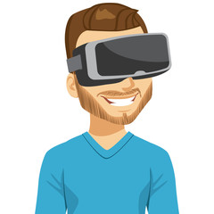
Generated
audio signal
Smartphone holding
VR headset
Reflected signal

