Slide 1
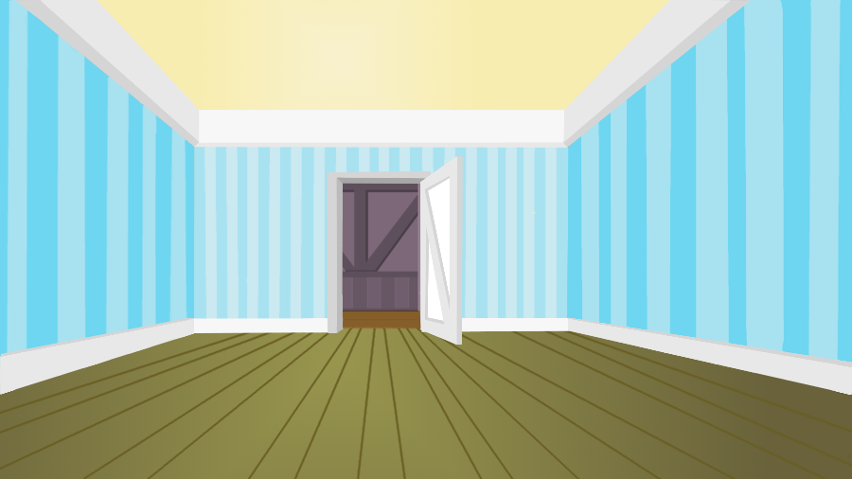

Ceiling
Corner
Corner
Reflected Signal
Room Walls
Generated
Audio Signal
Moving User
Smartphone
Floor
Moving Direction and Path

