Slide 1


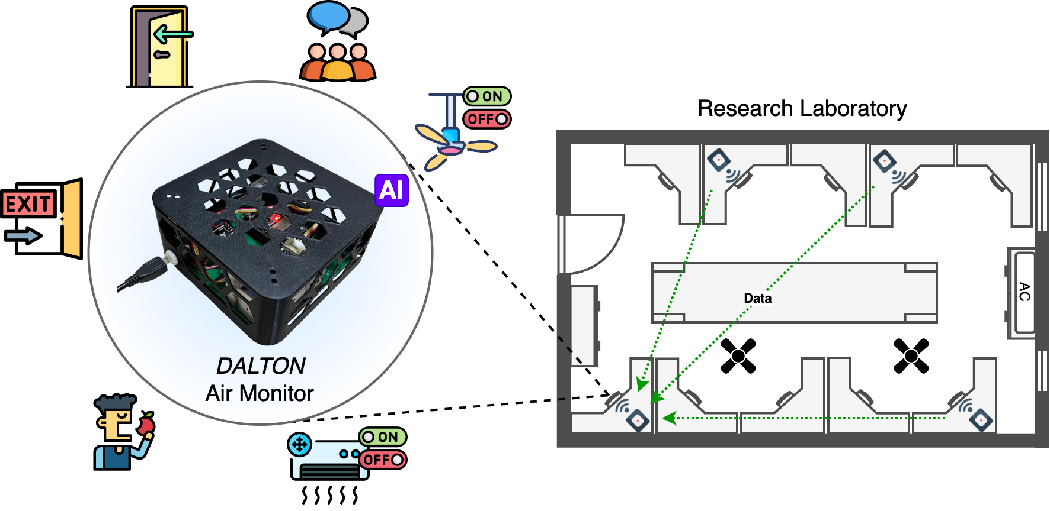
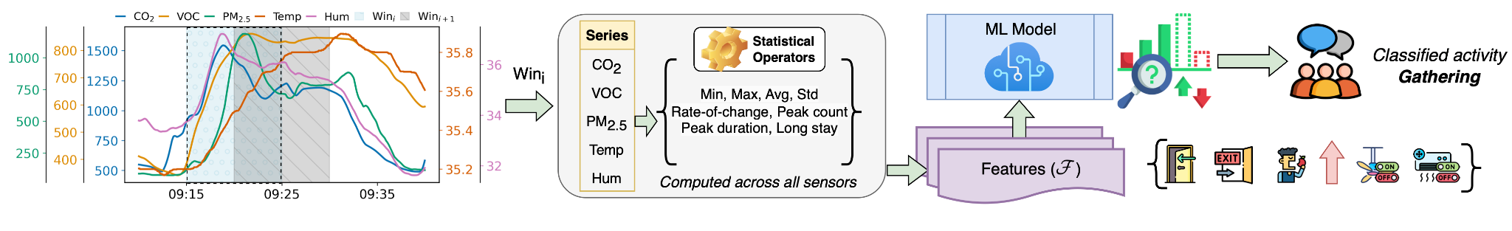
Exploiting Air Quality Monitors to Perform Indoor Surveillance: Academic Setting
Prasenjit Karmakar†, Swadhin Pradhan§, Sandip Chakraborty† †Indian Institute of Technology Kharagpur, India, §Cisco Systems, USA
Key Takeaways
1) Potential side-channel applications of air monitors
2) Sharing pollution data may compromise privacy
3) Identify specific activities with 97.7% F1-score
UbiNet
Email: prasenjitkarmakar52282@gmail.com
Sept 30th - Oct 3rd, 2024 , Australia

