Slide 1
Assessing Importance of Smartphone Notifications
Swadhin Pradhan
Lili Qiu

Slide 2


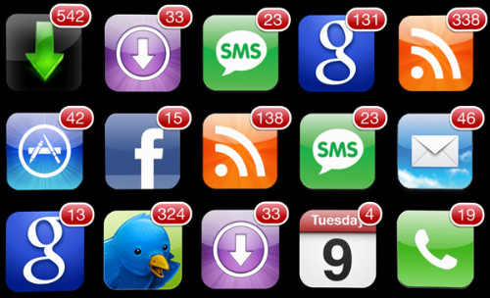



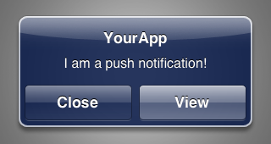
Motivation
~ 70 notifications
Overwhelming
Interruptions
Ongoing Tasks
Stress …
Notes:
Recent studies conservatively estimate that we get around 70 notifications a day which cause stress, unwanted interruptions which in turn causes less productivity due to frequent context switches. Sometimes people uinstall apps due to incessant notifications.

Slide 3
Problem Definition
When and Where to give What notification ?
Notification Usage
Notification Manager
What is the notification landscape ?
How many types of notification ?
Which apps generally provide more notifications ?
How do users respond to notifications ?
Can we curate the notifications according to perceived importance?
Personalized notification provision keeping in mind precious user attention budget.
Notes:
In this project, we want to address this problem and come up with a solution which will tell “when and where to give what notification”. We have planned to first understand the users’ notification usage pattern and later will manage it.

Slide 4
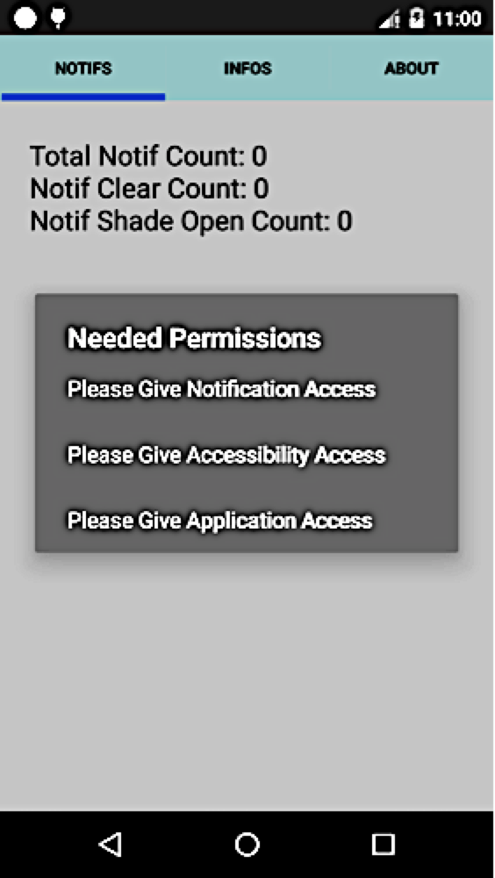
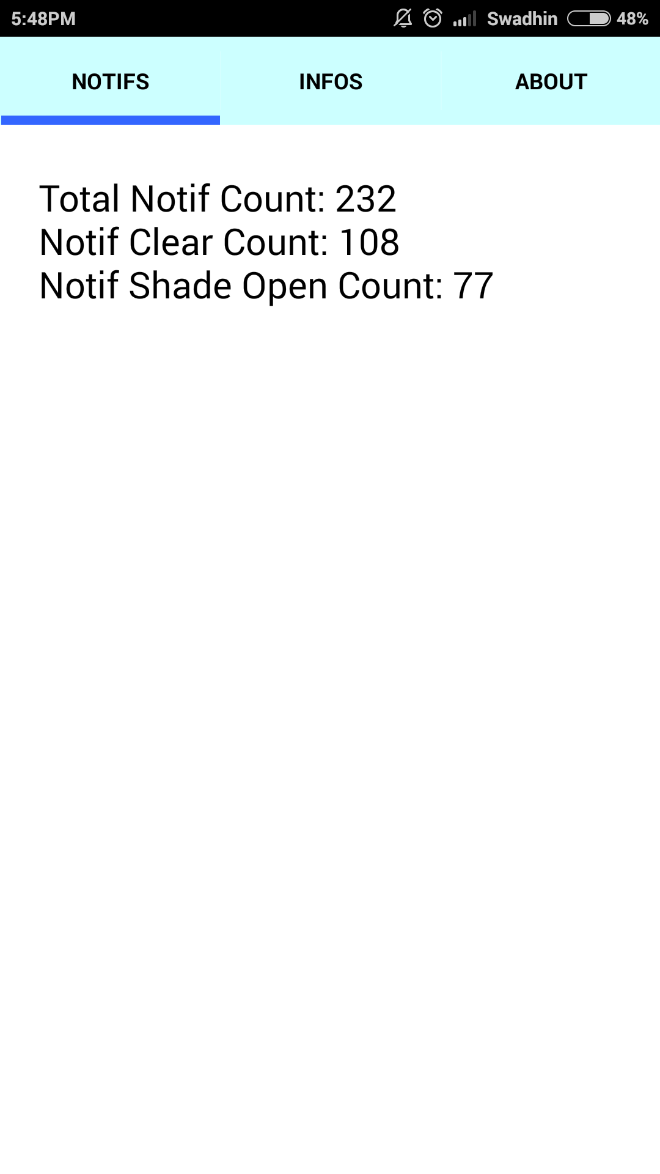
Notifbase : App for Collecting Notification Usage and Context

Slide 5
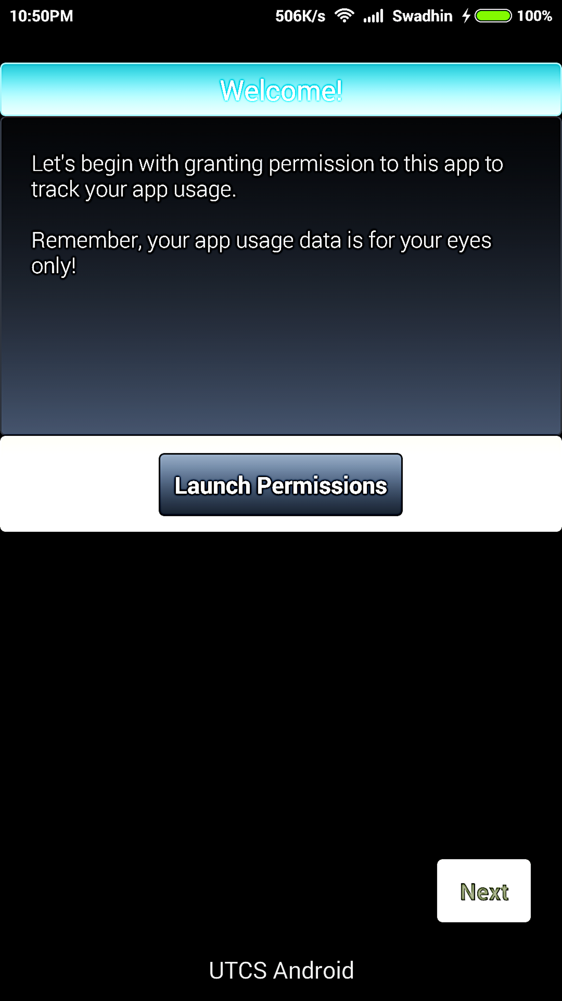
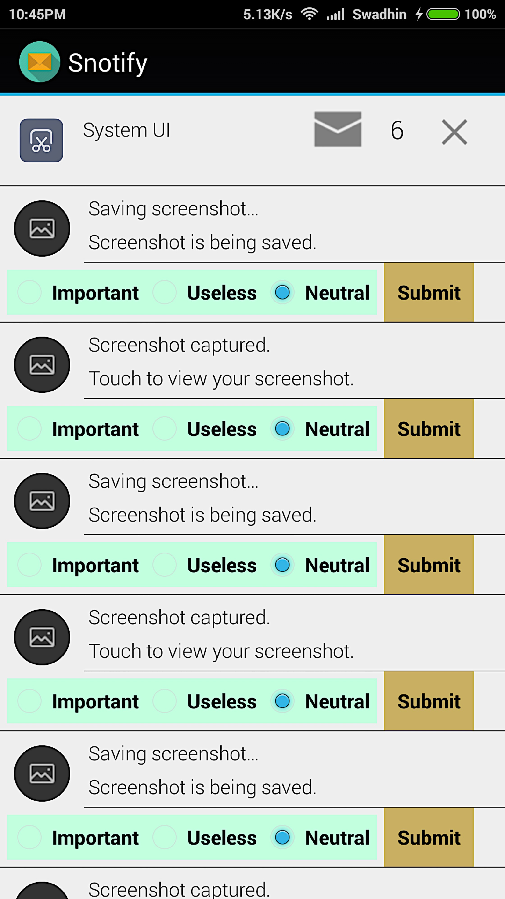
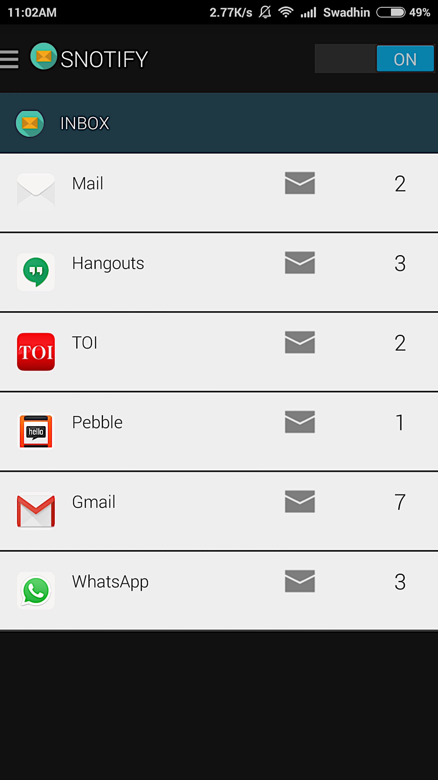
Snotify : Feedback App for Notification Importance

Slide 6
Needed Android Version >= Kitkat $25 Amazon Gift Card for 21 days More Details : https://www.cs.utexas.edu/~swadhin/notification_project.html Contact person: Swadhin Pradhan (swadhin@cs.utexas.edu, GDC 6.802D, 737-222-8807) Please Participate ☺

