Slide 1
Aggregating Inter-App Traffic to Optimize Cellular Radio Energy Consumption on Smartphones
Swadhin Pradhan¹, Sourav Kumar Dandapat², Bivas Mitra², Niloy Ganguly² and Pradipta De³.
¹UTAustin, USA ²IIT Kharagpur, India ³SUNY, Korea

Slide 2

Outline
Introduction
Balanced Scheduling Protocol
Evaluation Setup and Traces
Results and Takeaways
Conclusion and Future Works

Slide 3
Introduction
Display, Network, and CPU are main components of Energy Drain.[ Mittal et. al., MobiCom ‘13 ]
Poorly written apps can sap 30% to 40% of a phone’s battery. [Mahajan et. al., IMC ’09]
Network intensive applications are increasing ( ~69% of the apps are cloud based ).
Different background services running intermittently and waking up the network card for a small duration. [Qian et. al., WWW ’12]

Slide 4

Cellular Radio Energy Model
High Power
High Bandwidth
Data Transmission Energy (CD)
CELL_DCH
Ramp Up Energy (CR)
Tail Time
Total Energy = CR + CD + CT [2]
IDLE
CELL_FACH
Tail Time
Low Power
Low Bandwidth
No Power
No Bandwidth
Tail Energy (CT)
Total Energy Consumption = CR + CD + CT ,
where CR is the ramp up energy (IDLE to CELL DCH),
CD is the data transmission energy,
and CT is the tail energy (in CELL FACH).

Slide 5
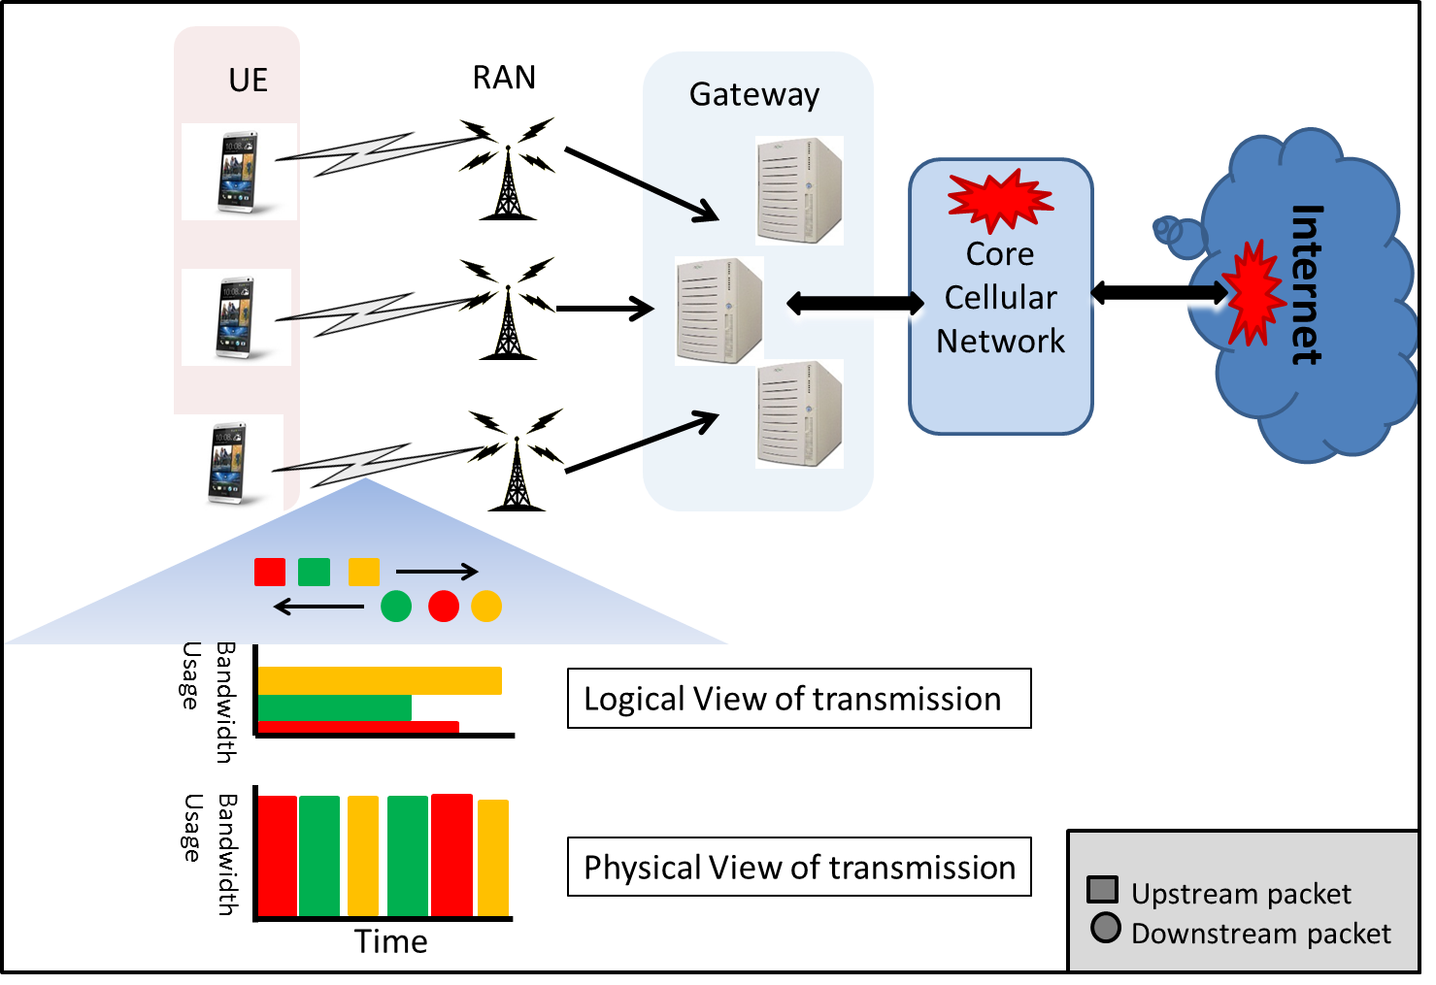


Total View of App Connectivity
Last hop Bandwidth
Concurrent Apps
Bottlenecks
Smart Scheduler

Slide 6
Idea : Cross Application Traffic Aggregation
Network Usage Intervals
A
B
C
App1
App2
D
E
F
Effectively Network Radio is On for this entire Interval
App2 with Stalling
D
E
Effectively Network Radio is On with our Strategy
Slack that does not hurt user’s experience

Slide 7
Problem Objective
Scheduling all network requests using minimum energy without hurting user’s experience.
Multi-objective optimization problem
  Minimum Energy => Best utilization of bandwidth (Side-effect : Lower Switching Frequency).
  User’s Experience => Request should be served within deadline.

Slide 8

Problem Constraints
Depending on expected response time of application, a flexibility or slack time is allowed to schedule each packet.
Requests from the same application cannot be triggered simultaneously.
Total bandwidth consumption by all the scheduled requests should be less than the available channel bandwidth (We consider constant last hop bandwidth).

Slide 9
Approach Intuition : Deciding Function
If a request is delayed then there is potentially more opportunity of batching.
If a request is delayed much, it may miss deadline.
So, we need to develop a function to decide at certain time if a request should be scheduled or should be delayed further.

Slide 10

Terminology
A_{i}= i^{th} application
A_{ij} = j^{th} request of i^{th} application
r_{ij} = Arrival time of A_{ij}
x_{ij} = Scheduling time of A_{ij}
f_{ij} = slack time time of A_{ij}
d_{ij} = service duration of A_{ij}
ft = finish time of all requests in run queue

Slide 11
Deciding Function (F)
F=β. Bandwidth_wastage +(1-β).Experience_user
Where β is normalizing constant.
F=α.β . Bandwidth_wastage +(1-α)(1-β).Experience_user
Where α is factor to give priority over other

Slide 12
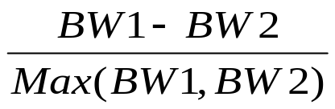
F : Bandwidth Wastage Component
New Request
Bandwidth Wastage
P5
P4
P4
P3
P3
P2
P2
P1
P1
Current Running Requests
Bandwidth_wastage =
BW1 : Bandwidth Wastage Before Scheduling
BW2 : Bandwidth Wastage After Scheduling

Slide 13
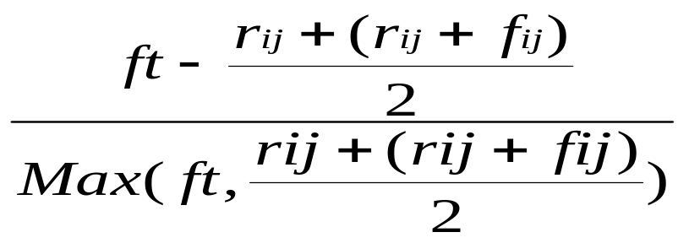
F : User Experience Component
r_{ij}
r_{ij} + f_{ij}
Mid point
Do not schedule if ft lies here Wait for more requests
Schedule if ft lies here
Experience_user =

Slide 14
Balanced Scheduling Protocol
There are two queues:
  Running Queue has all the running requests served by Cellular Radio.
  Waiting Queue has all the pending requests.
Requests are put into wait queue as soon as they arrive.
Pushed to run queue when Deciding Function (F) is positive.

Slide 15
Experimental Setup
Application Types (MobiSys '12)
  Gaming (Short Bursts)
  Browsing (Medium Bursts)
  Streaming (Large Bursts)

Slide 16
Experimental Setup
Synthetic Trace Generation tuning parameters
  User Interaction Timing (Power Law )
  Data Transmission Size ( Power Law with set of sizes)
  Bandwidth Demand ( Fixed Demand per App)
  Slack Duration (Fixed per application type)

Slide 17

Experimental Setup
Ramp Up Energy (CR)
Switching Strategies
  Fast Dormancy.
  Fast Dormancy with Fixed Tail Timer.
Total Energy
= CR + CD
Data Transmission Energy (CD)
IDLE
CELL_DCH
No Power
No Bandwidth
High Power
High Bandwidth
Instantly
Data Transmission Energy (CD)
High Power
High Bandwidth
CELL_DCH
Ramp Up Energy (CR)
Tail Time
Total Energy = CR + CD + CT [2]
IDLE
CELL_FACH
Tail Time
Low Power
Low Bandwidth
No Power
No Bandwidth
Tail Energy (CT)

Slide 18
Real Trace Collection
  Collected using ARO (AT&T) tool, tcpdump, and ps.
  Samsung Galaxy S3 GTI9300 (Rooted).
  One hour Browsing Trace from a user.
  Applications are differentiated through port mapping.

Slide 19
Evaluation Metrics
Energy Consumption per KB: Total energy spent to transmit one KiloByte of data.
Deadline Miss: Proportion of requests which have missed their transmission deadline.
State Switch Rate: Number of times per unit time the radio changes state - from IDLE to DCH, and DCH/FACH to IDLE.
Radio On Time: Radio on time as a fraction of total data transmission duration.

Slide 20
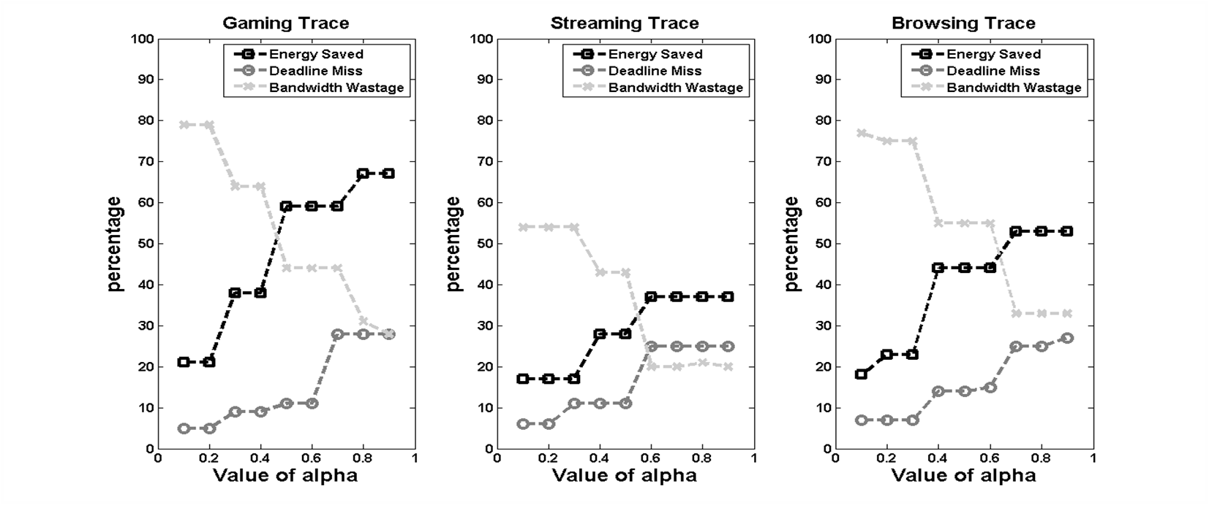
Alpha Value Tuning
Good Trade-off between Energy and User Experience

Slide 21
Competing Scheduling Techniques
TailEnder: Uses threshold based tail time prediction by considering deadlines of packets of an application.
PerES: Performance-aware Energy Scheduler or PerES models cross application energy-delay tradeoff as an optimization problem and applies Lyapunov optimization framework.
TOP: Tail Optimization Protocol reduces tail energy wastage by predicting the application behavior.

Slide 22
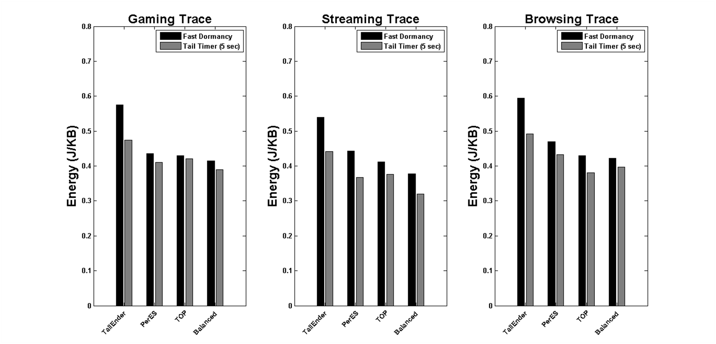
Energy Consumption per KB (~10%)

Slide 23
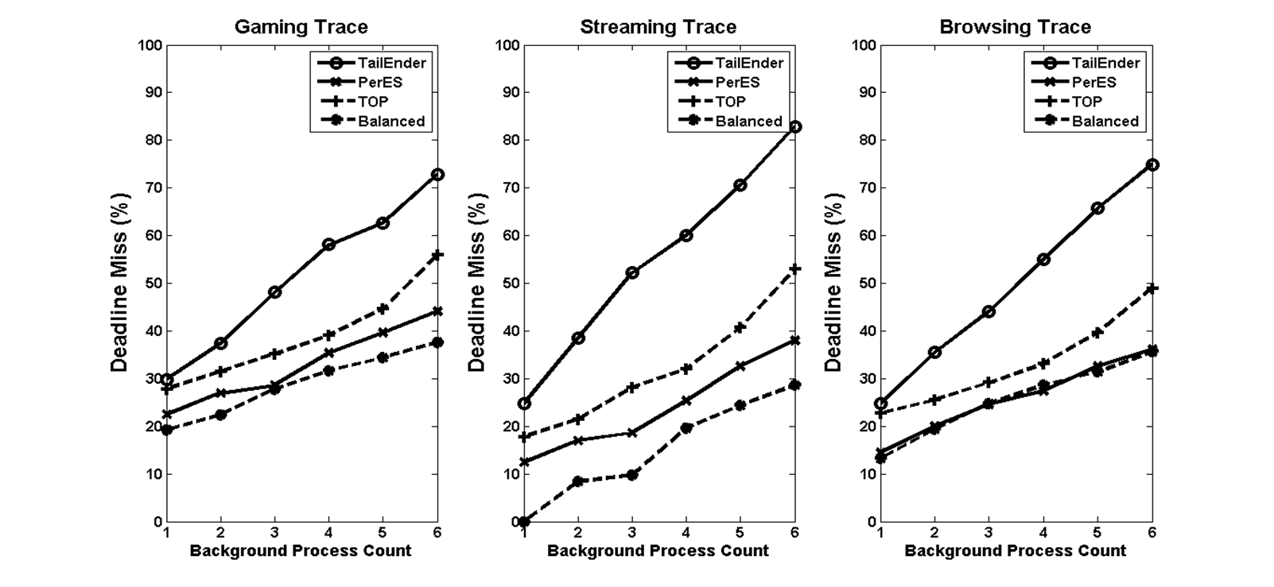
Deadline Miss

Slide 24
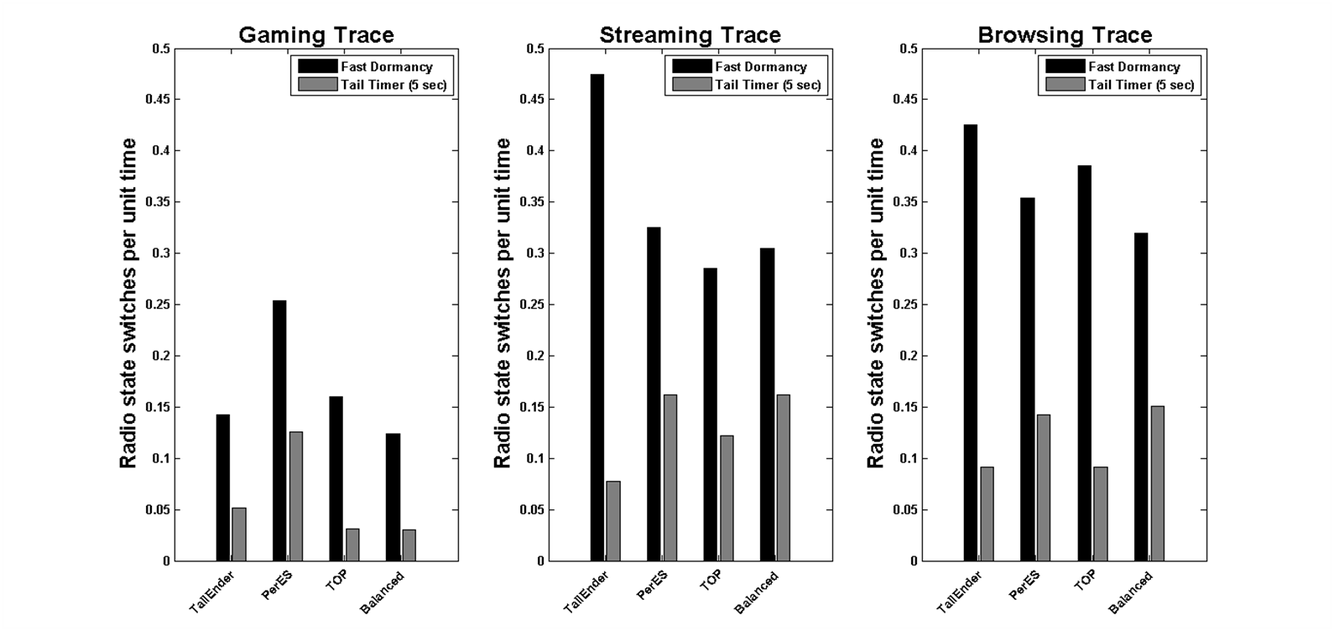
Switching

Slide 25
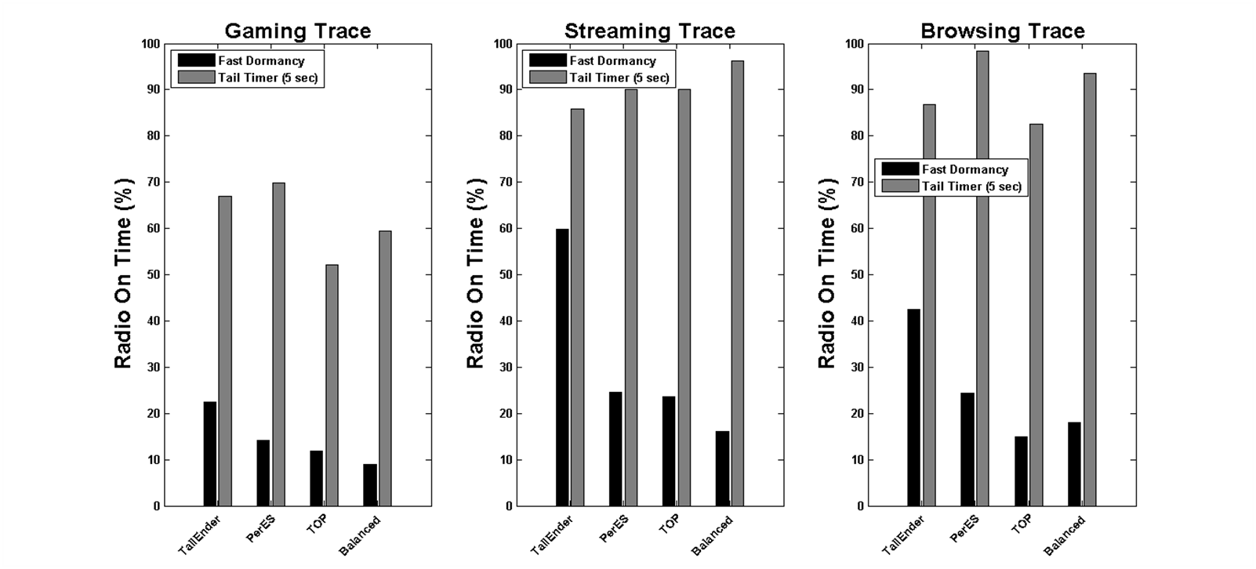
Radio On Time

Slide 26
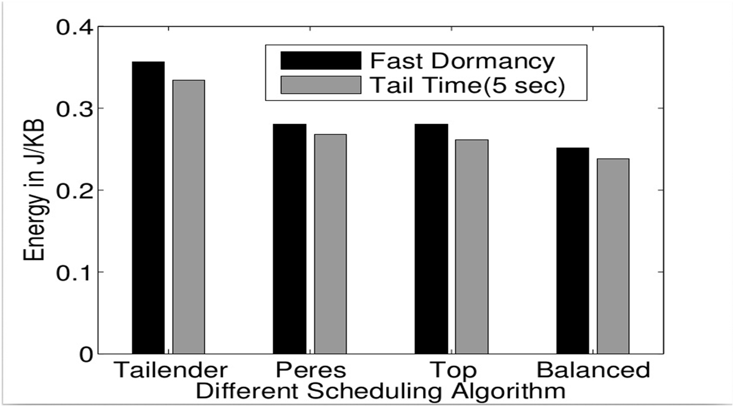
Energy Consumption in Real Trace

Slide 27
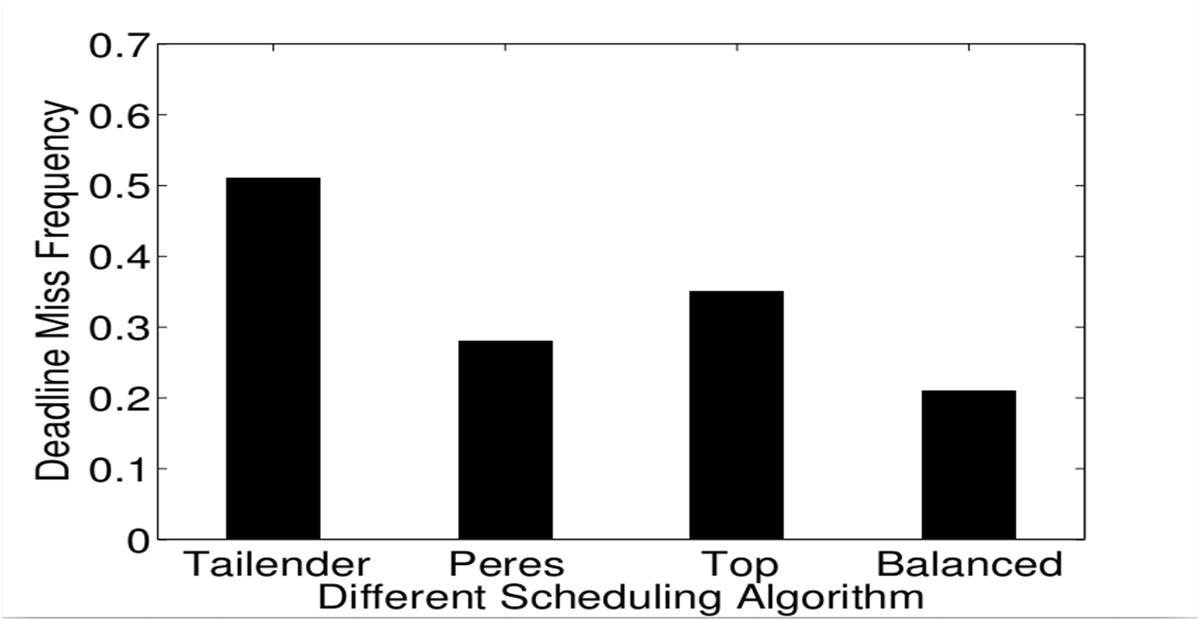
Deadline Miss in Real Trace

Slide 28

Takeaways
Around 10% better than PerEs and TOP in Energy Gain wise, but far better from TailEnder.
Percentage of Deadline Misses for Foreground App remains satisfactory.
Reducing number of state transitions of the network interface can save more energy than optimizing utilization of the tail period of the card.

Slide 29
Future Works
Extensive and large scale real trace based evaluation to validate the simulation based results.
Building middleware which will run our aggregation strategy across applications.
Extension and implementation of in other elements like sensors, GPS etc.
Building a Application network activity recorder tool which can be installed without rooting.

Slide 30

Thank you

