Slide 1
Sprinkler: Distributed Content Storage for Just-in-Time Streaming
CellNet -2013
Taipei, Taiwan
Presented By: Sourav Kumar Dandapat

Slide 2
Background
Mobile data traffic and its demand is increasing in exponential rate.
Traffic from wireless and mobile devices will exceed traffic from wired devices by 2016
Significant portion of this traffic is due to video and according to Cisco, two-thirds of the world's mobile data traffic will be video by 2017.

Slide 3
Cont..
Scientific community are exploiting different opportunities to accommodate this high demand.
Offloading cellular traffic to Wi-Fi enhances the efficiency of cellular network significantly.
For video traffic, lots of compression schemes have been proposed

Slide 4
Problem Definition

Slide 5
Opportunity
Many cities across world are being Wi-Fi enabled
Memory chip can be easily hooked with Wi-Fi AP can serve as local server.

Slide 6
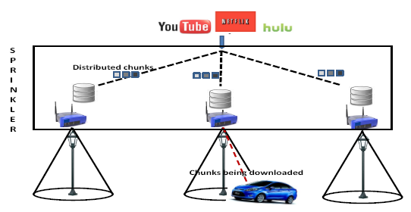
System Architecture

Slide 7
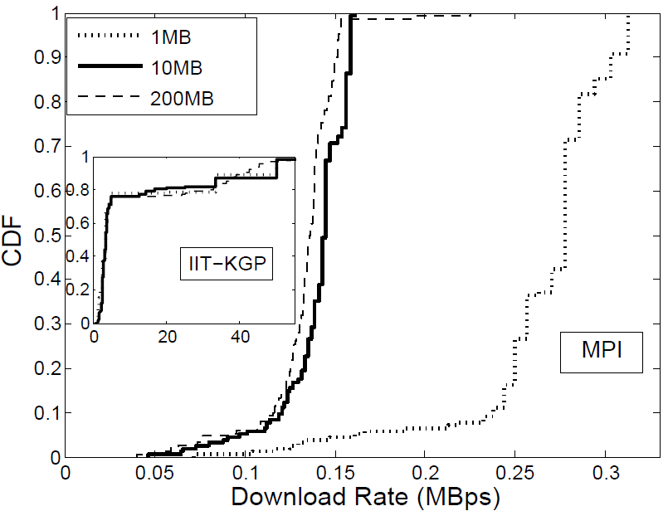
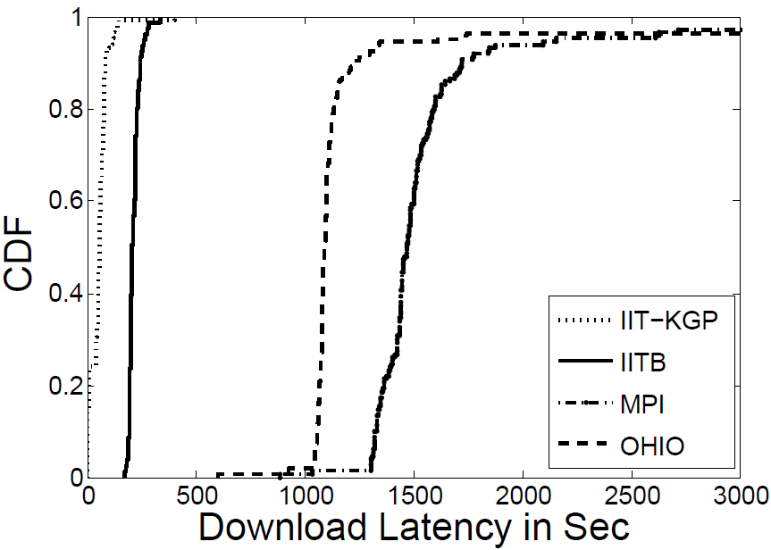
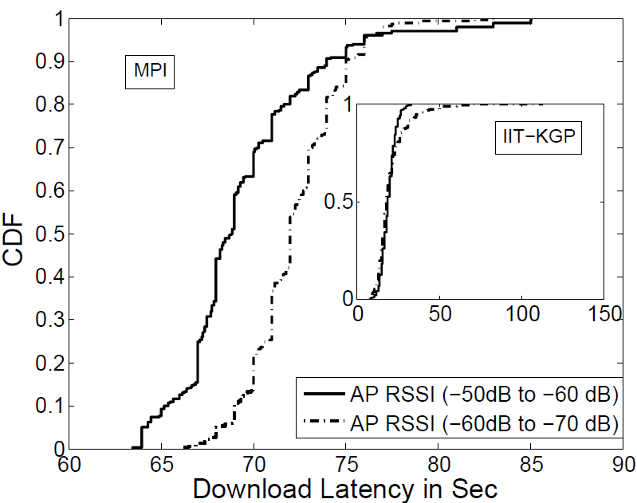
Motivation

Slide 8
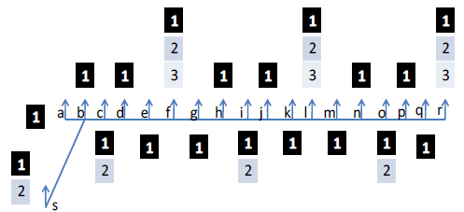
Chunk Distribution Strategy

Slide 9
Optimization Problem
First chunk is placed at every AP.
Every shortest path of length (p-1) x k has at least one copy of chunk 1 to p (k is the number of APs, a client crosses within viewing time of one chunk)
Total storage to host a movie is optimized

Slide 10
Sprinkler Protocol
1
1
Requests for chunk list of a specific movie
2
2
List of available chunks with server
Client
Server
3
3
Actual Chunk request
4
4
Serving actual chunk

Slide 11
Evaluation Metrics
Metrics of Interest :
  Fraction of data offload (FDO) measuring the percentage of the video packets during the vehicle’s journey downloaded over WiFi.
  Cost efficiency will capture FDO gained per AP. Like with X number of APs, FDO of a scheme is Y then cost efficiency of that scheme is Y/X.
  Switching frequency will reflect the number of times a client switches to other network (like 3G), to continue uninterrupted viewing, per unit time (minute).

Slide 12
Base Strategy for Comparison
Far-Sprinkler is a system where the APs don't locally host video, but pull them from a central server.
  Far-Sprinkler-I: 80% of servers are located nearby client and 20% of servers are located far away from client.
  Far-Sprinkler-II: 70% of servers are located nearby client and 30% of servers are located far away from client.
  Far-Sprinkler-III: 60% of servers are located nearby client and 40% of servers are located far away from client.

Slide 13
Experimental Setup and Parameters
Mobility Model : Shortest path map based mobility model, with and without pause time.
Data rates : 9Mbps/ 18Mbps/ 24Mbps
Speed : 20km/hour – 60km/hour
Traffic : 1-20 cars per path

Slide 14
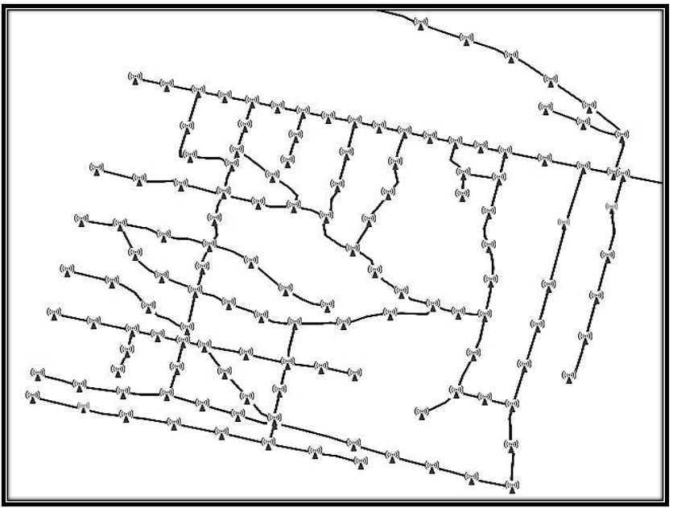
Road Map on which experiment was done
Mysore Road Map (APs are placed at every 100m)

Slide 15
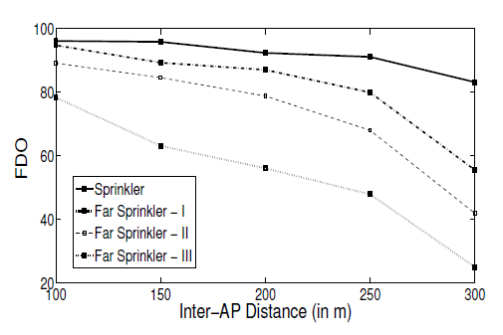
What is the effect of AP-density on Sprinkler?
Experimental Parameters
Chunk size= 3MB
Total Chunks in system = 30
Chunks are distributed considering 40km/Hour is ideal speed
Speed chosen for cars in range of 30km/hour – 50km/hour
Every AP can store 10 chunks
Offload more than 90% across wide range of speed
Performance degradation is very graceful of Sprinkler

Slide 16
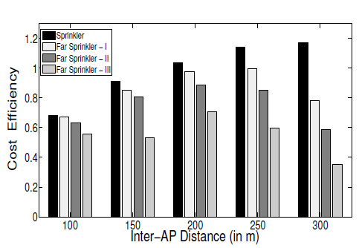
Cont..
With blanket AP coverage all schemes performs equally
As inter-AP distance increases cost efficiency of Sprinkler increases

Slide 17
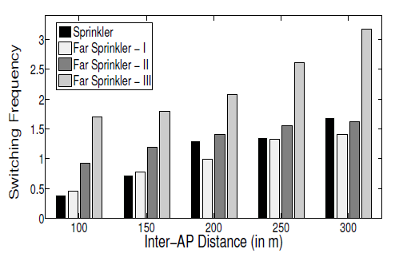
Cont..
With inter-AP distance switching frequency of all schemes increases
Degradation of Far-Sprinkler-III scheme is significant compared to other schemes

Slide 18
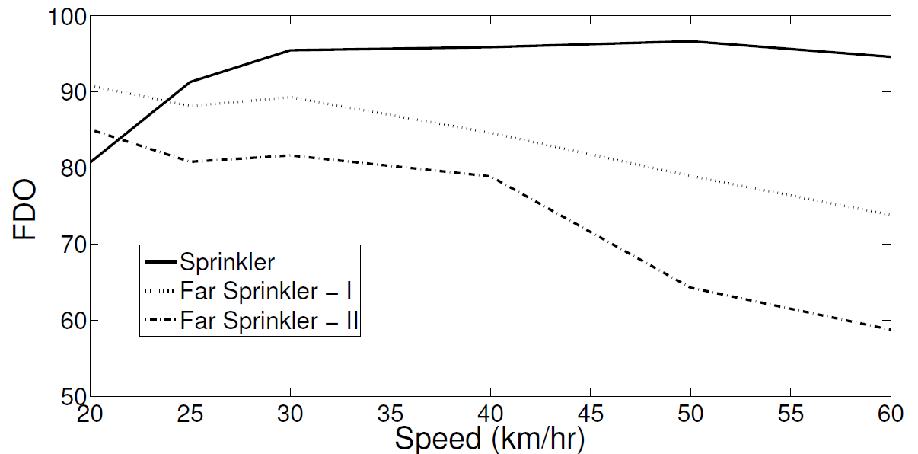
What is the effect of speed on Sprinkler?
Experimental Parameters
Inter-AP distance = 100m
Offload more than 90% across wide range of speed
Sprinkler maintains it FDO after a moderate speed (30km/hour)
FDO of Far-Sprinkler reduces with speed

Slide 19
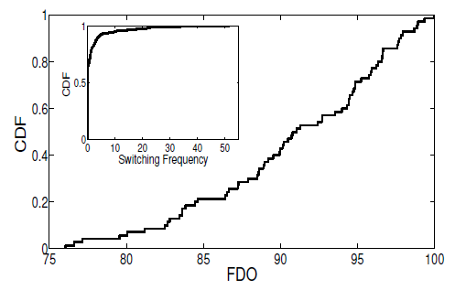
Cont..
Experimental Parameters
Inter-AP distance = 100m
Speed chosen for cars randomly in between 20km/hour – 60km/hour
Every experiment is done with 7 clients and total 70 runs taken
FDO of clients in between 76 to 100
60% clients do not switch to other network in their entire journey
10% clients switch 20-30 times a minute to other network.

Slide 20
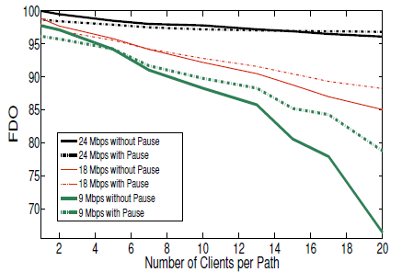
What is the effect of traffic on Sprinkler?
With traffic load performance degrades
With data-rate performance enhances
With traffic and pause time performance enhances, enhancement is
more significant when data rate is low

Slide 21
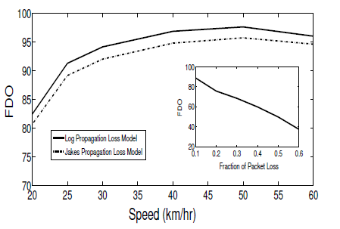
Different error model

Slide 22
Conclusion & Future Work
With the offload potential, Sprinkler provides a less costly video streaming opportunity
With this facility, future cities can be envisioned as “a movie theatre in my car”
System needs to be evaluated with different mobility model

Slide 23
References
P. Deshpande, X. Hou, and S. R. Das, “Performance Comparison of 3G and Metro-Scale WiFi for Vehicular Network Access,” in IMC, pp. 301–307, 2010.
S. Dimatteo, P. Hui, B. Han, and V. O. Li, “Cellular Traffic Offloading through WiFi Networks,” in 2011 IEEE 8th International Conference on Mobile Ad-Hoc and Sensor Systems (MASS), vol. 0, (Los Alamitos, CA, USA), pp. 192–201, IEEE, Oct. 2011.
J. Eriksson, H. Balakrishnan, and S. Madden, “Cabernet:Vehicular Content Delivery Using WiFi,” in Proceedings of the 14th ACM international conference on Mobile computing and networking, MobiCom, (New York, NY, USA), pp. 199–210, ACM, 2008.

Slide 24
Thank You!!!

