Slide 1
More on GPU Programming
Ghufran Baig
https://devblogs.nvidia.com/how-overlap-data-transfers-cuda-cc/
http://on-demand.gputechconf.com/gtc/2014/presentations/S4158-cuda-streams-best-practices-common-pitfalls.pdf
https://www.nvidia.com/docs/IO/116711/sc11-cuda-c-basics.pdf

Slide 2
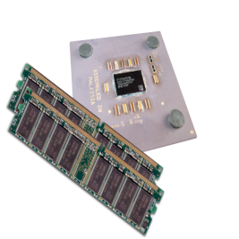
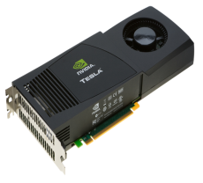
Heterogeneous Computing
#include <iostream>
#include <algorithm>
using namespace std;
#define N 1024
#define RADIUS 3
#define BLOCK_SIZE 16
__global__ void stencil_1d(int *in, int *out) {
__shared__ int temp[BLOCK_SIZE + 2 * RADIUS];
int gindex = threadIdx.x + blockIdx.x * blockDim.x;
int lindex = threadIdx.x + RADIUS;
// Read input elements into shared memory
temp[lindex] = in[gindex];
if (threadIdx.x < RADIUS) {
temp[lindex - RADIUS] = in[gindex - RADIUS];
temp[lindex + BLOCK_SIZE] = in[gindex + BLOCK_SIZE];
}
// Synchronize (ensure all the data is available)
__syncthreads();
// Apply the stencil
int result = 0;
for (int offset = -RADIUS ; offset <= RADIUS ; offset++)
result += temp[lindex + offset];
// Store the result
out[gindex] = result;
}
void fill_ints(int *x, int n) {
fill_n(x, n, 1);
}
int main(void) {
int *in, *out; // host copies of a, b, c
int *d_in, *d_out; // device copies of a, b, c
int size = (N + 2*RADIUS) * sizeof(int);
// Alloc space for host copies and setup values
in = (int *)malloc(size); fill_ints(in, N + 2*RADIUS);
out = (int *)malloc(size); fill_ints(out, N + 2*RADIUS);
// Alloc space for device copies
cudaMalloc((void **)&d_in, size);
cudaMalloc((void **)&d_out, size);
// Copy to device
cudaMemcpy(d_in, in, size, cudaMemcpyHostToDevice);
cudaMemcpy(d_out, out, size, cudaMemcpyHostToDevice);
// Launch stencil_1d() kernel on GPU
stencil_1d<<<N/BLOCK_SIZE,BLOCK_SIZE>>>(d_in + RADIUS, d_out + RADIUS);
// Copy result back to host
cudaMemcpy(out, d_out, size, cudaMemcpyDeviceToHost);
// Cleanup
free(in); free(out);
cudaFree(d_in); cudaFree(d_out);
return 0;
}
parallel fn
serial code
parallel code
serial code

Slide 3
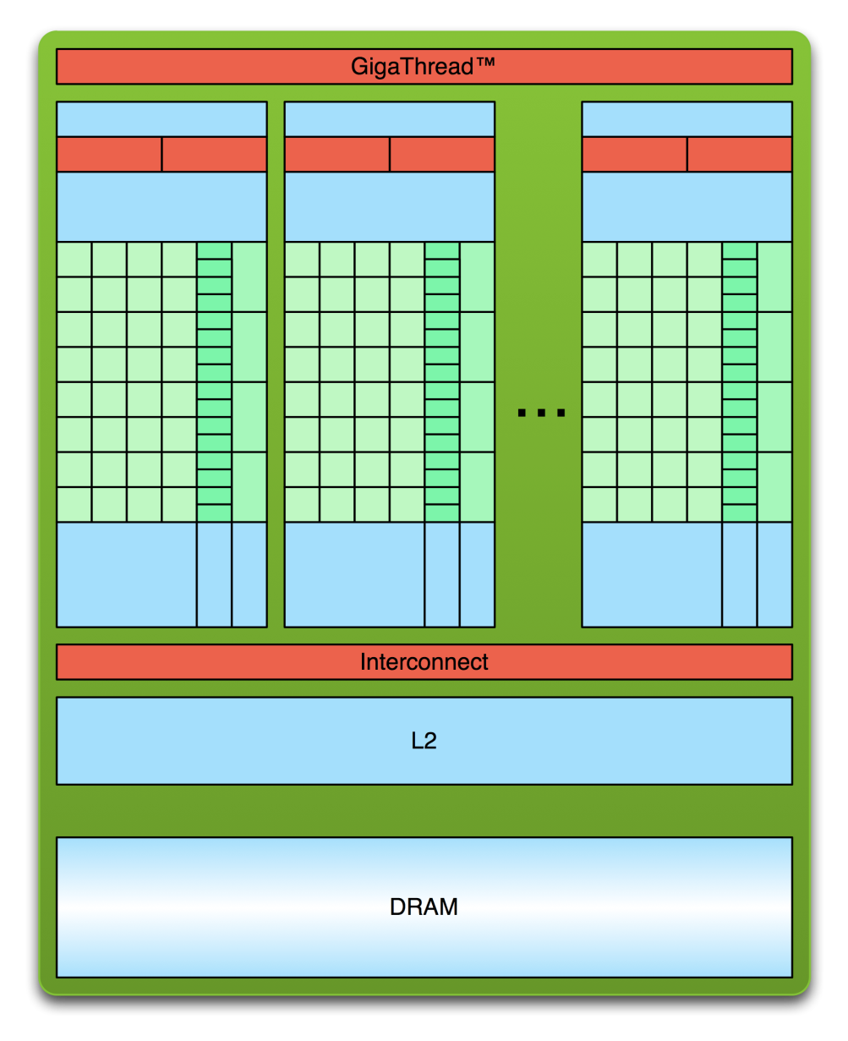
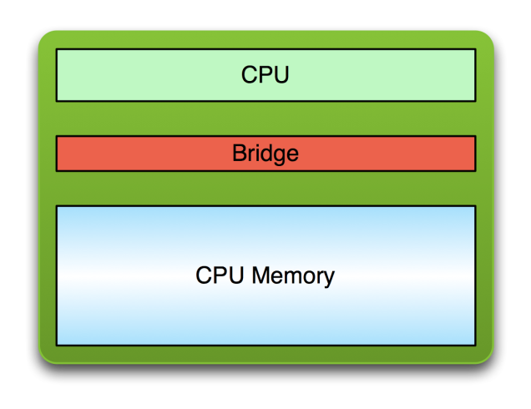
Simple Processing Flow
PCI Bus
Copy input data from CPU memory to GPU memory

Slide 4
Simple Processing Flow
PCI Bus
Copy input data from CPU memory to GPU memory
Load GPU program and execute, caching data on chip for performance

Slide 5
Simple Processing Flow
PCI Bus
Copy input data from CPU memory to GPU memory
Load GPU program and execute, caching data on chip for performance
Copy results from GPU memory to CPU memory

Slide 6
Opportunity for More Concurrency
Different kinds of action overlap are possible
Overlapped host computation and device computation
Overlapped host computation and host-device data transfer
Overlapped host-device data transfer and device computation
Concurrent device computation

Slide 7

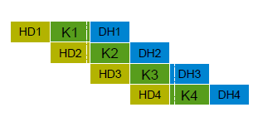
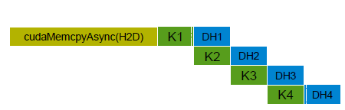
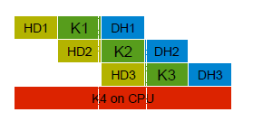
Concurrency
Serial (1x)
Overlap both memcpy with
Kernel (upto 3x)
Overlap D2H with kernel
(upto 2x)
Overlap with CPU
(upto 3x+)

Slide 8
CUDA Streams
CUDA Stream: a FIFO queue of CUDA actions to be performed
Every action (kernel launch, cudaMemcpy, etc) is enqueued in a stream
No operation in the stream will begin until all previously issued operations complete
Operations in different streams are unordered and can overlap
head
CUDA Stream
tail
CUDA Application
Kernel
cudaMemcpy
cudaMemcpy
CUDA Runtime & GPU

Slide 9
CUDA Streams for Overlap
Two types of streams in a CUDA program
The implicitly declared stream (NULL stream)
Explicitly declared streams (non-NULL streams)
Up until now, all code has been using the NULL stream by default
cudaMemcpy(...);
kernel<<<...>>>(...);
cudaMemcpy(...);
Non-NULL streams require manual allocation and management by the CUDA programmer

Slide 10
Synchronicity In CUDA
All CUDA calls are either synchronous or asynchronous w.r.t the host
Synchronous: enqueue work and wait for completion
Asynchronous: enqueue work and return immediately
Kernel Launches are asynchronous Automatic overlap with host

Slide 11
Asynchronous Operations for Overlap
cudaMemcpyAsync: Asynchronous memcpy
cudaMemcpyAsync does the same as cudaMemcpy, but may return before the transfer is actually complete

Slide 12
Asynchronous Operations for Overlap
Performing a cudaMemcpyAsync:
int *h_arr, *d_arr;
cudaStream_t stream;
cudaMalloc((void **)&d_arr, nbytes);
cudaMallocHost((void **)&h_arr, nbytes);
cudaStreamCreate(&stream);
cudaMemcpyAsync(d_arr, h_arr, nbytes, cudaMemcpyHostToDevice, stream);
...
cudaStreamSynchronize(stream);
cudaFree(d_arr); cudaFreeHost(h_arr); cudaStreamDestroy(stream);
page-locked memory allocation
Call return before transfer complete
Do something while data is being moved
Sync to make sure operations complete

Slide 13
CUDA Streams
Associate kernel launches with a non-NULL stream
Note that kernels are always asynchronous
kernel<<<nblocks, threads_per_block, smem_size, stream>>>(...);
The effects of cudaMemcpyAsync and kernel launching
Operations added to stream queue for execution
Actually operations may not happen yet

Slide 14
CUDA Streams
Vector sum example, A + B = C
Partition the vectors and use CUDA streams to overlap copy and compute
NULL stream
Copy A
Copy B
vector_sum<<<...>>>
Copy C
Stream A
A
B
v_s
C
Stream B
A
B
v_s
C
Stream C
A
B
v_s
C
Stream D
A
B
v_s
C

Slide 15
Implementation
Asynchronous implementation 1
loop over all the operations for each chunk
for (int i = 0; i < nStreams; ++i) {
int offset = i * streamSize;
cudaMemcpyAsync(&d_a[offset], &a[offset], streamBytes,
cudaMemcpyHostToDevice, stream[i]);
kernel<<<streamSize/blockSize, blockSize, 0, stream[i]>>>(d_a, offset);
cudaMemcpyAsync(&a[offset], &d_a[offset], streamBytes,
cudaMemcpyDeviceToHost, stream[i]);
}

Slide 16
Implementation
Asynchronous implementation 2
batch similar operations together
for (int i = 0; i < nStreams; ++i) {
int offset = i * streamSize;
cudaMemcpyAsync(&d_a[offset], &a[offset], streamBytes,
cudaMemcpyHostToDevice, stream[i]);
}
for (int i = 0; i < nStreams; ++i) {
int offset = i * streamSize;
kernel<<<streamSize/blockSize, blockSize, 0, stream[i]>>>(d_a, offset);
}
for (int i = 0; i < nStreams; ++i) {
int offset = i * streamSize;
cudaMemcpyAsync(&a[offset], &d_a[offset], streamBytes,
cudaMemcpyDeviceToHost, stream[i]);
}

Slide 17
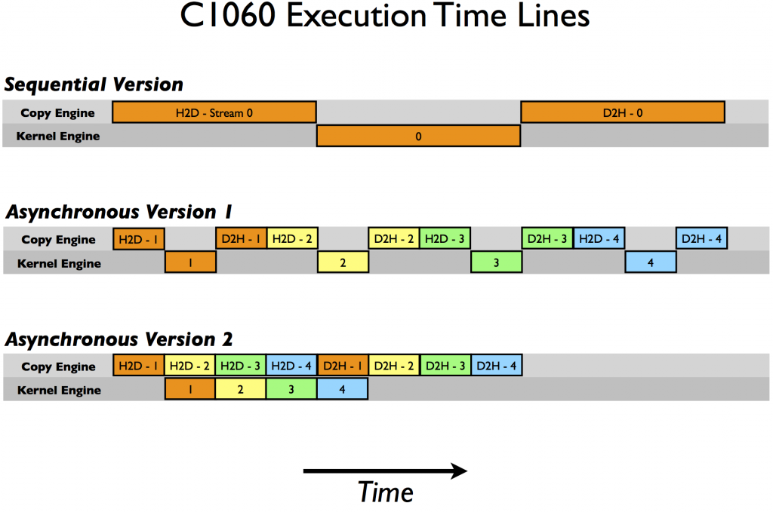
Execution over C1060
One copy engine
One kernel engine

Slide 18
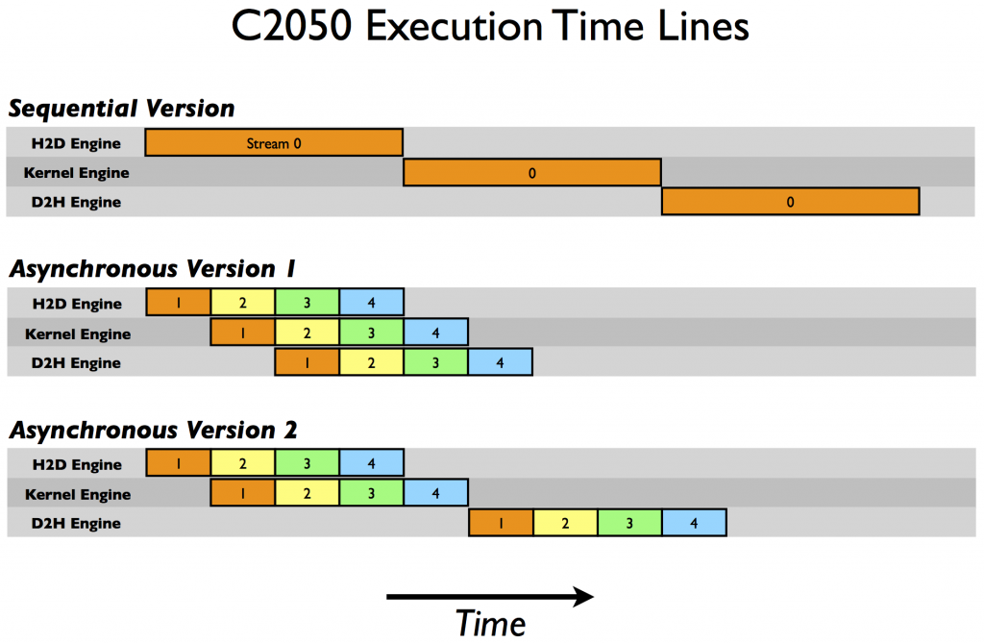
Execution over C2050
Two copy engines (H2D + D2H)
One kernel engine
Multiple kernels complete together

Slide 19
Overlap Data Transfers
Optimized implementation must be tailored for GPU architecture
Latest GPUs provide support to workaround this tailoring

Slide 20
PRIORITY STREAMS
You can give streams priority
High priority streams will preempt lower priority streams.
Currently executing blocks will complete but new blocks will only be scheduled after higher priority work has been scheduled.
Not applicable to memory transfers
Query available priorities:
cudaDeviceGetStreamPriorityRange(&low, &high)
Kepler: low: -1, high: 0
Create using special API:
cudaStreamCreateWithPriority(&stream, flags, priority)

Slide 21
Implicit and Explicit Synchronization
Two types of host-device synchronization:
Implicit synchronization causes the host to wait on the GPU, but as a side effect of other CUDA actions
Explicit synchronization causes the host to wait on the GPU because the programmer has asked for that behavior

Slide 22
Implicit and Explicit Synchronization
CUDA operations that include implicit synchronization:
A device memset (cudaMemset)
A memory copy between two addresses on the same device (cudaMemcpy(..., cudaMemcpyDeviceToDevice))

Slide 23
Implicit and Explicit Synchronization
Four ways to explicitly synchronize in CUDA:
Synchronize on a device
cudaError_t cudaDeviceSynchronize();
Synchronize on a stream
cudaError_t cudaStreamSynchronize();
Synchronize on an event
cudaError_t cudaEventSynchronize();
Synchronize across streams using an event
cudaError_t cudaStreamWaitEvent(cudaStream_t stream, cudaEvent_t event);

Slide 24
Implicit and Explicit Synchronization
cudaStreamWaitEvent adds inter-stream dependencies
Causes the specified stream to wait on the specified event before executing any further actions
event does not need to be an event recorded in stream
cudaEventRecord(event, stream1);
...
cudaStreamWaitEvent(stream2, event);
...
No actions added to stream2 after the call to cudaStreamWaitEvent will execute until event is satisfied

Slide 25
Cooperating GPU Threads

Slide 26
Cooperating GPU Threads
Although GPU threads SIMD archicture
Not all threads are being executed at a given instant
Cooperating threads need some synchronization
No mutexes or semaphores for explicit synchronization between threads

Slide 27
1D Stencil
Consider applying a 1D stencil to a 1D array of elements
Each output element is the sum of input elements within a radius
If radius is 3, then each output element is the sum of 7 input elements:
radius
radius

Slide 28
Implementing Within a Block
Each thread processes one output element
blockDim.x elements per block
Input elements are read several times
With radius 3, each input element is read seven times

Slide 29
Sharing Data Between Threads
Terminology: within a block, threads share data via shared memory
Extremely fast on-chip memory, user-managed
Declare using __shared__, allocated per block
Data is not visible to threads in other blocks

Slide 30
Implementing With Shared Memory
Cache data in shared memory
Read (blockDim.x + 2 * radius) input elements from global memory to shared memory
Compute blockDim.x output elements
Write blockDim.x output elements to global memory
Each block needs a halo of radius elements at each boundary
halo on left
halo on right
blockDim.x output elements

Slide 31
Stencil Kernel
__global__ void stencil_1d(int *in, int *out) {
__shared__ int temp[BLOCK_SIZE + 2 * RADIUS];
int gindex = threadIdx.x + blockIdx.x * blockDim.x;
int lindex = threadIdx.x + RADIUS;
// Read input elements into shared memory
temp[lindex] = in[gindex];
if (threadIdx.x < RADIUS) {
temp[lindex - RADIUS] = in[gindex - RADIUS];
temp[lindex + BLOCK_SIZE] =
in[gindex + BLOCK_SIZE];
}

Slide 32

Stencil Kernel
// Apply the stencil
int result = 0;
for (int offset = -RADIUS ; offset <= RADIUS ; offset++)
result += temp[lindex + offset];
// Store the result
out[gindex] = result;
}

Slide 33
Data Race!
The stencil example will not work…
Suppose thread 15 reads the halo before thread 0 has fetched it…
temp[lindex] = in[gindex];
if (threadIdx.x < RADIUS) {
temp[lindex – RADIUS = in[gindex – RADIUS];
temp[lindex + BLOCK_SIZE] = in[gindex + BLOCK_SIZE];
}
int result = 0;
result += temp[lindex + 1];
Store at temp[18]
Skipped, threadIdx > RADIUS
Load from temp[19]

Slide 34
__syncthreads()
void __syncthreads();
Synchronizes all threads within a block
Used to prevent RAW / WAR / WAW hazards
All threads must reach the barrier
In conditional code, the condition must be uniform across the block

Slide 35
Stencil Kernel
__global__ void stencil_1d(int *in, int *out) {
__shared__ int temp[BLOCK_SIZE + 2 * RADIUS];
int gindex = threadIdx.x + blockIdx.x * blockDim.x;
int lindex = threadIdx.x + radius;
// Read input elements into shared memory
temp[lindex] = in[gindex];
if (threadIdx.x < RADIUS) {
temp[lindex – RADIUS] = in[gindex – RADIUS];
temp[lindex + BLOCK_SIZE] = in[gindex + BLOCK_SIZE];
}
// Synchronize (ensure all the data is available)
__syncthreads();

Slide 36
Zero Copy Memory
Zero copy Access host memory directly from device code
Transfers implicitly performed as needed by device code
Zero copy will be faster if data is only read/written from/to global memory once
Copy input data to GPU memory
Run one kernel
Copy output data back to CPU memory

