Slide 1
Mobile Authentication
Swadhin Pradhan
Group Presentation

Slide 2
Single Level Authentication
How do we unlock phones ?
How do we login to different mobile apps ?
One-time passwords, Biometric passwords ..
Different perils : unwanted in-app purchases …
Shoulder Surfing, Smudge Attack with common Password Attacks ..

Slide 3
Smartphone and Users
As of 2013, over 90% of Americans claimed to own phones, the majority of whom use their devices to access the Internet, check email, or use third party applications (~50% store banking information). [Pew Internet Research]
Smartphones are for surfing the web, checking social networks or playing games than making phone call [5th activity by Mobile Network O2]

Slide 4
General Password Behavior
A landmark Microsoft study from 2007 found that the typical Web user had 25 accounts (In 2012, Experian revealed that the average 25-34 year old had 40 accounts online.) but only 6.5 unique passwords to protect them.
A 2014 SplashData report cited "123456" as the most common credential, having overtaken longstanding champion "password.
Password-cracking techniques such as offline dictionary attacks have become increasingly efficient. Last year, after Ars Technica gave three experts an encrypted password file with 16,000 entries, one of the individuals successfully revealed 90 percent of them.

Slide 5
Freemium Smartphone App Revenue
2012 report by the Pew Internet Project estimated that nearly a third of cell phone users have had a device lost or stolen (~$30 billion per year loss).
Google will be refunding $19 million to consumers who were charged for inadvertent in-app purchases made by their kids on the Play Store.
(71% of total iPhone app revenue comes from in-app purchases from freemium apps; 2,000 adults surveyed, 28% said that their children did in-app purchases)

Slide 6
Unlocking Behavior
~70% of the people lock their devices (Soups ‘13 and CCS ’14) from preserving their privacy from strangers or family members.
According to a study released by app maker Locket, the average person unlocks his or her phone 110 times each day (from its 150,000-plus users and even some people are around 900!).

Slide 7
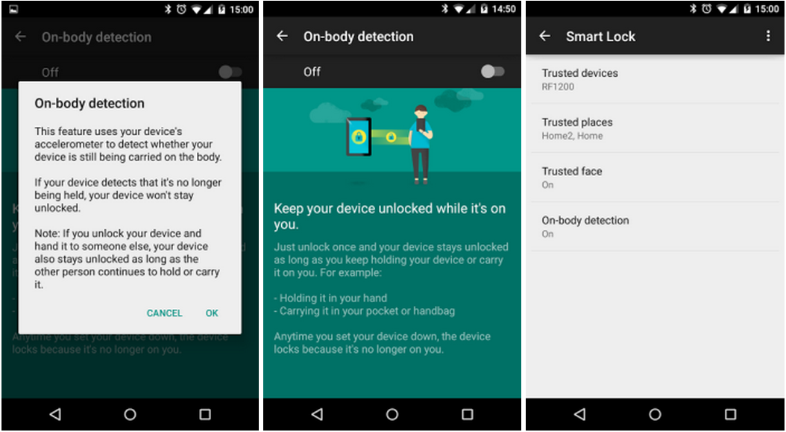
Google’s Smart Lock (On body detection)
Uses Accelerometer

Slide 8
Different Smartphone Locking Techniques
Nothing (simple swipe) (Soups ‘13 paper ~200 users – 35% no lock)
Pattern based unlocking. (Soups ‘13 – 51%) ~3.2s
PIN/Text based unlocking. (Soups ‘13 – 14%) ~1.5s
  People prefer Pattern more (Mobile HCI ‘13)
Finger print based unlocking (Biometric based)
  Apple fingerprint scanner
  Samsung fingerprint scanner

Slide 9
Text/Pin based Password
In most apps/services, we use textual passwords. Even in smartphones, 15% of the time, it is used.
Prone to common password guessing techniques, grammatical/factual relation among different passwords (Soups ‘12), derived from personal information easily available in social networks (CCS ‘11) etc.

Slide 10
Pattern based Password
Error prone and ~20% of the time pattern based password has to be repeated twice (Soups ‘13, Mobile HCI ‘12).
Touch screen based spatial feature based attack (Mobile HCI ‘12) or temporal feature based attack can be done.
Implicit Authentication based on Touch Screen Patterns (38 participants, Horizontal – Vertical – Two finger vertical, DTW {XY Coordinate, Pressure, Size, Time, Speed}, False Acceptance 21% and False Rejection 19%) [CHI ‘12].

Slide 11
Pattern based Password
Biometric-Rich Gestures: A Novel Approach to Authentication on Multi-touch Devices (CHI ‘12) (Five-finger touch gestures - 90% accuracy with single gestures, significant improvement when multiple gestures performed in sequence.)
Secure unlocking of mobile screen based on Gestures (Mobicom ‘13) (How they input – finger velocity, device acceleration, stroke time; 15009 samples from 50 volunteers; End system 0.5% error rate with 3 gestures.)

Slide 12
Keystroke based Authentication
Keystroke based user identification of smartphones with 25 users mainly using PIN has got low accuracy (RAID 2009). And there are also some works on devices with physical keyboard.
User Verification on Smartphones via Tapping Behaviors (Tech report 2014) (Four features (acceleration, pressure, size, and time) from accelerometer, gyroscope, and touch screen sensors; 80 users and 3.65% error rate)

Slide 13
Gait based Authentication
Some schemes have been proposed that utilize accelerometer in smart phones to authenticate users based upon their gaits -(ICASSP 2005, SensorKDD 2011, ). Such schemes have low true positive rates because gaits of people are different on different types of surfaces such as grass, road, snow, wet surface, and slippery surface.
The movement the user performs when answering (or placing) a phone call (ASIACCS 11)

Slide 14
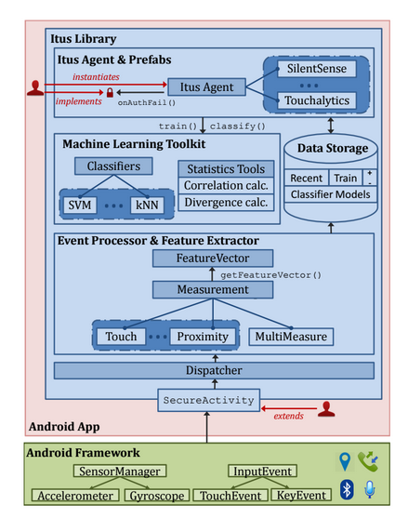
ITUS: Implicit Authentication Architecture (Mobicom 2014)

Slide 15
Dynamic Question(Usage) based Authentication
I Know What You Did Last Week! Do You? Dynamic Security Questions for Fallback Authentication on Smartphones (CHI 2015)
  Questions based on App usage, App installations, SMS etc.
  95.5% - 100% accuracy with 3 question based system.
ActivPass : Your Daily Activity is your Password (CHI 2015)
  Questions based on outlier activities from facebook, web, and smartphone activities.
  95% success with final 3 Question based system.

Slide 16
Sensors as Side Channels
HotMobile 2012 paper ‘ACCessory’ shows that accelerometer measurements can be used to extract 6-character passwords in as few as 4.5 trials (median). (also TouchLogger Usenix HotSec ‘11).
Microphone, Camera, GPS information also can leak security information (MobiHeld 2009).

Slide 17
Smudge Attack
Oily residues, or smudges, on the touch screen
surface, are one side effect of touches from which frequently used patterns such as a graphical password might be inferred.
Guessing space can be reduced by around ~50% (Usenix Security Workshop Woot ’10)

Slide 18
Shoulder Surfing
Shoulder-surfing – using direct observation techniques, such as looking over someone's shoulder, to get passwords, PINs and other sensitive personal information – is a problem that has been difficult to overcome.
Now You See Me, Now You Don’t – Protecting Smartphone Authentication from Shoulder Surfers (CHI 2014)
  Hiding some parts of the patterns.
Back of the Device Authentication on Smartphones (CHI 2013).

Slide 19
Two factor Authentication
Two step ⬄ Two factor authentication ?
Extra device needed for another level of security..
Smartphone for laptop/desktop (SMS reply, or SMS code to put in textboxes in laptop, or putting App based codes)?
Smartphone for Smartphone ?
Wearable for Smartphone ?

Slide 20
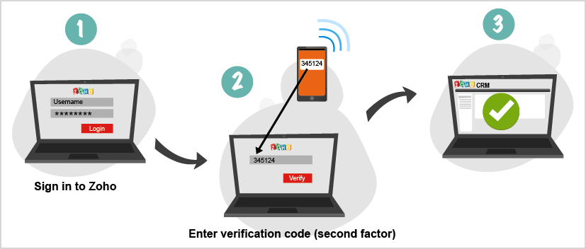
Example

Slide 21
Google buys SlickLogin
SlickLogin lets users log into a website on your computer by holding your phone within a few inches of it.
They claim to use uniquely generated sounds intentionally made inaudible to the human ear. Your computer plays the sound through its speakers, while an app on your smartphone uses the device’s built-in microphone to pick up the audio.
Same Idea: Unlaunched payments service Clinkle, SonicNotify is using the concept to let TV advertisers and retail stores send content to handsets, Chirp is trying to build an entire file transfer protocol based on the idea.

Slide 22
SoundProof Paper
Ambient sound from Laptop and smartphone.
Here, second authentication factor is the proximity of the user’s phone to the device being used to log in. The proximity of the two devices is verified by comparing the ambient noise recorded by their microphones.
Sound-Proof can be easily deployed as it works with major browsers without plugins.

Slide 23
Wearable as Second Authentication in Two-factor Authentication
Motion biometrics can be used
  Similar to vital biometrics, this would require that a smartwatch have a sophisticated motion detector like Apple’s M7 chip in the iPhone 5S.
Voice Biometrics through hotwords (“Ok Google” or “Hi Galaxy”) or passvoices .

Slide 24
Wearable as Second Authentication in Two-factor Authentication
Passthoughts used by wearable EEG headsets and they claim to get around 99% accuracy. (UbiComp 2014 paper)
Smartwatch gesture recognition can be used (HotMobile 14 – not explicit)

Slide 25
Ideas for Implicit Authentication (IA) for Single or Two Factor Authentication

Slide 26
A Few Ideas
Application usage trails of different users (How different users use different applications) – Single Implicit Authentication
Sensor signature similarity between wearables (e.g. smartwatch) and smartphone – Implicit Two-factor Authentication
Soft Biometrics from wearables (Nymi – ECG from heart, Fitbit – Accelerometer data of running ..) - Single Implicit Authentication

Slide 27
Thanks

